Slide 1

ParPark
The Y Team

Slide 2

Trouble in Big Cities...
You enter a crowded parking lot...
There are a few spots available, somewhere, you’re sure
Five minutes later, you just want to leave
All you ever wanted was milk
Disney World in Orlando, Fla.
Yann Arthus-Bertrand/Altitude

Slide 3
ParPark: Make Parking Easier!
An intelligent real-time system with...
Sensors - Detecting availability of each slot;
Arrows/Lights - Guiding drivers to empty ones at each turning point;
Screens - Showing number of spots available in each section.

Slide 4
Live Demo

Slide 5
Market & Target
Shopping malls, airports, hospitals, universities…
$7 billion parking infrastructures, $80 million smart parking industry
Price: Starting from $2000
Ref: http://www.academia.edu/4576117/Parking_Management_Market_worth_7.43_Billion_by_2018
http://www.grandviewresearch.com/industry-analysis/smart-parking-system-market

Slide 6
Business Model Canvas
Key Partners: Component Manufactures, Factories, Local Infrastructure Providers | Key Activities: Component Selection, R&D, Develop Sales Networks, Training, Brand Marketing, Customization, Maintenance | Key resources: great team cooperation, 6 professional ECE/CS engineers
Value Proposition: bring more profits for malls by reducing time customers spend on parking | Customer Relationships: bring more profits for customers, help maintenance | Channels: Website, Social Media
Customer Segments: Malls want to optimize customer experience and gain more profits by enhancing parking efficiency. | Cost Structure: Product Development, Marketing, Distributor Network Development, Training | Revenue Streams: Sales

Slide 7
Partners
Product Line
ParPark’s Role
Component Manufactures
Supplier
Supplier
Supplier
Components Selection
Factories
Manufacturer
Research & Development
Local Infrastructure Providers with Established Clients
Develop Sales Networks
Training
Distributor
Parking Lot Owners
Brand Marketing
Customize & Upgrade Solutions
Support for Maintenance
Clients

Slide 8
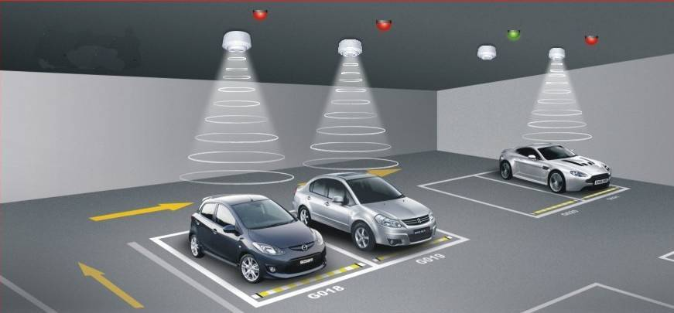
Competitive Landscape
Parking Guidance Systems, LLC
Smart Parking Technology
Lots of similar companies..

Slide 9
How Are We Different?
Easy installation, affordable price
Relaxing parking => positive impression
Customized style; individualized service
Zero effort for customers

Slide 10
Team
We are
3
+
3
=
6
Electrical and Computer Engineers
Computer Scientists
Enthusiastic Cornell Freshmen and Sophomores
Group Photo

Slide 11
Questions?

