Slide 1
MIT Academy of Engineering School of Computer Engineering and Technology Minor Project Presentation
“SMART PRESCRIPTION”
Group Members
1. S184044 Yushant Tyagi
2. S184033 Adhiksha Thorat
3. S184038 Pratiksha Gandhi
Guide Name
Prof. Pankaj Choudhary

Slide 2
Aim & Objective
In today’s day and age technology has surrounded human beings completely be it in the field of medical science or robots that can think on their own (AI robots).
We here present an app that can take us one step forward in the doctor and patient interaction and make it a delightful experience instead of a struggle to understand the prescriptions and remember the details and suggestions.

Slide 3
Problem Statement
To implement the smart prescription idea by printing a QR code of the multiple audios recorded related to the medicine dosage instructions ,extra recommendations etc. respectively on the doctor’s prescription and making an application one for generation and other for scanning the QR code used by doctors and patients respectively.

Slide 4
Literature Survey
1.PPD e-Prescription:
It is an official app of Philipine Pharmaceutical Directory developed for Phillipine doctors .It helps the healthcare professionals in clinical decision making process with information on about 3000 drugs and facility to provide prescriptions to patients via email.
Disadvantages:
There is no other source of access of prescription other than email by the patient.
2.Rexi E-Prescription Maker:
It is a prescription maker app made for Doctors which takes in all information related to create a prescription as well as label and creates an html file of the same which gets saved in the respective device .
Disadvantages:
There is no facility of providing the prescription to the patient through the app itself directly.The file is stored into the doctors phone.
The doctors can print the prescription by browsing it on a browser or have to share it separately to patient.
3. 1mg Online Medical Store:
View Medicine Information
Buy Medicines Online
Book Lab Tests & Health Check-ups
Consult Doctors Online
Read Regular Health Tips

Slide 5
Literature Survey
There is also a research paper on smart prescription. Which describes the application as follows:
An application for patients , doctor and admin.
The application allows to take appointments , get prescription and maintain database of the patients and doctors.
The admin controls the permission of the doctor to use the app.
The application aims at allowing the patient and doctor interaction by digital means.
http://www.iosrjournals.org/iosr-jce/papers/Vol19-issue6/Version-3/M1906038591.pdf

Slide 6
Advantages
Elimination of paper work and data entry.
Prescription do not cover each and every minute thing that doctor recommends or prescribes but the audio does.
The audios are multilingual and the best way for communication between the doctors and the patients.
Different application for patients as well as doctor.
Eliminating the tension of carrying prescription.
Backup of prescription available in phones of respective patient after downloading and the main file always exists on the firebase(secure and flexible).
People with diseases like alzheimer will be benefited as they won’t have to carry their prescription always and can download them and keep them always.
Large audio files can be uploaded as firebase supports 5TB of file upload at a time.

Slide 7
Technology Stack
Technology USED and WHY it was used:-
1.Android Studio:- It is platform to generate android apps which are compatible on most of the devices and is very stable and all rounded with many features. Also a Plugin called Intel INDE is provides us a multi-OS platform and just by adding some bits of code in the android app we can achieve the app for IOS too. It helps us to use Java instead of the Swift programming language used for developing IOS apps. Hence we chose to go for a Java support app building software Android Studio which can help us to make Multi-Os apps too.
2.Firebase:-
The Audios that we have generated will at maximum have a size of100MBs as :-
10 mins of a audio file takes almost 16MB of memory so a audio file can at maximum be of 66.66 mins. And Firebase being a very strong and powerful cloud storage supports about 5TB of file upload at one time which very much sufficient to record a very large audio file.
Firebase is very easy to use and a very strong storage system which we can be easily added into our apps. Hence we decided to make the database on firebase.

Slide 8
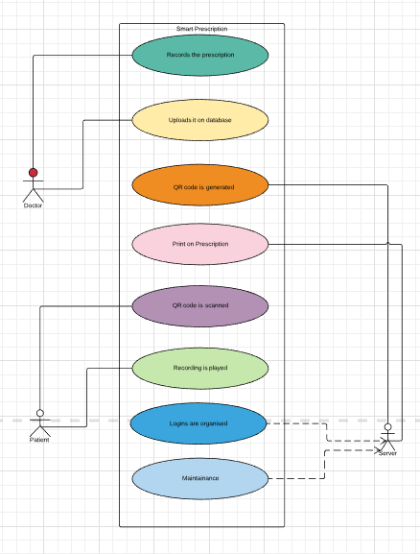
System Design
Use Case Diagram:-

Slide 9
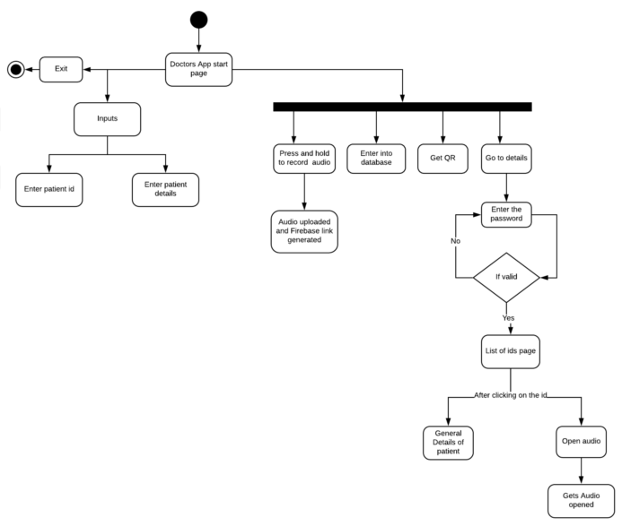
System Design
Doctor’s Side APP(Activity Diagram):-

Slide 10
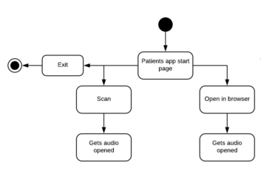
System Design
Patient’s Side APP(Activity Diagram):-

Slide 11
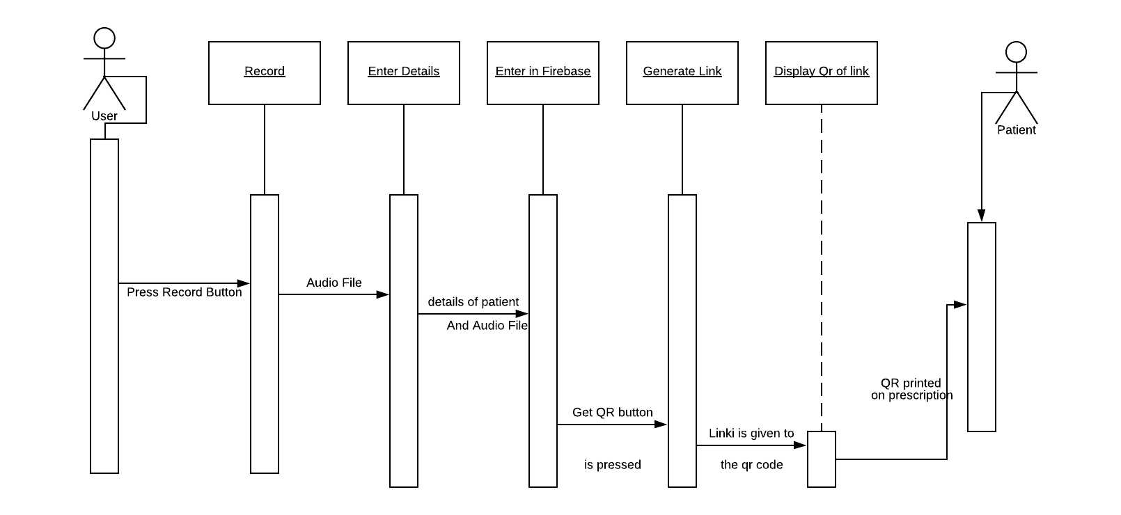
System Design
Sequence Diagram:-

Slide 12
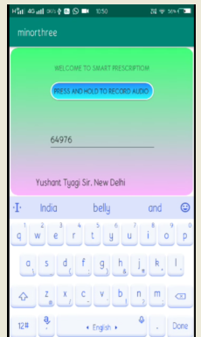
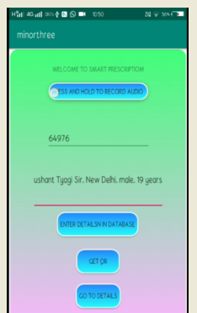
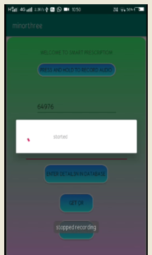
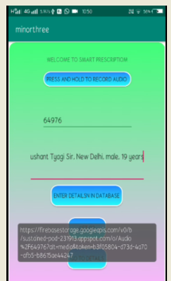
Doctor’s Side App

Slide 13
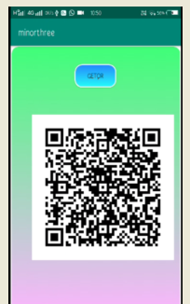
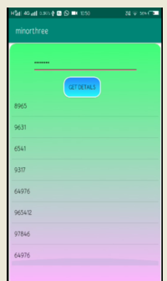
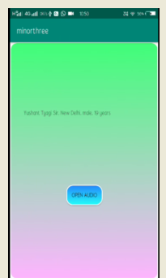
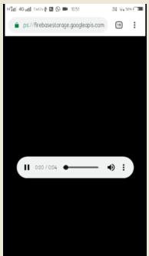
Doctor’s Side App (cntd)
PATIENT’S APP:

Slide 14
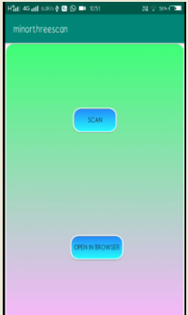
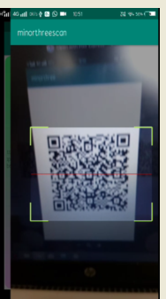
Patient’s Side App:-

Slide 15
Conclusion
We have come up with the solution so as to help people facing problems in remembering the medical recommendations given by the Doctors which will be also very helpful for Alzheimer patients and also put on ease to both Doctors and patients by making a simple application using QR code concept and audio as a resource of help to get back things remembered easily which are recommended by doctors and also get rid of struggling writing work.

Slide 16
Questions

Slide 17
Thank You……

