Slide 1
PROXIMO
Identity-Based AI Tutors
for Learning Motivation
Yu Sheng Aow | CS 598 | Boston University
HCI Research

Slide 2



01 | Problem
Why Do Students Give Up?
What if an AI tutor could speak to you not as a teacher — but as yourself, ten years from now?
The Motivation Gap
AI tutors like ChatGPT excel at answering questions but completely ignore emotional and motivational barriers — the real reason students disengage from hard topics.
Identity Disconnect
Students can't envision themselves as future experts. Educational psychology shows that future-self continuity is a key driver of academic persistence.
Unexplored Design Space
Prior work has studied AI tutoring and future-self reflection separately. No system integrates both into a real-time tutoring interaction.

Slide 3
01 | Background
Letters from Future Self
CHI 2025
Augmenting the Letter-Exchange Exercise with LLM-based Agents to Enhance Young Adults' Career Exploration
Key Findings
LLMs can convincingly simulate a future self
1
Technical finding
The study built an LLM agent that role-played each participant's future self — based on their own goals, values, and aspirations. Participants rated the simulation as authentic and reflective of who they hoped to become.
Future-self dialogue reduces career anxiety and builds hope
2
Psychological finding
After exchanging letters with their AI future self, participants reported significantly lower levels of career-related anxiety and higher feelings of hope and agency. The emotional framing of the interaction was a key driver.
Identity continuity strengthens long-term goal commitment
3
Behavioural finding
Participants who felt a strong connection to their AI future self were more likely to articulate concrete next steps toward their career goals. Imagining a successful future self helped bridge the gap between present uncertainty and future action.

Slide 4


01 | Background
Research Aims
Research Question
How does framing an AI tutor as a student's future self affect motivation, engagement, and perceived learning support compared to a standard AI tutor?
A1
A2
A3
Test identity-based motivation
Measure emotional & cognitive support
Generate HCI design guidelines
Investigate whether future-self framing measurably increases student motivation and engagement during active learning sessions — beyond simply answering questions well.
Assess whether the future-self tutor improves perceived support, self-confidence, and trust — addressing the emotional dimension that standard AI tutors neglect.
Produce actionable design insights for future AI tutoring systems that integrate identity-based scaffolding alongside cognitive support — especially for non-expert learners.

Slide 5
01 | Problem
Built on One Key Paper
Letters from Future Self
CHI 2025
Augmenting the Letter-Exchange Exercise with LLM-based Agents to Enhance Young Adults' Career Exploration
What the CHI 2025 paper showed
How Proximo extends it
1
LLM agents can convincingly simulate a person's future self
Proved the technical feasibility of future-self framing. Proximo applies the same LLM persona approach — but inside an active tutoring session, not letter exchange.
2
Future-self dialogue reduces anxiety and builds motivation
Participants felt more hopeful after talking to their AI future self. Proximo tests whether this emotional effect also reduces anxiety when actively struggling to learn hard CS and math topics.

Slide 6
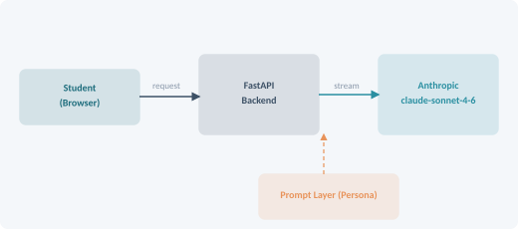

02 | Approach
System Architecture
Student Asks
1
Sends a question about recursion,
dynamic programming, or Bayes theorem
Prompt Engineering
2
LLM adopts future-self persona
via system-level prompt instructions
FastAPI + Uvicorn
Web server & API routing
Identity Response
claude-sonnet-4-6 + streaming
3
Powers both tutor personas via prompts
Tutor replies as the future YOU
who has already mastered this material

Slide 7
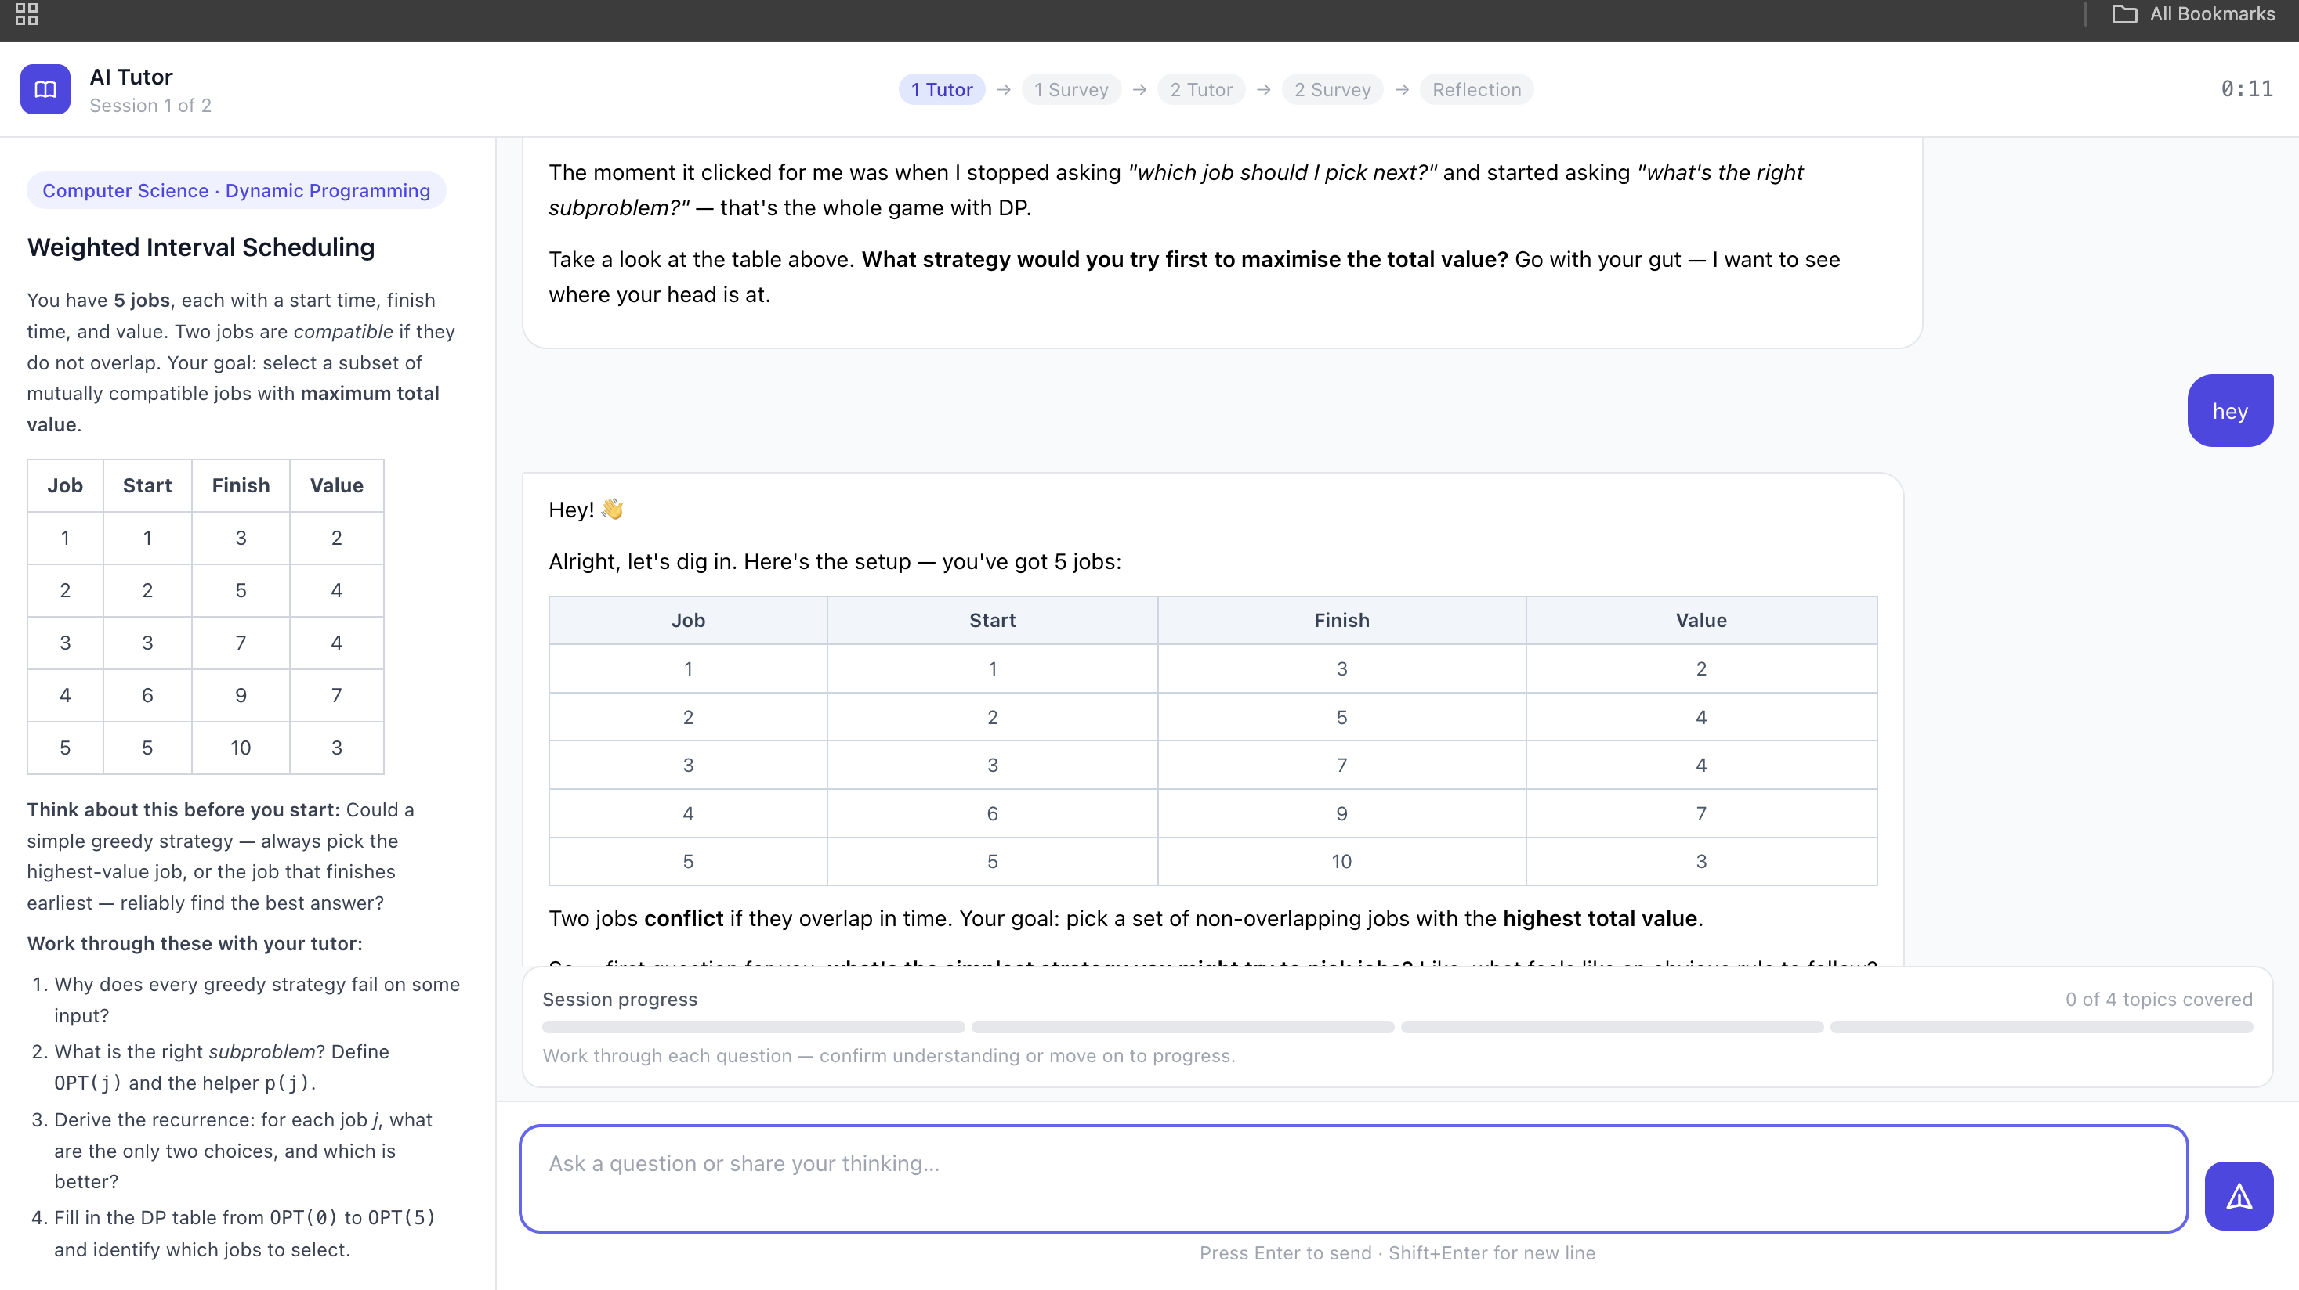
Design Interface
proximo-production-8872.up.railway.app

Slide 8
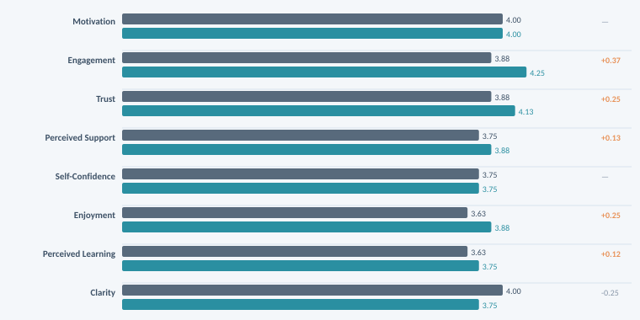
03 | Results
All Metrics

Slide 9
03 | Results
Messages Sent Per Session
A direct behavioural measure: how much did each participant interact with each tutor?
42 vs 35
avg messages: Future-Self vs Standard
3 sent more
P1 (+32), P3 (+10), P6 (+36)
most active with Future-Self
3 sent fewer
P2 (-10), P5 (-2), P7 (-10)
more active with Standard

Slide 10
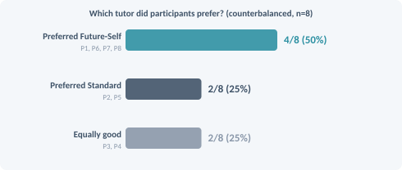
03 | Results
Who Preferred Which Tutor?
Key Finding
50% preferred the Future-Self tutor, 25% Standard, 25% equally good — after controlling for session order. Participants who preferred Future-Self consistently cited its relatable, collaborative tone.
"giving an identity to the tutor made everything more relatable and easier to understand rather than the first studying method."
— P1
"Session 1 felt less trivial. We developed the algorithm step by step it felt like."
— P8

Slide 11

04 | Conclusion
What the Data Tells Us
This pilot study found that identity-based AI tutoring produces measurable improvements in engagement (+0.37), trust (+0.25), and enjoyment (+0.25) over a standard AI tutor. Motivation was tied at 4.0 — but this conceals important individual variation driven by topic difficulty, session order, and learner background.
What worked
What was nuanced
What this means for HCI
Future-self framing drove the strongest gains in engagement — participants sent 20% more messages on average (42 vs 35).
Motivation was tied at 4.0 — partly because intrinsic interest in the problem itself (not tutor style) was the dominant driver for several participants.
Larger studies with controlled topic difficulty and more diverse populations are needed to isolate the identity framing effect.
50% of participants explicitly preferred the Future-Self tutor after controlling for session order.
Clarity scored slightly lower for Future-Self (3.75 vs 4.00) — the persona may occasionally prioritise warmth over precision.
The effect is strongest for learners who lack domain confidence. Proximo is most valuable as an onboarding tool.
Trust in the Future-Self tutor was consistently higher (+0.25), suggesting identity framing builds a stronger student–tutor relationship.
P3 and P4 scored both tutors identically, suggesting topic difficulty and session order can overshadow tutoring style entirely.
Future-self framing may need adaptive calibration: beginners benefit from emotional warmth, advanced learners may prefer directness.

Slide 12
05 | Future Work
Limitations & Next Steps
Limitations
Future Work
Small sample (n=8)
Scale the study
Results are exploratory, not generalisable. Statistical significance cannot be claimed — this is a pilot study.
Run a fully-powered study (n=30+) with matched task difficulty across conditions to isolate the identity framing effect.
Topic confound
Adaptive persona depth
The two tasks (Dynamic Programming vs Bayes Theorem) differ in difficulty. Task differences may have driven some motivation effects more than tutor style.
Let the system calibrate how strongly the future-self persona is expressed based on the learner's confidence level and topic familiarity.
Order effects
Longitudinal measurement
Despite counterbalancing, some participants may have been fatigued or primed by their first session, affecting how they experienced the second.
Track motivation and persistence over multiple sessions — one interaction is too short to observe identity formation effects.
Broader subject coverage
Test identity-based tutoring in writing, language learning, and other domains where emotional barriers to learning are well-documented.
github.com/yusheng036/proximo · Proximo: Identity-Based AI Tutors for Learning Motivation

