Slide 1
Book2
File created on: 8/15/2025 12:19:47 AM

Slide 2
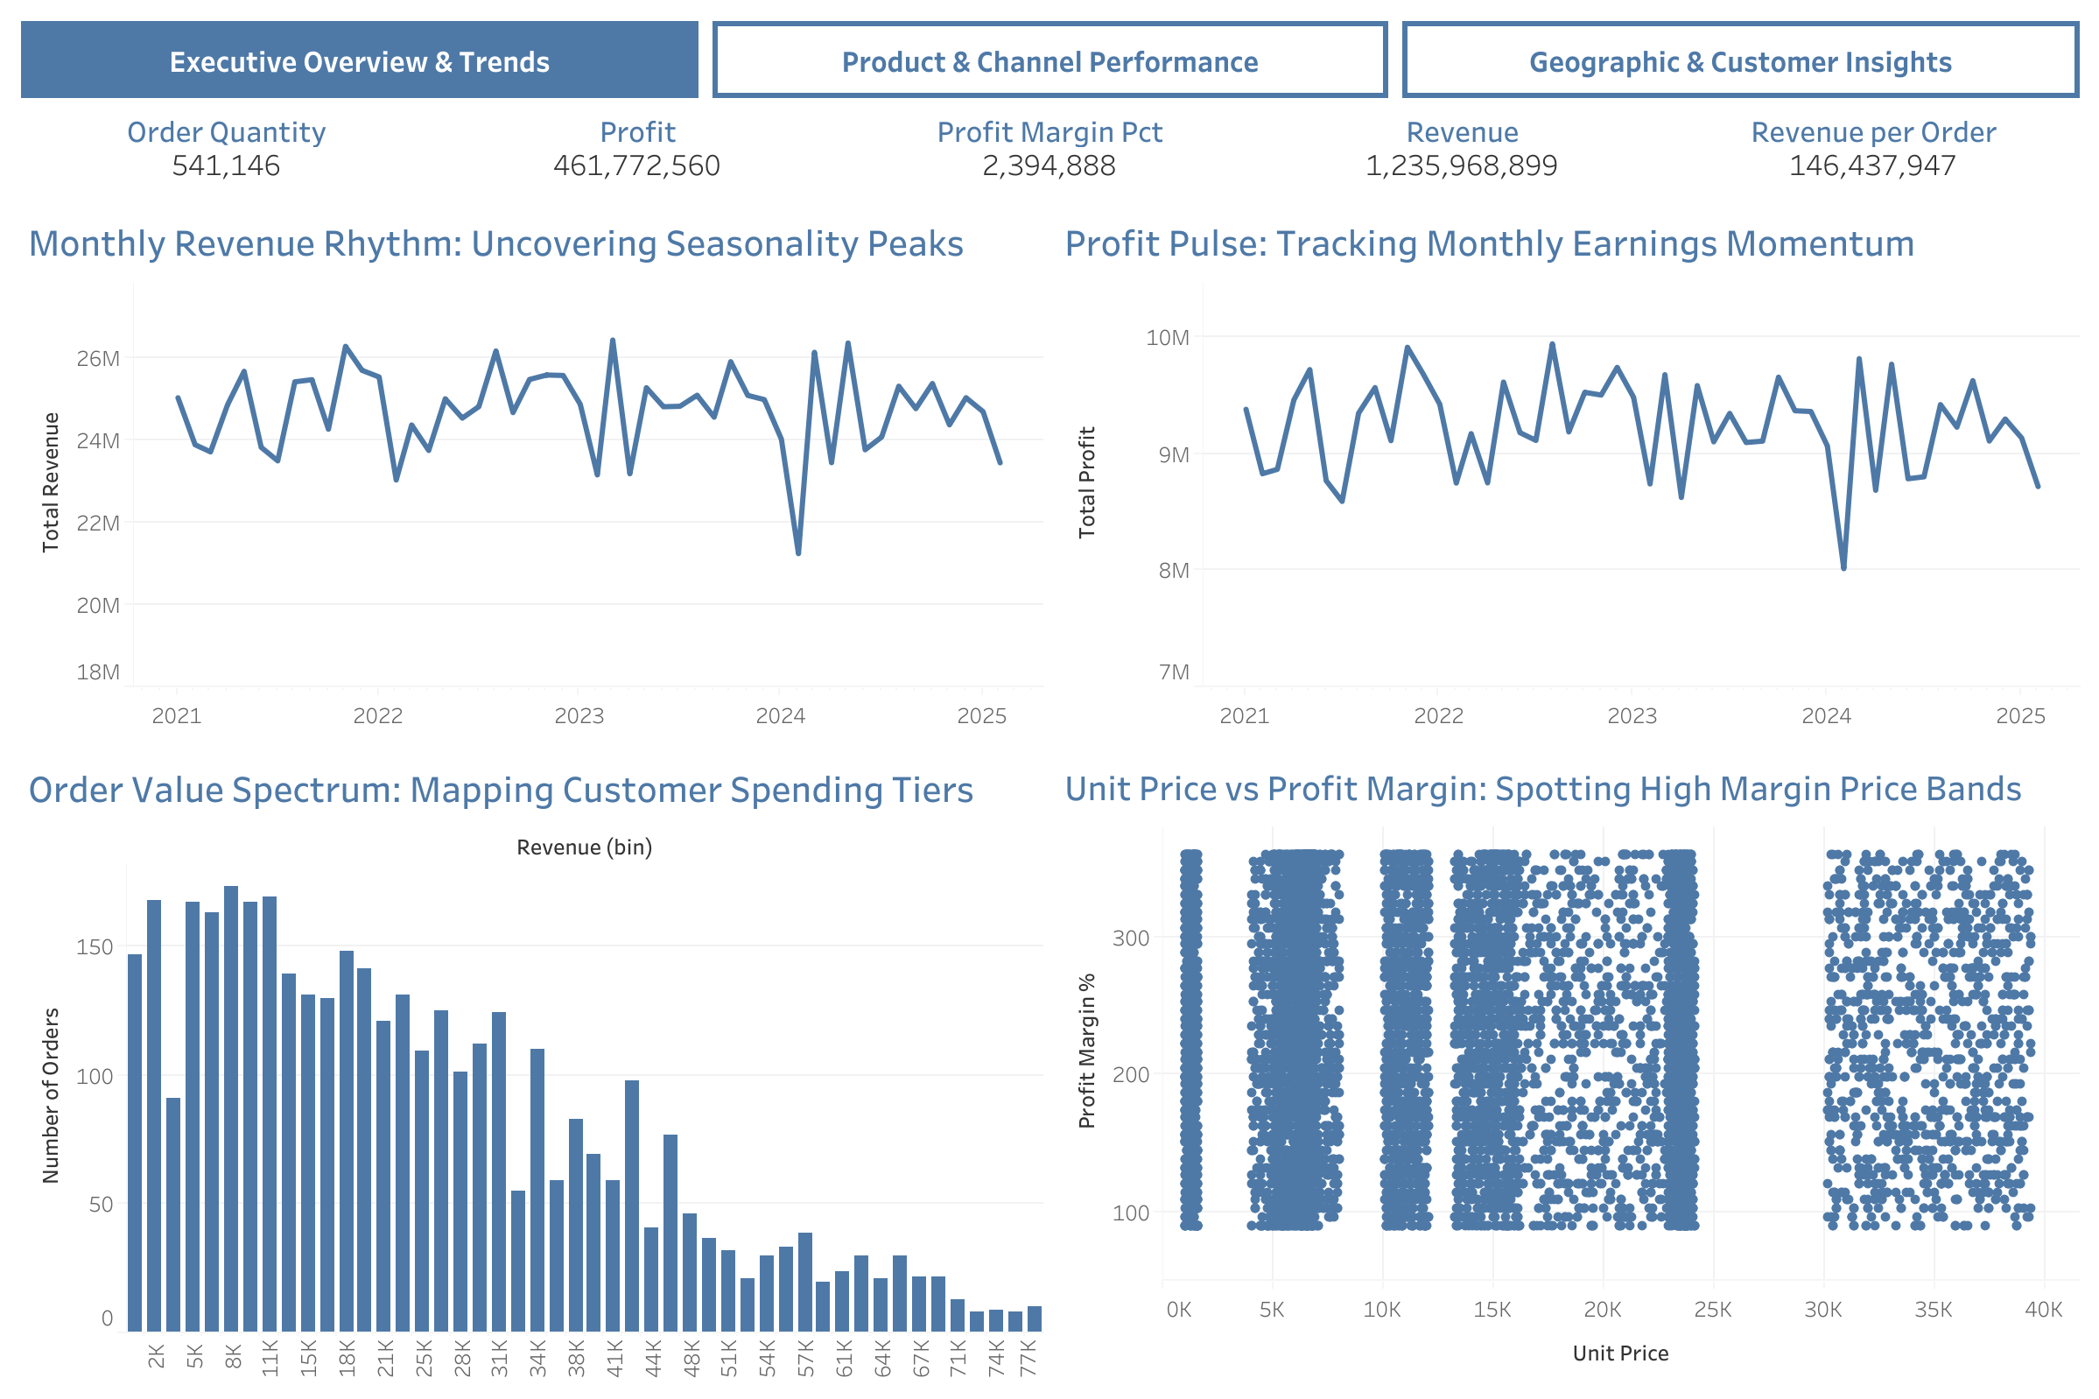

Slide 3
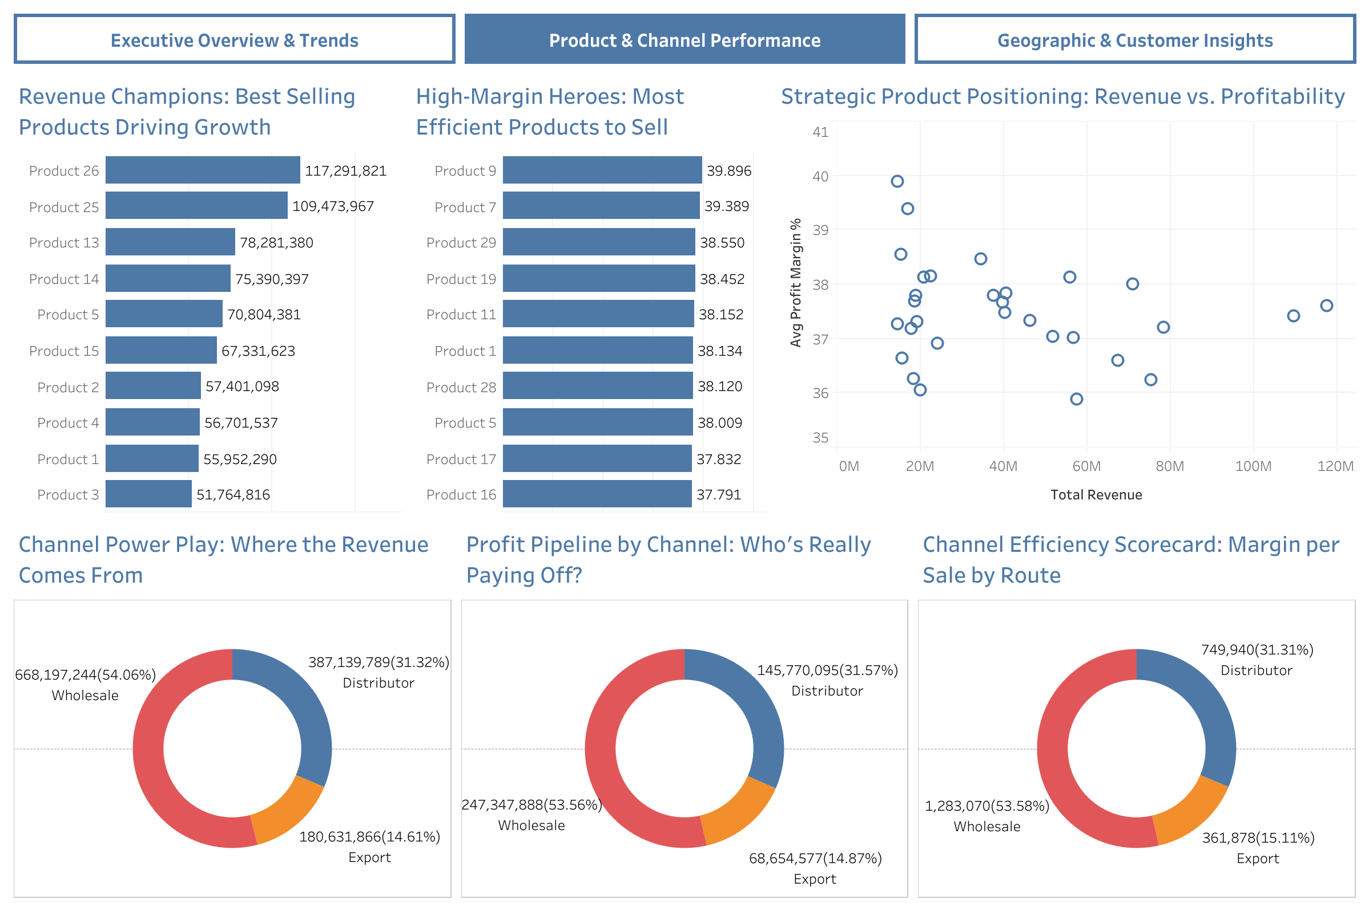

Slide 4
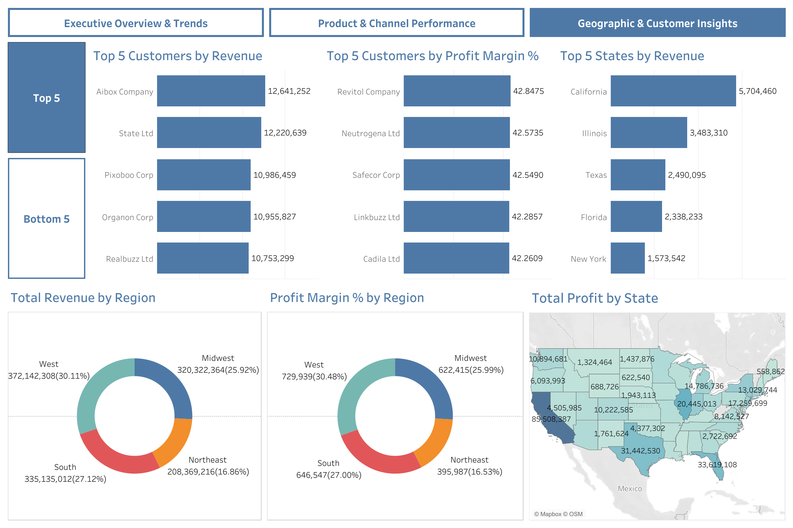

Slide 5
