Slide 1
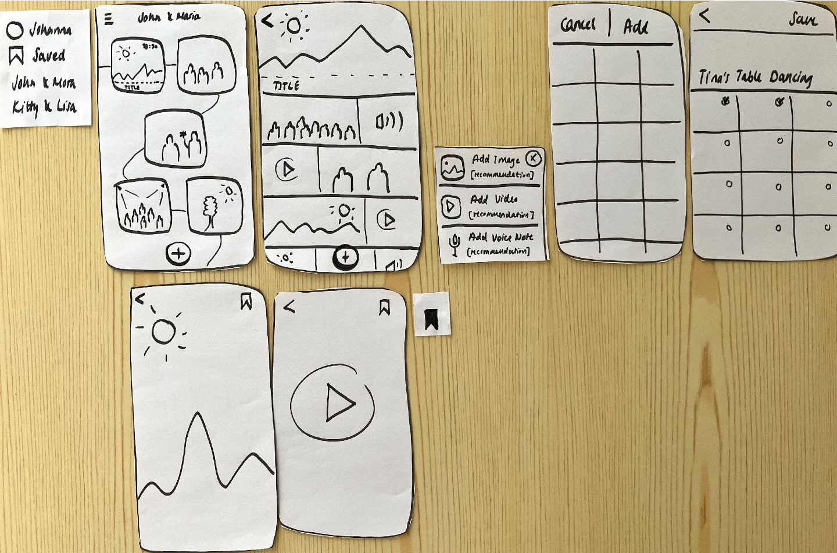
Timeline Visualization
We chose a vertical curved timeline with rotating photo slideshows for each moment. This provides an intuitive overview while making individual moments visually distinct.
Timestamp-Based Organization
Photos are automatically grouped by timestamp to minimize ambiguity and reduce the effort required from users.
No Comments, Just Saves
We deliberately excluded commenting to differentiate from social media. Instead, users can privately “save” meaningful photos for later reflection.
Floating Add Button
A single, prominent ”+” button encourages sharing while keeping the interface focused and simple.

