Slide 1
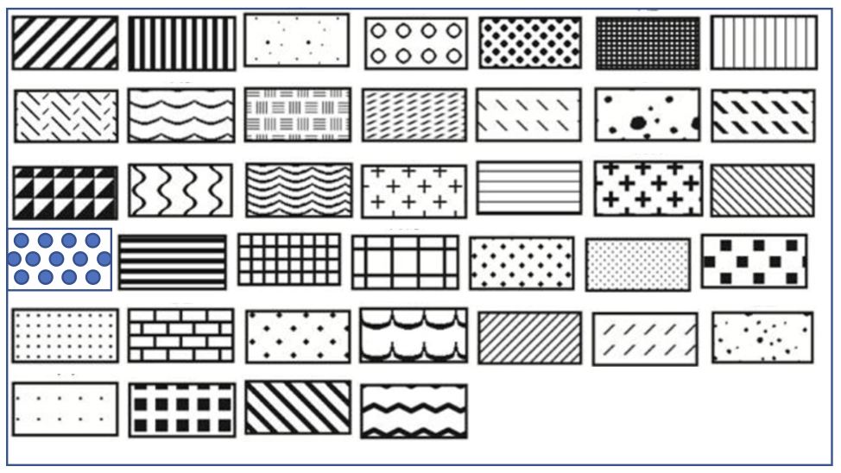
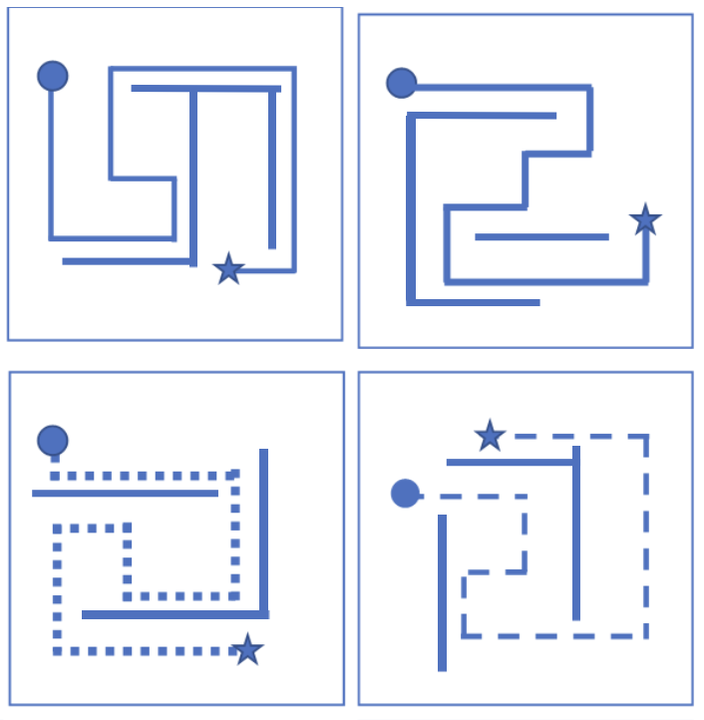
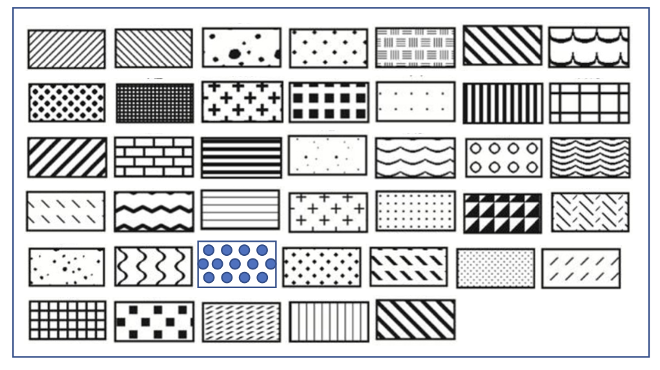
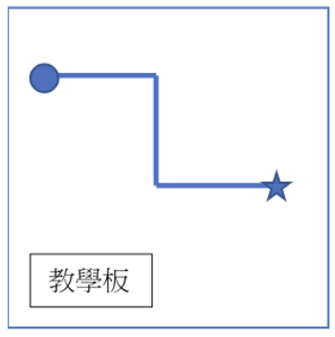


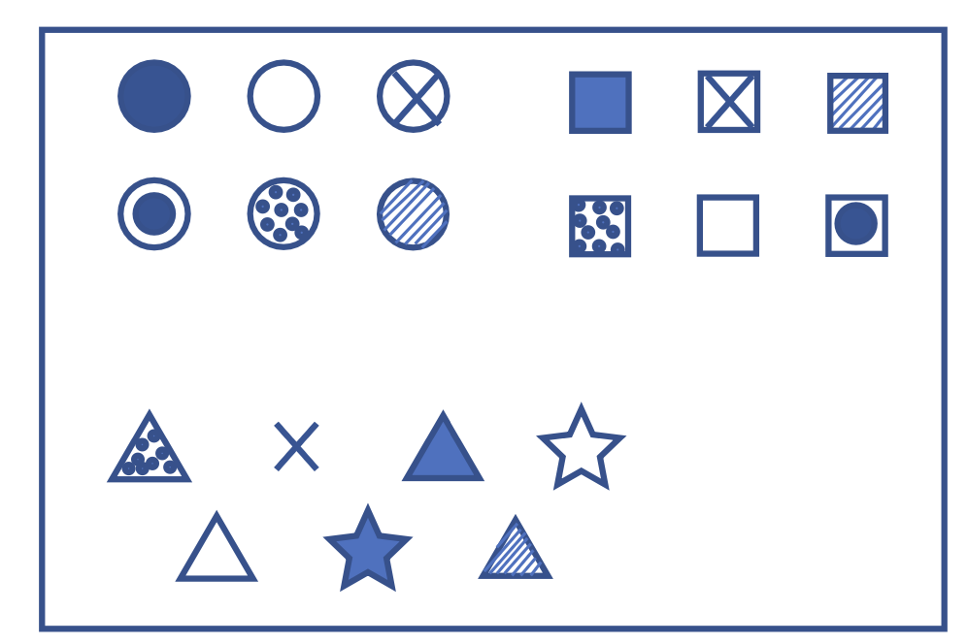
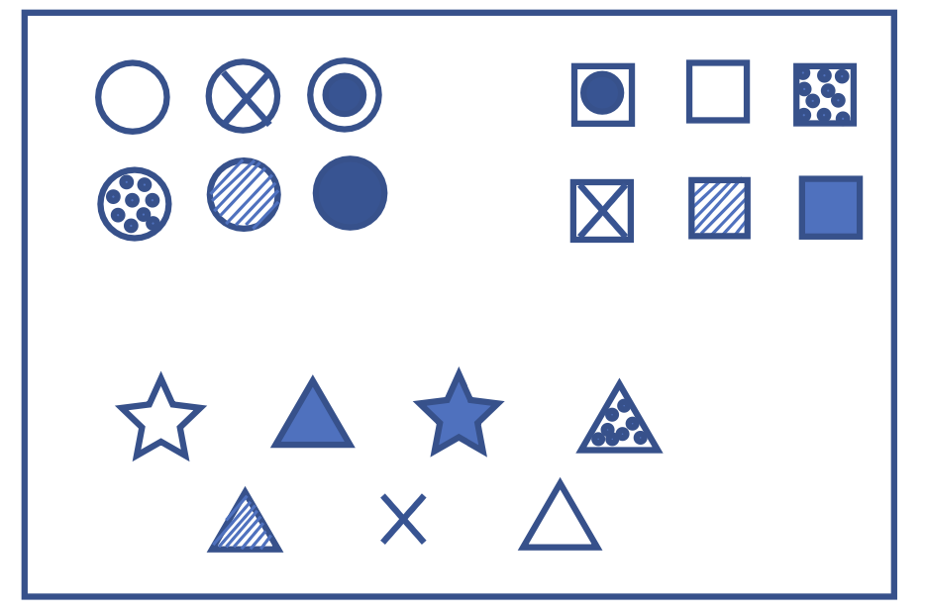

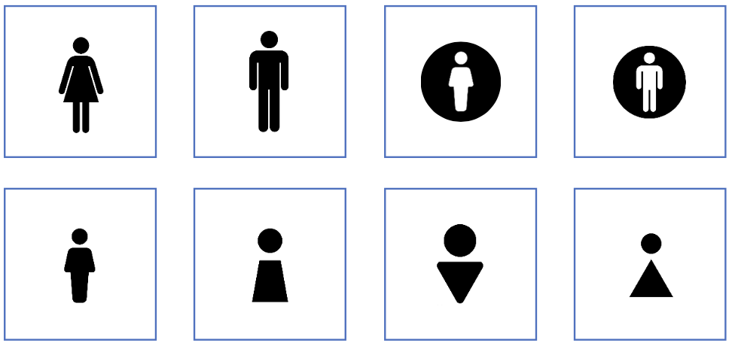
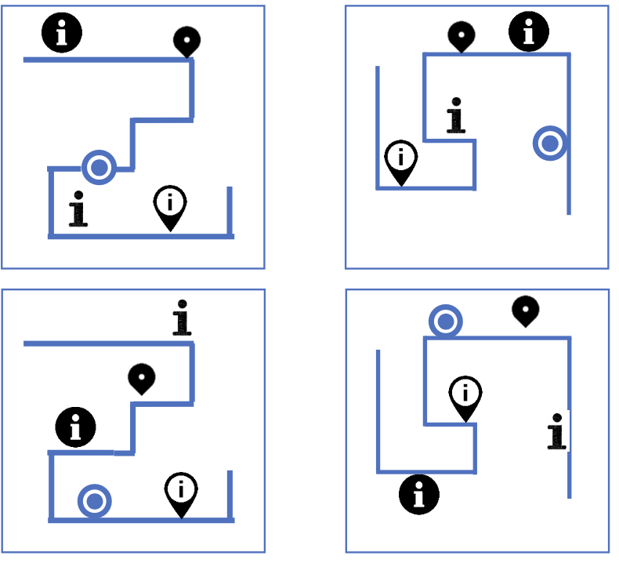
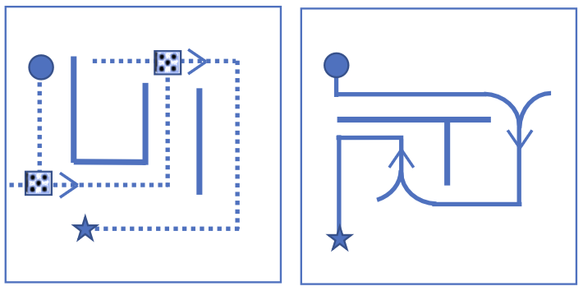
Texture
Line
Arrow
?
?
Shape
Corner
Icon
?
?

Slide 2
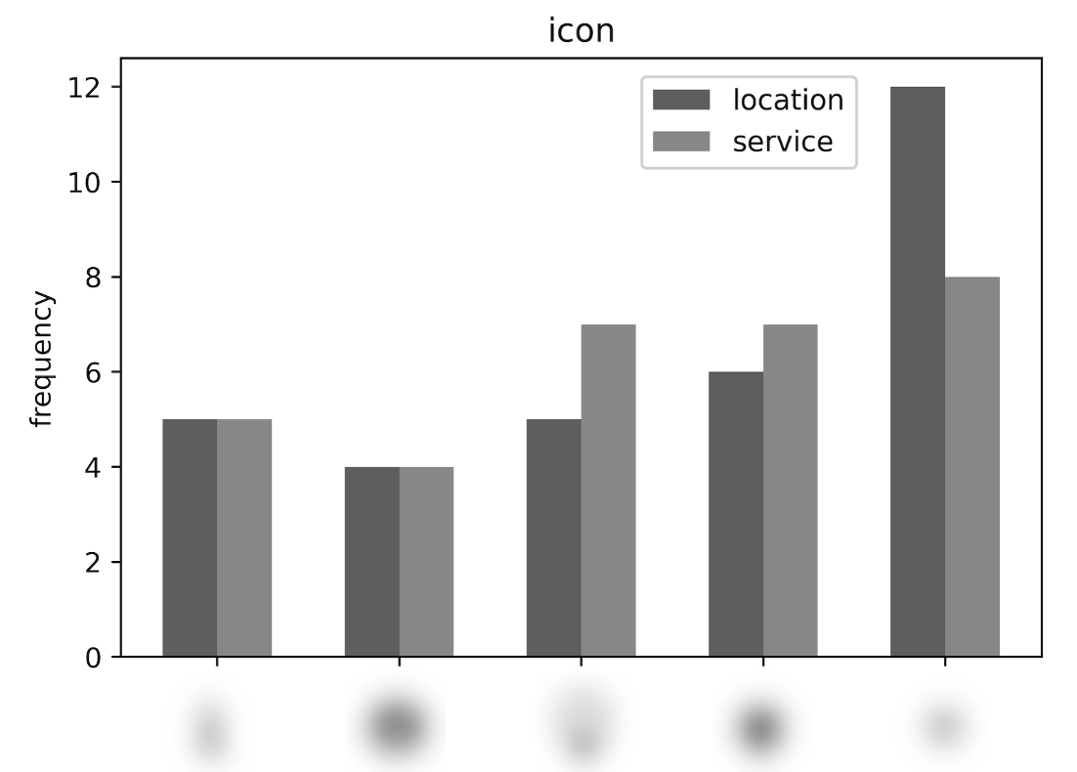
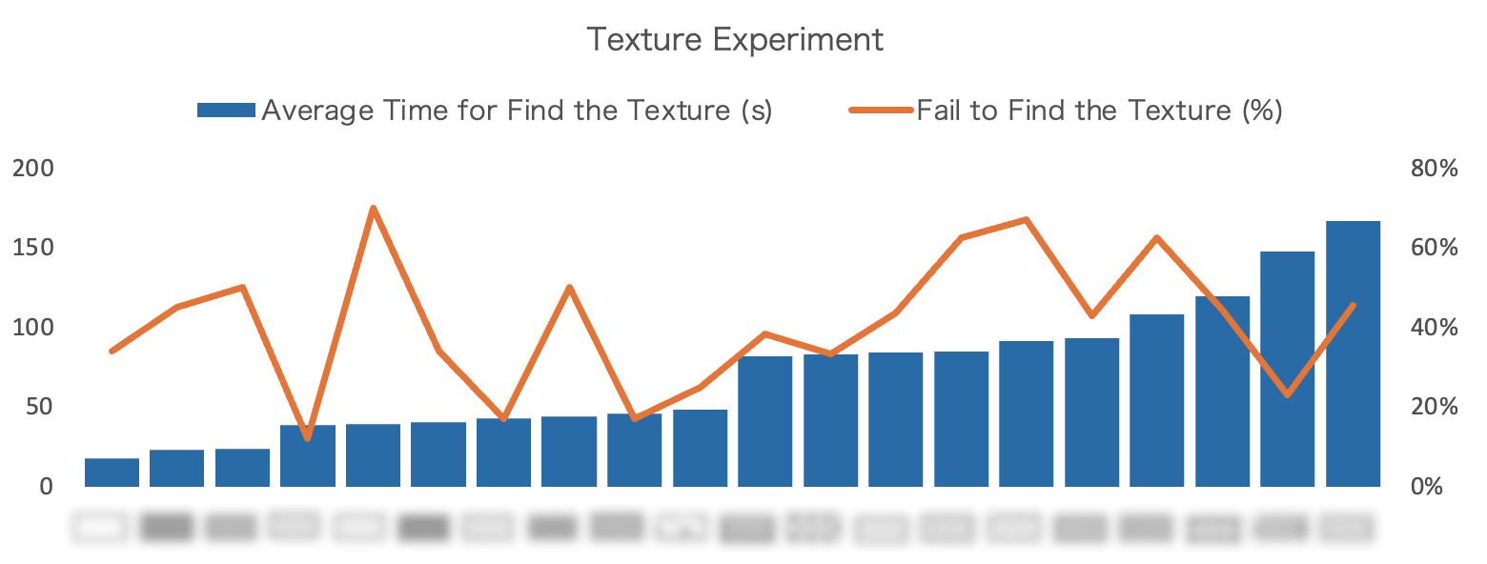
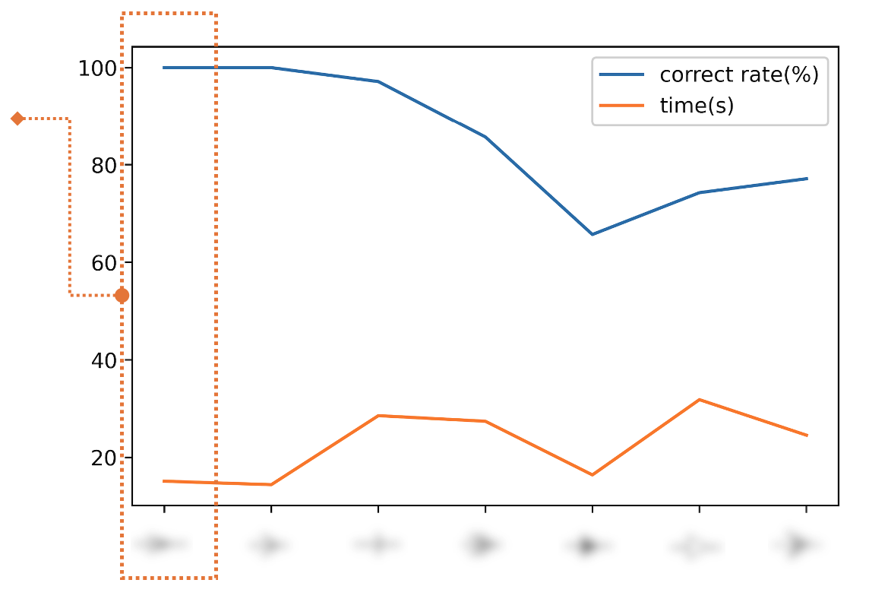
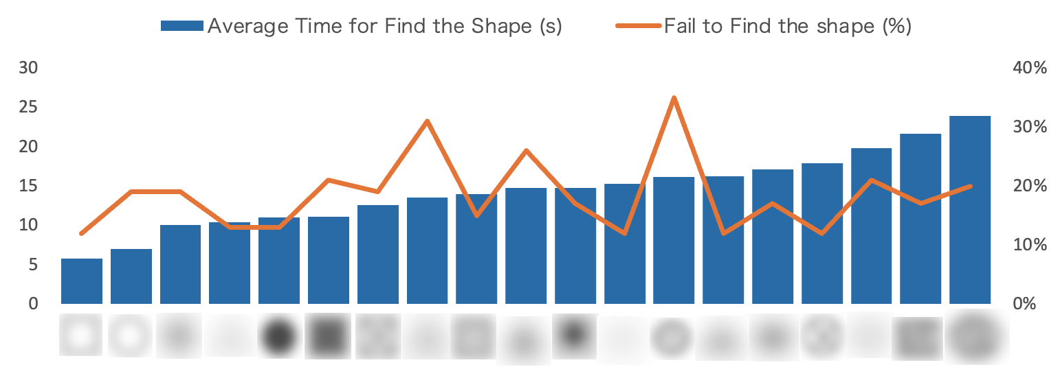
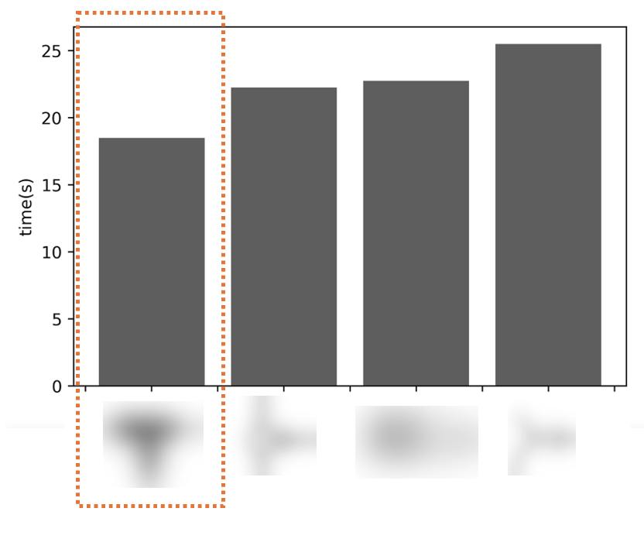
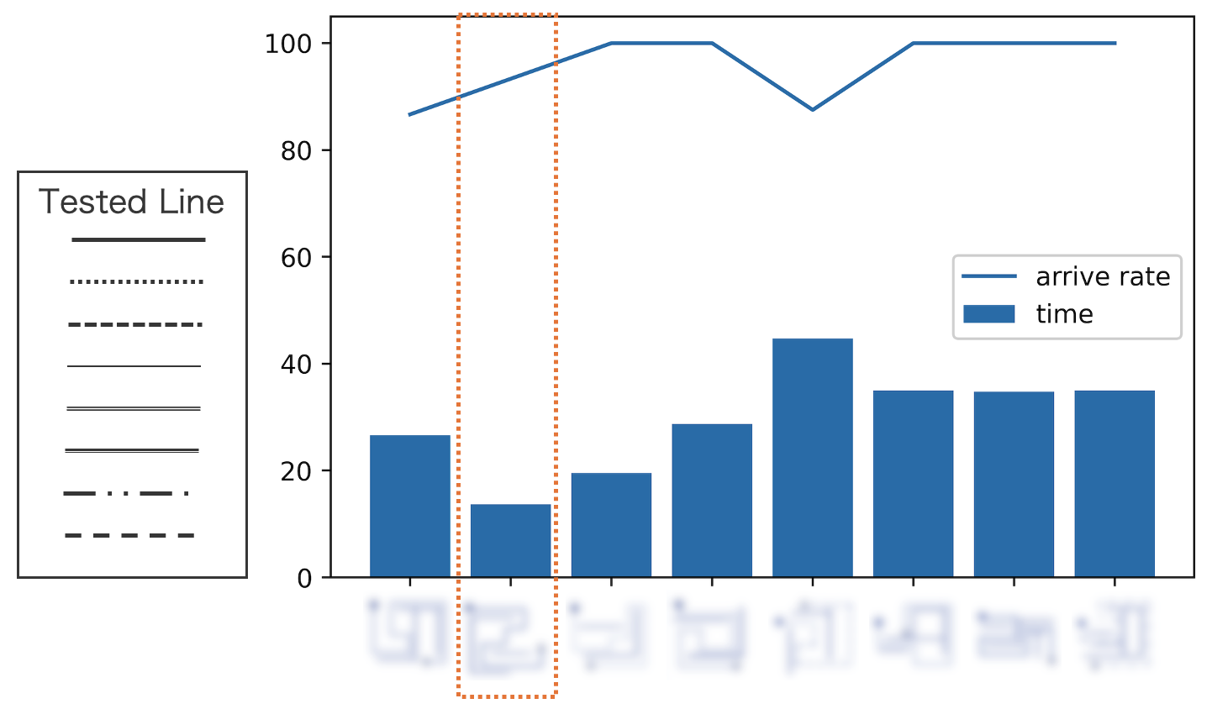
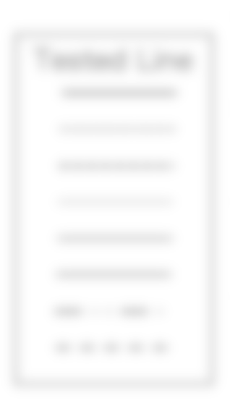
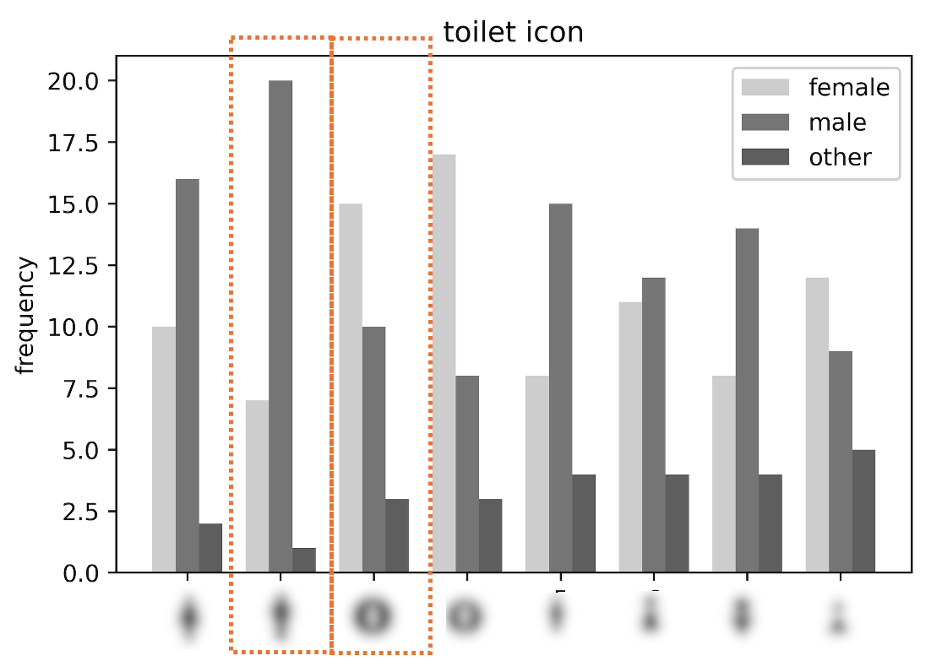

Slide 3
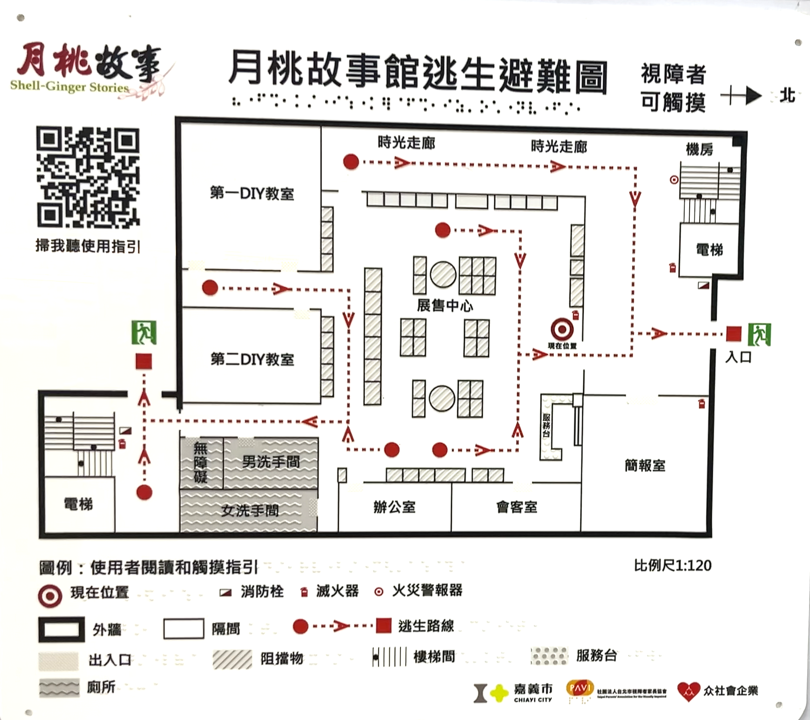

Slide 4
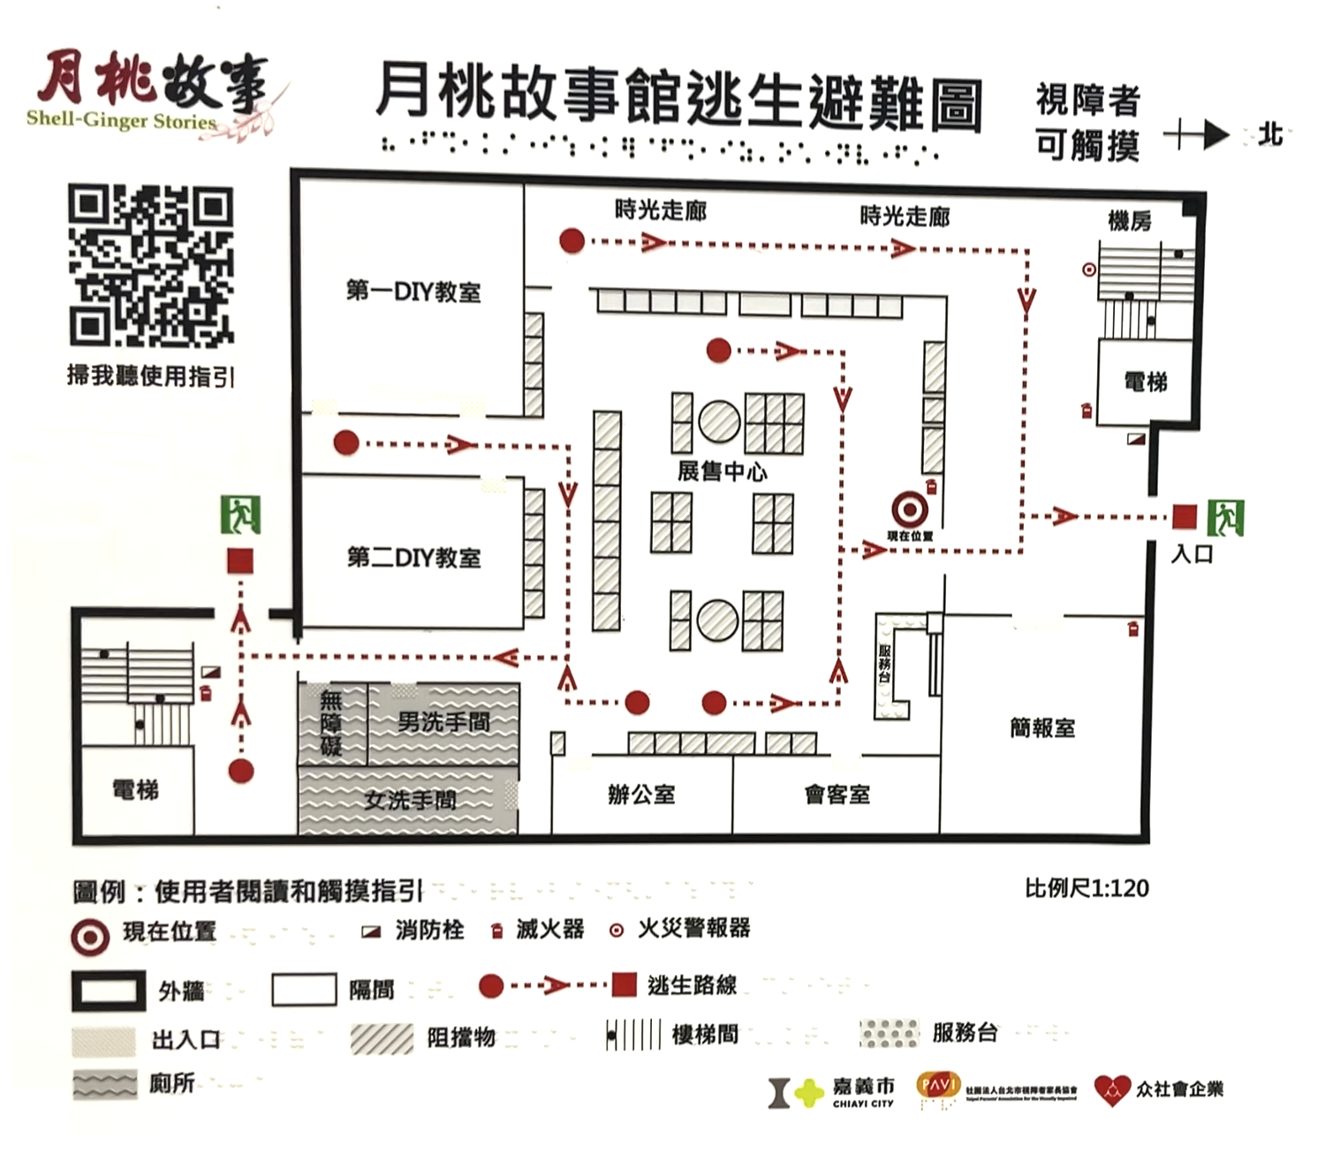

Slide 6
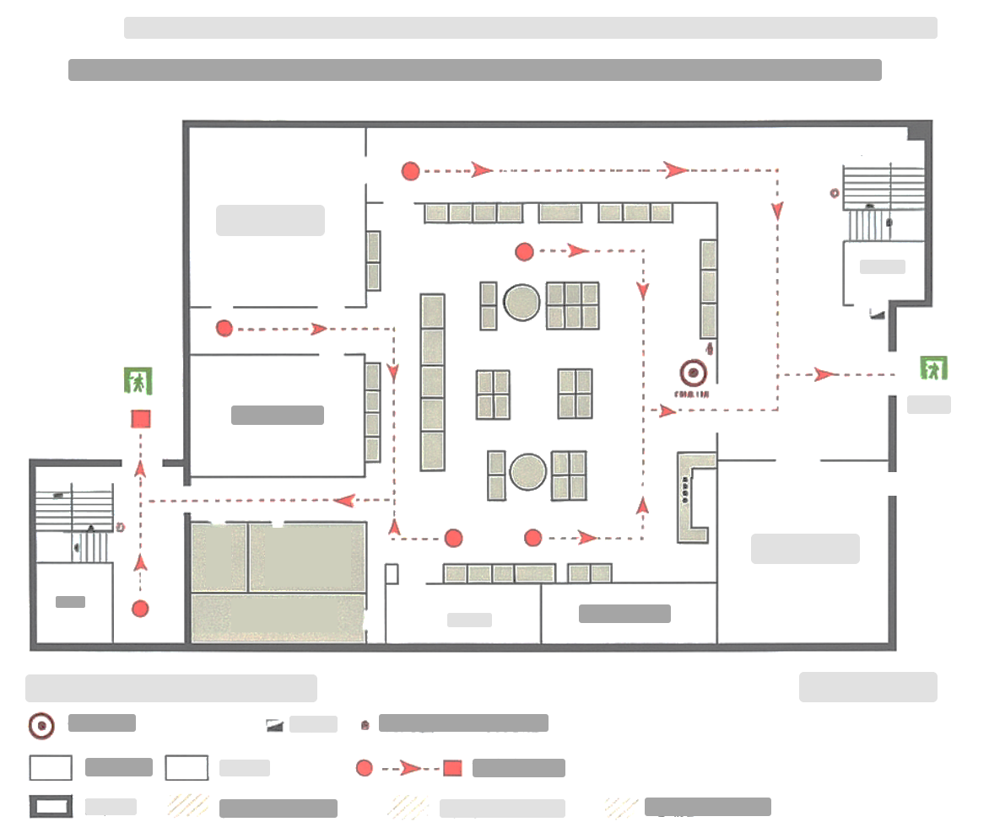
Avoid using icons on maps, as they are not intuitive for blind users. Replace them with shapes or textures when necessary.
Dot lines for represent route, and solid line represent wall
Use line arrows with angles that are most suitable for blind people to distinguish
Avoid radial shapes with sharp angles
The shapes should not contain textures within them
Limited the number of texture used. Only use top 3 textures in usability testing
Double circle represents current location

Slide 7


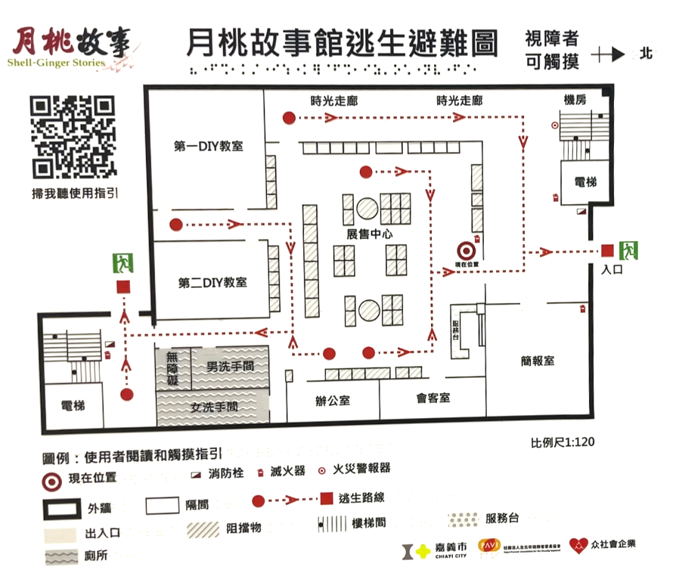



Results
Guideline 1
Avoid using icons on maps, as they are not intuitive for blind users. Replace them with shapes or textures when necessary.
Delete the icon
Guideline 2
For Arrow: line arrows with angles less than 45 degrees are preferable.
Arrow: Using line arrow for point the direction
Guideline 3
Avoid using different dot lines represent different meaning. The dotted line and the solid line are recommended.
Line: solid line represent wall
dot line represents route
Guideline 4
Avoid radial shapes with sharp angles, such as star shapes. Rounded, square, or simple triangular shapes are recommended.
The shapes should not contain textures within them, as this could create confusion about whether the focus is on the shape, the texture, or something else.
Using rounds represents current location
squares represent the exit
texture represent the restroom
All the shape we used are solid shape
Guideline 5
The internal patterns of the textures should be as simple as possible. Avoid textures that are too dense or intricate. Preferably, use textures composed of lines.
Texture: mainly using line textures
Use the top 3 textures
Fig. 1-23 Redesigned map

