Slide 1

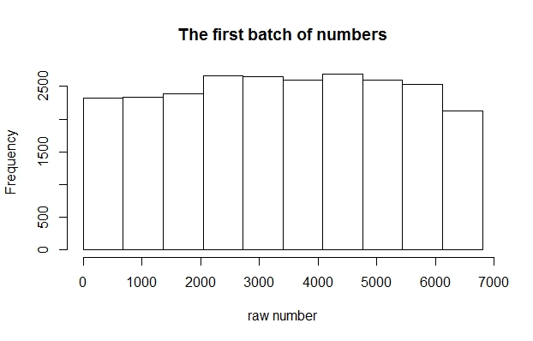
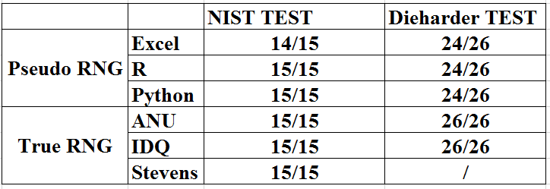
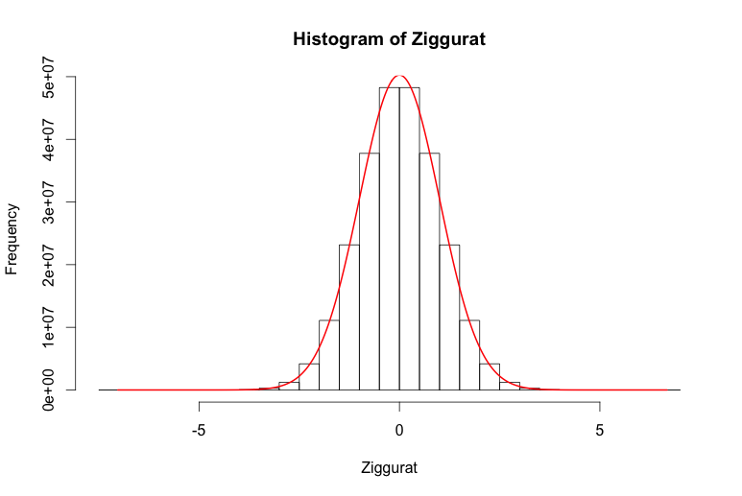
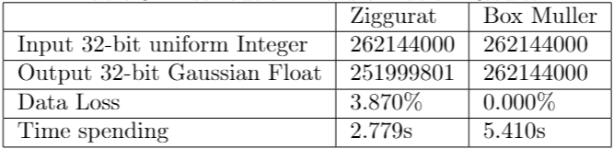
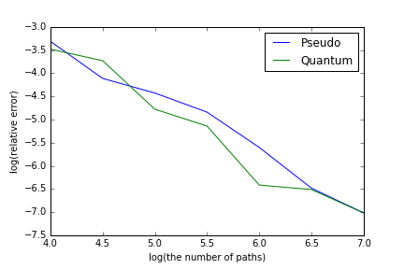
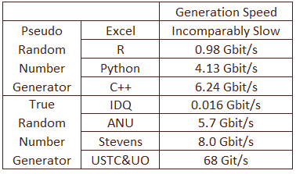
Quantum Random Number Generators in Monte Carlo Simulation
Anqi Zhou, Suhang Li, Yushi Zhao
Advisor: Dr. Rupak Chatterjee
Accenture Advisor: Carl M. Dukatz
Financial Engineering
April 25th, 2017
In Stevens, true randomness is being extracted from a Quantum system consisting of Photons.
This project is sponsored by Accenture. It aims to develop applications for Stevens Quantum Random Number Generator.
Most random numbers used in computer programs are pseudo-random, which means they are generated in a predictable fashion using a mathematical formula.
Statistical Tests have been designed to assess random number generator.
Stevens Quantum Random Number Generator
Statistical Tests Pass Rates
For options pricing using Monte Carlo simulation, Gaussian random numbers are required.
To transform the distributions, we implemented the following two algorithms.
From uniform to Gaussian
An Efficiency Comparison
on 1000 MB data samples
Pricing path-dependent options
Same Accuracy
Faster
http://www.stevens.edu/howe/academics/graduate/business-intelligence-analytics

