Slide 1
Prediction with probability

Slide 2
Prediction with probability
Problem: We have 10 randomly selected children under five years of age from Bangladesh. The task is to predict whether the children suffers from malnutrition (yes/no).
What minimum information do we need?
How can we predict?

Slide 3
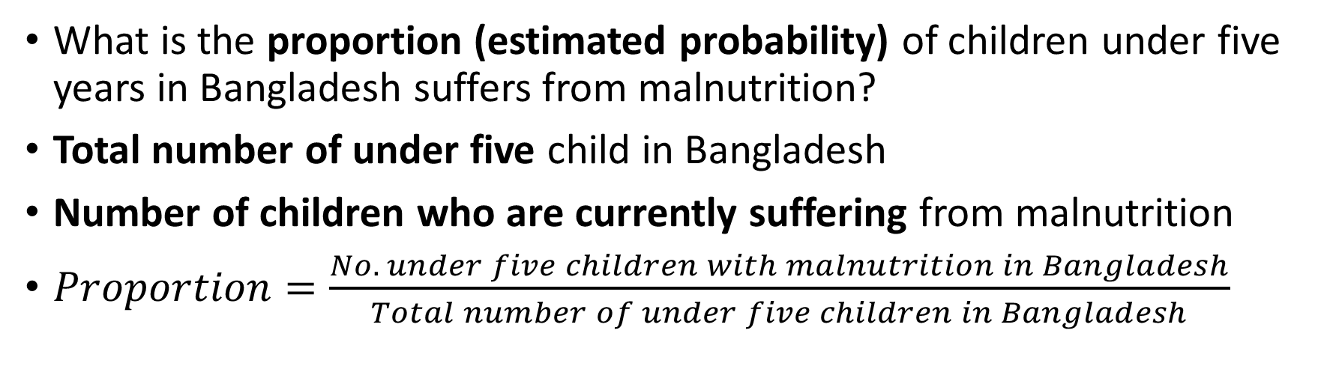
Required Information
What is the proportion (estimated probability) of children under five years in Bangladesh suffers from malnutrition?
Total number of under five child in Bangladesh
Number of children who are currently suffering from malnutrition
$Proportion=\frac{No. under five children with malnutrition in Bangladesh}{Total number of under five children in Bangladesh}$
Do we have these two information from whole population?

Slide 4
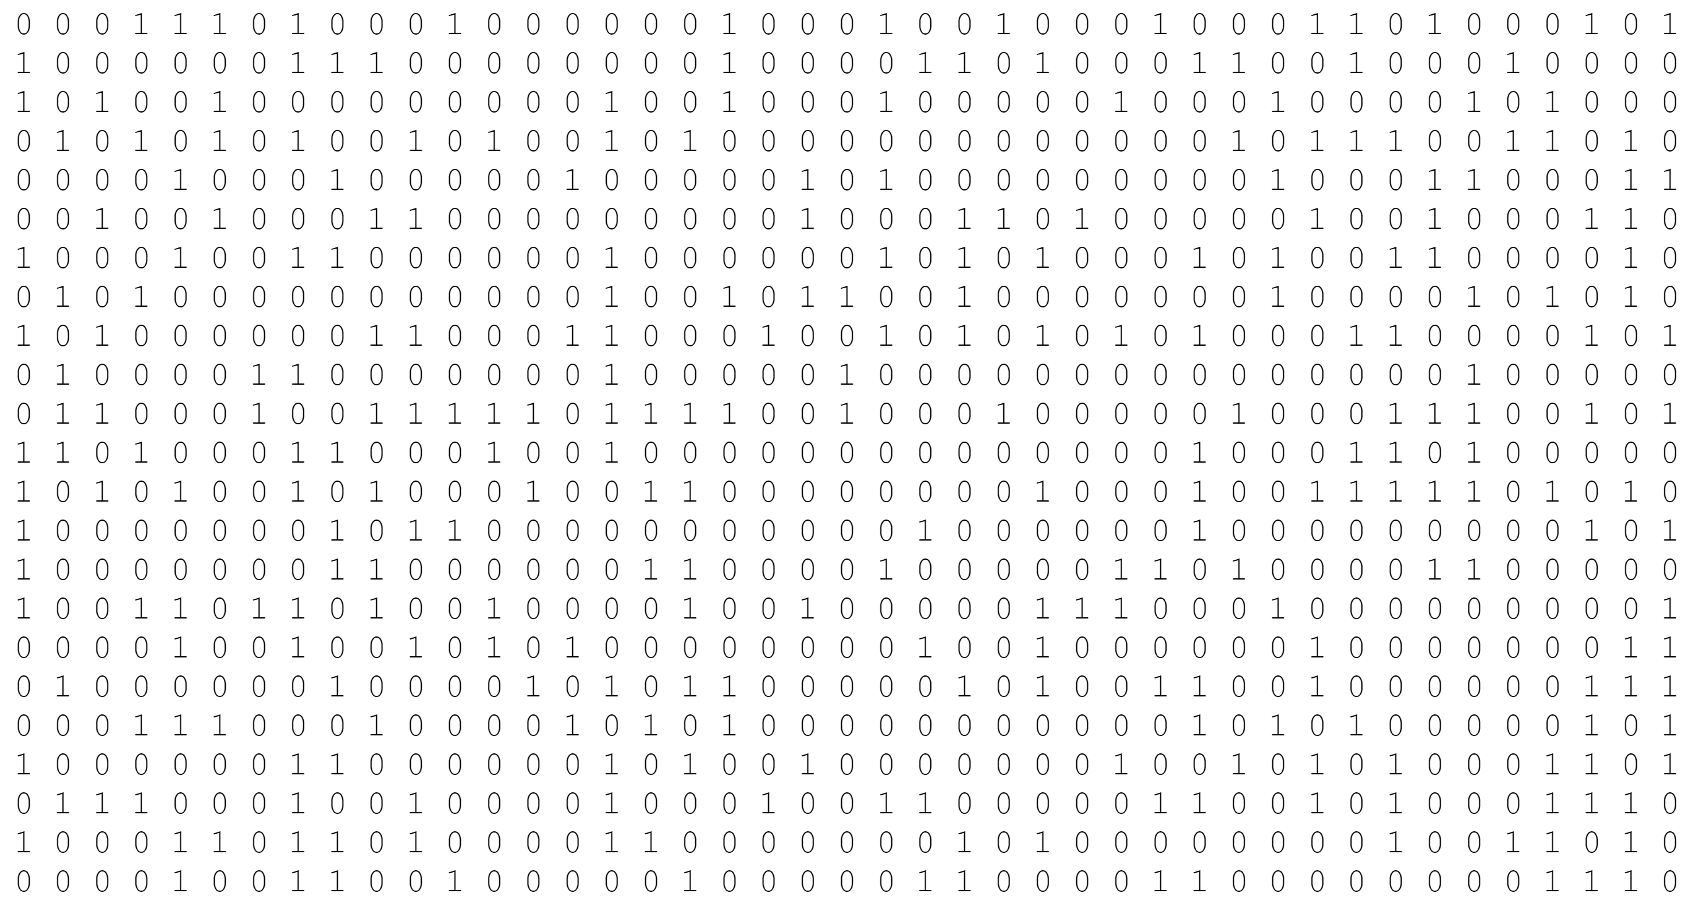
Population: All Under Five Children in Bangladesh

Slide 5
Estimated Proportion (Probability)
Conduct n experiments
Count number of malnutrition (m) among n experiments (No. of 1’s)
Estimated Proportion = m/n
The Estimated Proportion is our model to predict status of malnutrition of a newly selected children from the population
Estimated Proportion =0.30

Slide 6
How can we predict using probability?
Assign malnutrition status to “Yes” (1) to 30% of the children whose malnutrition status needs to predict
Assign 70% of their malnutrition status to “No” (0)
Randomly assign those “Yes” and “No” to the children of interest

Slide 7
Prediction with probability
ID | Malnutrition (Actual) | YS_1 | Fahim | Mahfuz | Hira | Razu | Farzana | Naim | Sumon | JA | YS_2
1 | 1 | 1 | 0 | 1 | 0 | 1 | 1 | 0 | 1 | 0 | 1
2 | 0 | 1 | 0 | 1 | 0 | 1 | 1 | 1 | 0 | 0 | 0
3 | 0 | 1 | 0 | 0 | 1 | 1 | 1 | 0 | 0 | 0 | 0
4 | 1 | 1 | 0 | 1 | 1 | 0 | 1 | 1 | 0 | 0 | 1
5 | 0 | 1 | 1 | 0 | 0 | 1 | 1 | 0 | 0 | 0 | 0
6 | 1 | 1 | 1 | 1 | 0 | 1 | 1 | 1 | 0 | 0 | 1
7 | 0 | 1 | 1 | 1 | 1 | 0 | 0 | 0 | 0 | 0 | 1
8 | 1 | 1 | 0 | 1 | 1 | 0 | 0 | 0 | 1 | 0 | 1
9 | 1 | 1 | 1 | 0 | 0 | 1 | 0 | 1 | 1 | 0 | 1
10 | 0 | 1 | 1 | 1 | 0 | 0 | 0 | 0 | 0 | 0 | 1

Slide 8
How many of the prediction were correct?
Confusion Matrix
 |  | Predicted
 |  | Yes | No | Total
Actual | Yes | 3 | 2 | 5
 | No | 2 | 3 | 5
 | Total | 5 | 5 | 10

Slide 9
Prediction Performance
What is the proportion of predicted malnutrition (yes) among who has malnutrition (yes)? (Sensitivity or True Positive Rate TPR)
What is the proportion of predicted malnutrition (no) among who does not have malnutrition (no)? (Specificity or True Negative Rate TNR)

