Slide 1
Objectives
Building statistical capacity by learning statistics, computing, and it’s application
Primarily, we will learn probability and its application in the next four months.
We will cover “A first course in Probability by Sheldon Ross” the first 5 chapters.
Successful achievements of the objective would empower us to learn the advanced statistics and it’s application in research.

Slide 2
What we will/will not do
Do
Attend meeting regularly
Take the responsibility to complete tasks.
Follow the highest possible standard for any output such as documentation and presentation
Be a leader
Don’t
Plagiarism (0 tolerance)
No sloppy work

Slide 3
?

Slide 4
What is a question?
Interrogative expression
The foundation of knowledge
Questioning is a powerful tool to exchange ideas
What do you think?

Slide 5
Use of questions (good things)
Good Use
To express interest to learn
To get a solutions
Questioning improves the intelligence
What else?
Problematic use
Showing disbelief or doubt
Asking private/sensitive information
Asking something metaphysical
What else?

Slide 6
Ask or don’t ask
“Asking a lot of questions unlocks learning and improves interpersonal bonding.”—Alison and Leslie (2018)
Don’t ask everything
“Be a good listener” --Dale Carnegie

Slide 7
What we should ask
Ask questions only to meet your thirst of learning (Objective)
Before asking think, how the answer to your question will help you
In research ask something about the population (Patterns)
In learning, ask something to reach the objective
In decision making ask about the uncertainty
Ask something precisely. Use WH questions Who, Which, What, When, How, Why, These questions has clear response that can be used further
For multiple query, ask and get answer one by one.
Don’t ask anything culturally sensitive, personal or metaphysical
Be respectful to everybody to ask or respond questions

Slide 8
Questioning Norms in the team
Our objectives are learning the world through statistics
We will be heavily involved with questions and questioning
We will be focused on learning and research questions mainly
We will Practice questioning
You are free to ask anything effective or stupid
Ask and get. Don’t ask, don’t get

Slide 9
Mathematical Approach
Probability is a discipline in mathematics as Geometry or Mechanics are
Each Mathematical discipline has three aspects
Logical content
Intuitive background
Application
Notes:
A measure of uncertainty

Slide 10
Logical Content
Mathematics deals with relations among undefined things
Examples from Chess
You cannot define Chess without the set of rules
The essential thing is to know how the pieces move or act
Examples in Geometry
Point and straight line. In geometry they are undefined notion
We define a relation/rule between them “Two points determine a line” or “only one straight line is possible through two points”.
The rule we set are called axioms, the building blocks to start mathematics with
Axioms are assumed true, and not proven.
We never prove the axioms, rather we use axioms to prove a theory
A theory is an abstract description of a system founded on axioms
Notes:
A measure of uncertainty

Slide 11
Homework
Identify some Axioms that Euclid set for geometry that you studied in school
Change/omit an axiom as you like
Show, how the change would impact to prove a theorem
Notes:
A measure of uncertainty

Slide 12
Intuitive Background
Intuition, “an accumulation of attitudes (including beliefs and opinions) derived from experience”--R. L. WILDER
The approach of looking into a problem to solve
Compare the set of rules in chess to win
Sum of all angles of a triangle is 180 degrees
You will be using the rules to reach the goal or explain the system
Intuition can be trained or developed
The theory of probability deserves intuitive attention to realize
Probability of a smoker getting lung cancer is 0.07
Don’t you think it is vague?
What is intuitive here?
Notes:
A measure of uncertainty

Slide 13
Probability
Historically the purpose of probability was to describe the experience connected with game of chance
In real life we use probability for decision making
We play a game of chance to predict the future consequence
We decide now based on the prediction of the future
Success of the decision depends on how precisely we made the prediction
A useful probability model may refer to non-observable world
Boson particle (In physics, was developed (1924–25) by Satyendra Nath Bose)
Probability of ruin (in insurance)

Slide 14
Statistical Probability
Tell me something from your day-to-day life
The intuitive notion of probability has two aspects in our life
Judgement: Jaynal is probably a happy man, Bangladesh government will probably be able to make Bangladesh people well off.
Judgement is an issue of philosophers or logicians
Inductive reasoning: Outcome of a conceptual experiment (Statistical probability)
We must agree with an idealized experiment such as tossing a coin
At the outset we must agree with the outcomes and the probabilities associated with them
The idealized model presumably meant “Out of infinitely may worlds one is selected at random”
It appears meaningless
An Event with probability .6 should be expected. This description is deliberately vague but provides a meaningful insight

Slide 15
Probability Interpretation
In Bangladesh, what is the probability of a male child?
What is your idealized experiment in your mind?
What are the possible outcomes of the experiment
What are the probabilities associated with the outcomes
Have you thought about infinite repetitions of the experiment
Male | 3005 (50.6%) | 2672 (50.4%) | 3907 (51.1%) | 3571 (51.3%) | 4065 (52.1%)
Female | 2932 (49.4%) | 2628 (49.6%) | 3740 (48.9%) | 3394 (48.7%) | 3741 (47.9%)

Slide 16
Discussion on writings
Assuming you all have submitted your assignments
Your Baseline standard
I will be sharing your writings anonymously

Slide 17
What we should ask
In research ask something about the population (Patterns)
In learning, ask something to reach the objective
In decision making ask about the uncertainty
You can add more
To ask a WH question
Think about the population and elements of the population
Think about an interesting parameter of the population
Fix the place and time, as the parameter might change over time
Pose the question

Slide 18
Example 1
what is the main cause of child marriage in Bangladesh?
what is the effect of per capital income with the population growth of Bangladesh?
why the population of Bangladesh is not going to be turned into an asset?
what is the relationship between the population growth and the average life expectancy of the people of Bangladesh?
How is the standard of living of the people of Bangladesh after the age of 60?
A statement which is so explicit or well-established and also accepted without contention or query is known as axiom. Taking something as a standard and consider a set of rules and thought to be clearly true and compare or follow related thing with it. Easily to solve any equation or any matter.

Slide 19
Example 2
An axiom is sort of a rule that you are allowed to assume is true. In math we have this thing that we have to prove results. There is the speciality of mathematician that they have to proof everything that they wanna stablish. In order to get these proofs we have to start from somewhere. So if you’re going to proof something we have to have a set of statements which we call axiom which everywhere everyone agrees are true. Axioms are very very simple statement and once you just say like these are true. Because once We have proven something we are absolutely certain that it is and will always be true. Now come up with hypothesis and theorem for better understanding. A result or observation that we think is true is called a Hypothesis. Once we have proven it, we call it a Theorem. Once we have proven a theorem, we can use it to prove other, more complicated results. Now the interesting part is questioning where to start from. We have to use something to prove anything. We need at least a few building block(s) to start with and this/these starting
How many people like mango and know about different types of mango?
Which percentage of people like online gaming of child?
How many student go abroad and satle there?
How much effective this for our country?
How many people of Bangladesh are using twitter?
What are the main reason of believing rumor of population of Bangladesh?

Slide 20
Example 3
What are the causes for population growth of Bangladesh?
What are the problems that Bangladesh is facing due to population growth?
How can we reduce population growth of Bangladesh?
How has the condition of Bangladesh if we fail to reduce population growth?
Is family planning effective to reduce population growth of Bangladesh?
The basic facts or statement which are taken for granted without proof are called axioms.
Examples:
is a natural number.
2.Two parallel lines never intersect each other.
These are the axioms because we accept the statement without any controversy and needs no proof. There are also many examples of axioms in mathematics. Such as:
1.a+b=b+a 2.a+(b+c)=(a+b)+c
Actually axioms are the rules and we follow the rules to make the logical system easy and we can easily solve the complicated mathematical problem.
Mathematics is not about choosing the right set of axioms but it helps us to get better way to solve the problem . Every area of mathematics has its own set of basic axioms…

Slide 21
Expectations in writing
Write for the audience, not for yourself.
While writing the email, Write the most important messages in the first line. Then explain each message in small paragraph. Greeting sentence will be the shortest one
Always write your assignment in the Word or latex document with minimal formatting. That will allow you to use the document for the other purpose. Please DON’T scanned or image files
Avoid plagiarism, write what you feel

Slide 22
Probability from the experience
In real life we use probability for decision making
Suppose I do not want to get wet by rain while walking outside
Should I carry an umbrella while going out for some time?
We play a game of chance to predict the future event
Is there a probability of rain?
We decide now based on the prediction of the future
I predict, there is no rain in the next two hours (based on the probability)
Success of the decision depends on how precisely we made the prediction
Get wet/dry if prediction fails/works

Slide 23
Probability measurement
We play a game of chance to predict the event
Is there a probability of rain?
The more precisely I can estimate the probability, the more chance I will win the game of prediction.
How can we estimate the probability?
In our problem we have a sense of high probability, low probability.
We need a model to measure the probability precisely

Slide 24
Informal probability calculation
সকালে কলেজে যেতে হলে আব্দুল্লাহপুর হতে আমাকে বাসে উঠতে হতো আর এতে আমি কোন বাসে উঠবো তা নিয়ে সম্ভাবনা প্রয়োগের একটি ব্যাপার চলে আসে। কিন্তু ঐ সময়ে সম্ভাবনা কিন্তু আমার মাথায় নেই।
তাও স্বয়ংক্রিয়ভাবে দেখা যেত যে আমি ভাবতাম বঙ্গবন্ধু বাস দিয়েও তো তেজগাঁও যাওয়া যাবে কিন্তু পূ্র্ববর্তী সময়ে এই ট্রান্সপোর্ট দিয়ে যাওয়া অভিজ্ঞতার রেকর্ড তো বেশি ভালো না তো আমি এটা দিয়ে আপাতত যাচ্ছি না। এরপর দেখলাম বিকাশ বাস কিন্তু সেই বাসের তো সব সিট ফাঁকা, এই বাসের অধিকাংশ সিটে যাত্রী নিয়ে আমাকে মনে হয় না এটি ঠিক সময়ে পৌছিয়ে দিবে! আবার দেখলাম আরেকটি বিকাশ বাস এটির আবার অধিকাংশ সিটে যাত্রী আছে তো এটি দিয়ে যাওয়া যায়। ওহ না, পেছনে তো ভি আই পি-২৭ বাস আসতেছে এই বাস দিয়ে যাওয়ার অভিজ্ঞতা যথেষ্ট ভালো আর বাসে যাত্রীও প্রায় পূর্ণ, এটি কিন্তু আবার চলন্ত অবস্থায় যাত্রী নিতে থাকে যাই হোক ঠিক সময়ে পৌছাতে সাবধানে একটু ঝুঁকি নেওয়াই যায়!
ঝুকির সাথে সাবধানতার ব্যাপারটা দারুণ।
তো আমি সর্বশেষে এই বাসে ওঠে কলেজে পৌছালাম।

Slide 25
Informal probability calculation
The decisions we take after calculating these incidents is whether to stay in the class or not. Some of my friends just go out when the see the teacher is not coming and some of them stays in the class. There is always a 50% chance that one period is a gap period. Some them decides to stay and some of them decides to go using probability.
The class representatives inform us the previous night whether the class is going to happen or not. They call the teachers and our teachers inform them if they are able to take classes. So after their messages I go to the class with a probability value of 1 in my mind that I have to participate in the lectures. But deep down I also know that there is a 25% chance that the teacher can not come to our class or some of the teachers will exchange the classes with another one.

Slide 26
Summary
You had data on different possible scenarios: Your experience
You had an objective function: Reach college in a shortest possible time
You made decision based on automated system of your brain. You brain was trained based on your previous data you observed

Slide 27
Questions arises from the solution
What was the guarantee that your decision was the best
Does your decision making system works for all different situations
Does another person will in the same situation will agree with your probability?
If not, why?

Slide 28
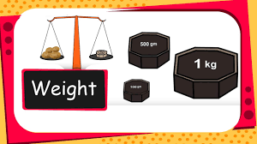
Mass Measurement Model
Measure the content of a material (mass)
The standards (wight of 1 Kg)
The mechanism to compare (The scale)
Get numbers for materials (1 Kg)
Get the number repeatedly for repeating weight process
We can compare weight with the other object of the mass
Do you think the measurement model will work everywhere?

Slide 29
Probability Measurement Model
We need a similar model to measure the probability of an event
Before that we need to fix few definitions and axioms involved with the measurement
We will discuss the probability in terms of relative frequency

Slide 30
Definitions
Experiment: An experiment or trial is any procedure that can be infinitely repeated and has a well-defined set of possible outcomes
Random Experiment: An experiment is said to be random if it has more than one possible outcome
Example: Tossing a coin
Sample Space: the set of all possible outcome of an experiment (S)
Event: Any subset of the sample space is an events (E)
Give examples of random experiment and the associated sample space and events relating to your assignment 3

Slide 31
Practice
In the bus tacking scenario what would be Experiment?
Was the experiments random?
What were the events for which you calculated the probability

Slide 32
Probability Definition
Suppose we performed an experiment repeatedly under the same condition (n experiments)
Example: n tosses of a coin
For an event of interest E, we have n(E) in the sample space
The probability of E defined as
The limiting proportion of the time of E occur, the limiting frequency of E

Slide 33
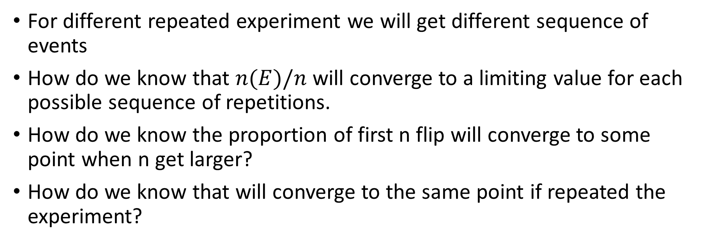
Limitations in the Probability Definition
For different repeated experiment we will get different sequence of events
How do we know that $n(E)/n$ will converge to a limiting value for each possible sequence of repetitions.
How do we know the proportion of first n flip will converge to some point when n get larger?
How do we know that will converge to the same point if repeated the experiment?
Do you have any solution in mind?

Slide 34
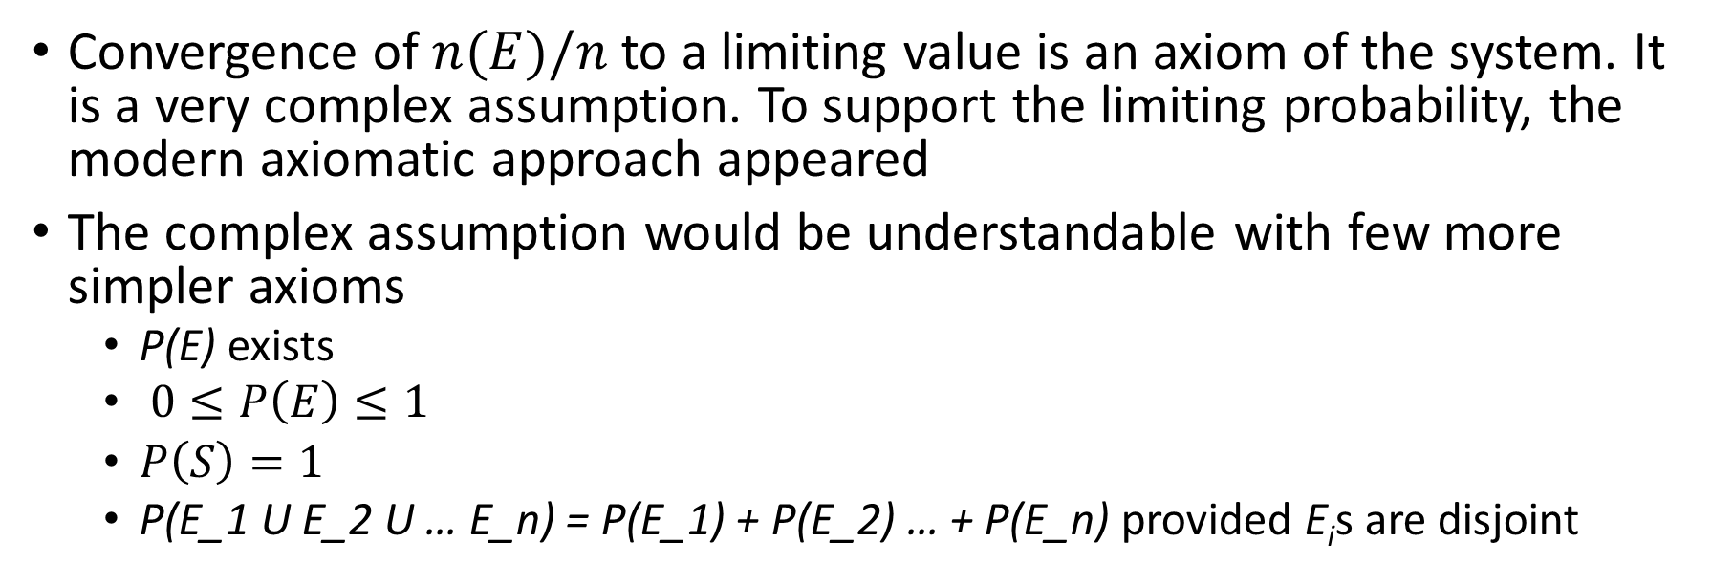
Assumptions or Axioms
Convergence of $n(E)/n$ to a limiting value is an axiom of the system. It is a very complex assumption. To support the limiting probability, the modern axiomatic approach appeared
The complex assumption would be understandable with few more simpler axioms
P(E) exists
$0≤P\left(E\right)≤1$
$P\left(S\right)=1$
P(E_1 U E_2 U … E_n) = P(E_1) + P(E_2) … + P(E_n) provided E_{i}s are disjoint

Slide 35
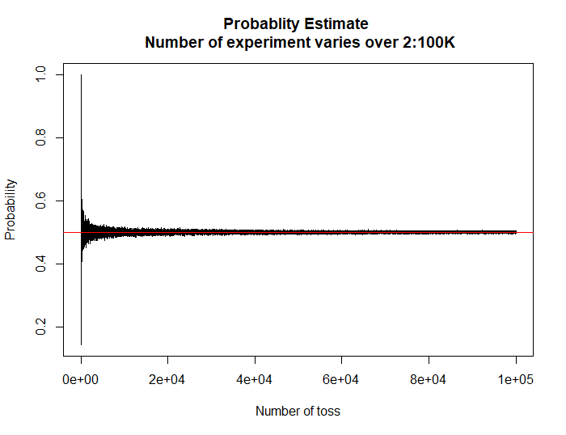
Evidence of convergence
If the number of experiment increases, the estimate approaches to 0.5

Slide 36
Statistics problem with a stick
Points on the stick are our subject of interest
What is the sample space?
What is the size of the sample space?
Can you define an event in the sample space?
Can you randomly select a single random point A on the stick?
P(A) = ?
What is the probability that A is on the stick
1 Unit

Slide 37
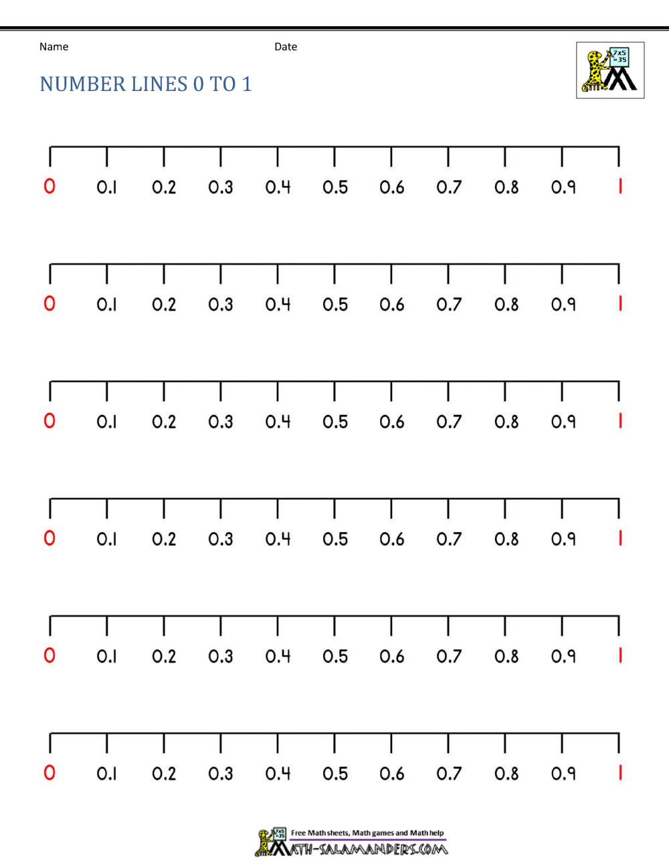
Statistics problem with a stick
Let us replace the stick with a number line
What is the sample space?
What is the size of the sample space
Can you randomly select a point A on an interval?
P(A < 0.5) = ?
P (A > 0.5) = ?
1 Unit

Slide 38
Statistics problem with a stick
Let us divide the number line into more equal part
What is the sample space?
What is the size of the sample space
P(0.1 <A < 0.2) = ?
P (0.6 < A < 0.7) = ?
What is needed to determine the probability of a point in an interval?
1 Unit

Slide 39
Statistics problem with a stick
You can prove that the probability of a point in an interval is 1/10.
You can prove that mathematically using the definitions and assumptions of probability
You can see that by simulation also
1 Unit

Slide 40

Statistics problem with a stick
Suppose 10 bulbs were set in each of the interval (1:10). When you switch, a machine randomly generates a number [0,1]. The bulb lights if the number is in the corresponding interval.
P(Bulb 10 will light) = ?
Interpret the probability of lighting a bulb
Give a similar example from your book
1 2 3 4 5 6 7 8 9 10

Slide 41
Take home messages
In the discrete countable space calculating probability is easier
All discrete set can be generalized by the continuous uncountable set if we know the range of the set.

Slide 42
Probability Application in Research
E is an event
n is the number of repetitions of an experiment or a single realization of an experiment with n experimental units
In research, we are interested to know the probability of an outcome in a population.
The collection of all experimental units may be considered as the population
For example, Children in Bangladesh

Slide 43
Probability Application in Research
We define an event such as a child being malnourished (E).
There exists a true probability of the malnourished child in the population. We do not know the true probability.
To estimate the probability, we need an n number of the experiment at a time. Record n(E) and n.
If we could experiment on the total population, that could provide us with the true probability of the event. However,
We do not have access to the whole population. So, we choose a sufficiently large n could provide use the reasonable estimate of the true probability

Slide 44
Prediction with probability
An estimate of probability provides a piece of valuable information about the population, not about the sample space.
Using the probability, we can predict the nourishment status of an unknown child or a group of unknown children within that population
For example, Suppose the probability of malnourished children in Bangladesh was estimated is 0.29 (Based on a finite number of the experiment).

Slide 45
Prediction with probability
For example, Suppose the probability of malnourished children in Bangladesh was estimated as 0.29 (Based on a finite number of experiments).
Prediction:
Approximately 29% of children of Bangladesh are malnourished
If we draw a random sample of 100 children from Bangladesh and predict 71% to be nourished and 29% to malnourished and randomly assign them to the observed 100 children should provide the best prediction among the other univariate prediction methods.
You can predict you can use the binomial model with the malnourished (success) probability of 0.29. This is the fundamental thought of Logistic regression which is a machine learning method commonly used for classification and causal inference.

Slide 46

Probability Recap
If you draw a ball randomly from the box.
What is the probability of selecting the red ball
What is your experiment
What is the sample space
What is the guarantee that your probability estimate is consistent

Slide 47


A twist in probability
Now we have two boxes. If you draw a ball randomly from a box.
What is the probability of selecting the red ball
What is your experiment
What is the sample space
What is the guarantee that your probability estimate is consistent

Slide 48
A twist in probability
Now we have two boxes. If you draw a ball randomly from a box.
What is the probability of selecting the red ball
What is your experiment
What is the sample space
What is the guarantee that your probability estimate is consistent
 | # Red Balls | # Non-red Balls | Total
Box 1 | 4 | 8 | 12
Box 2 | 1 | 6 | 7
Total | 5 | 14 | 19

Slide 49
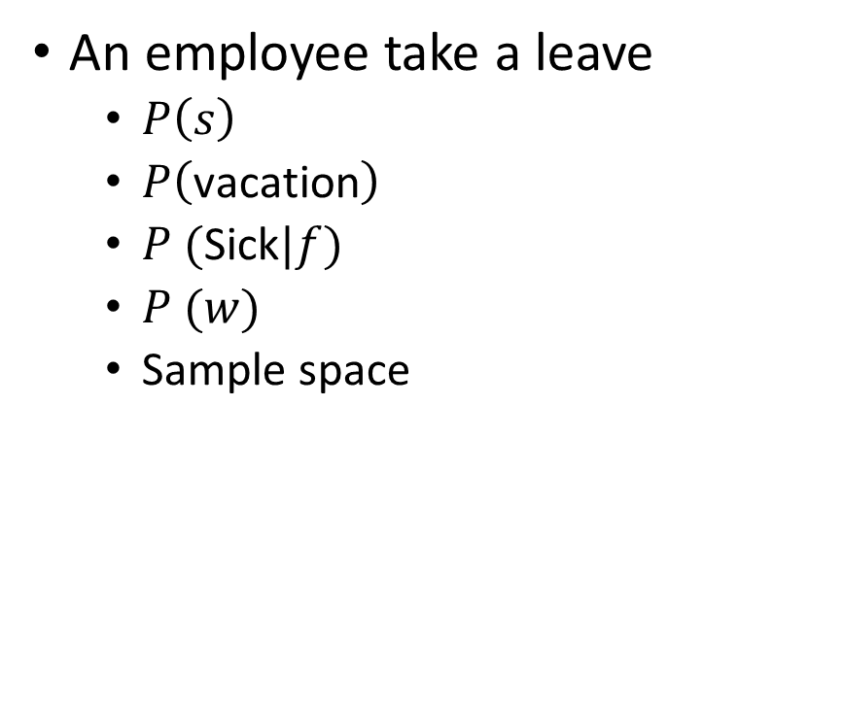
Conditional probability
Suppose there was an experiment
Suppose an event is defined jointly on two outcomes (two dimensional),
Say, they are
Leave type = {vacation, sickness}
Leave days = {s, m, t, w, t}
Employees are the experimental units
An employee take a leave
$P\left(s\right)$
$P\left(\text{vacation}\right)$
$P (\text{Sick}|f)$
$P (w)$
Sample space
 | s | m | t | w | t | f
Vacation
Sick

Slide 50
Conditional probability
Names | Leave | Days
Mahfuz | Vacation
sujaul | sick | th
Khalil | sick | s
Fahim | sick | f
Tamanna | Vacation | m
Yeasmin | sick | t
Naim | Vacation
Sumaiya | Vacation | m
Raju | sick
Sumon | sick | sa
How we can estimate the probability
Repeat the experiment
Let us do the pole
We will decide randomly who will go for vacation/who need to see a doctor
Respond the pole

Slide 51
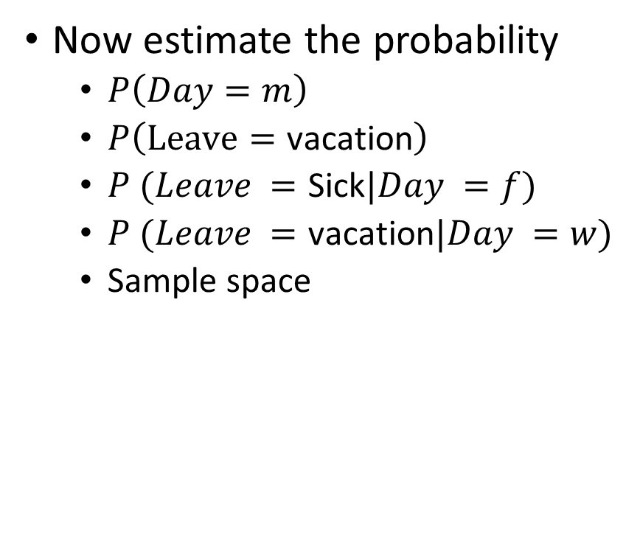
Conditional probability
Names | Leave | Days
Mahfuz | Vacation
sujaul | sick | th
Khalil | sick | th
Fahim | sick | f
Tamanna | Vacation | m
Yeasmin | sick | f
Naim | Vacation
Sumaiya | Vacation | m
Raju | sick
Sumon | sick | m
Now estimate the probability
$P\left(Day=m\right)$
$P\left(Leave=\text{vacation}\right)$
$P (Leave =\text{Sick}|Day =f)$
$P (Leave =\text{vacation}|Day =w)$
Sample space
 | m | t | w | t | f
Vacation | 2 | 0 | 0 | 0 | 0
Sick | 1 | 0 | 0 | 2 | 2
 | 3 | 0 | 0 | 2 | 2

Slide 52
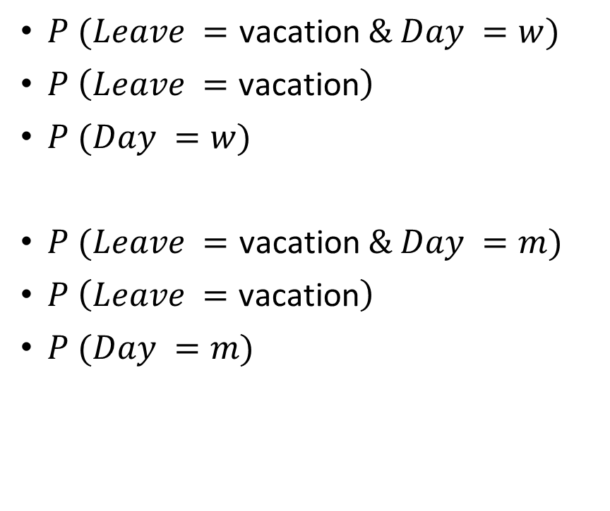
Independent Event
$P (Leave =\text{vacation} \& Day =w)$
$P \left(Leave =\text{vacation}\right)$
$P (Day =w)$
$P (Leave =\text{vacation} \& Day =m)$
$P \left(Leave =\text{vacation}\right)$
$P (Day =m)$
Now estimate the probability
$P\left(Day=m\right)$
$P\left(Leave=\text{vacation}\right)$
$P (Leave =\text{Sick}|Day =f)$
$P (Leave =\text{vacation}|Day =w)$
Sample space
 | m | t | w | t | f
Vacation | 2 | 0 | 0 | 0 | 0
Sick | 1 | 0 | 0 | 2 | 2
 | 3 | 0 | 0 | 2 | 2

