Slide 1
Team Imperial
AI in Orthopaedics Hackathon 2024

Slide 2
Deliverables
Model & Inference Code: Python code to run analysis and generate results in a Jupyter notebook.
Documentation: Document (e.g. text document, slide deck, etc.) to describe analysis, results, interpretation, conclusions, strategy for clinical implementation, and how to run the code.
Environment Info: List of libraries and packages, setup details, and additional items necessary to run the Jupyter notebook (e.g. a fix seed).
List of team members and their contribution.

Slide 3
Setup Guide
Visual Studio Code
Google Collab
Download the Jupyter notebook ‘Stryker_AI_Hackathon_notebook.ipynb’.
Download the file ‘requirements.txt’ .
Go to the terminal and navigate to the location of the Jupyter notebook and requirements.txt file.
Download required libraries using the command ‘pip install requirements.txt’.
Run all cells!
Download the Jupyter notebook ‘Stryker_AI_Hackathon_notebook.ipynb’.
Go to Google Collab and upload the notebook.
Run all cells.
That’s it!
All the code, setup instructions and hackathon resources referenced in this submission can be found in our project GitHub repository, available at : https://github.com/yusiGM/StrykerAI2024. This slide in combination with the ‘requirements.txt’ file target the “Environment Information” deliverable. The “Model and Inference Code deliverable” is addressed by the ‘Stryker_AI_Hackathon_notebook.ipynb’ file.

Slide 4
Team Members and Contributions
Mohamed Jama: Clinical Implementation Lead
Rohan Reddy: Proof of Concept Clinical Implementation and Clinical Implementation. Vanilla Logistic Regression Modelling
Guruvignesh Balaji: Modelling
Yusuf Salim (Leader): Modelling, Project Management
A timelined version of individual contributions can be found using the GitHub repository Commit history

Slide 5
Model and Inference Code

Slide 6
Model and Inference Code Contents
Problem Statement
Problem Context
Imports
Exploratory Data Analysis (EDA)
Modelling
Evaluation
Analysis
Further Work

Slide 7
Problem Statement
Goal: Classify orthopedic patients into two classes (normal and abnormal) based on six biomechanical and image-derived predictors using a machine-learning algorithm. Describe the steps to successfully deploy this solution into an orthopaedic outpatient clinical setting.
Bonus challenge: Extend the classifier to classify the patients’ population into three classes: normal, herniated disc, and spondylolisthesis.

Slide 8
Problem Context
Current System Description as described in msg chain
Shortcomings
How we think this solution fits into this + where it could go in the future

Slide 9
Imports
Required Libraries

Slide 10
Exploratory Data Analysis (EDA)
Description of Dataset
Nulls
Exploring the 6 Numeric Features
Distribution of target Class
Correlation Analysis and Principal Component Analysis

Slide 11
Modelling
Pre-Processing
Outlier Handling
Data scaling
Principal Components
Feature Redundancy
Logistic Regression
SVM
Decision Tree
Random Forest
AdaBoost

Slide 12
Evaluation
Accuracy vs Precision vs Recall vs F1
Recall vs F1
Confusion Matrix Description
Results of each model

Slide 13
Analysis
What model performed best and why Standard Challenge
Bonus challenge

Slide 14
Further Work
Extra models
Clustering

Slide 15
Clinical Implementation

Slide 16
Contents
Clinical Implementation Documentation: ‘ClinicalImplementation.pdf’
Clinical Implementation PowerPoint: ‘ClinicalImplementationPowerPoint.ppt’
Clinical Implementation Proof of Concept Design.

Slide 17
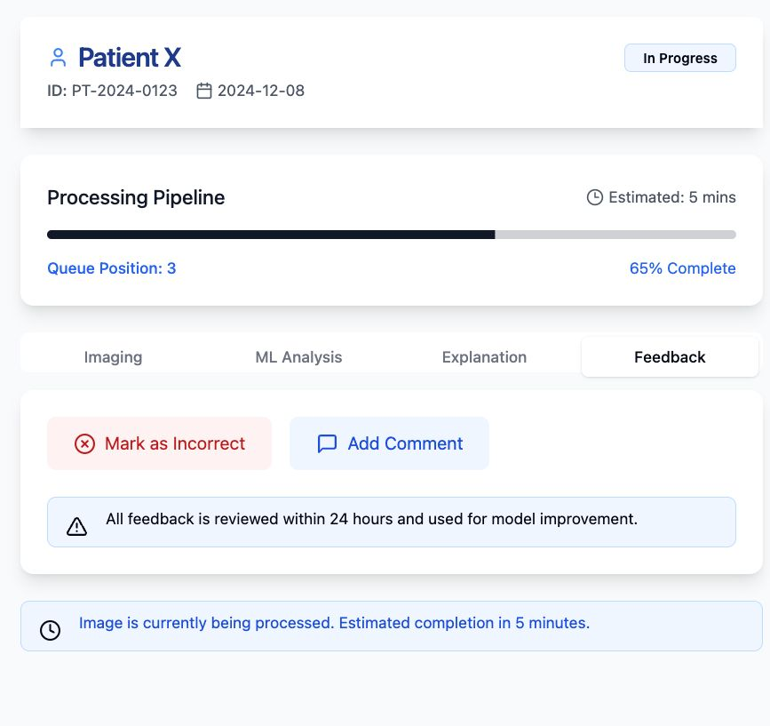
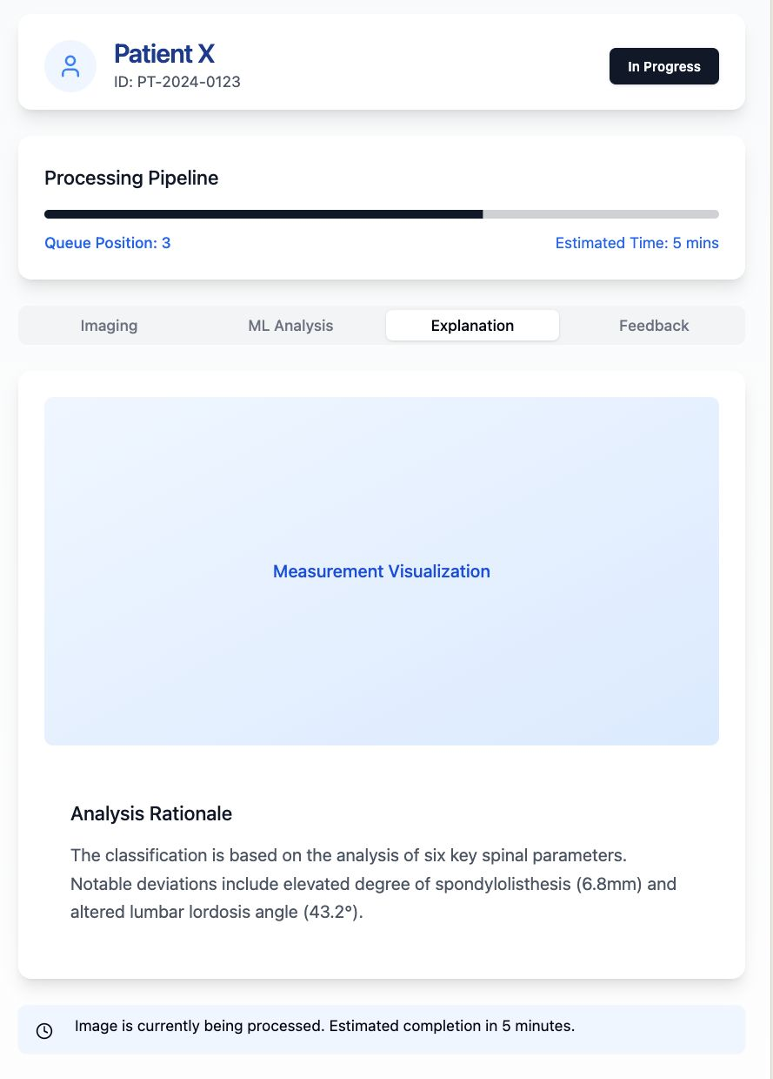
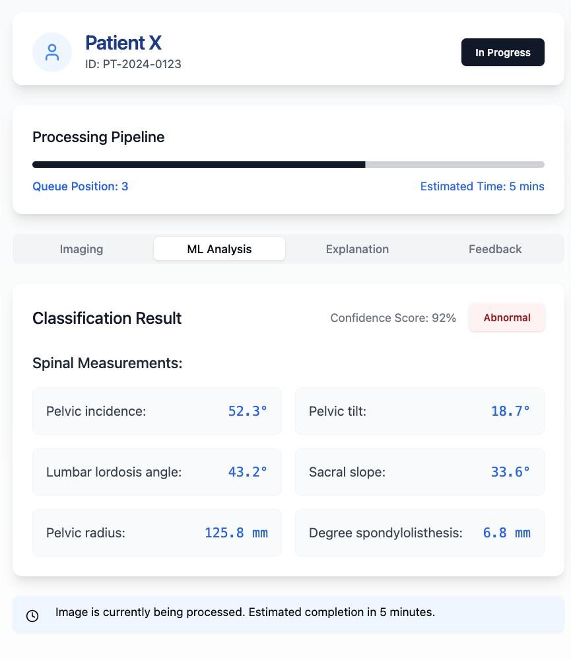
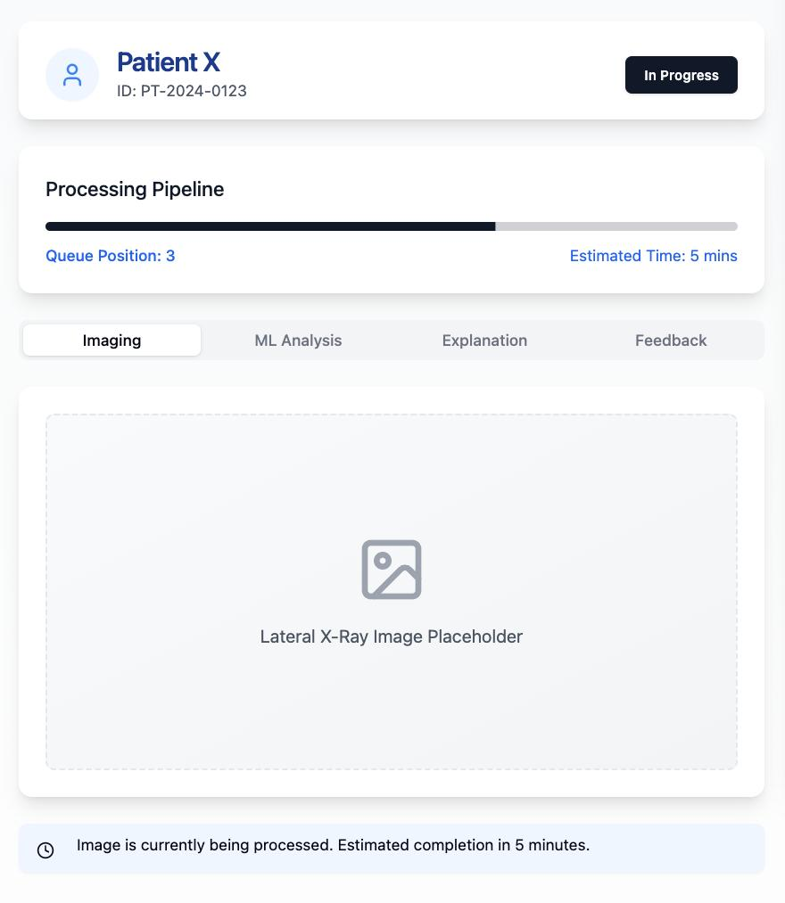
Contents

