Slide 1
Team Imperial
AI in Orthopaedics Hackathon 2024

Slide 2
Deliverables
Model & Inference Code: Python code to run analysis and generate results in a Jupyter notebook.
Documentation: Document (e.g. text document, slide deck, etc.) to describe analysis, results, interpretation, conclusions, strategy for clinical implementation, and how to run the code.
Environment Info: List of libraries and packages, setup details, and additional items necessary to run the Jupyter notebook (e.g. a fix seed).
List of team members and their contribution.

Slide 3
Setup Guide
Visual Studio Code
Google Collab
Download the Jupyter notebook ‘Stryker_AI_Hackathon_notebook.ipynb’.
Download the file ‘requirements.txt’ .
Go to the terminal and navigate to the location of the Jupyter notebook and requirements.txt file.
Download required libraries using the command ‘pip install requirements.txt’.
Run all cells!
Download the Jupyter notebook ‘Stryker_AI_Hackathon_notebook.ipynb’.
Go to Google Collab and upload the notebook.
Run all cells.
That’s it!
All the code, setup instructions and hackathon resources referenced in this submission can be found in our project GitHub repository, available at : https://github.com/yusiGM/StrykerAI2024. This slide in combination with the ‘requirements.txt’ file target the “Environment Information” deliverable. The “Model and Inference Code deliverable” is addressed by the ‘Stryker_AI_Hackathon_notebook.ipynb’ file.

Slide 4
Team Members and Contributions
Mohamed Jama: Clinical Implementation Lead.
Rohan Reddy: Proof of Concept Clinical Implementation and Logistic Regression Modelling.
Guruvignesh Balaji: Finetuning of the implemented models, outlier handling and reformatted the modelling section into a class.
Yusuf Salim (Leader): Implementation of skeleton models, exploratory data analysis and Project Management.
A time-lined version of individual contributions can be found using the GitHub repository commit history

Slide 5
Model and Inference Code

Slide 6
Model and Inference Code Contents
Problem description
Notebook Walkthrough
Problem Statement
Problem Context
Imports
Exploratory Data Analysis (EDA)
Modelling
Evaluation
Analysis
Further Work

Slide 7
Problem Description

Slide 8
Problem Statement
Goal: Classify orthopedic patients into two classes (normal and abnormal) based on six biomechanical and image-derived predictors using a machine-learning algorithm. Describe the steps to successfully deploy this solution into an orthopaedic outpatient clinical setting.
Bonus challenge: Extend the classifier to classify the patients’ population into three classes: normal, herniated disc, and spondylolisthesis.
The solution described in this submission addresses both the standard and bonus challenge.

Slide 9
Problem Context
Our understanding of the current process
Elective Diagnosis Process:
Patients visit a General Practitioner (GP) for initial evaluation.
GPs may refer patients to specialists for consultation and lateral X-Ray scans.
Specialists make a diagnosis and determine the treatment path based on severity:
Conservative Management: For mild conditions (e.g., slightly herniated discs), involving physiotherapy or other non-surgical approaches.
Surgical Intervention: Reserved for severe cases where conservative treatments fail, acting as a last resort.
Progression to Emergency Cases:
Conditions escalate to emergencies in severe situations such as:
Nerve compression causing loss of leg sensation or bowel control.
Acute, severe pain or slipped discs.
These cases demand urgent surgical intervention and differ from the elective process.
Delays in elective treatment increase the risk of escalation into emergencies.

Slide 10
Problem Context
Shortcomings of the Current Approach
How AI could fit into this
Resource Strain on the NHS:
High costs of surgeries and prolonged rehabilitation.
Significant physiotherapy expenses.
Delays in Diagnosis and Treatment:
Long patient wait times and delayed specialist referrals exacerbate the risk of emergency escalation
AI in Specialist Decision-Making:
Facilitates faster and more accurate diagnoses, simplifying the specialist's role to verifying AI outputs.
Used alongside clinical context (patient history, physical examination findings etc)
AI in GP Consultations:
Supports earlier diagnosis and treatment initiation without requiring immediate specialist referral.

Slide 11
Problem Context
Benefits of integrating AI into the process
Enhanced Efficiency:
Reduces patient wait times by streamlining the diagnostic process.
Decreases unnecessary specialist referrals, conserving NHS resources.
Prevention of Escalation:
Enables earlier interventions, preventing elective cases from becoming emergencies.
Reduces reliance on surgeries, which are costly, risky, and resource-intensive.

Slide 12
Notebook Walkthrough

Slide 13
Imports
The following libraries are utilised in our project. A brief description of each of their roles is provided.
1. Pandas
Data manipulation and analysis.
Handles structured data with DataFrames for cleaning, exploration, and preprocessing.
2. NumPy
Efficient numerical computations with arrays and matrices.
Supports mathematical operations crucial for ML algorithms.
3. Matplotlib and Seaborn
Creates static, interactive, and animated visualisations.
Essential for plotting trends, relationships, and model outputs.
4. SciPy
Advanced mathematical functions for optimisation, integration, and statistics.
Supports tasks like hypothesis testing and clustering.
5. Scikit-learn (sklearn)
Comprehensive machine learning toolkit.
Includes tools for preprocessing, model selection, training, evaluation, and metrics.
6. fetch_ucirepo
Used to import the dataset from UCI.

Slide 14
Exploratory Data Analysis (EDA)
Data Overview
Exploring the 6 Numeric Features
Outlier Handling
Correlation Analysis and Principal Component Analysis

Slide 15
Exploratory Data Analysis (EDA)
Data Overview
7 Rows, 6 Numerical Features 1 Categorical Output class
310 rows- Small dataset -> Possible to overfit to training data
No Nulls- Clean

Slide 16
Exploratory Data Analysis (EDA)
Data Overview
Class imbalance present
Standard Challenge:
100 Normal data points
210 Abnormal data points
Minority class likely to be misclassified as majority class if care is not taken during modelling
100
Normal
210
Abnormal

Slide 17
Exploratory Data Analysis (EDA)
Data Overview
Class imbalance present
Bonus Challenge:
100 Normal datapoints
60 Hernia datapoints
150 Spondylolisthesis datapoints
Minority class likely to be misclassified as majority class if care is not taken during modelling
150
Spondylolisthesis
60
Hernia
100
Normal

Slide 18
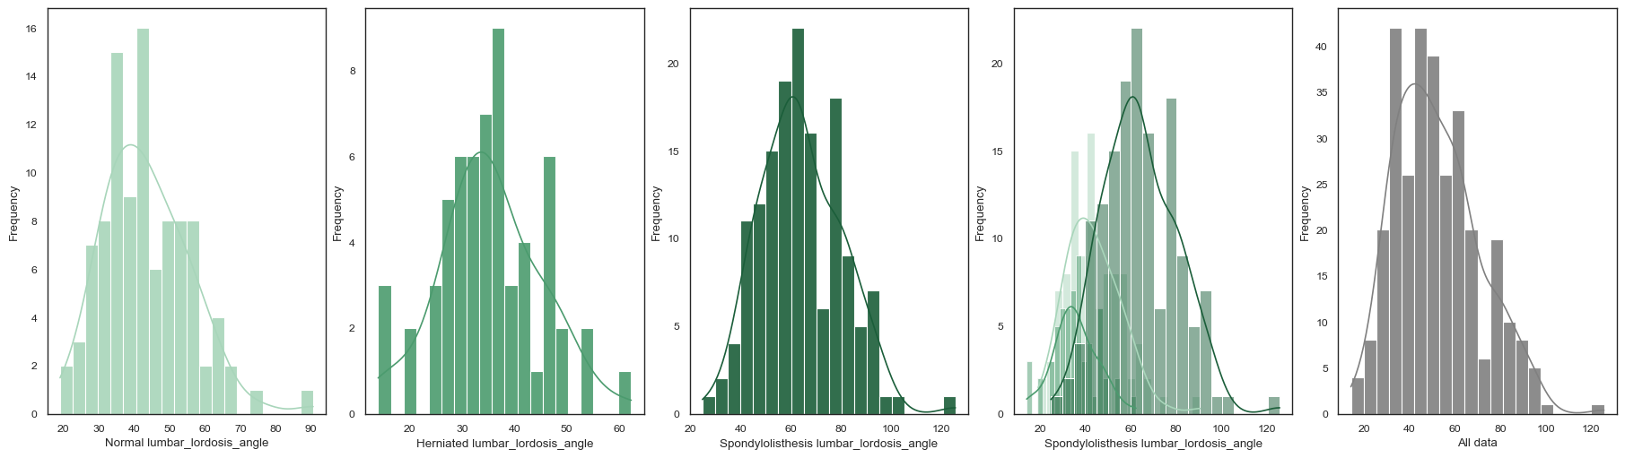
Exploratory Data Analysis (EDA)
Exploring the 6 Numeric Features
Plotted histograms, box plots and other plots to better understand the behaviour of each individual feature

Slide 19
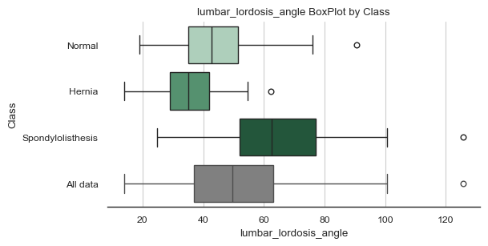
Exploratory Data Analysis (EDA)
Exploring the 6 Numeric Features
Plotted histograms, box plots and other plots to better understand the behaviour of each individual feature

Slide 20
Exploratory Data Analysis (EDA)
Exploring the 6 Numeric Features
Plotted histograms, box plots and swarm plots to better understand the behaviour of each individual feature
From these plots the following conclusions were made:
The data is not normally distributed
The data is generally skewed to the right
There are some extreme outliers present in the dataset

Slide 21
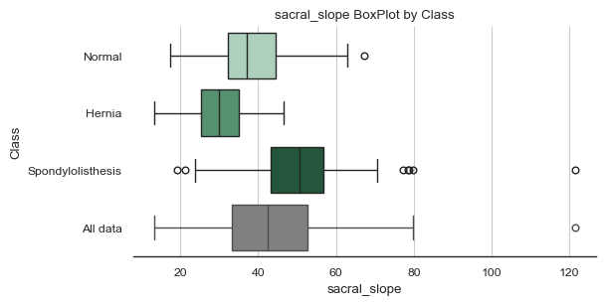
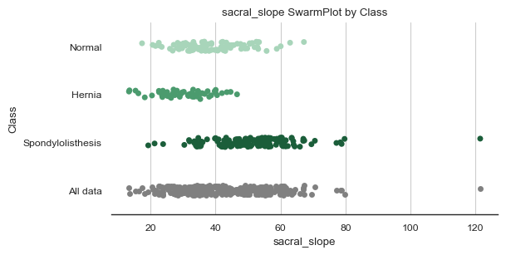
Exploratory Data Analysis (EDA)
Outlier Handling
As previously mentioned, the Boxplots and Scatter plots reveal several outliers both per class, and in the overall dataset.

Slide 22
Exploratory Data Analysis (EDA)
Outlier Handling
As previously mentioned, the Boxplots and Scatter plots reveal several outliers both per class, and in the overall dataset.
Several methods of detecting outliers were trialled:
Interquartile range
Z-score
Median of the absolute deviations (MAD)

Slide 23
Exploratory Data Analysis (EDA)
Outlier Handling
As previously mentioned, the Boxplots and Scatter plots reveal several outliers both per class, and in the overall dataset.
Several methods of detecting outliers were trialled:
Interquartile range: 26 outliers detected
Z-score: 10 outliers detected
Median of the absolute deviations (MAD): 16 outliers detected

Slide 24
Exploratory Data Analysis (EDA)
Outlier Handling
However discussion with medical proffesionals indicated that most of these outliers were physically possible, and so still encoded information about the natural variation of a population.
Ultimately only one outlier was removed, as this datapoint was described to be highly improbable

Slide 25
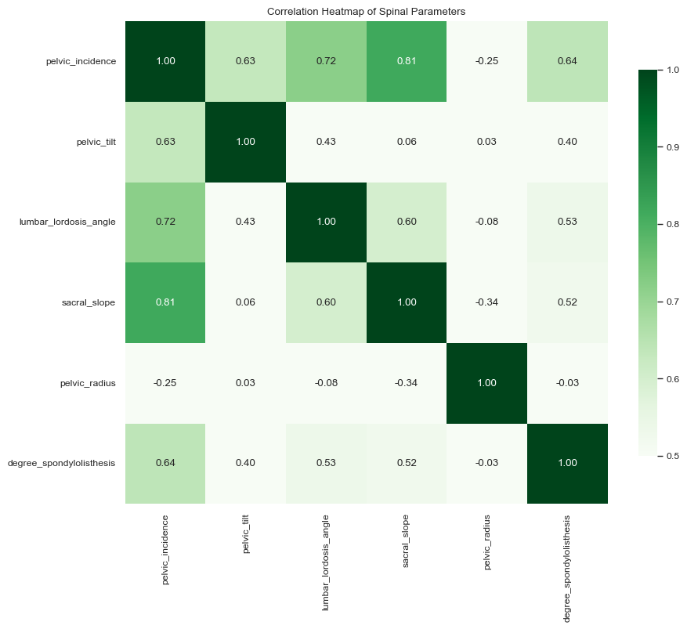
Exploratory Data Analysis (EDA)
Correlation Analysis and Principal Component Analysis (PCA)
Redundancy in 6 input features (non-linearity/high correlation)

Slide 26
Exploratory Data Analysis (EDA)
Correlation Analysis and Principal Component Analysis (PCA)
Redundancy in 6 input features (high correlation)
Significant correlation between sacral_slope, lumbar_lordosis_angle and pelvic_incidence.
It was discovered that Pelivc Incidence = pelivic tilt + sacral slope
Therefore pelvic tilt and sacral slope can be dropped as features, as their information is contained in pelvic incidence

Slide 27
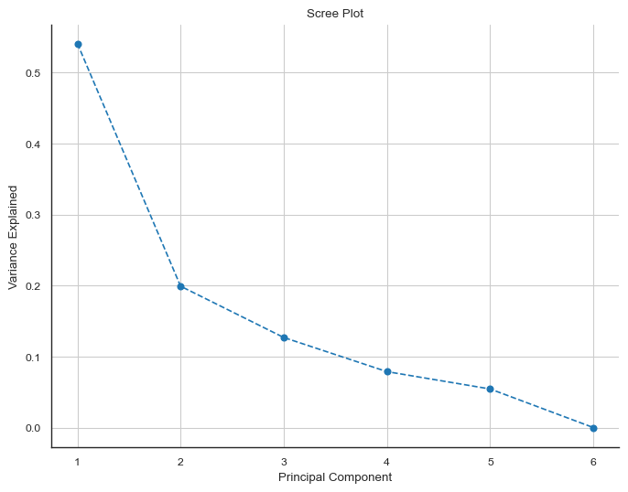
Exploratory Data Analysis (EDA)
Correlation Analysis and Principal Component Analysis (PCA)
Can we reduce the required number of input features using PCA
3 PC’s capture over 85% of the dataset information

Slide 28
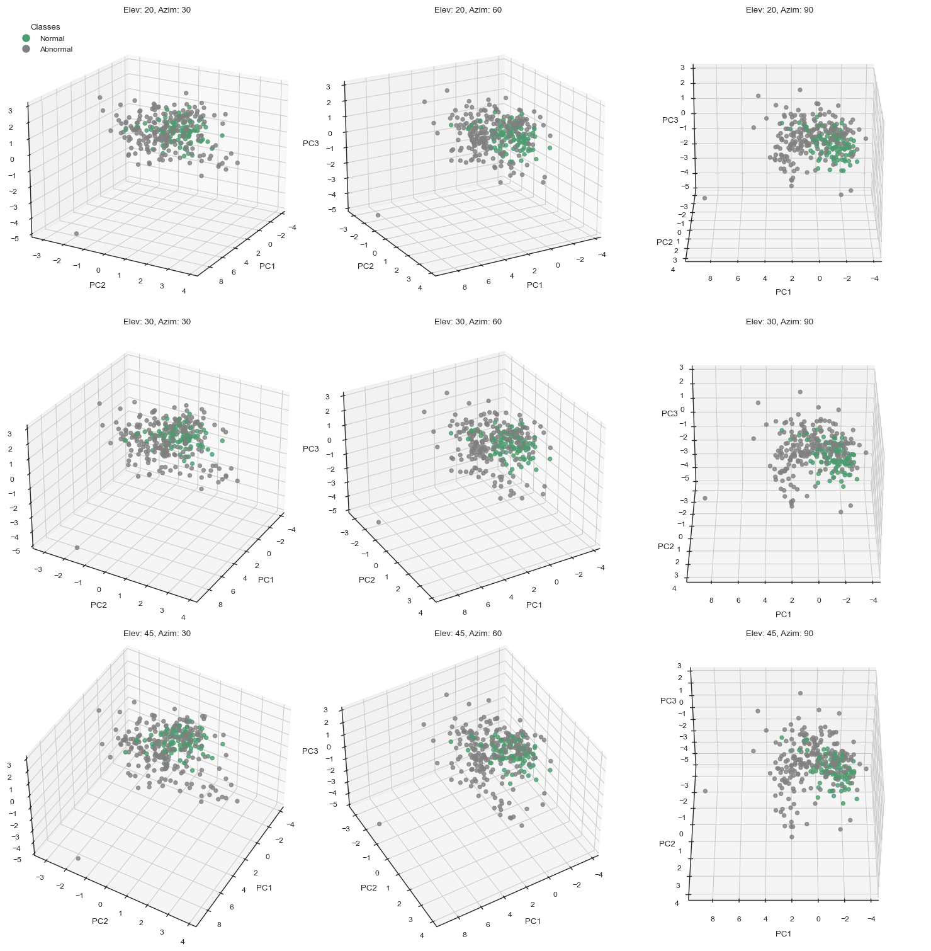
Exploratory Data Analysis (EDA)
Correlation Analysis and Principal Component Analysis (PCA)
Using the first three Principal components, the dataset was modelled in 3 dimensions
For the standard challenge, it is possible to see the central cluster of normal spinal classifications
Abnormalities in spinal classifications radiate out from this central cluster

Slide 29
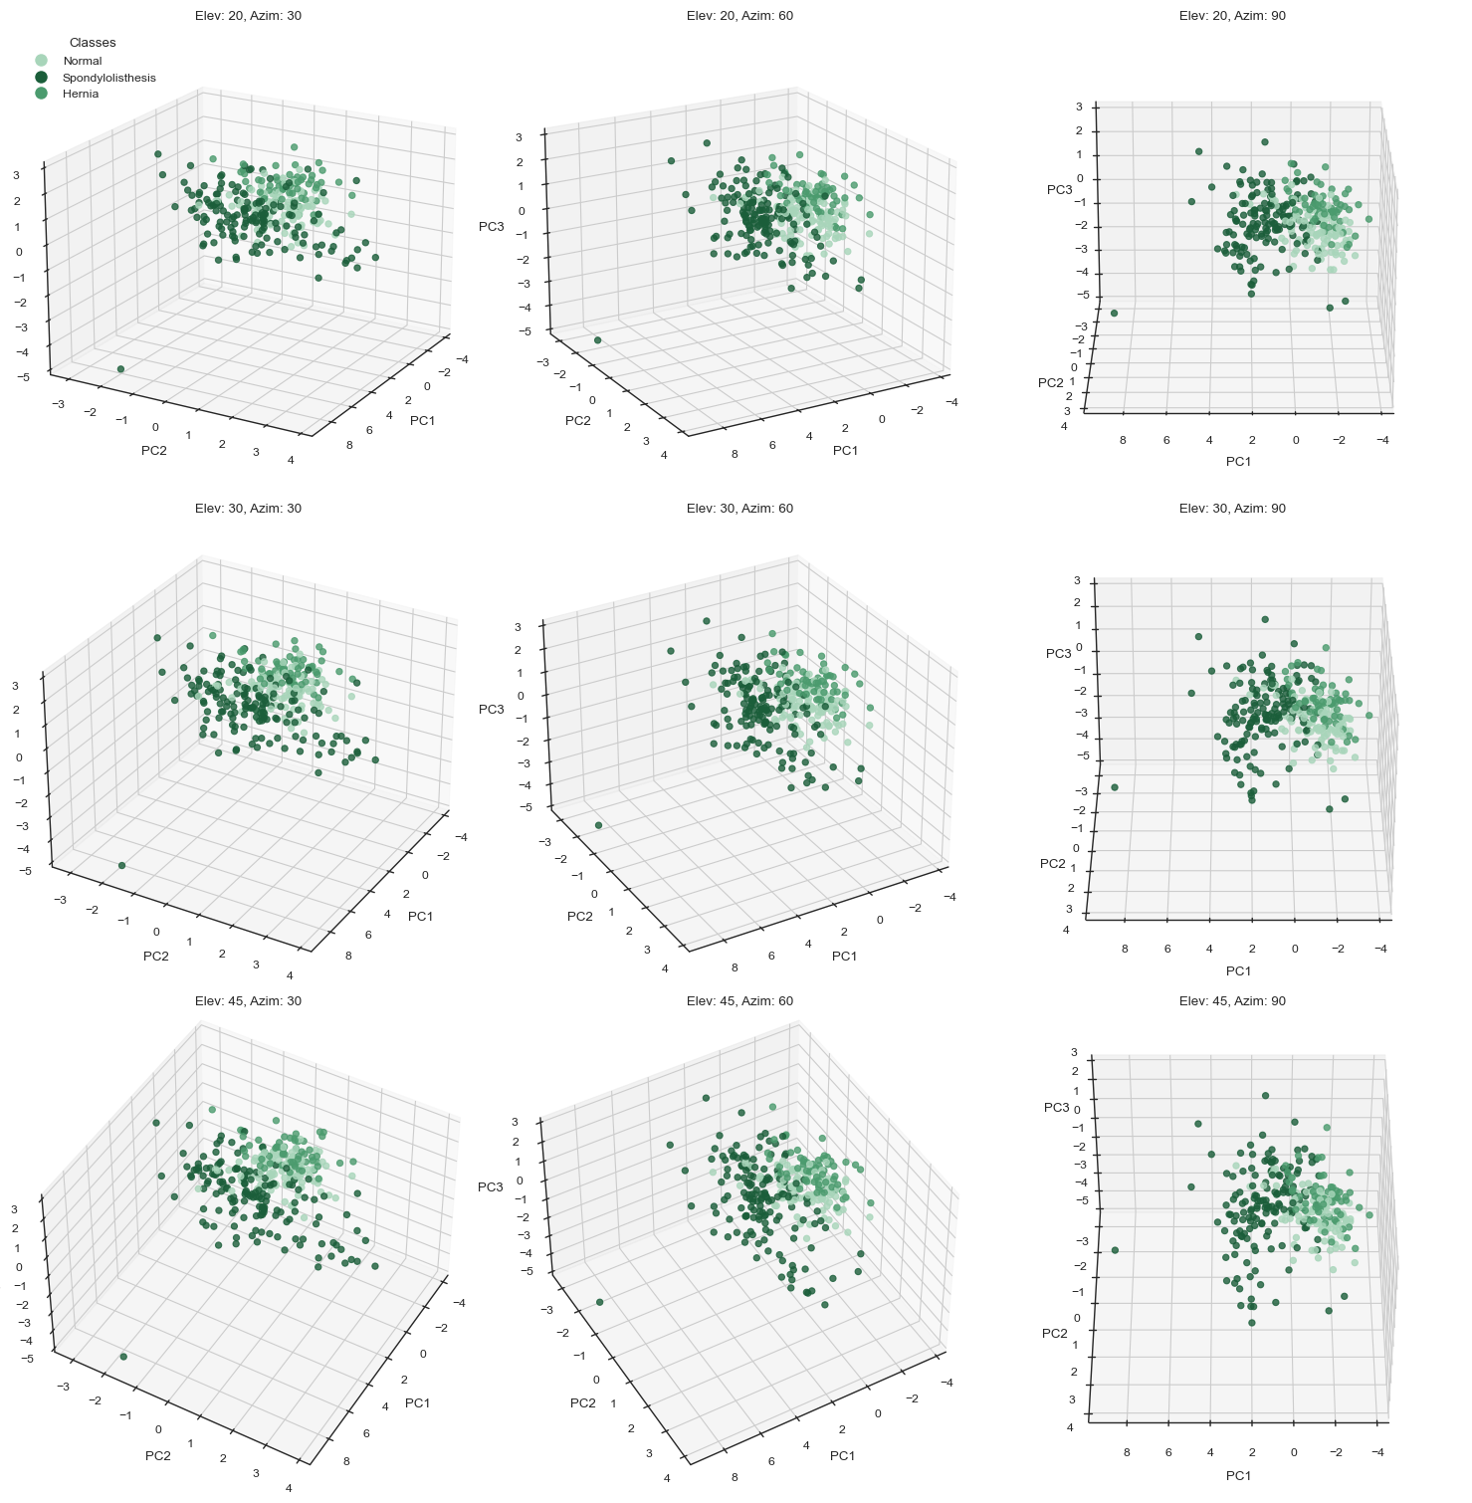
Exploratory Data Analysis (EDA)
Correlation Analysis and Principal Component Analysis (PCA)
Using the first three Principal components, the dataset was modelled in 3 dimensions
The central cluster of normal behaviour is still visible in the bonus challenge
The separation between “hernia” and “spondylolisthesis” classifications is less prominent

Slide 30
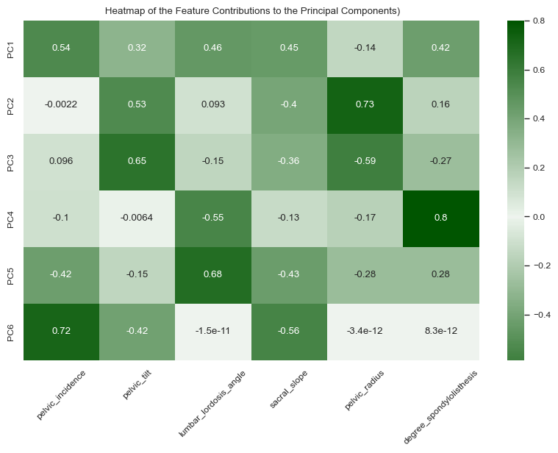
Exploratory Data Analysis (EDA)
Correlation Analysis and Principal Component Analysis (PCA)
Contribution of each of the 6 features to each of the principal components

Slide 31
Modelling
Pre-Processing
Data scaling
Feature Redundancy
Principal Components
Class imbalance Problem
Logistic Regression
SVM
Decision Tree
Random Forest
AdaBoost

Slide 32
Modelling
Pre-Processing
Data scaling
Scaling Necessary to ensure that features with different ranges contribute equally to the model, preventing bias towards features with larger magnitudes. Scaling also aids in convergence in gradient descent algorithms
Robust scalar used due to its resistance to outliers. Scales features based on median and IQR rather than using mean and STD which would be sensitive to outliers
Scaling performed per fold in K folds CV to prevent data leakage
Example of IQR Median vs STD Mean

Slide 33
Modelling
Pre-Processing
Feature Redundancy
Models were trained using both the entire set of 6 Features, as well as a reduced set of features in which only independent features remained
This is hanlded using L1 regression
In tree based models few decisions/splits will occur on non independent features

Slide 34
Modelling
Pre-Processing
Principal Components
Models were also trained using a set of the principal components as opposed to the scaled features to see if the reduced set of PC’s helped avoid overfitting.

Slide 35
Modelling
Pre-Processing
Class imbalance Problem
Class imbalance was handed using stratified cross validation
Cross validation maximised the amount of training data
Stratification ensured each fold contrained the correct proportion of each class

Slide 36
Evaluation
Metric choice
Confusion Matrix
Model Results

Slide 37
Evaluation
Metric choice
Choice between accuracy, prescision, recall, F1
Description of each metric + an example
Cant use accuracy due to class imbalance
Precision vs Recall vs F1 debate
Choice

Slide 38
Evaluation
Confusion Matrix
Confusion matrices consicely describe the number of correct vs incorrect predictions made by models and the type of erros the model tended to make
Description of FP, FN, TP, TN

Slide 39
Evaluation
Model Results: Standard Challenge

Slide 40
Evaluation
Model Results: Bonus Challenge

Slide 41
Analysis

Slide 42
Further Work
Clustering

Slide 43
Clinical Implementation

Slide 44
Contents
Clinical Implementation Documentation: ‘ClinicalImplementation.pdf’
Clinical Implementation PowerPoint: ‘ClinicalImplementationPowerPoint.ppt’
Clinical Implementation Proof of Concept Design.

Slide 45
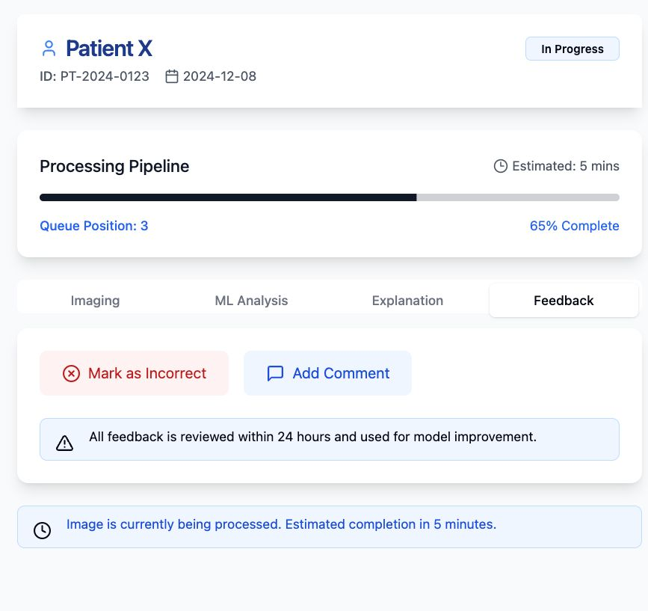
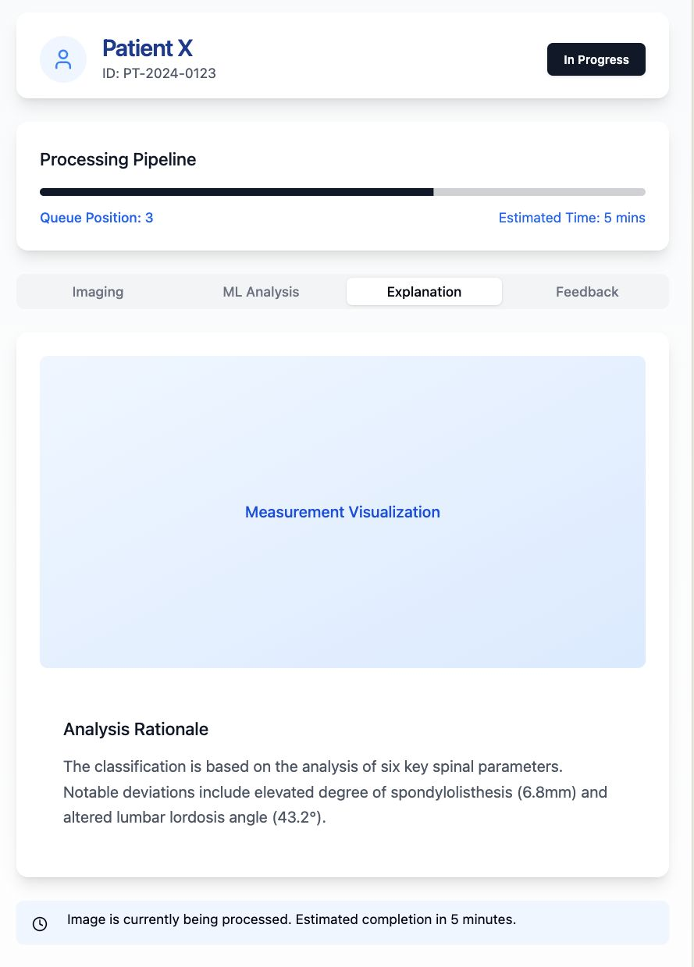
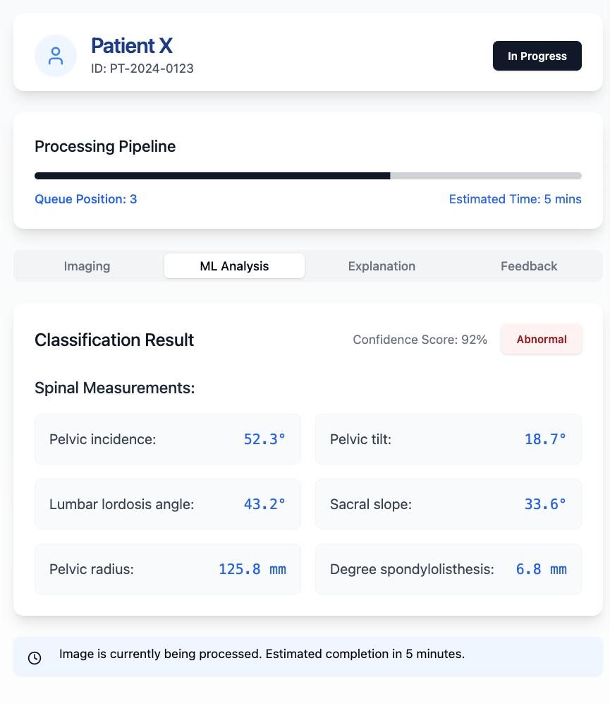
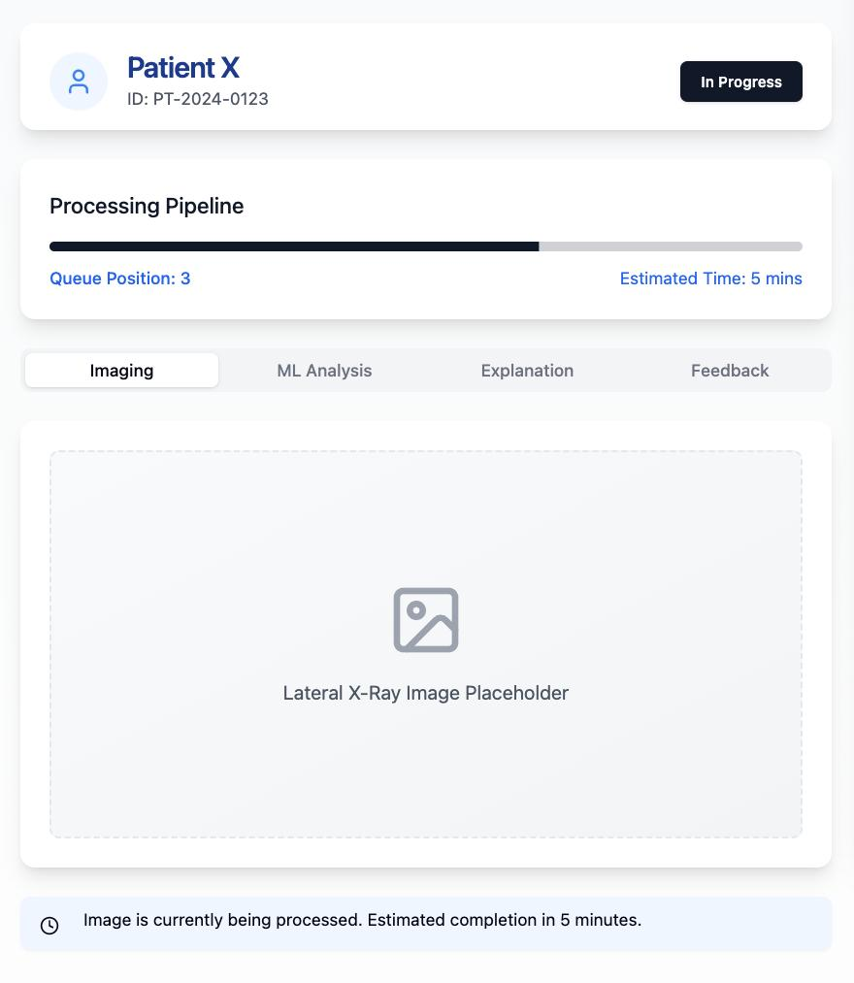
Contents

