Slide 1
Team Imperial
AI in Orthopaedics Hackathon 2024

Slide 2
Deliverables
Model & Inference Code: Python code to run analysis and generate results in a Jupyter notebook.
Documentation: Document (e.g. text document, slide deck, etc.) to describe analysis, results, interpretation, conclusions, strategy for clinical implementation, and how to run the code.
Environment Info: List of libraries and packages, setup details, and additional items necessary to run the Jupyter notebook (e.g. a fix seed).
List of team members and their contribution.

Slide 3
Setup Guide
Visual Studio Code
Google Collab
Download the Jupyter notebook ‘Stryker_AI_Hackathon_notebook.ipynb’.
Download the file ‘requirements.txt’ .
Go to the terminal and navigate to the location of the Jupyter notebook and requirements.txt file.
Download required libraries using the command ‘pip install requirements.txt’.
Open the notebook and run all cells!
Download the Jupyter notebook ‘Stryker_AI_Hackathon_notebook.ipynb’.
Go to Google Collab and upload the notebook.
Open the notebook and run all cells!
That’s it!
All the code, setup instructions and hackathon resources referenced in this submission can be found in our project GitHub repository, available at : https://github.com/yusiGM/StrykerAI2024. This slide in combination with the ‘requirements.txt’ file target the “Environment Information” deliverable. The “Model and Inference Code deliverable” is addressed by the ‘Stryker_AI_Hackathon_notebook.ipynb’ file.

Slide 4
Team Members and Contributions
Mohamed Jama: Clinical Implementation Lead.
Rohan Reddy: Proof of Concept Clinical Implementation. Logistic Regression Modelling. Middleware concept code.
Guruvignesh Balaji: Finetuning of the implemented models, outlier handling and reformatted the modelling section into a class.
Yusuf Salim (Leader): Implementation of skeleton models, exploratory data analysis and Project Management.
A time-lined version of individual contributions can be found using the GitHub repository commit history

Slide 5
Model and Inference Code

Slide 6
Model and Inference Code Contents
Problem description
Notebook Walkthrough
Problem Statement
Problem Context
Imports
Exploratory Data Analysis (EDA)
Modelling
Evaluation
Analysis
Further Work

Slide 7
Problem Description

Slide 8
Problem Statement
Goal: Classify orthopedic patients into two classes (normal and abnormal) based on six biomechanical and image-derived predictors using a machine-learning algorithm. Describe the steps to successfully deploy this solution into an orthopaedic outpatient clinical setting.
Bonus challenge: Extend the classifier to classify the patients’ population into three classes: normal, herniated disc, and spondylolisthesis.
The solution described in this submission addresses both the standard and bonus challenge.

Slide 9
Problem Context
Our understanding of the current process
Elective Diagnosis Process:
Patients visit a General Practitioner (GP) for initial evaluation.
GPs may refer patients to specialists for consultation and lateral X-Ray scans.
Specialists make a diagnosis and determine the treatment path based on severity:
Conservative Management: For mild conditions (e.g., slightly herniated discs), involving physiotherapy or other non-surgical approaches.
Surgical Intervention: Reserved for severe cases where conservative treatments fail, acting as a last resort.
Progression to Emergency Cases:
Conditions escalate to emergencies in severe situations such as:
Nerve compression causing loss of leg sensation or bowel control.
Acute, severe pain or slipped discs.
These cases demand urgent surgical intervention and differ from the elective process.
Delays in elective treatment increase the risk of escalation into emergencies.

Slide 10
Problem Context
Shortcomings of the Current Approach
How AI could fit into this
Difficulty in diagnosis:
Measuring the degree of displacement between vertebra to diagnose spondylolisthesis can be difficult and error prone.
Resource Strain on the NHS:
High costs of surgeries and prolonged rehabilitation.
Significant physiotherapy expenses.
Delays in Diagnosis and Treatment:
Long patient wait times and delayed specialist referrals exacerbate the risk of emergency escalation
AI in Specialist Decision-Making:
Facilitates faster and more accurate diagnoses, simplifying the specialist's role to verifying AI outputs.
Used alongside clinical context (patient history, physical examination findings etc)
AI in GP Consultations:
Supports earlier diagnosis and treatment initiation without requiring immediate specialist referral.

Slide 11
Problem Context
Benefits of integrating AI into the process
Consistency
AI algorithms can identify landmarks with greater precision and reproducibility reducing inter-observer variability
Automation
Automatically calculating angles and measurements saves time and reduces human error.
Scalability:
Enables widespread access to advanced diagnostic tools in resource-limited settings, where specialist expertise may be scarce.
Enhanced Efficiency:
Reduces patient wait times by streamlining the diagnostic process.
Decreases unnecessary specialist referrals, conserving NHS resources.
Prevention of Escalation:
Enables earlier interventions, preventing elective cases from becoming emergencies.
Reduces reliance on surgeries, which are costly, risky, and resource-intensive.

Slide 12
Notebook Walkthrough

Slide 13
Imports
The following libraries are utilised in our project. A brief description of each of their roles is provided.
1. Pandas
Data manipulation and analysis.
Handles structured data with DataFrames for cleaning, exploration, and preprocessing.
2. NumPy
Efficient numerical computations with arrays and matrices.
Supports mathematical operations crucial for ML algorithms.
3. Matplotlib and Seaborn
Creates static, interactive, and animated visualisations.
Essential for plotting trends, relationships, and model outputs.
4. SciPy
Advanced mathematical functions for optimisation, integration, and statistics.
Supports tasks like hypothesis testing and clustering.
5. sklearn
Comprehensive machine learning toolkit.
Includes tools for preprocessing, model selection, training, evaluation, and metrics.
6. fetch_ucirepo
Used to import the dataset from UCI.

Slide 14
Exploratory Data Analysis (EDA)
Data Overview
Exploring the 6 Numeric Features
Correlation Analysis and Principal Component Analysis
Outlier Handling

Slide 15
Exploratory Data Analysis (EDA)
Data Overview
Data Overview
7 Rows, 6 Numerical Features 1 Categorical Output class
310 rows- Small dataset -> Possible to overfit to training data
No Nulls- Clean

Slide 16
Exploratory Data Analysis (EDA)
Data Overview
Data Overview
Class imbalance present
Standard Challenge:
100 Normal data points
210 Abnormal data points
Minority class likely to be misclassified as majority class if care is not taken during modelling
100
Normal
210
Abnormal

Slide 17
Exploratory Data Analysis (EDA)
Data Overview
Data Overview
Class imbalance present
Bonus Challenge:
100 Normal datapoints
60 Hernia datapoints
150 Spondylolisthesis datapoints
Minority class likely to be misclassified as majority class if care is not taken during modelling
150
Spondylolisthesis
60
Hernia
100
Normal

Slide 18
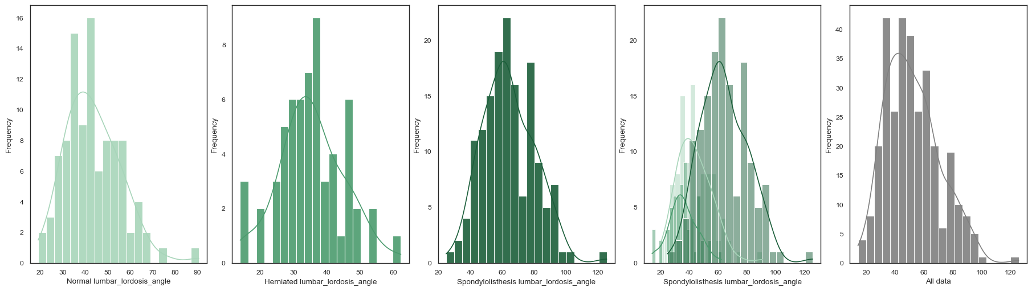
Exploratory Data Analysis (EDA)
Exploring the 6 Numeric Features
Exploring the 6 Numeric Features
Plotted histograms, box plots and other plots to better understand the behaviour of each individual feature

Slide 19
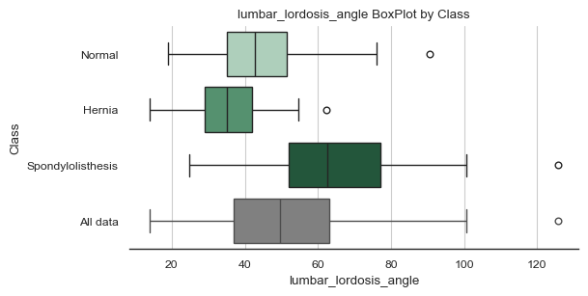
Exploratory Data Analysis (EDA)
Exploring the 6 Numeric Features
Exploring the 6 Numeric Features
Plotted histograms, box plots and other plots to better understand the behaviour of each individual feature

Slide 20
Exploratory Data Analysis (EDA)
Exploring the 6 Numeric Features
Exploring the 6 Numeric Features
Plotted histograms, box plots and other plots to better understand the behaviour of each individual feature
From these plots the following conclusions were made:
The data is not normally distributed
The data is generally skewed to the right
There are some extreme outliers present in the dataset

Slide 21
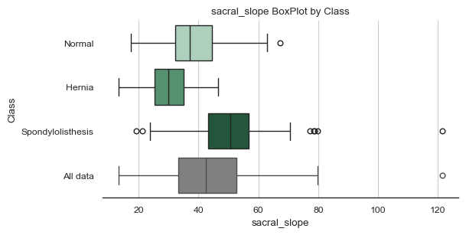
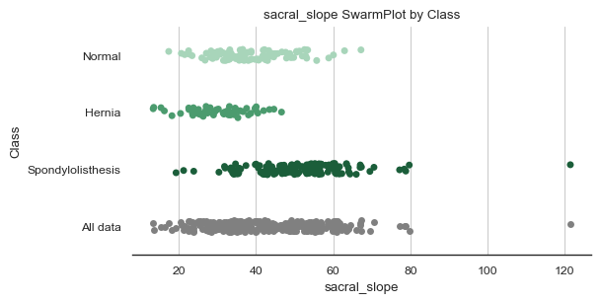
Exploratory Data Analysis (EDA)
Outlier Handling
Outlier Handling
Outlier Handling
As previously mentioned, the boxplots and other plots reveal several outliers both per class, and in the overall dataset. An example is shown for sacral_slope

Slide 22
Exploratory Data Analysis (EDA)
Outlier Handling
Outlier Handling
As previously mentioned, the Boxplots and Scatter plots revealed several outliers both per class, and in the overall dataset.
Several methods of detecting outliers were trialled:
Interquartile range
Z-score
Median of the absolute deviations (MAD)

Slide 23
Exploratory Data Analysis (EDA)
Outlier Handling
Outlier Handling
As previously mentioned, the Boxplots and Scatter plots reveal several outliers both per class, and in the overall dataset.
Several methods of detecting outliers were trialled:
Interquartile range: 26 outliers detected
Z-score: 10 outliers detected
Median of the absolute deviations (MAD): 16 outliers detected

Slide 24
Exploratory Data Analysis (EDA)
Outlier Handling
Outlier Handling
Discussion with medical professionals indicated that most of these outliers were physically possible, and so still encoded information about the natural variation of a population.
Ultimately only one outlier was removed, as this datapoint was described to be highly improbable.
Erroneous datapoint

Slide 25
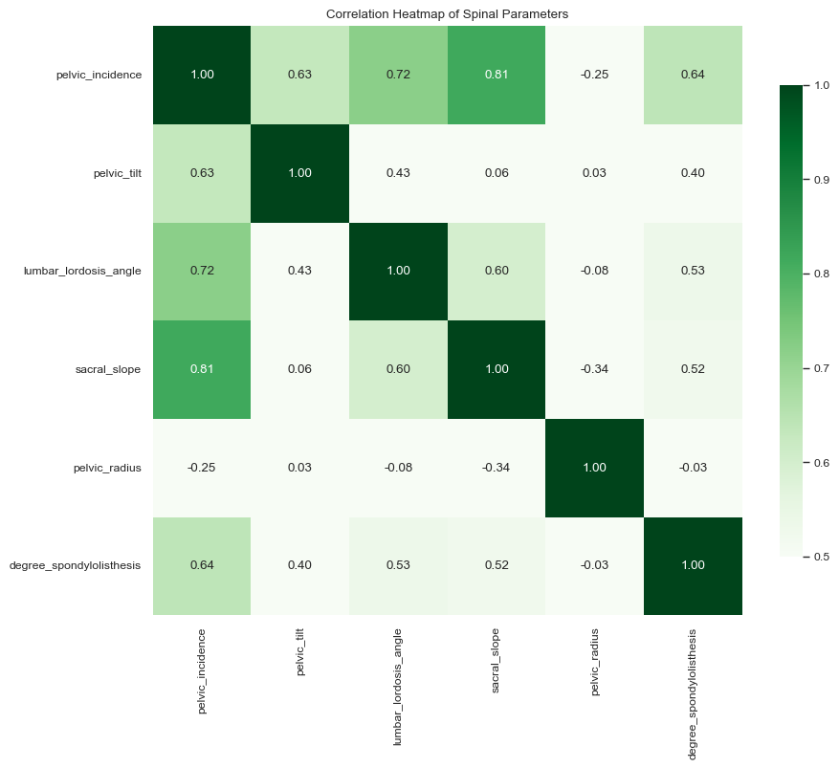
Exploratory Data Analysis (EDA)
Correlation Analysis and Principal Component Analysis
Correlation Analysis and Principal Component Analysis (PCA)
Redundancy in the set of provided input features (high correlation).
Machine learning models generally require independent input features to avoid biasing the model to a particular input.
The heatmap displays features with high correlation in dark green, and low correlation in white
Note: The diagonal of dark green (correlation =1) can be ignored as this is feature self correlation

Slide 26
Exploratory Data Analysis (EDA)
Correlation Analysis and Principal Component Analysis
Correlation Analysis and Principal Component Analysis (PCA)
Significant correlation between sacral_slope, lumbar_lordosis_angle and pelvic_incidence.
It was discovered that:
“pelivc_incidence = pelivic_tilt + sacral_slope”
Research also showed that lumbar_lordosis_angle is generally within 9 degrees of pelvic_incidence
Therefore, both pelvic_tilt, sacral_slope and lumbar_lordosis could potentially be dropped as input features, as their information is encoded in pelvic_incidence .

Slide 27
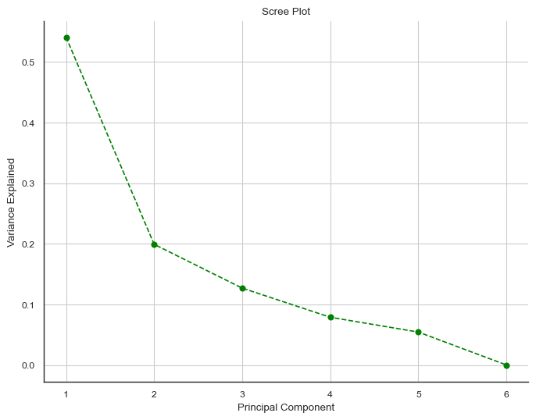
Exploratory Data Analysis (EDA)
Correlation Analysis and Principal Component Analysis
Correlation Analysis and Principal Component Analysis (PCA)
Can we further reduce the set of input features using PCA?
PCA creates new axis within the data that maximises the variance captured.
The Scree plot opposite shows the cumulative variance captured by increasing the number of principal components
Around 85% of the original dataset can be captured by only using 3 principal components
Decreasing returns when incorporating higher order principal components
54% of the dataset captured by PC1
87% of the dataset captured by
PC1,PC2 and PC3
100% of the dataset captured by all 6 PC’s

Slide 28
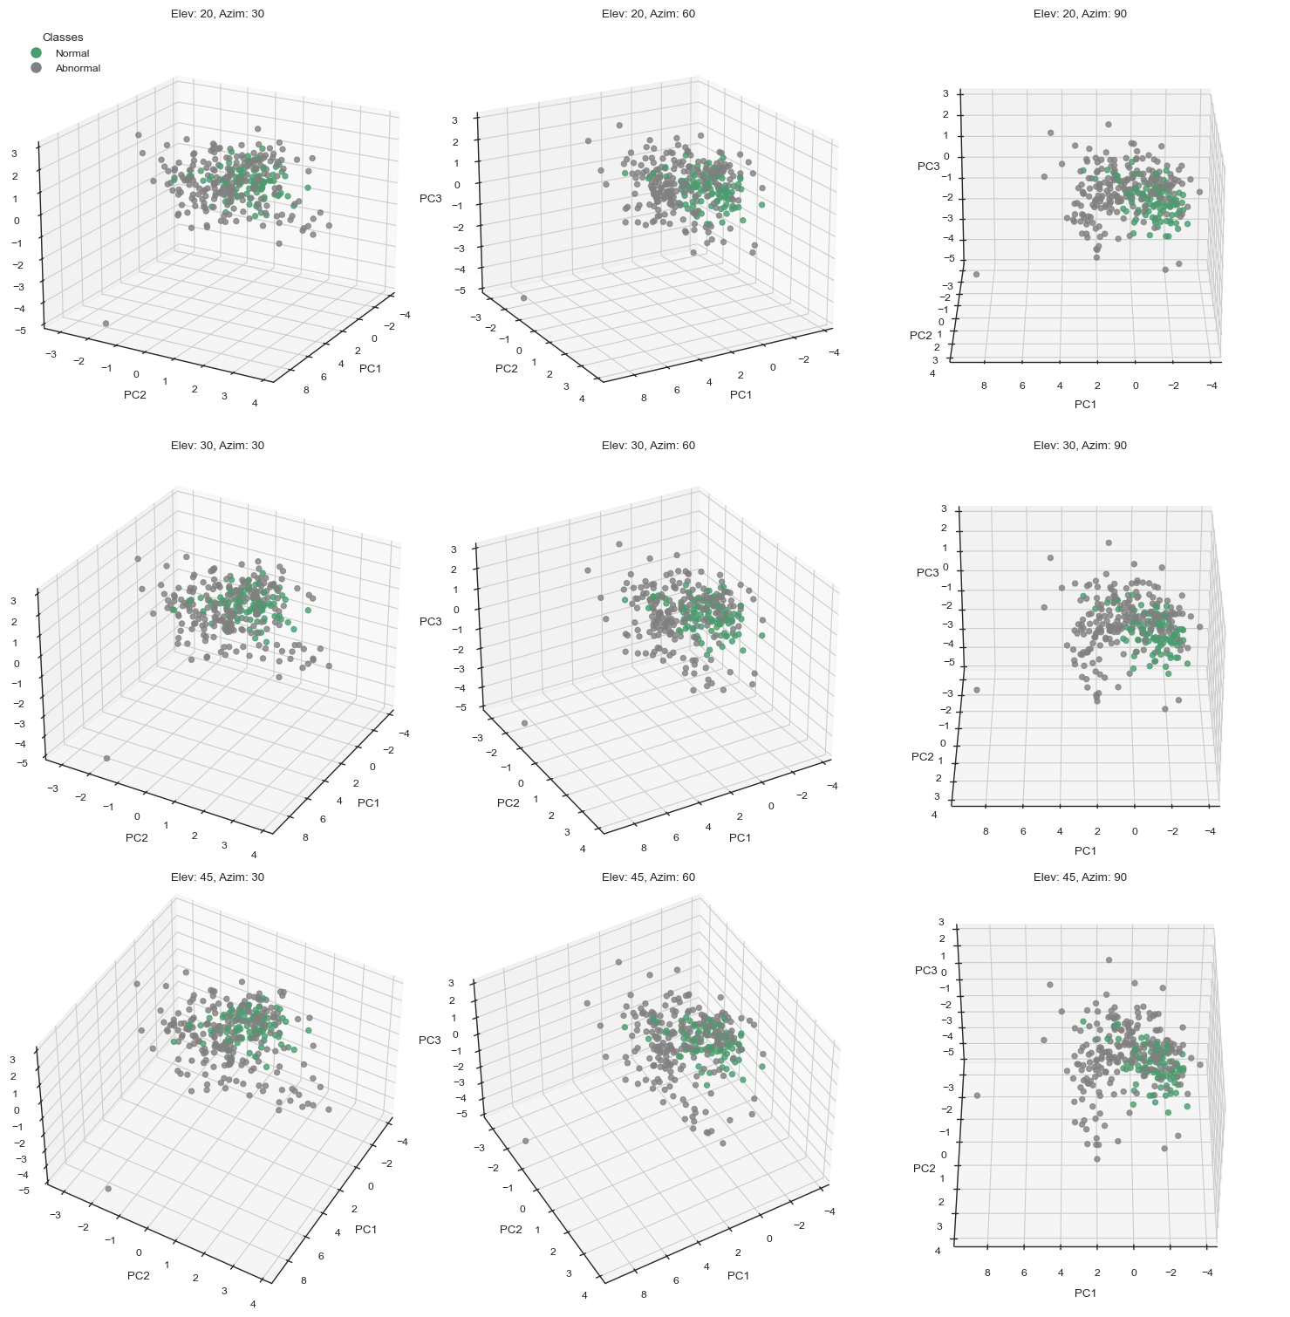
Exploratory Data Analysis (EDA)
Correlation Analysis and Principal Component Analysis (PCA)
Using the first three Principal components, the dataset was modelled in 3 dimensions.
For the standard challenge, it is possible to see the central cluster of normal spinal classifications.
Abnormalities in spinal classifications radiate out from this central cluster.
Correlation Analysis and Principal Component Analysis

Slide 29
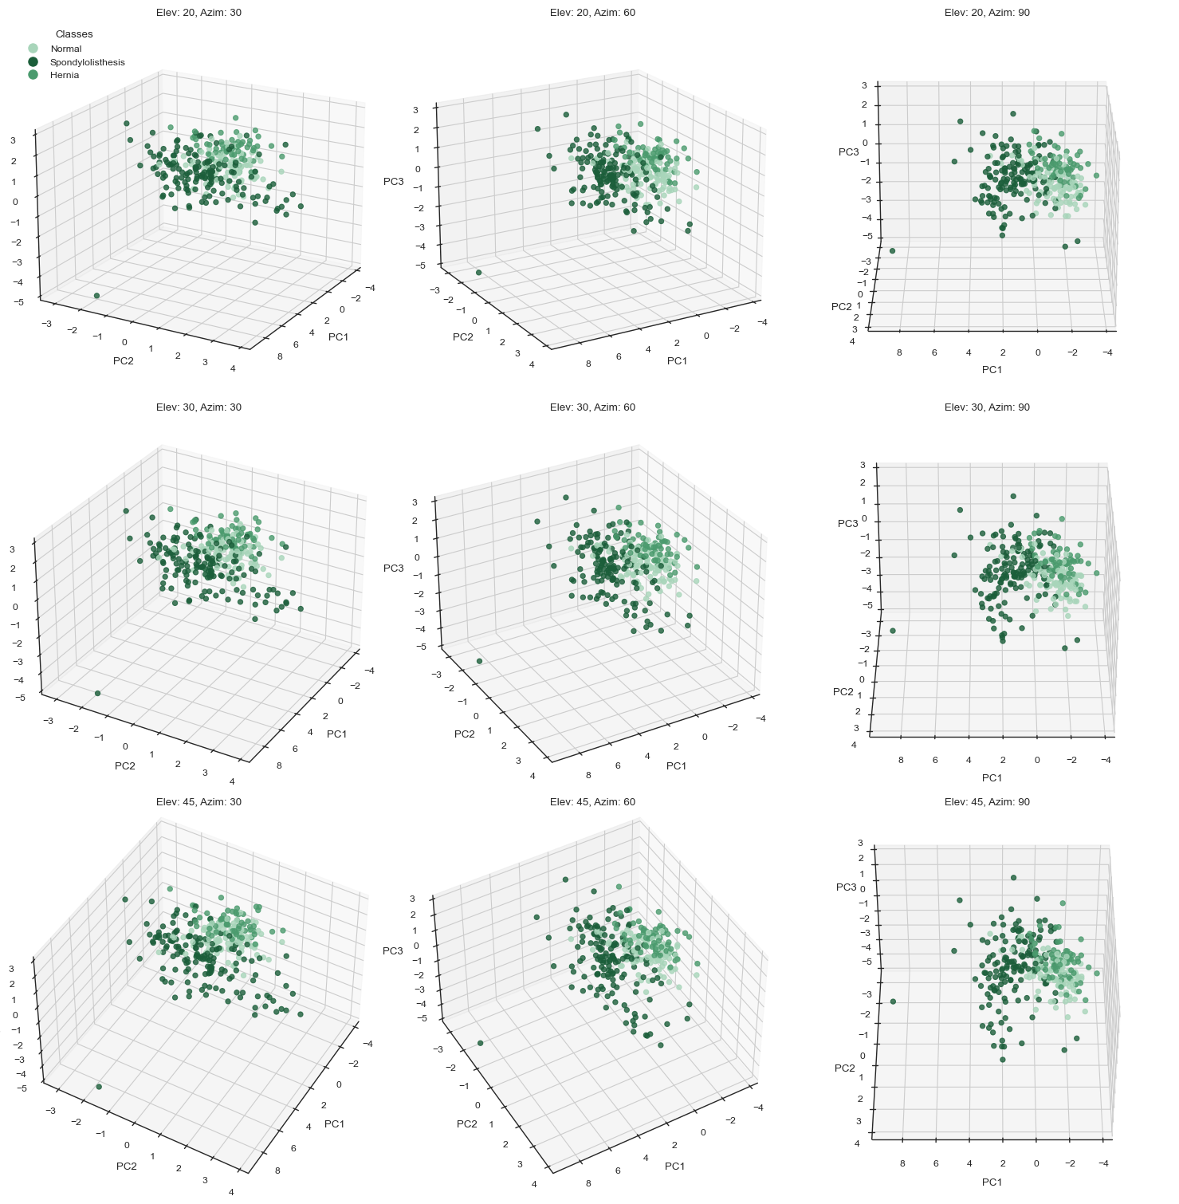
Exploratory Data Analysis (EDA)
Correlation Analysis and Principal Component Analysis (PCA)
Using the first three Principal components, the dataset was modelled in 3 dimensions.
The central cluster of ‘normal’ behaviour is still visible in the bonus challenge.
The separation between ‘hernia’ and ‘spondylolisthesis’ classifications is less prominent.
Correlation Analysis and Principal Component Analysis

Slide 30
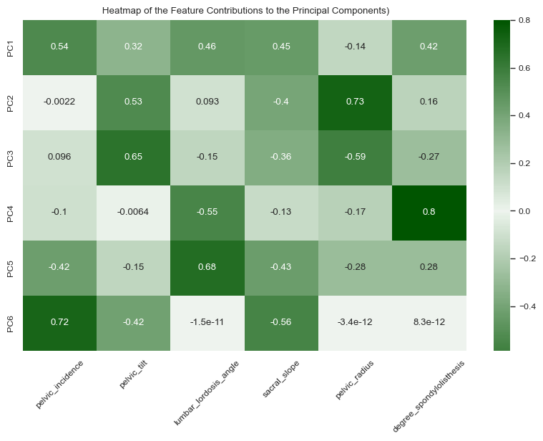
Exploratory Data Analysis (EDA)
Correlation Analysis and Principal Component Analysis (PCA)
Contribution of each of the 6 features to each of the principal components depicted using a heatmap.
Large magnitude contributions between features and PC’s are depicted in dark green.
eg PC4 is primarily built from degree_spondylolisthesis, with lesser contributions from lumbar_lordosis_angle and pelvic_radius and negligible contributions from pelvic_tilt.
Correlation Analysis and Principal Component Analysis

Slide 31
Modelling
Pre-Processing
Data scaling
Feature Selection and Principal Components
Small dataset Problem
Class imbalance Problem
Models

Slide 32
Modelling
Pre-Processing: Data scaling
Pre-Processing
Data scaling
Scaling in Pre-Processing:
Ensures features with varying ranges contribute equally, avoiding bias towards features with larger magnitudes.
Facilitates faster convergence in gradient descent algorithms.
Robust Scaler used:
Resilient to outliers as it scales data using the median and interquartile range (IQR) instead of mean and standard deviation.
Applied per fold during K-fold cross-validation to prevent data leakage.

Slide 33
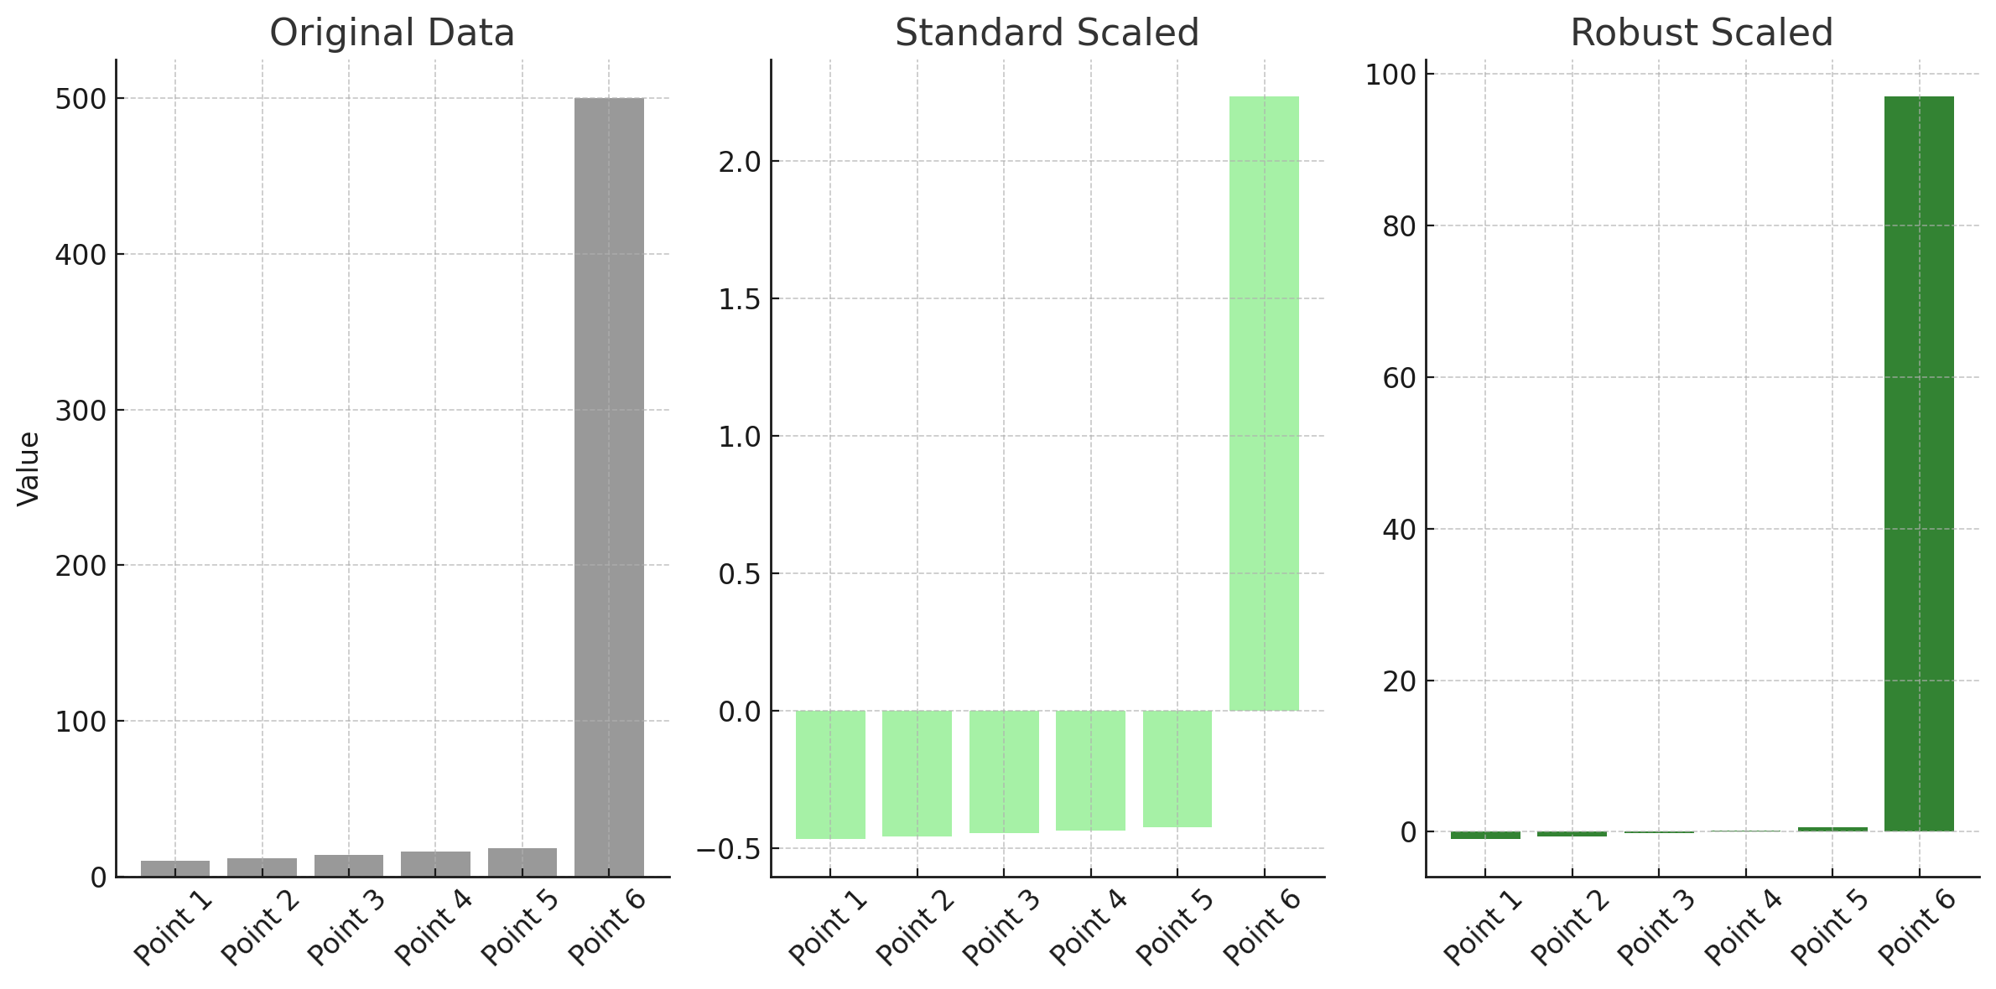
Modelling
Robust Scaler used:
Resilient to outliers as it scales data using the median and interquartile range (IQR) instead of mean and standard deviation.
Applied per fold during K-fold cross-validation to prevent data leakage.
Pre-Processing: Data scaling
Scaling with the median and interquartile range minimises the outlier's influence
Outlier skews the scaling of other datapoints

Slide 34
Modelling
Pre-Processing: Feature Selection
Pre-Processing
Feature Selection and Principal components
Models were trained using:
entire set of 6 features
reduced set of features in which only independent features remained
Reduced set of principal components instead of the raw features
This was implemented slightly differently in different model architectures.
Eg Logistic Regression: feature selection handled by lasso regularisation which prefers sparse (few nonzero) coefficients

Slide 35
Modelling
Pre-Processing: Small dataset Problem
Pre-Processing
Small dataset Problem
K-Fold Cross-Validation (CV):
K Fold CV, with K=5 was used to overcome the problem of only having limited amounts of data. The dataset is split into multiple folds, with 1 being used for validation and the rest being used to train the model. This enables the model to learn from nearly the entire dataset.
The model performance is determined across all folds and then aggregated to provide a more robust measure of performance.

Slide 36
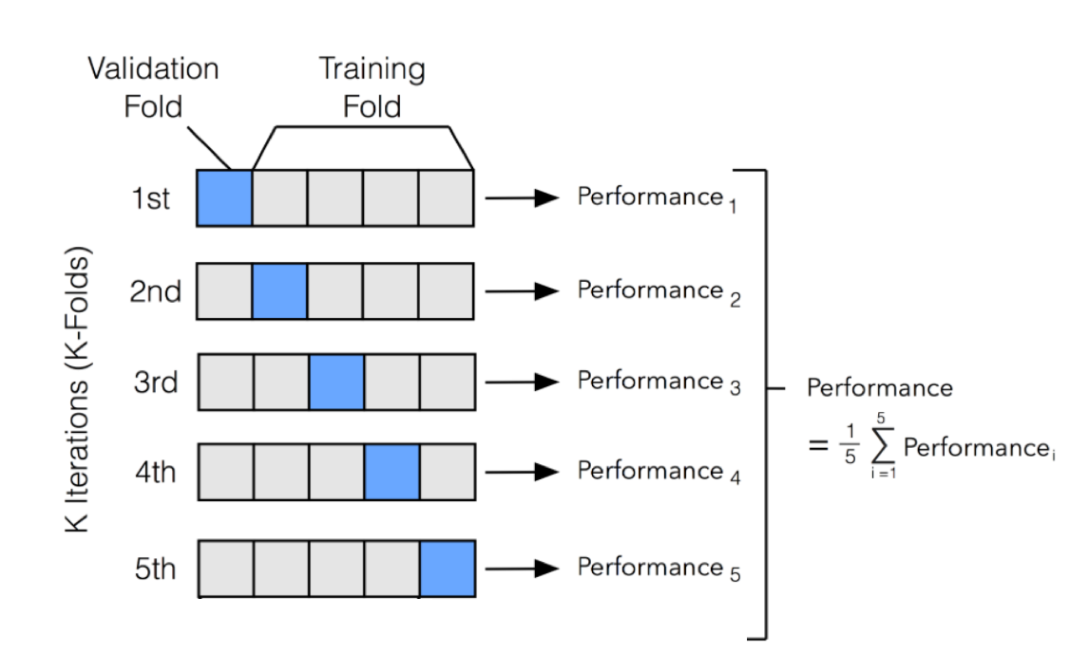
Modelling
Pre-Processing: Small dataset Problem
Pre-Processing
Small dataset Problem
K-Fold Cross-Validation (CV):
K Fold CV, with K=5 was used to overcome the problem of only having limited amounts of data. The dataset is split into multiple folds, with 1 being used for validation and the rest being used to train the model. This enables the model to learn from nearly the entire dataset.
The model performance is determined across all folds and then aggregated to provide a more robust measure of performance.

Slide 37
Modelling
Pre-Processing: Class imbalance Problem
Pre-Processing
Class Imbalance Problem
Stratified CV:
Stratified CV was used to ensure that each fold contained approximately the same class distribution as the original dataset
This prevents biases in training or validation due to a fold not containing sufficient minority class examples

Slide 38
Modelling
Models
Models
Standard Challenge
Bonus Challenge
Logistic Regression
SVM
Decision Tree
Random Forest
AdaBoost
Logistic Regression
SVM
Random Forest
AdaBoost
Logistic Regression was used as the baseline to evaluate classification performance for both challenges.
Other models were then implemented to try and beat this benchmark performance.
Linear models (Logistic Regression, SVM) and tree-based models (Decision Tree, Random Forest, AdaBoost) were both implemented.
Rationale: Linear models assess linear separability between classes whereas Tree-based models explore non-linear separability.

Slide 39
Modelling
Models
Models
Standard Challenge
Bonus Challenge
Logistic Regression
SVM
Decision Tree
Random Forest
AdaBoost
Logistic Regression
SVM
Random Forest
AdaBoost
Models write optimised using a grid search over various combinations of parameters. This set of parameters varied across the linear and non-linear classifiers.
Only the best performing set of parameters for each model were returned.

Slide 40
Modelling
Models
Standard Challenge
Bonus Challenge
Logistic Regression
SVM
Decision Tree
Random Forest
AdaBoost
Logistic Regression
SVM
Random Forest
AdaBoost

Slide 41
Evaluation
Confusion Matrix
Metric choice
Model Results

Slide 42
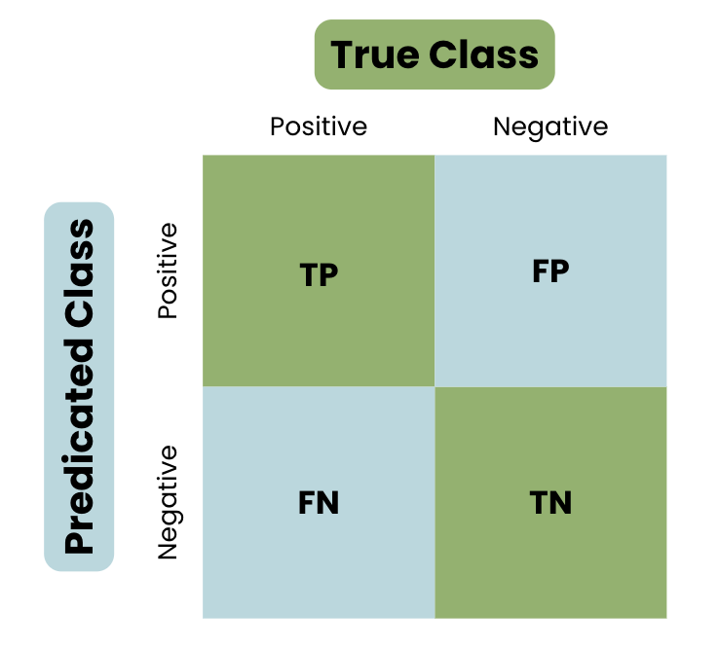
Evaluation
Confusion Matrix
Confusion Matrix
Confusion matrices provide a concise visual description of the predictions made by models and the type of errors the model tended to make
False Positives (FP) - the model incorrectly predicted a positive classification when the true result is negative
True Positives (TP) – the model correctly predicted a positive classification
False Negatives (FN) - the model incorrectly predicted a negative classification when the true result is positive
True Negatives (TN) - the model correctly predicted a negative classification

Slide 43
Evaluation
Confusion Matrix
Confusion Matrix
In the standard challenge :
False Positives (FP) – Abnormal datapoint misclassified as a Normal datapoint
True Positives (TP) – Correctly classified Normal datapoint
False Negatives (FN) – Normal datapoint misclassified as an Abnormal datapoint
True Negatives (TN) – Correctly classified Abnormal datapoint

Slide 44
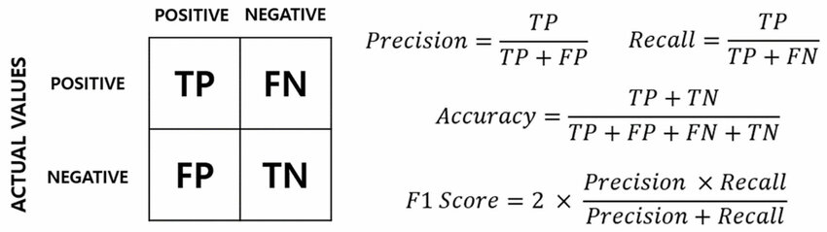
Evaluation
Metric choice
Metric choice
Various metrics can be calculated from the confusion matrix.

Slide 45
Evaluation
Metric choice
Metric choice
Various metrics can be calculated from the confusion matrix.
Choice between prioritising accuracy, precision, recall, F1-score
Accuracy unsuitable due to class imbalance. Accuracy may remain high even if the minority class is consistently misclassified.
Precision may result in undercounting the true number of positive classifications, focusing only on the correctness of positive predictions.
Recall may result in overcounting the true number of positive classification,
F1-score incorporates both measures and thus provides a reliable measure for a classification model to be trained on in an imbalanced dataset setting.

Slide 46
Evaluation
Model Results

Slide 47
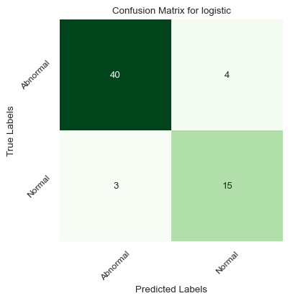
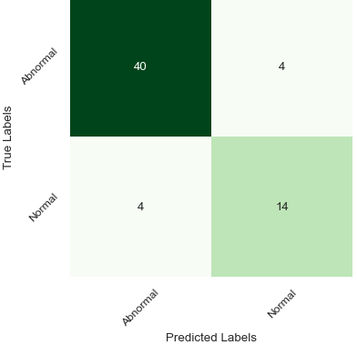
Evaluation
Model Results: Linear Regression Standard Challenge
Using the 6 Input Features: Macro avg F1: 87%
Using PCA: Macro avg F1: 84%
Note that only one sample was classified differently across the two variants

Slide 48
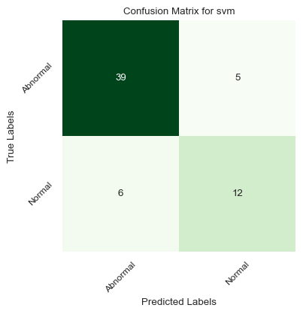
Evaluation
Model Results: SVM Standard Challenge
Using the 6 Input Features: Macro avg F1: 78%
Using PCA: Macro avg F1: 78%
Note that samples were classified the same using both PCA vs the 6 input features.

Slide 49
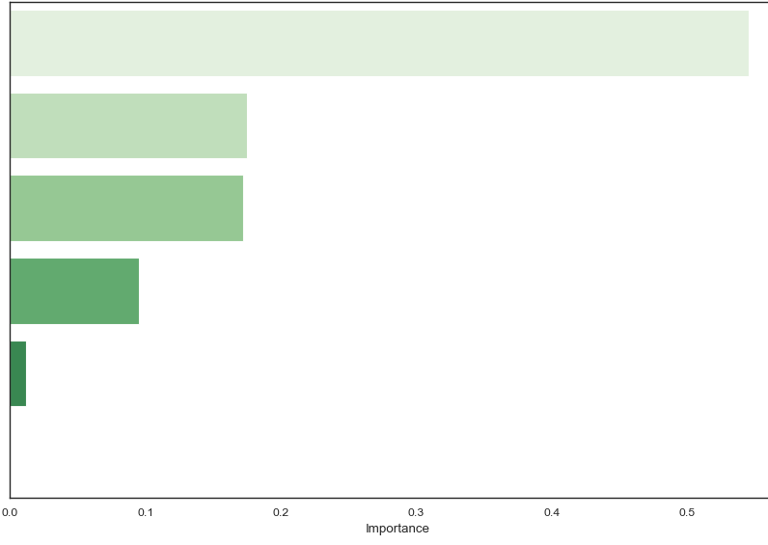
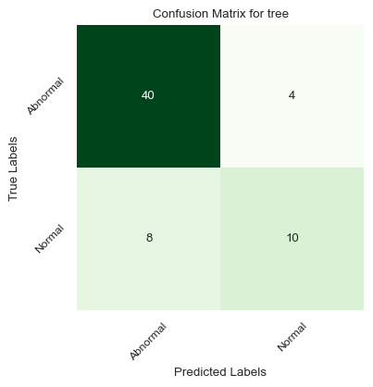
Evaluation
Model Results: Decision Tree Standard Challenge
Feature Importance
Using the 6 Input Features: Macro avg F1: 75%
degree_spondylolisthesis: 0.55
Pelvic_radius: 0.18
Sacral_slope: 0.17
Pelvic_incidence: 0.10
Lumbar_lordosis_angle: 0.012
Pelvic_tilt: 0.00
Note that features with high correlation were deemed less important by the model, demonstrating how tree-based classifiers are able to deal with input feature correlation and feature selection innately

Slide 50
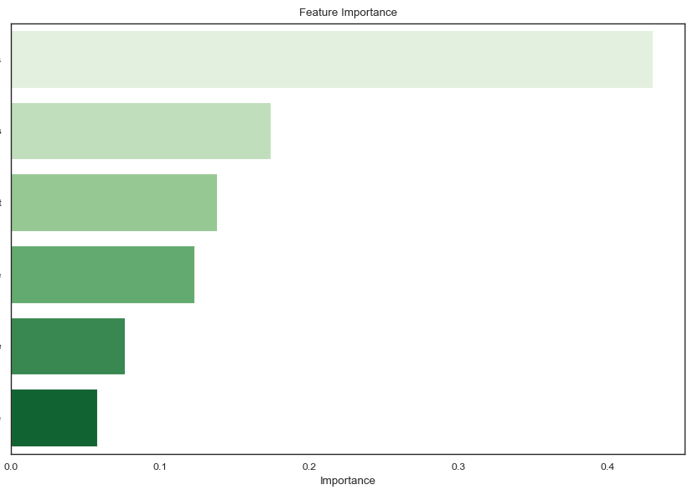
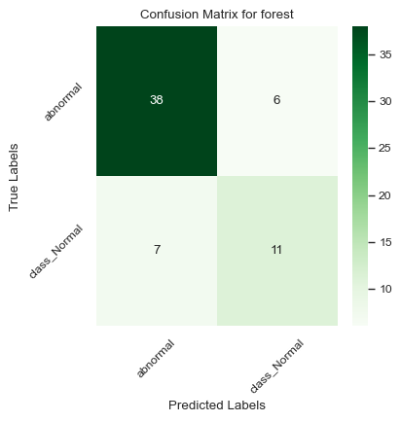
Evaluation
Model Results: Random Forest Standard Challenge
Feature Importance
Using the 6 Input Features: Macro avg F1: 74%
degree_spondylolisthesis: 0.43
Pelvic_radius: 0.18
Pelvic_tilt: 0.13
Pelvic_incidence: 0.12
Lumbar_lordosis_angle: 0.08
Sacral_slope: 0.06
Note that feature importance is more balanced in the random forest as opposed to in the decision tree model.

Slide 51

Evaluation
Model Results: AdaBoost Standard Challenge
Standard Challenge Findings:
Using the 6 Input Features: Macro avg F1: 79%
AdaBoost performs marginally better than other non-linear classifiers.
The AdaBoost classifier slightly outperforms the linear SVM classifier.
No classifier beats the logistic regression model.

Slide 52
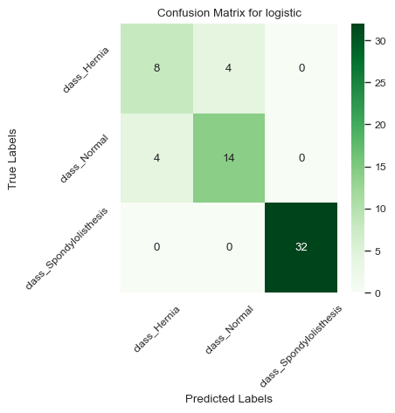
Evaluation
Model Results: Linear Regression Bonus Challenge
Using the 6 Input Features: Macro avg F1: 81%

Slide 53

Evaluation
Model Results: SVM Bonus Challenge
Using the 6 Input Features: Macro avg F1: 81%

Slide 54
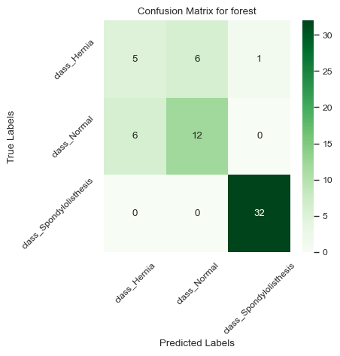
Evaluation
Model Results: Random Forest Bonus Challenge
Using the 6 Input Features: Macro avg F1: 70%

Slide 55
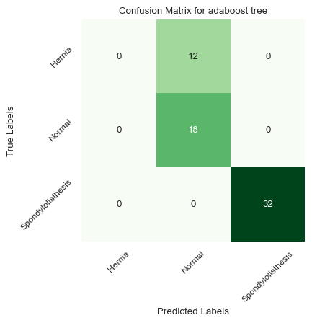
Evaluation
Model Results: AdaBoost Bonus Challenge
Using the 6 Input Features: Macro avg F1: 58%

Slide 56
Evaluation
Model Results: Bonus Challenge
Bonus Challenge Findings:
As in the standard challenge, the linear classifiers performed better than the non-linear classifiers.
The performance of the two logistic regression models in this section were equivalent
The proportion of misclassified samples increased when using non-linear classifiers.
This is especially evident in the Bonus Challenge AdaBoost model, which consistently failed to correctly classify the minority Hernia Class

Slide 57
Analysis
Logistic regression using 5 PC’s performs marginally worse than when using 6 raw features, although the performance is comparable.
Logistic regression had the best performance across both classification tasks.
As an added bonus, as the optimal parameters across both tasks are consistent, the same logistic regression model can be used for both tasks without the need for retraining.
Non-linear classifiers underwhelming performance could be attributed to the small dataset. If the dataset were more extensive, these classifiers could experience an increase in performance.
Linear classification models are sufficiently capable across both challenges.
Logistic Regression with L1- Regularisation is sufficient in handling feature selection from the 6 correlated features.

Slide 58
Further Work
Perform a more exhaustive grid search.
Improve feature engineering – provide a more robust method for dealing with class imbalance e.g. SMOTE.
Experiment with the XGBoost classifier architecture.
Experiment with a greater range of base classifiers in the AdaBoost classifier architecture.
Delve deeper into PCA and clustering analysis to see if a more interpretable means of classification is possible.

