Slide 1
1
2
4
3
5
Clinical Implementation
Integration & Secure Result Delivery
Model Classification & Radiologist Validation
Patient Imaging & Data Ingestion
Clinical Decision Support & Handling Ambiguity
Training, Adoption & Continuous Improvement

Slide 2
Imaging Acquisition
The patient arrives and undergoes an X-ray or CT scan as requested by their physician. This imaging study provides the raw data needed to evaluate the patient’s spinal and pelvic parameters.
Patient Imaging & Data Ingestion
1
1
2
2
3
4
5
Patient Imaging & Data Ingestion
Patient Imaging & Data Ingestion
Model Classification & Radiologist Validation
Integration & Secure Result Delivery
Model Classification & Radiologist Validation
Clinical Decision Support & Handling Ambiguity
Training, Adoption & Continuous Improvement

Slide 3
Upload to PACS
Once the imaging is captured, it is automatically stored in the PACS system, the standard repository for clinical images, ensuring secure and organised archiving.
2
2
4
1
3
1
The patient arrives and undergoes an X-ray or CT scan as requested by their physician. This investigation provides the raw data needed to evaluate the patient’s spinal and pelvic parameters.
5
Imaging Acquisition
Integration & Secure Result Delivery
Model Classification & Radiologist Validation
Clinical Decision Support & Handling Ambiguity
Patient Imaging & Data Ingestion
Model Classification & Radiologist Validation
Training, Adoption & Continuous Improvement

Slide 4
Image Pre-Processing
4
1
The patient arrives and undergoes an X-ray or CT scan as requested by their physician. This imaging study provides the raw data needed to evaluate the patient’s spinal and pelvic parameters.
1
5
2
3
Imaging Acquisition
Once the imaging is captured, it is automatically stored in the PACS system, the standard repository for clinical images, ensuring secure and organised archiving.
Clinical Decision Support & Handling Ambiguity
Patient Imaging & Data Ingestion
Integration & Secure Result Delivery
Model Classification & Radiologist Validation
Training, Adoption & Continuous Improvement
Upload to PACS
Before the system extracts features, the images are standardised for brightness and contrast. This ensures consistent landmark detection regardless of variations in the original imaging conditions. Such optimisation reduces errors and ensures the model receives the best possible visual input.

Slide 5
Feature Extraction
4
Once the imaging is captured, it is automatically stored in the PACS system, the standard repository for clinical images, ensuring secure and organised archiving.
1
The patient arrives and undergoes an X-ray or CT scan as requested by their physician. This imaging study provides the raw data needed to evaluate the patient’s spinal and pelvic parameters.
1
5
2
3
Imaging Acquisition
Clinical Decision Support & Handling Ambiguity
Patient Imaging & Data Ingestion
Integration & Secure Result Delivery
Model Classification & Radiologist Validation
Training, Adoption & Continuous Improvement
Upload to PACS
Before the system extracts features, the images are standardised for brightness and contrast. This ensures consistent landmark detection regardless of variations in the original imaging conditions. Such optimisation reduces errors and ensures the model receives the best possible visual input.
Image Pre-Processing

Slide 6
The extracted parameters are then sent to the machine learning model for classification. This step sets the stage for accurate and rapid diagnostic support, significantly reducing clinician workload.
Parameter Input to ML Model
4
Once the imaging is captured, it is automatically stored in the PACS system, the standard repository for clinical images, ensuring secure and organised archiving.
1
The patient arrives and undergoes an X-ray or CT scan as requested by their physician. This imaging study provides the raw data needed to evaluate the patient’s spinal and pelvic parameters.
1
Advanced computer vision algorithms identify key anatomical landmarks on the pre-processed images. These landmarks allow the system to derive critical biomechanical parameters. This process is fully automated, eliminating the need for manual measurements.
5
2
3
Imaging Acquisition
Before the system extracts features, the images are standardised for brightness and contrast. This ensures consistent landmark detection regardless of variations in the original imaging conditions. Such optimisation reduces errors and ensures the model receives the best possible visual input.
Clinical Decision Support & Handling Ambiguity
Patient Imaging & Data Ingestion
Integration & Secure Result Delivery
Model Classification & Radiologist Validation
Training, Adoption & Continuous Improvement
Upload to PACS
Image Pre-Processing
Feature Extraction

Slide 7
Advanced computer vision algorithms identify key anatomical landmarks on the pre-processed images. These landmarks allow the system to derive critical biomechanical parameters. This process is fully automated, eliminating the need for manual measurements.
The ML model takes in the six extracted parameters and classifies the patient’s condition as Normal, Herniated Disc, or Spondylolisthesis. This classification is generated in real-time, leveraging the model’s learned patterns from prior training and refinement.
Model Classification & Radiologist Validation
Automated Classification
1
4
2
1
The extracted parameters are then sent to the machine learning model for classification. This step sets the stage for accurate and rapid diagnostic support, significantly reducing clinician workload.
5
2
Imaging Acquisition
Patient Imaging & Data Ingestion
Clinical Decision Support & Handling Ambiguity
Model Classification & Radiologist Validation
Training, Adoption & Continuous Improvement
Upload to PACS
Parameter Input to ML Model
Model Classification & Radiologist Validation
3
Image Pre-Processing
Feature Extraction
Once the imaging is captured, it is automatically stored in the PACS system, the standard repository for clinical images, ensuring secure and organised archiving.
Before the system extracts features, the images are standardised for brightness and contrast. This ensures consistent landmark detection regardless of variations in the original imaging conditions. Such optimisation reduces errors and ensures the model receives the best possible visual input.
Integration & Secure Result Delivery
The patient arrives and undergoes an X-ray or CT scan as requested by their physician. This imaging study provides the raw data needed to evaluate the patient’s spinal and pelvic parameters.

Slide 8
Radiologist Interface for Review
A dedicated interface allows radiologists and spine specialists to review the automatically extracted features and the resulting classification. If they notice discrepancies, they can adjust parameters or annotate specific areas of concern.
1
2
The ML model takes in the six extracted parameters and classifies the patient’s condition as Normal, Herniated Disc, or Spondylolisthesis. This classification is generated in real-time, leveraging the model’s learned patterns from prior training and refinement.
Automated Classification
Model Classification & Radiologist Validation

Slide 9
Any refinements or corrections made by the radiologist are securely logged and later incorporated back into the model’s training data. Over time, the model becomes increasingly accurate and reliable, benefiting from real-world clinical feedback and expertise.
Continuous Model Improvement
The ML model takes in the six extracted parameters and classifies the patient’s condition as Normal, Herniated Disc, or Spondylolisthesis. This classification is generated in real-time, leveraging the model’s learned patterns from prior training and refinement.
1
3
2
Automated Classification
A dedicated interface allows radiologists and spine specialists to review the automatically extracted features and the resulting classification. If they notice discrepancies, they can adjust parameters or annotate specific areas of concern.
Integration & Secure Result Delivery
Model Classification & Radiologist Validation
Radiologist Interface for Review

Slide 10
A secure middleware layer manages all communication between the ML model, PACS, and EHR systems. Utilizing healthcare data standards like FHIR and DICOM ensures that the flow of information is seamless, consistent, and interoperable with existing hospital IT infrastructure.
Middleware Connectivity
The ML model takes in the six extracted parameters and classifies the patient’s condition as Normal, Herniated Disc, or Spondylolisthesis. This classification is generated in real-time, leveraging the model’s learned patterns from prior training and refinement.
1
3
2
Automated Classification
Integration & Secure Result Delivery
Model Classification & Radiologist Validation
Radiologist Interface for Review
Any refinements or corrections made by the radiologist are securely logged and later incorporated back into the model’s training data. Over time, the model becomes increasingly accurate and reliable, benefiting from real-world clinical feedback and expertise.
A dedicated interface allows radiologists and spine specialists to review the automatically extracted features and the resulting classification. If they notice discrepancies, they can adjust parameters or annotate specific areas of concern.
Continuous Model Improvement

Slide 11
Privacy & Compliance Controls
Implemented role-based access controls and audit logs guarantee that patient data remains private and accessible only to authorized clinicians. This approach maintains compliance with healthcare privacy regulations and fosters trust in the system’s security.
3
A secure middleware layer manages all communication between the ML model, PACS, and EHR systems. Utilizing healthcare data standards like FHIR and DICOM ensures that the flow of information is seamless, consistent, and interoperable with existing hospital IT infrastructure.
Middleware Connectivity
Integration & Secure Result Delivery

Slide 12
Once classification is complete, the model’s results, including confidence scores and annotated images highlighting abnormal regions, are sent directly into the EHR or radiologist dashboard. Clinicians receive timely notifications that new results are available, so they can promptly review findings within the same workflow they already use, avoiding unnecessary platform switching.
Results in Clinician Workflow
3
A secure middleware layer manages all communication between the ML model, PACS, and EHR systems. Utilizing healthcare data standards like FHIR and DICOM ensures that the flow of information is seamless, consistent, and interoperable with existing hospital IT infrastructure.
Middleware Connectivity
Implemented role-based access controls and audit logs guarantee that patient data remains private and accessible only to authorized clinicians. This approach maintains compliance with healthcare privacy regulations and fosters trust in the system’s security.
Integration & Secure Result Delivery
Privacy & Compliance Controls

Slide 13
The integrated Clinical Decision Support System (CDSS) presents the model’s outputs in a clear, actionable format. Predictions are labelled plainly as Normal, Herniated Disc, or Spondylolisthesis, accompanied by confidence scores that help clinicians gauge the certainty of the result.
Implemented role-based access controls and audit logs guarantee that patient data remains private and accessible only to authorized clinicians. This approach maintains compliance with healthcare privacy regulations and fosters trust in the system’s security.
Real-Time Decision Support
3
A secure middleware layer manages all communication between the ML model, PACS, and EHR systems. Utilizing healthcare data standards like FHIR and DICOM ensures that the flow of information is seamless, consistent, and interoperable with existing hospital IT infrastructure.
4
Middleware Connectivity
Integration & Secure Result Delivery
Clinical Decision Support & Handling Ambiguity
Privacy & Compliance Controls
Once classification is complete, the model’s results, including confidence scores and annotated images highlighting abnormal regions, are sent directly into the EHR or radiologist dashboard. Clinicians receive timely notifications that new results are available, so they can promptly review findings within the same workflow they already use, avoiding unnecessary platform switching.
Results in Clinician Workflow

Slide 14
Visual overlays on the imaging highlight which parameters and anatomical landmarks influenced the classification. By seeing the exact areas of abnormal curvature or structural change, surgeons and radiologists can better understand the underlying reasoning, ultimately aiding them in treatment planning.
Enhanced Interpretability
Enhanced Interpretability
4
The integrated Clinical Decision Support System (CDSS) presents the model’s outputs in a clear, actionable format. Predictions are labelled plainly as Normal, Herniated Disc, or Spondylolisthesis, accompanied by confidence scores that help clinicians gauge the certainty of the result.
Real-Time Decision Support
Visual overlays on the imaging highlight which parameters and anatomical landmarks influenced the classification. By seeing the exact areas of abnormal curvature or structural change, surgeons and radiologists can better understand the underlying reasoning, ultimately aiding them in treatment planning.
Clinical Decision Support & Handling Ambiguity

Slide 15
Managing Uncertainty
4
The integrated Clinical Decision Support System (CDSS) presents the model’s outputs in a clear, actionable format. Predictions are labelled plainly as Normal, Herniated Disc, or Spondylolisthesis, accompanied by confidence scores that help clinicians gauge the certainty of the result.
Real-Time Decision Support
Visual overlays on the imaging highlight which parameters and anatomical landmarks influenced the classification. By seeing the exact areas of abnormal curvature or structural change, surgeons and radiologists can better understand the underlying reasoning, ultimately aiding them in treatment planning.
Clinical Decision Support & Handling Ambiguity
Enhanced Interpretability
When the model’s confidence is low or the findings seem ambiguous, the system automatically prompts additional clinical review. In some cases, it may recommend obtaining further imaging. This ensures that patient safety is always prioritized, and no questionable results go unchecked.

Slide 16
To ensure smooth adoption, practical workshops and hands-on sessions are conducted, led by technical specialists and experienced radiologists who have tested the system in pilot environments. These sessions provide clinicians with insights on interpreting confidence scores, understanding visual overlays, and offering corrective feedback.
Workshops and Training Sessions
5
4
The integrated Clinical Decision Support System (CDSS) presents the model’s outputs in a clear, actionable format. Predictions are labelled plainly as Normal, Herniated Disc, or Spondylolisthesis, accompanied by confidence scores that help clinicians gauge the certainty of the result.
Real-Time Decision Support
Training, Adoption & Continuous Improvement
Clinical Decision Support & Handling Ambiguity
Enhanced Interpretability
When the model’s confidence is low or the findings seem ambiguous, the system automatically prompts additional clinical review. In some cases, it may recommend obtaining further imaging. This ensures that patient safety is always prioritized, and no questionable results go unchecked.
Managing Uncertainty
Visual overlays on the imaging highlight which parameters and anatomical landmarks influenced the classification. By seeing the exact areas of abnormal curvature or structural change, surgeons and radiologists can better understand the underlying reasoning, ultimately aiding them in treatment planning.

Slide 17
Enhanced Interpretability
5
To ensure smooth adoption, practical workshops and hands-on sessions are conducted, led by technical specialists and experienced radiologists who have tested the system in pilot environments. These sessions provide clinicians with insights on interpreting confidence scores, understanding visual overlays, and offering corrective feedback.
Workshops and Training Sessions
Training, Adoption & Continuous Improvement
A dedicated help desk and periodic system updates guarantee that clinicians remain well-supported. Regular communication ensures users understand that this technology complements, rather than replaces, their clinical judgment and expertise.

Slide 18
Feedback-Driven Evolution
5
To ensure smooth adoption, practical workshops and hands-on sessions are conducted, led by technical specialists and experienced radiologists who have tested the system in pilot environments. These sessions provide clinicians with insights on interpreting confidence scores, understanding visual overlays, and offering corrective feedback.
Workshops and Training Sessions
A dedicated help desk and periodic system updates guarantee that clinicians remain well-supported. Regular communication ensures users understand that this technology complements, rather than replaces, their clinical judgment and expertise.
Training, Adoption & Continuous Improvement
Ongoing Support and Communication
Difficult or ambiguous cases, once flagged and corrected by radiologists, feed back into the model’s training data. Over time, this continuous refinement process improves the system’s accuracy, adaptability, and clinical value, resulting in an evolving, learning tool that keeps pace with real-world clinical demands.

Slide 19
5
To ensure smooth adoption, practical workshops and hands-on sessions are conducted, led by technical specialists and experienced radiologists who have tested the system in pilot environments. These sessions provide clinicians with insights on interpreting confidence scores, understanding visual overlays, and offering corrective feedback.
Workshops and Training Sessions
Training, Adoption & Continuous Improvement
Ongoing Support and Communication
Difficult or ambiguous cases, once flagged and corrected by radiologists, feed back into the model’s training data. Over time, this continuous refinement process improves the system’s accuracy, adaptability, and clinical value, resulting in an evolving, learning tool that keeps pace with real-world clinical demands.
Feedback-Driven Evolution
A dedicated help desk and periodic system updates guarantee that clinicians remain well-supported. Regular communication ensures users understand that this technology complements, rather than replaces, their clinical judgment and expertise.

Slide 20
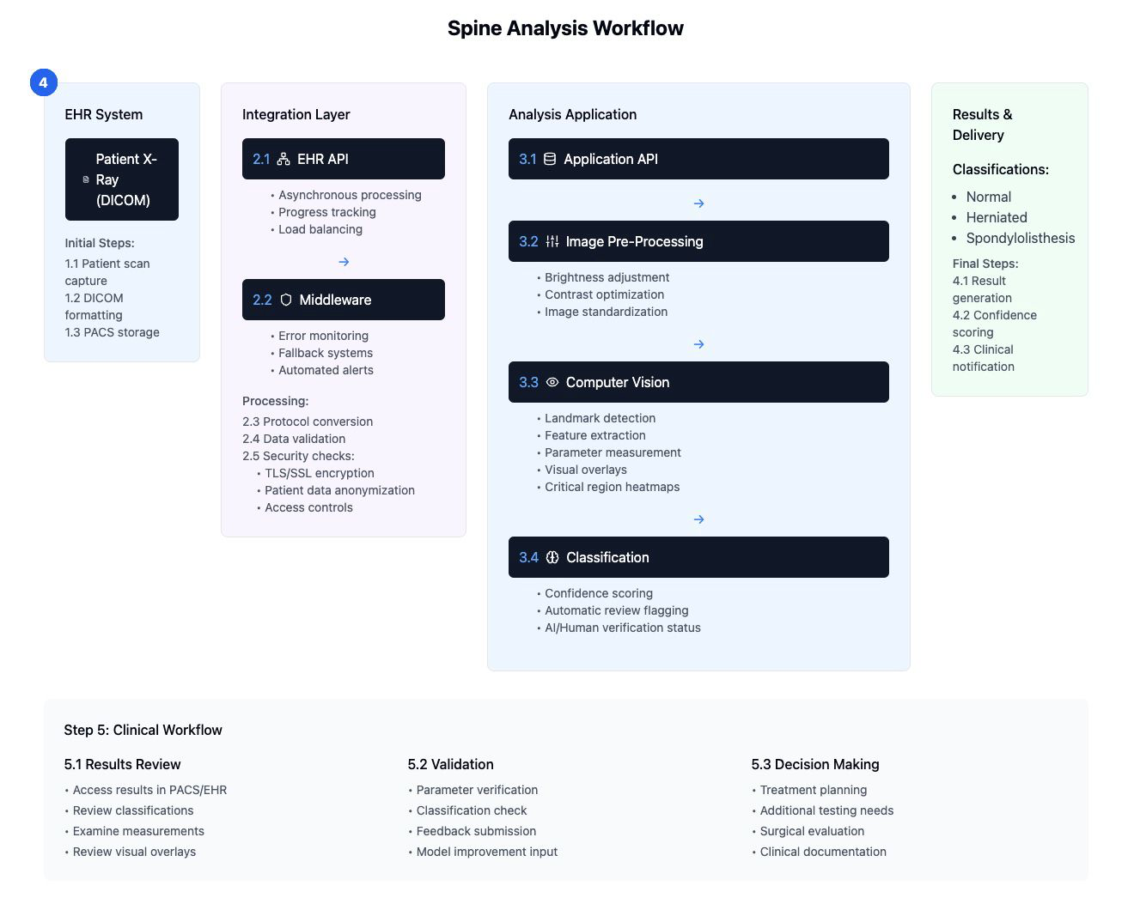
Ongoing Support and Communication
Workshops and Training Sessions
Feedback-Driven Evolution
5
To ensure smooth adoption, practical workshops and hands-on sessions are conducted, led by technical specialists and experienced radiologists who have tested the system in pilot environments. These sessions provide clinicians with insights on interpreting confidence scores, understanding visual overlays, and offering corrective feedback.
Training, Adoption & Continuous Improvement
A dedicated help desk and periodic system updates guarantee that clinicians remain well-supported. Regular communication ensures users understand that this technology complements, rather than replaces, their clinical judgment and expertise.
Difficult or ambiguous cases, once flagged and corrected by radiologists, feed back into the model’s training data. Over time, this continuous refinement process improves the system’s accuracy, adaptability, and clinical value, resulting in an evolving, learning tool that keeps pace with real-world clinical demands.

Slide 21
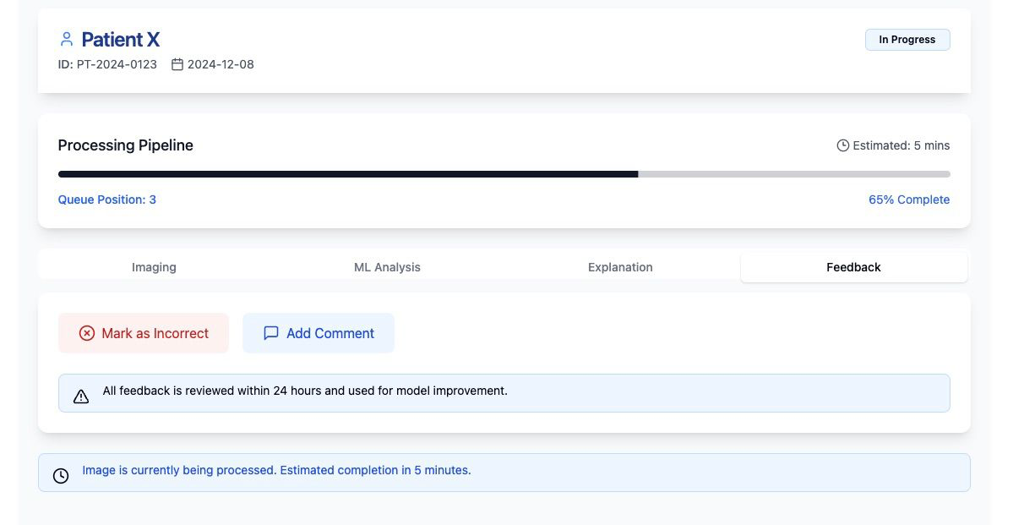

Slide 22
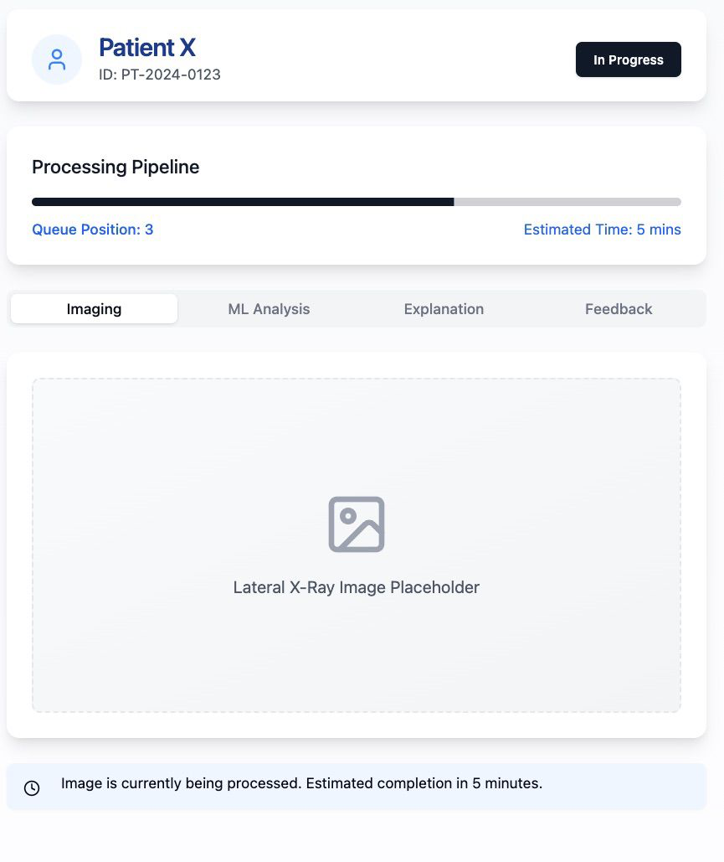

Slide 23
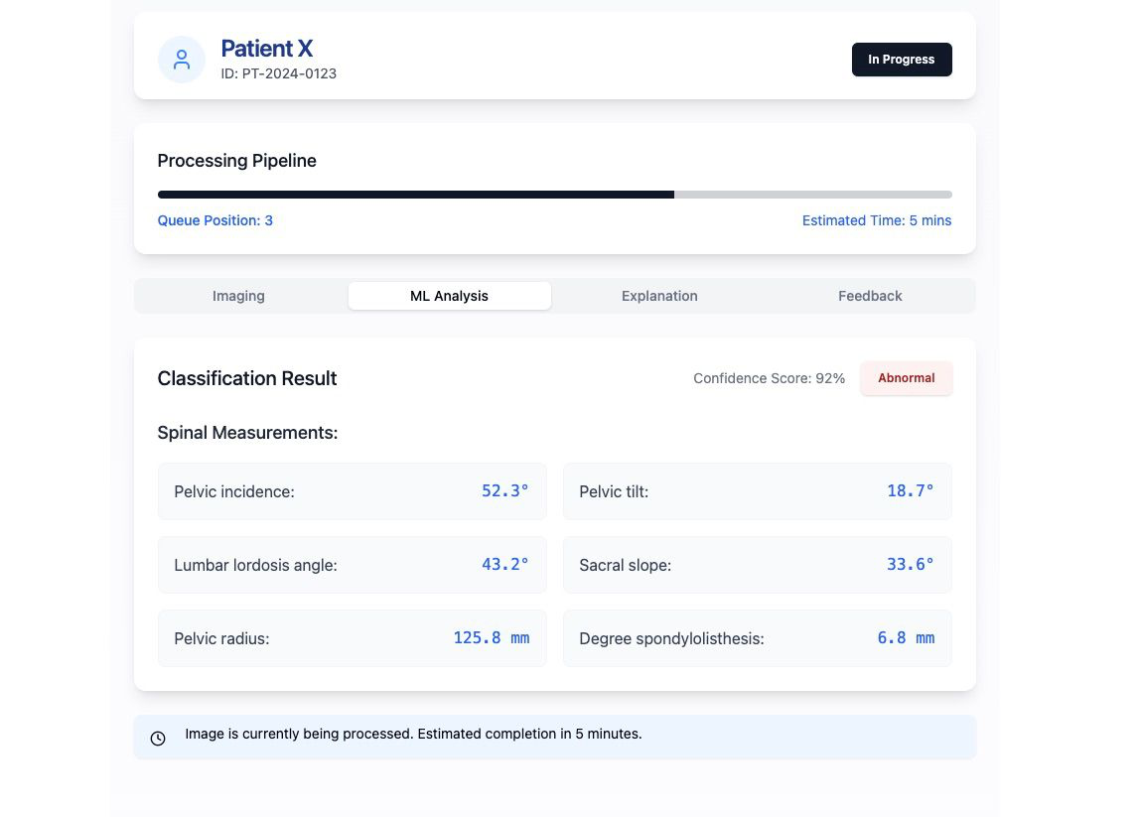

Slide 24
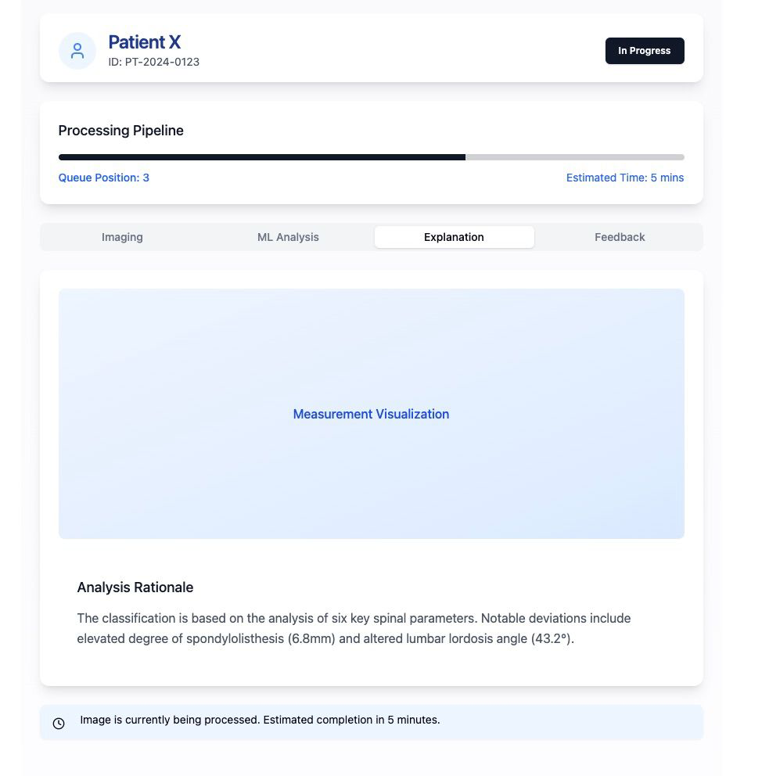

Slide 25
THANK YOU
Ongoing Support and Communication
Workshops and Training Sessions
Feedback-Driven Evolution
5
To ensure smooth adoption, practical workshops and hands-on sessions are conducted, led by technical specialists and experienced radiologists who have tested the system in pilot environments. These sessions provide clinicians with insights on interpreting confidence scores, understanding visual overlays, and offering corrective feedback.
Training, Adoption & Continuous Improvement
A dedicated help desk and periodic system updates guarantee that clinicians remain well-supported. Regular communication ensures users understand that this technology complements, rather than replaces, their clinical judgment and expertise.
Difficult or ambiguous cases, once flagged and corrected by radiologists, feed back into the model’s training data. Over time, this continuous refinement process improves the system’s accuracy, adaptability, and clinical value, resulting in an evolving, learning tool that keeps pace with real-world clinical demands.

