Slide 1
LASTBITE: SOLVING FOOD WASTAGE
By Raafae, Kavish, Robbert and Yusif

Slide 2
TABLE OF CONTENTS
01
02
03
04
THE PROBLEM
The issue we're trying to solve
THE SOLUTION
The website we created
THE IMPACT
The impact our website can have
THE FUTURE
How we can expand our project further

Slide 3
01
Problem

Slide 4
The Problem
Food waste is invisible at the household level
People don’t know what they have
They don’t know when it expires
They don’t see the cost of waste in real time
Result
Food is bought → forgotten → thrown away
At scale, this becomes a $1T inefficiency with climate consequences.

Slide 5
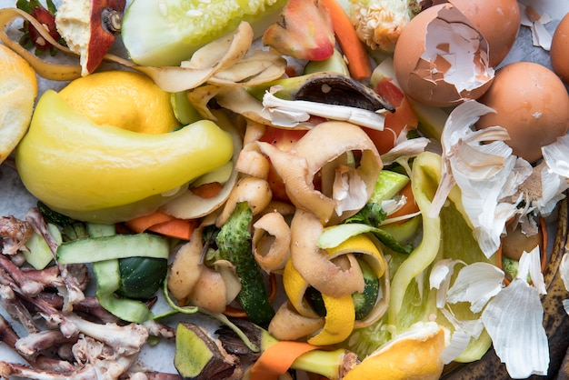
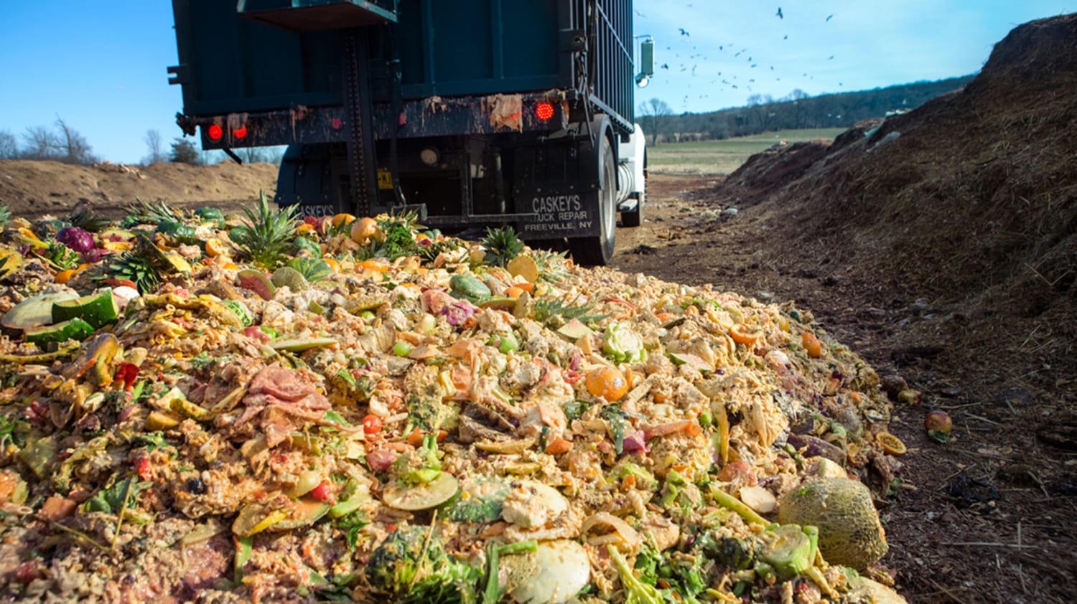
The facts
$1T+
1.3B tons
8–10%
30–40%
Worth of food wasted globally every year
Of food discarded annually worldwide
Of global greenhouse gas emissions linked to food waste
Of household food purchased is never consumed

Slide 6
02
The Solution

Slide 7
LastBite – Making food waste Visible and Actionable
A single platform that helps households:
Track what food they own
Know when it expires
Replenish only what they need
Waste reduction becomes automatic.

Slide 8
HOW IT WORKS
Capture
Barcode scanning & manual input
Visual pantry with expiry dates
Interactive tracking of food items
Redistribute
Optimize
Donate surplus food directly through the app
Connects excess to local communities
Smart reminders before expiry
AI recipe suggestions using available items

Slide 9
WHY IT WORKS
VISIBILITY
Households can finally see what they own, what’s expiring, and what’s running low - in one place.
TIMING
Smart alerts intervene before food becomes waste, not after.
INTEGRATION
Direct links to online grocery stores remove friction from restocking and prevent overbuying.
INCENTIVE ALIGNMENT
Users save money and time while naturally reducing waste - no behavior forcing.
SCALABILITY
Digital-first system scales across households, retailers, and regions with minimal marginal cost.

Slide 10
03
The impact

Slide 11
IMPACT
SUSTAINABILITY
ACCESIBILITY
S
A
Reduces food waste and environmental impact by ensuring food is used or redistributed instead of discarded​
Makes it easier for users to find recipes and donation options in one simple platform
EFFICIENCY
RESPONSIBILITY
E
R
Streamlines meal planning by quickly turning available, soon-to-expire items into usable recipes
Encourages ethical behavior by promoting food donation and conscious consumptions
AFFORDABILITY
A
A
AWARENESS
Helps users save money by maximizing use of food they have already bought​
Increases understanding of expiry dates, food wastage issues, and sustainable eating habits

Slide 12
WHO BENEFITS?
Households & Students
Families
Food Charities & Shelters
Local Communities
Environment
Retail & Supply chains
Save money and reduce food waste through smarter meal planning
Easier cooking decisions and better use of groceries before expiry
Receive more timely and usable food donations
Improved food redistribution and reduced inequality
Lower landfill waste and reduced carbon emissions
Reduced demand pressure and wasted resources

Slide 13


Slide 14
04
The Future

Slide 15
NEW FEATURES
USEABILITY
Scope for future additions
We want to improve our UI and how our consumers interact with the website:
Push notifications
Photo-to-pantry
Quick-cook mode
Adding a "why this recipe?" button that highlights to users what's being saved and its impact
Future integration with online grocery retailers
Accessibility – Include speech to text, larger text and read aloud
Scaling – While made for households, the same infrastructure can be embedded to student housing, cafeterias, and other institutions
Using a rewards system for when you chose to donate leftovers that gives you discounts
Smarter Intelligence
As usage grows, LastBite evolves from a tracking tool into a predictive system. By learning consumption patterns, it can anticipate shortages, predict waste risk, and recommend smarter purchasing decisions before problems occur. This shifts the platform from reactive reminders to proactive optimization.
Expanded Impact Analytics
LastBite will provide users and partners with clear, data-driven insights into waste reduction, cost savings, and environmental impact. These analytics can support personal sustainability goals, school or community initiatives, and ESG reporting for aligned partners.

Slide 16
THANKS
Any questions?

