Slide 1
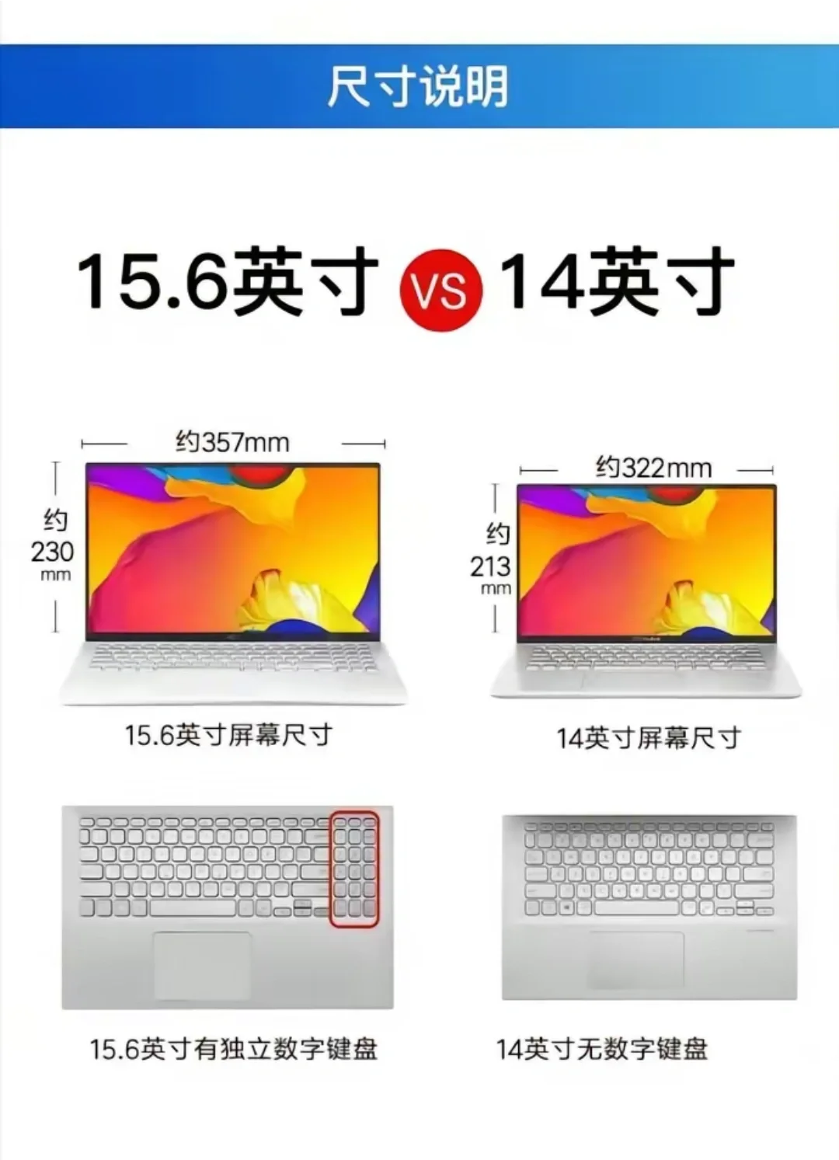
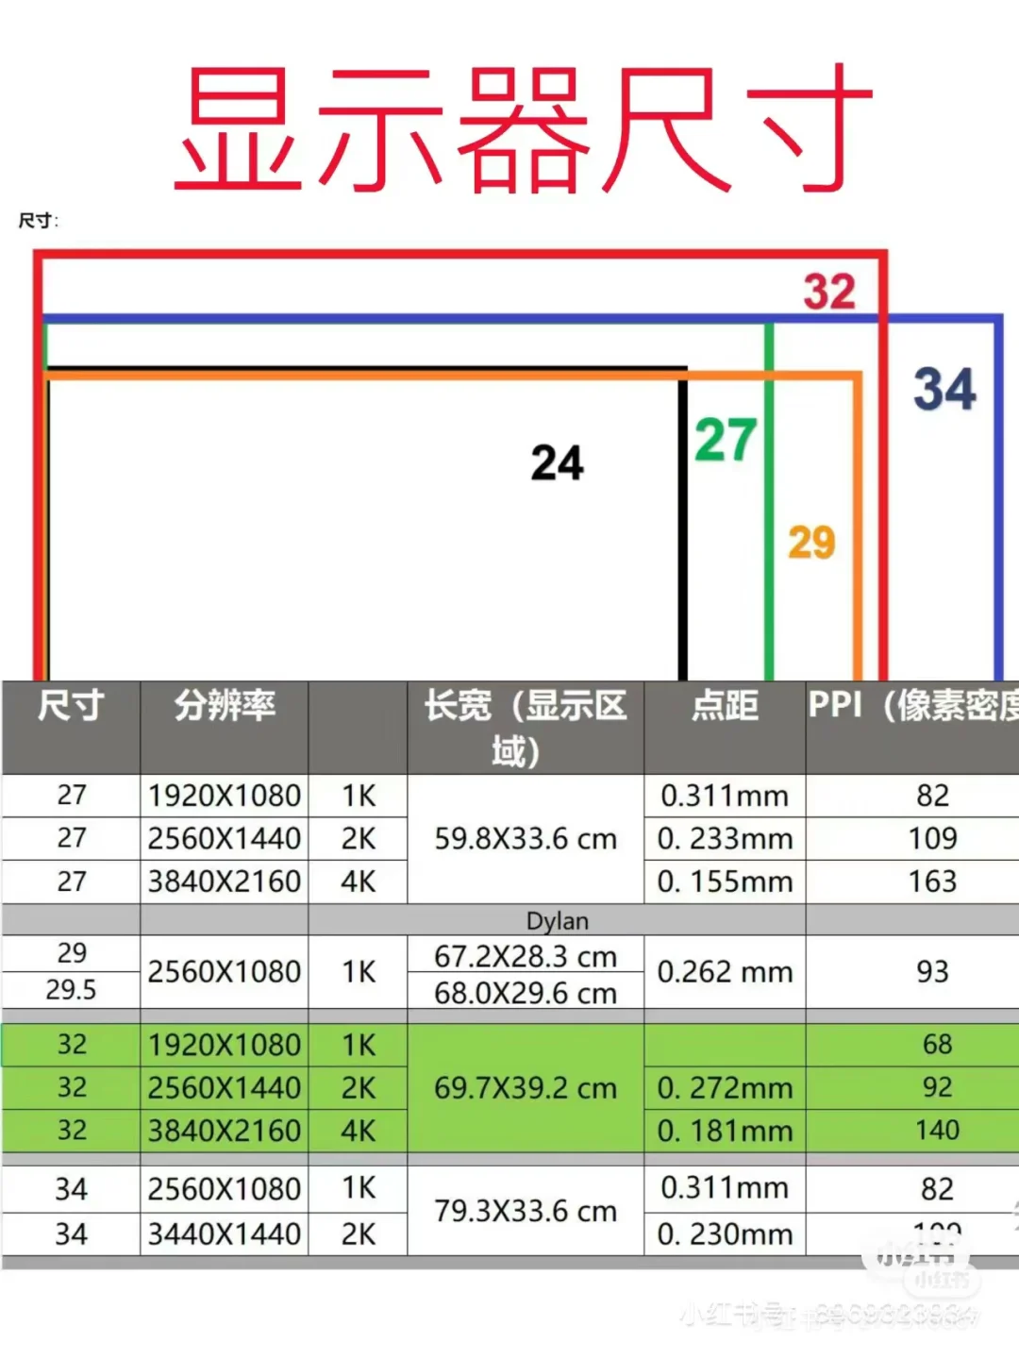
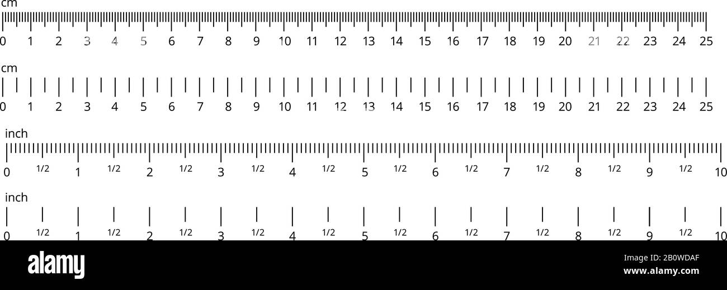
15.6”
34”
15.6”
15.6”
34”
14”
PC
Mouse Pad
14”
iPad
Fridge
dehumidifier

Slide 2
Bed Mattress Size:
190 cm x 91 cm x 23 cm
desk
Bed

Slide 3
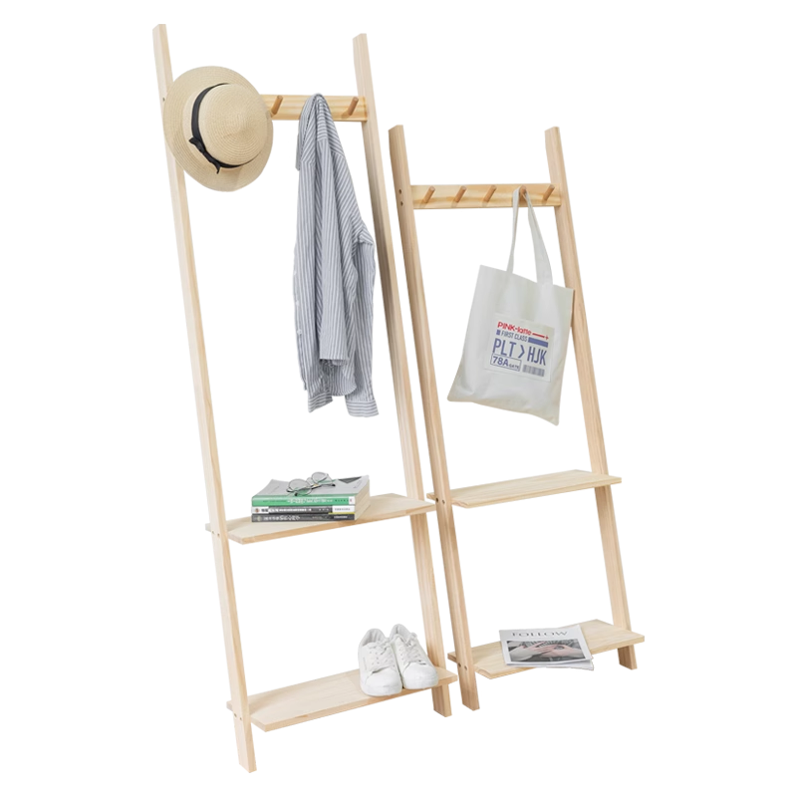
0.4m
0.5m
1.0m

Slide 4
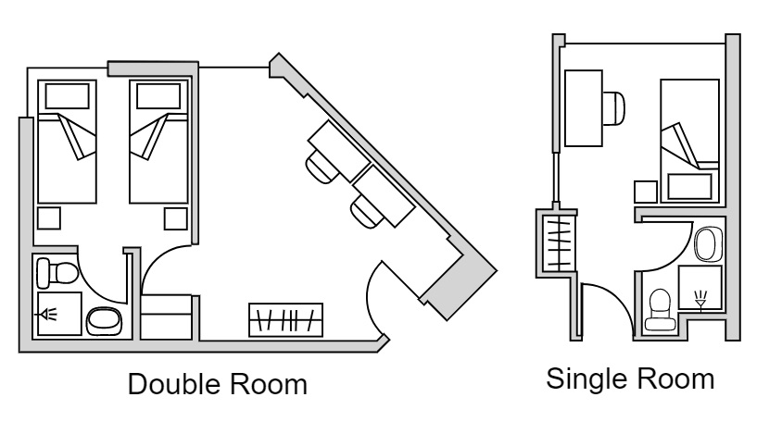
Bed
desk
4.50
Toilet
2.00 m2
Wardrobe

Slide 5
desk
Fridge
Bed
14”
desk
Mouse Pad
4.50
PC
Wardrobe
dehumidifier
Toilet
2.00 m2
Wardrobe

Slide 6
Bed
Bed

Slide 7
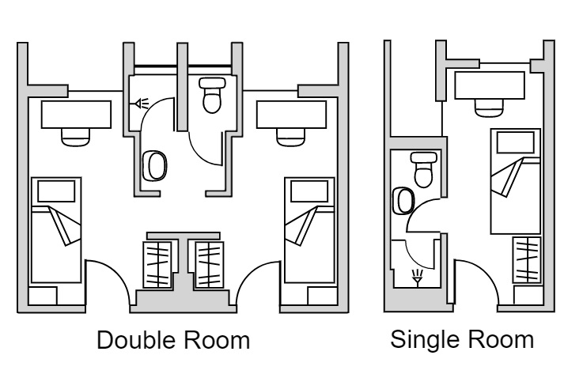
desk
Bed
4.50
Toilet
2.25m2
Wardrobe

Slide 8
Bed

Slide 9
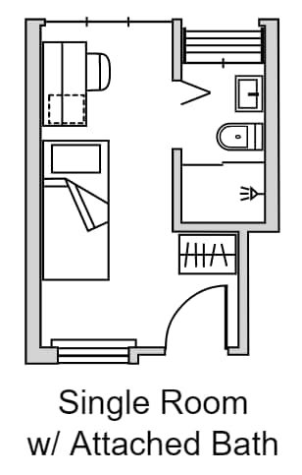
desk
Toilet
2.45 m2
Single Room Size: 7.75 sqm
Single Room with Ensuite Toilet Size: 13.2 m2
Excluding Toilet ~10.75 m2
4.50
Bed
Wardrobe
3.45

Slide 10
desk
Fridge
Toilet
2.45 m2
Single Room Size: 7.75 sqm
Single Room with Ensuite Toilet Size: 13.2 m2
Excluding Toilet ~10.75 m2
14”
desk
Mouse Pad
4.50
PC
Bed
Wardrobe
dehumidifier
3.45

Slide 11
desk
Toilet
2.45 m2
14”
Mouse Pad
desk
4.50
Bed
Wardrobe

Slide 12
desk
Toilet
2.45 m2
14”
Mouse Pad
desk
4.50
Bed
Wardrobe

Slide 13
desk
Toilet
2.45 m2
desk
4.50
Bed
Wardrobe

Slide 14
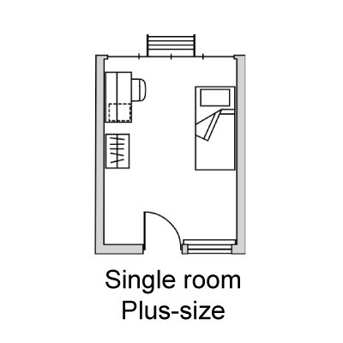
desk
Bed
4.50
Wardrobe

Slide 15
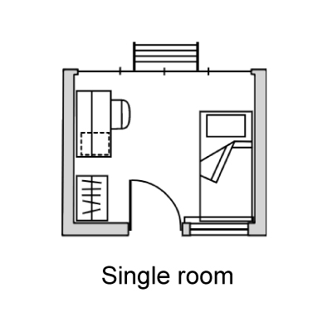
desk
Bed
2.80
Wardrobe

Slide 16
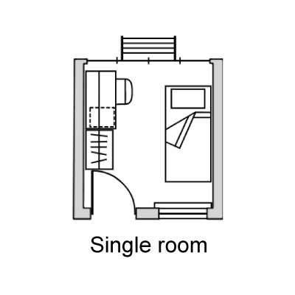
desk
Bed
2.80
Wardrobe

