Slide 1

工作总结 / 工作计划 / 工作汇报
BUSINESS PLAN
软通试用期员工转正申请
The user can demonstrate on a projector or computer, or print the presentation and make it into a film to be used in a wider field
申请人：余红阳
日期：2018.10.22
部门：深圳HW海思实施部

Slide 2

CONTENTS
1
自我介绍
print the presentation and make it into a film a wider field
2
绩效及业务模块介绍
print the presentation and make it into a film a wider field
3
工作态度和个人品德
print the presentation and make it into a film a wider field
4
个人优势及特长
print the presentation and make it into a film a wider field
5
工作计划及个人目标
print the presentation and make it into a film a wider field

Slide 3
PART 01
自我介绍
The user can demonstrate on a projector or computer, or print the presentation and make it into a film to be used in a wider field

Slide 4
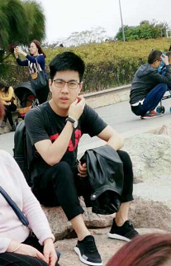
转正申请--个人履历
print the presentation and make it into a film to be used in a wider field
个人履历
姓名: 余红阳
年龄: 27岁
毕业院校: 上海海事大学
毕业时间: 2015年6月
工作经历:
2015-2017 深圳海顺海事服务有限公司 爬虫工程师
2017-2018 海航期货股份有限公司 爬虫/数据分析
The user can demonstrate on a projector or computer, or presentation and make it film to be used in a wider field

Slide 5
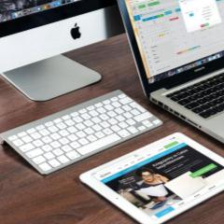

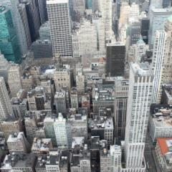

2.绩效及业务模块
print the presentation and make it into a film to be used in a wider field
SLT业务模块
WLT业务模块
(1)Summary前台显示数据配置;
(2)SLT log文件解析结果后台数据配置;
(3)SLT 新上线芯片后台对应关系数据配置;
(1)DIEID采集任务;
(2)参数PARAM采集任务;
(3)DIEID提取和解析数据提取等规则数据配置;
MES市场返修数据模块
BOM及ORT模块
(1)每月两次导出市场返修数据,分3504和非3504的编码;
(2)启动爬虫脚本,爬取相应的SN和CHIP_CODE;
(3)通过接口刷新发货去向并入库;
(4)刷入DWD数据表;
(1)BOM清单和BOM电路图脚本开发;
(2)ORT爬虫脚本开发;
(3)ORT数据采集/清洗并入库;

Slide 6
3.工作态度和品德
print the presentation and make it into a film to be used in a wider field
1.本人工作认真,勤奋上进;
The user can demonstrate on a projector or computer
2.时刻为项目组和公司的利益着想;
The user can demonstrate on a projector or computer
3.能准时保质保量完成领导交代的任务;
The user can demonstrate on a projector or computer
4.不断学习前沿的IT技术,充实并提升自我;
The user can demonstrate on a projector or computer
5.时刻以客户方为重,努力做好为客户方创好的印象;
The user can demonstrate on a projector or computer

Slide 7

4.个人优势
print the presentation and make it into a film to be used in a wider field
标题文本预设
1.勤奋好学,喜欢接触前言的技术;
The user can demonstrate on a projector or computer
标题文本预设
2.专业技能扎实,有责任心,努力做好自己的本职工作;
The user can demonstrate on a projector or computer
标题文本预设
3.较好的人缘和道德品质;
The user can demonstrate on a computer
标题文本预设
4.有个人主见,明确的个人发展方向;
The user can demonstrate on a projector or computer

Slide 8
不足之处
print the presentation and make it into a film to be used in a wider field
虚心程度不够,不懂的需要多请教他人;
责任心有待进一步提高,时刻要以公司的利益为重;
print the presentation and make it film to be used in a wider field
print the presentation and make it film to be used in a wider field
编程技能和管理能力需不断学习并实战练习;
个人品德和素养需多培养,,努力提升个人人格魅力;
print the presentation and make it film to be used in a wider field
print the presentation and make it film to be used in a wider field

Slide 9
5.未来工作计划
print the presentation and make it into a film to be used in a wider field
01
继续熟悉SLT数据配置关系业务
01
LOG Pattern清洗;
深入熟悉DIEID解析规则
The user can demonstrate on a projector or computer
The user can demonstrate on a projector or computer
The user can demonstrate on a projector or computer, or presentation and make it film to be used in a wider field
02
WLT业务实时监控;
02
LogChecker版本更新;
The user can demonstrate on a projector or computer
The user can demonstrate on a projector or computer
继续优化爬虫脚本
MES市场返修数据精准导入;
爬虫脚本迭代更新;
03
The user can demonstrate on a projector or computer, or presentation and make it film to be used in a wider field
03
The user can demonstrate on a projector or computer
The user can demonstrate on a projector or computer

Slide 10
谢谢观看!
The user can demonstrate on a projector or computer, or print the presentation and make it into a film to be used in a wider field

