Slide 1

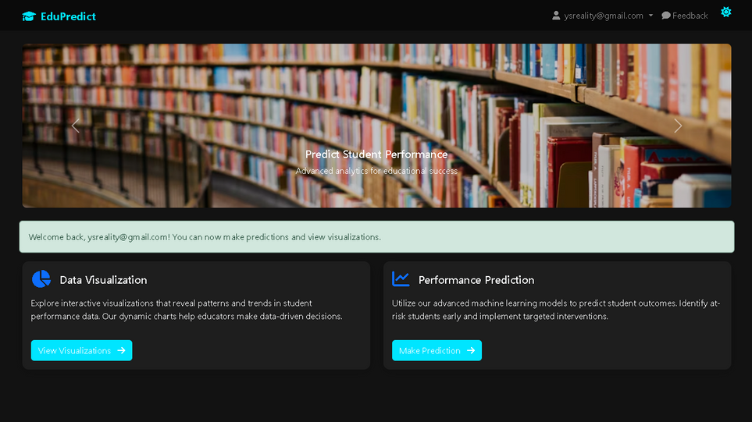
YEAR
PRESENTERS
2025
STUDENTS OF SIR ASEEF AHMED
EDUCATION PREDICTION
Big Data
BATCH COORDINATOR
Miss Iqra Khan

Slide 2
01
02
03
WELCOME!
Introduction
Introduction
AI Functionalities
Other Functionalities
Project Description
Conclusion and Future Scope
Visualizations
Machine Learning Model
OTP-based Email Verification
Feedback System
Security and Session Management
Report Generation (PDFs)
NEXT

Slide 3
Summary
Problem Statement
INTRODUCTION
A web-based system to evaluate student data Predicts whether a student is likely to continue or drop out Stores and visualizes data per user Allows detailed reports (individual and all) in downloadable PDF format
Education institutions worldwide face numerous challenges, such as declining student retention rates, inefficient resource allocation, and the need to personalize learning experiences. At the same time, advancements in technology and data availability present significant opportunities to address these challenges through data-driven approaches.
Project Description
NEXT

Slide 4
INTRODUCTION
Visualization
Interactive graphs such as pie charts, scatter plots, bar charts, heatmaps, and violin plots offer a deep dive into performance trends and metrics correlations.
1
2
Libraries Used
Types of Visuals:
Matplotlib & Seaborn
Pie Chart: Prediction Distribution
Scatter Plot: Test Scores vs Attendance
Bar Chart: Feature Importance
Heatmap: Feature Correlation
Histogram: Study Hours Distribution
Boxplot & Violin Plot: Metrics by Prediction
Stacked Bar: Performance Metrics Comparison
NEXT

Slide 5


MODEL USED
Random Forest Classifier
Features Used for Training:
Prediction Labels:
Test Scores
Attendance
Number of Absences
Homework Completion
Participation
Study Hours per Week
"Continue Studies"
"Likely to Dropout"
NEXT

Slide 6
WHY USING
Random Forest Classifier
Random Forest is not just a tree — it’s a forest of intelligence.
1
2
3
Output is Categorical, Not Continuous
Better Suitability for Binary Decisions
Interpretability of Results
We're not predicting a score like "88.7" or "67.5%".
We're assigning one of two distinct labels (classes).
Classifiers like Random Forest are built to split decisions and separate groups.
"Dropout" vs "Not Dropout" is easier to understand for users and educators.
Regression would give uncertain numeric thresholds.
NEXT

Slide 7


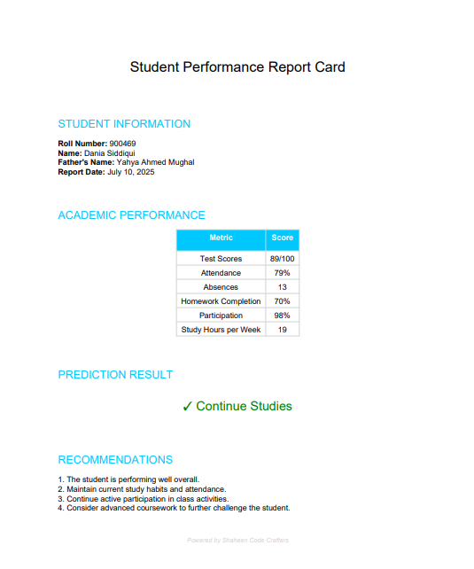
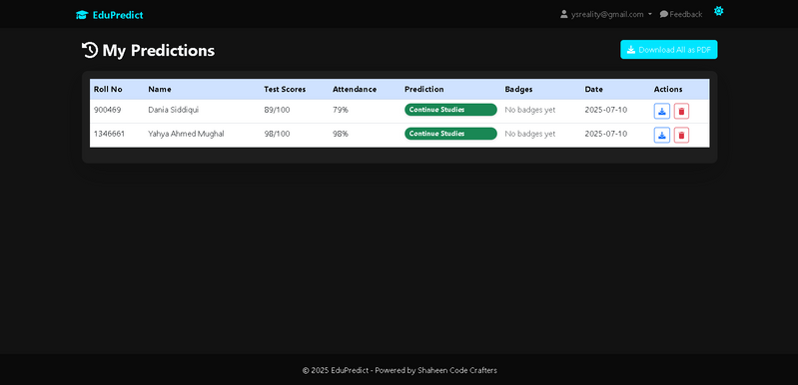
GENERATION OF
Report
ReportLab
Individual Student Report
Users can generate and download personalized or all-in-one reports showing academic performance, prediction results, and improvement recommendations.
All Predictions Report
NEXT

Slide 8
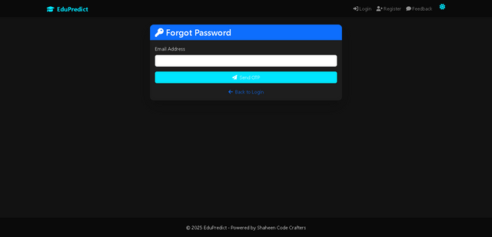
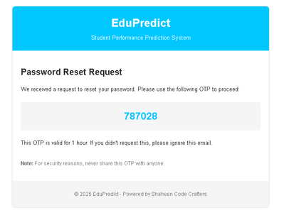


01
Forgot Password Functionality
In Case of Forgetting Password User Can Request For Password Updation Facility.
INTRODUCTION TO
OTP-based
02
OTP
By Requesting For Updating Password User will receive a 6-digit random number
Email Verification
03
OTP Expiry Time Duration
Requested OTP can only be Active For 1 hr
NEXT

Slide 9
OTHER
Notable Features
NEXT

Slide 10

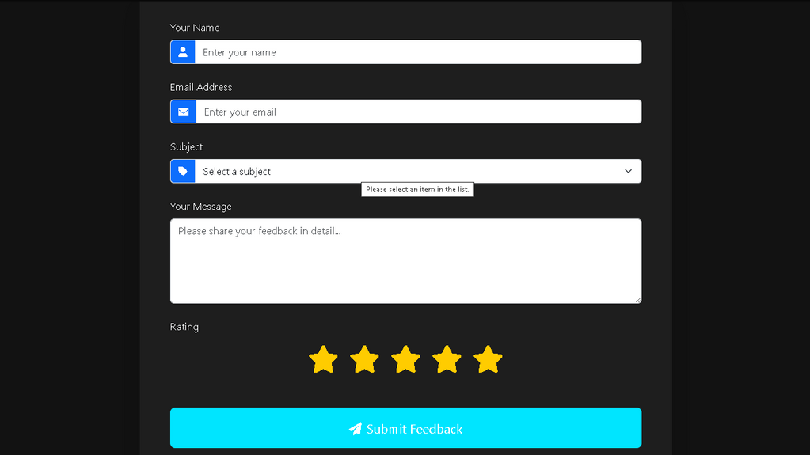
FORM FOR
Feedback

Slide 11
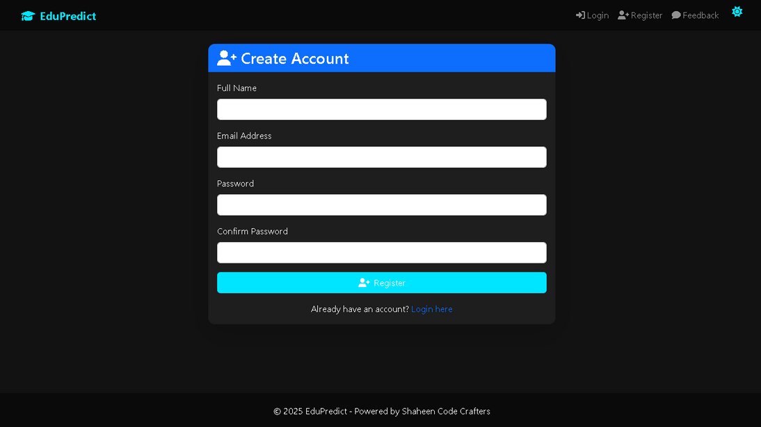
LOGIN/REGISTER WITH
Security & Sessions
Passwords stored using generate_password_hash()
Login state maintained via Flask Sessions
All routes like /predict, /visualization, /download_report, etc., are protected
MongoDB access with TLS and certificate validation
NEXT

Slide 12
WORK
Distribution
01.
DANIA SIDDIQUI
Tableau Dashboard
Machine learning algorithms
Training and Testing of Machine Learning Model
Code Testing and SQA
03.
05.
07.
ZAINAB
SYED USMAN AHMED
SYED MUHAMMAD FURQAN .
Developer Guide
Dataset Management and Correction
Documentations and Status Report Creation
User Guide
02.
04.
06.
YAHYA AHMED MUGHAL
HAMZA
HAMMAD RAJPUT
Data Collection
Dataset Creation
Status Reports
Developer Guide
Python App Design
Python App Development
Error Handling
Connection with Machine Learning Model
NEXT

Slide 13
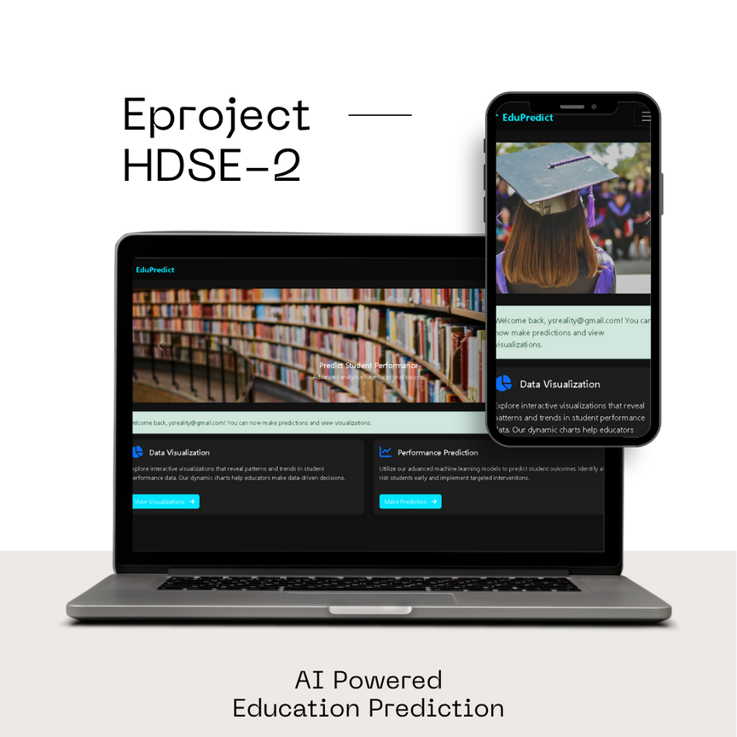
Thank You
If you have any Queries You can ask
aseefahmed@contour-software.com

