Slide 1

Hands–On Workshop
Environmental Data Collection, Management, and Analysis
with Python & R
Assoc. Prof. Dr. Yusri Yusup & Dr. Ninu Krishnan
Environmental Technology, School of Industrial Technology

Slide 2
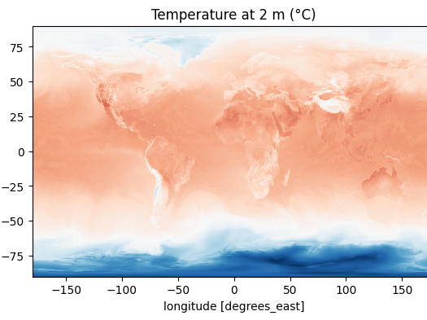
Introduction to Environmental Data Analysis with ERA5
Python (Colab) & R (RStudio Cloud)

Slide 3
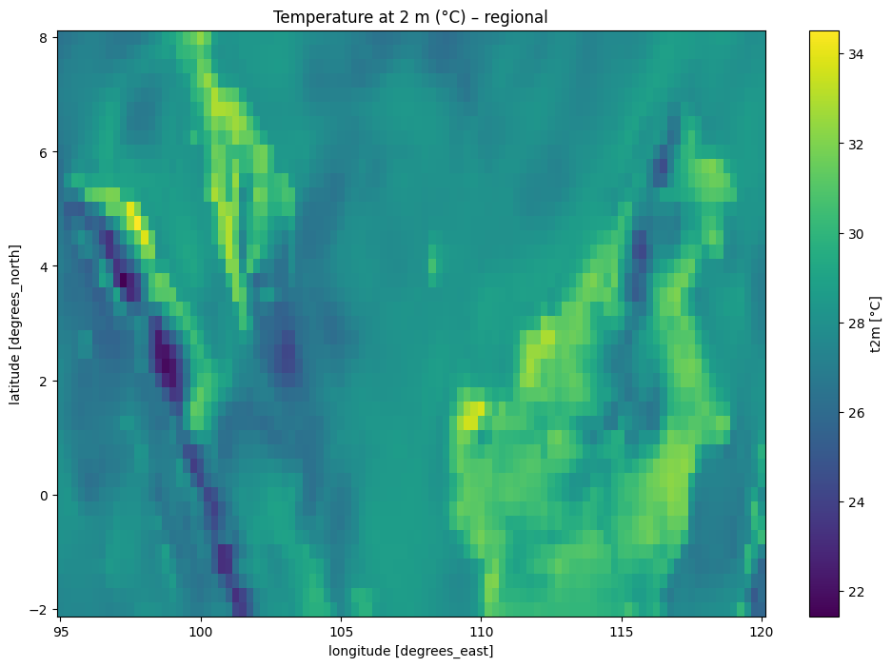
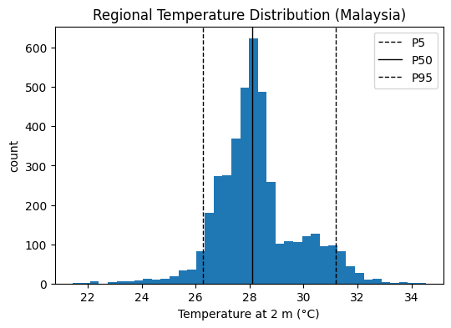
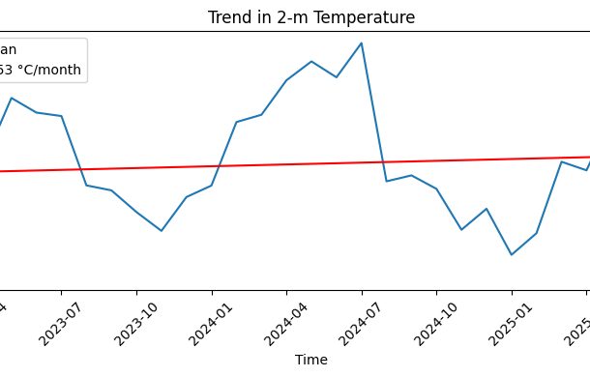
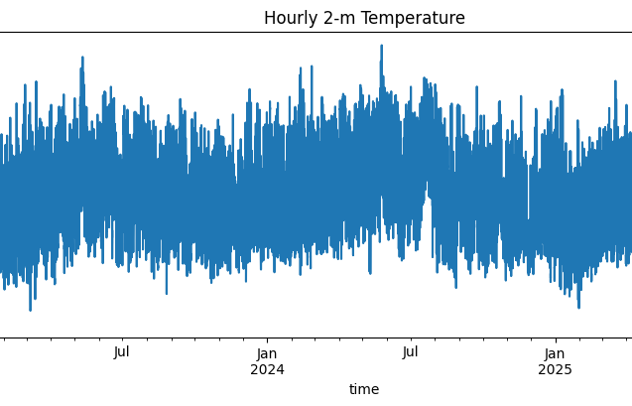

Slide 4
Learning Objectives
Understand ERA5 "reanalysis" data.
Run analysis in the cloud (Google Colab, RStudio Cloud).
Use Python and R,
To perform time series analysis on ERA5
To create spatial visualizations (maps)

Slide 5
What is Reanalysis Data?
Reanalysis data is
A comprehensive, gridded, and temporally consistent record of past weather and climate by combining historical observations with modern numerical weather prediction (NWP) models through data assimilation.
The result is a globally complete dataset that provides the best estimate of the state of the atmosphere, land surface, and oceans at any point in time (ECMWF, 2023, NOAA NCEI, 2023).

Slide 6
Examples of Reanalysis Data
ERA5 (1940-present; ~31km)
ERA5-Land (1950-present; ~9km)
ERA-Interim (1979 – 2019; 80km)
MERAA- 2 (1980 – present; 50km)
JRA-55 (1958-present; 55km)
NCEP/NCAR(R1) (1948-present; 210km)
NCEP-DOE(R2) (1979-present; 210km)
CFSR/CFSv2, 20CRv3,20CRv2c

Slide 7
Module 1: ERA5 Overview & Cloud Setup
ERA5 reanalysis: global climate dataset
Coverage: 1940–present,
Hourly (single and 37-pressure level (1 to 1000hPa)
Global, ~31 km resolution
Variables: temperature, precipitation, wind, etc.
Format: GRIB and NetCDF (multi-dimensional data)
Access: Copernicus Climate Data Store (CDS)

Slide 8
Accessing ERA5 Data
Visit the ECMWF website https://www.ecmwf.int/
Create a free account.
Go to Forecasts → Datasets → Archived data → popular: ERA5 →Climate Data Store
Choose ERA5 hourly time-series data on single levels from 1940 to present.
Coordinate: 5.35776, 100.30193 (5.5, 100.25)
Explore the data available
Download the time series data.

Slide 9
Module 2: Time Series Analysis
Python: analyze time series, plot (matplotlib)
R: analyze and plot time series (ggplot2, ts objects)
Hands-On Exercise: Analyze for trend, seasonality, variability.

Slide 10
Prerequisites
Requirement: Have a Google account.
Create accounts for Google Colab and RStudio. Cloud by signing up using your Google account.
Google Colab: https://colab.research.google.com/
RStudio Cloud: https://posit.cloud

Slide 11
Uploading Data to Google Drive
Go to https://drive.google.com
Take note of the folder you place your data.
Settings > General > Uploads: Untick Convert uploads to Google Docs editor format.

Slide 12
Continue the Analysis on Google Colab

Slide 13
Module 3: Spatial Analysis
Python: quick map with xarray.plot; advanced with Cartopy.
R: quick raster map plotting; optional ggplot2/tmap
Hands-On Exercise: Analyze gridded data, maps.

Slide 14
What is GRIB File?
Short for GRIdded Binary.
A file format used in meteorology and climate science to store large volumes of gridded data.
Self-describing, includes metadata (e.g., variable name, units, level, time) along with the data itself.

Slide 15
Continue the Analysis on Google Colab

Slide 16
Wrap-Up
Skills learned:
ERA5 basics
time series
mapping

