Slide 1
REddyProc for Eddy Covariance Data Analysis
Yusri Yusup

Slide 2
Acknowledgements
This content was built on top of the talk by Thomas Wutzler. Credit goes to him for his:
Presentation at (https://www.youtube.com/watch?v=-b0vc4u8kls&t=354s) and
Material at https://github.com/bgctw/EGU19EddyCourse/blob/master/Source/DEGebExample_complete.Rmd.
You can view more details about the package at https://bgc.iwww.mpg.de/5622399/REddyProc.

Slide 3
Prerequisites
Knowledge
It would be easier for you to follow the talk if you have brief backgrounds on:
R language
Eddy covariance
Net Ecosystem Exchange
Software
You would need the software below to perform the steps discussed in the talk.
R
RStudio
Packages: REddyProc

Slide 4
Introduction to the REddyProc Package: When Do We Use It?
The REddyProc package become useful after the pre-processing of the raw, high-frequency eddy covariance data.
Using software, such as EddyPro, the data was already quality-checked using protocols, e.g., 0-1-2, 0-9 quality flag systems, etc.
We use this package to:
Post-process the Net Ecosystem Exchange (NEE) data.
Estimate NEE, e.g., the annual, seasonal sums.
Determine the contributions of processes within NEE, e.g., production and respiration.

Slide 5
Steps in Using REddyProc
There are three main steps in a typical REddyProc analysis workflow.
Check for under-developed turbulence or low friction velocity ($u_{*}$).
The package can suggest threshold values of $u_{*}$.
Fill gaps introduced due to the discarding of fluxes below the thresholds.
Separating fluxes into groups: Gross Primary Production (GPP) and Ecosystem Resipiration ($R_{eco}$).

Slide 6
Learning Outcomes
At the end of the walk-through, you would be able to:
Understand the functions of the REddyProc package.
Explain the analysis steps of the package.

Slide 7
Step 0: Preliminary Work
Install the Package
The package needs to be installed prior to use. You might also need to install other packages to run REddyProc. You can do so by using the install.packages command for their installation.
#install.packages("REddyProc", repos = "http://cran.us.r-project.org")
You will need to load the package after a successful installation.
library(REddyProc)

Slide 8
Step 1: Prepare the Data
Step 1-1: Import the Data
The eddy covariance data that will be used in this walk-through are included in the package. They are for demo purposes.
DEGebExample, the Gebesee, Germany, data from 2004 to 2006.
Example_DETha98, the Tharandt, Germany, data for the year 1998.
The full data is downloadable at http://www.europe-fluxdata.eu/home/ after registration.
Load the Gebesee data.
data(DEGebExample)
Load the Tharandt data.
data(Example_DETha98)

Slide 9
Data Overview: Gebesee
Get an overview of the data. Look at the data parameters and take note of missing data or NA.
The Gebesee, Germany, Data
Characteristics
Surface: Agriculture
Time zone: +1 GMT
Latitude, Longitude: 51.1N, 10.9E

Slide 10
Notice that VPD is not in the dataset.
summary(DEGebExample)
## DateTime NEE Ustar ## Min. :2004-01-01 00:30:00 Min. :-49.919 Min. :0.0000 ## 1st Qu.:2004-10-01 00:22:30 1st Qu.: -1.864 1st Qu.:0.0640 ## Median :2005-07-02 00:15:00 Median : 0.635 Median :0.1490 ## Mean :2005-07-02 00:15:00 Mean : -1.935 Mean :0.1884 ## 3rd Qu.:2006-04-02 00:07:30 3rd Qu.: 1.834 3rd Qu.:0.2800 ## Max. :2007-01-01 00:00:00 Max. : 19.008 Max. :2.0450 ## NA's :21849 NA's :1149 ## Tair rH Rg ## Min. :-16.710 Min. : 15.87 Min. : 0.00 ## 1st Qu.: 3.360 1st Qu.: 66.61 1st Qu.: 0.00 ## Median : 9.970 Median : 79.10 Median : 2.04 ## Mean : 9.664 Mean : 75.24 Mean : 124.71 ## 3rd Qu.: 15.520 3rd Qu.: 87.07 3rd Qu.: 176.03 ## Max. : 34.680 Max. :100.00 Max. :1046.03 ## NA's :1

Slide 11
Data Overview: Tharandt
The Tharandt, Germany, Data
Characteristics
Surface: Forest
Time zone: +2 GMT
Latitude, Longitude: 51.0N, 13.6E

Slide 12
Note that the timestamp is not in REddyProc-usable format.
names(Example_DETha98)
## [1] "Year" "DoY" "Hour" "NEE" "LE" "H" "Rg" "Tair" "Tsoil" ## [10] "rH" "VPD" "Ustar"
head(Example_DETha98)
## Year DoY Hour NEE LE H Rg Tair Tsoil rH VPD Ustar ## 1 1998 1 0.5 -1.21 1.49 -11.77 0 7.4 4.19 55.27 4.6 0.72 ## 2 1998 1 1.0 1.72 3.80 -13.50 0 7.5 4.20 55.95 4.6 0.52 ## 3 1998 1 1.5 NA 1.52 -18.30 0 7.1 4.22 57.75 4.3 0.22 ## 4 1998 1 2.0 NA 3.94 -17.47 0 6.6 4.23 60.20 3.9 0.20 ## 5 1998 1 2.5 2.55 8.30 -21.42 0 6.6 4.22 59.94 3.9 0.33 ## 6 1998 1 3.0 NA 1.33 -20.55 0 6.5 4.21 59.25 4.0 0.15

Slide 13
Important Parameters
Parameters required for REddyProc are:
DateTime in the POSIX format.
NEE or carbon dioxide flux.
Ustar or friction velocity
Meteorological data for the gap-filling and partitioning steps.
Rg, *Tair,
rH, and or
VPD
Note that:
Rg is global solar radiation.
Tair is air temperature.
rH is relative humidity.
VPD is vapor pressure deficit.

Slide 14
Step 1-2: Calculate Needed Parameters
Essential parameters can be calculated from existing parameters using functions available in REddyProc.
Some useful functions are:
fConvertTimeToPosix. We will use this in the demo.
fCalcVPDfromRHandTair. We will use this in the demo.
fCalcETfromLE
fConvertCtoK
There are other functions in the package and the function name begins with the prefix f.

Slide 15
Step 1-3-1: Tharandt Dataset: Addressing the Unsupported Timestamp Format
In the Tharandt dataset, the date-time columns are not suitable for REddyProc. It needs to be converted to the POSIX format.
head(Example_DETha98)
## Year DoY Hour NEE LE H Rg Tair Tsoil rH VPD Ustar ## 1 1998 1 0.5 -1.21 1.49 -11.77 0 7.4 4.19 55.27 4.6 0.72 ## 2 1998 1 1.0 1.72 3.80 -13.50 0 7.5 4.20 55.95 4.6 0.52 ## 3 1998 1 1.5 NA 1.52 -18.30 0 7.1 4.22 57.75 4.3 0.22 ## 4 1998 1 2.0 NA 3.94 -17.47 0 6.6 4.23 60.20 3.9 0.20 ## 5 1998 1 2.5 2.55 8.30 -21.42 0 6.6 4.22 59.94 3.9 0.33 ## 6 1998 1 3.0 NA 1.33 -20.55 0 6.5 4.21 59.25 4.0 0.15

Slide 16
Convert the Timestamp to POSIX
We can convert the timestamp using the fConvertTimeToPosix function. It will add the DateTime column into the data frame.
The 'YDH' means Year-Day-Hour, and the Year, Day, and Hour arguments require the columns that contains the Year, DoY, and Hour information.
You can find other valid time configurations in the documentation by running the command ?fConvertTimeToPosix.

Slide 17
Example_DETha98V1 <- fConvertTimeToPosix(Example_DETha98, TFormat = c('YDH'), Year = 'Year', Day = 'DoY', Hour = 'Hour')
## Converted time format 'YDH' to POSIX with column name 'DateTime'.
head(Example_DETha98V1)
## DateTime Year DoY Hour NEE LE H Rg Tair Tsoil rH VPD ## 1 1998-01-01 00:30:00 1998 1 0.5 -1.21 1.49 -11.77 0 7.4 4.19 55.27 4.6 ## 2 1998-01-01 01:00:00 1998 1 1.0 1.72 3.80 -13.50 0 7.5 4.20 55.95 4.6 ## 3 1998-01-01 01:30:00 1998 1 1.5 NA 1.52 -18.30 0 7.1 4.22 57.75 4.3 ## 4 1998-01-01 02:00:00 1998 1 2.0 NA 3.94 -17.47 0 6.6 4.23 60.20 3.9 ## 5 1998-01-01 02:30:00 1998 1 2.5 2.55 8.30 -21.42 0 6.6 4.22 59.94 3.9 ## 6 1998-01-01 03:00:00 1998 1 3.0 NA 1.33 -20.55 0 6.5 4.21 59.25 4.0 ## Ustar ## 1 0.72 ## 2 0.52 ## 3 0.22 ## 4 0.20 ## 5 0.33 ## 6 0.15

Slide 18
Step 1-3-2: Missing VPD in the Gebesee Data
The Gebesee dataset does not have the VPD parameter, which could be useful for gap-filling and partitioning.
head(DEGebExample)
## DateTime NEE Ustar Tair rH Rg ## 35041 2004-01-01 00:30:00 NA 0.092 -0.06 96.13 0 ## 35042 2004-01-01 01:00:00 NA 0.090 -0.14 96.10 0 ## 35043 2004-01-01 01:30:00 NA 0.023 -0.16 95.93 0 ## 35044 2004-01-01 02:00:00 NA 0.038 -0.17 95.80 0 ## 35045 2004-01-01 02:30:00 NA 0.077 -0.19 95.67 0 ## 35046 2004-01-01 03:00:00 NA 0.025 -0.23 95.47 0

Slide 19
Calculate VPD
We can calculate VPD using the function fCalcVPDfromRHandTair. The input arguments’ units are stated in the documentation, ?fCalcVPDfromRHandTair.
VPD <- fCalcVPDfromRHandTair(DEGebExample$rH, # The unit is % DEGebExample$Tair) # The unit is degree Celsius DEGebExampleV1 <- cbind(DEGebExample,VPD) rm(VPD) # A house-keeping step. head(DEGebExampleV1)
## DateTime NEE Ustar Tair rH Rg VPD ## 35041 2004-01-01 00:30:00 NA 0.092 -0.06 96.13 0 0.2353394 ## 35042 2004-01-01 01:00:00 NA 0.090 -0.14 96.10 0 0.2357827 ## 35043 2004-01-01 01:30:00 NA 0.023 -0.16 95.93 0 0.2457012 ## 35044 2004-01-01 02:00:00 NA 0.038 -0.17 95.80 0 0.2533640 ## 35045 2004-01-01 02:30:00 NA 0.077 -0.19 95.67 0 0.2608249 ## 35046 2004-01-01 03:00:00 NA 0.025 -0.23 95.47 0 0.2720758

Slide 20
Step 2: Create the Gebesee REddyProc Object Class
Before REddyProc can work on your data, the data has to be converted to the REddyProc object.
Create the data object for the Gebesee data. The ID is DE-Geb and the parameters are:
NEE
Rg
Tair
VPD
Ustar
EProcDEGeb <- sEddyProc$new('DE-Geb', DEGebExampleV1, c('NEE','Rg','Tair','VPD','Ustar'))
## New sEddyProc class for site 'DE-Geb'

Slide 21
Check the Object
Check the additional info of the data.
EProcDEGeb$sLOCATION
## $LatDeg ## [1] NA ## ## $LongDeg ## [1] NA ## ## $TimeZoneHour ## [1] NA

Slide 22
Add the location information. This is important for the daytime-nighttime partitioning analysis because it requires the time to be accurate.
EProcDEGeb$sSetLocationInfo(LatDeg = 51.1, LongDeg = 10.9, TimeZoneHour = 1) EProcDEGeb$sLOCATION
## $LatDeg ## [1] 51.1 ## ## $LongDeg ## [1] 10.9 ## ## $TimeZoneHour ## [1] 1

Slide 23
Step 2: Create the Tharandt REddyProc Object Class
Create the class for the Tharandt data. The ID is DE-Tha and the parameters are:
Net Ecosystem Exchange: NEE
Global Radiation: Rg
Air temperature: Tair
Vapor pressure deficit: VPD
Friction velocity: Ustar
EProcDETha <- sEddyProc$new('DE-Tha', Example_DETha98V1, c('NEE','Rg','Tair','VPD','Ustar'))
## New sEddyProc class for site 'DE-Tha'

Slide 24
Check the Object
Check the additional info of the data.
EProcDETha$sLOCATION
## $LatDeg ## [1] NA ## ## $LongDeg ## [1] NA ## ## $TimeZoneHour ## [1] NA

Slide 25
Add the location information.
EProcDETha$sSetLocationInfo(LatDeg = 51.0, LongDeg = 13.6, TimeZoneHour = 2) EProcDETha$sLOCATION
## $LatDeg ## [1] 51 ## ## $LongDeg ## [1] 13.6 ## ## $TimeZoneHour ## [1] 2

Slide 26
Step 3: u*-Threshold Estimation
Year | Start Day
2004 | 70, 210, 320
2005 | 70, 180, 320
2006 | 120, 350
Friction velocity, or $u_{*}$, varies seasonally at Gebesee. Thus, the $u_{*}$-threshold needs to be estimated for each season. We do this because $u_{*}$ changes with surface cover.
A previous study determined the days on which the seasons and $u_{*}$ shifted. It can be determined by the visual inspection of the data.

Slide 27
Step 3-1-2: Adding the Start Days for the Gebesee Data.
Create a data frame for the start days.
df_startDays <- data.frame(day=c(70,210,320,70,180,320,120,305), year=c(2004,2004,2004,2005,2005,2005,2006,2006)) df_startDays
## day year ## 1 70 2004 ## 2 210 2004 ## 3 320 2004 ## 4 70 2005 ## 5 180 2005 ## 6 320 2005 ## 7 120 2006 ## 8 305 2006

Slide 28
Creating the Seasonal Factors for Row-Tagging
We can use usCreateSeasonFactorYdayYear to change the df_startDays data frame to a factor vector that contains values that tag each rows to their respective seasons.
Create the factor vector.
Note that the product 15*60 is used to make the time be between 00:00 and 00:30.
The summary shows that there are 3312 observations for season 2004001, i.e., between days 1 and 70, etc.
seasonFactor <- usCreateSeasonFactorYdayYear(DEGebExampleV1$DateTime - 15*60, starts = df_startDays)

Slide 29
## 2004001 2004070 2004210 2004320 2005070 2005180 2005320 2006120 2006305 ## 3312 6720 5280 5568 5280 6720 7920 8880 2928
## [1] 2004001 2004001 2004001 2004001 2004001 2004001 ## 9 Levels: 2004001 2004070 2004210 2004320 2005070 2005180 2005320 ... 2006305

Slide 30
Optional: Viewing the Gebesee Data with Season Demarcation-Lines
Because the start days data frame is a collection of integers, we need to change it to the POSIX format.
Create timestamps in the POSIX format from df_startDays. Here, we embed a new data frame with the additional column Hour into the fConvertTimeToPosix function call. The hour is set at 0.25 to be between 00:00 and 00:30, i.e., 00:15.

Slide 31
seasonStartsDate <- fConvertTimeToPosix(data.frame(Year = df_startDays$year, DoY = df_startDays$day, Hour = 0.25), TFormat = 'YDH', Year = "Year", Day = "DoY", Hour = "Hour")
## Converted time format 'YDH' to POSIX with column name 'DateTime'.
seasonStartsDate
## DateTime Year DoY Hour ## 1 2004-03-10 00:15:00 2004 70 0.25 ## 2 2004-07-28 00:15:00 2004 210 0.25 ## 3 2004-11-15 00:15:00 2004 320 0.25 ## 4 2005-03-11 00:15:00 2005 70 0.25 ## 5 2005-06-29 00:15:00 2005 180 0.25 ## 6 2005-11-16 00:15:00 2005 320 0.25 ## 7 2006-04-30 00:15:00 2006 120 0.25 ## 8 2006-11-01 00:15:00 2006 305 0.25

Slide 32
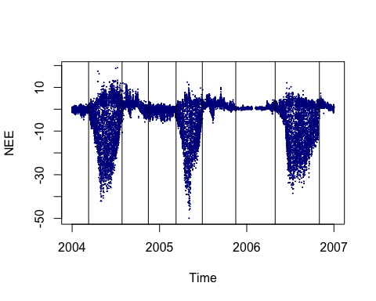
You can check the dates by plotting them on the time series.
plot(DEGebExample$DateTime, DEGebExample$NEE, pch=19, xlab = "Time", ylab = 'NEE', cex = 0.1, col = "darkblue") abline(v = seasonStartsDate$DateTime)

Slide 33
Step 3-2-2: Calculate the u*-Thresholds Distributions
We will estimate the ($u_{*}$) limits using the sEstimateUstarScenarios function. The function will write to the data object. The seasonFactor is needed here to tell REddyProc the season intervals that it must estimate the $u_{*}$ thresholds.
The $u_{*}$ threshold estimation uses the usEstUstarThreshold function, which requires the NEE, Tair, and seasonFactor. The function returns the median value.

Slide 34
The u*-Threshold Distributions
In this example, the $u_{*}$-threshold is estimated, using the usEstUstarThreshold function, 30 times, and the $u_{*}$ limits are reported using the default quantiles of 5%, 50%, and 95%: The low, median, and high values of $u_{*}$-threholds.
The function adds data to the REddyProc object. It creates the $u_{*}$ scenarios and place it in the object.
EProcDEGeb$sEstimateUstarScenarios(seasonFactor = seasonFactor, nSample = 30, probs = c(0.05,0.50,0.95))
##
## Estimated UStar distribution of: ## uStar 5% 50% 95% ## 1 0.1604118 0.1248513 0.1557158 0.1921264 ## by using 30 bootstrap samples and controls: ## taClasses UstarClasses ## 7 20 ## swThr minRecordsWithinTemp ## 10 100 ## minRecordsWithinSeason minRecordsWithinYear ## 160 3000 ## isUsingOneBigSeasonOnFewRecords ## 1

Slide 35
Viewing the Results
The function sGetEstimatedUstarThresholdDistribution displays the results.
Useful functions for handling the data in the object:
sExportData: Export class internal sDATA data frame.
sExportResults: Export class internal sTEMP data frame with result columns. We can use this after gap-filling the data.
Note that you can create the plots of NEE versus ($u_{*}$) by using the function sPlotNEEVersusUStarForSeason.

Slide 36
EProcDEGeb$sGetEstimatedUstarThresholdDistribution()
## aggregationMode seasonYear season uStar 5% 50% ## 1 single NA <NA> 0.16041176 0.12485128 0.15571577 ## 2 year 2004 <NA> 0.13500000 0.12221000 0.15040278 ## 3 year 2005 <NA> 0.16041176 0.12356256 0.15031920 ## 4 year 2006 <NA> 0.25094444 0.06093690 0.21282986 ## 5 season 2004 2004001 0.13500000 0.10055500 0.12953846 ## 6 season 2004 2004070 0.12037500 0.09047188 0.10755000 ## 7 season 2004 2004210 0.08925000 0.08805750 0.12531944 ## 8 season 2005 2004320 0.16041176 0.09593319 0.13635415 ## 9 season 2005 2005070 0.12533333 0.10440079 0.14273214 ## 10 season 2005 2005180 0.13473214 0.07952335 0.11585714 ## 11 season 2006 2005320 0.04842361 0.04659865 0.06208750 ## 12 season 2006 2006120 0.06966667 0.05801250 0.07086364 ## 13 season 2006 2006305 0.25094444 0.08255000 0.22000000 ## 95% ## 1 0.19212639 ## 2 0.19702500 ## 3 0.17686354 ## 4 0.27135250 ## 5 0.18061361 ## 6 0.12700694 ## 7 0.19205000 ## 8 0.19242701 ## 9 0.16996250 ## 10 0.15067054 ## 11 0.09087500 ## 12 0.09068636 ## 13 0.27394750

Slide 37
Step 4-1: Gap-Filling the Gebesee Data
Step 4-1-1: Check the Use of Seasonal ($u_{*}$) Thresholds
First, we have to ensure the use of seasonal $u_{*}$-thresholds. If it is not set in the previous step, check that it is used now.

Slide 38
Show the default thresholds: annual
EProcDEGeb$sGetUstarScenarios()
## season uStar U05 U50 U95 ## 1 2004001 0.1350000 0.1222100 0.1504028 0.1970250 ## 2 2004070 0.1350000 0.1222100 0.1504028 0.1970250 ## 3 2004210 0.1350000 0.1222100 0.1504028 0.1970250 ## 4 2004320 0.1604118 0.1235626 0.1503192 0.1768635 ## 5 2005070 0.1604118 0.1235626 0.1503192 0.1768635 ## 6 2005180 0.1604118 0.1235626 0.1503192 0.1768635 ## 7 2005320 0.2509444 0.0609369 0.2128299 0.2713525 ## 8 2006120 0.2509444 0.0609369 0.2128299 0.2713525 ## 9 2006305 0.2509444 0.0609369 0.2128299 0.2713525

Slide 39
Instruct REddyProc to use the seasonal thresholds.
EProcDEGeb$useSeaonsalUStarThresholds()

Slide 40
Confirm that the seasonal thresholds are used by displaying it.
EProcDEGeb$sGetUstarScenarios()
## season uStar U05 U50 U95 ## 5 2004001 0.13500000 0.10055500 0.12953846 0.18061361 ## 6 2004070 0.12037500 0.09047188 0.10755000 0.12700694 ## 7 2004210 0.08925000 0.08805750 0.12531944 0.19205000 ## 8 2004320 0.16041176 0.09593319 0.13635415 0.19242701 ## 9 2005070 0.12533333 0.10440079 0.14273214 0.16996250 ## 10 2005180 0.13473214 0.07952335 0.11585714 0.15067054 ## 11 2005320 0.04842361 0.04659865 0.06208750 0.09087500 ## 12 2006120 0.06966667 0.05801250 0.07086364 0.09068636 ## 13 2006305 0.25094444 0.08255000 0.22000000 0.27394750

Slide 41
Step 4-1-2: Gap-Fill the Gebesee Data
Gap-fill the data using the function sMDSGapFillUStarScens. It will filter the data using the $u_{*}$-thresholds and gap-fill it.
MDS means Marginal Distribution Sampling, which combines:
the Look Up Table (LUT)
Mean Diurnal Course (MDC)
Quality flags are created for the gap-filled data:
0: original data
1: good quality gap-filled data, i.e., more parameters and shorter time-windows used.
More than 1: low quality, i.e., less parameters and longer time-windows used.
The function also calculates the random error for non-gap records by replacing the original values with gap-filled values.
EProcDEGeb$sMDSGapFillUStarScens("NEE", FillAll = TRUE)

Slide 42
Check the New Columns
Check the columns created. Examples are:
NEE_05_f
NEE_95_fall
NEE_50_fqc
Definitions:
NEE__f: gaps replaced by modeled values (gap-filled).
NEE__fall: all NEE replaced by modeled values.
NEE__fqc: quality flag: 0 observations, 1 good quality of gap-filling.
The non-bootstrapped data has the uStar suffix.
The bootstrapped data has the scenario suffix, e.g., U50, U95, etc.

Slide 43
colnames(EProcDEGeb$sExportResults())
## [1] "season" "Ustar_uStar_Thres" "Ustar_uStar_fqc" ## [4] "NEE_uStar_orig" "NEE_uStar_f" "NEE_uStar_fqc" ## [7] "NEE_uStar_fall" "NEE_uStar_fall_qc" "NEE_uStar_fnum" ## [10] "NEE_uStar_fsd" "NEE_uStar_fmeth" "NEE_uStar_fwin" ## [13] "Ustar_U05_Thres" "Ustar_U05_fqc" "NEE_U05_orig" ## [16] "NEE_U05_f" "NEE_U05_fqc" "NEE_U05_fall" ## [19] "NEE_U05_fall_qc" "NEE_U05_fnum" "NEE_U05_fsd" ## [22] "NEE_U05_fmeth" "NEE_U05_fwin" "Ustar_U50_Thres" ## [25] "Ustar_U50_fqc" "NEE_U50_orig" "NEE_U50_f" ## [28] "NEE_U50_fqc" "NEE_U50_fall" "NEE_U50_fall_qc" ## [31] "NEE_U50_fnum" "NEE_U50_fsd" "NEE_U50_fmeth" ## [34] "NEE_U50_fwin" "Ustar_U95_Thres" "Ustar_U95_fqc" ## [37] "NEE_U95_orig" "NEE_U95_f" "NEE_U95_fqc" ## [40] "NEE_U95_fall" "NEE_U95_fall_qc" "NEE_U95_fnum" ## [43] "NEE_U95_fsd" "NEE_U95_fmeth" "NEE_U95_fwin"

Slide 44
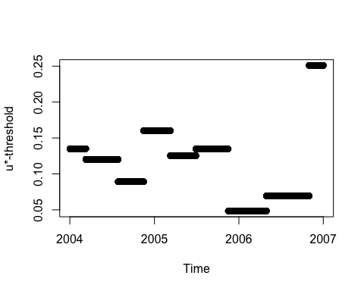
View Some Columns
Plotting a column of the REddyProc object.
plot(EProcDEGeb$sDATA$sDateTime, EProcDEGeb$sExportResults()$Ustar_uStar_Thres, pch = 19, xlab = 'Time', ylab = 'u*-threshold')

Slide 45
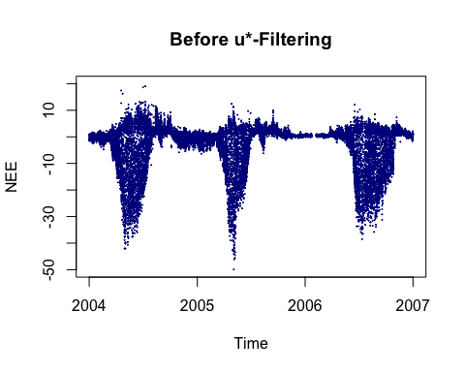
plot(DEGebExampleV1$DateTime,DEGebExampleV1$NEE, pch = 19, cex = 0.1, col = "darkblue", xlab = 'Time', ylab = 'NEE', ylim=c(-50,20), main = "Before u*-Filtering")

Slide 46
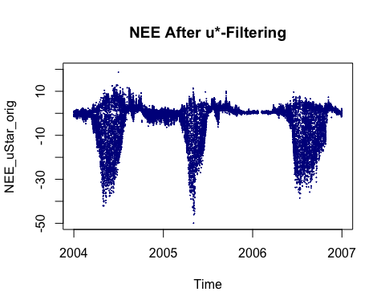
plot(EProcDEGeb$sDATA$sDateTime, EProcDEGeb$sExportResults()$NEE_uStar_orig, pch = 19, cex = 0.1, col = "darkblue", xlab = 'Time', ylab = 'NEE_uStar_orig', ylim=c(-50,20), main = "NEE After u*-Filtering")

Slide 47
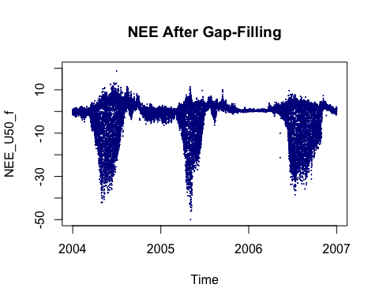
plot(EProcDEGeb$sDATA$sDateTime, EProcDEGeb$sExportResults()$NEE_U50_f, pch = 19, cex = 0.1, col = "darkblue", xlab = 'Time', ylab = 'NEE_U50_f', ylim=c(-50,20), main = "NEE After Gap-Filling")

Slide 48

plot(EProcDEGeb$sDATA$sDateTime, EProcDEGeb$sExportResults()$NEE_U50_fall, pch = 19, cex = 0.1, col = "darkblue", xlab = 'Time', ylab = 'NEE_U50_fall', ylim=c(-50,20), main = "NEE After Gap-Filling All")

Slide 49
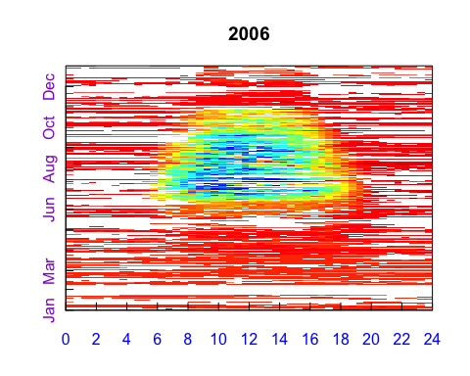
Step 4-1-3: Gebesee Fingerprint Plot
We can also generate a fingerprint plot using the function sPlotFingerprintY. This is for the NEE_U50_f parameter and the year 2004.
EProcDEGeb$sPlotFingerprintY('NEE_uStar_orig', Year = 2006)

Slide 50
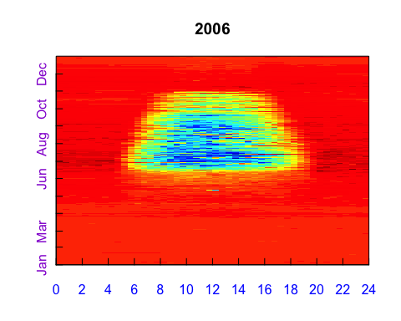
EProcDEGeb$sPlotFingerprintY('NEE_U50_f', Year = 2006)

Slide 51
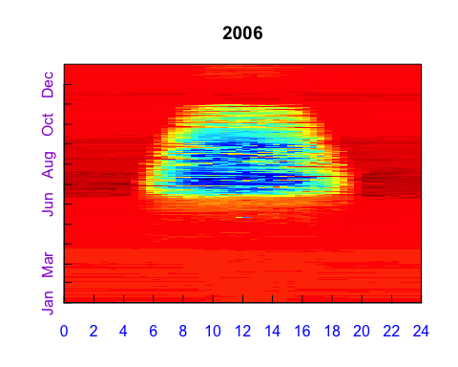
EProcDEGeb$sPlotFingerprintY('NEE_U50_fall', Year = 2006)

Slide 52
We can also produce PDF files with legend for all years in sub-directory “figs.”
EProcDEGeb$sPlotFingerprint('NEE_U50_f', Dir = "figs")
## sPlotFingerprint:::.self$.sxOpenPlot:::fSetFile::: Directory created: figs
## Saved plot to: figs/DE-Geb_04-06_FP_NEE_U50_f.pdf

Slide 53
Step 5-1: Gebesee Preparing the Data for Partitioning
This step requires the data to have the location (lat, lon) and time zone info because REddyProc uses time to estimate day and night hours. We already did this in the Step 2.
There are some weather values that are missing and can be gap-filled here. However, we do not need to replace the original values with gap-filled values because we are not going to calculate random error, FillAll = FALSE.
EProcDEGeb$sMDSGapFill('Rg', FillAll = FALSE) EProcDEGeb$sMDSGapFill('Tair', FillAll = FALSE) EProcDEGeb$sMDSGapFill('VPD', FillAll = FALSE)

Slide 54
Step 5-1-1: Gebesee Reichstein Partitioning
In this part, we will partition the data into fractions of the Gross Primary Production (GPP) and ecosystem respiration ($R_{eco}$) using all $u_{*}$ scenarios. This uses the ’sMRFluxPartitionUStarScens` function.
Results are added to the object.
More details on the equations used can be found in the paper Reichstein et al. (2005).
EProcDEGeb$sMRFluxPartitionUStarScens()

Slide 55
Step 5-1-2: Plotting the GPP
View the result columns. Columns [46] to [104] are added.
names(EProcDEGeb$sExportResults())
## [1] "season" "Ustar_uStar_Thres" "Ustar_uStar_fqc" ## [4] "NEE_uStar_orig" "NEE_uStar_f" "NEE_uStar_fqc" ## [7] "NEE_uStar_fall" "NEE_uStar_fall_qc" "NEE_uStar_fnum" ## [10] "NEE_uStar_fsd" "NEE_uStar_fmeth" "NEE_uStar_fwin" ## [13] "Ustar_U05_Thres" "Ustar_U05_fqc" "NEE_U05_orig" ## [16] "NEE_U05_f" "NEE_U05_fqc" "NEE_U05_fall" ## [19] "NEE_U05_fall_qc" "NEE_U05_fnum" "NEE_U05_fsd" ## [22] "NEE_U05_fmeth" "NEE_U05_fwin" "Ustar_U50_Thres" ## [25] "Ustar_U50_fqc" "NEE_U50_orig" "NEE_U50_f" ## [28] "NEE_U50_fqc" "NEE_U50_fall" "NEE_U50_fall_qc" ## [31] "NEE_U50_fnum" "NEE_U50_fsd" "NEE_U50_fmeth" ## [34] "NEE_U50_fwin" "Ustar_U95_Thres" "Ustar_U95_fqc" ## [37] "NEE_U95_orig" "NEE_U95_f" "NEE_U95_fqc" ## [40] "NEE_U95_fall" "NEE_U95_fall_qc" "NEE_U95_fnum" ## [43] "NEE_U95_fsd" "NEE_U95_fmeth" "NEE_U95_fwin" ## [46] "Rg_orig" "Rg_f" "Rg_fqc" ## [49] "Rg_fall" "Rg_fall_qc" "Rg_fnum" ## [52] "Rg_fsd" "Rg_fmeth" "Rg_fwin" ## [55] "Tair_orig" "Tair_f" "Tair_fqc" ## [58] "Tair_fall" "Tair_fall_qc" "Tair_fnum" ## [61] "Tair_fsd" "Tair_fmeth" "Tair_fwin" ## [64] "VPD_orig" "VPD_f" "VPD_fqc" ## [67] "VPD_fall" "VPD_fall_qc" "VPD_fnum" ## [70] "VPD_fsd" "VPD_fmeth" "VPD_fwin" ## [73] "PotRad_U05" "FP_NEEnight_U05" "FP_Temp_U05" ## [76] "E_0_U05" "R_ref_U05" "Reco_U05" ## [79] "GPP_U05_f" "GPP_U05_fqc" "PotRad_U50" ## [82] "FP_NEEnight_U50" "FP_Temp_U50" "E_0_U50" ## [85] "R_ref_U50" "Reco_U50" "GPP_U50_f" ## [88] "GPP_U50_fqc" "PotRad_U95" "FP_NEEnight_U95" ## [91] "FP_Temp_U95" "E_0_U95" "R_ref_U95" ## [94] "Reco_U95" "GPP_U95_f" "GPP_U95_fqc" ## [97] "PotRad_uStar" "FP_NEEnight_uStar" "FP_Temp_uStar" ## [100] "E_0_uStar" "R_ref_uStar" "Reco_uStar" ## [103] "GPP_uStar_f" "GPP_uStar_fqc"

Slide 56
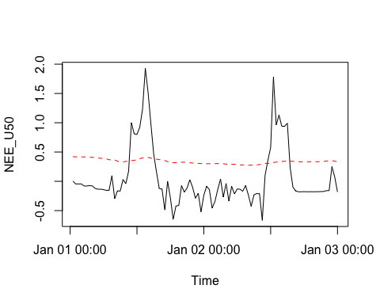
Plot the GPP and Reco
Plot the GPP and Reco for U50 scenario against time for two days (48*2).
nRec = 48*2 plot(head(DEGebExampleV1$DateTime, nRec), head(EProcDEGeb$sExportResults()$GPP_U50_f, nRec), type = "l", xlab = 'Time', ylab = 'NEE_U50') lines(head(DEGebExampleV1$DateTime, nRec), head(EProcDEGeb$sExportResults()$Reco_U50,nRec), type = "l", lty = 2, col = 'red')

Slide 57
Step 5-1-3: Gebesee Lasslop Partitioning
Partitioning the data into the fractions of the Gross Primary Production (GPP) and ecosystem respiration ($R_{eco}$) using all $u_{*}$ scenarios. This uses the ’sGLFluxPartitionUStarScens` function.
Results are added to the object.
More details on the equations used can be found in the Lasslop et al. (2010).

Slide 58
EProcDEGeb$sGLFluxPartitionUStarScens()
## Warning in sqrt(dsAssoc$wBefore^2 * varPred2[[1]][, "varGPP"] + ## dsAssoc$wAfter^2 * : NaNs produced

Slide 59
View the result columns. Columns [105] to [140] are added.
names(EProcDEGeb$sExportResults())
## [1] "season" "Ustar_uStar_Thres" "Ustar_uStar_fqc" ## [4] "NEE_uStar_orig" "NEE_uStar_f" "NEE_uStar_fqc" ## [7] "NEE_uStar_fall" "NEE_uStar_fall_qc" "NEE_uStar_fnum" ## [10] "NEE_uStar_fsd" "NEE_uStar_fmeth" "NEE_uStar_fwin" ## [13] "Ustar_U05_Thres" "Ustar_U05_fqc" "NEE_U05_orig" ## [16] "NEE_U05_f" "NEE_U05_fqc" "NEE_U05_fall" ## [19] "NEE_U05_fall_qc" "NEE_U05_fnum" "NEE_U05_fsd" ## [22] "NEE_U05_fmeth" "NEE_U05_fwin" "Ustar_U50_Thres" ## [25] "Ustar_U50_fqc" "NEE_U50_orig" "NEE_U50_f" ## [28] "NEE_U50_fqc" "NEE_U50_fall" "NEE_U50_fall_qc" ## [31] "NEE_U50_fnum" "NEE_U50_fsd" "NEE_U50_fmeth" ## [34] "NEE_U50_fwin" "Ustar_U95_Thres" "Ustar_U95_fqc" ## [37] "NEE_U95_orig" "NEE_U95_f" "NEE_U95_fqc" ## [40] "NEE_U95_fall" "NEE_U95_fall_qc" "NEE_U95_fnum" ## [43] "NEE_U95_fsd" "NEE_U95_fmeth" "NEE_U95_fwin" ## [46] "Rg_orig" "Rg_f" "Rg_fqc" ## [49] "Rg_fall" "Rg_fall_qc" "Rg_fnum" ## [52] "Rg_fsd" "Rg_fmeth" "Rg_fwin" ## [55] "Tair_orig" "Tair_f" "Tair_fqc" ## [58] "Tair_fall" "Tair_fall_qc" "Tair_fnum" ## [61] "Tair_fsd" "Tair_fmeth" "Tair_fwin" ## [64] "VPD_orig" "VPD_f" "VPD_fqc" ## [67] "VPD_fall" "VPD_fall_qc" "VPD_fnum" ## [70] "VPD_fsd" "VPD_fmeth" "VPD_fwin" ## [73] "PotRad_U05" "FP_NEEnight_U05" "FP_Temp_U05" ## [76] "E_0_U05" "R_ref_U05" "Reco_U05" ## [79] "GPP_U05_f" "GPP_U05_fqc" "PotRad_U50" ## [82] "FP_NEEnight_U50" "FP_Temp_U50" "E_0_U50" ## [85] "R_ref_U50" "Reco_U50" "GPP_U50_f" ## [88] "GPP_U50_fqc" "PotRad_U95" "FP_NEEnight_U95" ## [91] "FP_Temp_U95" "E_0_U95" "R_ref_U95" ## [94] "Reco_U95" "GPP_U95_f" "GPP_U95_fqc" ## [97] "PotRad_uStar" "FP_NEEnight_uStar" "FP_Temp_uStar" ## [100] "E_0_uStar" "R_ref_uStar" "Reco_uStar" ## [103] "GPP_uStar_f" "GPP_uStar_fqc" "PotRad_NEW" ## [106] "Reco_DT_U05" "GPP_DT_U05" "Reco_DT_U05_SD" ## [109] "GPP_DT_U05_SD" "Reco_DT_U50" "GPP_DT_U50" ## [112] "Reco_DT_U50_SD" "GPP_DT_U50_SD" "Reco_DT_U95" ## [115] "GPP_DT_U95" "Reco_DT_U95_SD" "GPP_DT_U95_SD" ## [118] "FP_VARnight" "FP_VARday" "NEW_FP_Temp" ## [121] "NEW_FP_VPD" "FP_RRef_Night" "FP_qc" ## [124] "FP_dRecPar" "FP_errorcode" "FP_GPP2000" ## [127] "FP_k" "FP_beta" "FP_alpha" ## [130] "FP_RRef" "FP_E0" "FP_k_sd" ## [133] "FP_beta_sd" "FP_alpha_sd" "FP_RRef_sd" ## [136] "FP_E0_sd" "Reco_DT_uStar" "GPP_DT_uStar" ## [139] "Reco_DT_uStar_SD" "GPP_DT_uStar_SD"

Slide 60
Plot the GPP and Reco for U50 scenario against time for two days (48*2).
nRec <- 48*2 plot(head(DEGebExampleV1$DateTime, nRec), head(EProcDEGeb$sExportResults()$GPP_U50_f,nRec), type = "l", xlab = 'Time', ylab = 'NEE_U50') lines(head(DEGebExampleV1$DateTime, nRec), head(EProcDEGeb$sExportResults()$Reco_U50,nRec), type = "l", lty = 2, col = 'red')

Slide 61
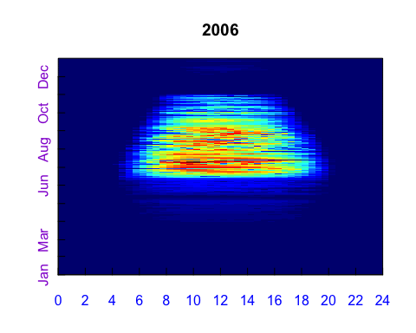
Step 5-1-4: Fingerprint Plots of GPP_DT and Reco_DT
The fingerprint plots can be plotted for the GPP and $R_{eco}$.
EProcDEGeb$sPlotFingerprintY('GPP_DT_U50', Year = 2006)

Slide 62
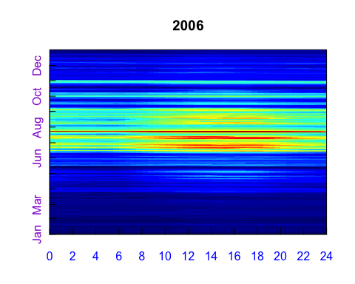
EProcDEGeb$sPlotFingerprintY('Reco_DT_U50', Year = 2006)

Slide 63
Step 5-1-5: Export the Gebesee Results
This part will produce a text file for analysis outside of R. It will be placed in the folder results.
GebData <- EProcDEGeb$sExportData() # Write the original data to GebData. GebResults <- EProcDEGeb$sExportResults() # Write the results of REddyProc to GebResults. GebCombResults <- cbind(GebData, GebResults) fWriteDataframeToFile(GebCombResults, "DE-Geb_Part.txt", Dir = "results")
## fWriteDataframeToFile:::fSetFile::: Directory created: results
## Number of NA convertered to '-9999': 1841044
## Wrote tab separated textfile: results/DE-Geb_Part.txt

Slide 64
Step 6-1: Gebesee: Bias with u*-Threshold
Calculating the Bias for the Year 2004
We will be calculating the bias of NEE due to the $u_{*}$-threshold for 2004.
Check the names of the columns of GebCombResults.
names(GebCombResults)
## [1] "DateTime" "NEE" "Rg" ## [4] "Tair" "VPD" "Ustar" ## [7] "season" "Ustar_uStar_Thres" "Ustar_uStar_fqc" ## [10] "NEE_uStar_orig" "NEE_uStar_f" "NEE_uStar_fqc" ## [13] "NEE_uStar_fall" "NEE_uStar_fall_qc" "NEE_uStar_fnum" ## [16] "NEE_uStar_fsd" "NEE_uStar_fmeth" "NEE_uStar_fwin" ## [19] "Ustar_U05_Thres" "Ustar_U05_fqc" "NEE_U05_orig" ## [22] "NEE_U05_f" "NEE_U05_fqc" "NEE_U05_fall" ## [25] "NEE_U05_fall_qc" "NEE_U05_fnum" "NEE_U05_fsd" ## [28] "NEE_U05_fmeth" "NEE_U05_fwin" "Ustar_U50_Thres" ## [31] "Ustar_U50_fqc" "NEE_U50_orig" "NEE_U50_f" ## [34] "NEE_U50_fqc" "NEE_U50_fall" "NEE_U50_fall_qc" ## [37] "NEE_U50_fnum" "NEE_U50_fsd" "NEE_U50_fmeth" ## [40] "NEE_U50_fwin" "Ustar_U95_Thres" "Ustar_U95_fqc" ## [43] "NEE_U95_orig" "NEE_U95_f" "NEE_U95_fqc" ## [46] "NEE_U95_fall" "NEE_U95_fall_qc" "NEE_U95_fnum" ## [49] "NEE_U95_fsd" "NEE_U95_fmeth" "NEE_U95_fwin" ## [52] "Rg_orig" "Rg_f" "Rg_fqc" ## [55] "Rg_fall" "Rg_fall_qc" "Rg_fnum" ## [58] "Rg_fsd" "Rg_fmeth" "Rg_fwin" ## [61] "Tair_orig" "Tair_f" "Tair_fqc" ## [64] "Tair_fall" "Tair_fall_qc" "Tair_fnum" ## [67] "Tair_fsd" "Tair_fmeth" "Tair_fwin" ## [70] "VPD_orig" "VPD_f" "VPD_fqc" ## [73] "VPD_fall" "VPD_fall_qc" "VPD_fnum" ## [76] "VPD_fsd" "VPD_fmeth" "VPD_fwin" ## [79] "PotRad_U05" "FP_NEEnight_U05" "FP_Temp_U05" ## [82] "E_0_U05" "R_ref_U05" "Reco_U05" ## [85] "GPP_U05_f" "GPP_U05_fqc" "PotRad_U50" ## [88] "FP_NEEnight_U50" "FP_Temp_U50" "E_0_U50" ## [91] "R_ref_U50" "Reco_U50" "GPP_U50_f" ## [94] "GPP_U50_fqc" "PotRad_U95" "FP_NEEnight_U95" ## [97] "FP_Temp_U95" "E_0_U95" "R_ref_U95" ## [100] "Reco_U95" "GPP_U95_f" "GPP_U95_fqc" ## [103] "PotRad_uStar" "FP_NEEnight_uStar" "FP_Temp_uStar" ## [106] "E_0_uStar" "R_ref_uStar" "Reco_uStar" ## [109] "GPP_uStar_f" "GPP_uStar_fqc" "PotRad_NEW" ## [112] "Reco_DT_U05" "GPP_DT_U05" "Reco_DT_U05_SD" ## [115] "GPP_DT_U05_SD" "Reco_DT_U50" "GPP_DT_U50" ## [118] "Reco_DT_U50_SD" "GPP_DT_U50_SD" "Reco_DT_U95" ## [121] "GPP_DT_U95" "Reco_DT_U95_SD" "GPP_DT_U95_SD" ## [124] "FP_VARnight" "FP_VARday" "NEW_FP_Temp" ## [127] "NEW_FP_VPD" "FP_RRef_Night" "FP_qc" ## [130] "FP_dRecPar" "FP_errorcode" "FP_GPP2000" ## [133] "FP_k" "FP_beta" "FP_alpha" ## [136] "FP_RRef" "FP_E0" "FP_k_sd" ## [139] "FP_beta_sd" "FP_alpha_sd" "FP_RRef_sd" ## [142] "FP_E0_sd" "Reco_DT_uStar" "GPP_DT_uStar" ## [145] "Reco_DT_uStar_SD" "GPP_DT_uStar_SD"

Slide 65
Create a Factor Column to Distinguish the Year
First, create an integer column year.
GebCombResults$year <- as.POSIXlt(GebCombResults$DateTime)$year + 1900 str(GebCombResults$year)
## num [1:52608] 2004 2004 2004 2004 2004 ...

Slide 66
Create a subset data frame from the combined results.
Geb2004 <- subset(GebCombResults, year == 2004)

Slide 67
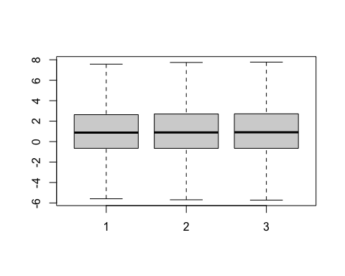
Visualize the Difference of NEE Among the Scenarios
Using a box plot, we can see the changes.
boxplot(Geb2004$NEE_U05_f, Geb2004$NEE_U50_f, Geb2004$NEE_U95_f, outline = FALSE)

Slide 68
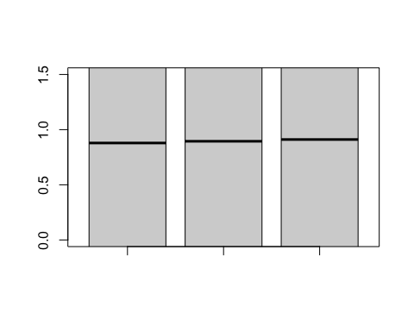
boxplot(Geb2004$NEE_U05_f, Geb2004$NEE_U50_f, Geb2004$NEE_U95_f, outline = FALSE, ylim = c(0,1.5))

Slide 69
Step 6-1-1: Calculate the Annual Mean of NEE for each u*-Threshold Scenario for 2004
We will use the gap-filled 2004 data of the difference scenarios.
Create a variable that contains the means of the different scenarios: U05, U50, and U95.
GebScenarios <- c("uStar","U05","U50","U95") NEE_UStar <- sapply(GebScenarios, function(suffix){ colName = paste0("NEE_",suffix,"_f") mean(Geb2004[[colName]]) }) NEE_UStar
## uStar U05 U50 U95 ## -0.5667606 -0.5769460 -0.5651671 -0.5510332
Step 6-1-2: Calculate the Statistics
Calculate the mean, standard deviation, and relative error.
c(mean(NEE_UStar), sd(NEE_UStar), sd(NEE_UStar)/abs(mean(NEE_UStar)))
## [1] -0.56497673 0.01065995 0.01886794

Slide 70
Step 7-1: Random Uncertainty Aggregation
Step 7-1-1: Gebesee Calculate Error Terms
To calculate the error, the replaced NEE, the NEE calculated using the gap-filling method or NEE_uStar_fall, is subtracted from the original NEE values NEE_ustar_orig. The resulting value is the residual.
The original number of non-bootstrapped data for all and 2004.
n_all <- sum(GebCombResults$NEE_uStar_fqc == 0) n_all
## [1] 27496
n_2004 <- sum(Geb2004$NEE_uStar_fqc == 0) n_2004
## [1] 9617
The residuals are calculated for all the results and the year 2004 for comparison.
GebCombResults$residual <- ifelse(GebCombResults$NEE_uStar_fqc == 0, GebCombResults$NEE_uStar_orig - GebCombResults$NEE_uStar_fall, NA) Geb2004$residual <- ifelse(Geb2004$NEE_uStar_fqc == 0, Geb2004$NEE_uStar_orig - Geb2004$NEE_uStar_fall, NA)

Slide 71
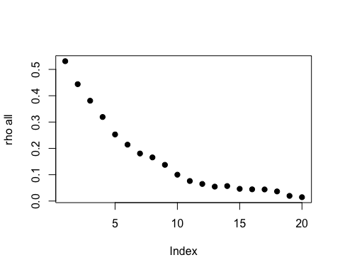
Step 6-1-2: Calculate the Empirical Autocorrelation Function
Calculate the effective autocorrelation components.
library(lognorm) rho_all <- computeEffectiveAutoCorr(GebCombResults$residual) plot(rho_all[-1], ylab = 'rho all', pch = 19)

Slide 72
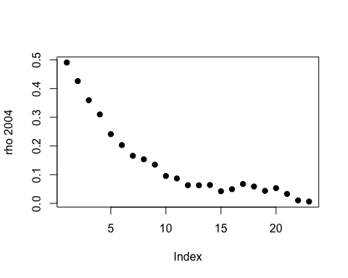
rho_2004 <- computeEffectiveAutoCorr(Geb2004$residual) plot(rho_2004[-1], ylab = 'rho 2004', pch = 19)

Slide 73
Step 6-1-3: Calculate the Effective Number of Observations
We can calculate the number by using the autocorrelation function. Create the variable nEff_all and compare to the number of good observations n_all.
nEff_all <- computeEffectiveNumObs(GebCombResults$residual, na.rm = TRUE, effAcf = rho_all) c(nEff_all, n_all)
## [1] 4699.79 27496.00

Slide 74
Step 6-1-4: Calculate the Effective Number of Observation for 2004
For 2004, create the variable nEff_2004 and compare to the number of good observations n_2004.
nEff_2004 <- computeEffectiveNumObs(Geb2004$residual, na.rm = TRUE, effAcf = rho_2004) c(nEff_2004, n_2004)
## [1] 1662.043 9617.000

Slide 75
Step 6-1-5: Calculate the Mean Annual NEE and Standard Deviation for 2004
Using the non-gap-filled data (NEE_Ustar_f), the relative error can be calculated.
Do not use gap-filled records in the uncertainty estimation here.
The mean, standard deviations, and covariance.
NEE_notGapFilled <- mean(Geb2004$NEE_uStar_f) sd_notGapFilled <- Geb2004$NEE_uStar_fsd[Geb2004$NEE_uStar_fqc == 0] sdNEE_notGapFilled = sqrt(mean(sd_notGapFilled^2)) / sqrt(nEff_all - 1) c(mean = NEE_notGapFilled, sd = sdNEE_notGapFilled, cv = sdNEE_notGapFilled/abs(NEE_notGapFilled))
## mean sd cv ## -0.56676058 0.02972696 0.05245064
Step 6-1-6: Combined Uncertainties for the $u_{*}$-Thresholds and Random Uncertainties
Calculate the combined uncertainties of the:
NEE for different $u_{*}$ scenarios.
NEE not gap-filled.
The combined uncertainties.
sdNEEUStar <- sd(NEE_UStar) sdNEECombined <- sqrt(sdNEEUStar^2 + sdNEE_notGapFilled^2) sdNEECombined
## [1] 0.03158047

Slide 76
References
Lasslop G, Reichstein M, Papale D, et al. (2010) Separation of net ecosystem exchange into assimilation and respiration using a light response curve approach: critical issues and global evaluation. Global Change Biology, Volume 16, Issue 1, Pages 187-208
Reichstein M, Falge E, Baldocchi D et al. (2005) On the separation of net ecosystem exchange into assimilation and ecosystem respiration: review and improved algorithm. Global Change Biology, 11, 1424-1439.

