Slide 1
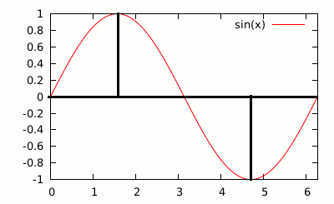
Forms of waves
Consider the Sin(x) function
repeats every 2 %pi
Peaks(1) at pi/2
0 at pi
-1 at 3pi/2
For the sake of discussion, take note that:
sin(0)=0,
sin(pi/4)=sqrt(2)/2 =~ 0.707
sin(pi/2)=1
sin(3pi/4)=~ 0.707

Slide 2
Now confider sin(2x)
Repeats ever pi
sin(2*{pi /4}) = 1
Hence, f(x)=sin(x)+sin(2x) at pi/4 ~= 1.707...

Slide 3
Turns out, there are plenty of ways to add series' of sin functions together to generate a different kind of wave, or a repeating phenomena
Adding waves in the form sin(x)/1 + sin(2x)/2 + sin(3x)/3 + sin(4x)/4 … gives out a “saw” shape wave. The more terms added, the finer the “teeth” of the saw become
Taking the above series, and dropping the even terms, ie sin(x)+[sin(3x)/3]+ [ sin(5x)/5] … converges into what looks like a square wave. Infact it only ever is a square wave if you add all the odd terms into infinity
By choosing which terms to add to the sum, we can generate in theory any repeating cycle phanomena.
Conversely, any repeating phanomena can be “split” into components of it's “sum”.
Sometimes even a non repeating phanomena can be treated as a repeating one, and then split into it's component sum functions

