Slide 1
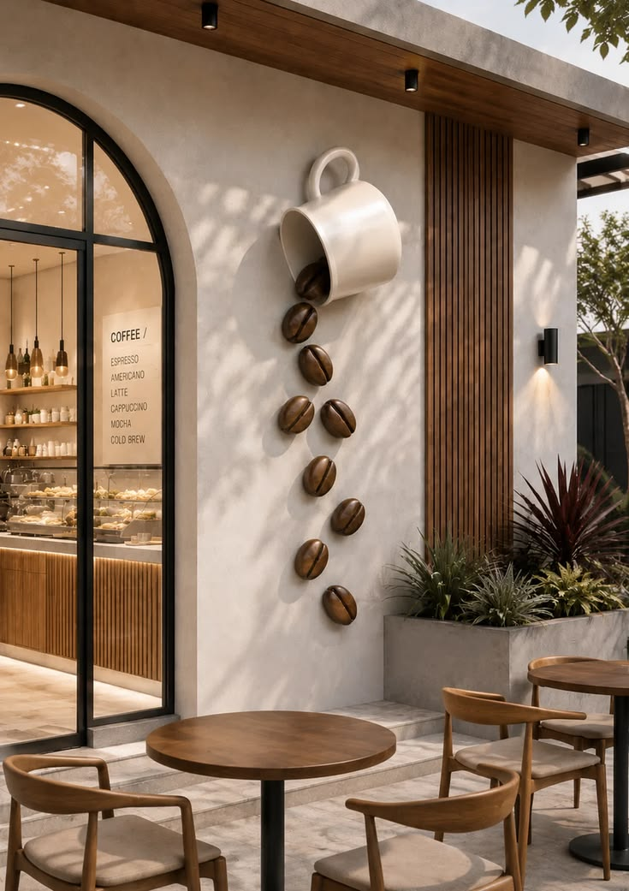
Coffee Shop Dashboard
Created by
Yussif Muhamed

Slide 5








Key Insights
Turning data into better decisions
Project Goal
Understand sales performance , customer behavior and product trends to drive growth and improve profitability
Revenue Driver
Which category generates the highest revenue?
Best Performing Branch
Which branch has the highest sales?
Result:
Drinking chocolate is the top category contributing ~ 44.41% of total revenue ($ 6.34K)
Meaning:
Drinking chocolate is the main revenue driver , so it’s critical to maintain stock levels and keep it promoted
Recommendation:
Focus on marketing coffee product and ensure consistent availability, especially at peak times.
Result:
Long island branch generated the highest sales
($ 35.4K),accounting for 35% of total sales.
Meaning:
The long island branch is strongest location and has the highest customer demand.
Recommendation:
Analyze what makes longisland branch successful and apply similar strategies to other branches.
Customer Behavior
Which customer segment spend the most?
Growth Opportunity
Which product has the highest growth potential?
Result:
Females account for 44% of total customers and have the highest average order value ($4.62)
Meaning:
Females are the most valuable segment, both in number and spending power.
Recommendation:
Create targeted offers and loyalty programs for female customers.
Result:
Loose tea have the lowest sales 2%
Meaning:
Loose tea are underperforming now, but the growing trend shows potential for higher sales.
Recommendation:
Consider special offers, bundle deals, or better in stote display to boost loose tea sales.

