Slide 1
Model Context Protocol
Tutorial: Weather MCP server & Claude Desktop Integration

Slide 2
What is MCP?
An open standard by Anthropic that defines how AI models communicate with external tools, data sources and services.
Without MCP:
LLM <-> custom glue code <-> Tool A
LLM <-> another custom glue code <-> Tool B
With MCP:
LLM (MCP Client) <-> MCP Protocol <-> Any MCP Server

Slide 3
MCP Architecture
MCP HOST
MCP CLIENT
MCP SERVER
Claude Desktop, Cursor, VS Code
Built into the host app
FastMCP
⟷
⟷
Tools (get_alerts, get_forecast)
Resources (file, DB access)
Prompts (reusable templates)
Transport: stdio | HTTP/SSE

Slide 4
MCP Primitives
Tools
Functions the LLM can call
Have typed input schemas
Return structured results
Example:
get_alerts(state=“CA”)
get_forecast(lat, lon)
Resources
Read-only data the LLM can access as context
Files, DB rows, API data
Example:
File://logs/app.log
Db://users/schema
Resources
Pre-built prompt templates
Reusable across requests
Accept dynamic arguments
Example:
weather_summary(state)
Explain_alert(alert_id)

Slide 5
Tutorial: Weather MCP Server A Weather MCP Server built with Python and FastMCP that connects Claude Desktop to the US National Weather Service API, enabling real-time weather alerts and forecasts through natural language.
What it does?
Fetches live weather data from the NWS API
Get_alerts(state) – active alerts for any US state
Get_forecast(lat, lon) – 5-period forecast
Runs locally, called by Claude PC
Tech stack
Python + FastMCP (mcp[cli])
Httpx for async HTTP requests
Uv for dependency & env management
Stdio transport for Claude PC
NWS API (free, no key needed)
Source: https://github.com/yusuf-bolat/mcp-weather-server

Slide 6
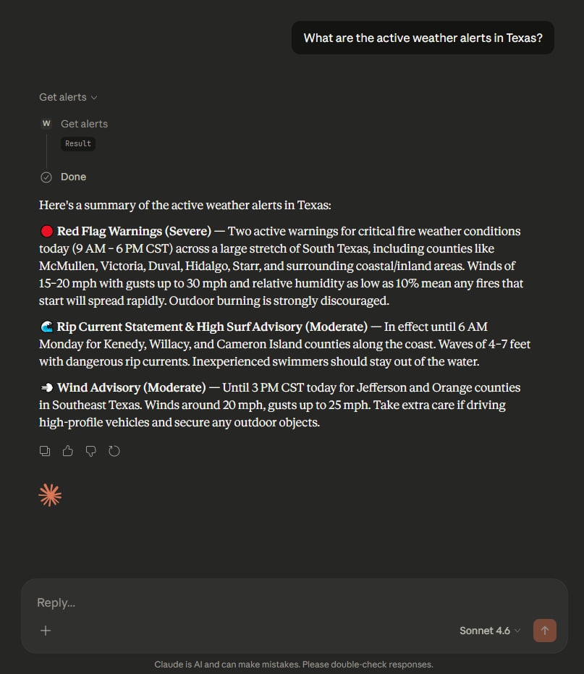
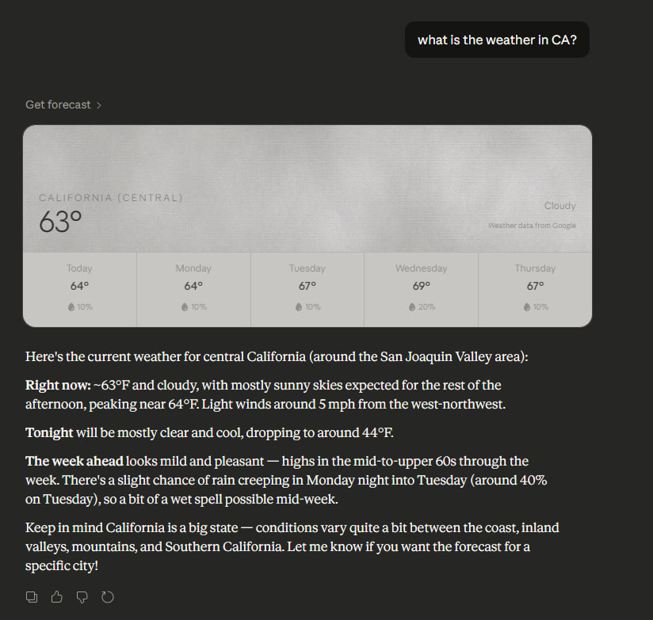
Result

Slide 7
What can you build with MCP?
🗄 Data & Databases
🛠 Developer Tools
● Query SQL/NoSQL databases
● Read files & documents
● Access internal APIs
● Run tests, build pipelines
● Search GitHub / Jira / Notion
● Execute terminal commands
🌐 External Services
🤖 AI Workflows
● Weather, maps, finance APIs
● Send emails / Slack messages
● Scrape & summarize web pages
● Chain multiple MCP servers
● Memory / vector search tools
● Agent orchestration

Slide 8
Thank you

