Slide 1
Istanbul’s choıce
2019 Elections

Slide 2
Business Case
The political parties are investing a lot to measure the aim of the electors and to convince them to vote for their party.
The environment where the voter lives is very much related to her/his choices. In this study I will pursue an answer to this question by comparing venues data from Foursquare and voting rates to the 2 main political parties in Istanbul.

Slide 3
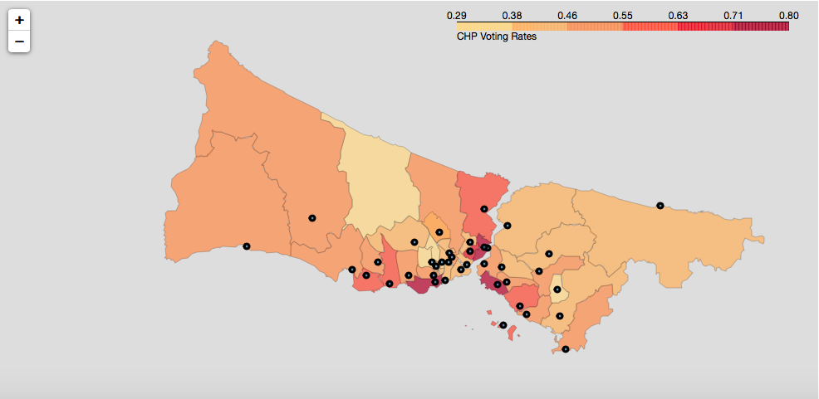
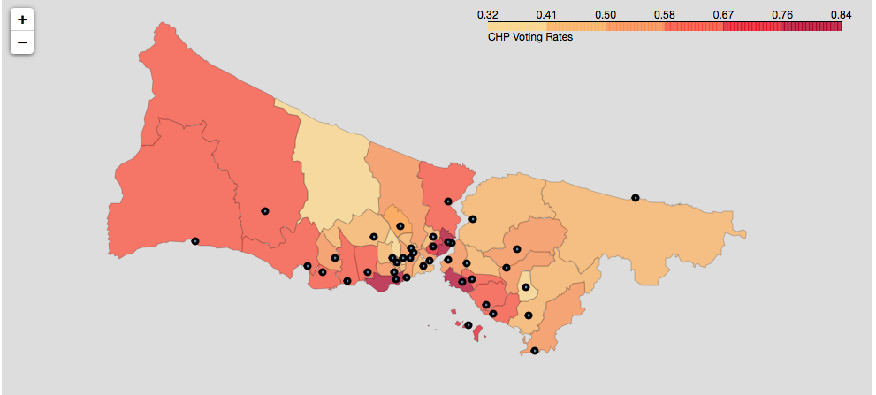
Comparing Two Elections
Since CHP’s candidate Ekrem İmamoğlu who was a common candidate for the opposition won the election two times the analysis is build upon CHP votes.
When the Graph1 and Graph2 below are compared, it is obvious that from all towns of Istanbul people tend to vote more to Ekrem İmamoğlu.

Slide 4
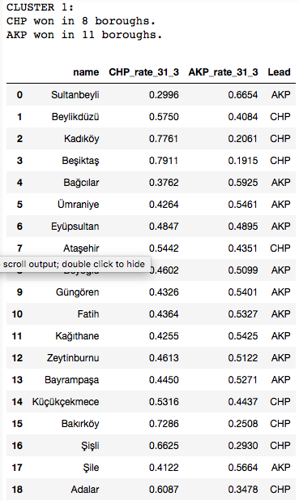
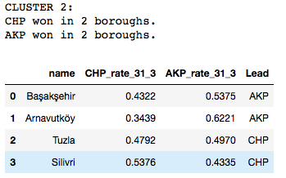
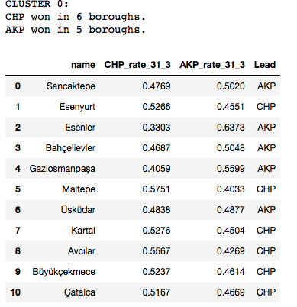
Clustering The Boroughs of Istanbul
When the 3 cluster data compared there is no statistical evidence that shows the voting habits between clusters are different.

Slide 5
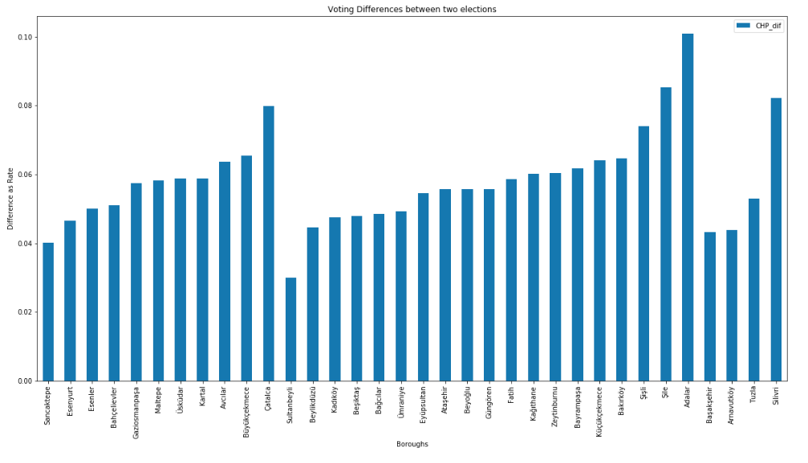
Voting Changes Among Clusters
All the boroughs preferred to vote CHP over 4% compared to the previous election.

Slide 6
Conclusion
When the voting difference between two elections compared there is not a specific behvaiour among 3 clusters. All the booughs changed their choices over %4 percent in the favor of CHP's candidate Ekrem İmamoğlu.
The environment where the voter lives is very much related to her/his choices. In this study I tried to understand the political aim of the Istanbul voters by using Foursquare data. We cannot say that with the clustering depend on the Foursquere data we can determine Istanbul boroughs' political choices. We need more details and other data sources.

