Slide 1
YZV 322E · Applied Data Engineering · Spring 2026
IoT Scooter Fleet Data Pipeline
End-to-end containerized pipeline: 50 electric scooters, real-time anomaly detection, automated batch aggregation
Yusuf Oğuz · 150220322 Yusuf Öksüzer · 150220334
Istanbul Technical University

Slide 2
MOTIVATION
Why does this pipeline exist?
Scooter fleets generate thousands of telemetry events per minute
Goal
A toppled scooter or critical battery discovered late → accident risk + revenue loss
Single command startup
Manual inspection of log files is not scalable beyond a handful of vehicles
Real-time anomaly routing & alerting
Nightly aggregation (trip revenue, hotspot density) needs to run reliably without human trigger
Automated nightly aggregation
Zero host-side dependencies

Slide 3
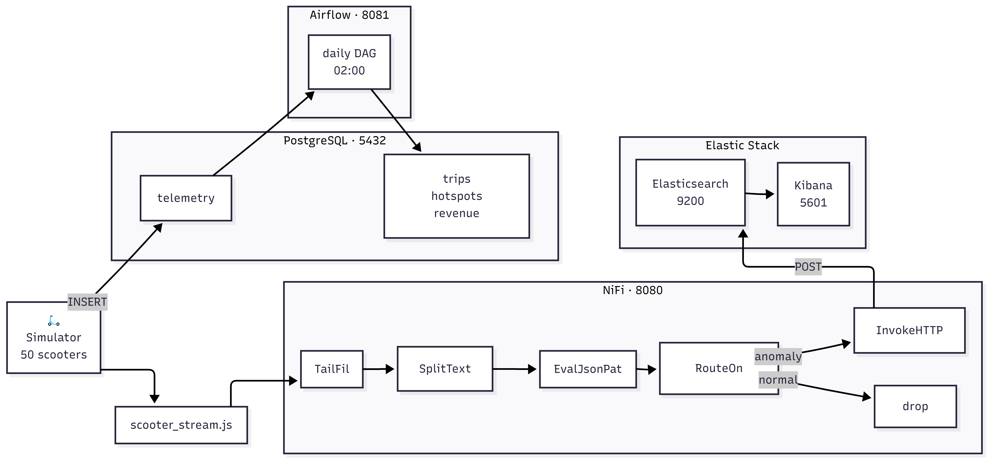
ARCHITECTURE
System Overview
[ ARCHITECTURE DIAGRAM (mermaid.live export) ]

Slide 4
DATA GENERATION
Python Simulator
50
50 rec/s
4%
2
scooters
throughput
anomaly rate
sinks
Each scooter maintains its own state:
Two write paths:
GPS position: random walk within Şişli-Beşiktaş bounding box
PostgreSQL ← direct INSERT via psycopg2
Speed, battery %, odometer: physically realistic updates each tick
/data/scooter_stream.jsonl → NiFi TailFile
Trip lifecycle: starts and ends trips autonomously
Anomaly injection: topple · critical_battery · gps_loss · motor_fault
Anomaly types:
topple
critical_battery
gps_loss
motor_fault

Slide 5
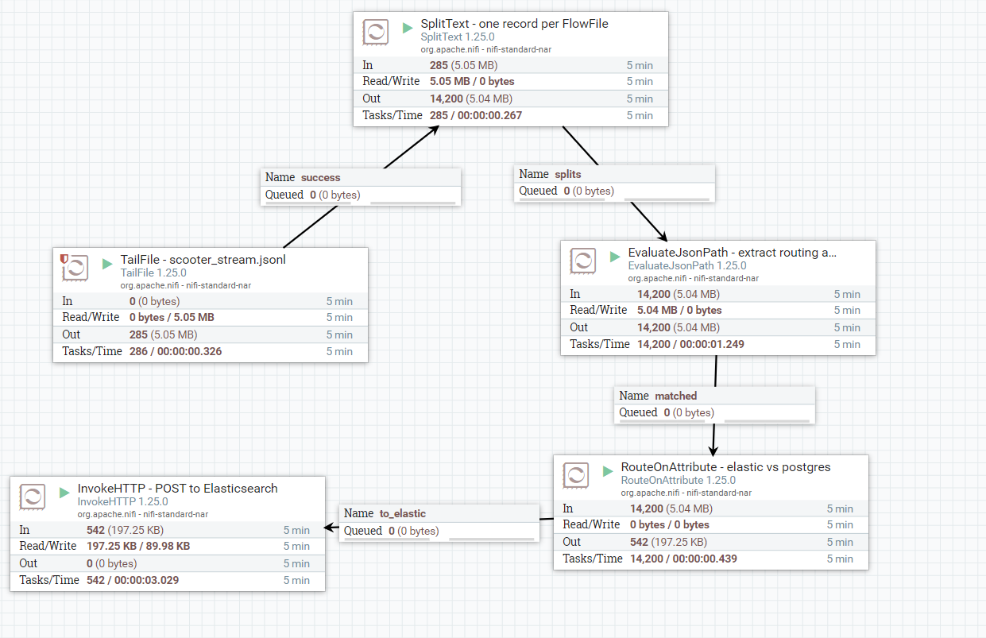
STREAM PROCESSING
Apache NiFi & Real-Time Routing
1. TailFile
Reads new lines from JSONL as they arrive
▼
2. SplitText
One FlowFile per JSON record
▼
3. EvaluateJsonPath
Extracts anomaly_type & fault_code attributes
[ NiFi UI processor graph screenshot ]
▼
4. RouteOnAttribute
anomaly_type not empty → anomaly route
▼
5. InvokeHTTP
HTTP POST to Elasticsearch scooter-alerts index
Normal telemetry → dropped (already in PostgreSQL via direct INSERT)

Slide 6
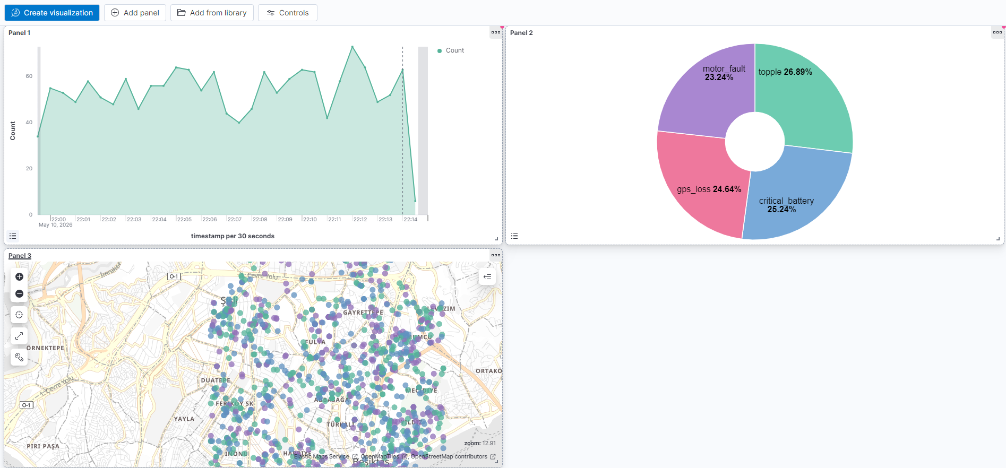
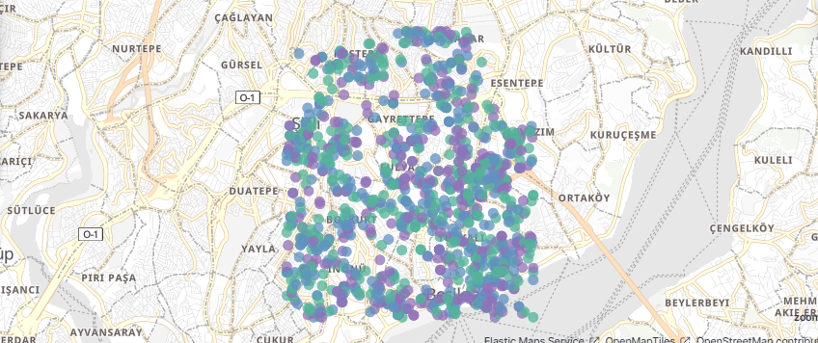
VISUALIZATION
Elasticsearch & Kibana
Index: scooter-alerts
geo_point mapping → native map support
Only anomaly records ingested (NiFi routes)
[ Kibana Dashboard area chart + pie + map (full screenshot) ]
8 900+ documents after ~3 min runtime
Kibana dashboard panels:
Area chart: anomaly event rate over time
Donut pie: breakdown by anomaly type
Interactive map: GPS locations plotted
Dashboard auto-imported on first startup

Slide 7
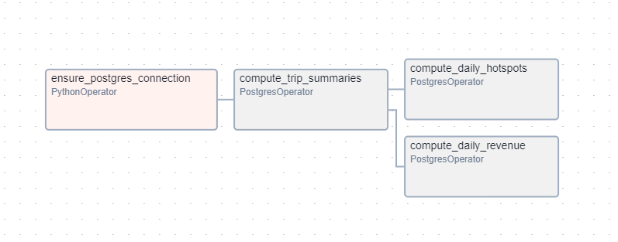
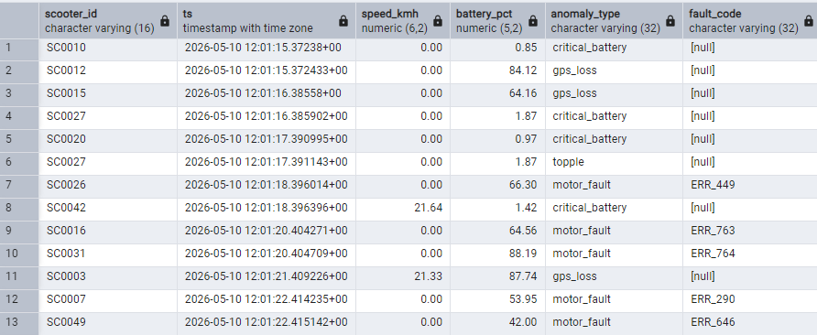
BATCH LAYER
PostgreSQL & Airflow
public.telemetry
Raw IoT records: all scooters, all events
public.trips
Trip summaries: distance, duration, revenue
[ Airflow DAG Graph View screenshot ]
public.daily_hotspots
500 m grid ride-density per day
public.daily_revenue
Fleet-wide revenue aggregates per day
scooter_daily_summary DAG · runs 02:00 UTC
compute_trip_summaries
[ pgAdmin telemetry table with anomaly rows ]
compute_daily_hotspots
compute_daily_revenue

Slide 8
DESIGN DECISIONS
Why these tools?
NiFi
Airflow
Low-code dataflow with a REST API that lets us automate the entire pipeline setup. (no manual UI clicks after clone.)
DAG dependency graph cleanly models the compute_trips → hotspots/revenue fan-out, with built-in retry and scheduling.
Elasticsearch
PostgreSQL
Native geo_point support and sub-second full-text search makes it the right fit for anomaly storage and map queries.
ACID guarantees for raw telemetry; the aggregation tables are foreign-key–linked and queryable by any SQL tool.
Kibana
Docker Compose
Tight ES integration means geo maps, time-series, and pie charts share one index pattern with zero ETL glue.
Eleven services, one command. Health-check–based depends_on ensures startup order without sleep hacks.

Slide 9
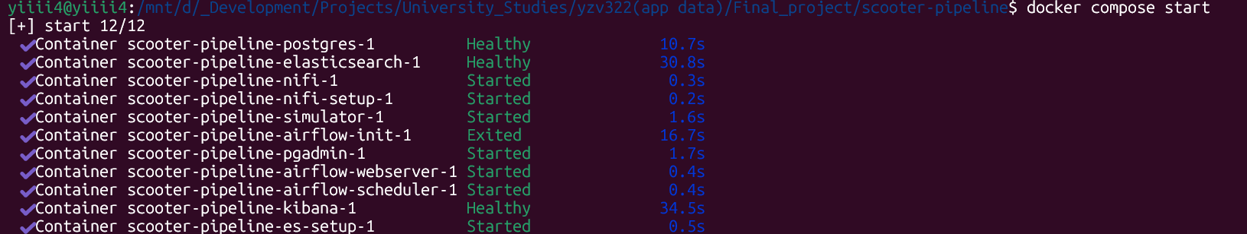
RESULTS
What actually ran
194 K+
8 900+
11
1 cmd
telemetry rows in PostgreSQL
anomaly docs in Elasticsearch
containers all healthy
docker compose up --build
[ docker ps all containers HEALTHY (terminal screenshot) ]

Slide 10
LIMITATIONS FUTURE
What we know is missing and what comes next
No TLS between services
Future directions
All inter-container traffic is plain HTTP on the internal bridge network. Fine for dev, not for prod.
Replace NiFi with Apache Flink for stateful stream processing
Single-threaded simulator
Scales to ~50 scooters comfortably; beyond that, async I/O or multiprocessing would be needed.
Add Prometheus + Grafana for container health monitoring
Airflow tables empty on first boot
The DAG runs at 02:00 UTC. Aggregation tables are empty until the first scheduled (or manual) trigger.
TLS everywhere + Vault for secret management
JSONL rotation edge case
NiFi TailFile tracks byte offset; log rotation can cause a brief gap until NiFi picks up the new file path.
Scale to 500+ scooters with async simulator

Slide 11
AI USAGE DECLARATION
Use of AI Tools & Transparency Statement
What AI was used for
Docker Compose configuration and inter-service networking
NiFi REST API scripting and processor property debugging
Elasticsearch index mapping (geo_point) and Kibana saved-object format
Python simulator logic: psycopg2 batch inserts, RotatingFileHandler
What AI was NOT used for
Architectural decisions and tool selection rationale was our own
Report writing and all analysis and evaluation text authored by the team
All AI-generated code was reviewed, tested, and debugged by the authors. No AI output appears in this presentation or the accompanying report without human verification. Tool used: Claude (Anthropic).

Slide 12
Thank you
Repository
github.com/yusuf-oguz/yzv322_final_project
Services on localhost
NiFi :8080 · Kibana :5601 · Airflow :8081 · pgAdmin :5050 · ES :9200
Questions?

