Slide 1
NBA Statistics Dashboard
Visualizing 80 Years of Basketball Evolution
DataVIZZ
Nurettin Macit · Mehmet Arda Öncel · Yusuf Oğuz
YZV475E – Data Visualization · ITU · May 2026

Slide 2
Agenda
1
Dataset & Motivation
2
RQ1 — Three-Point Revolution
3
RQ2 — Physical Attributes vs Performance
4
RQ3 — Career Arc & Peak Age
5
RQ4 — Geography of NBA Players
6
RQ5 — Position Profiles
7
Technical Implementation
8
Conclusion
2

Slide 3
Dataset & Motivation
Dataset
Why NBA?
NBA Players & Teams Statistics (1947–2024)
Source: Kaggle / Basketball Reference
33,278 rows × 32 columns · 11 MB
22 CSV files
+ 2 supplementary datasets
(country & birthplace data)
Leagues: NBA, ABA, BAA
Nearly 80 years of continuous data
Multiple analysis dimensions:
temporal, spatial, physical,
performance
Publicly available & well-structured
One of the most tactically
transformed sports leagues
in history
3

Slide 4
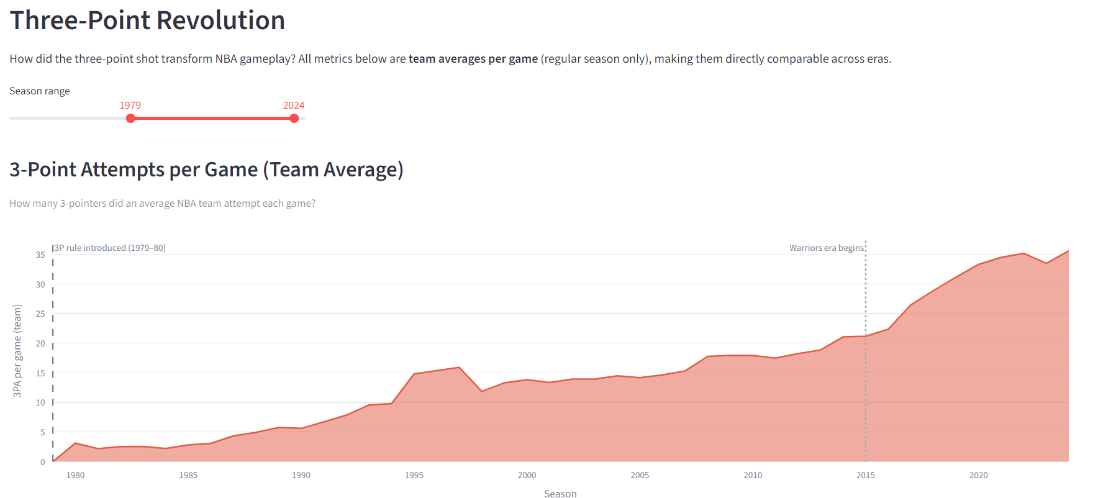
RQ1 — Three-Point Revolution
How has the three-point shot transformed NBA gameplay?
Key Facts
FIGURE 1
Open app → Tab '📈 Three-Point Revolution'
Set slider to 1979–2024
Take screenshot of the area chart (3PA/game)
3.1
3PA / game in 1980
35.6
3PA / game in 2024
11×
increase in 44 years
39.6%
of all FGA in 2024 are 3s
Key inflection: 2015–16 Golden State Warriors era
4

Slide 5
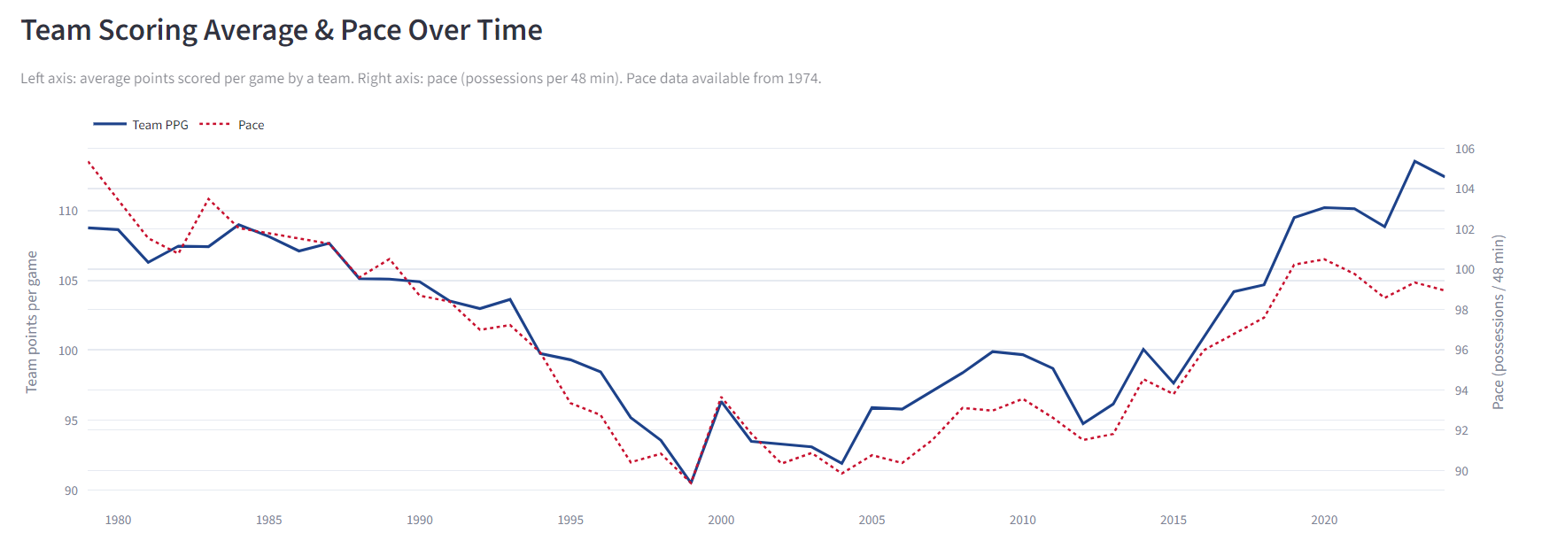
RQ1 — Scoring & Pace Over Time
FIGURE 1b
Open app → Tab '📈 Three-Point Revolution'
Scroll down to the second chart: 'Scoring Average & Pace Over Time'
Take screenshot of the dual-axis line chart
Team scoring peaked at ~113 PPG in 2024. Pace declined from the 1960s until ~2014, then rebounded with the modern up-tempo style.
5

Slide 6
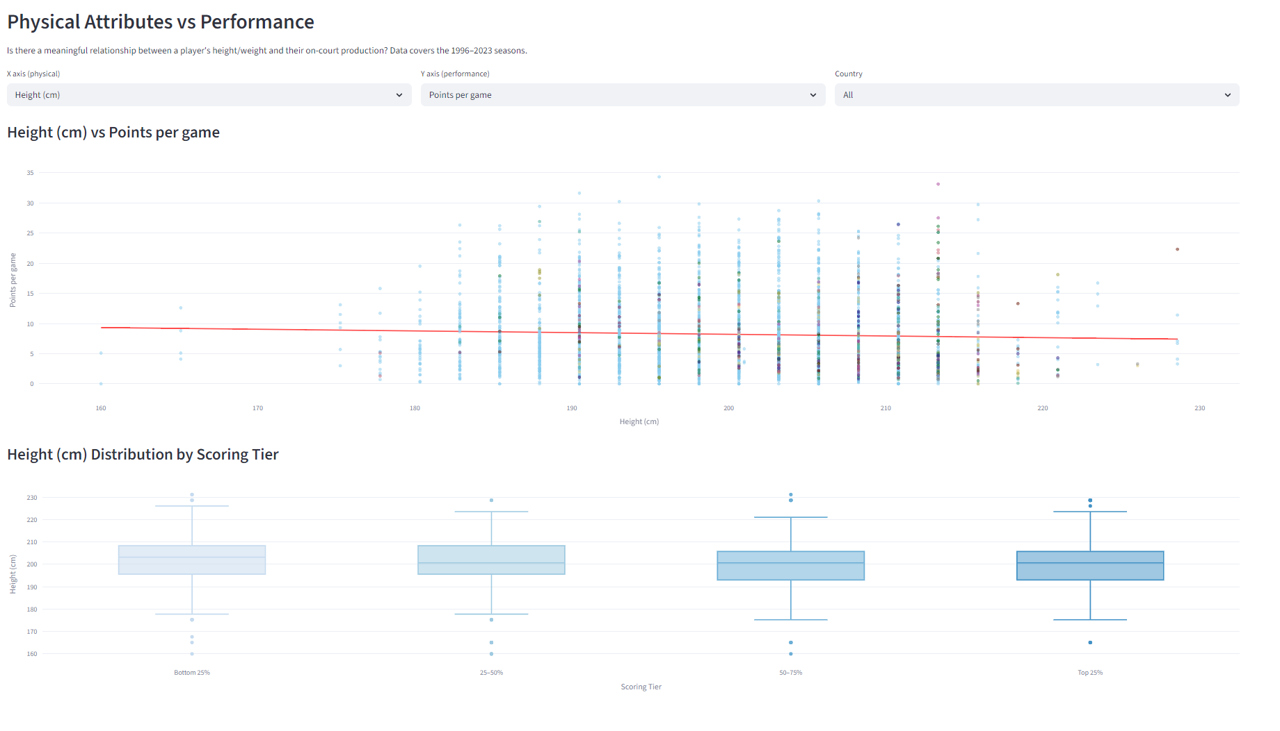
RQ2 — Physical Attributes vs Performance
Does height or weight predict on-court success?
Key Findings
FIGURE 2
Open app → Tab '💪 Physical vs Performance'
Set X: Height (cm), Y: Points per game
Take screenshot showing scatter plot
with the red OLS trendline visible
12,844 player-seasons (1996–2023)
82 countries represented
Height vs PPG: weak negative
correlation (big men contribute
via rebounds & defense)
Height vs Win Shares: near-neutral
Weight: minimal correlation with
any offensive metric
OLS trendline via statsmodels
6

Slide 7
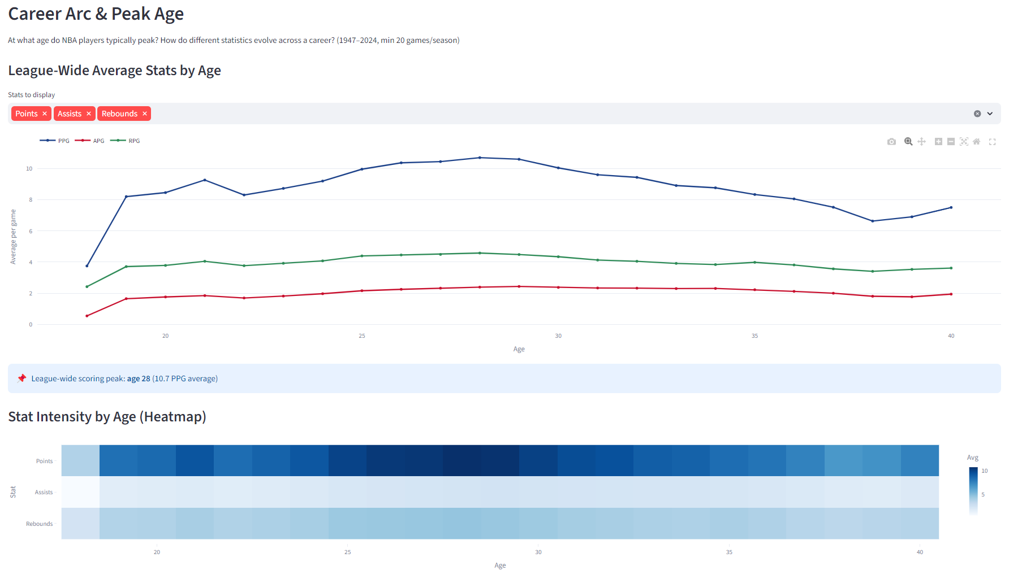
RQ3 — Career Arc & Peak Age
When do NBA players peak?
Key Findings
FIGURE 3
Open app → Tab '📊 Career Arc & Peak Age'
Select all 3 stats: Points, Assists, Rebounds
Take screenshot of the multi-line chart +
the blue info box showing peak age
Peak scoring age
26 – 27
Data: 1947–2024, min 20 games/season
Assists peak: age 24–25
Rebounds peak: age 25–26
After age 35: survivorship bias
(only elite players remain)
Sample drops sharply after age 32
7

Slide 8
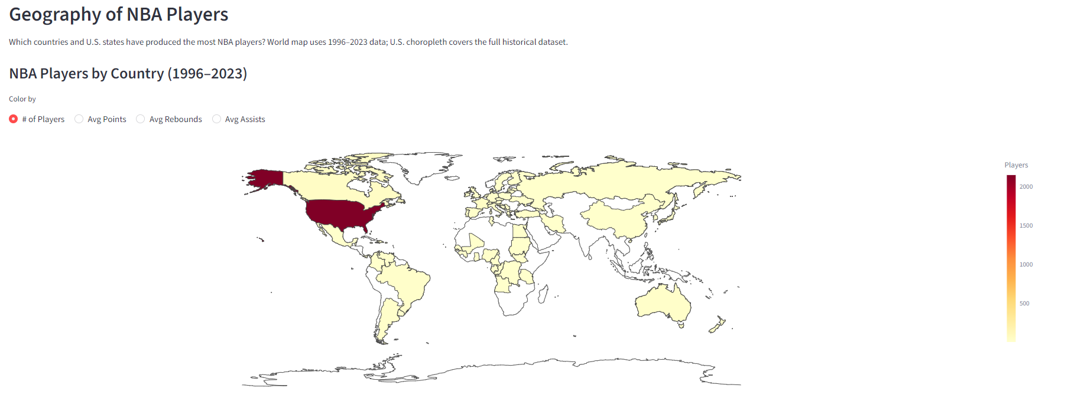
RQ4 — Geography: Where Do NBA Players Come From?
Country-level distribution (1996–2023)
FIGURE 4
Open app → Tab '🌍 Geography'
The world map appears at the top — set color to '# of Players'
Take screenshot when map is fully rendered (may take 1–2 seconds to load)
10,721
205
190
100
93
82 countries
🇺🇸 USA
🇨🇦 Canada
🇫🇷 France
🇦🇺 Australia
🇪🇸 Spain
🌐 Total
8

Slide 9
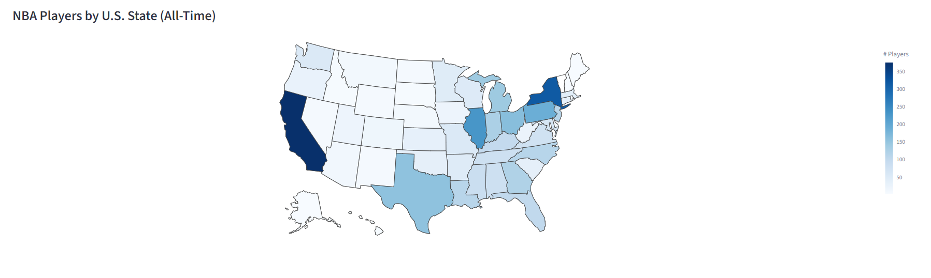
RQ4 — Geography: U.S. State Breakdown
All-time NBA player birthplaces by state
Key Findings
FIGURE 5
Open app → Tab '🌍 Geography'
Scroll down past the bar chart
to the U.S. state choropleth map
Take a screenshot of the full USA map
Covers entire NBA history (all-time player data)
Top states: California, New York, Texas
South highly represented: Georgia, N. Carolina, Louisiana
Western states: fewer players (lower population)
9

Slide 10
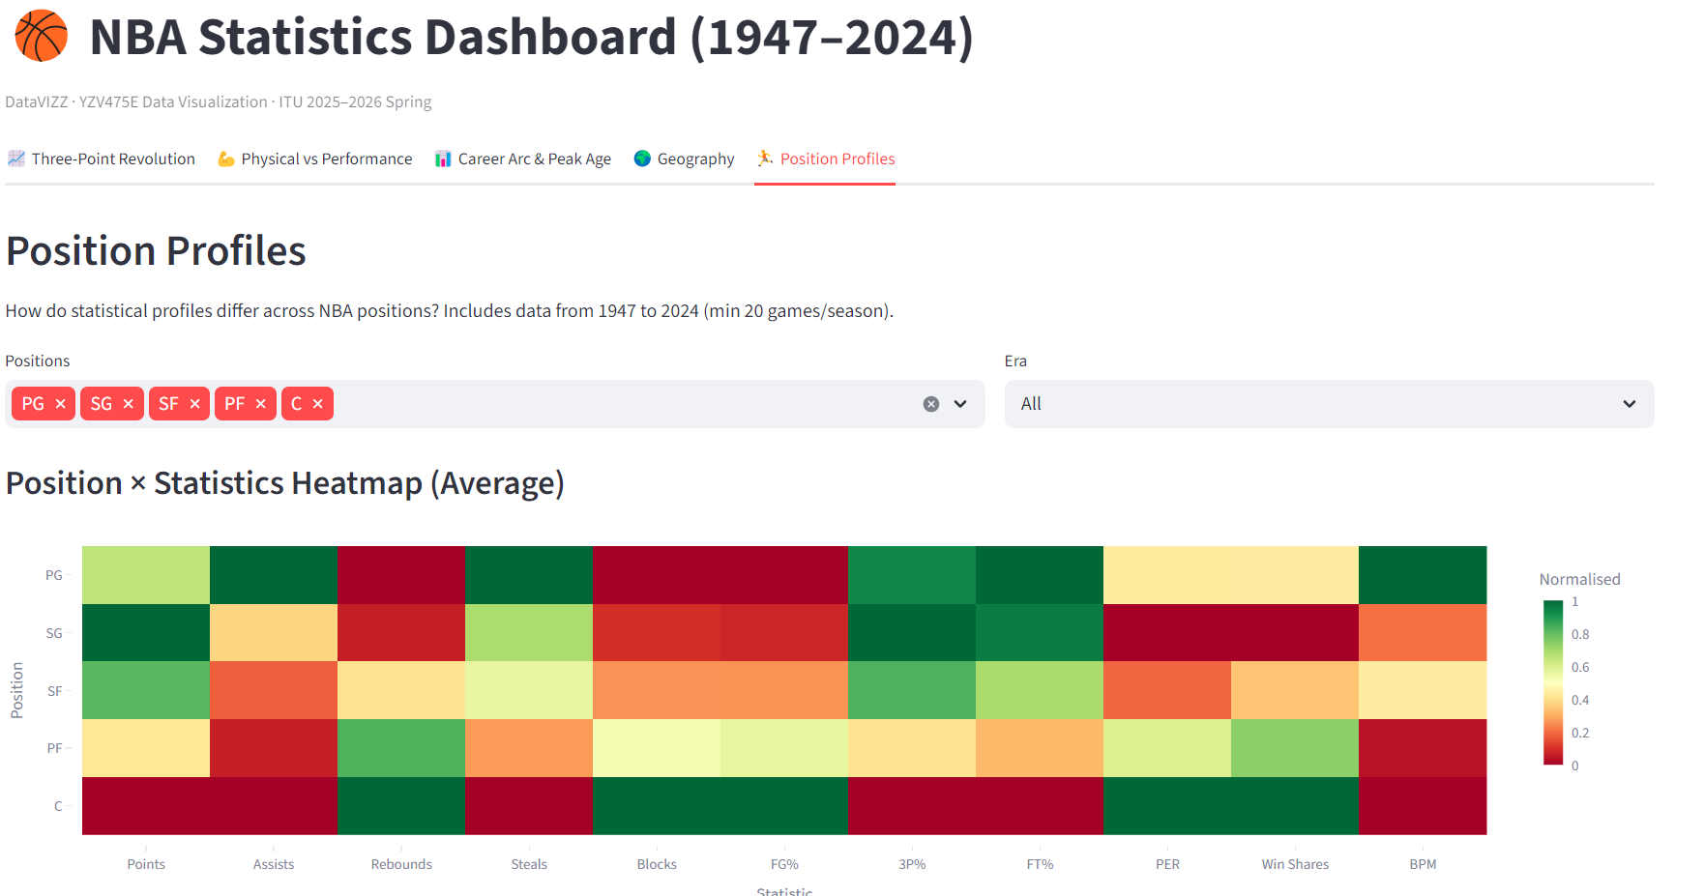
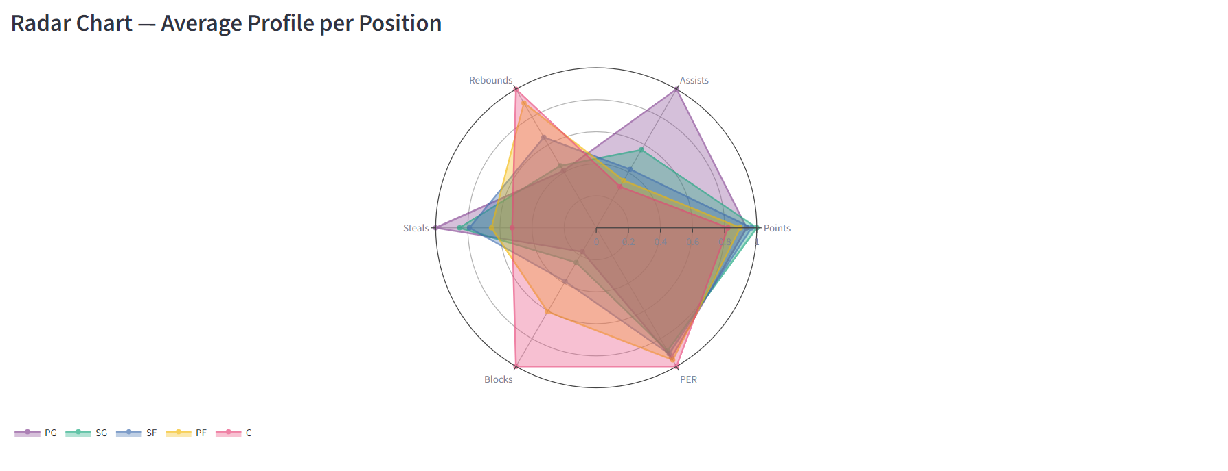
RQ5 — Position Profiles
How do PG, SG, SF, PF, and C differ statistically?
FIGURE 6a
Open app → Tab '🏃 Position Profiles'
All 5 positions selected, Era: All
Take screenshot of the HEATMAP (top chart)
FIGURE 6b
Still in Tab '🏃 Position Profiles'
Scroll down to the RADAR CHART
Take screenshot of the radar chart
PG
SG
SF
PF
C
Leads: assists, 3P%
Balanced: scoring + perimeter
Most balanced overall profile
Transitional: inside + outside
Leads: blocks, rebounds, WS
Modern era: positional roles are converging — PFs & Cs now shoot significantly more 3-pointers than in earlier eras.
10

Slide 11
Technical Implementation
Technology Stack
Project Structure
Python 3.10
Language
app.py ← entry point
data_loader.py ← @st.cache_data
Streamlit ≥ 1.32
Dashboard
tabs/
Plotly ≥ 5.20
Interactive charts
tab_threept.py ← RQ1
tab_physical.py ← RQ2
Statsmodels
OLS trendlines
tab_career.py ← RQ3
Pandas + NumPy
Data processing
tab_geo.py ← RQ4
tab_positions.py← RQ5
All charts are interactive — hover, zoom, filter by era / position / country
11

Slide 12
Conclusion
🏀
📏
Three-Point Revolution
Physical Attributes
11× increase in 3PA/game since 1979; strategy fundamentally transformed.
Height/weight weakly predict scoring; diverse body types rewarded.
📈
🌍
Career Arc
Globalization
Universal scoring peak at age 26–27; survivorship bias after 35.
NBA talent spans 82 countries; international growth accelerated post-2000.
🏃
💻
Position Convergence
Dashboard
Distinct profiles remain, but positional boundaries are blurring.
5 tabs · 15+ interactive charts · dynamic filters for exploration.
12

Slide 13
Thank You
Questions & Discussion
DataVIZZ
Nurettin Macit · Mehmet Arda Öncel · Yusuf Oğuz
Dataset: Kaggle / Basketball Reference · Tools: Python · Streamlit · Plotly · Pandas

