Slide 1
Compass Star Tracker
Mobile App
GTU COMPUTER ENG CSE 496
FINAL PRESENTATION
Yusuf Abdullah ARSLANALP
Proje Danışmanı: Prof. Dr. Hasari ÇELEBİ
Kasım 2021

Slide 2

Compass Star Tracker
A GPS like application.
No GPS connection is needed.
We find location from a night sky image.

Slide 3
Articales
Texas A&M University
  - Compass star tracker for GPS-like applications
- A Proof of Concept Compass Star Tracker
- Coordinate determination
University of Chile
- An Ultra-Low-Cost Star Tracker Concept Based on a Raspberry-Pi and Open-Source Astronomy Software
- Attitude determination

Slide 4
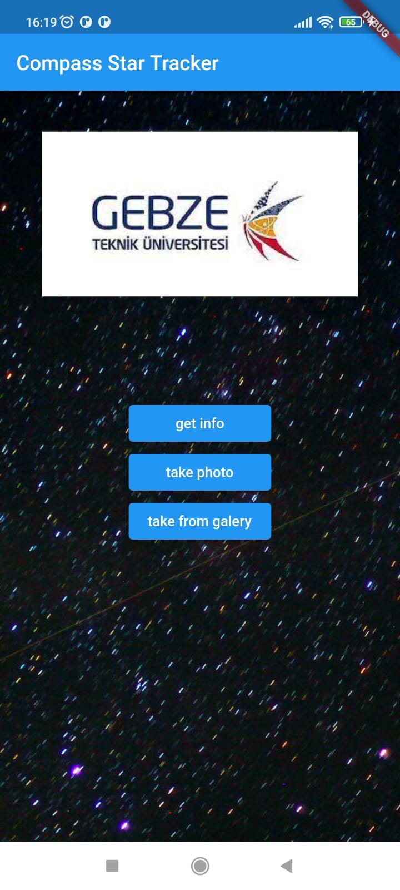
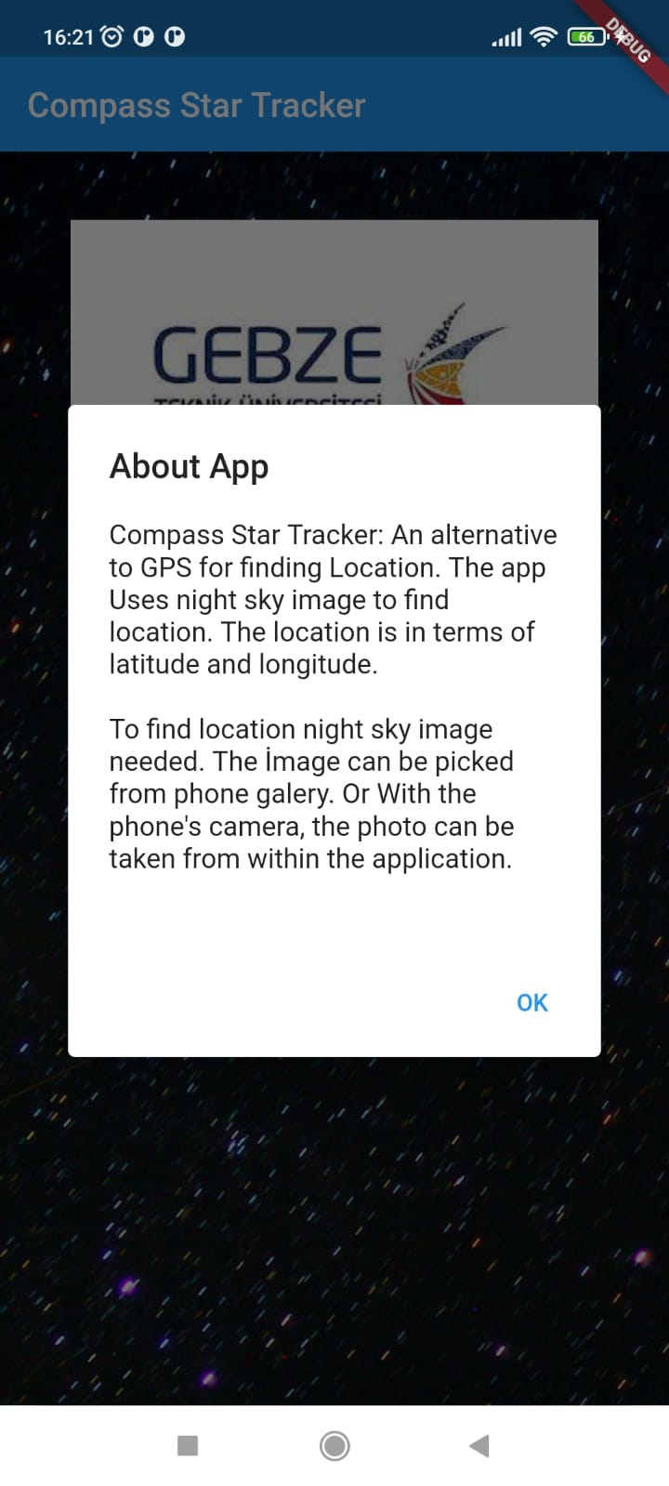

Slide 5
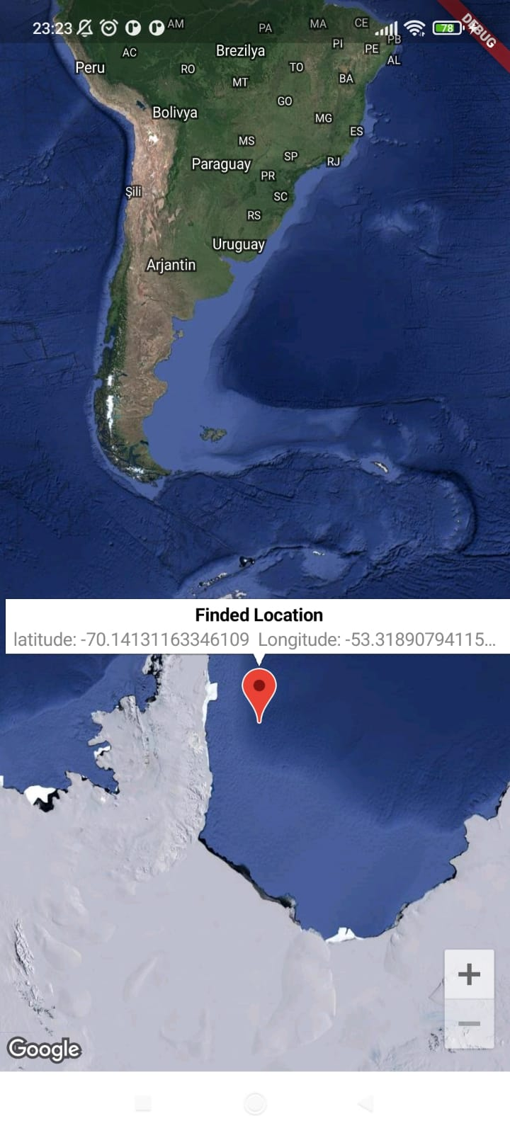

Slide 6

Night Sky Image
  Tiny white dots in the image are stars

Slide 7
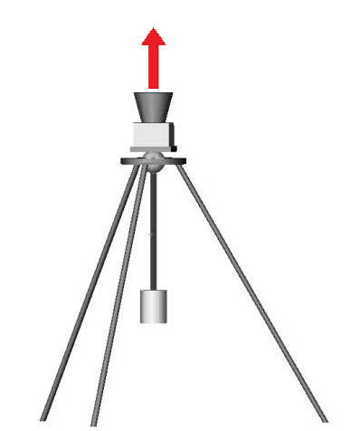
How to Take Photo
While taking photo of night sky, the camera axis should be vertical to the ground.
Other wise determined location will be wrong.
[2]

Slide 8
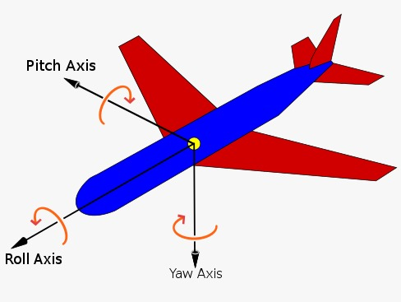
Finding Cordinate - Attitude
  Attitude is a set of angle. These angles are yaw, pitch and roll.
  Attitude is orientation of an aerospace vehice with respect to an inertial frame

Slide 9
SPEL - Open Star Tracker
  Find attitude from night sky image with using SPEL Software.
  SPEL compares night sky image with a star catalog(database) and finds attitude of camera.

Slide 10
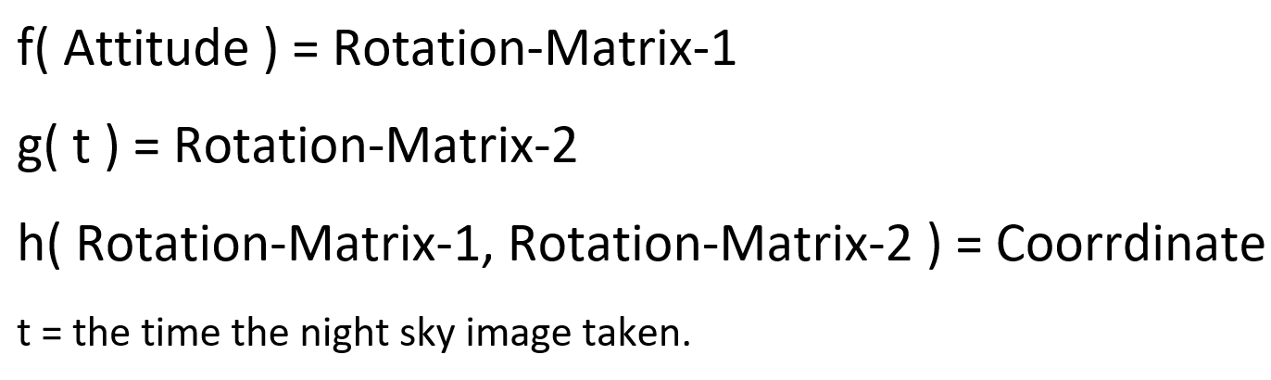
Problem Formula
I have implemented f, g and h functions.

Slide 11
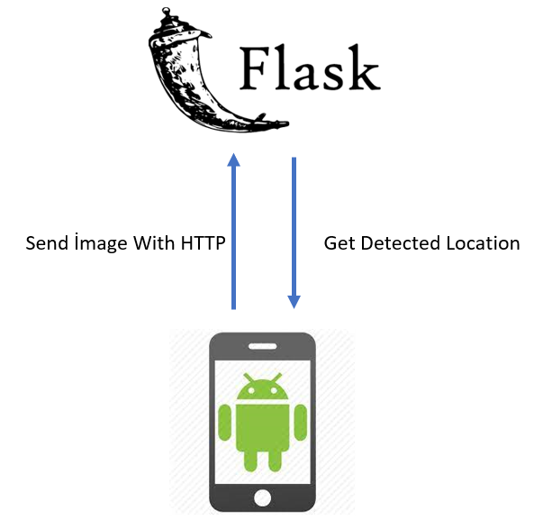
Application Structure
Flutter

Slide 12
Night Sky Images
The images in SPELL software. Taken in Chili.
The images I taken. Taken in Istanbul

Slide 13
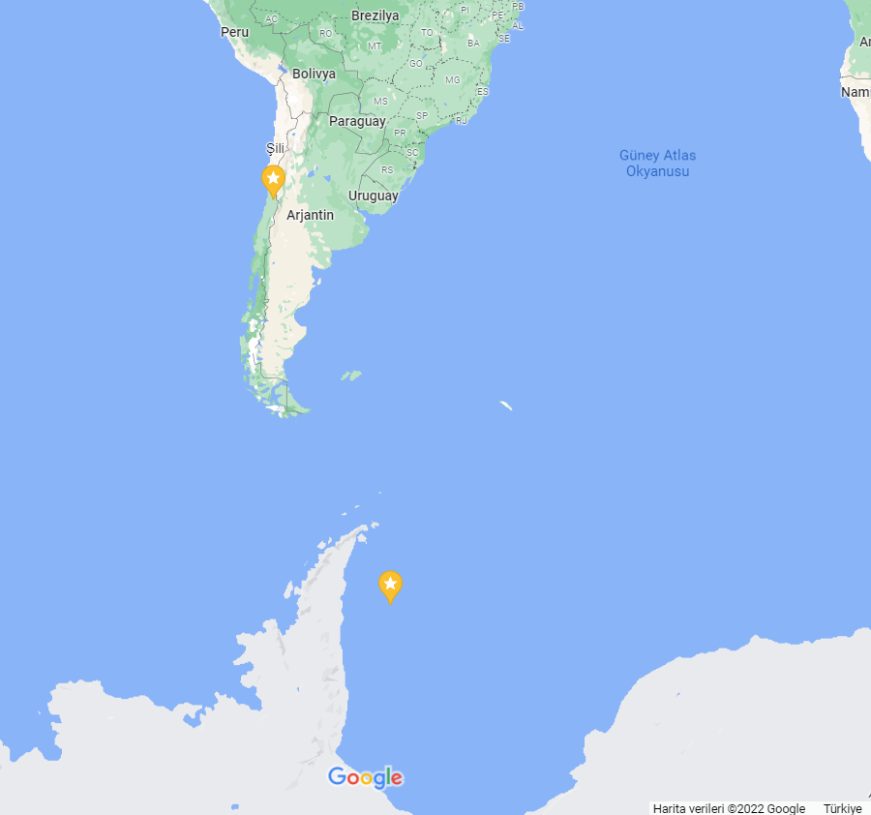
Results
The place where the image taken
Calculated Coordinate

Slide 14
How to Take Photo
While taking photo of night sky, the camera axis should be vertical to the ground.
Other wise determined location will be wrong.
[2]

Slide 15
Results
Coordinates was determined from the sample images in SPEL software.
User can select a sample night sky image from the app and finds the location.
I have taken 20 night sky image in January 14 2022.
The images I was taken, was not compatible with SPEL software. So the coordinates couldn't be determined for my images.

Slide 16
Success Criteria
Finding location with an appropriate image in cell phone gallery
Finding location using front camera of the cell phone in the app.
For an image taken by a camera which optical axis is precisely parallel to the gravity direction:
  Finding latitude with 0.02 degree (~2km) sensitivity
  Finding longitude with 0.01 degree (~1km) sensitivity

Slide 17






Progress Plan
--Understanding and implementing Centroiding algorithm and Star Identification Algorithm
-- Implementing mobile application
-- Test the application
Last Presentation/Demo
2.Presentation
1.Presentation
3.Presentation
-- Defining project
-- Explaining how to solve problem
-- Defining success criteria
--Detecting location from appropriate night sky image

Slide 18
Resources
http://guilfordgeo.com/geo340/Navigation.html
Compass Star Tracker for GPS Applications1 Malak A. Samaan2, Daniele Mortari3, and John L. Junkins4
Samaan, M. A., Pollock, T. C., and Junkins, J. L., \Predictive Centroiding for Star Trackers with the Effect of Image Smear," Journal of the Astronautical Sciences, Vol. 50, 2002, pp. 113{123.
Berry, R., Burnell, J., \The Handbook of Astronomical Image Processing",
Mortari, D., Junkins, J.L., and Samaan, M.A. \Lost-In-Space Pyramid Algorithm for Robust Star Pattern Recognition"
Mortari, D. \Second Estimator of the Optimal Quaternion," Journal of Guidance, Control, and Dynamics, Vol. 23, No. 5, Sept.-Oct. 2000, pp. 885-888.

