Slide 1
Night Pharmacy in Ankara
Applied Data Science Capstone Project
IBM Data Science by Coursera

Slide 2
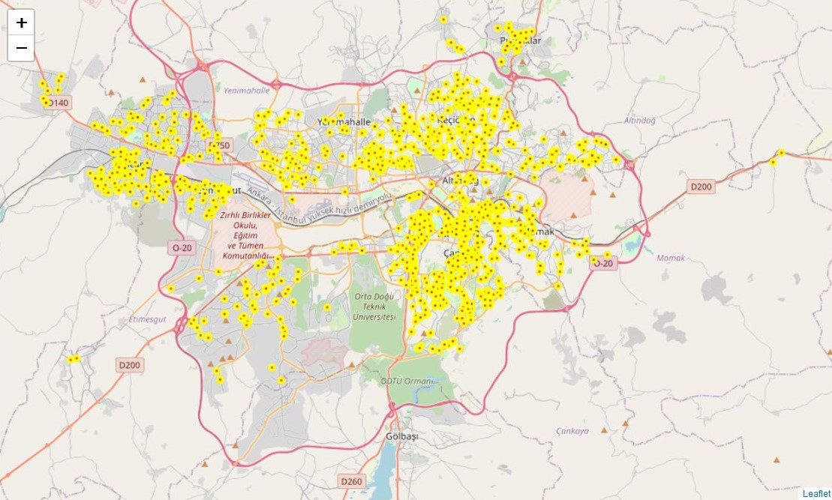
Night Pharmacy in Ankara - Background
There are 1341 pharmacy
In 9 district
IBM Data Science by Coursera – Applied Data Science Capstone Project – Night Pharmacy in Ankara

Slide 3
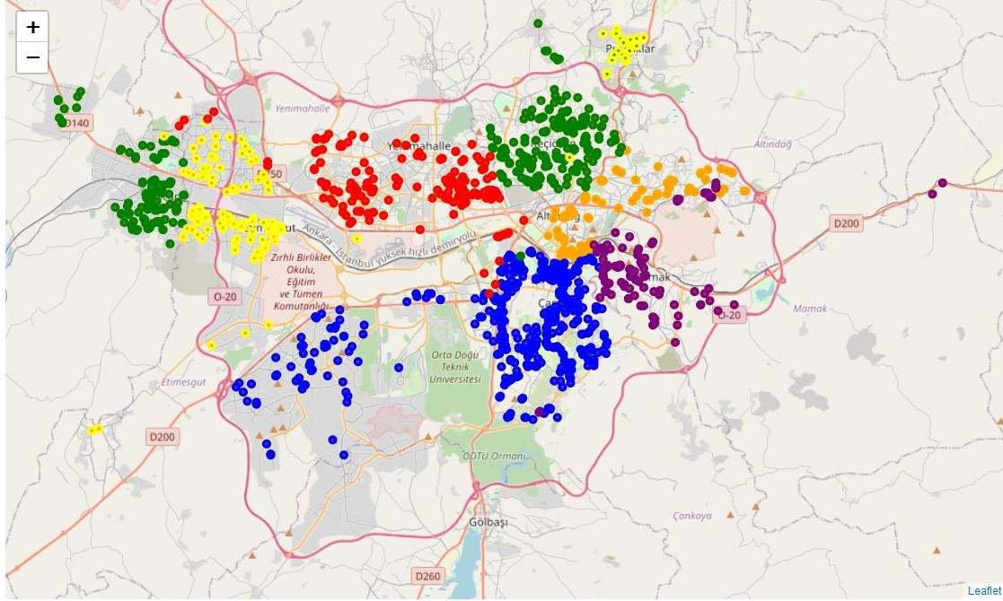
Night Pharmacy Groups by District Base
IBM Data Science by Coursera – Applied Data Science Capstone Project – Night Pharmacy in Ankara

Slide 4
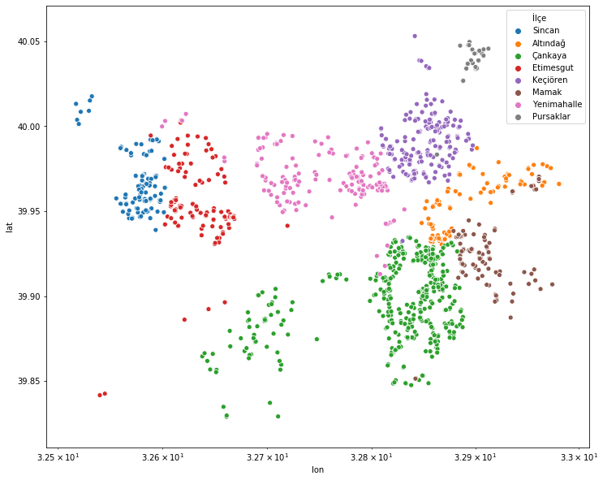
Night Pharmacy Groups by District Base
IBM Data Science by Coursera – Applied Data Science Capstone Project – Night Pharmacy in Ankara

Slide 5
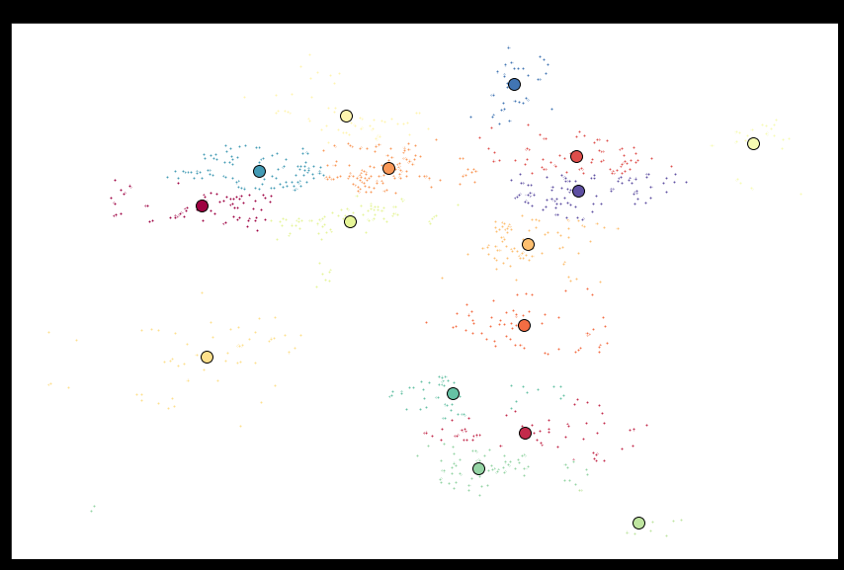
Night Pharmacy Groups by K-means Clusters
IBM Data Science by Coursera – Applied Data Science Capstone Project – Night Pharmacy in Ankara

Slide 6
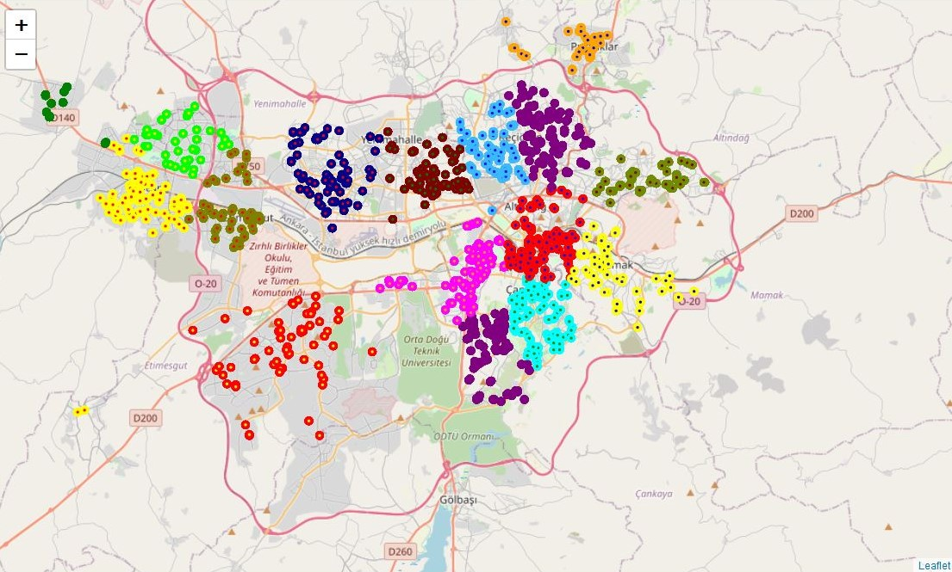
Night Pharmacy Groups by K-means Clusters
IBM Data Science by Coursera – Applied Data Science Capstone Project – Night Pharmacy in Ankara

Slide 7
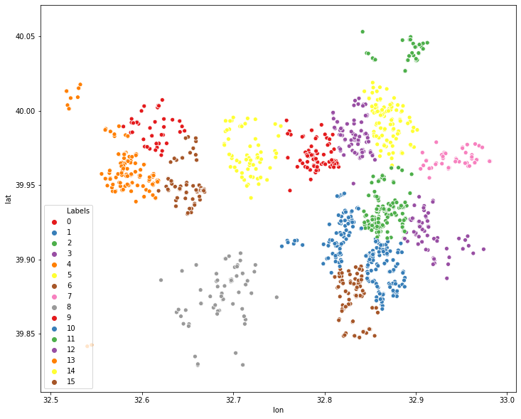
Night Pharmacy Groups by K-means Clusters
IBM Data Science by Coursera – Applied Data Science Capstone Project – Night Pharmacy in Ankara

Slide 8
Comparison between K-means Clusters Based and Districts Based
IBM Data Science by Coursera – Applied Data Science Capstone Project – Night Pharmacy in Ankara

Slide 9
Comparison between K-means Clusters Based and Districts Based
IBM Data Science by Coursera – Applied Data Science Capstone Project – Night Pharmacy in Ankara

