Slide 1




YUSUFJON
202438404
CROWDFUNDING
BLOCKCHAIN

Slide 2






1
Definition
2
5 types:pros/cons
CONTENTS
3
Blockchain helps?
4
Use Case Example

Slide 3
You ask for money for your bussiness ?!

Slide 4

it just
starts
pouring
in...

Slide 5

Sometimes
but not always

Slide 6
  Traditional vs Crowdfunding
1
When a bank or few
investors give money
to fund
a bussiness or project
When many individuals
each give small
contributions to fund
a bussiness or project

Slide 7
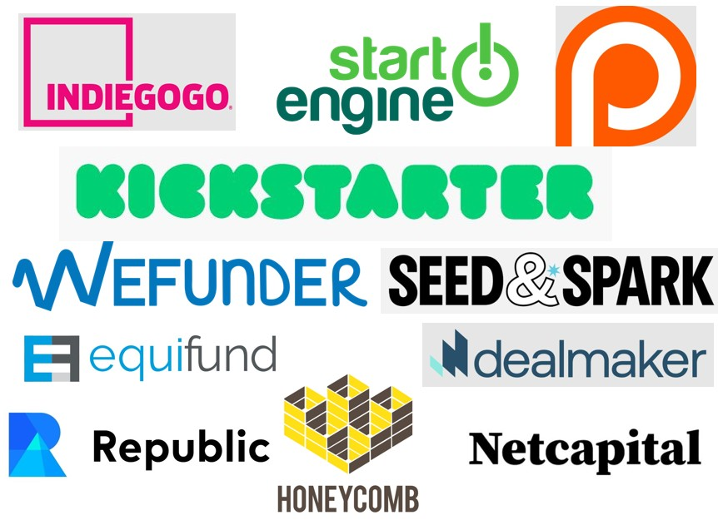

  Value & Scale
  $16.2 billion

Slide 8
  5 Types of
  Crowdfunding
2
Rewards
Debt
Donation
Equity
Royalty

Slide 9
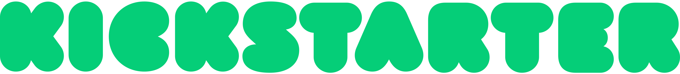
  Rewards Type
Investors get rewards in exchange for monetary contributions
Pros
Cons
Low bar entry
Can generate buzz for your bussiness
Doubles as market research
Most campaigns are not successful: $10k: 14%
You’ll need spend some money for promotion
Takes 3 to 6 months to prep and run campaign

Slide 10

  Equity Crowdfunding
also known as crowdinvesting, is popular with startups
Pros
Cons
Potential to connect with
experienced investors
Opportunity to raise substantial funds
Slow and complex process, with lots of red tape
You’re giving some ownership stake in your bussiness

Slide 11

  Debt Type
Known as per-to-per lending. Like a loan, but from many people
Pros
Cons
Quick way to raise funds
Need for a good credit score
Interest Rates can be very high
Risks your personal credit rating

Slide 12

  Donation Type
is no-string-attached funding
Pros
Cons
No need to give rewards, share revenue, or take on debt
Not a good fit for a for-profit bussiness or venture

Slide 13
  Royalty Crowdfunding
is not that common (yet)
Pros
Cons
You keep ownership of your bussiness
You need to show a lot of revenue potential
Not many platforms available yet
Not well-known among investors

Slide 14

3
  How Blockchain
  helps Crowdfunding?
Decentralization
Eliminates reliance on centralized platforms. Reduces control by intermediaries, lowers fees, and allows broader access for both creators and investors.
Tokenization
Converts ownership or assets into digital tokens (e.g., ICOs). Enables fractional ownership, aligns investor returns with project success, and introduces new funding models.
High Availability & Immediate Access
Open participation for anyone with internet access. Faster funding processes and reduced fraud risk through transparent blockchain records and instant ownership distribution.
Smart Contracts
Automates funding conditions and enforces milestones. Releases funds only when predefined requirements are met, increasing accountability and reducing misuse.

Slide 15
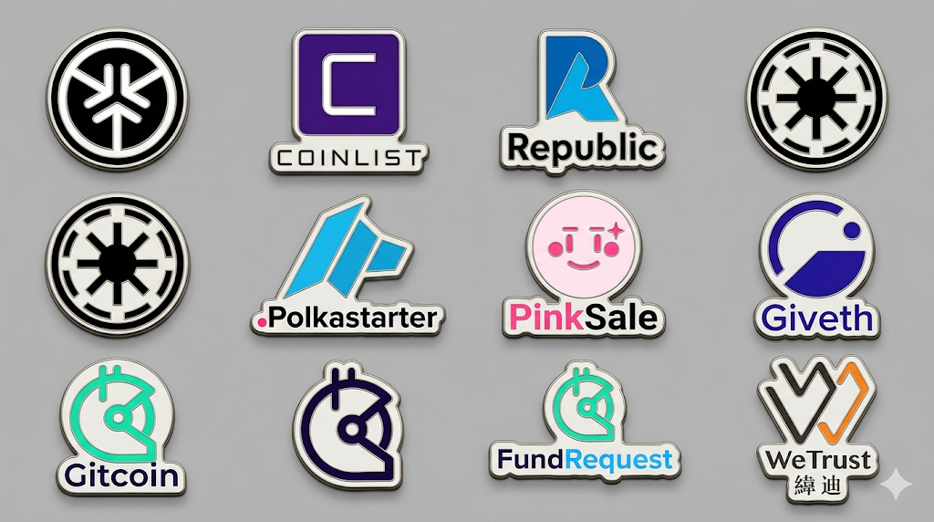

  Platforms using Blockchain

Slide 16

4
  Real Example: KickICO
Blockchain-based crowdfunding platform
Uses tokenization (ICOs) to raise funds
Smart contracts automate funding rules
and distribution
Investors receive digital tokens representing
value or utility
Removes intermediaries, reducing costs and
increasing transparency
Enabled global participation from investors

Slide 17



THANK YOU

