Slide 1
Web Programming
Assignment #6
Name: Akhmedov Yusufjon Muhammad ugli
Major: Computer Engineering
Student Number: 202438404
Due date: 2025.05.30
Submission date: 2025.05.29

Slide 2
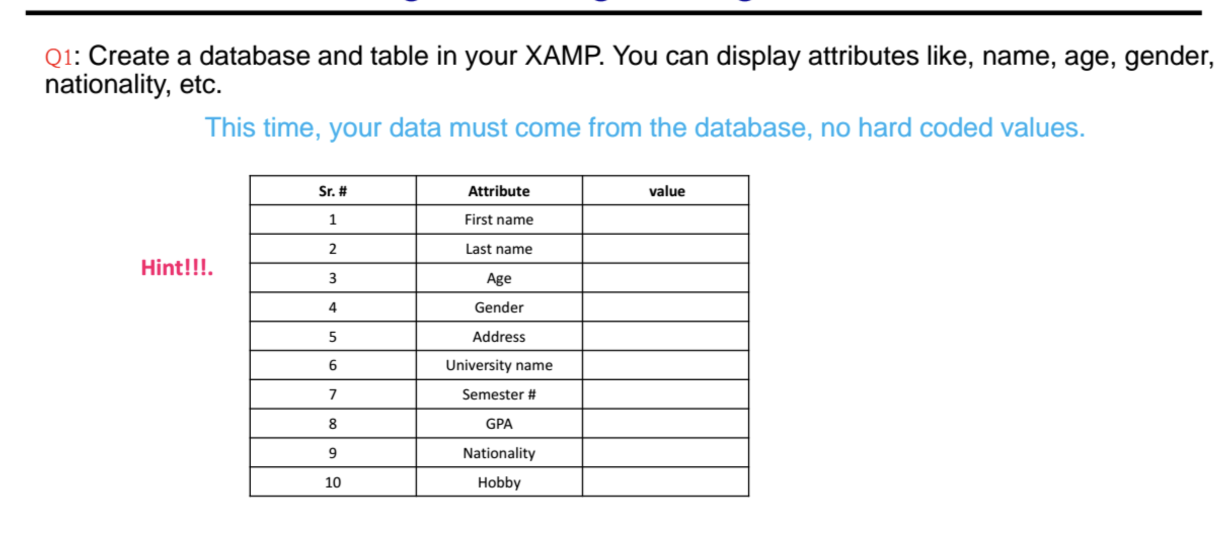
Question 1

Slide 3
Q1. PHP Code
<!DOCTYPE html><html lang="en"><head><meta charset="UTF-8"><title>Students Database</title><link rel="stylesheet" href="style.css"></head><body><h1>Students personal information</h1><?php
$servername="localhost";$username="root";$password="root";$databasename="school";
$conn=new mysqli($servername,$username,$password,$databasename);
if($conn->connect_error){die("Connection failed: ".$conn->connect_error);}
$query="SELECT * FROM `student`;";
$columns=['first_name'=>'First name','last_name'=>'Last name','age'=>'Age','gender'=>'Gender','address'=>'Address','university_name'=>'University name','semester'=>'Semester #','gpa'=>'GPA','nationality'=>'Nationality','hobby'=>'Hobby'];
$result=$conn->query($query);
if($result->num_rows>0){?><div class="table-container"><?php while($row=$result->fetch_assoc()){?><table border="1"><thead><tr><th>Sr.#</th><th>Attribute</th><th>Value</th></tr></thead><tbody><?php $sr=0;foreach($columns as $key=>$value){?><tr><td><?=++$sr;?></td><td><?=$value?></td><td><?=$row[$key]?></td></tr><?php }?></tbody></table><?php }?></div><?php }else{echo"0 results";}
$conn->close();?></body></html>

Slide 4
Q1. CSS Code
.table-container {
display: flex;
gap: 1rem;
flex-wrap: wrap;
}
table {
border-collapse: collapse;
text-align: center;
width: fit-content;
}
td {
padding: 0 10px;
}

Slide 5
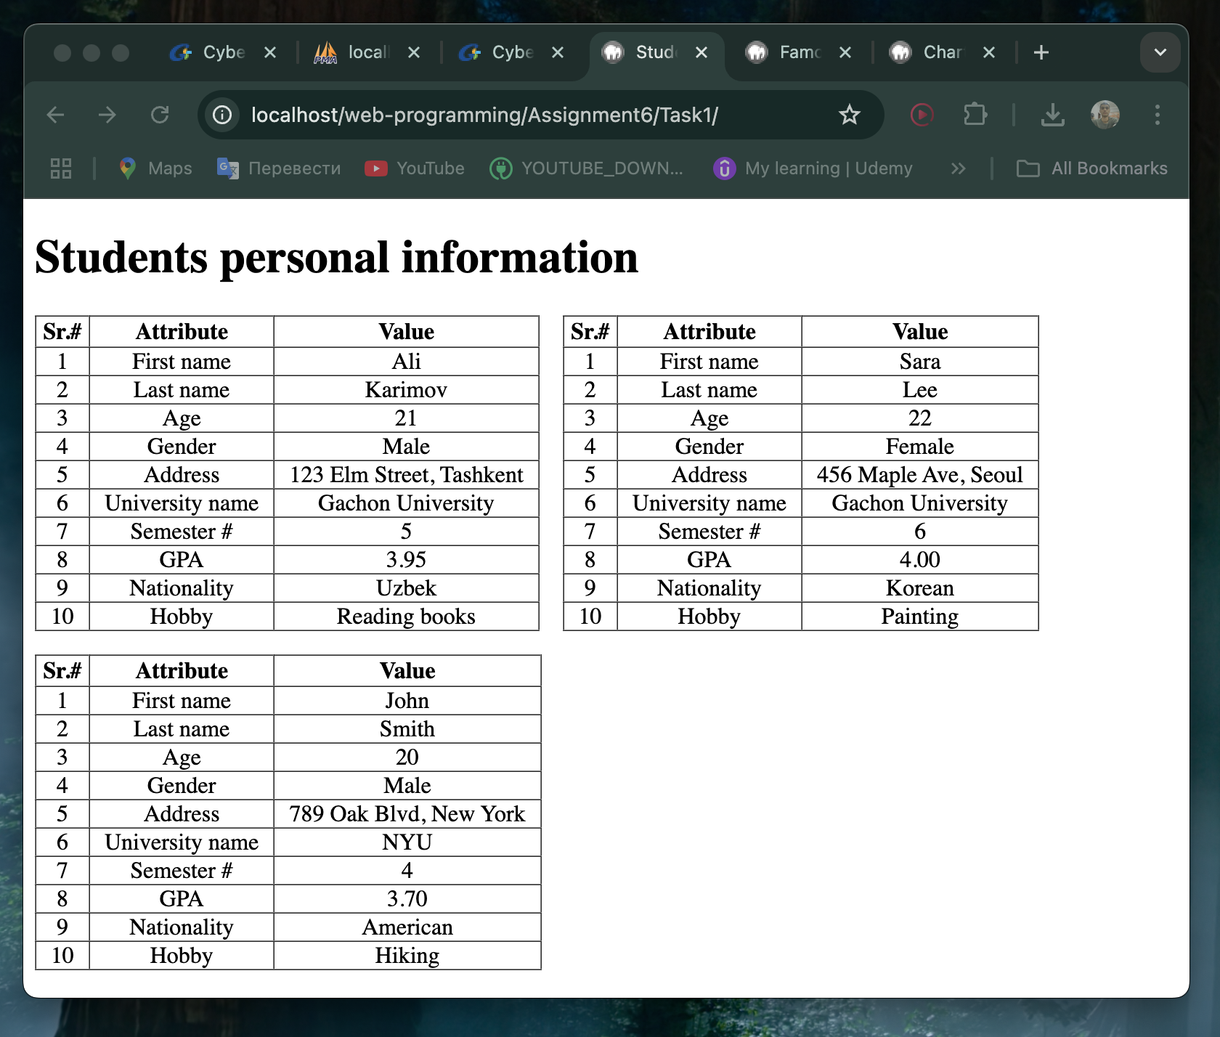
Output#1

Slide 6
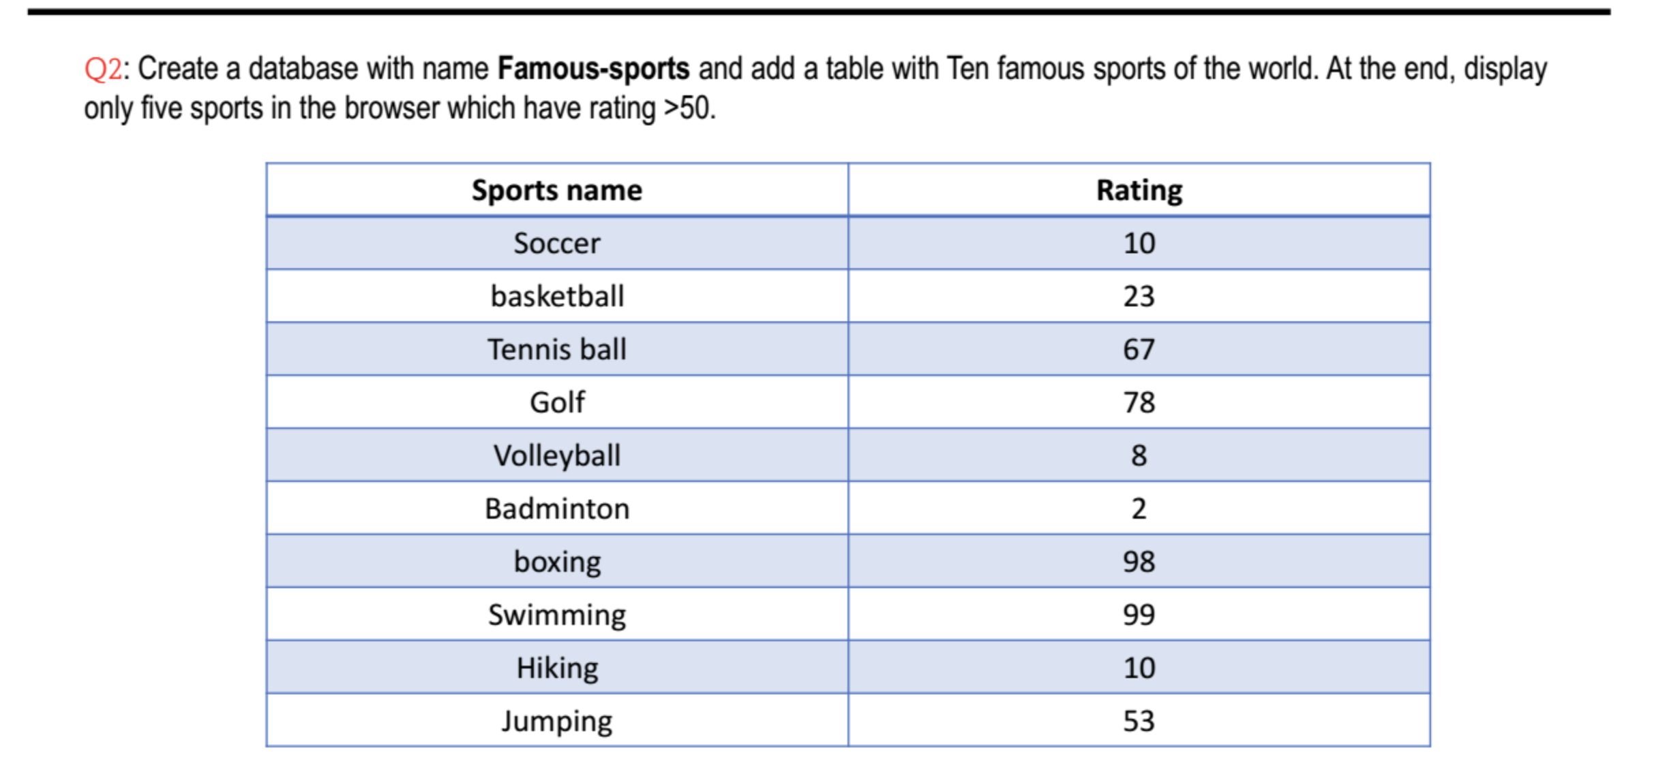
Question 2

Slide 7
Q2. PHP Code
<!DOCTYPE html><html lang="en"><head><meta charset="UTF-8"><title>Famous Sports</title><link rel="stylesheet" href="../../Assignment3/bootstrap.min.css"></head><body class="p-3"><h1>Sports with rating over 50</h1><?php
$servername="localhost";$username="root";$password="root";$databasename="famous-sports";
$conn=new mysqli($servername,$username,$password,$databasename);
if($conn->connect_error){die("Connection failed: ".$conn->connect_error);}
$query="SELECT * FROM `sports` WHERE rating > 50;";
$result=$conn->query($query);
if($result->num_rows>0){?><table class="table table-sm table-bordered table-striped w-25"><thead><tr><th>Sports Name</th><th>Rating</th></tr></thead><tbody><?php while($row=$result->fetch_assoc()){?><tr><td><?=$row['sports_name']?></td><td><?=$row['rating']?></td></tr><?php }?></tbody></table><?php }else{echo"0 results";}
$conn->close();?></body></html>

Slide 8
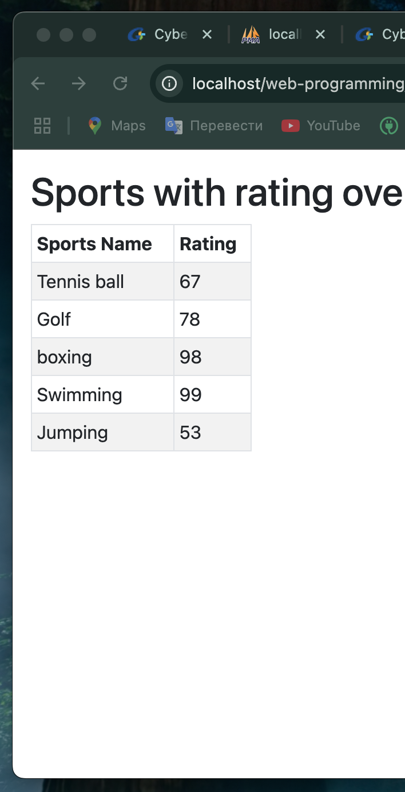
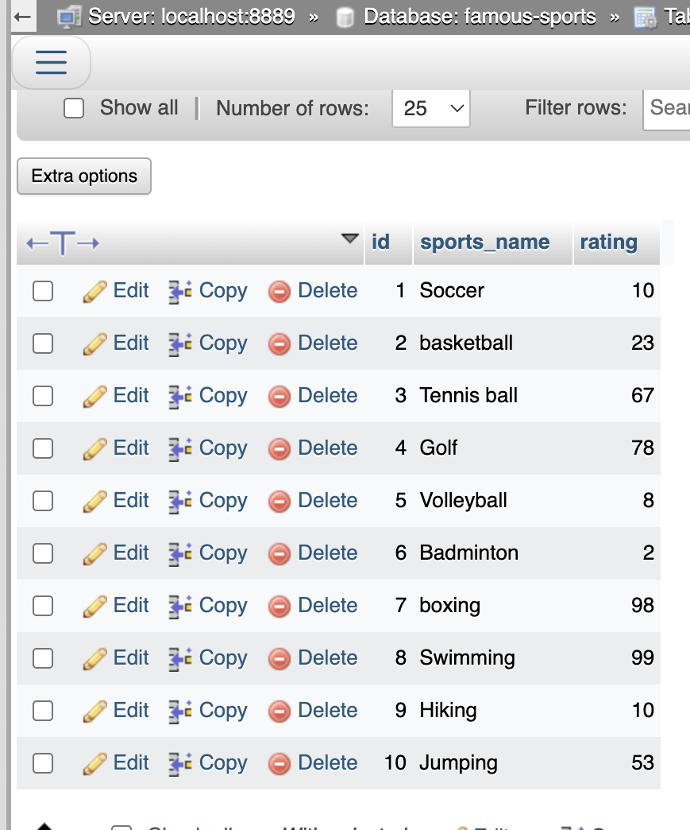
Output
#2

Slide 9
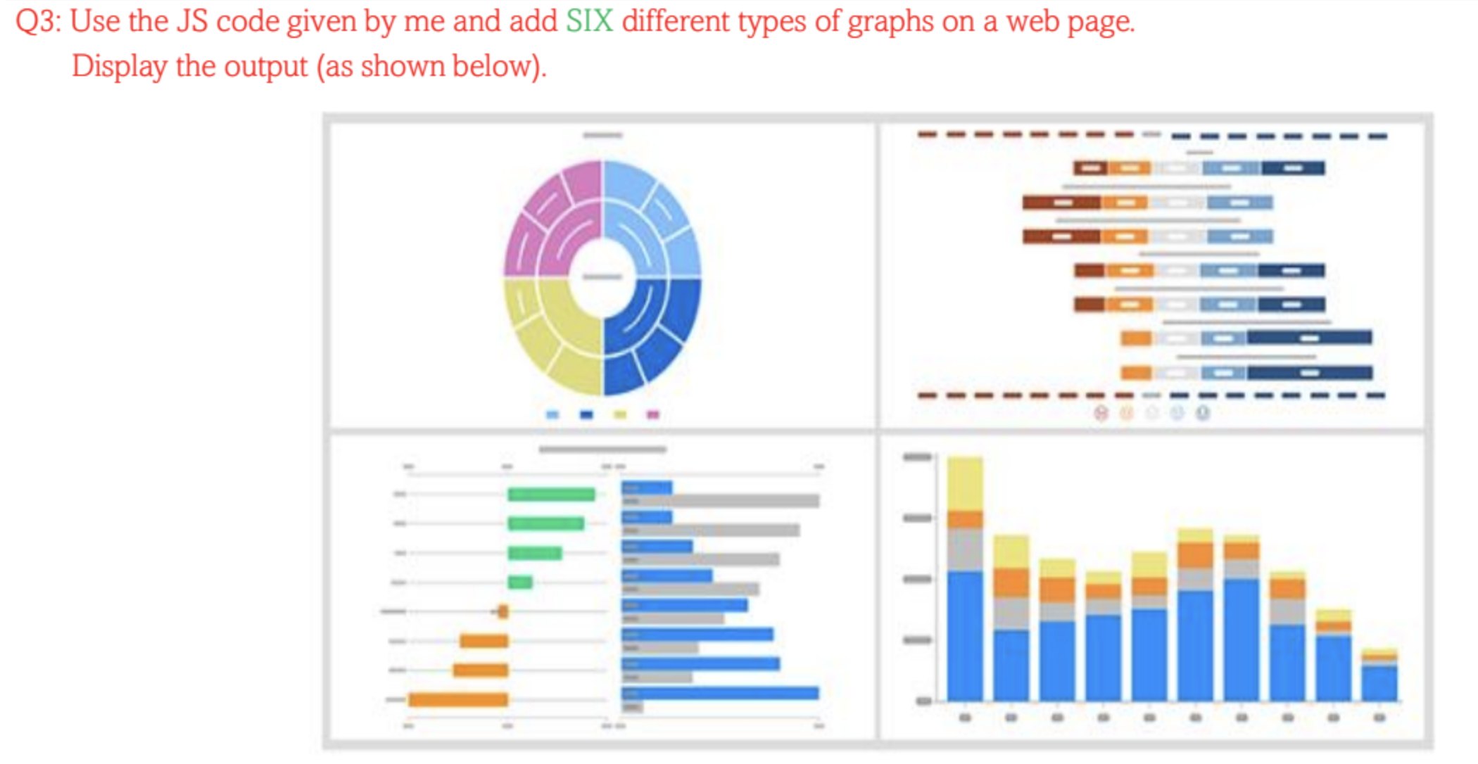
Question 3

Slide 10
Q1. HTML Code
<!DOCTYPE html>
<html>
<head>
<title>ChartJS - 6 types</title>
<link href="css/default.css" rel="stylesheet" />
</head>
<body>
<div class="wrapper">
<div class="chart-container">
<canvas id="bar-chartcanvas"></canvas>
</div>
<div class="chart-container">
<canvas id="line-chartcanvas"></canvas>
</div>
<div class="chart-container-sm">
<canvas id="doughnut-chartcanvas-1"></canvas>
</div>
<div class="chart-container-sm">
<canvas id="doughnut-chartcanvas-2"></canvas>
</div>
<div class="chart-container-sm">
<canvas id="pie-chartcanvas-1"></canvas>
</div>
<div class="chart-container-sm">
<canvas id="pie-chartcanvas-2"></canvas>
</div>
</div>
<!-- javascript -->
<script src="js/jquery.min.js"></script>
<script src="js/Chart.min.js"></script>
<script src="js/doughnut.js"></script>
<script src="js/bar.js"></script>
<script src="js/line.js"></script>
<script src="js/pie.js"></script>
</body>
</html>

Slide 11
Q1. CSS Code
.wrapper{
display: flex;
flex-wrap: wrap;
}
.chart-container {
width: 50%;
height: 33%;
margin: 0 auto;
}
.chart-container-sm {
width: 25%;
height: 33%;
margin: 0 auto;
}

Slide 12
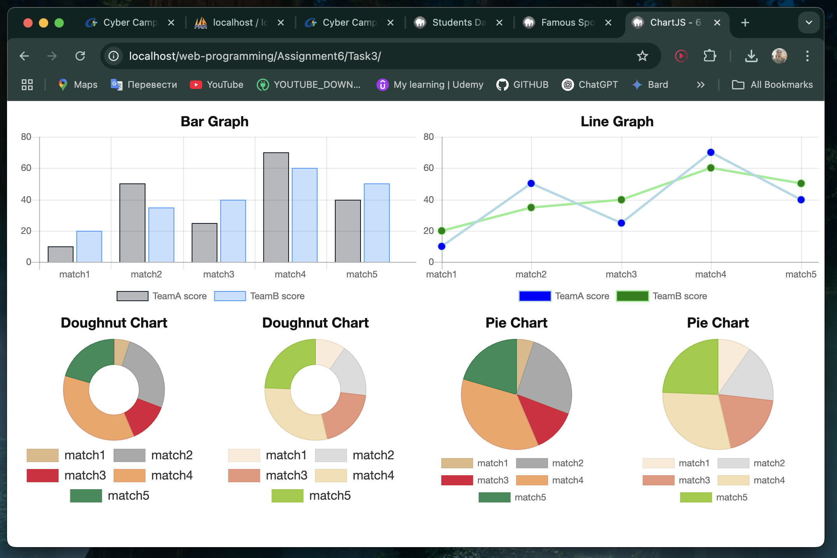
Output
#3

Slide 13
Question 5
Q4: Why JS functions are used in web developments. Please write answer with 2~3 sentences only.
Answer: JS functions are used in web development to make code understandable and reusable. They also perform actions when user trigger some event such as click of a button or scroll of a page

Slide 14
Question 6
Q5:Why are database-powered websites more useful than static ones? Please answer in THREE to FIVE lines only.
Answer: Efficiency of database-powered websites is huge because if we want to change the data on page, we don’t have to change that file manually. I cannot imagine good website without dynamic features, such as login, comment, personalized or recommended data for user, which cannot almost be made without database.

