Slide 1
DB Integrated Chart
Five marks activity
Name: Akhmedov Yusufjon Muhammad ugli
Major: Computer Engineering
Student Number: 202438404
Due date: 2025.06.01
Submission date: 2025.06.01

Slide 2
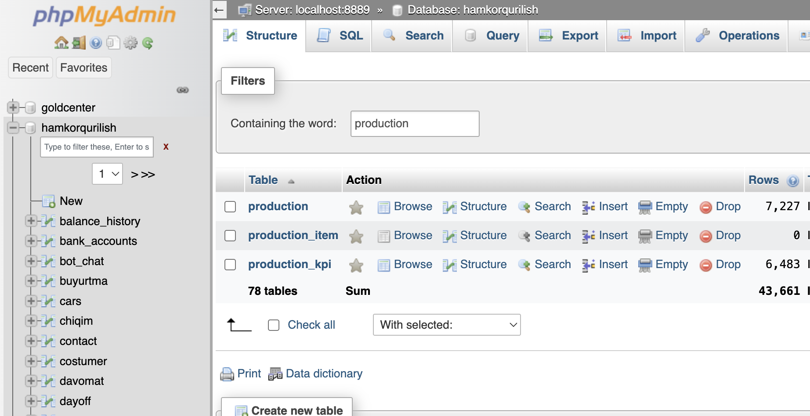
Setup DB
Database named hamkorqurilish a which I created for beton24 startup in my country

Slide 3
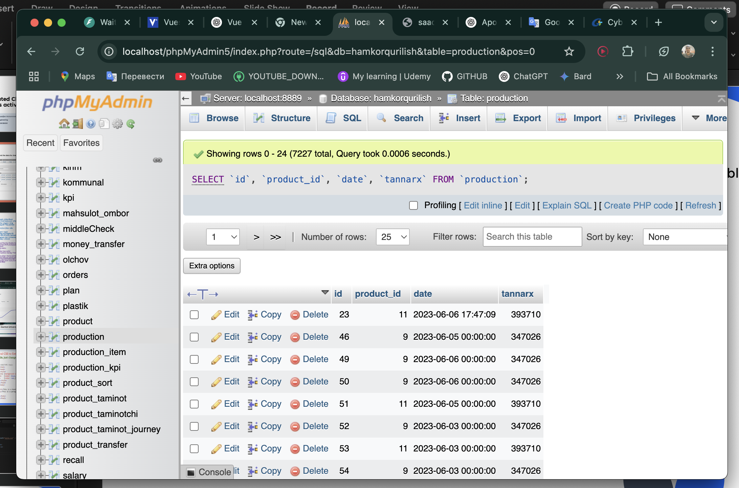
Create a table
A table named production a which gives information about when special product was produced

Slide 4
Add data to table: Code
This code is part of a Yii2 controller that primarily handles the addition of production data based on requests from the frontend. It identifies which products are being produced and in what quantities, then verifies whether there are enough raw materials available for production. If the requirements are met, the production data is saved. Additionally, the tannarx column stores the calculated cost of the product, derived from the costs of its raw materials.
if($plan_id=$request->post('save_btn')){$plan=Plan::findOne($plan_id);$id_arr=explode(';',$plan->product_id);$unique_ids=array_unique($id_arr);$all_error_names='';$total_errors=0;$plan->plan_value+=$request->post('plan_value');foreach($unique_ids as $id){$count=count(array_keys($id_arr,$id));$product=Product::findOne($id);if(!$product->getTarkib()->count()){$session->setFlash('danger','No composition assigned to the product.');return $this->refresh();}$production=new Production(['date'=>$plan->date,'product_id'=>$product->id,'value'=>$request->post('plan_value')*$count]);$validation=self::checkProduction($product,$production);if($validation['number_error']>0){$all_error_names.="<br>".$validation['number_error_names'];$total_errors++;}}if($total_errors>0){$session->setFlash('danger','Not enough raw materials: '.$total_errors.$all_error_names);return $this->refresh();}foreach($unique_ids as $id){$count=count(array_keys($id_arr,$id));$product=Product::findOne($id);if(!$product->getTarkib()->count()){$session->setFlash('danger','No composition assigned to the product.');return $this->refresh();}$production=new Production(['date'=>$plan->date,'product_id'=>$product->id,'value'=>$request->post('plan_value')*$count,'seh_id'=>$plan->seh_id,'plan_id'=>$plan->id]);self::makeProduction($production,$product,$plan->seh,0,0,0);$plan->save();}$this->setFlash('success',Yii::t('app','Saved'));return $this->refresh();}

Slide 5
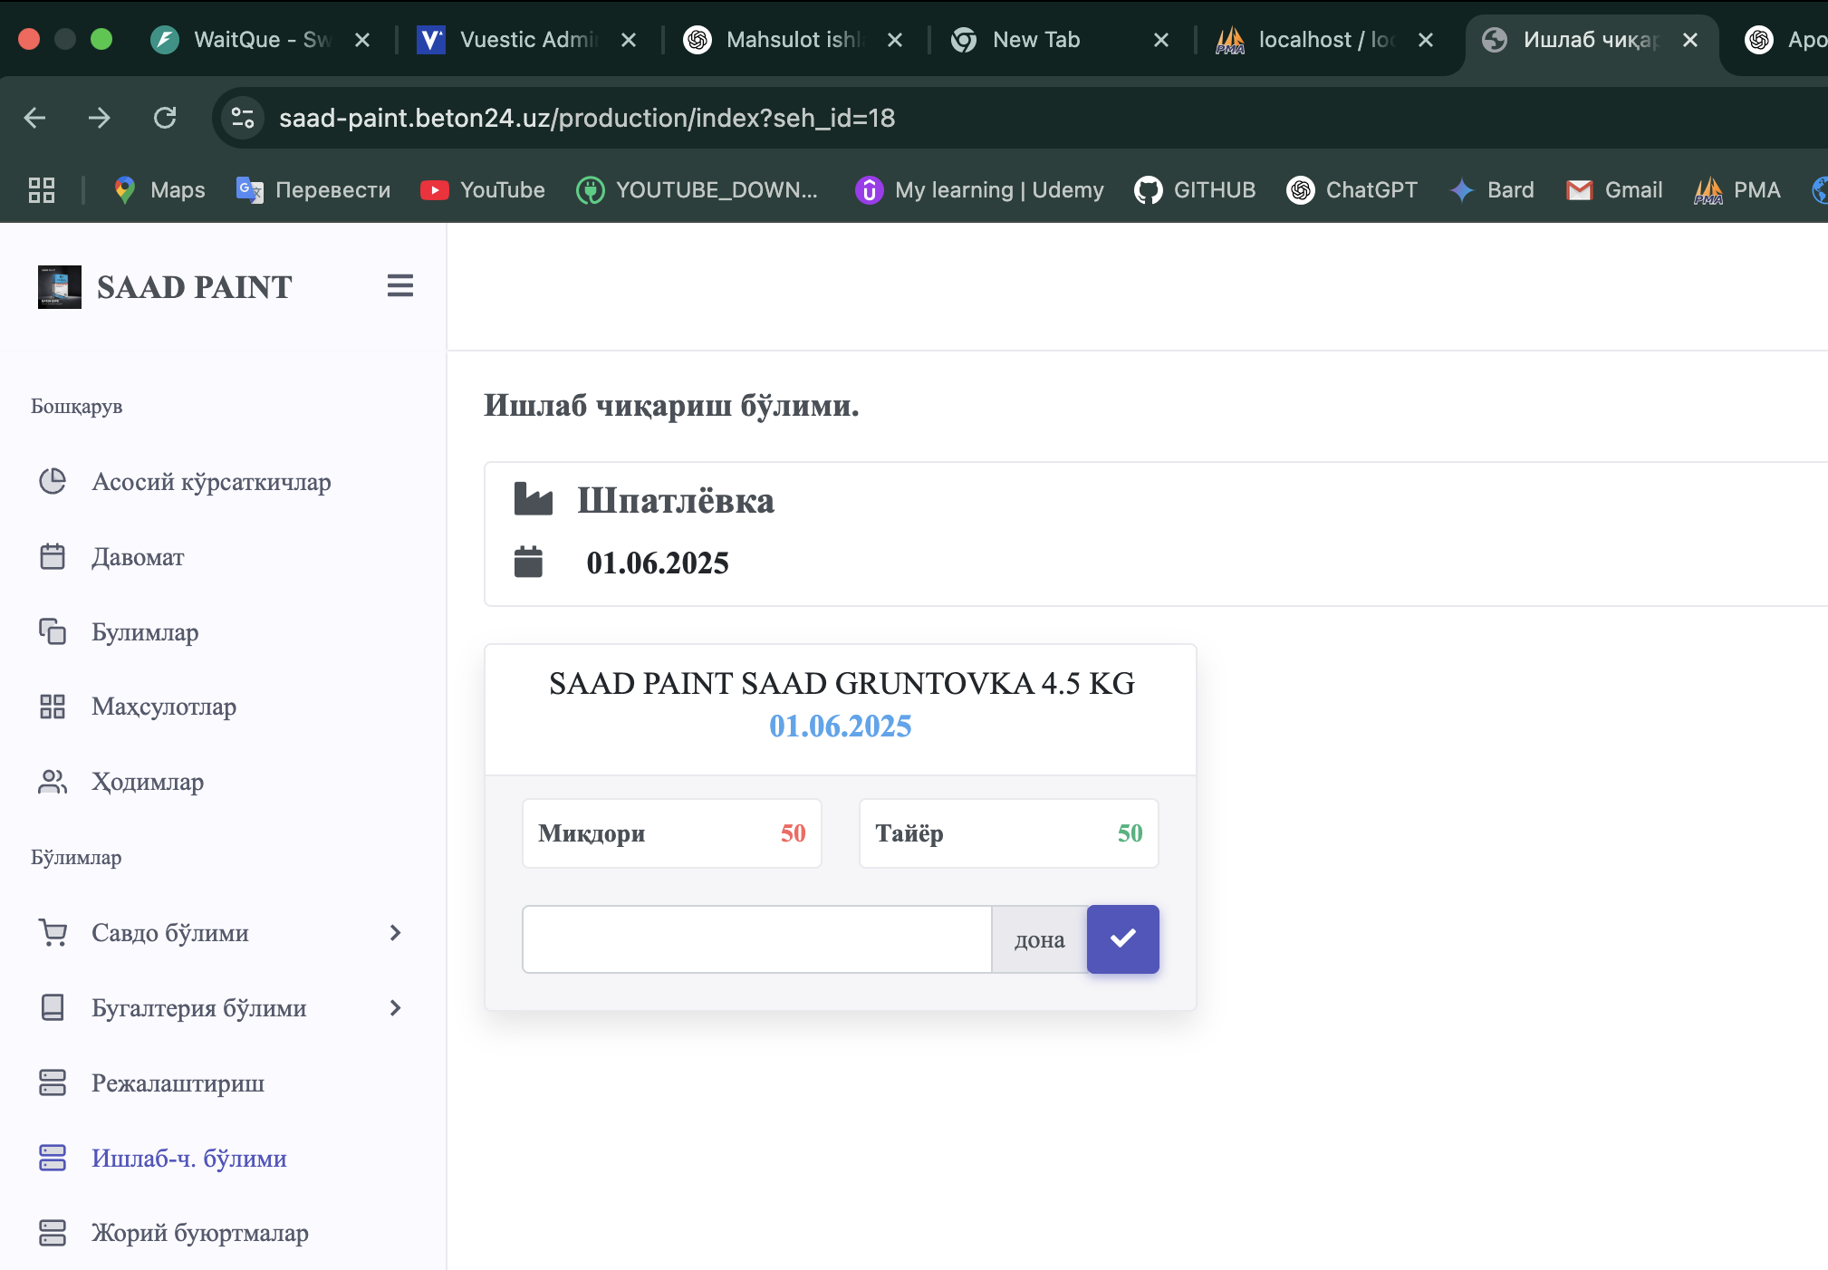
Add data to table: Front side
Here actual quantity should be entered on specific product card which was planned to be produced.
In this case, product is (Gruntovka 4.5KG)

Slide 6
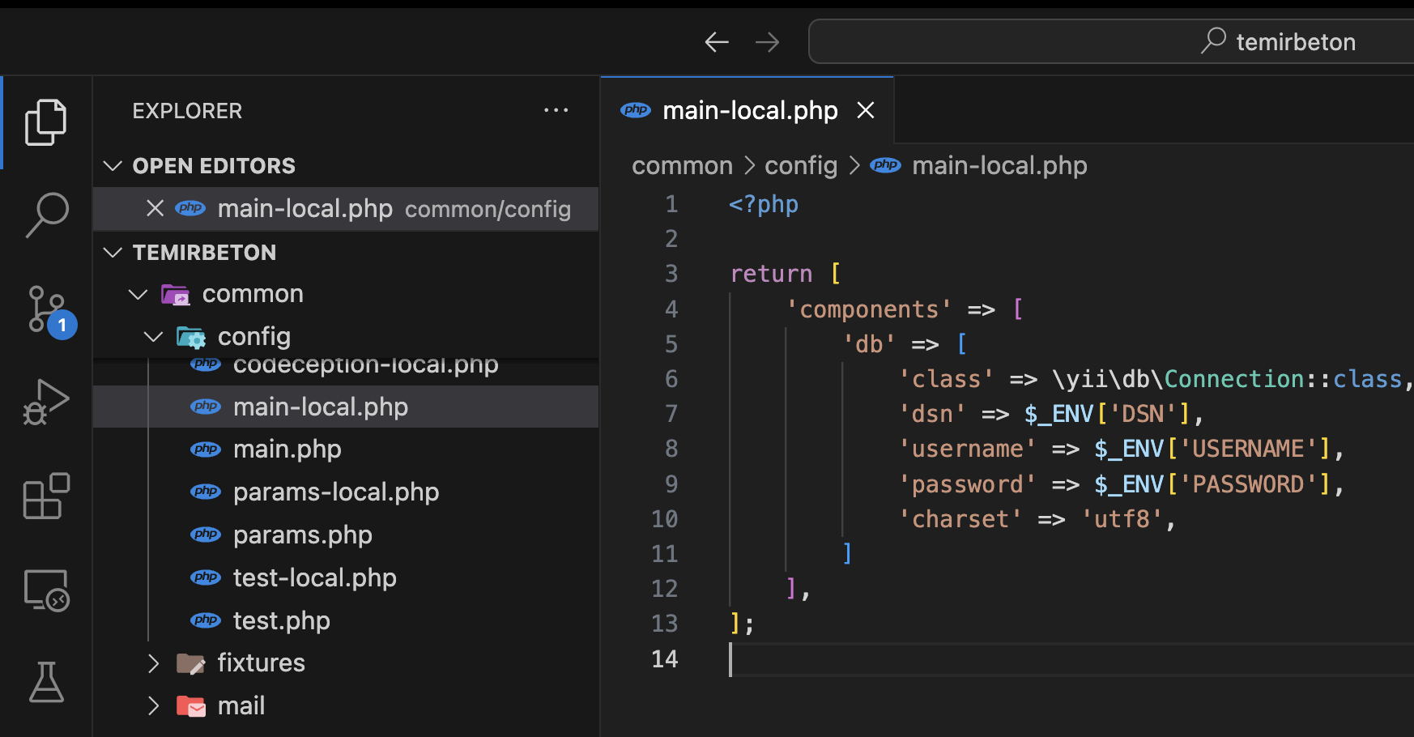
Add details of the database in PHP files
Database connection file: we should put db credentials here so that YII2 Framework be able to connect to DB

Slide 7
Query code: controller
Query code to DB for cost fluctuation chart:
$monyhlyProduction = $product->getProduction()
->orderBy('date DESC’)
->limit(10)->all();
usort($monyhlyProduction, fn($a, $b) => strcmp($a->date, $b->date));

Slide 8
Frontend code: cost_chart.php
This Yii2 view displays a line chart of product costs (tannarx) over the month using ApexCharts. It maps production data on the y-axis and day-month labels on the x-axis, formatted and localized as needed.
<?php use common\widgets\RegisterJS;use yii\helpers\ArrayHelper;?><div id="chart"></div><?php $this->registerJsFile("https://cdn.jsdelivr.net/npm/apexcharts");RegisterJS::begin();$data=ArrayHelper::getColumn($monyhlyProduction,'tannarx');$categories=ArrayHelper::getColumn($monyhlyProduction,function($p){return date('d',strtotime($p->date)).'-'.Yii::t('app',date('F',strtotime($p->date)));});?><script>var options={series:[{name:'<?=Yii::t('app','Tannarx')?>',data:<?=json_encode($data)?>}],chart:{height:350,type:'line',zoom:{enabled:!1}},dataLabels:{enabled:!1},stroke:{curve:'straight',colors:["#5156be"]},grid:{row:{colors:['#f3f3f3','transparent'],opacity:.5}},yaxis:{labels:{formatter:function(v){return v.toLocaleString().replace(/,/g,' ')+' <?=Yii::t('app','som')?>';}}},xaxis:{categories:<?=json_encode($categories)?>}};new ApexCharts(document.querySelector("#chart"),options).render();</script><?php RegisterJS::end(); ?>

Slide 9
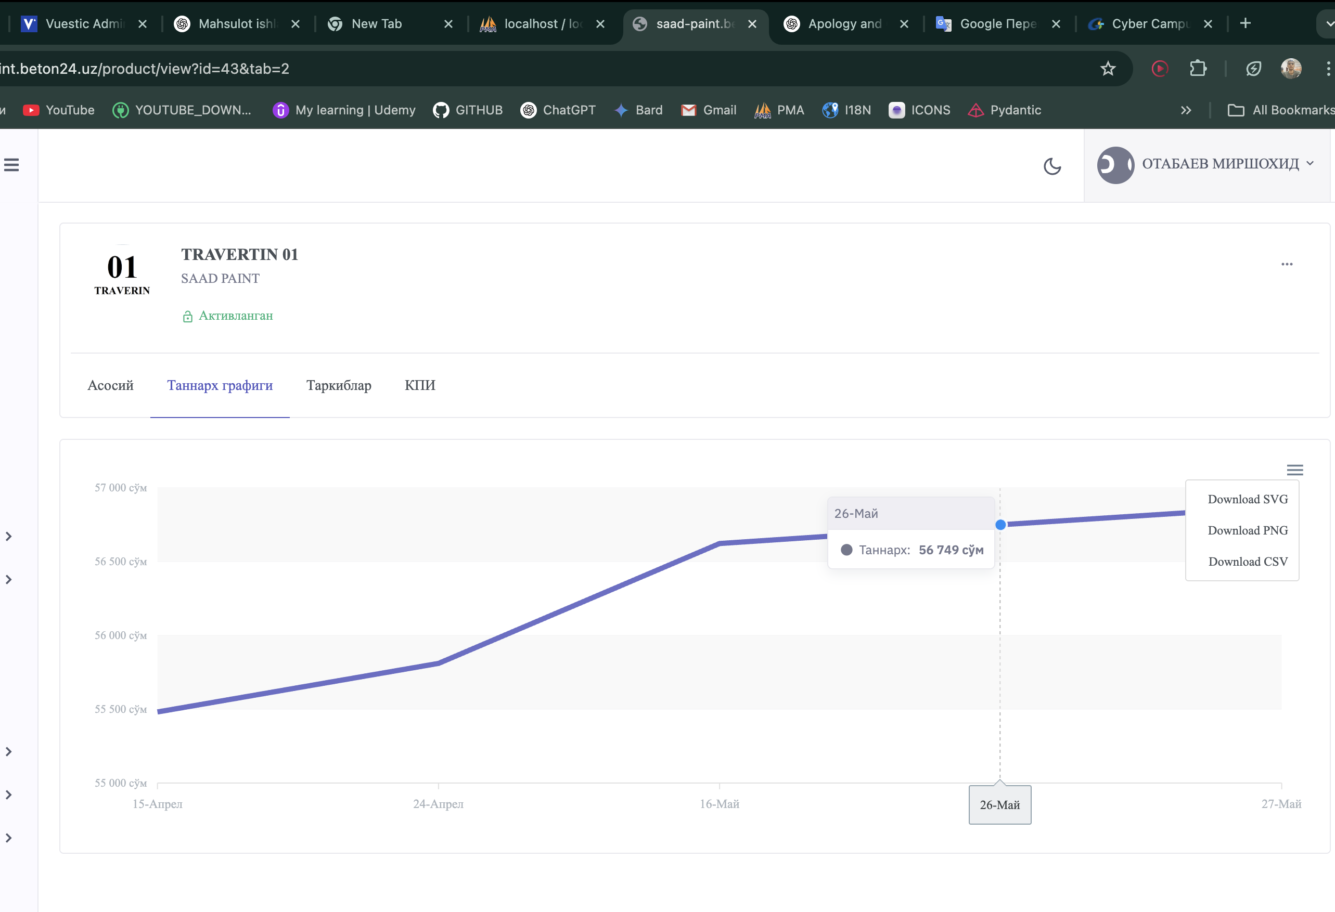
Final
Output

