Slide 1
SYSTEMD by Akhmedov Yusufjon (202438404) for Linux class

Slide 2
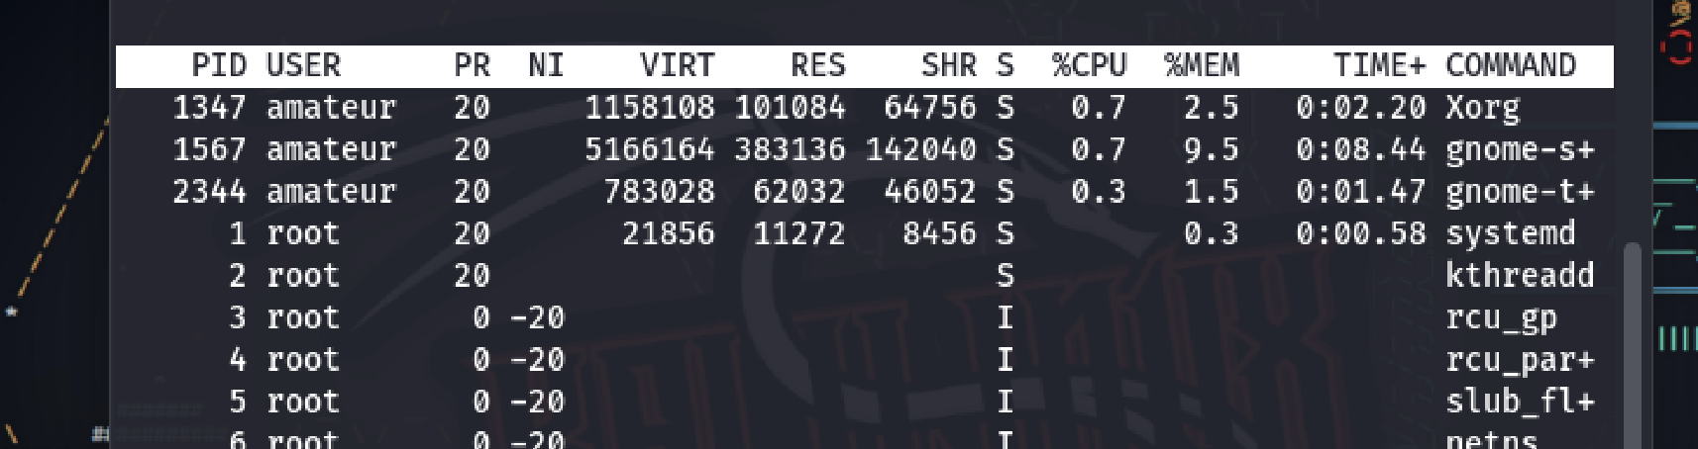
What is systemd ?
SYSTEMD is the most common init-system nowadays
Init-sytem of your Linux installation is the most important process (PID 1)
It is the very first process that starts on your system to schedule all other services
It is a very critical part of any linux server or linux installation

Slide 3
Systemd UNITs
Units in Systemd are resources/files that it’s able to manage. These include services, timers, mounts, targets etc. We’ll focus on services but keep in mind there are also other important ones

Slide 4
Systemd unit directories/folders
/
/etc/systemd/system/
/lib/systemd/system/
Directories provided are ordered in terms of priority level from top to bottom
Here, Files have most priority while execution. We do mainly here
/run/systemd/system/
temporary systemd unit files used at runtime and is cleared on reboot.
Built-in & installed app’s (default) unit files. Take a copy and customize in /etc

Slide 5
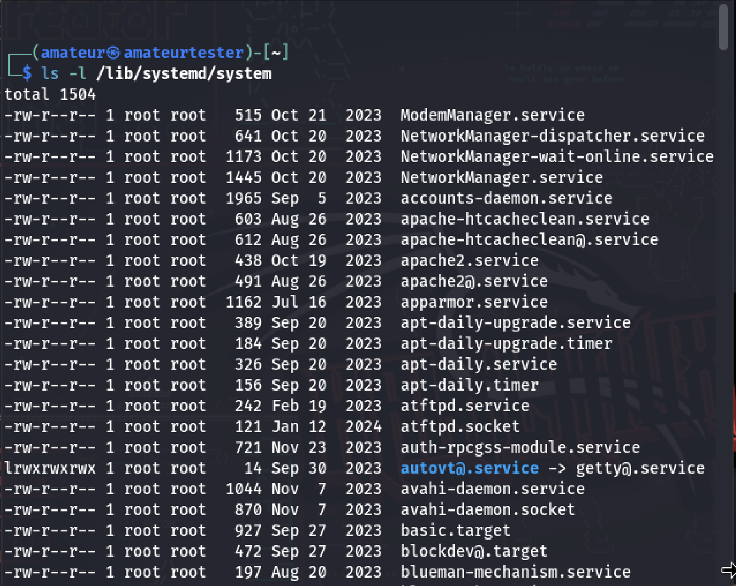
Unit files locations preview
ls -l /etc/systemd/system
ls -l /run/systemd/system
ls -l /run/systemd/system

Slide 6
What are the .service files?
.service files control how services start and run on Linux using systemd.
They define details like startup commands, dependencies, and restart rules.
Common locations are /etc/systemd/system/ and /lib/systemd/system/.

Slide 7
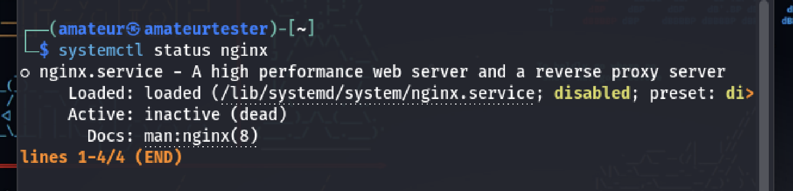
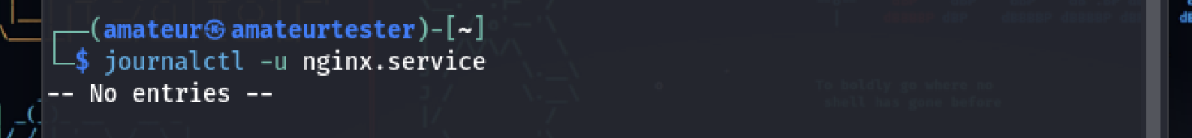
How to manage .service files
systemctl is the main tool to control and manage systemd services.
You can use it to start, stop, enable, disable, reload, and check the status of services.
journalctl is used to view logs collected by systemd’s journal.
It shows system logs, service logs, and boot logs in real time or from the past.

Slide 8
01
02
03
Start
Check
Enable
04
05
06
Disable
Edit
daemon-reload
Most common and important systemctl command lines you should know
systemctl start service-name
systemctl status service-name
systemctl enable service-name
systemctl disable service-name
systemctl edit service-name
systemctl edit --full
systemctl daemon-reload
systemd reloads configuration files
07
08
Reload
Restart
systemctl reload service-name
systemctl restart service-name

Slide 9
Let’s create own .service file!
We are gonna create a service file to run simple telegram bot made using python. To do so:
Deploy your project files to the linux (server) and save it inside your user’s home directory anywere.
For example, in /home/amateurtester/telegram_bot/….
Now you got bot.py file which you can run by python bot.py on the terminal
We’ll do all other stuff inside /etc/systemd/system/ folder so go to there using cd command
Then open new .service file for this app to make it running always on background
sudo nano telegram_bot.service Here you can put all your service settings, lets do it
The next step on the next slide ...

Slide 10
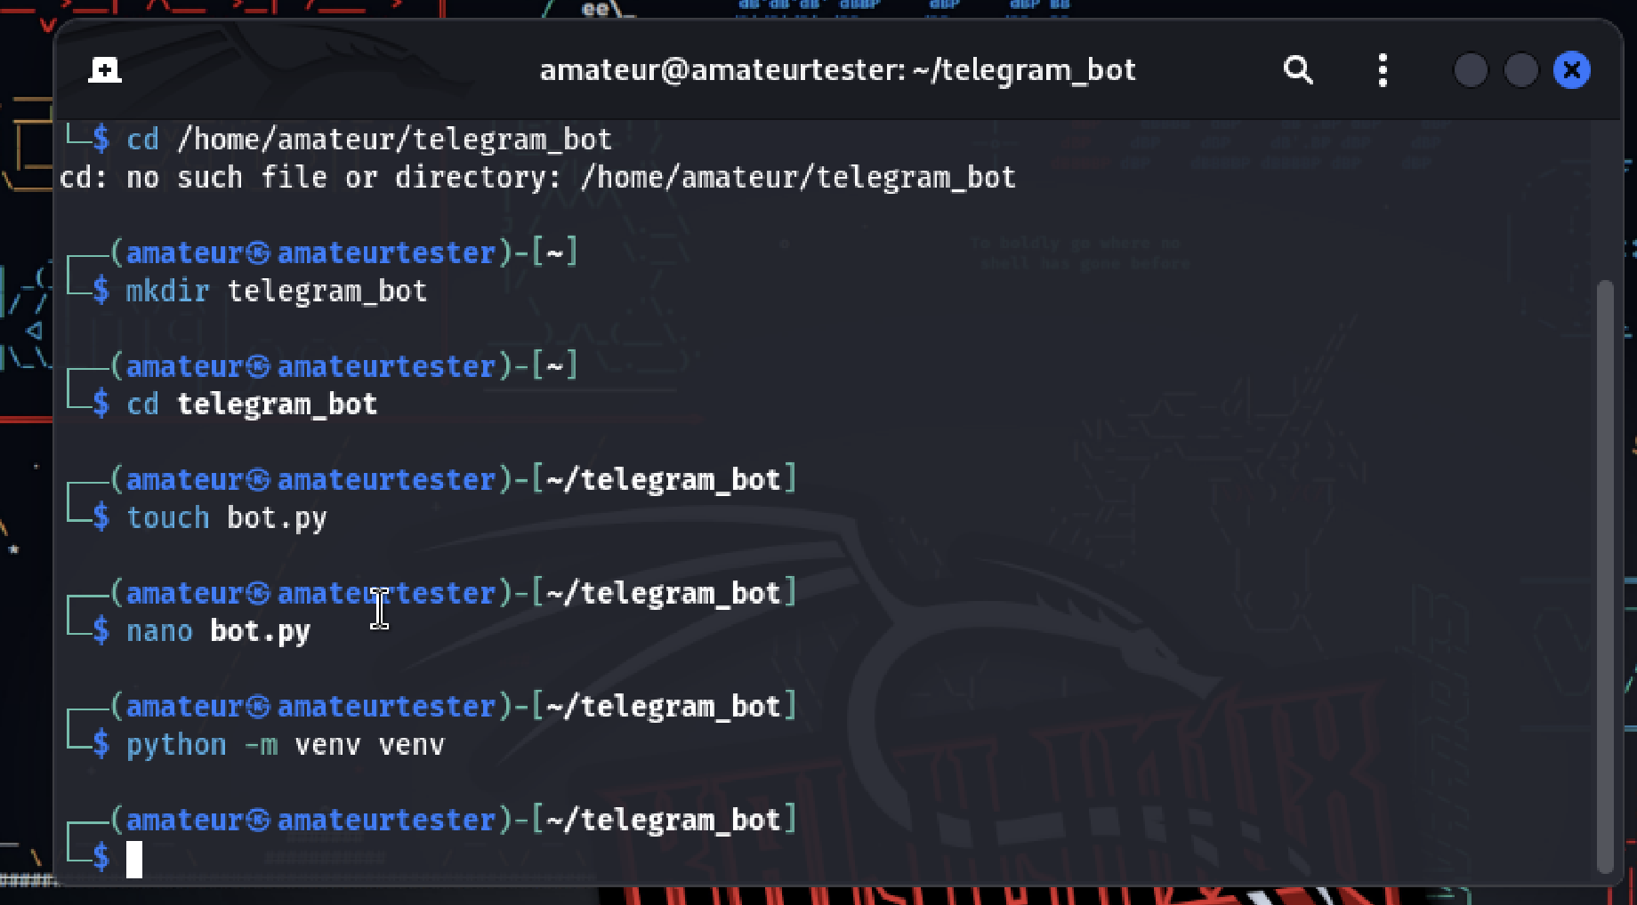
If you don’t have Bot:

Slide 11
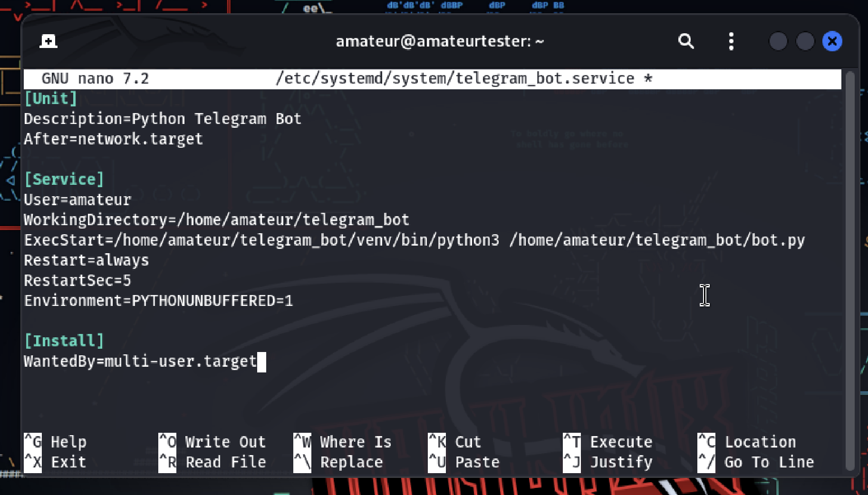
.service file syntax for our bot:

Slide 12
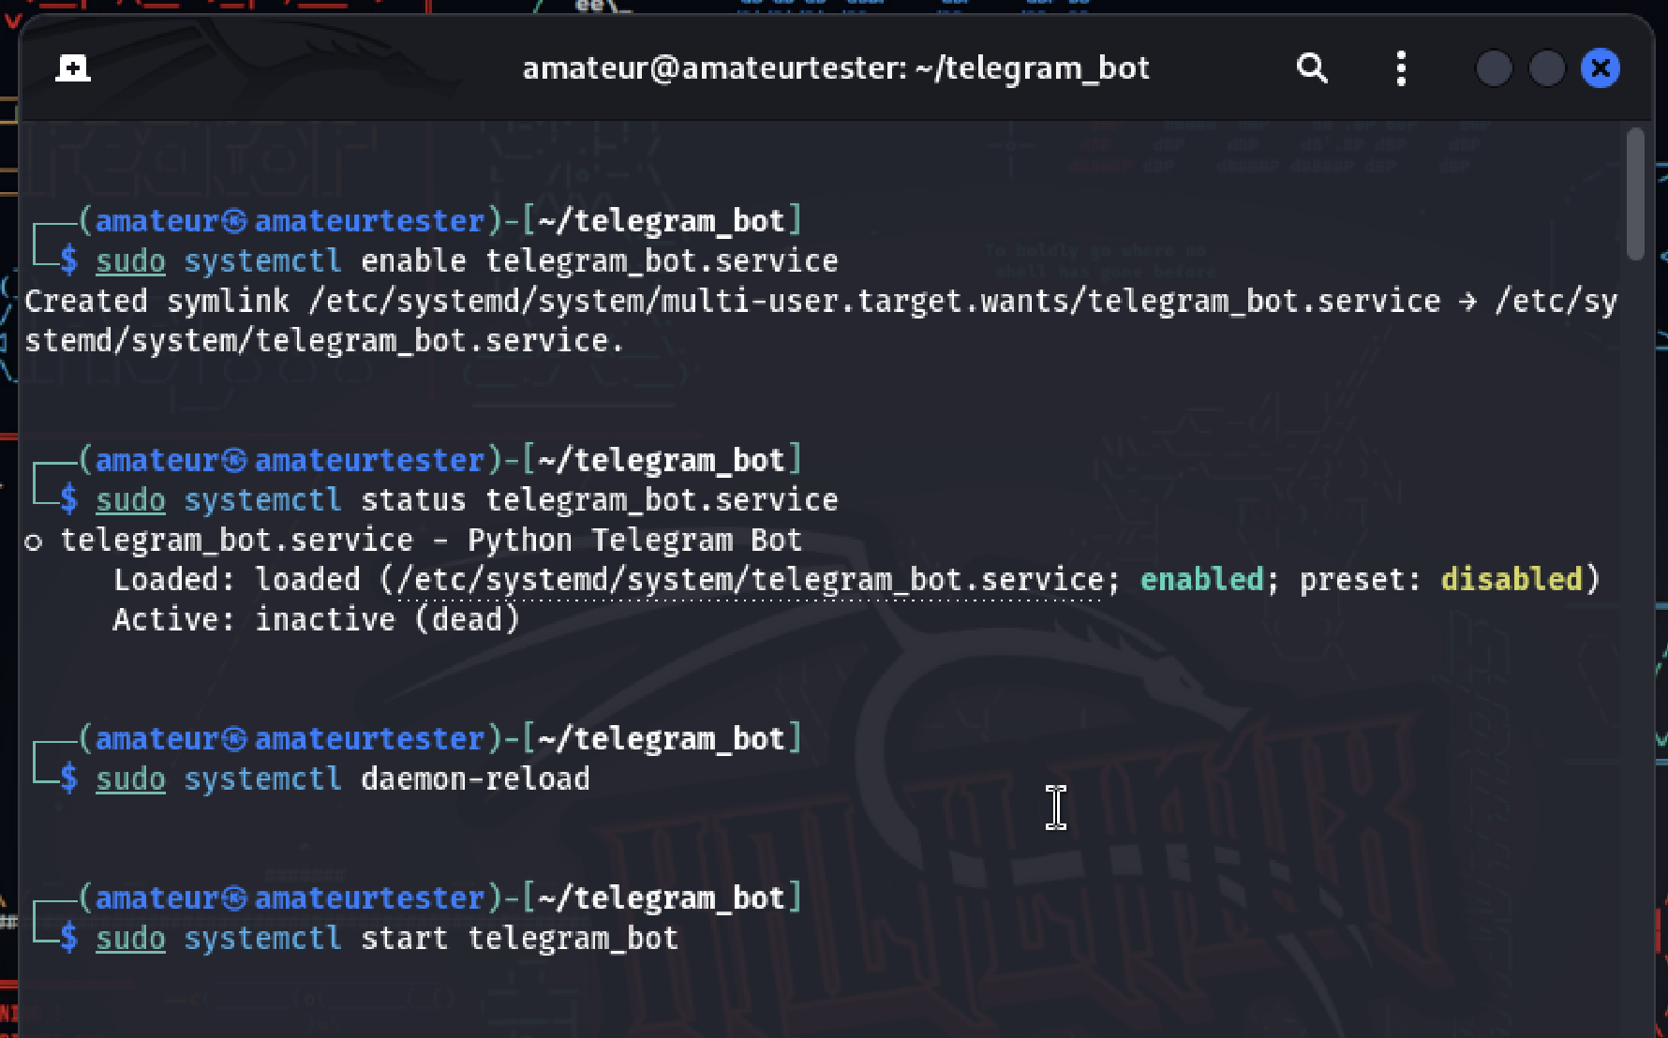
Use systemctl commands in 8th slide:

Slide 13
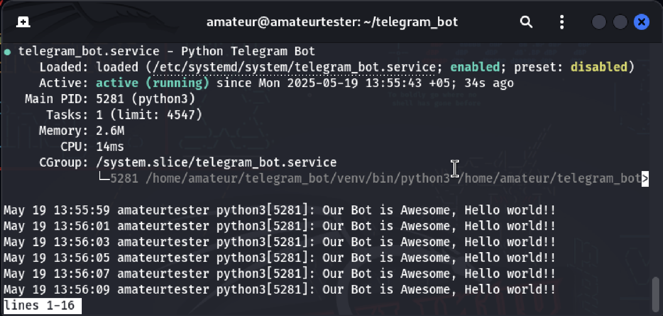
systemctl status telegram_bot:

Slide 14
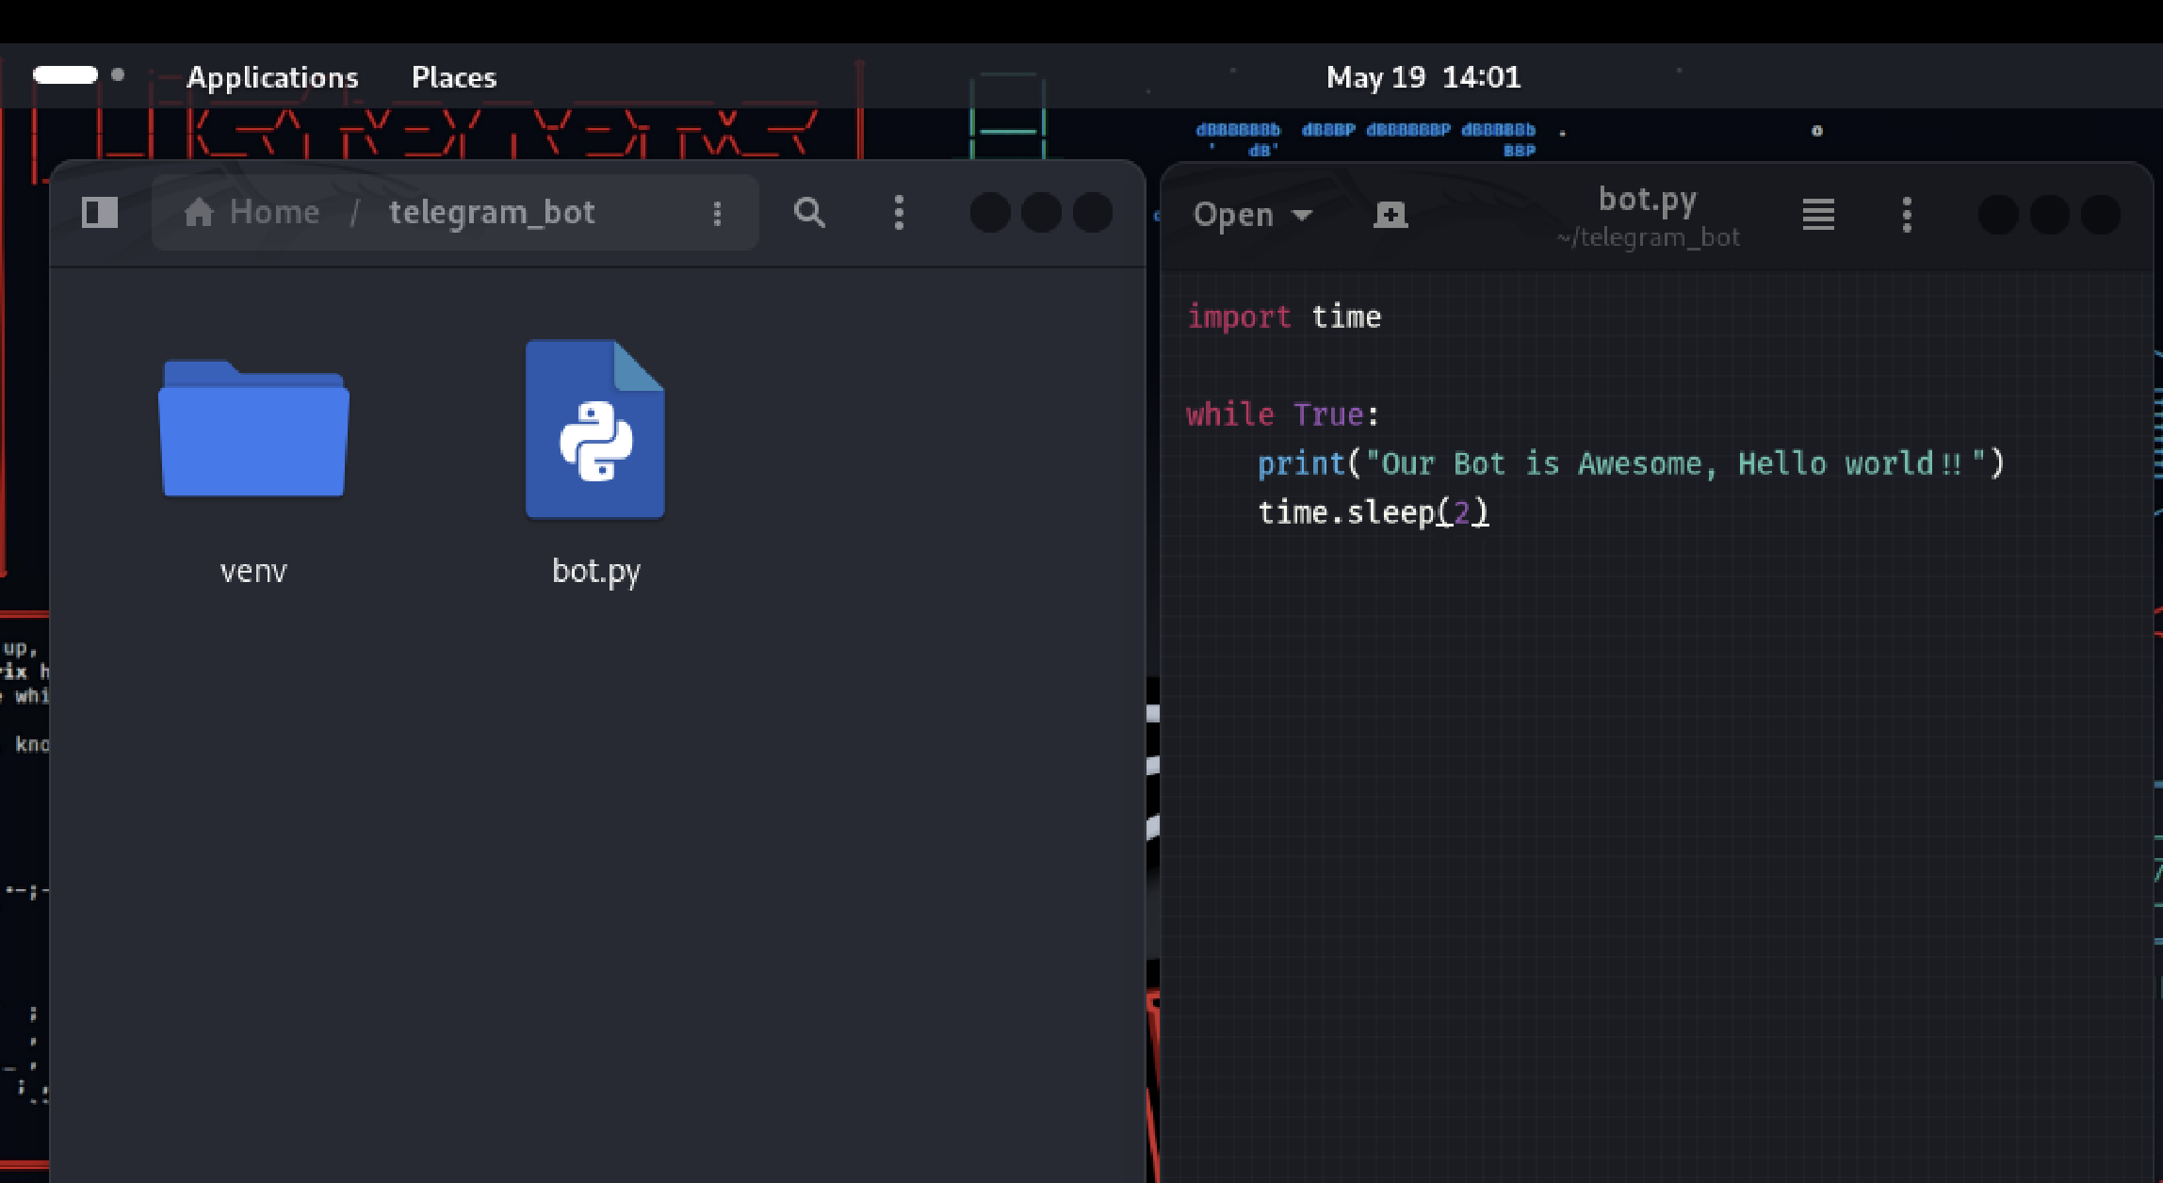
What was our bot/service ☺
I used While True, just to see active (running) when I see the status of telegram_bot service.

Slide 15
THANK YOU

