Slide 1

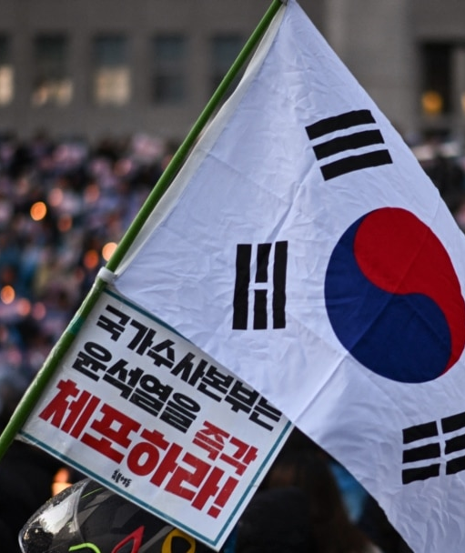
Korean Presidents &
Their Contributions
Republic of Korea, 1948–2026
AKHMEDOV YUSUFJON - 202438404

Slide 2
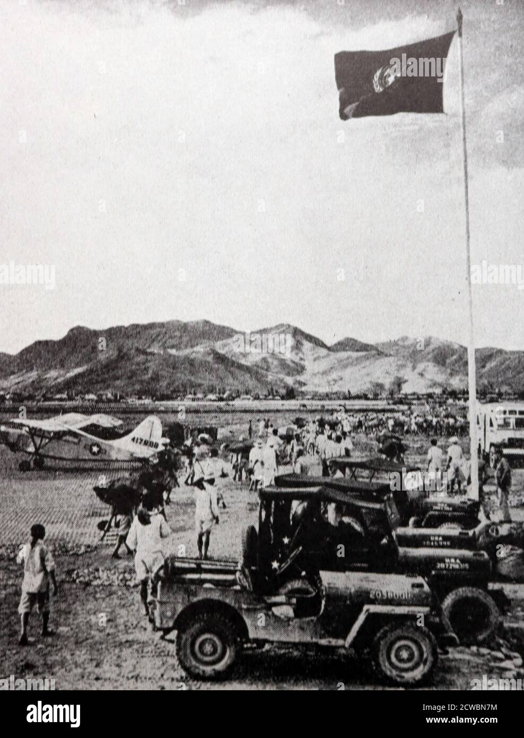
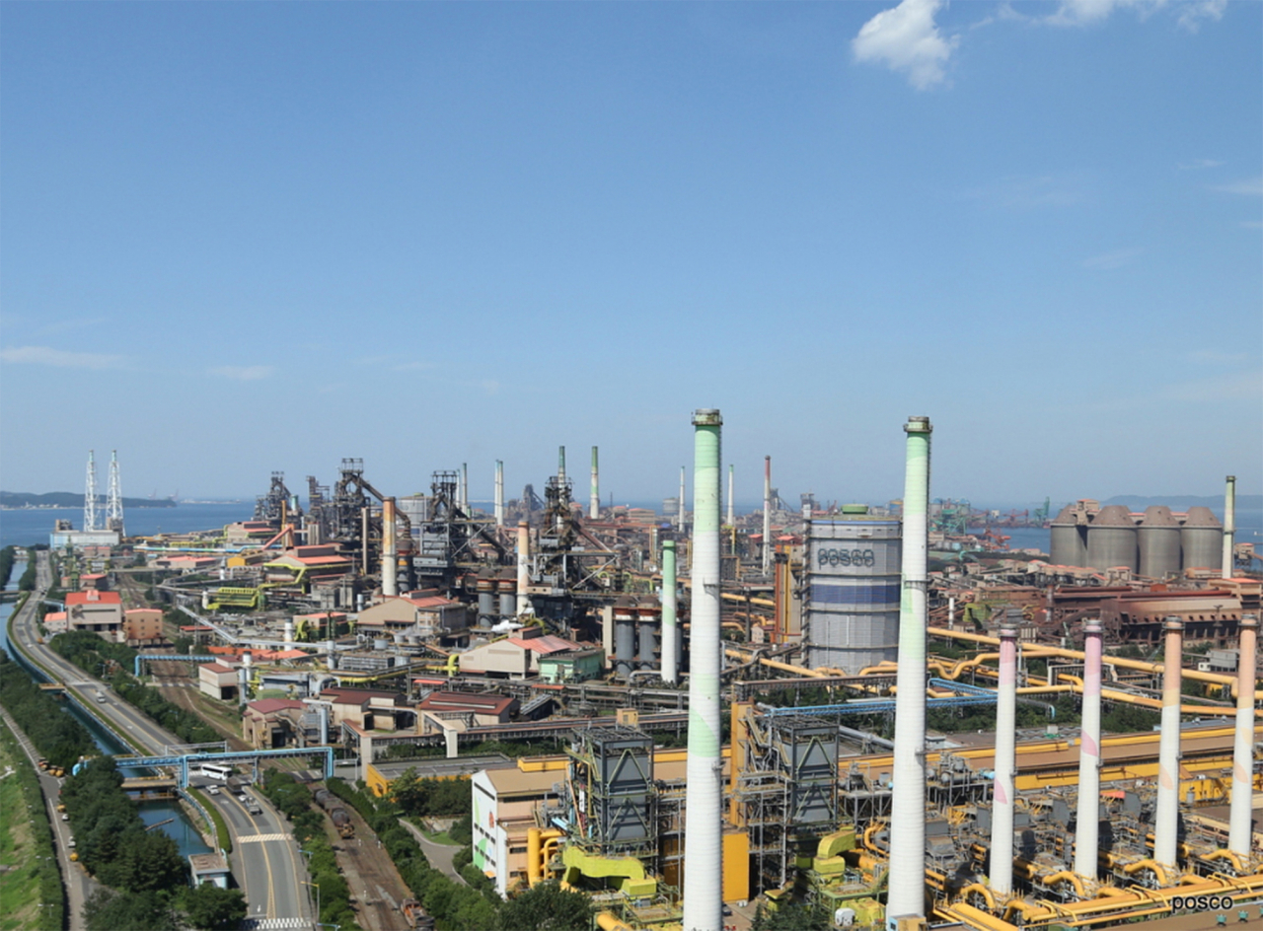
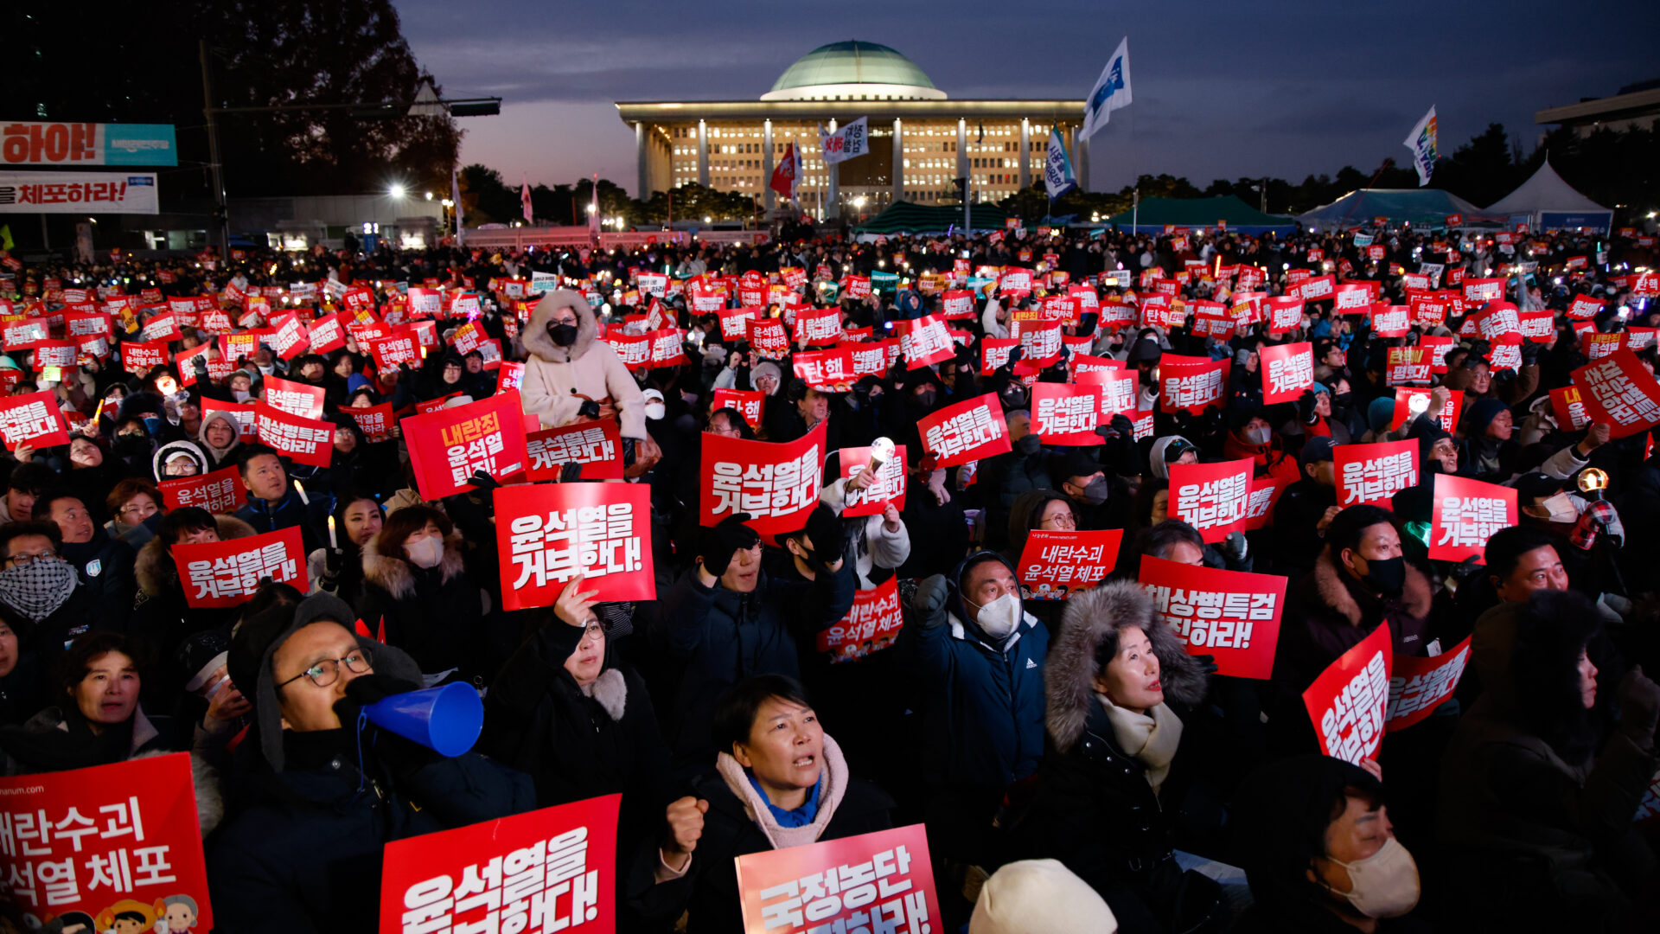
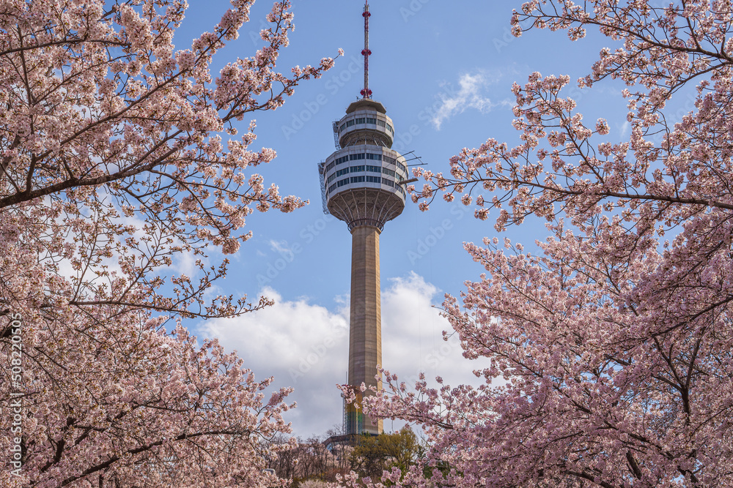
01
02
03
04
Modern Democracy (1993–2022)
Foundation Era (1948–1961)
Authoritarian Era (1963–1993)
Legacy & Impact

Slide 3
01
Foundation Era (1948–1961)

Slide 4
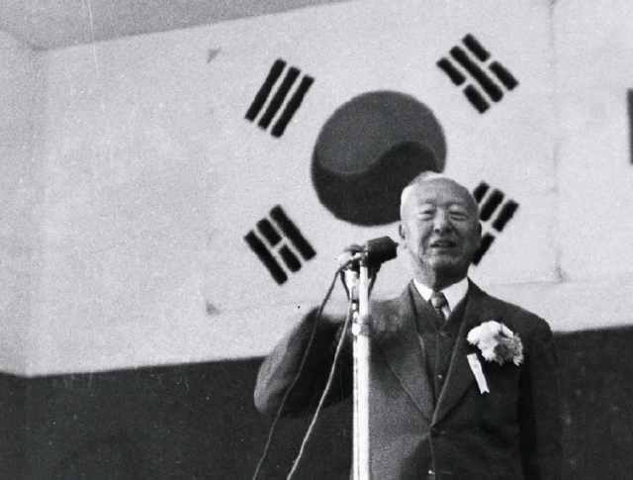
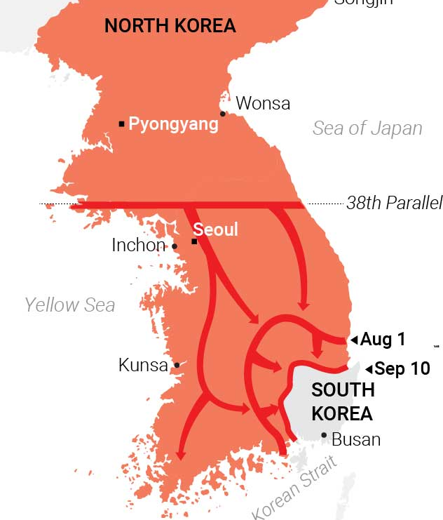
Syngman Rhee 이승만 | 1st President (1948–1960)
First president of the Republic of Korea.
Established the constitutional government and aligned Korea with the US during the Cold War.
Led the nation through the Korean War (1950–53) but governed increasingly autocratically.
Key Events: Constitutional elections (1948) | Korean War (1950–53) | April Revolution (1960)
Impact: Built foundations of the modern Korean state, but set early precedents of authoritarian rule.

Slide 5
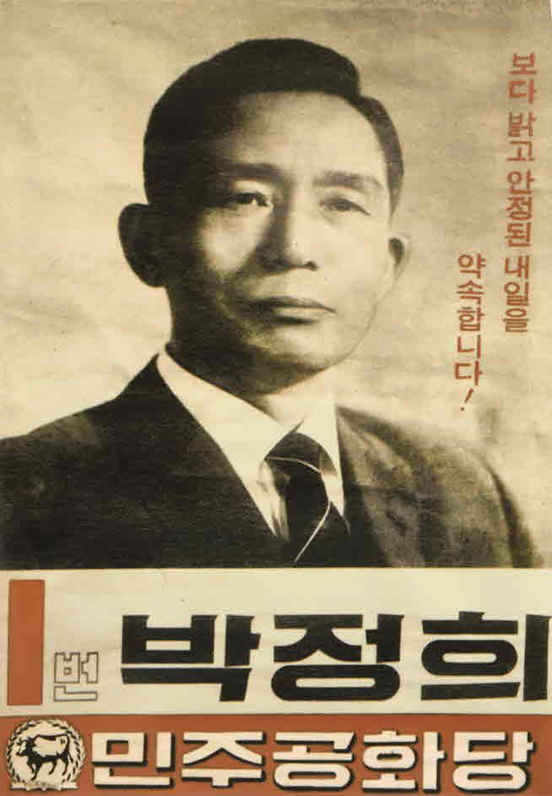
Yun Po-sun 윤보선 (1960-1962) Park Chung-hee (1963-1979)
2nd & 3rd Presidents
First president under the Second Republic (parliamentary system). Unable to prevent political instability after the April Revolution. Resigned after Park Chung-hee's military coup (1961).
Park Chung-hee 박정희 Masterminded the "Miracle on the Han River" — transforming Korea from a poor agrarian society into an industrial powerhouse. Implemented the authoritarian Yushin Constitution (1972). Assassinated by KCIA director in 1979.
Key Events: 5-Year Economic Plans | Japan Normalization (1965) | Yushin Constitution (1972) | Assassination (1979)

Slide 6
02
Authoritarian Era (1963–1993)

Slide 7
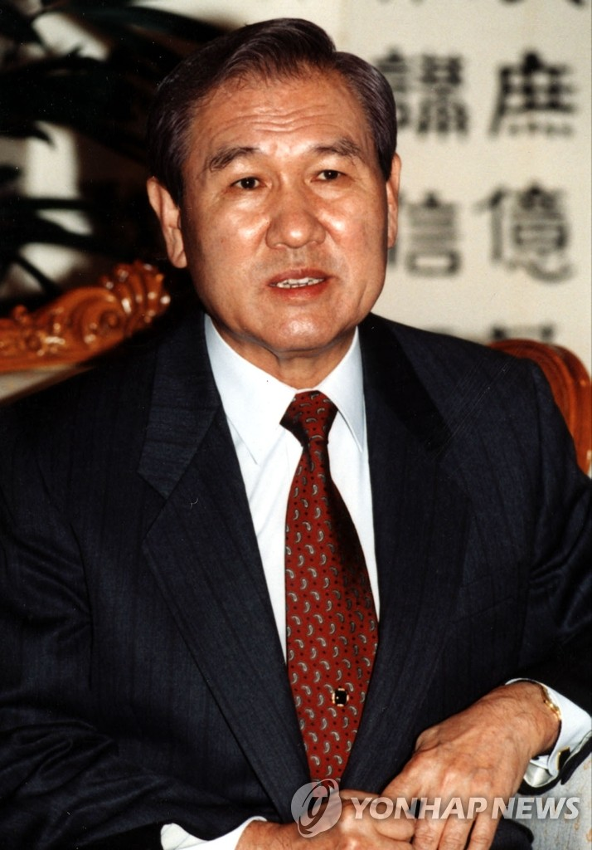
Chun Doo-hwan 전두환 (1980–1988)
Roh Tae-woo 노태우(1988–1993)
5nd & 6rd Presidents
Seized power via coup after Park's assassination. Violently suppressed the Gwangju Uprising (1980). Continued economic growth but ruled autocratically. Stepped down amid the June Democracy Movement.
Key Events: Gwangju Uprising (1980) | June Democracy Movement (1987).
First directly elected president under the new democratic constitution. Hosted the 1988 Seoul Olympics. Pursued "Nordpolitik" — opening diplomatic ties with the USSR and China. Oversaw Korea's UN membership (1991).
Key Events: Seoul Olympics (1988) | UN Membership (1991) | Nordpolitik

Slide 8
03
Modern (1993-2022)
Democracy

Slide 9
Kim Young-sam 김영삼 (1993–1998)
Kim Dae-jung 김대중 (1998–2003)
7nd & 8rd Presidents
First civilian president in 30 years. Launched anti-corruption reforms, abolished secret bank accounts, and prosecuted former military rulers. Managed the 1997 Asian Financial Crisis.
Key Events: Real-name financial system (1993) | OECD membership (1996) | IMF Bailout (1997)
Democracy activist who led Korea out of the IMF crisis. Pioneered the "Sunshine Policy" toward North Korea, leading to the historic inter-Korean Summit (2000). Nobel Peace Prize laureate.
Key Events: IMF recovery | Sunshine Policy | Inter-Korean Summit (2000) | Nobel Peace Prize

Slide 10
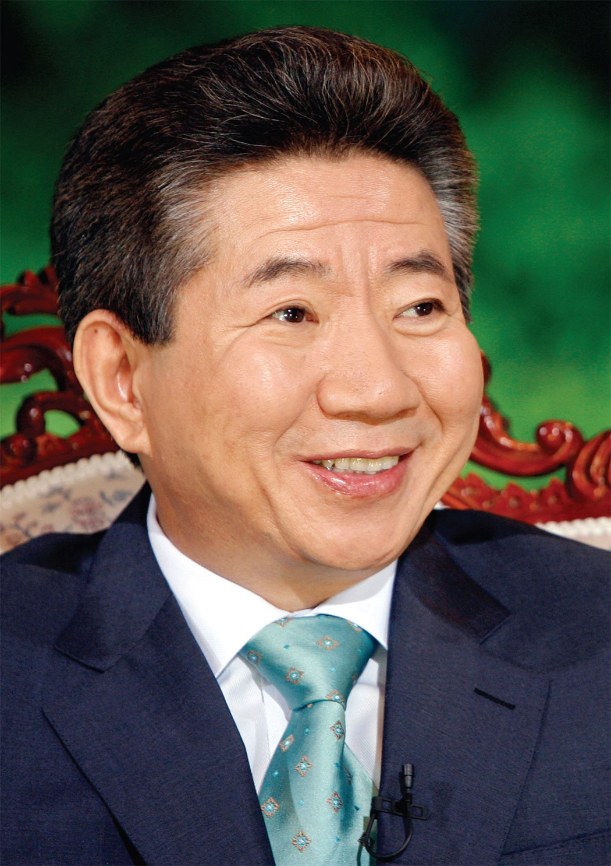
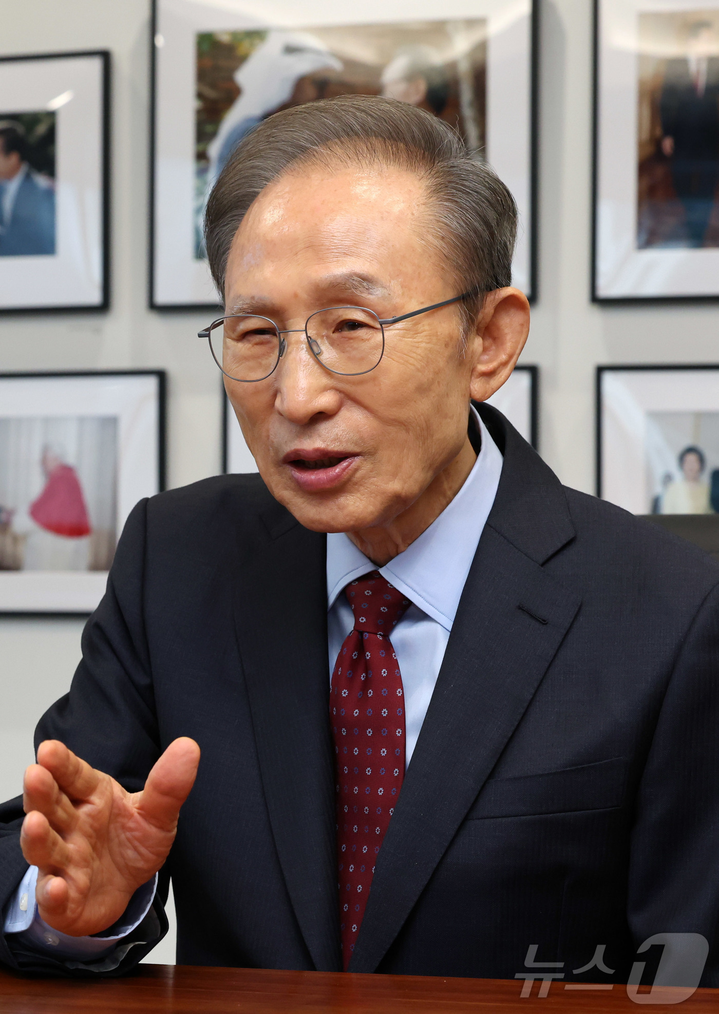
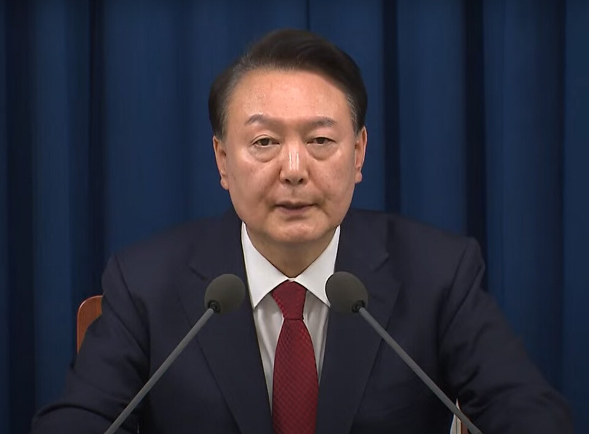
Recent Presidents (2003–2025)
Korea's democracy proved resilient — constitutional order held firm through every crisis.
President | Term | Key Contribution | Key Events
Roh Moo-hyun 노무현 (9th) | 2003–2008 | Promoted participatory democracy & decentralization. Continued Sunshine Policy with 2nd inter-Korean summit. | Impeachment & reinstatement (2004) · 2nd Inter-Korean Summit (2007)
Lee Myung-bak 이명박 (10th) | 2008–2013 | Former Hyundai CEO. Focused on economic growth. Hosted G20 Seoul Summit. Ended Sunshine Policy. | G20 Seoul (2010) · Cheonan sinking (2010) · Four Rivers Project
Park Geun-hye 박근혜 (11th) | 2013–2017 | First female president. Term derailed by Sewol disaster & Choi Soon-sil corruption scandal. | Sewol Disaster (2014) · Candlelight Revolution (2016) · Impeachment (2017)
Moon Jae-in 문재인 (12th) | 2017–2022 | Revived inter-Korean diplomacy. Three summits in 2018. Praised for COVID-19 response. | Inter-Korean Summits (2018) · Trump-Kim facilitation · Korean New Deal
Yoon Suk-yeol 윤석열 (13th) | 2022–2025 | Strengthened Korea-US alliance. Declared martial law (Dec 2024) — overturned within hours. Impeached. | Martial Law (Dec 2024) · National Assembly override · Impeachment (2025)

Slide 11
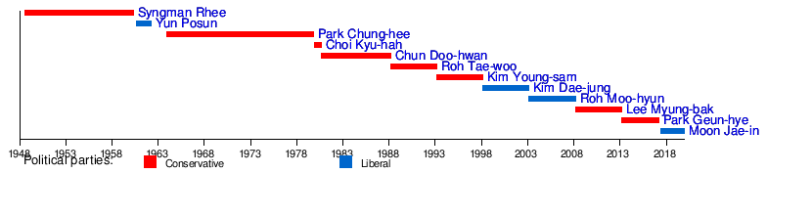
Timeline of All Presidents

Slide 12
CONCLUSION
From a war-torn nation in 1948 to the world's 10th largest economy
Three key themes: Nation-building → Economic Miracle → Democratic Consolidation
Korea's presidential history is a story of struggle, growth, and the resilience of democracy

Slide 13
THANKS
Do you have any questions?

