Slide 1

Predictive Expense Analytics
Yusufjon Akhmedov
202438404

Slide 2
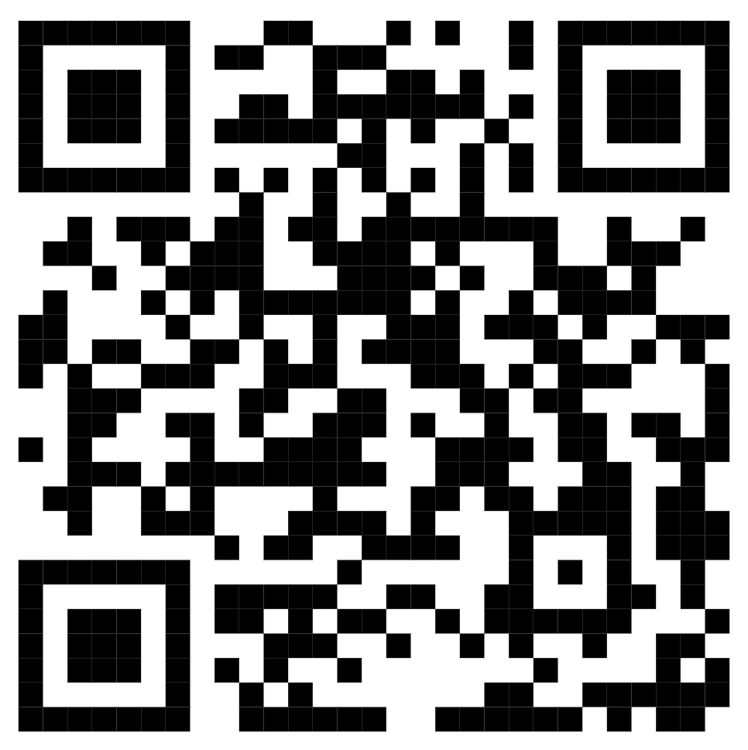
Overview
Requirements & Specifications
Technologies used
Data Cleaning
Grouping & Visualizing Trends
Training Regression Model
Final Visualization

Slide 3

Requirements & Specifications
Design a budget management app that analyzes user spending and predicts future expenses.
Clean mislabeled categories and missing expense values.
Group transactions by category and visualize monthly trends.
Build a simple regression model for next-month expense prediction.
Visualization: Category-wise bar chart and forecast line graph.

Slide 4






Slide 5
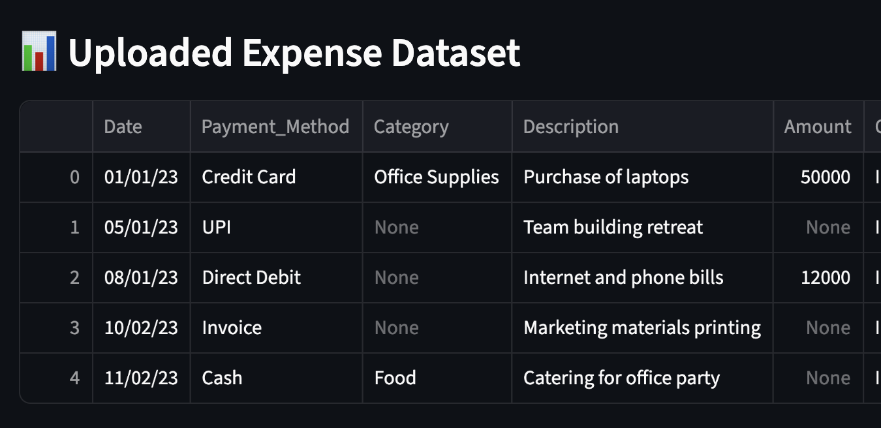
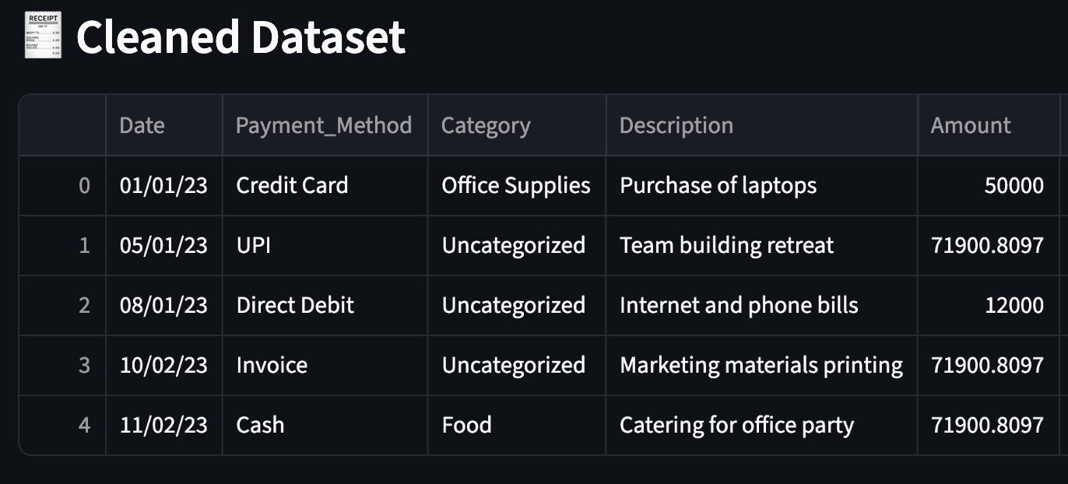
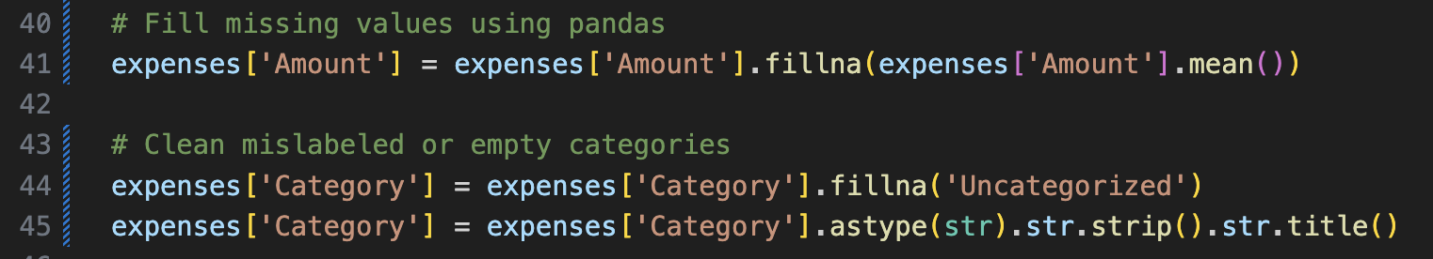
Data Cleaning
Cleaning mislabeled categories and missing expense values

Slide 6
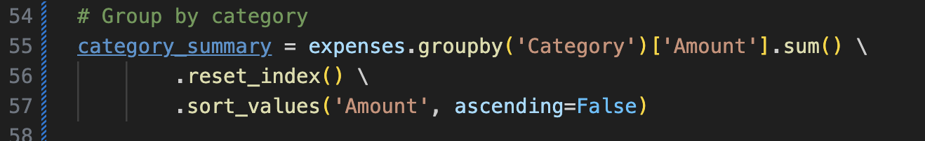
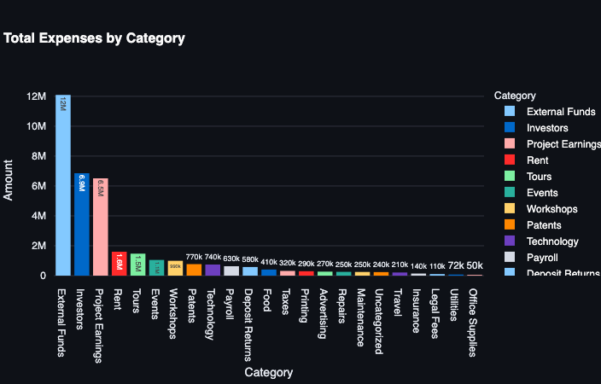
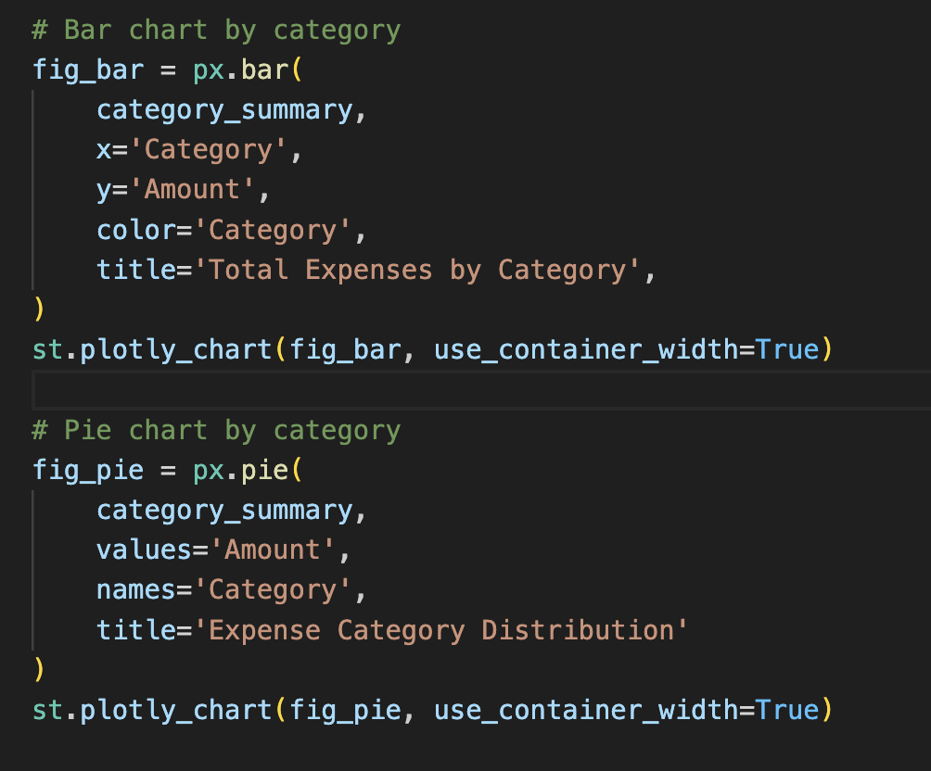
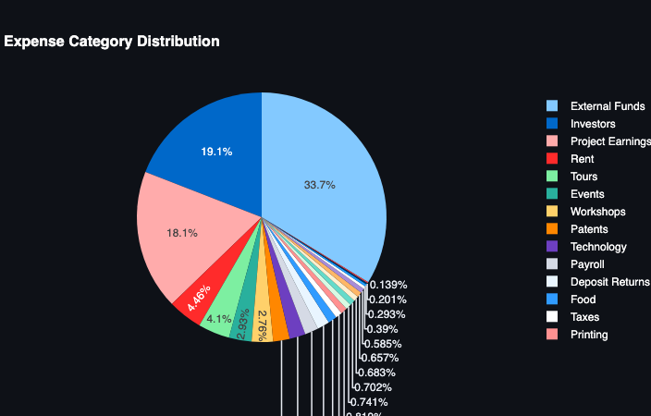
Grouping & Visualizing Trends

Slide 7
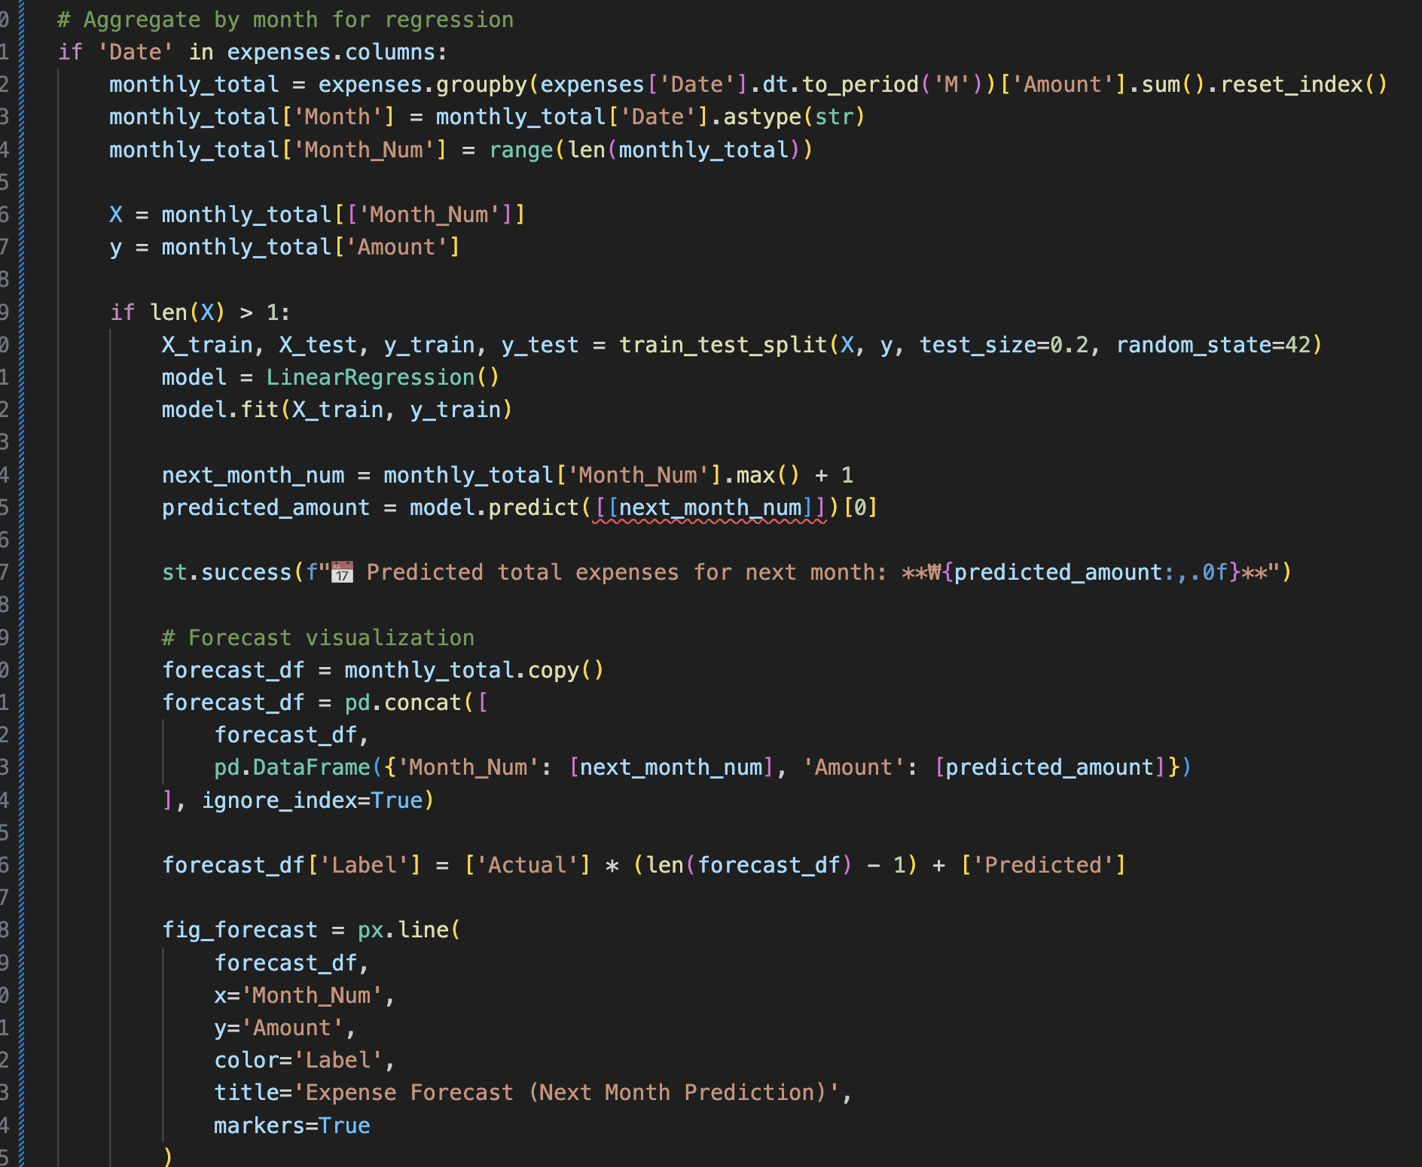
Group by columns and summing Amount to calculate monthly expense
Train regression model using skit-learn.LinearRegression model
Predicting Next month expense
Visualizing predicted amount with all months in a line graph

Slide 8
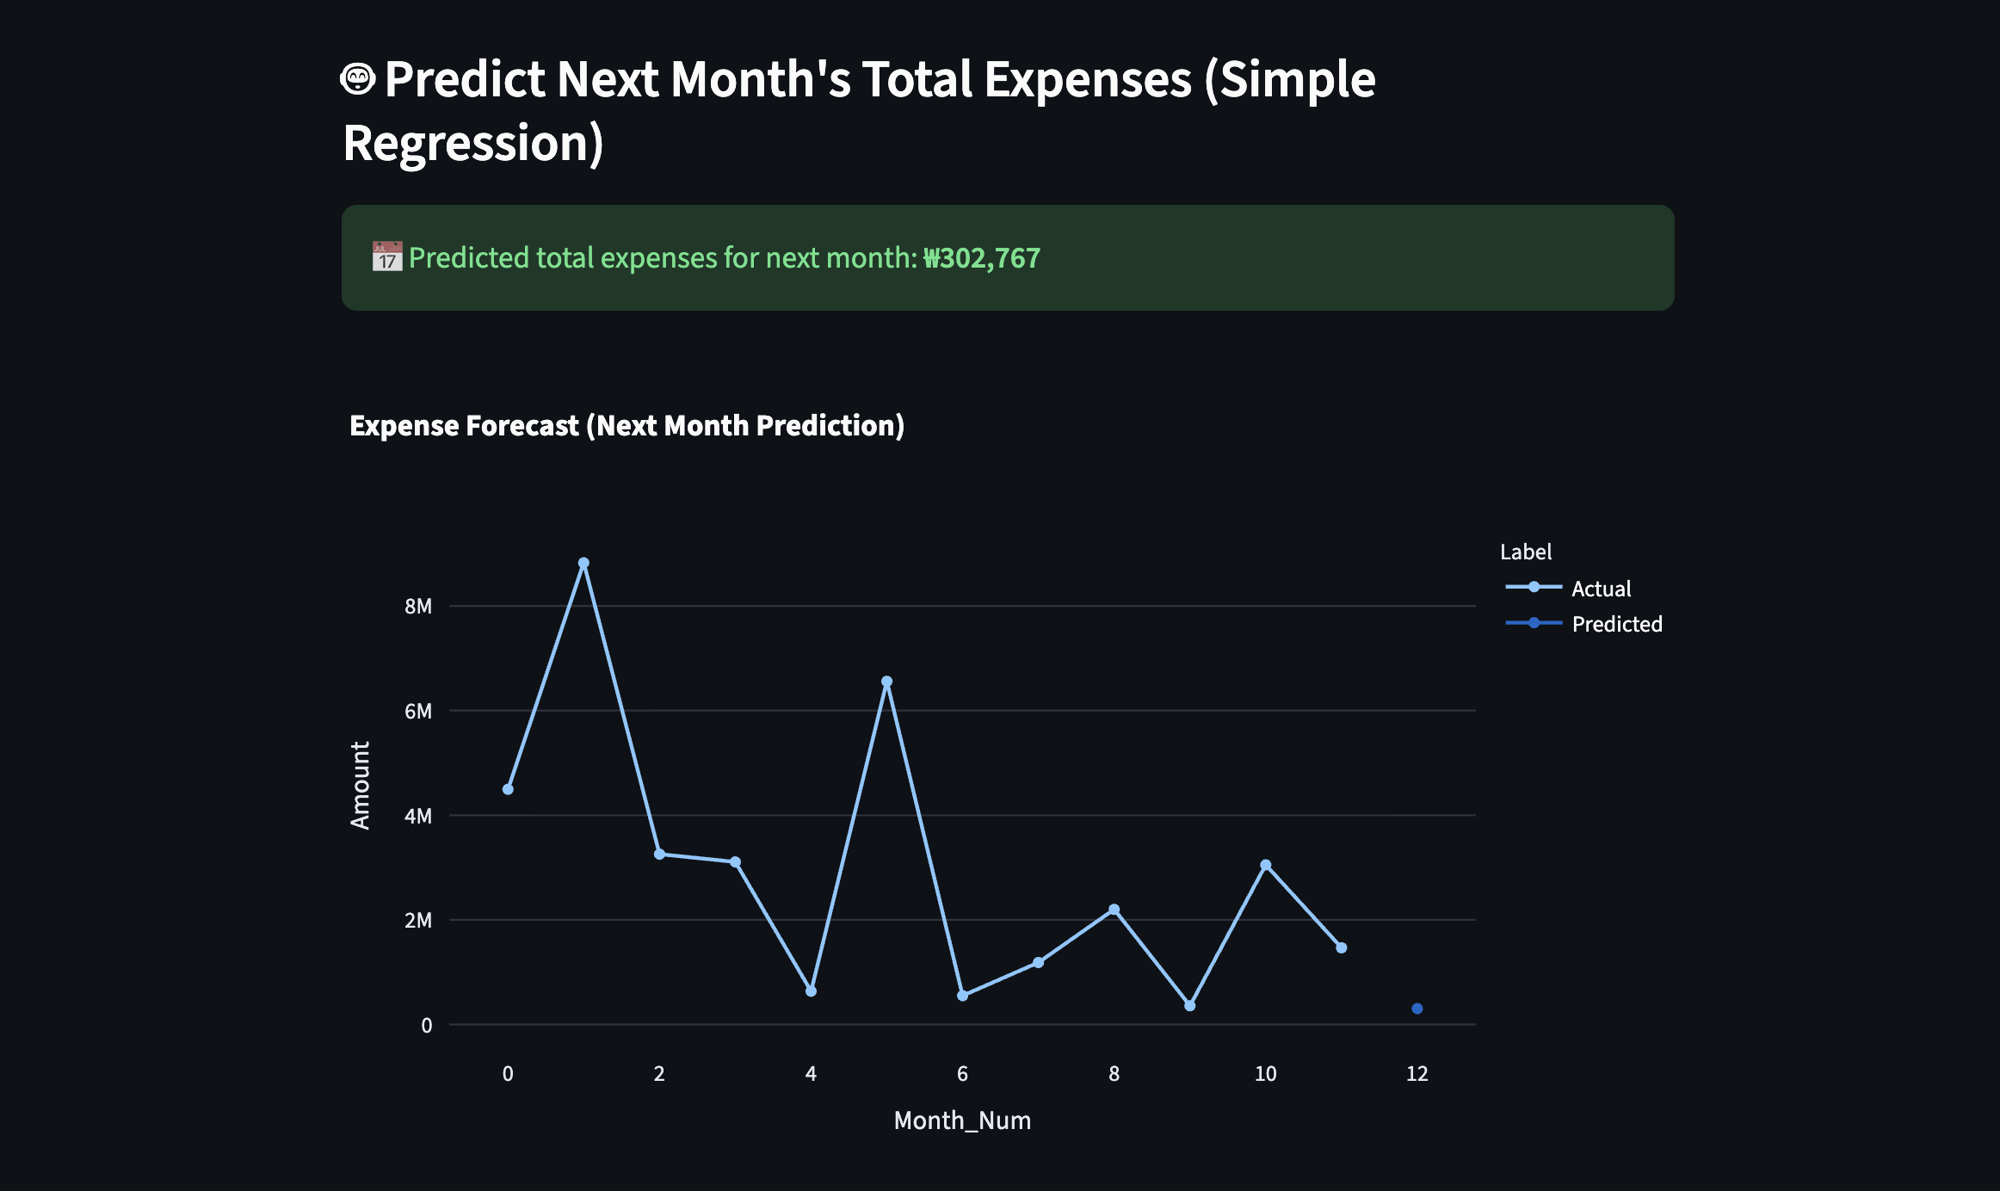
Final Output

Slide 9
Application Preview
Website Running
https://gcbudgethelper.onrender.com/
Source Code (GitHub)
https://github.com/yusufjonc07/expense_analyzer.git

