Slide 1
Web Programming Assignment #2
Name: Akhmedov Yusufjon Muhammad ugli
Major: Computer Engineering
Student Number: 202438404
Due date: 2025.03.31
Submission date: 2025.03.28

Slide 2
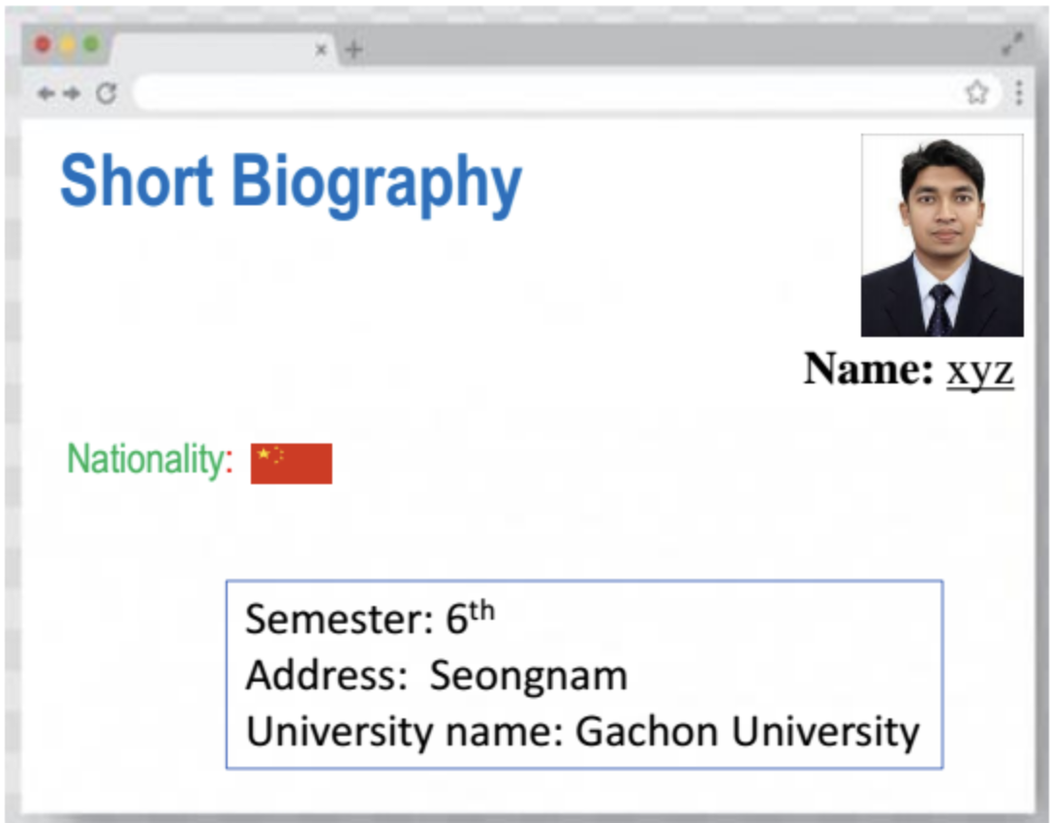
Question 1.
Write an HTML code and display your biography in the below format. Please apply relevant CSS to name (Times New Roman font, alignment: right), nationality (align left), and other formation (solid blue border, etc.)

Slide 3
<!doctype html> <html lang=en> <head> <title>Short Biography</title> <link rel=stylesheet href=style.css> </head> <body> <span id=title> Short Biography </span> <img align=right id=portrait src=portrait.png alt="My portrait image"> <div id=text> <div id=name><b>Name:</b><u>Yusufjon</u></div> <div id=nationality> <span style=color:#39c176>Nationality</span> <span style=color:red>: </span> <img src=flag.png height=35 alt="Nationality flag"> </div> </div> <div id=info> Semester: 2<sup>nd</sup> <br> Address: Seongnam <br> University name: Gachon University </div> </body> </html>
@import url(https://fonts.googleapis.com/css2?family=Rubik:ital,wght@0,300..900;1,300..900&display=swap);#info,body{padding:1rem}#header{height:45vh}#title{font-size:12vh;color:#0070c0;font-family:sans-serif}#info,#nationality,#text{font-size:5vh}#portrait{width:30vh;border:1px solid #000}#text{margin-top:27vh}#name{font-family:"Times New Roman",Times,serif;text-align:right}#nationality{display:flex;align-items:center;font-family:'Franklin Gothic Medium','Arial Narrow',Arial,sans-serif}#nationality img{margin-left:10px}#info{border:2px solid #0070c0;width:fit-content;margin:10vh auto;font-family:Rubik,sans-serif;font-weight:400}

Slide 4
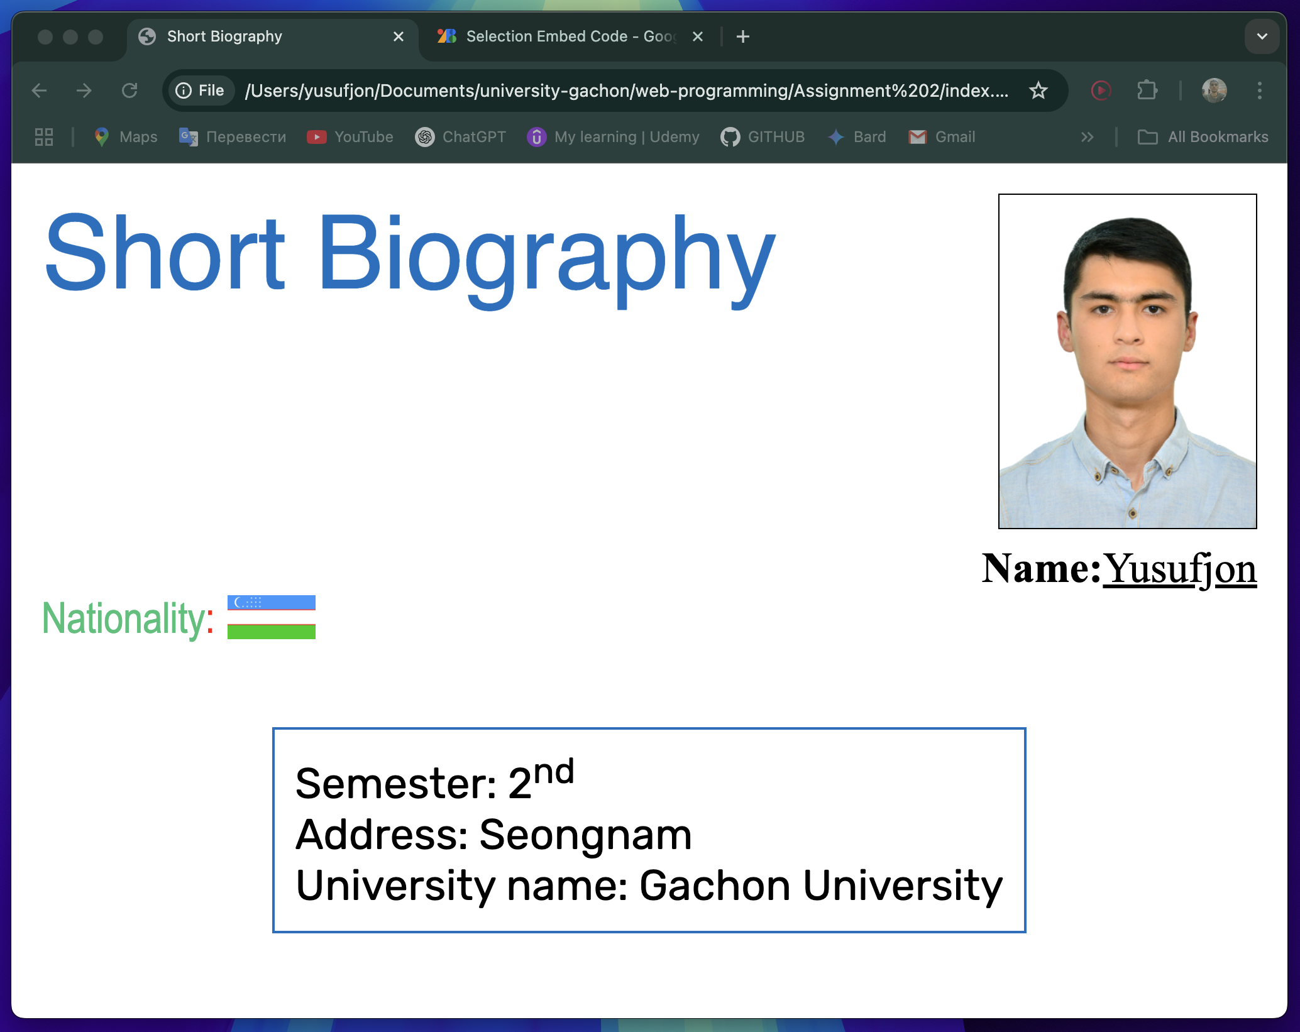
Output

Slide 5
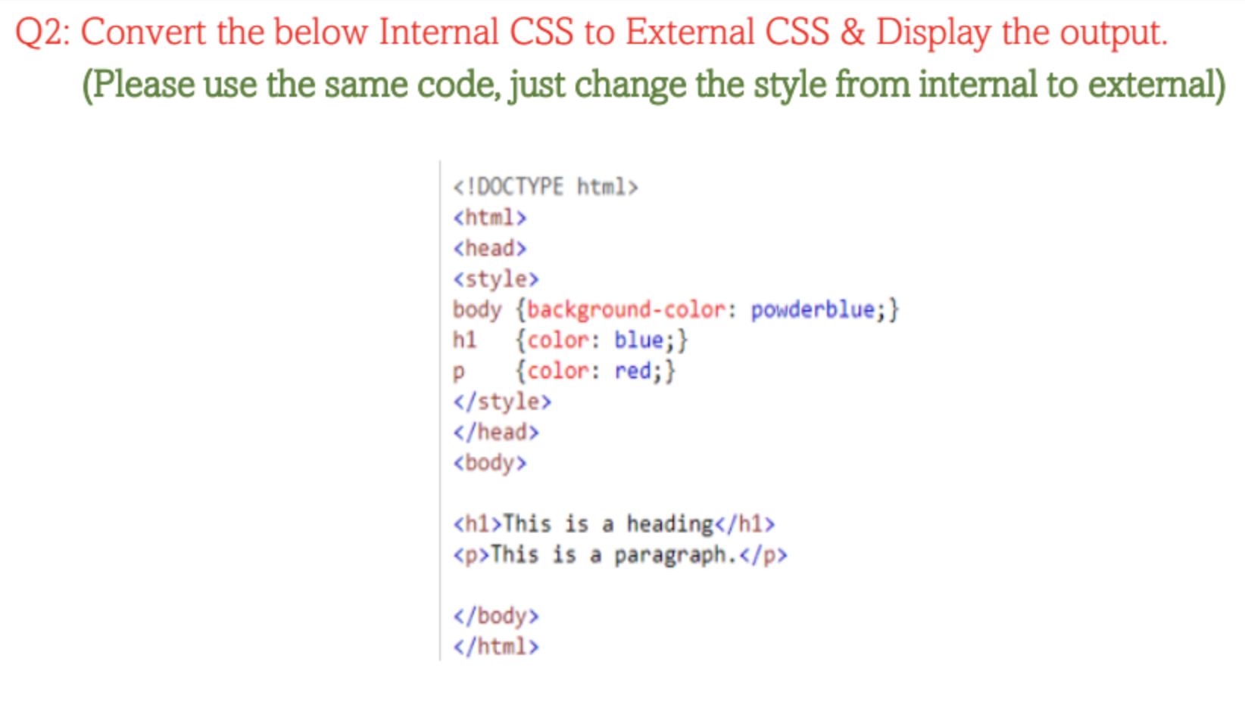

Slide 6
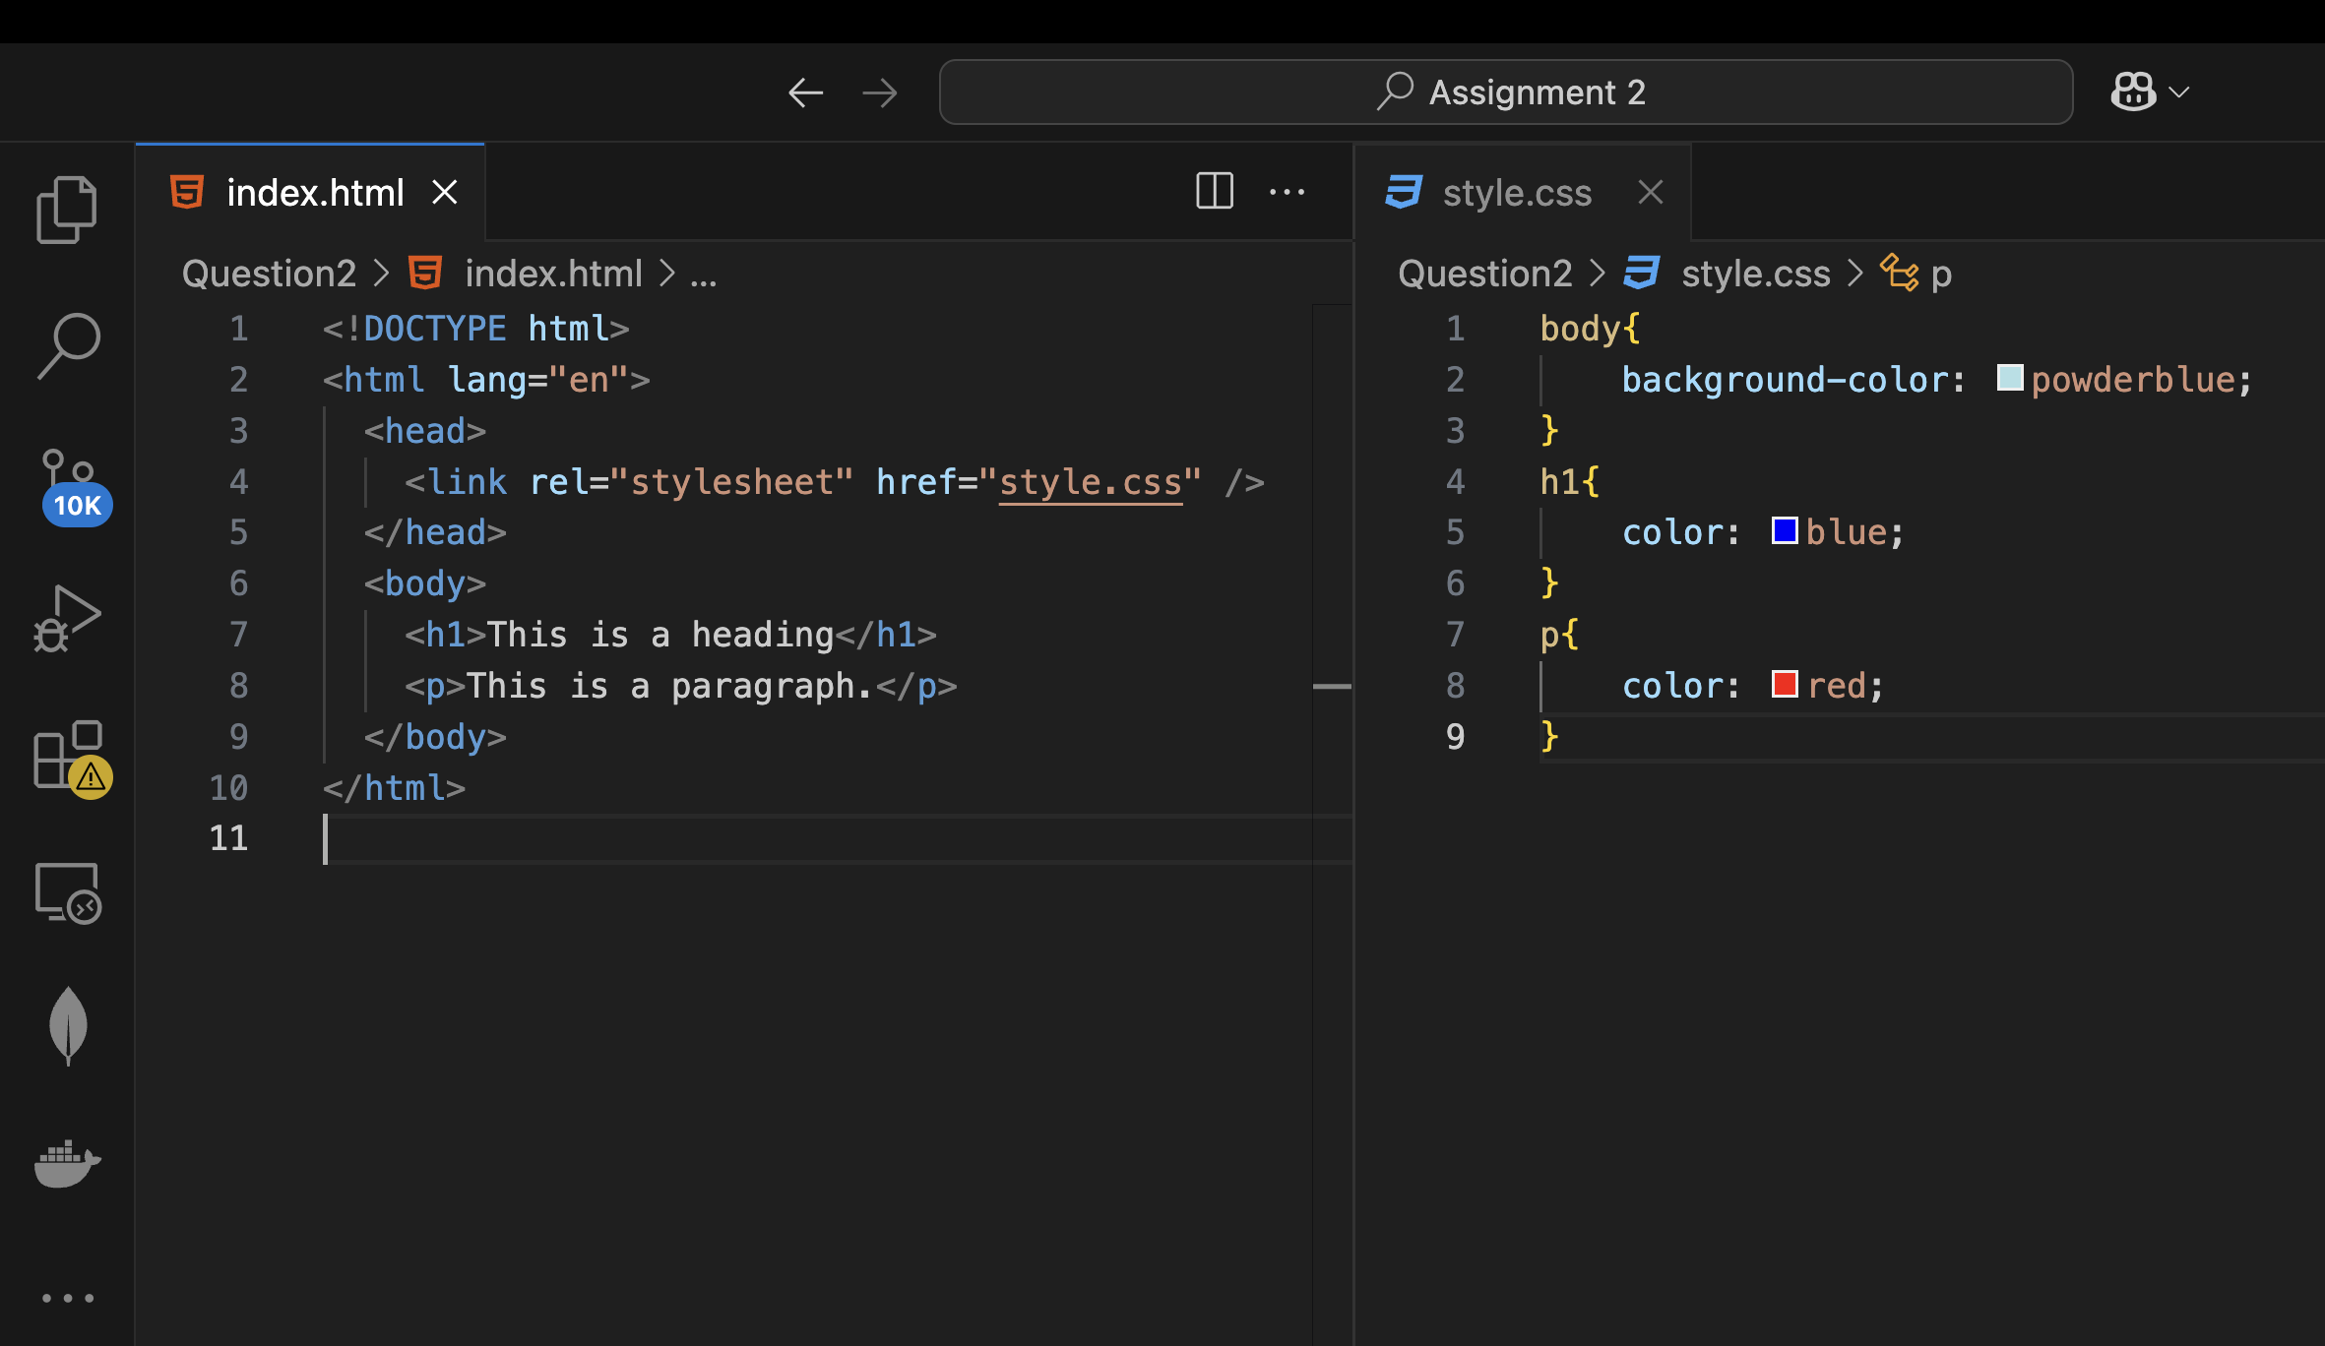
Enhancing your presentation

Slide 7
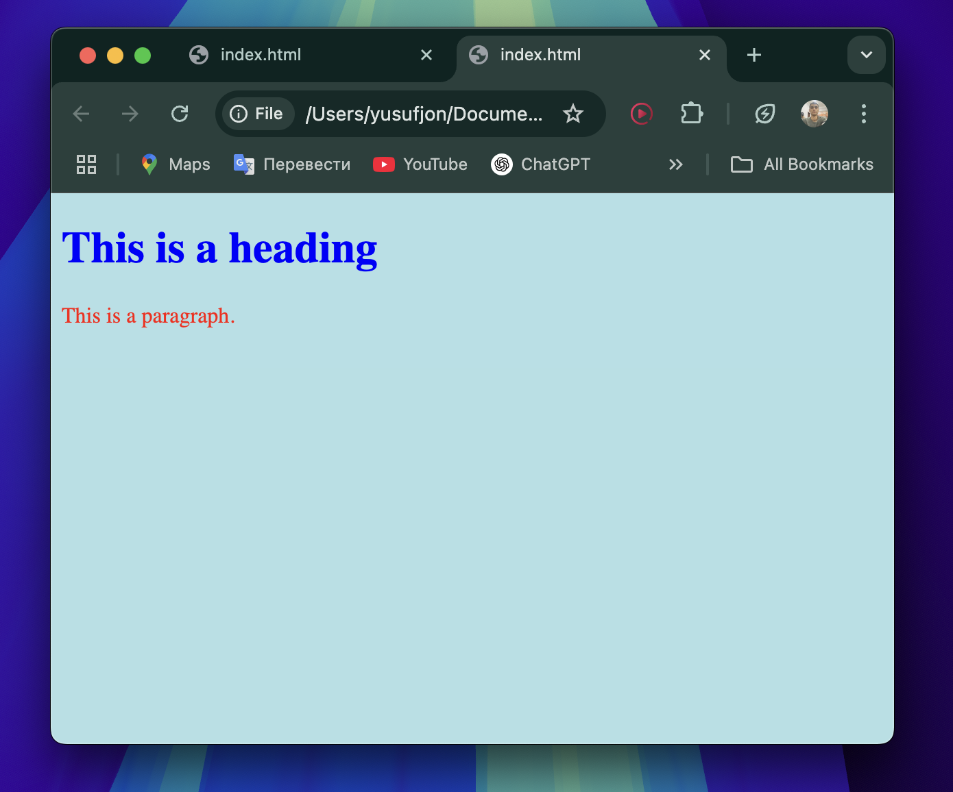
Output

Slide 8
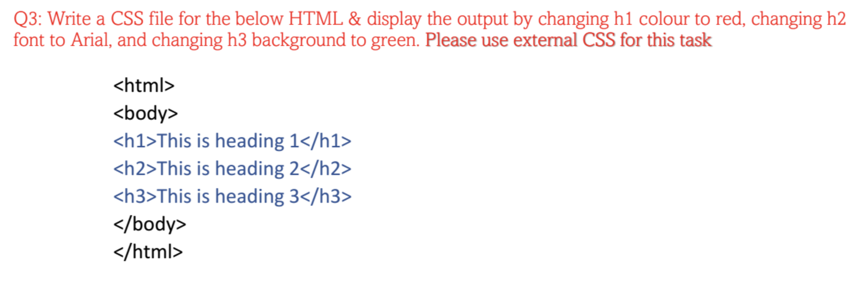

Slide 9
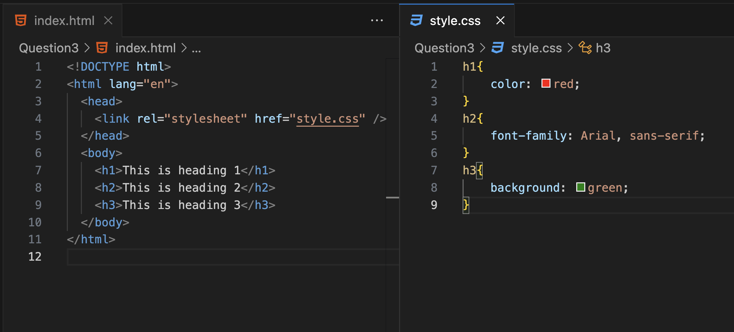

Slide 10
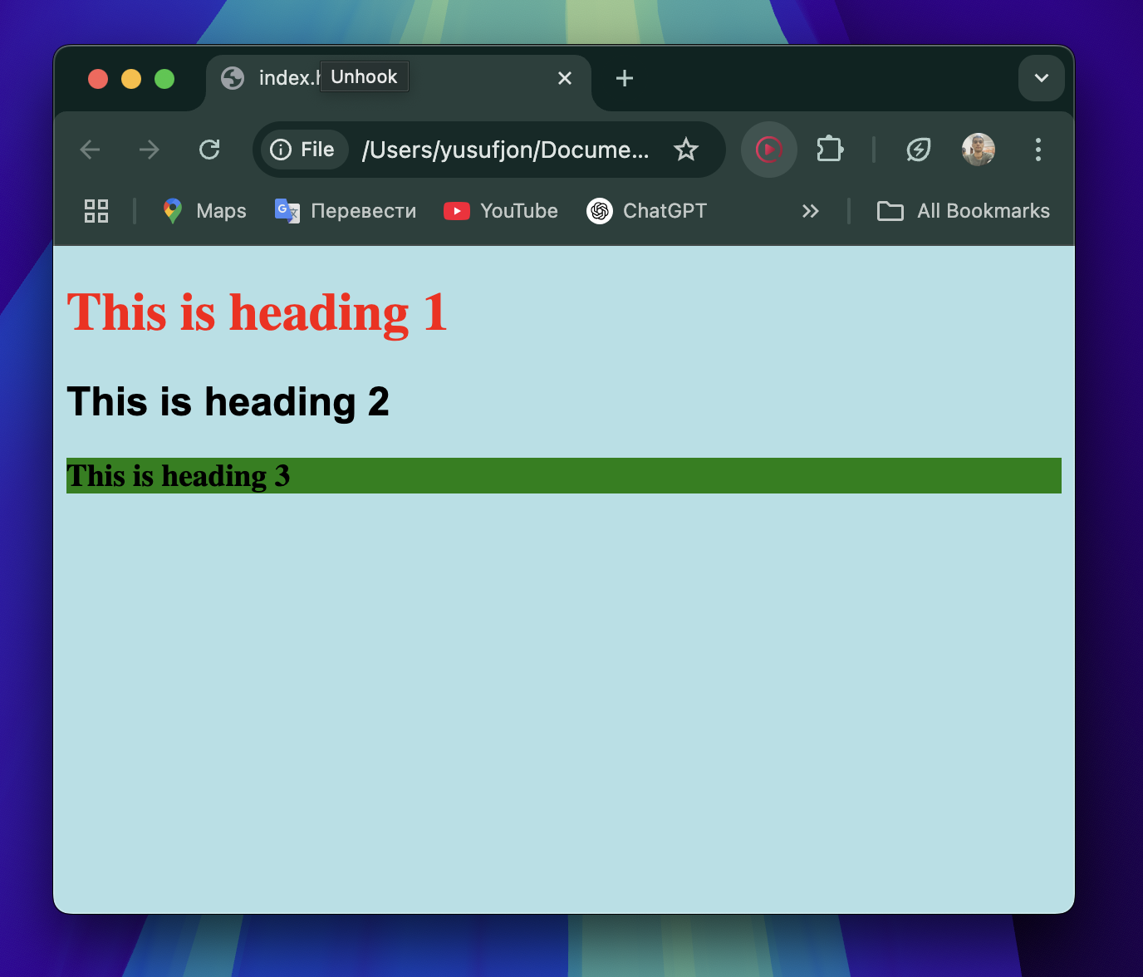
Output

Slide 11

Question 4 Why external CSS is better than inline and internal. Please write answer with 2~3 sentences only.
External CSS files can be cached by browser reducing load time. They also can be applied for multiple pages globally providing faster development time and will be easy to update.

