Slide 1


AKHMEDOV YUSUFJON
202438404
Chapter 11
Cloud and Cyber Security Data-Oriented Mechanisms

Slide 2




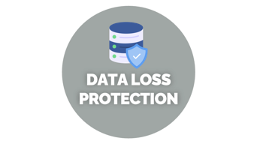
MONITORING
IN CLOUD COMPUTING

Slide 3

ACTIVITY
LOG

Slide 4





ACTIVITY LOG MONITORING
Event logs, device configuration logs, OS logs, Database etc.
Patterns of activity
Indicate potential security breaches
AWS
CloudWatch
Google Cloud
Audit Logs
Microsoft
Azure Monitor
Oracle Cloud Infrastructure
OCI Logging
Notes:
The activity log monitor (see Figure 11.11) reviews past log files or database records to identify patterns of network activity that might suggest potential security breaches. These logs can include information from event logs, device configuration logs, operating system logs, and other similar sources.

Slide 5
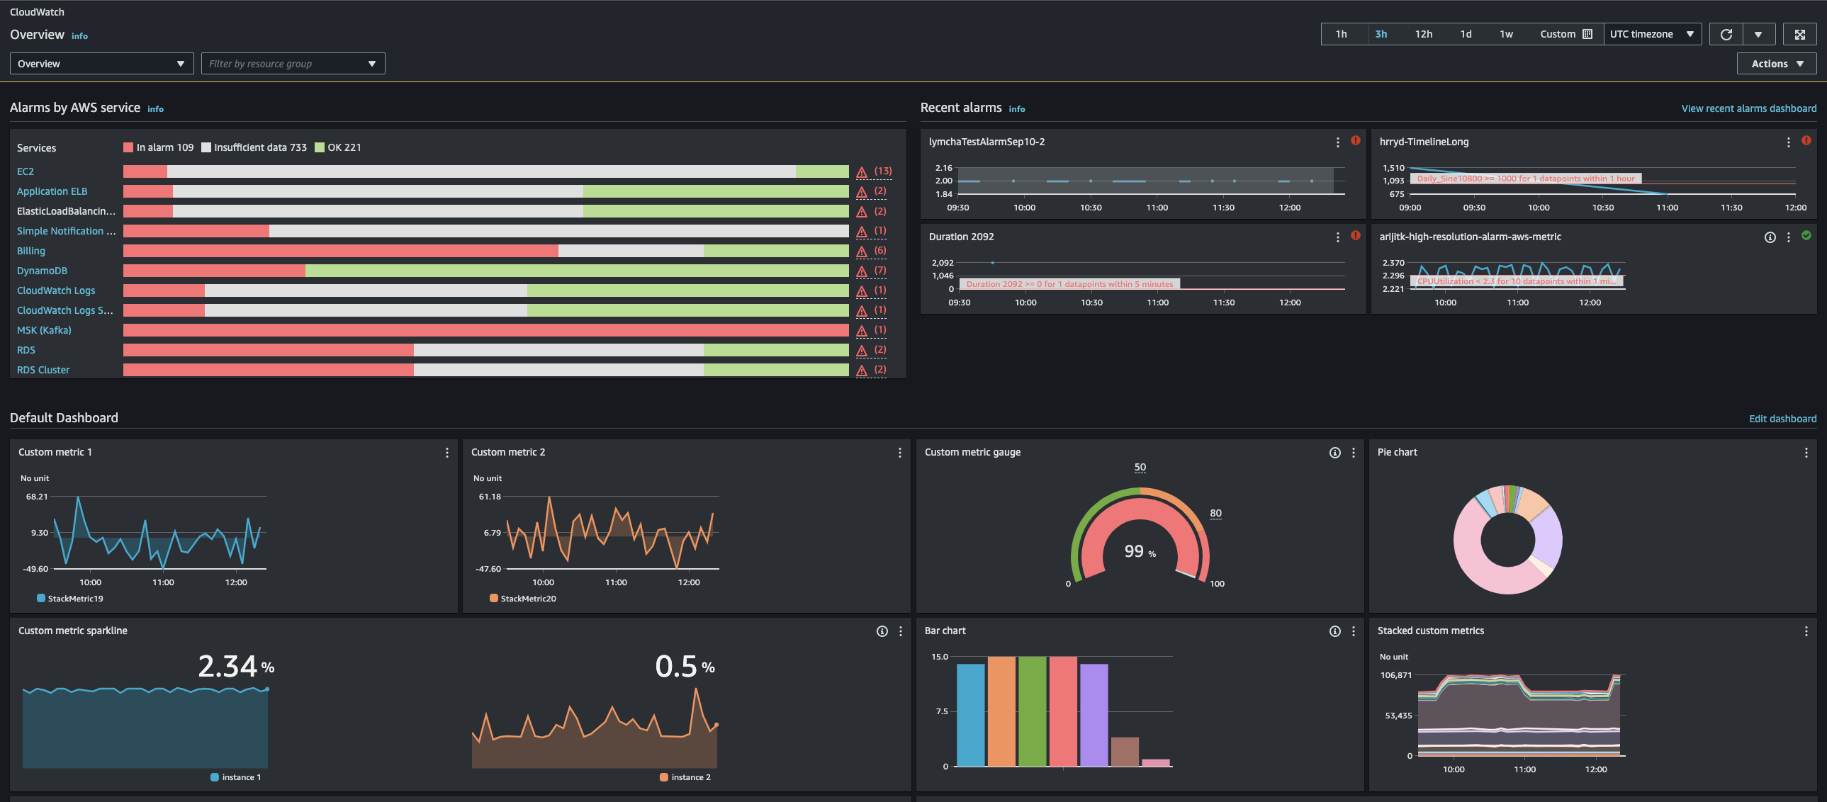
Notes:
The activity log monitor (see Figure 11.11) reviews past log files or database records to identify patterns of network activity that might suggest potential security breaches. These logs can include information from event logs, device configuration logs, operating system logs, and other similar sources.

Slide 6

TRAFFIC

Slide 7




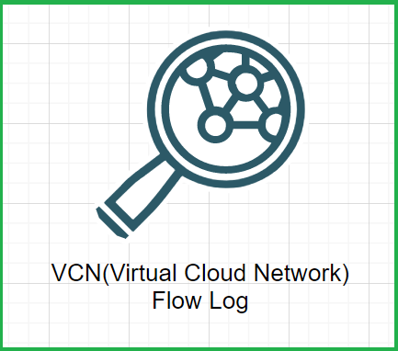
TRAFFIC MONITOR MECHANISM
Monitors network traffic to detect abnormalities affecting performance, availability, or security
Provides real-time data and long-term trends for network activity
Assists administrators in analyzing and maintaining healthy network operations
AWS
VPS Flow Logs
Google
VPS Flow Log
Azure
Network Security
Groups
Oracle Cloud
VCN Flow Log

Slide 8
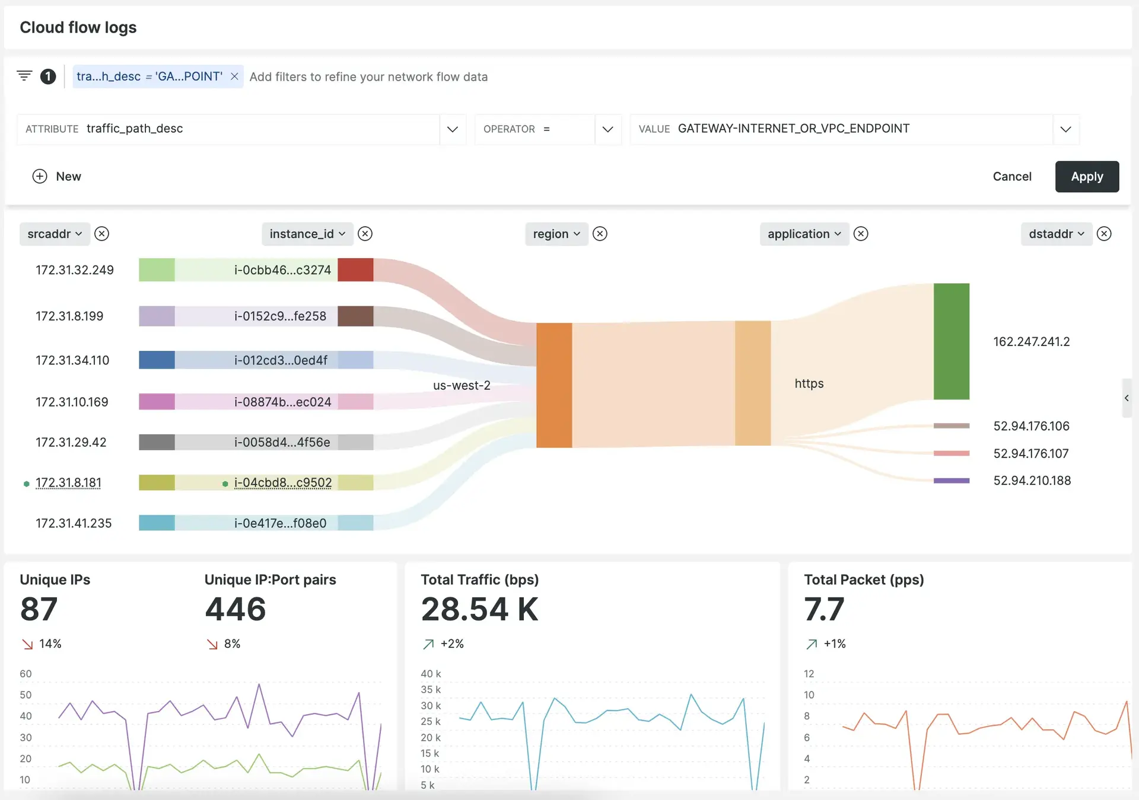
Notes:
The activity log monitor (see Figure 11.11) reviews past log files or database records to identify patterns of network activity that might suggest potential security breaches. These logs can include information from event logs, device configuration logs, operating system logs, and other similar sources.

Slide 9

DATA LOSS
PROTECTION

Slide 10

Data Loss Protection (DLP) Monitor
Safeguards vital data using capture/replay technology for investigating data loss incidents.
Alerts relevant parties (senders, recipients, content owners, administrators) to streamline remediation.
Protects critical information assets (source code, memos, patents, etc.).
Monitors all ports and protocols to detect sensitive content and unknown threats.
Analyzes and applies rules to prevent future data leaks.
Provides reports detailing who sent data, where it went, and how it was transmitted.

Slide 11
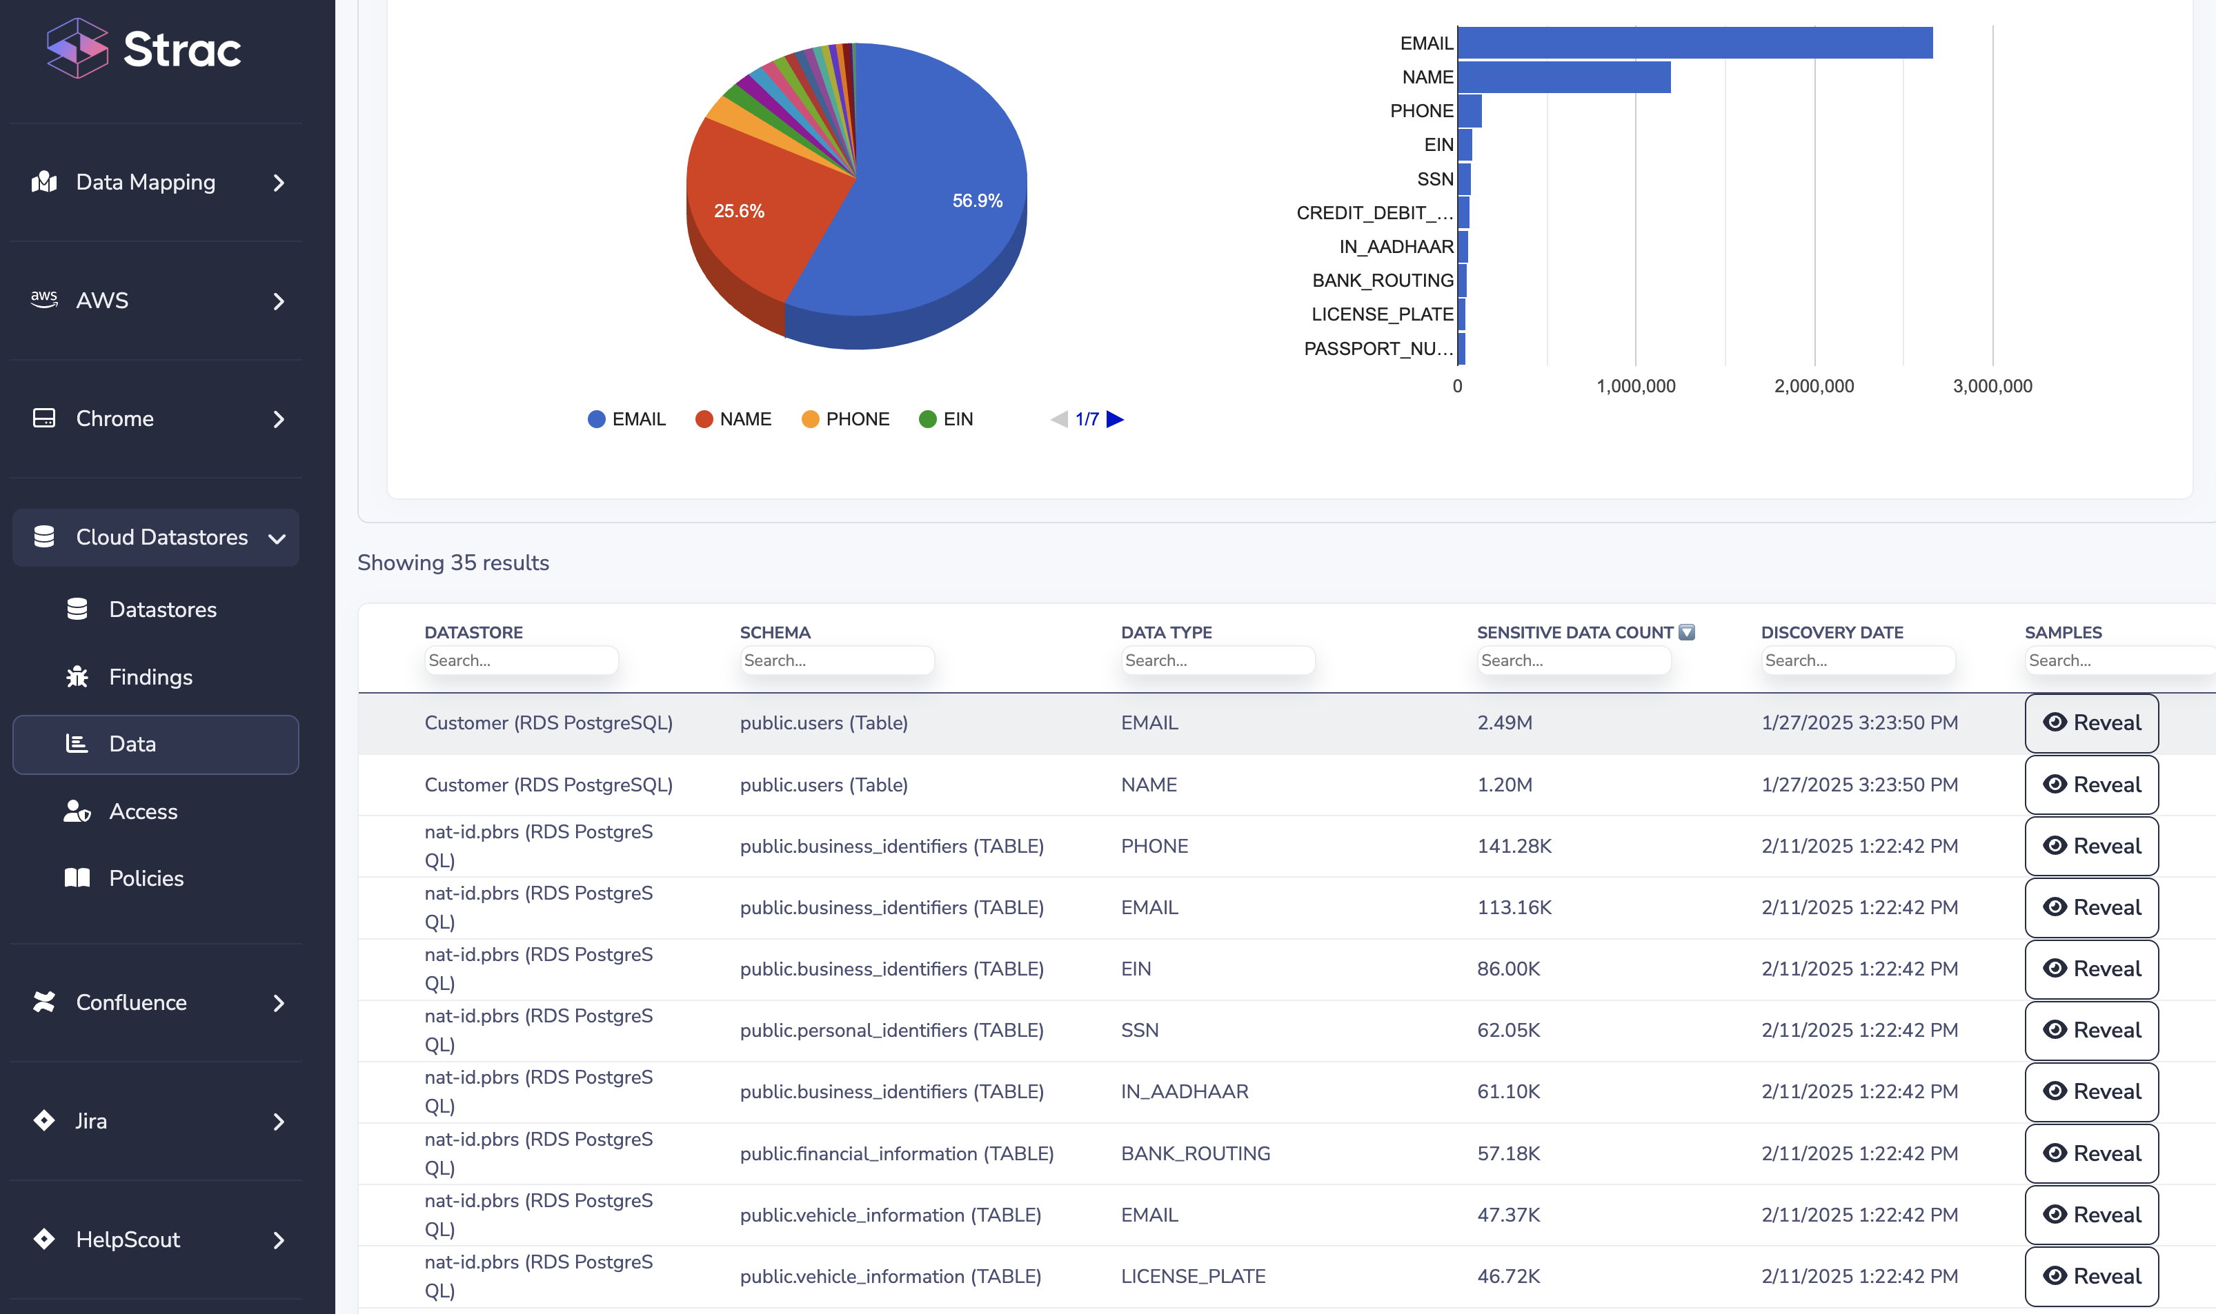
Notes:
The activity log monitor (see Figure 11.11) reviews past log files or database records to identify patterns of network activity that might suggest potential security breaches. These logs can include information from event logs, device configuration logs, operating system logs, and other similar sources.

Slide 12
Q&A.

Slide 13


THANK YOU

