Slide 1

TASK 2 by
Yusufjon &
Lazizbek
202438404 202438418 16.10.2025

Slide 2
Question
5. Duplicate Handling and Index Validation Remove duplicate rows or reset index as needed. Ensure unique identifiers exist where required.

Slide 3
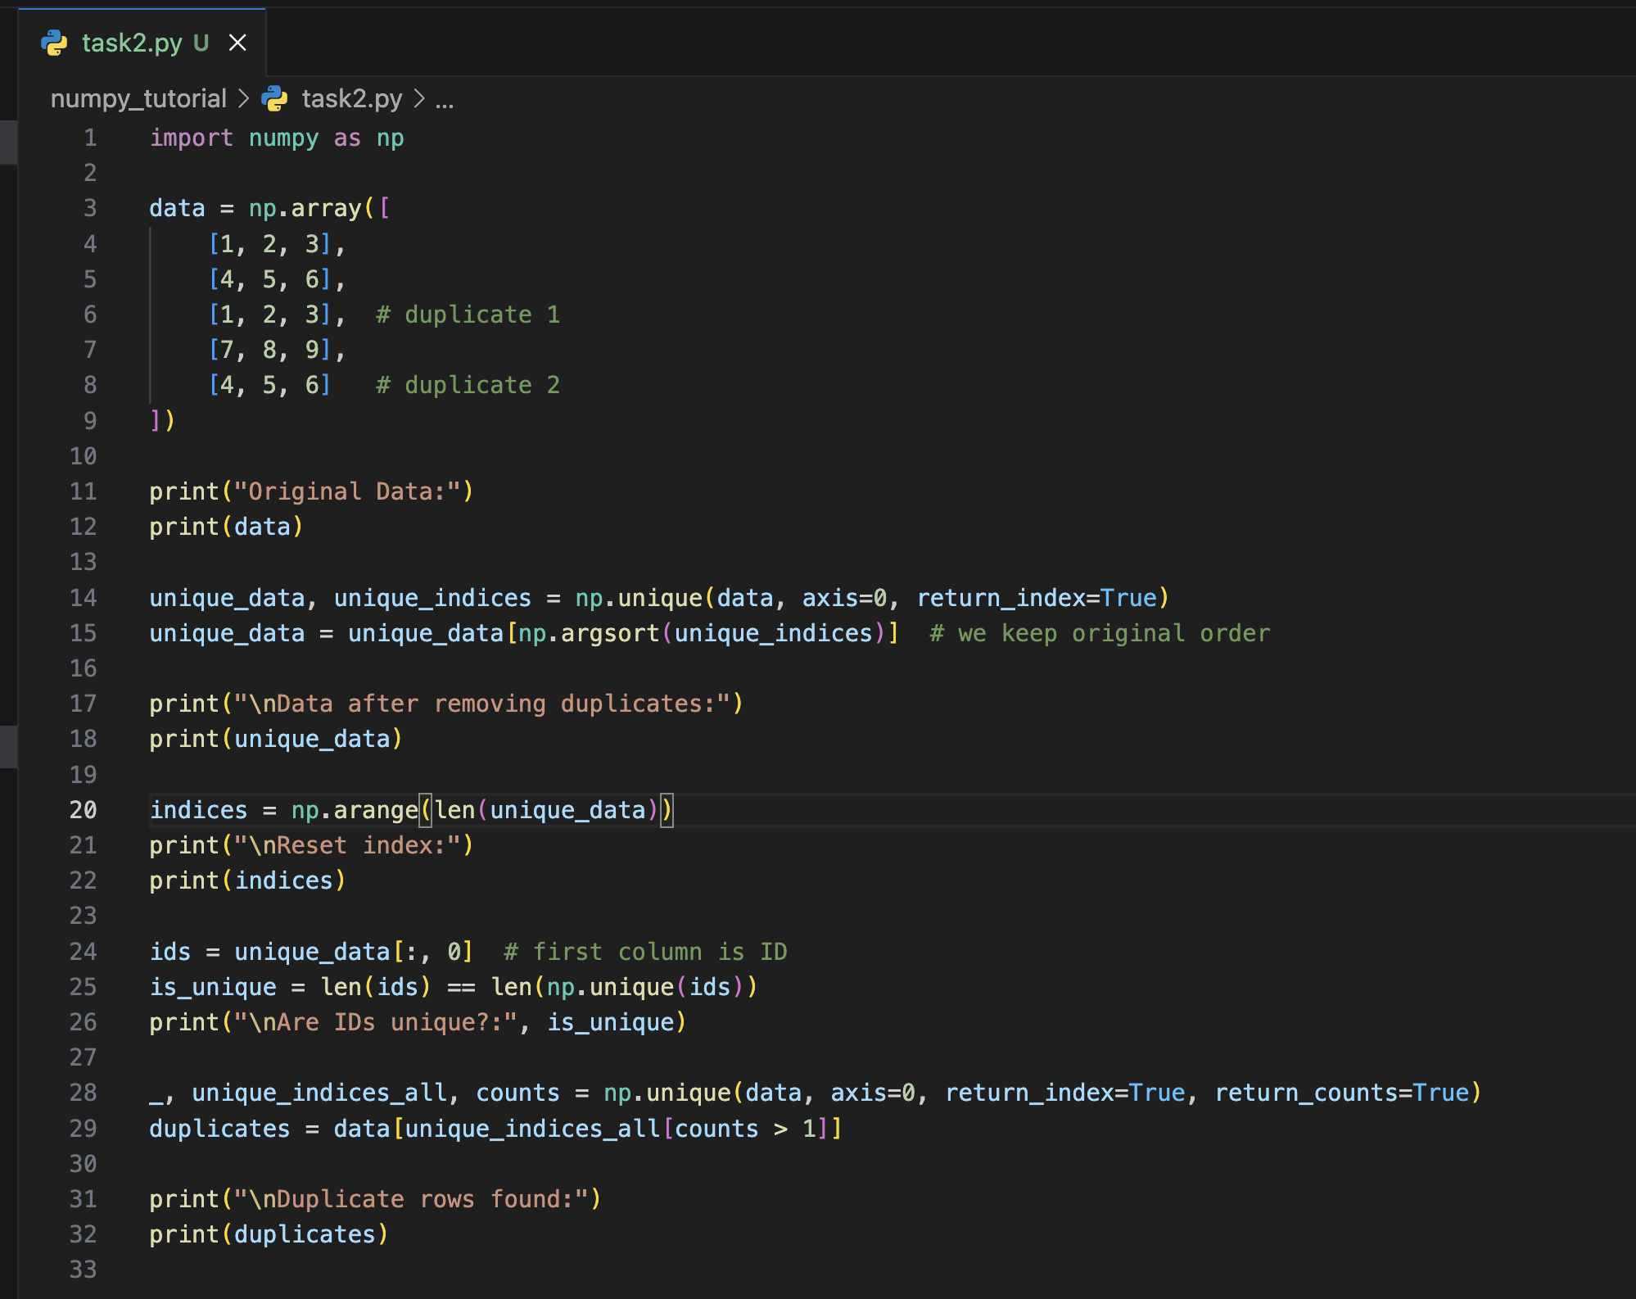
Code
The code removes duplicate rows with np.unique(axis=0), resets the index using np.arange(), and checks for unique identifiers by comparing the length of IDs with np.unique(ids).

Slide 4
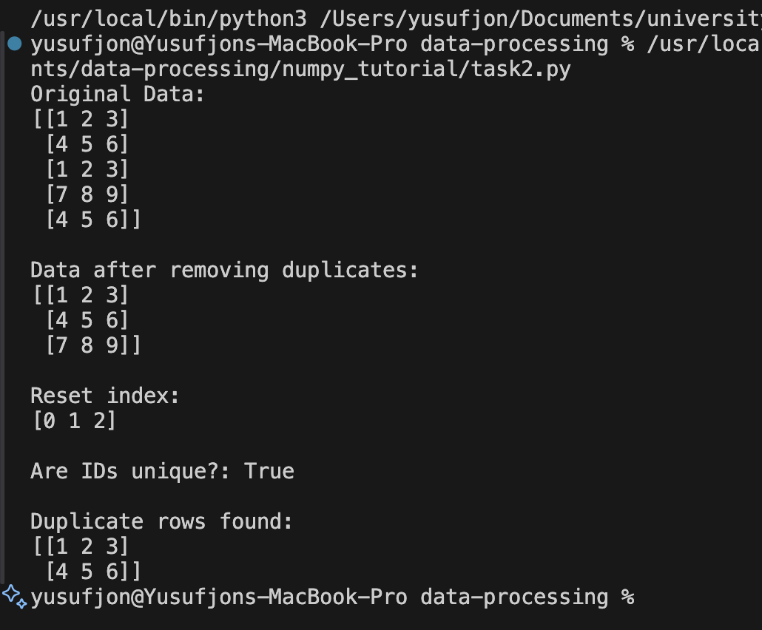
output
Shows the original data.
Prints data after removing duplicate rows.
Displays the reset index (0, 1, 2, …).
Confirms if ID column values are unique (True or False).
Lists the duplicate rows that were removed.

