Slide 1

Homework #2
DBMS
Due Date 14.09.2025
Student details
AKHMEDOV YUSUFJON (202438404)
Computer Engineering, 3rd semester

Slide 2
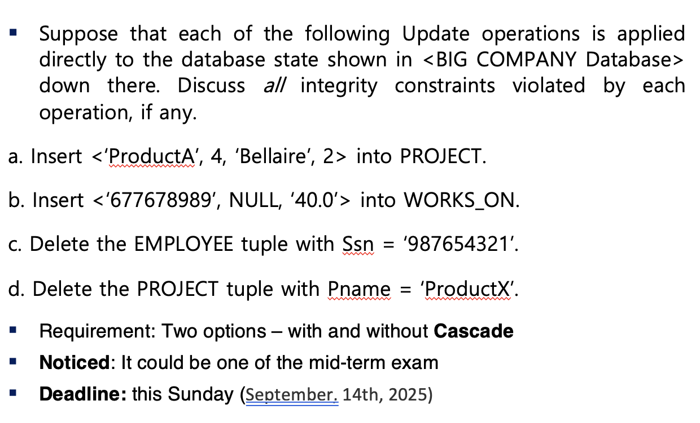
HW task: Mockup test

Slide 3
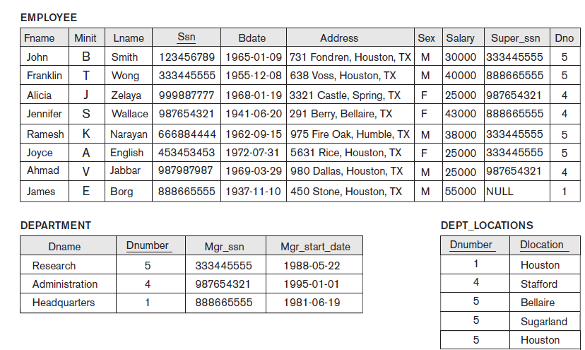
COMPANY DB Instances

Slide 4
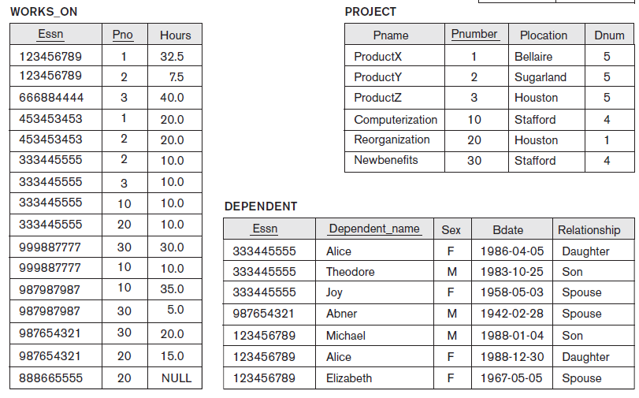
COMPANY DB Instances

Slide 5
a. Insert <'ProductA', 4, 'Bellaire', 2> into PROJECT.
PROJECT table has attributes of Pname, Pnumber, Plocation, Dnum.
We are given to insert <'ProductA', 4, 'Bellaire’, 2> into this table and should discuss all
Integrity constraints violations which can occur.
First of all, Pname which is the name of product column has no possible violations when we
Instert ‘ProductA’, even it might have constraints like unique or primary.
Secondly, 4 to Pnumber attribute: this looks also no having integrity violations because
4 as a Pnumber is new value to the PROJECT instance.
Thirdly, Plocation have no integrity constraint violations like Pname when insterting ‘Bellaire’
Finally, here is the thing: 2 is being insterted to Dnum which is Department Number,
but considering Dnum has foreign key constraint and referencing to DEPARTMENT table,
it will cause Violation of referential integrity error.
And thus, our query to insert a new product to PROJECT table fails!

Slide 6
b. INSERT <'677678989', NULL, '40.0'> INTO WORKS_ON.
WORKS_ON table has attributes of:
Essn refercening to Essn of an employee,
Pno refercening to Pno of project number,
Hours defining worked hours of an employee
We are given to insert <'ProductA', 4, 'Bellaire’, 2> into this table and should discuss all
Integrity constraints violations which can occur.
First of all, Essn which is the employee ssn column must match to some employee in EMPLOYEE table, but here ‘677678989’ is not found in employee list, so this will cause foreign key violation.
Secondly, Pno is set to NULL, but this should also match with some project number in PROJECT table. Since NULL is not valid here, it makes another referential integrity problem.
Thirdly, Hours has value 40.0 and that looks fine because it is numeric and no constraint violated here.
Finally, the insert query fails because both Essn and Pno are not valid with respect to foreign keys.

Slide 7
c. EMPLOYEE table has attributes like Ssn, Name, Salary, Super_ssn, Dno etc.
EMPLOYEE table has attributes like Ssn, Name, Salary, Super_ssn, Dno etc.
We are given to delete employee with Ssn = ‘987654321’ and should discuss all Integrity constraints violations which can occur.
First of all, this employee is manager of DEPARTMENT 4 (Administration), so deleting her will leave department manager reference broken.
Secondly, she is also supervisor (Super_ssn) for employees Alicia and Ahmad. If deleted, their supervisor link is lost and becomes invalid.
Thirdly, she is working on some projects in WORKS_ON table, so deleting will break those references too.
Finally, she also has dependent (Abner) in DEPENDENT table, and deleting her will make that tuple dangling. So without cascade delete this is impossible because of many foreign key violations. With cascade option, the delete would remove department 4.

Slide 8
d. PROJECT table has attributes of Pname, Pnumber, Plocation, Dnum.
PROJECT table has attributes of Pname, Pnumber, Plocation, Dnum.
We are given to delete project with Pname = ‘ProductX’ and should discuss all Integrity constraints violations which can occur.
Pnumber of this project is 1, and this number is used in WORKS_ON table by some employees.
Secondly, if we try to delete without cascade those WORKS_ON tuples will point to nothing, so that is violation of referential integrity.
With cascade option those WORKS_ON tuples which have Pno = 1 will be deleted automatically and then there is no violation.

