Slide 1
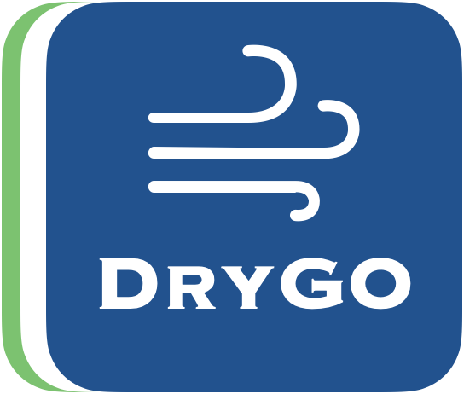
STAY DRY. STAY FRESH
DryGO
Portable Towel Drying Bag
A consumer product that solves a daily hygiene problem
for gym users, athletes, and active people.
TEAM MEMBERS
YUSUFJON AKHMEDOV
JAMIL HASAN
JAVOHIR ABDUVOSITOV
김영목
TEAM DRYBAG | MIDTERM PRESENTATION 2026

Slide 2



THE CHALLENGE
The Problem
After gym sessions, wet towels sit in bags for hours — creating the perfect environment for bacteria and bad smell.
Wet Towels Stay Damp
Bacteria & Odor
No Portable Solution
Towels remain moist for hours inside closed gym bags with no air circulation.
Moisture + warmth causes rapid bacterial growth and unpleasant smell on fabric.
Existing dryers are large household appliances — nothing exists for on-the-go use.

Slide 3



THE CHALLENGE
Our Solution
Smart DryBag
A portable, self-contained bag that actively dries and sanitizes towels using built-in airflow, mild heat, and optional UV-C — no outlet, no laundry needed.
Active Airflow
Removes moisture through built-in fan + low heat
UV-C Sanitation
Optional UV-C light reduces bacteria on fabric
Fully Portable
Rechargeable battery — fits in any gym bag

Slide 4




PRODUCT OVERVIEW
Product Description & Features
A waterproof portable bag with a sealed internal compartment that actively dries wet towels using integrated technology.
Sealed Waterproof Chamber
Mini Fan + Mild Heat
Isolates wet towels from other belongings — no moisture transfer.
Accelerates moisture evaporation and cuts drying time significantly.
Optional UV-C Light
Rechargeable Battery
Reduces bacteria on fabric for hygiene beyond simple drying.
No outlet needed. Fits any gym bag or backpack.

Slide 5




FUNCTIONALITY
How It Works
01
02
03
04
Place & Seal
Humidity Detection
Active Drying
Auto-Stop
Put wet towel in, close the compartment.
Sensor measures moisture inside.
Fan + low heat remove moisture.
System shuts off when dry.
HUMIDITY THRESHOLD LOGIC
Above 70%
Wet
40 – 60%
Drying
Below 40%
Dry
Full drying cycle active
Airflow continues
System stops automatically

Slide 6


BRAND IDENTITY
Logo & Slogan
"STAY DRY. STAY FRESH"
Our slogan speaks directly to the two pain points from our research:
Stay Dry
For the 78% who carry wet towels because they're rushing between gym, work, and home.
Stay Fresh
For the 64% bothered by odor and the 71% who want a hygiene solution.
Blue = comfort • Green = health • White = tidiness • T = Towel, Time, Tidiness

Slide 7
MARKET RESEARCH
Survey Results
We surveyed active gym-goers in urban Korea. The results confirmed strong, unmet demand for a portable hygiene solution.
78%
64%
71%
Carry Wet Towels
Experience Odor
Want a Solution
take damp towels home in bags after gym
report bad smell from stored wet towels
are interested in a portable drying product
Korea's fitness market context: 13% of consumers hold gym memberships and 43% actively spend on sports monthly (Statista, 2024–2025).

Slide 8



TARGET AUDIENCE
Who We're Selling To
Large Urban Gym Population
Primary Target
Korea has a booming fitness culture, especially in Seoul, Busan, Incheon.
Urban Gym-Goers, Age 18 – 35
Students and young professionals
Regular gym habits (3+ times a week)
Health- and hygiene-conscious
Digital-native — live on phone
Willing to pay for convenience
Humid Climate
Korean summers keep fabrics damp longer — product relevance increases.
Post-Pandemic Hygiene
Consumers are more sensitive to sanitation than ever before.

Slide 9






MARKETING PLAN
How We Reach Them
Digital-first strategy — our audience lives on their phone, so we skip TV entirely and focus spend where they already are.
ADVERTISING CHANNELS
WHERE WE SELL
Instagram & TikTok
Direct-to-Consumer Website
Before/after Reels: wet in, dry out in 30 min
Primary channel — full margin
YouTube Fitness Creators
Coupang & Naver Smart Store
Mid-tier Korean influencers (10k–100k)
Korea's biggest e-commerce reach
In-App Fitness Ads
Gym Partnerships
Strava, MyFitnessPal, Nike Training Club
Anytime Fitness, Fitness Club kiosks

Slide 10



MARKETING PLAN
Brand, Promos & Companion App
Brand Vibe
Promotions
Companion App
Dark, minimal, tech-meets-gym
Blue–white accents from logo
Hero video: seal bag → dry towel 30 min later
Instagram grid: clean, editorial tone
Launch: 20% off first 1,000 units
Free quick-dry towel bundled
Referral: bring a friend, both save
Student discount for 18–25 segment
Real-time drying cycle tracking
Battery + UV bulb health alerts
Hygiene tips & reminders
Gamified "dry streak" challenges

Slide 11
FINANCIAL PLAN
Cost, Pricing & Profit
PRODUCTION COST PER UNIT
RETAIL PRICE
COMPONENT | COST (KRW)
Waterproof bag + chamber | 10,000
Mini fan + heating element | 12,000
UV-C LED module | 4,000
Humidity sensor + PCB | 8,000
Rechargeable battery | 10,000
Assembly + packaging | 6,000
TOTAL COGS | ₩50,000
₩119,000
~ $89 USD
~58% gross margin
YEAR 1 PROJECTION (CONSERVATIVE)
Units sold
10,000
Revenue
₩1.19 B
COGS
₩500 M
Marketing + Ops
₩400 M
NET PROFIT
~ ₩290 M

Slide 12


CONCLUSION
Why Smart DryBag Wins
Portable & Effortless
Superior Hygiene
Cost-Efficient to Build
Drop towel in, seal, walk away. No setup, no plug, no laundry.
Active drying + UV-C beats letting towels rot in a gym bag.
Simple accessible components keep production costs manageable.
Thank You — Questions?

