Slide 1

BIG DATA
ANALYSIS
REPORT 1
유수프존 (202438404)

Slide 2
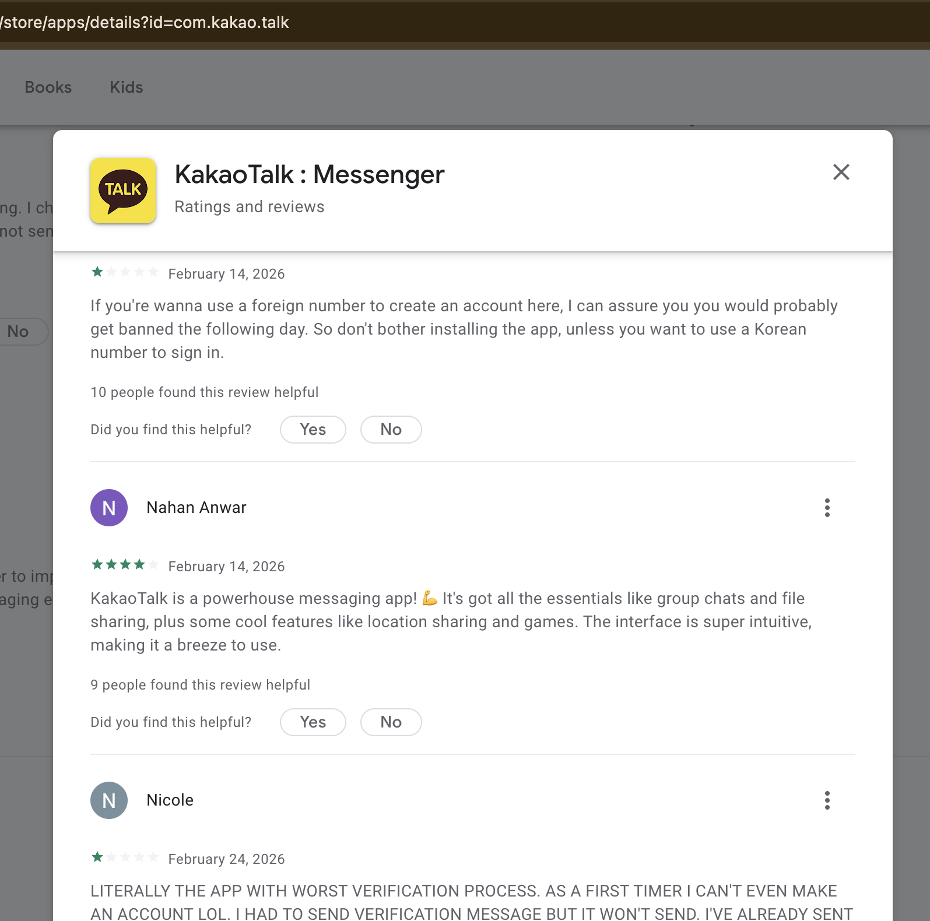
1# Overview:
Crawling reviews from the Google Play Store
I selected KakaoTalk to crawl reviews about from GooglePlayStore
I am crawling 7 elements of each review:
reviewer - Who wrote the review
rating - How much rated
date - Review Date
review - Review Content
helpful_count - Helpful Count
dev_reply - Reply by Developer
scraped_at - When I scraped
Max rows of review: 200

Slide 3
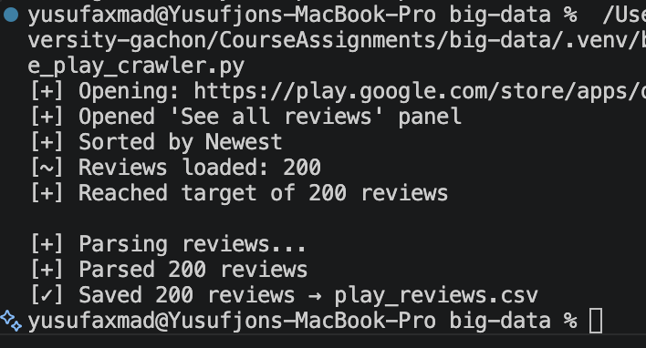
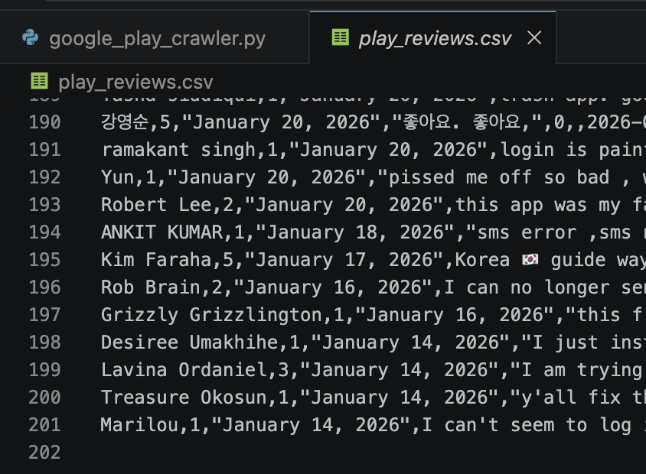
1# Result:
Crawling reviews from the Google Play Store
Workflow:
  1. Open Google Play app page
  2. Open See all reviews popup
  3. Set sort to Newest
  4. Scroll until target review count
  5. Parse review fields (name, rating, date, text, helpful, reply)
  6. Save results to play_reviews.csv
  7. Close browser and return data
play_reviews.csv
reviewer - Who wrote the review
rating - How much rated
date - Review Date
review - Review Content
helpful_count - Helpful Count
dev_reply - Reply by Developer
scraped_at - When I scraped
Max rows of review: 200

Slide 4
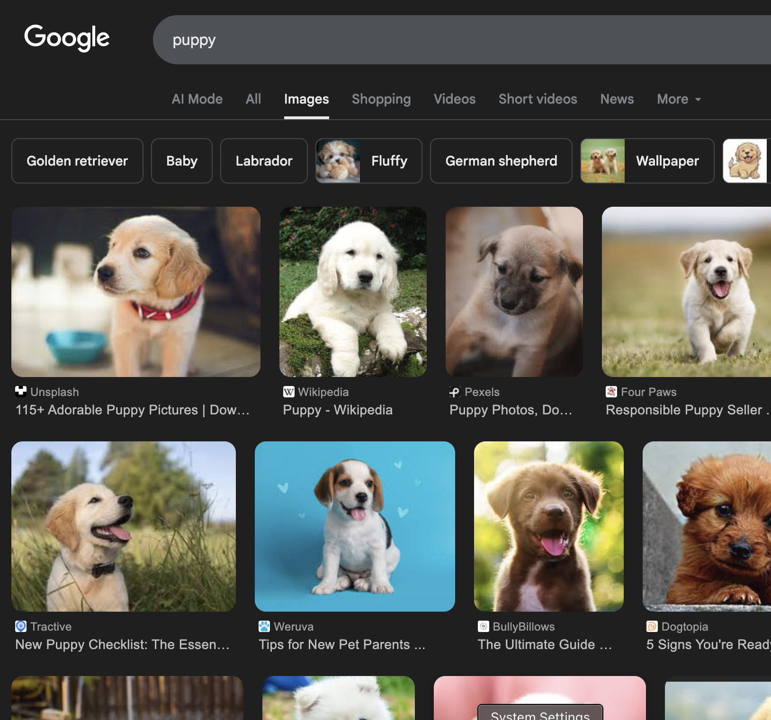
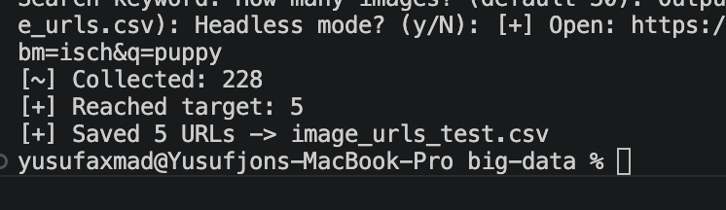
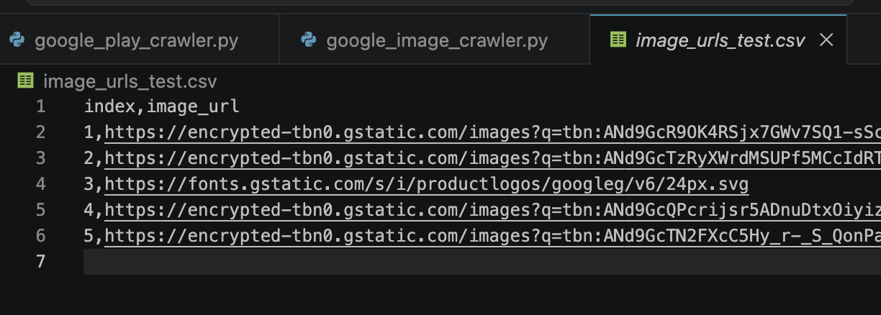
2# Overview & Result:
Crawling images from the Google with custom search input
I selected puppy to crawl images about from Google Images
I am crawling 2 elements of each image:
index
image_url

Slide 5
1# Result:
Crawling reviews from the Google Play Store
Workflow:
  1. Open Google Play app page
  2. Open See all reviews popup
  3. Set sort to Newest
  4. Scroll until target review count
  5. Parse review fields (name, rating, date, text, helpful, reply)
  6. Save results to play_reviews.csv
  7. Close browser and return data
play_reviews.csv
reviewer - Who wrote the review
rating - How much rated
date - Review Date
review - Review Content
helpful_count - Helpful Count
dev_reply - Reply by Developer
scraped_at - When I scraped
Max rows of review: 200

