Slide 1
ELL - 880 Social Network Analysis
Network Analysis in Table Tennis Championships
Presented by - Mohammad Yusuf
2023EET2757

Slide 2
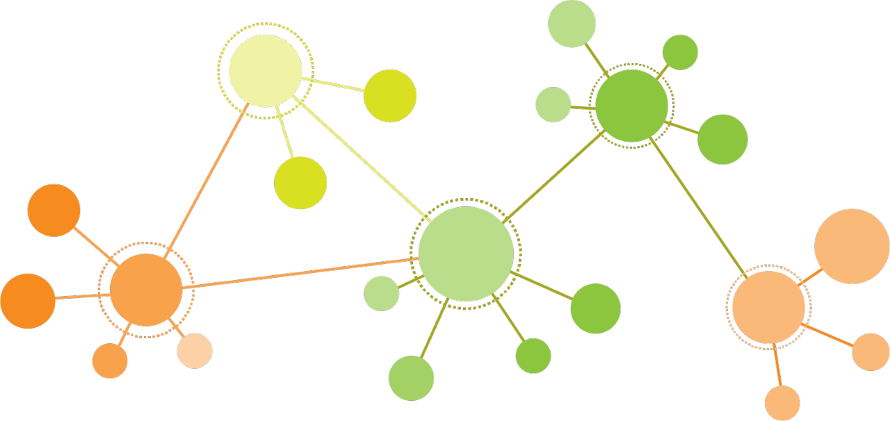
Introduction
Table Tennis is considered in top 10 mainstream sports. [1]
Started in England in late 19th century, inspired from lawn tennis. [2]
The governing body for Table Tennis is called International Table Tennis Federation (ITTF), founded in 1926 and headquartered at Lausanne, Switzerland [3].
Notes:
As mainstream sport goes, table tennis is relatively new but is considered in top 10 mainstream sports around the globe.
It has an incredible popularity with 850 million fans.
One of the reasons this game is so popular is that the rules are fairly easy to pick up, equipment is cheap, is space-efficient which makes the sport very accessible.
It was in England, in the late 19th century, that table tennis made its appearance. Taking inspiration from lawn tennis, the first players belonged to middle-class Victorian society.
The International Table Tennis Federation is the governing body for all national table tennis associations. The role of the ITTF includes overseeing rules and regulations and seeking technological improvement for the sport of table tennis.

Slide 3
Similar Work
[4] Focusing only on Italian table tennis players from 2011 to 2016, the research finds that the quality and structure of an athlete's match network significantly influence their performance.
[5] This paper ranks cricket teams and captains based on match quality rather than just the number of wins, using the PageRank algorithm.
[6] Utilizes network theory to model social interactions among professional men's tennis players through undirected weighted networks from 2018 to 2020.
Notes:
Idea of nw analysis is not new…. So taking inspiration from these

Slide 4
Objective and Motivation
Modeling match stats via network of table tennis players.
Verifying if the network follows real world property.
Calculating various metrics, community detection and inferring performances.
Ranking players based on PageRank and HITS algorithm and comparing with ITTF Rankings.

Slide 5
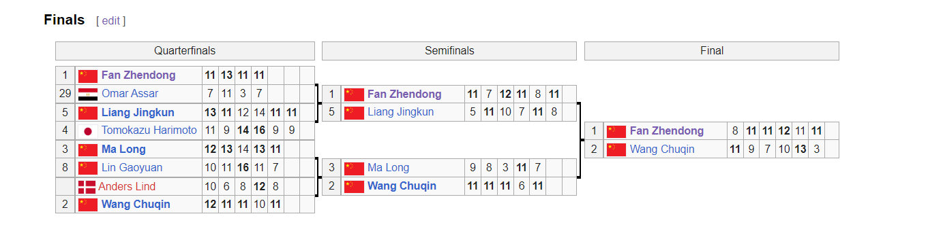
Dataset
Considering a period of 10 years (2013 - 2023), collected data of prestigious tournaments like - ITTF World Championship (2013/15/17/19/21/23), Olympics (2016/20) and World Cup (2017/18/19/20) and Grand Slam (2022/23).
Data was collected from Wikipedia [7] and WTT website [8].
ITTF 2023 World Championship Finals. [7]
Notes:
So ittf has different class of tournis, winner of these tournis gains points.
Collected data of only prestigious tournis which are 2000 points worth, there are many tournis with points <1500,
Considered this only because top players are definitely seen in top tournis rather than regional tournaments
Most difficult part of this project,as much data was not present for these tournis, WTT website has only 2021 - 23 data majority of them regional

Slide 6
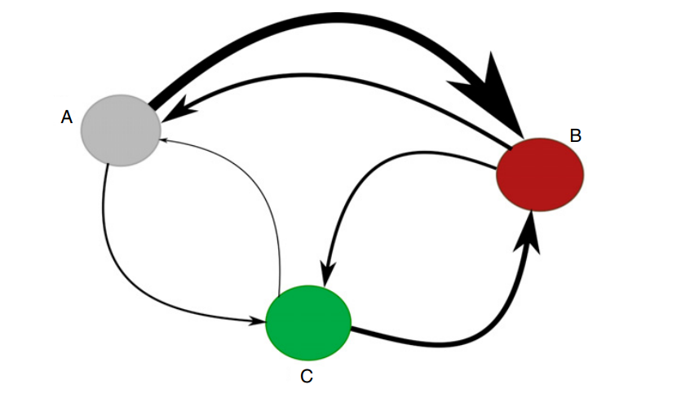
Methodology - How was the network formed?
A single match is represented by a link between two opponents.
If player A wins against player B, a directed link is drawn from B to A.
A weighted representation of the directed network is obtained by assigning a weight w_{BA} to the link, where w_{BA} is equal to the total number of times player B wins against player A [5].
Notes:
We analyze the network of players by analyzing the head-to-head encounter of competing players.

Slide 7
Tools and Programming Languages used for Analysis
Gephi
NetworkX
C++
Notes:
Gephi for network formation and visualisation
Networkx library mainly for metric calculations like degree distribution and fitting
Cpp scripts to clean the data set and generating edge lists

Slide 8
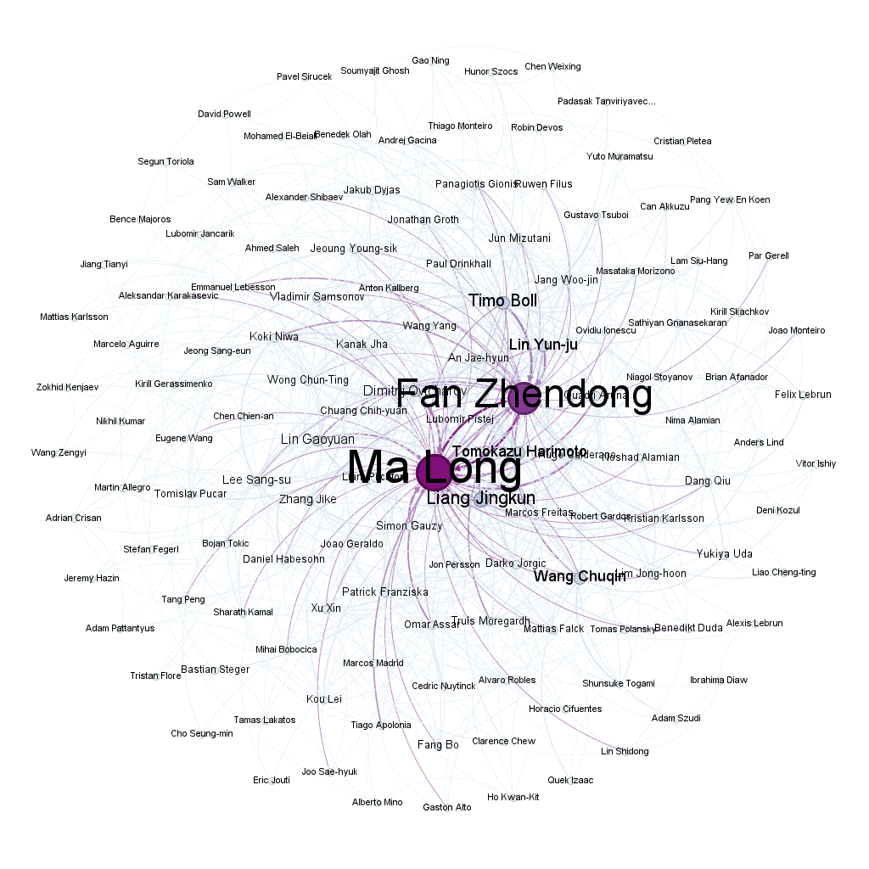
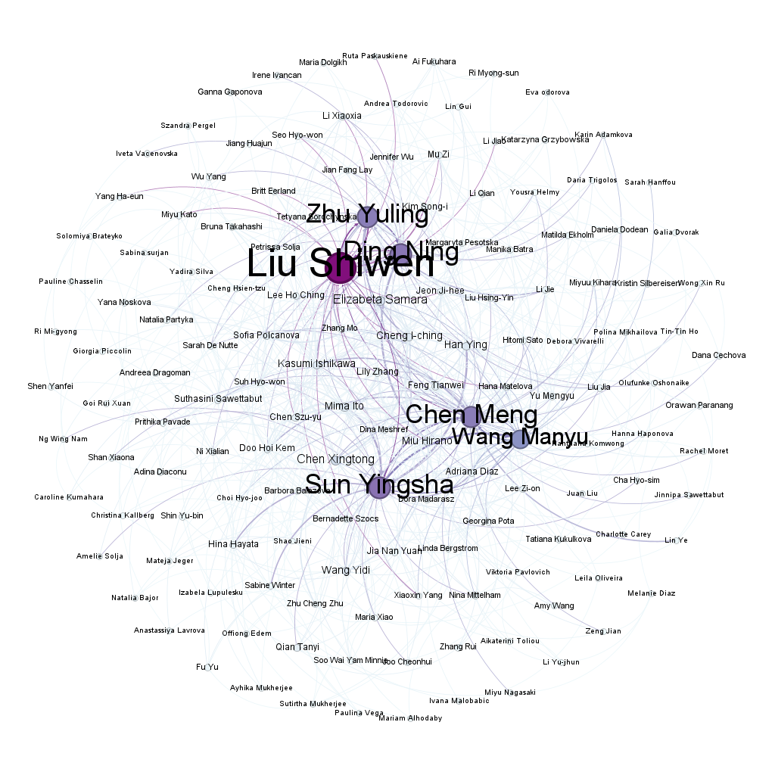
Results
Men Singles Network
Women Singles Network
Notes:
Selected degree range > 4 for better visuals
Size proportional to PR values

Slide 9
Table 1 | Men | Women
# Nodes | 297 | 333
# Edges | 916 | 926
# Matches | 964 | 968
# Tournaments | 14 | 14
Avg. Degree | 3.084 | 2.781
Avg. Weighted Degree | 3.246 | 2.907
N/w Density | 0.01 | 0.008
N/w Diameter | 11 | 14
Avg. Shortest Path | 3.901 | 4.825
Avg. Clustering Coefficient | 0.034 | 0.024
Strongly Conn.Components | 183 | 198
Notes:
# nodes, # edges… nw density is quite low for both networkss

Slide 10
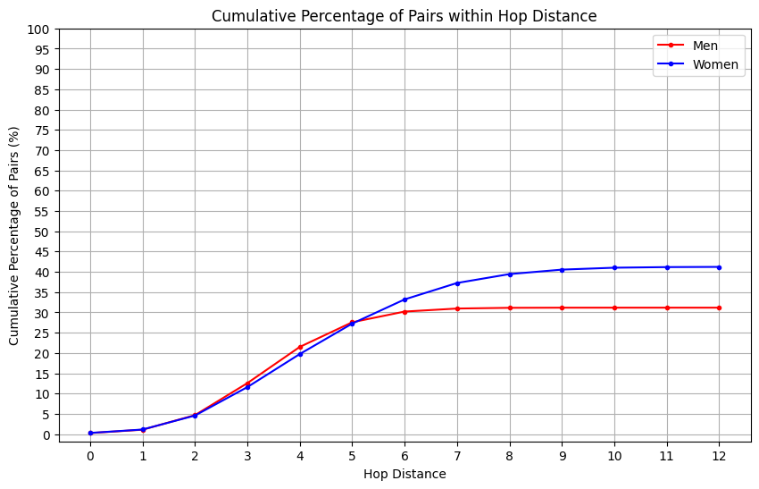
Diameter of Networks
<d_{men}> = 3.901
<d_{women}> = 4.825
Notes:
Diameter is the maxm shhortest path in a network
we realize that the worst cases are achieved only by a small fraction of nodes, thus reducing the variance of this metric. Notice that the curve for the directed graph does not reach 100% because some of the nodes are disconnected from the giant component.

Slide 11
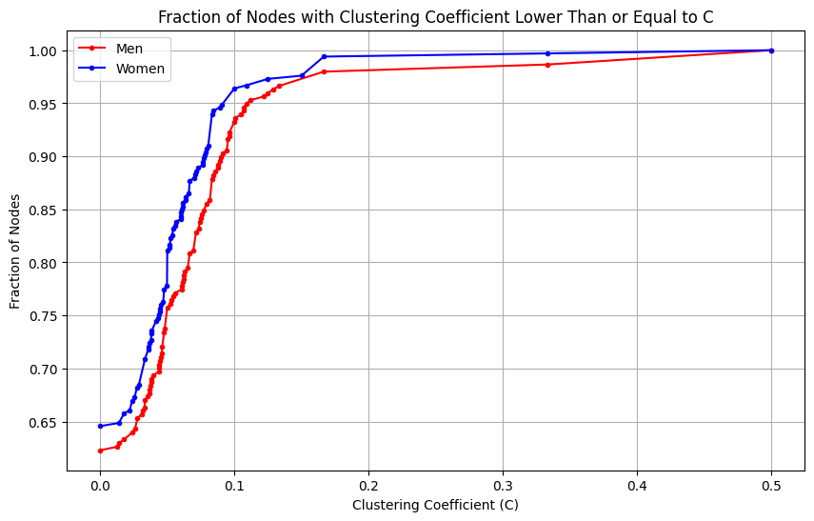
Clustering Coefficient
C_{men}= 0.034
C_{women}= 0.024
Notes:
CC is a metric which defines how well connected the neighbors of a node are
CC is quite low for these graphs
Maxm of nodes lie before C

Slide 12
Small World Property
Calculate the mean shortest path length <d> and the clustering coefficient C of your network.
Generate an appropriate ensemble of null-model networks.
Calculate the average of the mean shortest path length <d>_{r} over this ensemble of null-model networks; calculate C_{r} analogously.
λ:=<d>/<d>_{r} . and γ:=C/C_{r}
If λ≈1 and γ>1, call the network a small-world network. [6]
Men : λ≈1.1 and γ:=3
Women : λ≈1.4 and γ=3

Slide 13
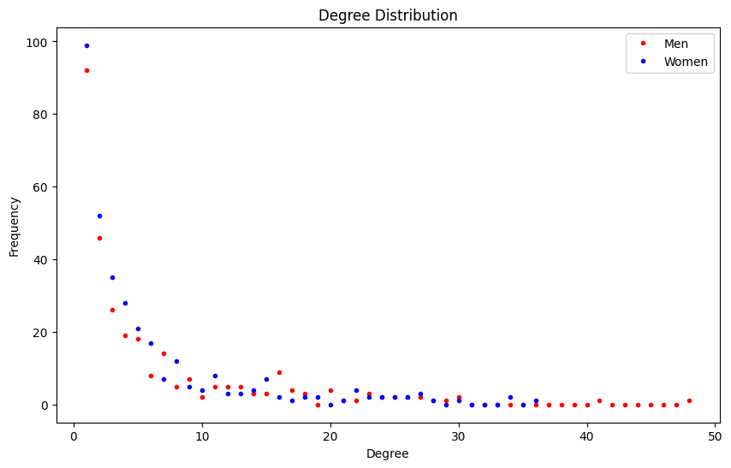
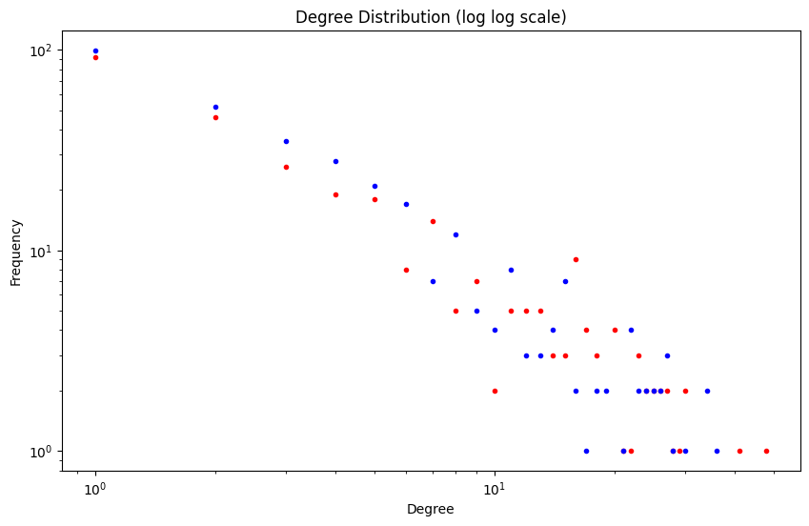
Degree Distribution
Linear Binning
Log Log plot
Notes:
I further calculated and plotted the degr distr both using linear binning and on log log plot for both graphs.
The first look on both does indicate that it follows a powerlaw
Exponential decre in 1st and linear decre in 2nd

Slide 14
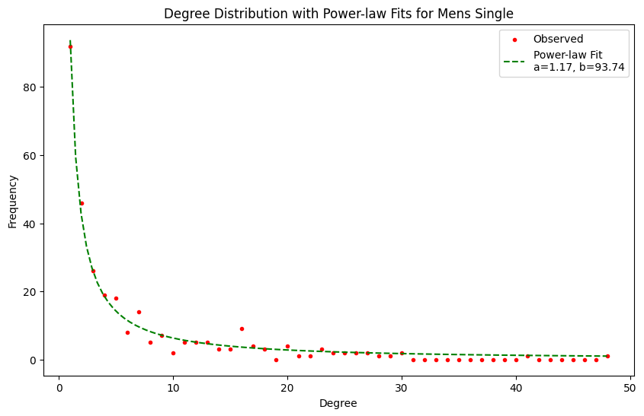
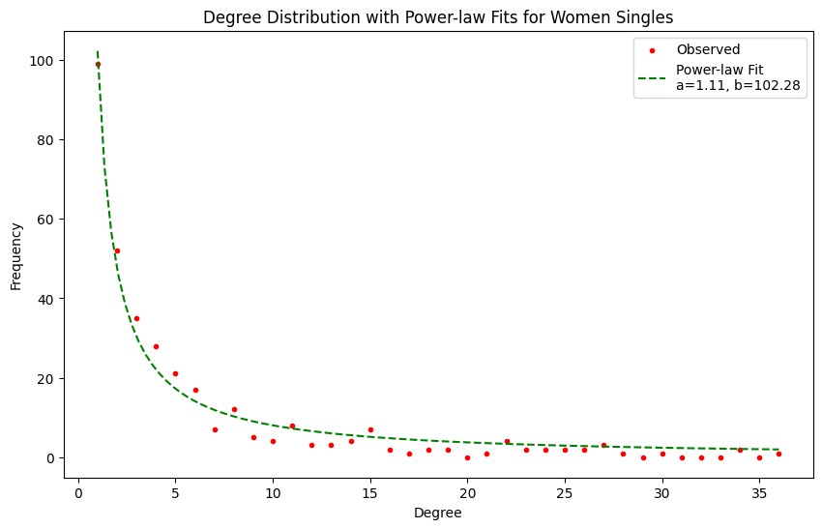
Power Law (p_{k} = b * k^{-a})
Power Law fit for both networks
Notes:
A is much less than real world networks of around 2.5 to 3. One intuitive reason for small exponent could be the lower tier ranked players are actually new emerging stars and given it is data of past decade, olders players have retired.

Slide 15
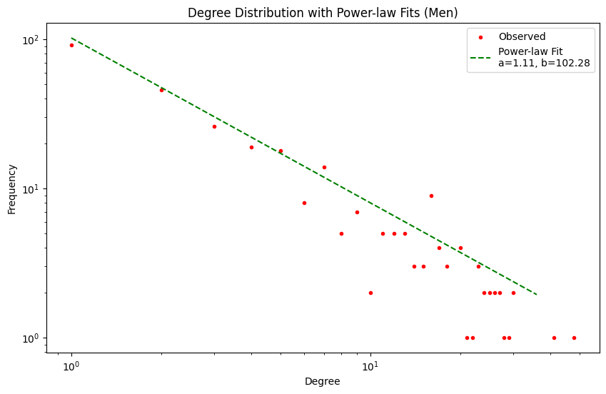
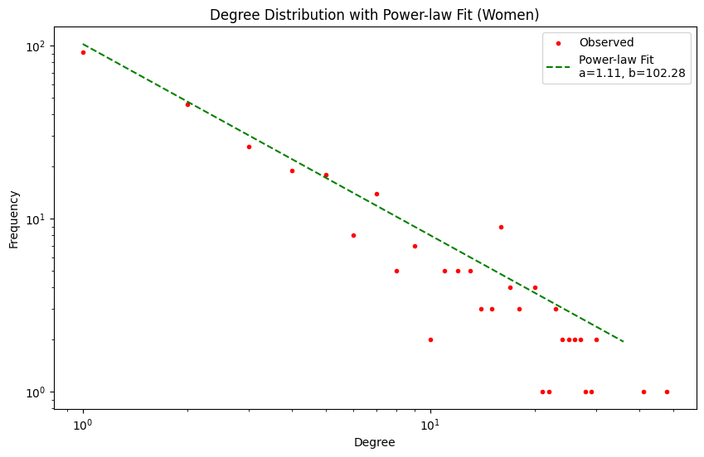
Power Law Fit
Power Law fit for both networks (log log plot)
Notes:
The same is plotted on log log plot for both networks

Slide 16
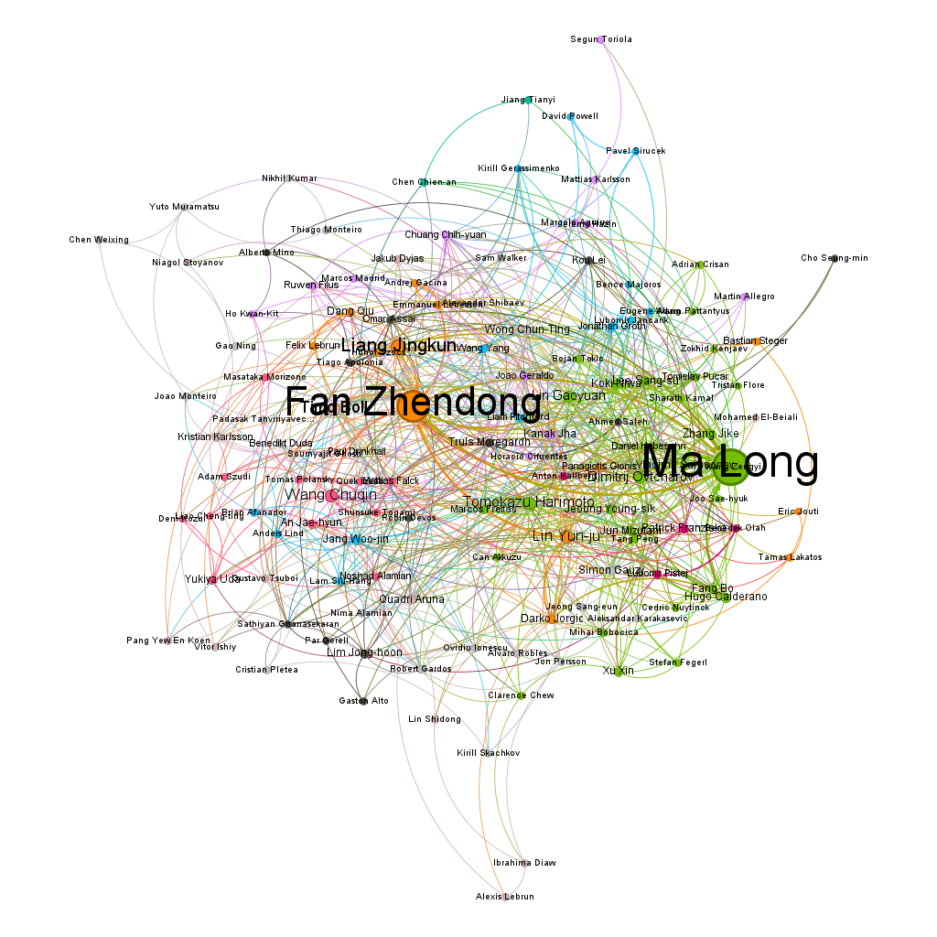
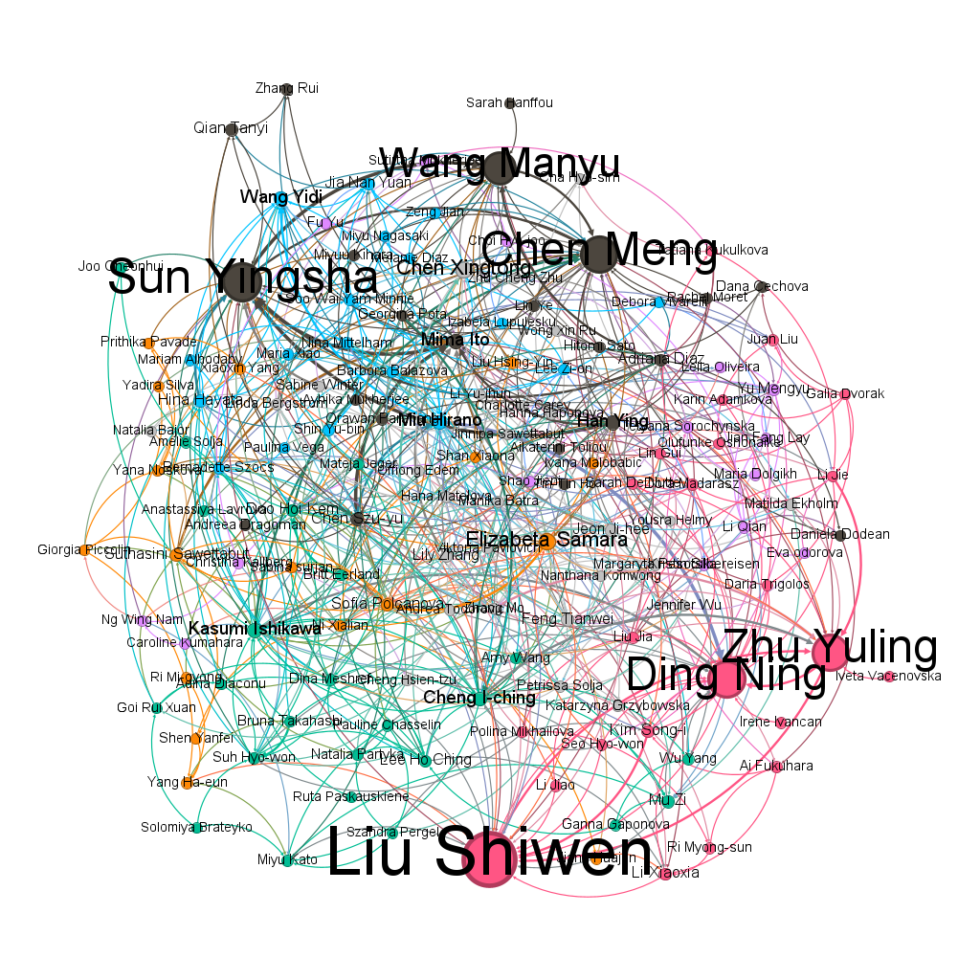
Communities
Men Singles Network
Women Singles Network
Notes:
Modularity = 0.256 women, 0.336 men
Using Gephi’s community detection using louvain method i detected 11 comm for men and 9 for women
Since it separates players with less matches with each other, Communities may have 2 meanings:
It forms communities between old and new players
It can represent various tourni seedings and interact in later stages

Slide 17
Ranking of Players
Simple Page Rank
Page Rank with Teleportation
HITS algorithm

Slide 18
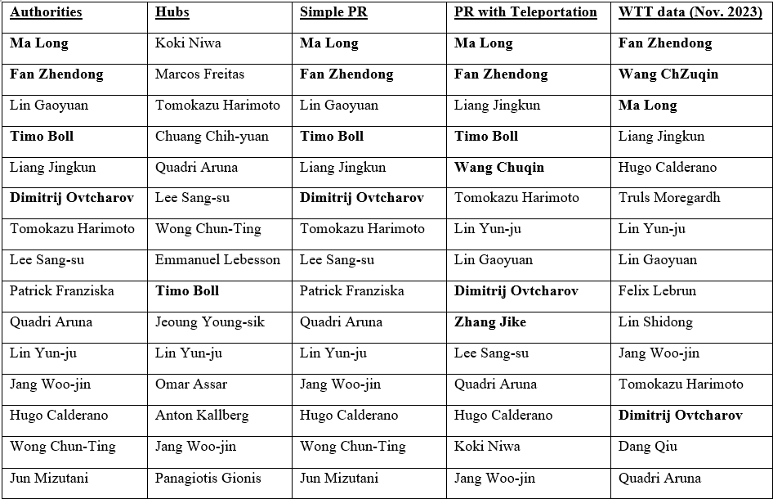
Comparison (Men)
RANKING METHODS OUTCOMES; THE BOLD NAMES ARE PLAYERS WHO HAVE BEEN AT THE FIRST ITTF POSITION DURING THEIR CAREER.

Slide 19
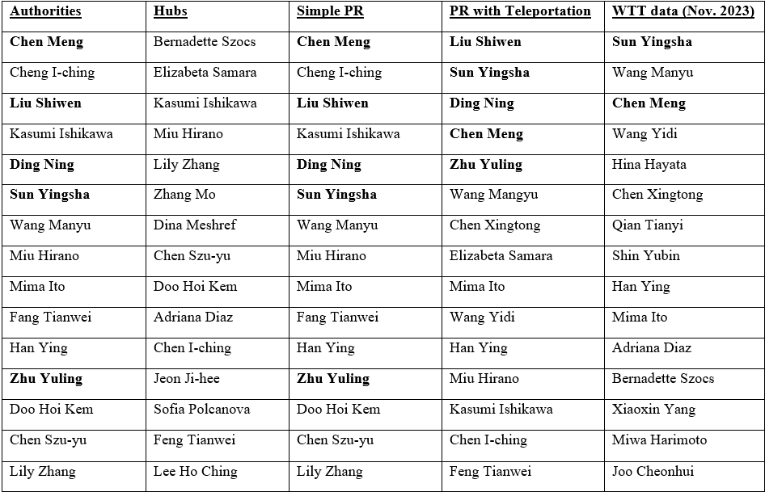
Comparison (Women)
RANKING METHODS OUTCOMES; THE BOLD NAMES ARE PLAYERS WHO HAVE BEEN AT THE FIRST ITTF POSITION DURING THEIR CAREER.

Slide 20
Conclusion and Future Work
Shown how to map ITTF single tennis matches into different graph representations.
Performed different rankings techniques.
Shown Ma Long (Men Singles) and Liu Shiwen (Women Singles) are best players in the previous decade in Prestige tournaments.
Inferred properties from metrics and community structure of the network.
Future work may include Extensive Dataset generation, Link prediction, study on Robustness of network and looking into more advanced ranking techniques.

Slide 21
References
[1] https://www.pledgesports.org/2017/03/top-10-most-watched-sports/
[2] https://en.wikipedia.org/wiki/Table_tennis
[3] https://www.ittf.com/
[4] M. Lai, R. Meo, R. Schifanella, and E. Sulis, “The role of the network of matches on predicting success in table tennis,” Journal of Sports Sciences, vol. 36, no. 23, pp. 2691–2698, Jun. 2018, doi: https://doi.org/10.1080/02640414.2018.1482813.
[5] S. Mukherjee, “Identifying the greatest team and captain—A complex network approach to cricket matches,” Physica A: Statistical Mechanics and its Applications, vol. 391, no. 23, pp. 6066–6076, Dec. 2012, doi: https://doi.org/10.1016/j.physa.2012.06.052.
[6] U. Michieli, “Complex Network Analysis of Men Single ATP Tennis Matches”, arXiv preprint arXiv:1804.08138, 2018.
[7] https://en.wikipedia.org/wiki/World_Table_Tennis_Championships
[8] https://worldtabletennis.com/rankings

