Slide 1

Operations
Control Tower
Seasonal campaign fulfilment
A business portfolio case study
Yusuf Ondes
Fictional company. Synthetic business data.
HALY synthetic portfolio case study
01 / 17
Notes:
HALY is a fictional powdered-drink manufacturer. This portfolio demonstrates a realistic campaign-fulfilment problem with synthetic data. The project connects accepted dispatch promises to stock allocation, controlled shipments and accountable exceptions. It is a local demonstration with source published to a Private GitHub repository, not a production client implementation. The cover is an AI-generated representative concept image, not a photograph of an actual HALY company or facility.
Sources: Repository: docs/DEMO.md; docs/TASKS.md, TASK-0007; docs/evidence/task-0007/README.md. Presentation design reference: https://support.microsoft.com/en-us/powerpoint/tips-for-creating-and-delivering-an-effective-presentation and https://support.microsoft.com/en-us/powerpoint/combining-colors-in-powerpoint-mistakes-to-avoid Cover asset: docs/portfolio/assets/haly-cover-concept.png. Generated with the built-in image tool on 15 October 2026.

Slide 2
The campaign creates a 400-unit stock gap
HALY manufactures powdered drinks from raw materials bought from two suppliers.
900
500
400
units ordered
finished units in stock
units to manufacture
The business task: fulfil discounted campaign orders while protecting accepted dispatch commitments.
HALY synthetic portfolio case study
02 / 17
Notes:
The synthetic campaign starts with 900 units of demand and 500 finished units on hand. HALY closes the remaining 400-unit gap through its own manufacturing process rather than buying finished products. Two suppliers provide raw materials. These values describe the validated end-to-end scenario, not a real sales forecast or measured company result.
Sources: Repository: docs/DEMO.md; docs/TASKS.md, TASK-0007; docs/evidence/task-0007/README.md.

Slide 3
The operating problem
A stock shortage creates decisions that standard records alone do not resolve.
Which order should receive
the next available unit?
Competing commitments
Changing promises
A large corporate order must not automatically outrank an earlier promise.
A proposal must not silently become a new commitment or hide the original date.
HALY synthetic portfolio case study
03 / 17
Notes:
This case focuses on the gap between having ERP records and enforcing a consistent business policy. Priority follows accepted warehouse dispatch dates. The customer type governs whether a partial shipment is permitted. Teams also need to see who owns a shortage and what action comes next. This is the designed business problem, not evidence that a real company previously suffered these losses.
Sources: Repository: docs/DEMO.md; docs/TASKS.md, TASK-0007; docs/evidence/task-0007/README.md.

Slide 4
The fulfilment workflow
Standard purchasing and manufacturing support focused campaign controls.
01
Confirm the order and dispatch promise
Sales records the shipment policy and accepted warehouse date.
02
Allocate the available stock
Earlier accepted commitments receive eligible stock first.
03
Purchase inputs and manufacture the shortage
Staff record receipts and production through standard Odoo operations.
04
Ship within the customer policy
Individuals receive complete orders. Corporate customers can receive batches.
05
Act on exceptions
A linked risk item shows the responsible owner and the next action.
HALY synthetic portfolio case study
04 / 17
Notes:
This is the business workflow, not a claim that physical work happens automatically. Sales establishes the accepted warehouse dispatch commitment. The campaign addon allocates eligible stock under the approved policy. Procurement and manufacturing users record real input receipts and completed production. Warehouse users prepare and validate shipments. Derived risk information supports coordinated follow-up.
Sources: Repository: docs/DEMO.md; docs/TASKS.md, TASK-0007; docs/evidence/task-0007/README.md.

Slide 5
Promise dates set stock priority
Three confirmed orders compete for 500 available finished units.
Order | Shipment policy | Ordered | Dispatch date | Allocated
A | Individual: complete | 200 | 15 Dec 2026 | 200
B | Corporate: batches | 600 | 16 Dec 2026 | 300
C | Individual: complete | 100 | 17 Dec 2026 | 0
Total |  | 900 |  | 500
Dispatch dates determine priority for both customer types.
HALY synthetic portfolio case study
05 / 17
Notes:
Initial allocation is A200, B300, C0. The first accepted dispatch date receives stock first. For equal dates, earlier confirmation wins. Stable order ID breaks an exact tie. An incomplete individual order retains its eligible allocated stock but cannot ship until complete. These are illustrative warehouse-dispatch dates, not delivery dates or a promised universal service level. Arithmetic: 200+600+100=900 ordered and 200+300+0=500 initially allocated.
Sources: docs/DEMO.md, Campaign walkthrough table; docs/DECISIONS.md,D-015; Repository: docs/DEMO.md; docs/TASKS.md, TASK-0007; docs/evidence/task-0007/README.md.

Slide 6
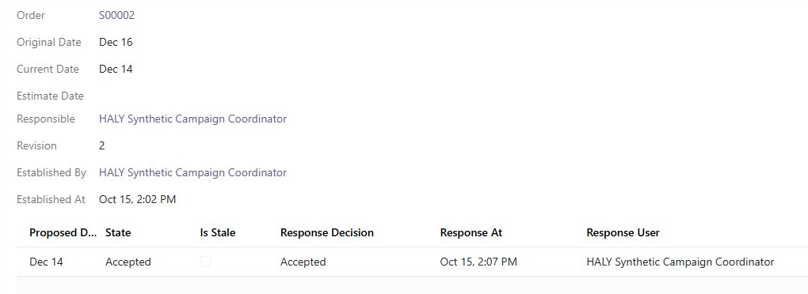
One order keeps its promise history
Original commitment: 16 December. Recorded accepted commitment: 14 December.
HALY synthetic portfolio case study
06 / 17
Notes:
The real synthetic browser capture shows order B with original 16 December and current 14 December after a coordinator records acceptance. The original promise remains visible and the revision/history identify the applied change. Staff record response evidence manually. The application does not authenticate customer consent or contact the customer. Screenshot is cropped for readability without altering the original source image.
Sources: docs/evidence/task-0007/04-accepted-date-history.png; Repository: docs/DEMO.md; docs/TASKS.md, TASK-0007; docs/evidence/task-0007/README.md.

Slide 7
Customer responses control date changes
Staff record the customer response before a new date controls priority.
Recorded response | Active commitment | Stock-priority effect
Pending | Existing accepted date | No change
Rejected | Existing accepted date | No change
Accepted and current | New accepted date | Recalculate eligible stock
Unanswered or rejected proposals keep the existing commitment and its risk visible.
HALY synthetic portfolio case study
07 / 17
Notes:
A pending proposal, rejection or internal estimate does not move the campaign priority date. An accepted, non-stale response updates the current promise and can reprioritize stock that staff have not prepared. Original commitment and response history remain traceable. Acceptance is manually recorded by a coordinator; the addon does not send messages or capture authenticated customer consent. On rejection the team keeps the existing promise and records its next operational action.
Sources: docs/DECISIONS.md,D-011,D-012,D-015; Repository: docs/DEMO.md; docs/TASKS.md, TASK-0007; docs/evidence/task-0007/README.md.

Slide 8
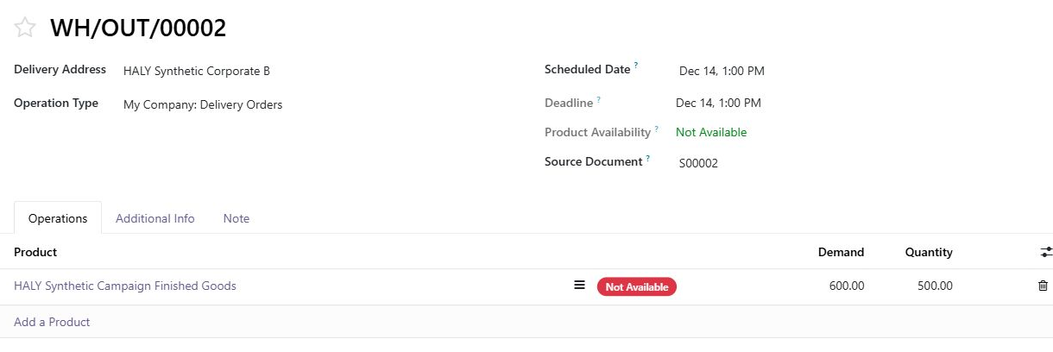
An earlier accepted date can change allocation
Browser example: B moves to 14 December, before A. It then receives 500 units.
Prepared stock and outside reservations remain protected.
HALY synthetic portfolio case study
08 / 17
Notes:
This is a later browser state, not the initial 200/300/0 allocation. B has an accepted date of 14 December and now receives all 500 eligible unprepared units against 600 demand. It wins because its promise is earlier, not because it is corporate. The application preserves prepared moves and outside reservations. It refuses unsupported or unmanaged competition rather than taking stock silently. A partly prepared short individual order needs warehouse unprepare/recheck before extra allocation.
Sources: docs/evidence/task-0007/05-accepted-priority-reserves-500.png; Repository: docs/DEMO.md; docs/TASKS.md, TASK-0007; docs/evidence/task-0007/README.md.

Slide 9
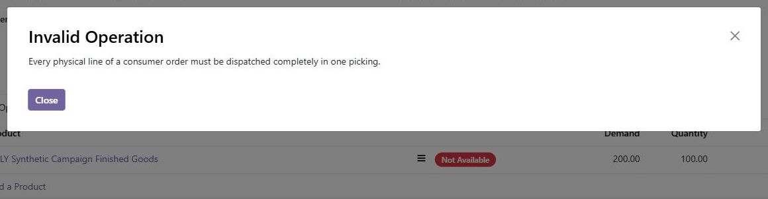
Individual orders require a complete shipment
Attempt: dispatch 100 units against an individual order for 200.
The system refuses the incomplete shipment before physical completion.
HALY synthetic portfolio case study
09 / 17
Notes:
The browser screenshot shows an actual refused synthetic consumer shipment. Demand is 200 and the entered quantity is 100. Every physical line of the supported individual order must ship completely in one picking. Allocated stock can remain reserved while the order waits for completion. This is a policy-specific control within the configured one-step, untracked-goods scope.
Sources: docs/evidence/task-0007/02-consumer-partial-blocked.png; Repository: docs/DEMO.md; docs/TASKS.md, TASK-0007; docs/evidence/task-0007/README.md.

Slide 10
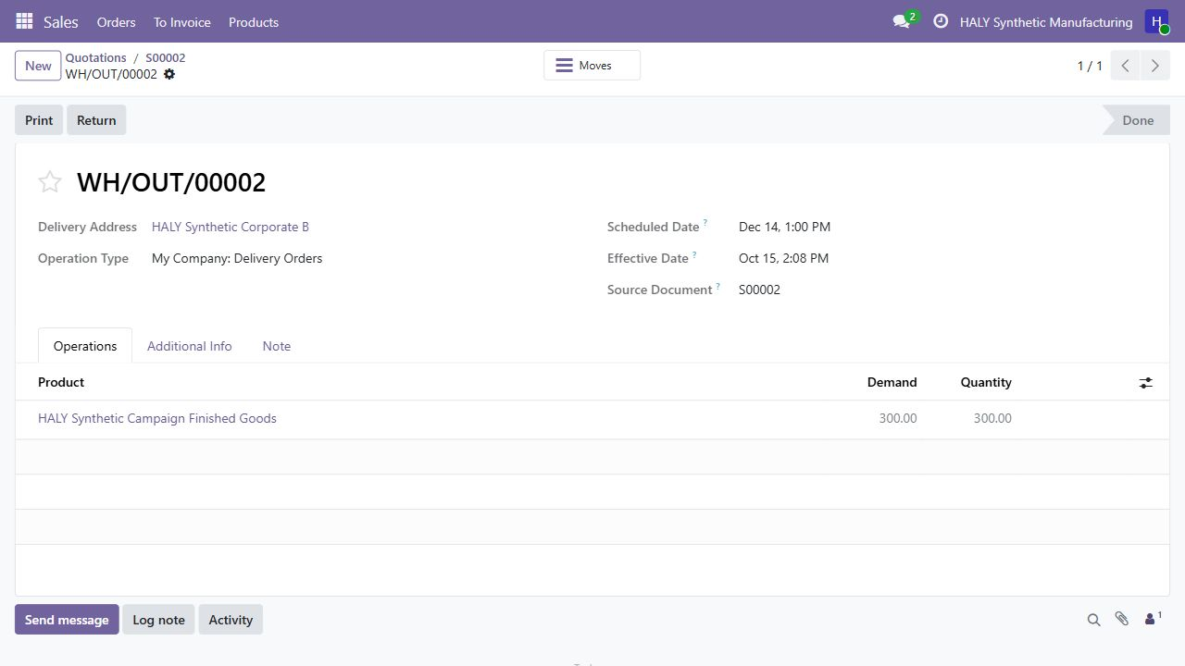
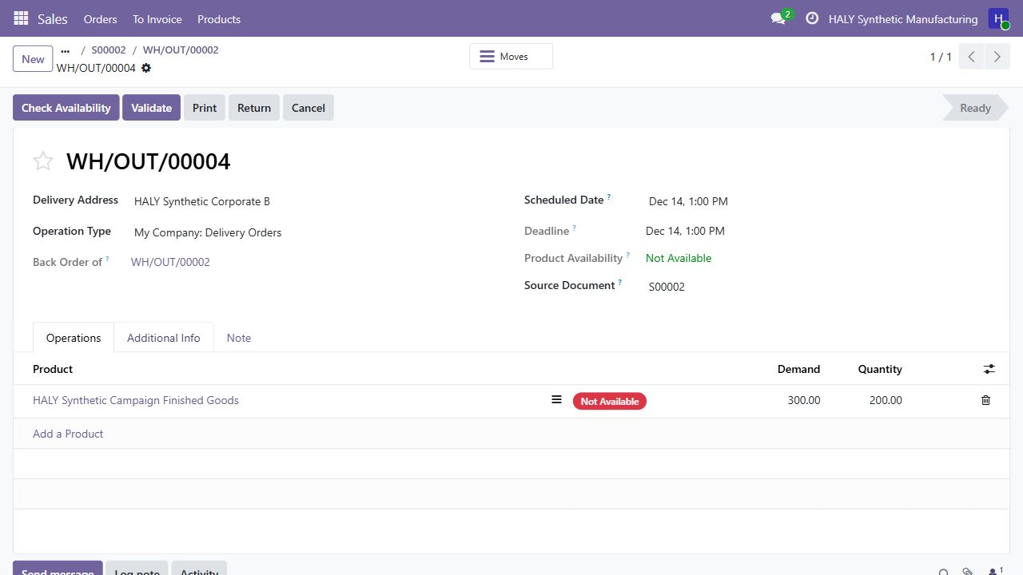
Corporate shipments retain the open balance
Browser example: 600 ordered, 300 dispatched, 300 left to fulfil.
300 dispatched
300 still outstanding
200 reserved for the next batch
A backorder keeps the remaining demand visible for the next shipment.
HALY synthetic portfolio case study
10 / 17
Notes:
The left browser capture shows a 300-unit corporate shipment completed. The right capture shows the retained 300-unit backorder, with 200 currently available/reserved. The remaining demand does not disappear when a batch leaves. This browser path later shipped 100 and 50 in separate checks; it is not the end-to-end 300/200/100 manufacturing scenario shown later. No real shipment occurred.
Sources: docs/evidence/task-0007/06-corporate-300-dispatched.png; docs/evidence/task-0007/07-corporate-backorder-preserved.png; Repository: docs/DEMO.md; docs/TASKS.md, TASK-0007; docs/evidence/task-0007/README.md.

Slide 11
HALY manufactures the missing 400 units
The end-to-end scenario uses two raw-material suppliers.
01
Two raw-material suppliers
The scenario creates two 400-unit input purchase orders.
02
Record the incoming materials
Standard receipts make the inputs available for production.
03
Complete HALY production
A manufacturing order produces 400 finished units.
500 opening stock + 400 manufactured = 900 units available
HALY synthetic portfolio case study
11 / 17
Notes:
This slide describes the validated automated purchase/manufacturing/dispatch scenario. Two 400-unit raw-material POs supply two inputs. Their 800 raw units are not 800 finished units. The bill of materials and one 400-unit manufacturing order produce 400 finished goods, which combine with 500 opening finished units. Procurement, receipt and production are recorded standard Odoo actions. The separate browser preview has no raw-material or manufacturing fixture.
Sources: scripts/validate_campaign.py; docs/evidence/task-0007/README.md; Repository: docs/DEMO.md; docs/TASKS.md, TASK-0007; docs/evidence/task-0007/README.md.

Slide 12
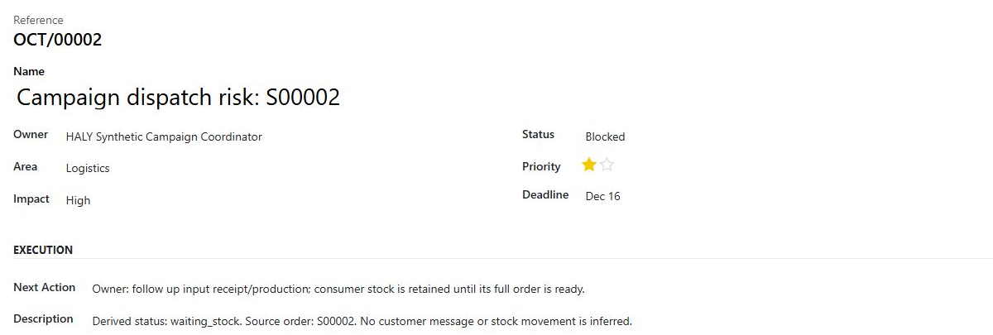
Every shortage has an owner and a next action
A source-linked risk item connects the sales commitment with operational follow-up.
The team can see who must act and which order needs attention.
HALY synthetic portfolio case study
12 / 17
Notes:
The browser capture shows a campaign shortage linked to the source order, with a coordinator, Blocked state and a next action. Separate runtime cases test supplier delay, one linked risk item and repeated updates without duplicates. Supply-risk dates use a one-level input/production signal, not exact order pegging or a guaranteed feasible date. A card/status does not imply physical shipment or customer contact.
Sources: docs/evidence/task-0007/03-owned-risk-item.png; Repository: docs/DEMO.md; docs/TASKS.md, TASK-0007; docs/evidence/task-0007/README.md.

Slide 13
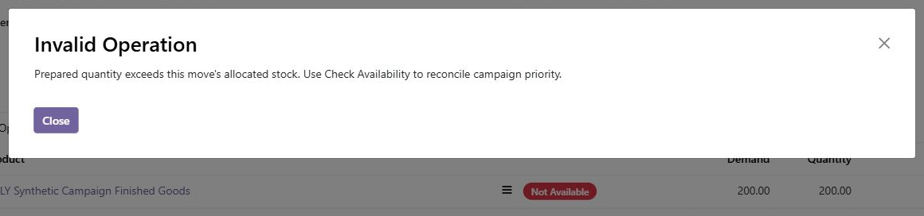
Manual preparation respects stock priority
Warehouse users cannot claim more campaign stock than the order receives.
An invalid quantity stops at Save, before it can become a completed shipment.
HALY synthetic portfolio case study
13 / 17
Notes:
This final-source browser capture demonstrates the repaired preparation guard. The application refuses a saved prepared quantity above the move allocation and asks the operator to reconcile availability. Independent review found two bypasses during development. Both were reproduced, repaired and retested. The final supported guards cover saved move/raw-line preparation and nested commands; they are not a claim that a privileged administrator cannot change any ERP data.
Sources: docs/evidence/task-0007/12-final-preparation-guard.png; docs/TASKS.md,TASK-0007 repair history.

Slide 14
The full scenario fulfils all 900 units
Validated end-to-end scenario, separate from the browser examples.
Order | Ordered | Dispatch pattern | Total shipped
A: individual | 200 | One complete shipment | 200
B: corporate | 600 | 300 + 200 + 100 | 600
C: individual | 100 | One complete shipment | 100
Total | 900 |  | 900
500 opening + 400 manufactured = 900 dispatched
HALY synthetic portfolio case study
14 / 17
Notes:
The actual local campaign probe passes the 500+400=900 arithmetic. A ships 200 completely, B ships 600 in 300/200/100 batches, C ships 100 completely. Final main finished-goods stock is 0. Seven final probe quants remain nonnegative and not over-reserved. These are synthetic test outcomes, not measured performance of a real operation. The browser screenshots depict a separate partial-shipment walkthrough.
Sources: scripts/validate_campaign.py; docs/evidence/task-0007/README.md.

Slide 15
Project work and validation
Business decisions became explicit rules with evidence behind the results.
Standard ERP foundation
81
Sales, inventory, purchasing and own manufacture.
local test methods
Focused extensions
Promise history, date-first allocation, shipment guards and owned exceptions.
11
Reviewed delivery
campaign cases
Independent review, repairs, regression checks and owner acceptance.
HALY synthetic portfolio case study
15 / 17
Notes:
Yusuf owns the project and approved its business rules. The work includes requirement clarification, standard-flow assessment, focused optional extensions, synthetic scenarios, negative/concurrency checks and review-driven repairs. AI-assisted implementation supported this work. The recorded local result is 81 methods:8 base, 22 promise, 51 campaign, plus 11 campaign probe cases. Those are distinct test units, not 92 independent business processes and not 81 GitHub CI tests. No time-saving, ROI or delivery-rate improvement has been measured.
Sources: docs/TASKS.md,TASK-0003 through TASK-0008; docs/evidence/task-0007/README.md.

Slide 16
Business capability and next opportunities
Capabilities demonstrated in a controlled synthetic scenario.
Business need | Capability demonstrated
Consistent stock decisions | Accepted-date priority with protected reservations
Clear customer commitments | Original/current dates and recorded response history
Controlled fulfilment | Complete individual orders and corporate backorders
Accountable follow-up | One source-linked risk item with owner and next action
Possible next phase
Capacity planning, carrier integration and a separately validated production rollout.
HALY synthetic portfolio case study
16 / 17
Notes:
These are demonstrated capabilities, not measured business impact or a real-client implementation. The supported scope is one-step make-to-stock, untracked configured goods. Staff record responses and physical operations. Carrier/WMS adapters, formal quality release, capacity optimization, authenticated consent and production hosting are not delivered. Future opportunities shown here are proposals, not existing features or approved implementation commitments.
Sources: docs/ARCHITECTURE.md; docs/DECISIONS.md; docs/evidence/task-0007/README.md.

Slide 17
Technology and delivery
Standard Odoo with focused extensions and a reproducible synthetic demonstration.
Business platform
Data and environment
Odoo 19 Community
Sales, Inventory, Purchase, Manufacturing
PostgreSQL 15
Docker and PowerShell validation helpers
Implementation
Version control
Python business rules
XML views and CSV access controls
Git and Private GitHub repository
Portfolio scope: synthetic data, no production deployment. CI startup-health follow-up remains open.
HALY synthetic portfolio case study
17 / 17
Notes:
Source repository: https://github.com/yusufondes/Operations-Control-Tower . The repository is Private at the verified publication checkpoint, so readers need access. No installation is needed to understand this deck. The source uses Odoo 19 Community, Python, PostgreSQL15, Docker, XML/CSV and PowerShell. Git/GitHub retain both initial histories. Development was AI-assisted with Codex and independent agent review. Local 81/11 checks passed. The first remote CI run passed repository checks and 8 base tests but failed its later HTTP-health check with curl 56; do not claim green CI or full campaign remote coverage. TASK-0008 preview-helper fixes are local/unpushed at this checkpoint. No production deployment or customer messaging exists.
Sources: README.md; compose.yaml; .github/workflows/ci.yml; docs/TASKS.md,TASK-0006,TASK-0008. Repository: https://github.com/yusufondes/Operations-Control-Tower . CI evidence: https://github.com/yusufondes/Operations-Control-Tower/actions/runs/38748554245 .

