Slide 1

Operations
Control Tower
HALY seasonal campaign fulfilment
Business case study
Yusuf Ondes
Fictional company. Synthetic business data.
HALY synthetic portfolio case study
01 / 14
Notes:
HALY is a fictional powdered-drink manufacturer. This portfolio demonstrates a realistic campaign-fulfilment problem with synthetic data. The project connects accepted dispatch promises to stock allocation, controlled shipments and accountable exceptions. The source repository is on GitHub. This is a local portfolio demonstration with no production client implementation. The cover is an AI-generated representative concept image, not a photograph of an actual HALY company or facility.
Sources: Repository: docs/DEMO.md; docs/TASKS.md, TASK-0007; docs/evidence/task-0007/README.md. Presentation design reference: https://support.microsoft.com/en-us/powerpoint/tips-for-creating-and-delivering-an-effective-presentation and https://support.microsoft.com/en-us/powerpoint/combining-colors-in-powerpoint-mistakes-to-avoid Cover asset: docs/portfolio/assets/haly-cover-concept.png. Generated with the built-in image tool on 15 October 2026.

Slide 2
The campaign stock gap
HALY makes powdered drinks using inputs from two suppliers.
900
500
400
units ordered
finished units in stock
units to manufacture
The challenge: limited stock, competing dispatch dates.
HALY produces the shortage in-house.
HALY synthetic portfolio case study
02 / 14
Notes:
The synthetic campaign starts with 900 units of demand and 500 finished units on hand. HALY closes the remaining 400-unit gap through its own manufacturing process rather than buying finished products. Two suppliers provide raw materials. These values describe the validated end-to-end scenario, not a real sales forecast or measured company result.
Sources: Repository: docs/DEMO.md; docs/TASKS.md, TASK-0007; docs/evidence/task-0007/README.md.

Slide 3
Order fulfilment, step by step
Teams record physical work. Campaign rules control stock and shipment decisions.
01
Order and dispatch promise
Sales records the accepted warehouse dispatch date.
02
Stock allocation
Orders with earlier accepted dates receive available stock first.
03
Purchasing and production
HALY buys raw materials and manufactures the shortage.
04
Shipment
Individual orders ship in full. Corporate orders can ship in batches.
05
Exception follow-up
A linked risk item records the owner and next action.
HALY synthetic portfolio case study
03 / 14
Notes:
This is the business workflow. Physical work does not happen automatically. Sales establishes the accepted warehouse dispatch commitment. The campaign addon allocates eligible stock under the approved policy. Procurement and manufacturing users record input receipts and completed production. Warehouse users prepare and validate shipments. All operations in this demonstration use synthetic records. Derived risk information supports coordinated follow-up.
Sources: Repository: docs/DEMO.md; docs/TASKS.md, TASK-0007; docs/evidence/task-0007/README.md.

Slide 4
Dispatch dates set stock priority
Initial allocation of 500 finished units across three orders.
Order | Shipment policy | Ordered | Dispatch date | Allocated
A | Individual: complete | 200 | 15 Dec 2026 | 200
B | Corporate: batches | 600 | 16 Dec 2026 | 300
C | Individual: complete | 100 | 17 Dec 2026 | 0
Total |  | 900 |  | 500
The accepted dispatch date sets priority for both customer types.
HALY synthetic portfolio case study
04 / 14
Notes:
Initial allocation is A 200, B 300, C 0. The first accepted dispatch date receives stock first. For equal dates, earlier confirmation wins. Stable order ID breaks an exact tie. An incomplete individual order retains its eligible allocated stock but cannot ship until complete. These are illustrative warehouse-dispatch dates, not delivery dates or a promised universal service level. Arithmetic: 200+600+100=900 ordered and 200+300+0=500 initially allocated.
Sources: docs/DEMO.md, Campaign walkthrough table; docs/DECISIONS.md, D-015; Repository: docs/DEMO.md; docs/TASKS.md, TASK-0007; docs/evidence/task-0007/README.md.

Slide 5
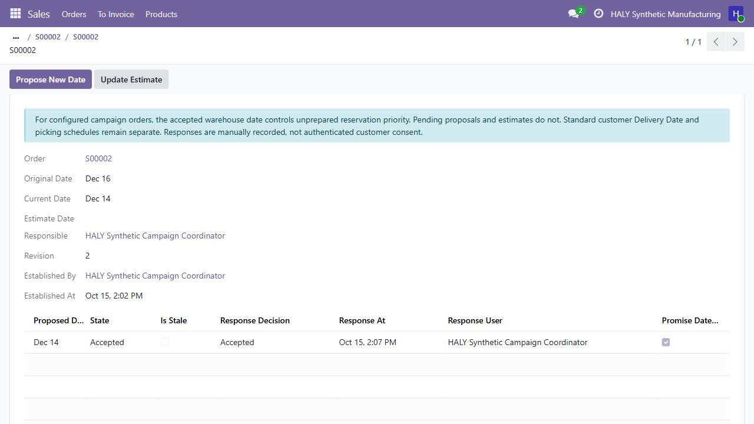
A new date needs customer acceptance
Order B: 16 December originally, 14 December after recorded acceptance.
Acceptance of a valid proposal updates the date.
Pending or rejected proposals keep the current date.
HALY synthetic portfolio case study
05 / 14
Notes:
The real synthetic browser capture shows order B with original 16 December and current 14 December after a coordinator records acceptance. The original promise remains visible and response history identifies the applied change. A pending proposal, rejection, stale response or internal estimate does not move priority. Acceptance of the latest valid proposal updates the promise and can reprioritize stock not yet prepared. Staff record responses manually. The application does not authenticate customer consent or contact the customer. On rejection the existing promise and its risk remain visible, with an operational next action. The screenshot crop does not alter the source image.
Sources: docs/evidence/task-0007/04-accepted-date-history.png; docs/DECISIONS.md, D-011, D-012, D-015; Repository: docs/DEMO.md; docs/TASKS.md, TASK-0007; docs/evidence/task-0007/README.md.

Slide 6
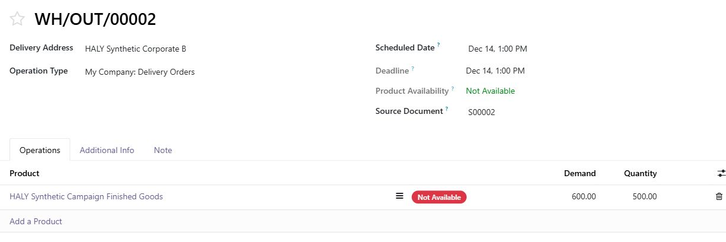
Stock follows the updated date
B's accepted 14 December date comes before A's 15 December date.
B now has 500 units reserved. Prepared and outside reservations stay protected.
HALY synthetic portfolio case study
06 / 14
Notes:
This is a later browser state, not the initial 200/300/0 allocation. B has an accepted date of 14 December and now receives all 500 eligible unprepared units against 600 demand. It wins because its promise is earlier, not because it is corporate. The application preserves prepared moves and outside reservations. It refuses unsupported or unmanaged competition rather than taking stock silently. A partly prepared short individual order needs warehouse unprepare/recheck before extra allocation.
Sources: docs/evidence/task-0007/05-accepted-priority-reserves-500.png; Repository: docs/DEMO.md; docs/TASKS.md, TASK-0007; docs/evidence/task-0007/README.md.

Slide 7
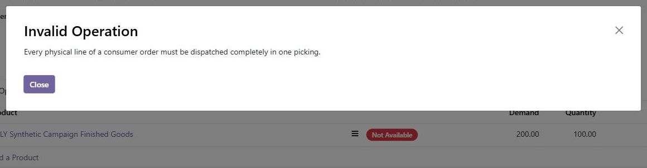
Individual orders ship in full
Example: a user tries to ship 100 of the 200 units ordered.
The partial shipment cannot be validated.
HALY synthetic portfolio case study
07 / 14
Notes:
The browser screenshot shows an actual refused synthetic consumer shipment. Demand is 200 and the entered quantity is 100. Every physical line of the supported individual order must ship completely in one picking. Allocated stock can remain reserved while the order waits for completion. This is a policy-specific control within the configured one-step, untracked-goods scope.
Sources: docs/evidence/task-0007/02-consumer-partial-blocked.png; Repository: docs/DEMO.md; docs/TASKS.md, TASK-0007; docs/evidence/task-0007/README.md.

Slide 8
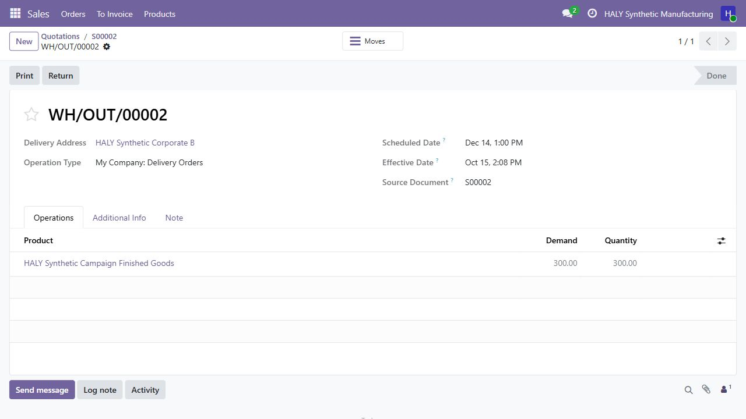
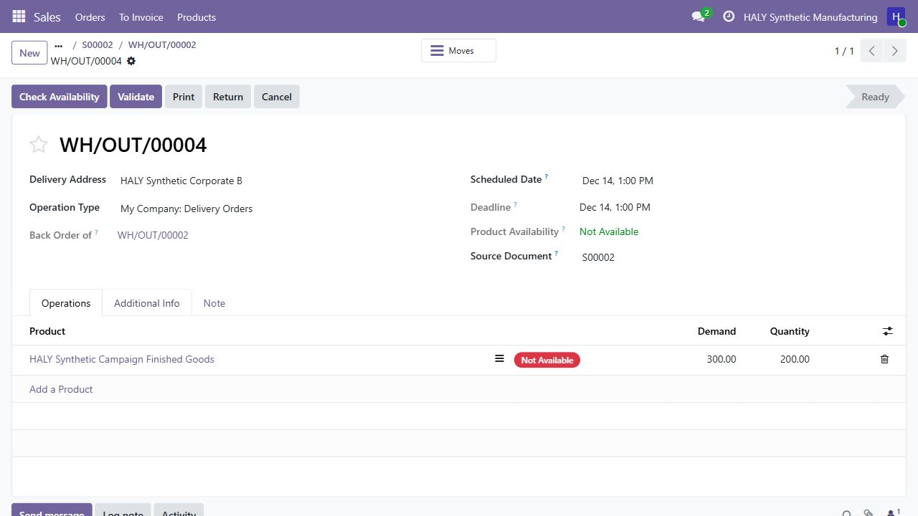
Corporate orders can ship in batches
Browser example: 600 ordered, 300 shipped, 300 remaining.
300 shipped
300 remaining
200 reserved for the next batch
The remaining 300 units stay on a backorder.
HALY synthetic portfolio case study
08 / 14
Notes:
The left browser capture shows a 300-unit corporate shipment completed. The right capture shows the retained 300-unit backorder, with 200 currently available/reserved. The remaining demand does not disappear when a batch leaves. This browser path later shipped 100 and 50 in separate checks; it is not the end-to-end 300/200/100 manufacturing scenario shown later. No real shipment occurred.
Sources: docs/evidence/task-0007/06-corporate-300-dispatched.png; docs/evidence/task-0007/07-corporate-backorder-preserved.png; Repository: docs/DEMO.md; docs/TASKS.md, TASK-0007; docs/evidence/task-0007/README.md.

Slide 9
HALY produces the missing 400 units
Two suppliers provide raw materials. HALY makes the finished product.
01
Purchase raw materials
Buy 400 units of each required input from two suppliers.
02
Receive the inputs
Record the materials arriving into stock.
03
Manufacture 400 finished units
Complete HALY's own production order.
500 opening + 400 manufactured = 900 units in total
HALY synthetic portfolio case study
09 / 14
Notes:
This slide describes the validated automated purchase/manufacturing/dispatch scenario. Two 400-unit raw-material POs supply two inputs. Their 800 raw units are not 800 finished units. The bill of materials and one 400-unit manufacturing order produce 400 finished goods, which combine with 500 opening finished units. Procurement, receipt and production are recorded standard Odoo actions. The separate browser preview has no raw-material or manufacturing fixture.
Sources: scripts/validate_campaign.py; docs/evidence/task-0007/README.md; Repository: docs/DEMO.md; docs/TASKS.md, TASK-0007; docs/evidence/task-0007/README.md.

Slide 10
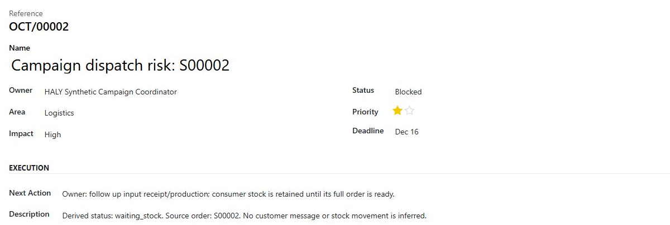
Shortages have an owner
Each risk item links to its sales order and records the next action.
The coordinator can track the order's next action.
HALY synthetic portfolio case study
10 / 14
Notes:
The browser capture shows a campaign shortage linked to the source order, with a coordinator, Blocked state and a next action. Separate runtime cases test supplier delay, one linked risk item and repeated updates without duplicates. Supply-risk dates use a one-level input/production signal, not exact order pegging or a guaranteed feasible date. A card/status does not imply physical shipment or customer contact.
Sources: docs/evidence/task-0007/03-owned-risk-item.png; Repository: docs/DEMO.md; docs/TASKS.md, TASK-0007; docs/evidence/task-0007/README.md.

Slide 11
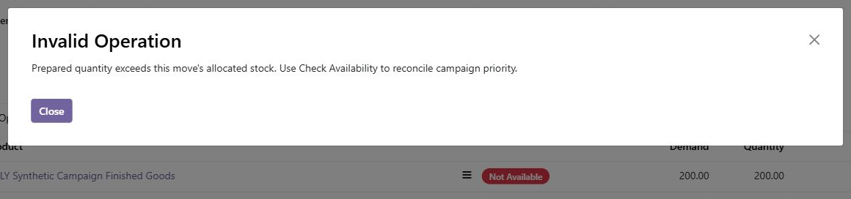
Preparation stays within allocated stock
Warehouse users cannot prepare more than the order's allocation.
The system blocks the invalid quantity when the user saves.
HALY synthetic portfolio case study
11 / 14
Notes:
This final-source browser capture demonstrates the repaired preparation guard. The application refuses a saved prepared quantity above the move allocation and asks the operator to reconcile availability. Independent review found two bypasses during development. Both were reproduced, repaired and retested. The final supported guards cover saved move/raw-line preparation and nested commands; they are not a claim that a privileged administrator cannot change any ERP data.
Sources: docs/evidence/task-0007/12-final-preparation-guard.png; docs/TASKS.md, TASK-0007 repair history.

Slide 12
All 900 units ship in the full test scenario
Automated local scenario, separate from the browser examples.
Order | Ordered | Shipment pattern | Total shipped
A: individual | 200 | In full | 200
B: corporate | 600 | 300 + 200 + 100 | 600
C: individual | 100 | In full | 100
Total | 900 |  | 900
500 opening + 400 manufactured = 900 dispatched
HALY synthetic portfolio case study
12 / 14
Notes:
The actual local campaign probe passes the 500+400=900 arithmetic. A ships 200 completely, B ships 600 in 300/200/100 batches, C ships 100 completely. Final main finished-goods stock is 0. Seven final probe quants remain nonnegative and not over-reserved. These are synthetic test outcomes, not measured performance of a real operation. The browser screenshots depict a separate partial-shipment walkthrough.
Sources: scripts/validate_campaign.py; docs/evidence/task-0007/README.md.

Slide 13
What we built and checked
Standard Odoo operations with campaign-specific business rules.
Standard operations
81
Sales, purchasing, inventory and own production.
local test methods
passed
Added controls
Date history, stock priority and shipment safeguards.
11
Review and testing
Code review and regression checks.
campaign cases
passed
Future options: capacity planning and carrier integration.
HALY synthetic portfolio case study
13 / 14
Notes:
Yusuf owns the project and approved its business rules. The work includes requirement clarification, standard-flow assessment, focused extensions, synthetic scenarios, negative/concurrency checks and review-driven repairs. AI-assisted implementation and a separate agent review supported this work. Local validation on 15 October 2026 passed 81 test methods with zero failures and zero errors: 8 base, 22 promise and 51 campaign methods. A separate campaign probe passed 11 cases. These historical local results are separate from GitHub CI and business performance KPIs. No time-saving, ROI or delivery-rate improvement has been measured. Date history makes commitments visible, priority controls stock decisions, shipment guards enforce customer policy and a linked risk item assigns follow-up. Supported scope is one-step make-to-stock with configured untracked goods. Staff record customer responses and physical work. Capacity planning, carrier/WMS integration, formal quality release, authenticated consent and production hosting are not delivered. Future options are proposals, not approved commitments.
Sources: docs/TASKS.md, TASK-0003 through TASK-0010; docs/ARCHITECTURE.md; docs/DECISIONS.md; docs/evidence/task-0007/README.md.

Slide 14
Technology and source
Platform and tools used in the local demonstration.
Business platform
Data and environment
Odoo 19 Community
Sales, Inventory, Purchase, Manufacturing
PostgreSQL 15
Docker and PowerShell validation helpers
Implementation
Version control
Python business rules
XML views and CSV access controls
Git and GitHub
Source code on GitHub
Synthetic demo. No production deployment.
HALY synthetic portfolio case study
14 / 14
Notes:
Source repository: https://github.com/yusufondes/Operations-Control-Tower . No installation is needed to understand this deck. The source uses Odoo 19 Community, Python, PostgreSQL 15, Docker, XML/CSV and PowerShell. Git and GitHub preserve the project history. Development was AI-assisted with Codex and a separate agent review. Local validation on 15 October 2026 passed 81 custom-addon test methods and 11 separate campaign probe cases. GitHub CI covers repository checks and the eight base-addon test methods. The optional promise and campaign suites use a separate local validation runner. This deck does not claim full campaign coverage in remote CI. The repository README and Actions page provide current build status. No production deployment or automated customer messaging exists.
Sources: README.md; compose.yaml; .github/workflows/ci.yml; docs/TASKS.md, TASK-0010 and TASK-0012. Repository: https://github.com/yusufondes/Operations-Control-Tower . Actions: https://github.com/yusufondes/Operations-Control-Tower/actions .

