Slide 1

Seasonal orders at HALY
Operations Control Tower
HALY makes powdered drink mixes
and packs them in cans.
An Odoo portfolio case
Yusuf Ondes
October 2026
Fictional company and synthetic business data
HALY / Operations Control Tower
1
Notes:
HALY is a fictional powdered-drink manufacturer used to explore seasonal order fulfilment. Yusuf owns the case and approved the business rules. Implementation, testing and separate-agent review used AI assistance. This is a local portfolio demonstration, not a real-client implementation. It covers accepted dispatch dates, eligible stock allocation, in-house production and controlled shipments with synthetic records.
Sources: docs/TASKS.md, TASK-0007 and TASK-0010; docs/evidence/task-0007/README.md; docs/DECISIONS.md, D-015. Design references: https://support.microsoft.com/en-us/powerpoint/tips-for-creating-and-delivering-an-effective-presentation https://www.nngroup.com/articles/engaging-reports-presentations/ https://www.gov.uk/government/publications/handbook-for-standard-managers/functional-standards-writing-style-guide https://www.reddit.com/r/powerpoint/comments/1u3xxm9/is_it_just_me_or_do_all_ai_generated_decks_look/ https://www.reddit.com/r/consulting/comments/1fmzvnr/how_can_i_make_slides_like_these/ Cover illustration: AI-generated fictional HALY / DRINK MIX canisters, made with the built-in image generation tool on 16 October 2026. Asset: docs/portfolio/assets/haly-drink-mix-canisters.png. Can packaging is a presentation concept requested by the owner, not a tested packaging/BOM/compliance feature or a real commercial product.

Slide 2
The stock shortage
HALY is a powdered-drink manufacturer.
A seasonal promotion creates more orders
than the available finished stock can cover.
900 units ordered
500 units in stock
400 units to make
Two suppliers provide the raw materials.
HALY uses them to make the remaining units.
The question is who gets the available stock while production catches up.
HALY / Operations Control Tower
2
Notes:
This is the verified synthetic end-to-end scenario: 900 finished units ordered, 500 opening finished units and 400 finished units manufactured. The manufacturer buys raw materials, not finished products. The two raw-material POs each contain 400 units of a different input; those quantities must not be added as finished units. No real sales forecast, commercial result, capacity guarantee or measured ROI is implied.
Sources: docs/TASKS.md, TASK-0007 and TASK-0010; docs/evidence/task-0007/README.md; docs/DECISIONS.md, D-015.

Slide 3
How the work flows
1. Sales
Record the accepted warehouse dispatch date.
2. Stock
Reserve eligible stock in accepted-date order.
3. Supply
Receive raw materials and record in-house production.
4. Warehouse
Prepare and validate the permitted shipments.
5. Follow-up
Give shortages an owner and a next action.
Standard Odoo records the purchases, production and shipments.
The custom addons add date history, stock priority and dispatch checks.
HALY / Operations Control Tower
3
Notes:
Standard Odoo records purchasing, receipts, manufacturing and warehouse operations. The custom promise and campaign addons add the agreed date history, eligible stock allocation and shipment controls. Physical work and customer responses do not occur automatically. A date refers to the warehouse dispatch commitment, not the separate standard customer Delivery Date.
Sources: docs/TASKS.md, TASK-0007 and TASK-0010; docs/evidence/task-0007/README.md; docs/DECISIONS.md, D-015.

Slide 4
First stock allocation
The first 500 units go to the orders with the earliest accepted dispatch dates.
Order | Shipment policy | Units ordered | Accepted dispatch date | Units reserved
A | Individual: full order | 200 | 15 Dec 2026 | 200
B | Corporate: batches | 600 | 16 Dec 2026 | 300
C | Individual: full order | 100 | 17 Dec 2026 | 0
Total |  | 900 |  | 500
Customer type changes the shipment policy, not the stock priority.
HALY / Operations Control Tower
4
Notes:
Initial reservations are A 200, B 300 and C 0. Demand totals 200 + 600 + 100 = 900 and initial reservations total 200 + 300 + 0 = 500. Accepted warehouse date comes first, then the protected current confirmation timestamp, then smaller order ID for an exact tie. Incomplete individual orders retain eligible allocated stock, but cannot dispatch until complete. Dates are illustrative 2026 dates, not an SLA.
Sources: docs/TASKS.md, TASK-0007 and TASK-0010; docs/evidence/task-0007/README.md; docs/DECISIONS.md, D-015.

Slide 5
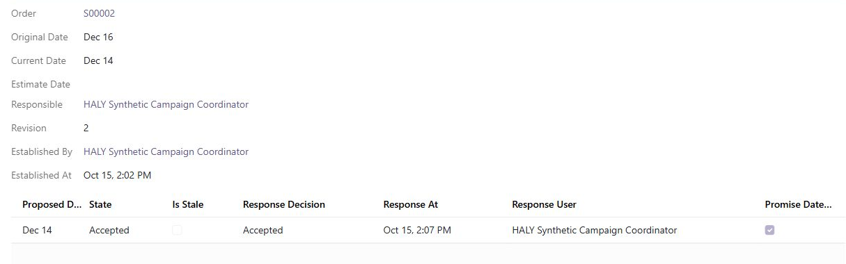
Changing a dispatch date
A coordinator records acceptance of a proposal to move B from 16 to 14 December.
The original date stays in the history. Pending or rejected proposals keep the current date.
Staff enter the response manually. The system does not contact the customer.
HALY / Operations Control Tower
5
Notes:
This browser example demonstrates acceptance of a valid proposal and retained original/current history. Its earlier accepted date is a controlled priority check, not an assertion that an earlier date is always physically feasible. A pending, rejected, stale or conflicting response and an internal estimate do not move the operative promise. Customer rejection retains the existing date and its follow-up risk. Staff manually record evidence; the software does not authenticate customer consent. The original screenshot is unchanged apart from a display crop.
Sources: docs/evidence/task-0007/04-accepted-date-history.png; docs/DECISIONS.md, D-011, D-012, D-015; docs/TASKS.md, TASK-0007 and TASK-0010; docs/evidence/task-0007/README.md; docs/DECISIONS.md, D-015.

Slide 6
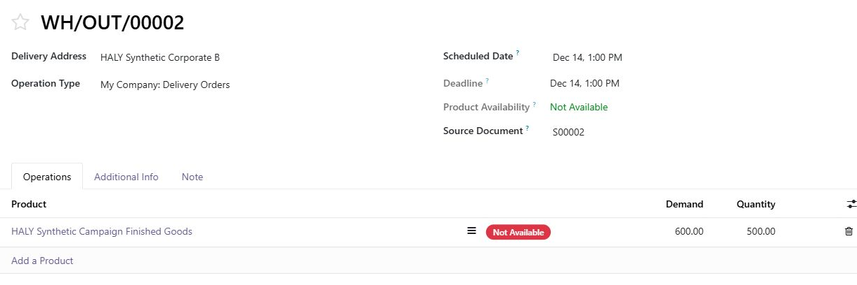
Stock after the date change
B now has the
earliest accepted
dispatch date.
600 units ordered
500 units reserved
The 500 eligible units move to B because they have not entered preparation.
Stock already in preparation and reservations outside the campaign stay protected.
HALY / Operations Control Tower
6
Notes:
This is a later browser state, not the initial A 200 / B 300 / C 0 allocation. B receives 500 eligible unprepared units against 600 demand because its accepted December 14 date is earlier than A December 15. Corporate status does not grant priority. Prepared moves and outside reservations remain protected. Unsupported or uncovered unmanaged competing demand fails closed. A partly prepared short individual move needs explicit warehouse unprepare/recheck before further allocation.
Sources: docs/evidence/task-0007/05-accepted-priority-reserves-500.png; docs/TASKS.md, TASK-0007 and TASK-0010; docs/evidence/task-0007/README.md; docs/DECISIONS.md, D-015.

Slide 7
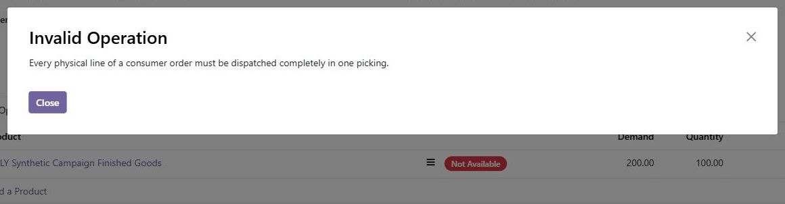
Individual orders
Separate check: an individual order for 200 units cannot ship only 100.
It keeps its allocated stock while it waits for the full quantity.
The partial shipment is refused before dispatch.
HALY / Operations Control Tower
7
Notes:
The actual synthetic screenshot shows the consumer full-order guard refusing a partial dispatch. Every physical line must dispatch completely in one picking within the supported one-step, untracked-goods scope. This safeguard check is separate from the preceding B allocation state. Stock reservation alone does not guarantee a completed shipment.
Sources: docs/evidence/task-0007/02-consumer-partial-blocked.png; docs/TASKS.md, TASK-0007 and TASK-0010; docs/evidence/task-0007/README.md; docs/DECISIONS.md, D-015.

Slide 8
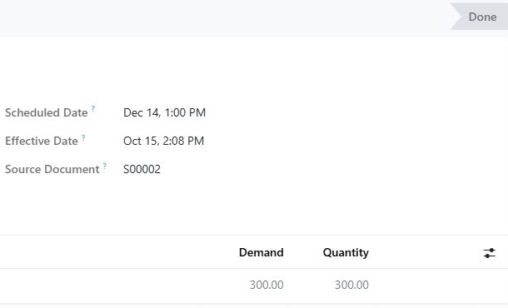
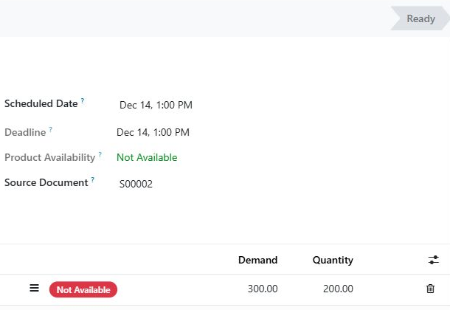
Corporate shipments
Corporate orders can leave in batches. Here, 300 of the 600 units have shipped,
and the other 300 remain on a backorder.
First shipment: 300 units
Backorder: 300 outstanding
Browser example, separate from the
full test scenario on slide 12.
200 units reserved for the next batch
HALY / Operations Control Tower
8
Notes:
Left: a 300-unit corporate shipment is complete. Right: 300 units remain on a backorder, of which 200 are currently reserved. Outstanding demand is not silently cancelled. This browser path later shipped 100 and 50 in separate checks. It is separate from the full 300 / 200 / 100 manufacturing test on slide 12. No real shipment took place.
Sources: docs/evidence/task-0007/06-corporate-300-dispatched.png; docs/evidence/task-0007/07-corporate-backorder-preserved.png; docs/TASKS.md, TASK-0007 and TASK-0010; docs/evidence/task-0007/README.md; docs/DECISIONS.md, D-015.

Slide 9
Making the remaining stock
The full test scenario covers purchasing and production, as well as dispatch.
1. Buy the inputs
400 units of each required raw material, from two suppliers.
2. Record receipt
Add the received inputs to stock.
3. Make the product
Complete a production order for 400 finished units.
500 opening units + 400 manufactured = 900 finished units
HALY / Operations Control Tower
9
Notes:
The automated local test records two raw-material POs, receipts, a bill of materials and one 400-finished-unit manufacturing order. Each PO supplies 400 units of a different input; 800 raw-material units do not mean 800 finished goods. The 400 finished units combine with 500 opening finished units. Standard Odoo actions record procurement, receipt and manufacture. The separate browser preview contains only opening stock/orders and has no purchase or manufacturing fixture.
Sources: scripts/validate_campaign.py; docs/evidence/task-0007/README.md; docs/TASKS.md, TASK-0007 and TASK-0010; docs/evidence/task-0007/README.md; docs/DECISIONS.md, D-015.

Slide 10
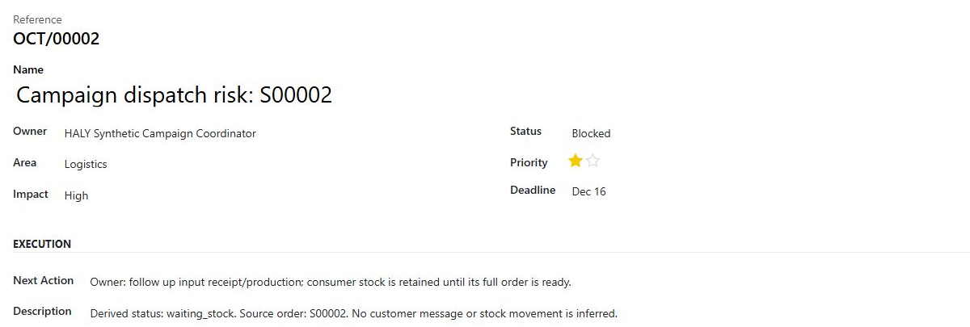
Following up on a shortage
Follow-up
The coordinator
can see who owns
the issue and
what to do next.
Each shortage links back to its sales order. The record stays visible
while the issue is open.
HALY / Operations Control Tower
10
Notes:
The browser record demonstrates a linked campaign shortage, owner, Blocked state, deadline and next action. Separate local runtime cases check supplier delay and repeated risk updates without duplicates. The derived supply-risk signal uses one-level raw-material purchases/open production, not exact supplier-to-order pegging, capacity optimisation or a delivery guarantee. A control item does not imply shipment or customer contact.
Sources: docs/evidence/task-0007/03-owned-risk-item.png; docs/TASKS.md, TASK-0007 and TASK-0010; docs/evidence/task-0007/README.md; docs/DECISIONS.md, D-015.

Slide 11
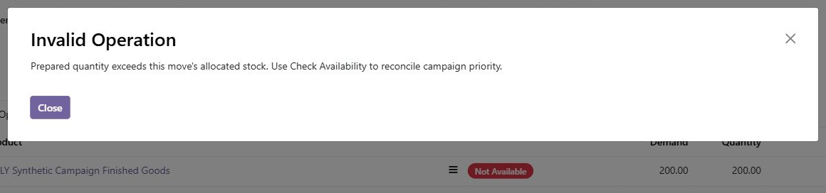
Checking preparation quantities
Separate check: a warehouse user tries to prepare more than the order's
allocated stock. The system refuses the quantity when it is saved.
The operator must reconcile availability before preparing more stock.
HALY / Operations Control Tower
11
Notes:
This final-source screenshot demonstrates the repaired saved-preparation guard. Separate agent review found manual-preparation and nested raw-line capability bypasses. Both were reproduced, repaired and retested, including this browser refusal. Within supported workflows, a user cannot prepare more than allocated stock. This is not a claim that a privileged administrator cannot alter all ERP data.
Sources: docs/evidence/task-0007/12-final-preparation-guard.png; docs/TASKS.md, TASK-0007 repair history; docs/TASKS.md, TASK-0007 and TASK-0010; docs/evidence/task-0007/README.md; docs/DECISIONS.md, D-015.

Slide 12
The completed test scenario
Local synthetic end-to-end test, separate from the browser examples.
Order | Units ordered | Shipments | Units dispatched
A: individual | 200 | One full shipment | 200
B: corporate | 600 | 300 + 200 + 100 | 600
C: individual | 100 | One full shipment | 100
Total | 900 |  | 900
The test combines 500 opening units with 400 manufactured units.
All 900 ordered units are dispatched.
HALY / Operations Control Tower
12
Notes:
The recorded campaign probe passed 500 + 400 = 900 finished-unit arithmetic. A dispatched 200 fully, B dispatched 600 as 300 / 200 / 100, and C dispatched 100 fully. Final finished-goods stock was zero and seven checked final quants were nonnegative and not over-reserved. These are synthetic test outcomes, not real operating performance or proof of throughput.
Sources: scripts/validate_campaign.py; docs/evidence/task-0007/README.md; docs/TASKS.md, TASK-0007 and TASK-0010.

Slide 13
My work on the case
Business decisions
Checks and results
I defined the scenario and approved the
rules for dispatch dates, reservations
and partial shipments.
81 local test methods passed.
11 campaign checks also passed.
Recorded on 15 October 2026.
Review and revision
Outside the current scope
Review exposed ways to prepare stock
outside the allocation. Those cases shaped
the final controls and regression checks.
Capacity planning, carrier/WMS
integration and production hosting
would need separate work.
These checks demonstrate functional behaviour, not measured savings or delivery-rate improvements.
HALY / Operations Control Tower
13
Notes:
Yusuf defined the case and approved its business rules. Standard Odoo handles sales, purchasing, stock and production. Custom additions cover warehouse promise history, allocation priority and shipment guards. AI assistance supported implementation, testing and a separate agent review. Local validation on 15 October 2026 passed 81 methods: 8 base, 22 promise and 51 campaign, plus 11 separate campaign cases. GitHub CI covers eight base methods only. No measured savings or delivery-rate improvement is claimed.
Sources: docs/TASKS.md, TASK-0003 through TASK-0012; README.md; docs/ARCHITECTURE.md; docs/DECISIONS.md.

Slide 14
Technology and source
ERP platform
Odoo 19 Community
Sales, Inventory, Purchase and Manufacturing
Custom work
Python business rules
XML views and CSV access controls
Environment
PostgreSQL 15, Docker and PowerShell
Source
github.com/yusufondes/Operations-Control-Tower
Implementation, testing and review used AI assistance.
Synthetic local demonstration. No production deployment.
HALY / Operations Control Tower
14
Notes:
The source repository is public. No installation is required to understand this case. The supported scope is one configured pool per warehouse, one-step make-to-stock and untracked storable goods. Customer responses and physical operations are manually recorded. Capacity planning, carrier/WMS adapters, formal quality release, authenticated customer consent and production hosting are outside this delivery. The full 81-method validation and 11 campaign cases are local evidence. GitHub CI covers repository checks, eight base-addon test methods and service health. The current Actions page provides build status.
Sources: README.md; compose.yaml; .github/workflows/ci.yml; docs/TASKS.md, TASK-0010 through TASK-0013. Repository: https://github.com/yusufondes/Operations-Control-Tower . Actions: https://github.com/yusufondes/Operations-Control-Tower/actions .

