Slide 1
Taking a scientific approach
to science & eng. education*
and most other subjects
Carl Wieman
Stanford University
Department of Physics and Grad School of Education
New talk—student focused:
how to optimize your study & learning
what you should demand from instruction
relevant to MIT faculty (the 98% not here)
copies of
slides to be
available
*based on the research of many people, some from my science ed research group

Slide 2
Exper. #1. 3 equal groups of students. All given instructions to “Learn as much as possible. Will be tested.”
group # 1
group # 2
group # 3
Don’t go to class, Spent the time studying instructor’s notes.
Go to class,
take notes.
Go to class, don’t take notes.
Predict learning: most to least ( raise hand to vote)
a. 1,2,3 b. 3,2,1 c. 2,1,3 d. other
learns most learns least

Slide 3
correct answer. B. 3,2,1. Not attend class, studying instructor notes learns the most, taking notes in class the least.
Why? Talk to neighbors, come up with reasons,
Volunteer explanations.
Taking notes added demands on short term memory (“cognitive load”) compared to focusing on understanding in class. Already overtaxed. 2>1
Reading over notes (#3) --at learners speed, better organization, more mental processing by learner, so 3>2
Opposite to what most faculty would predict.
You students now have more expertise than most faculty about learning.
By end of lecture– have a lot more.
Goal: Take more responsibility, be more assertive
⇒ improve your learning

Slide 4
Equivalent groups of students. All given instructions to
“Learn as much as possible. Will be tested.”
group # 1
group # 2
group # 3
Don’t go to class, Spent the time studying instructor’s notes.
Go to class,
take notes.
Go to class, don’t take notes.
Tested on remembering ideas and information presented
in lecture. Like typical course exam.
Focus of this talk is on much more important kind of learning. “Expertise”– learning to think/make-decisions like an expert in the discipline (physics, bioeng., ...)
Research showing much more effective ways to learn expertise than any of the three above. Doing the right things in class.

Slide 5

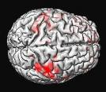
Major advances past 1-2 decades
New insights on how to learn & teach complex thinking
University
science & eng.
classroom
studies
brain
research
today
cognitive
psychology
Strong arguments for
why this applies to most fields

Slide 6
Will be telling some of you ways to learn that may be quite different from what you have found effective.
Are you wrong?
No and Yes
No – you learned how to do well on typical exams, get good grades, SAT scores, etc.
Yes – Exam scores have little correlation with performance on real world, meaningful tasks (“expertise”).
Why? 1) exams bad, mostly figure out instructor,
2) highly artificial conditions & questions. Remembering info and procedures rapidly, not decisions/expertise.
Contradiction apparent in my atomic phys grad students,
led to my studying for last 30 years.

Slide 7
I. What is “thinking like a scientist or engineer?”
II. How is it learned?
III. Examples of teaching practices you will encounter in sci. & eng. classes.
How research shows they are bad, and what you can do to learn anyway.
IV. A few quick examples of data from courses backing my claims.

Slide 8


I. Research on expert thinking*
historians, scientists, chess players, doctors,...
Expert thinking/competence =
Factual knowledge
Mental organizational framework ⇒ retrieval and application
scientific concepts,
(& criteria for when apply)
or ?
Ability to monitor own thinking and learning
New ways of thinking— everyone requires MANY hours of intense practice to develop.
Brain changed— rewired, not filled!
*Cambridge Handbook on Expertise and Expert Performance

Slide 9
II. Learning expertise*--
Challenging but doable tasks/questions
Practicing specific thinking skills
Feedback on how to improve
brain “exercise”
Science & eng. thinking skills
Decide: what concepts are relevant (selection criteria), what information is needed, what is irrelevant.
Decide: what approximations are appropriate.
‘’ : potential solution method(s) to pursue
....
‘’ : if solution/conclusion make sense- criteria for tests
Knowledge/topics important but only as integrated part with how and when to use.
* “Deliberate Practice”, A. Ericsson research. See “Peak;…” by Ericsson for
accurate, readable summary

Slide 10
effective teaching & learning
but must have
enablers
Address prior knowledge and experience
Motivation
Cognitive demand/
brain limitations
diversity
Students learn the thinking/decision-making they practice with good feedback (timely, specific, guides improvement).
Requires expertise in discipline & expertise in teaching it.
disciplinary expertise
knowledge & thinking
of science
Universities (MIT) not recognize,
biggest barrier to change
(like med. 1870)

Slide 11
III. Examples of bad teaching practices you will encounter in sci. & eng. classes.
How research shows are bad, and what you can do to learn anyway.
0. Skip--What tested on exams (done)
Organization of how each topic presented
Organization of course and exams
What information given
Feedback on answers
Instructor talking—

Slide 12
Organization of how each topic presented.
Standard teaching practice: Begin with formalism, definitions, equations, then use to solve problems.
What is wrong with this?
Not motivating–no idea as to relevance or value, meaningless stuff to memorize,
b) Bigger issue– poor knowledge organization. Random separate pieces of information.
Expert knowledge organization essential.
Faced with novel situation, recognizing key features and how link to particular concepts, strategies, knowledge to solve. And when do not apply. Knowledge organized as tools to use and when & how to use.
Fix– you ask right way. What is the important problem? How formalism provides tools to solve?
More expert org, less cognitive demand, motivating.

Slide 13
2. Organization of course and exams.
Standard teaching practice--chap. 3 material--Lectures, HW, exam ch. 3, done.
chap. 4 ditto, done.
Material organized in brain chronologically by chap.
But real problems not labelled with chap. #!
Expertise— decide when and how to use which material.
You fix– keep asking yourself & others--
How material in all chapters related & different?
What aspects of a problem mean use which parts?

Slide 14
B. T. 3. What information given
Standard practice– on HW problems and exams
Give all the information needed to solve and only solve that information (nothing extraneous)
What simplifications and approximations to use--
“Neglect air resistance.”, ...
Major element of expertise--recognizing what information is relevant and what is irrelevant, what approximations and simplifications to use.
You fix: figure out criteria to use to justify any simplifications or approximations given. Find another example where it would apply, and one where would not. Pick realistic problem, figure out criteria for deciding what information is relevant to solve, what not.

Slide 15
B. T. 4. Feedback on answers
Standard practice– you get wrong.
Feedback—”That is wrong, here is correct solution.”
Why bad? Research on feedback—simple right-wrong with correct answer very limited benefit.
Learning happens when feedback timely and specific on what thinking was incorrect and why, and how to improve.
You fix—demand to know what wrong with your thinking and what needs to be changed. Or go through with classmates for everything that is incorrect. Very hard to do alone.

Slide 16
...
B. T. 35. Instructor talking.
Standard teaching practice— instructor spends 90+% talking while students listen passively, maybe take notes, ask very occasional question.
Why bad—student brain is not doing processing. Practicing expert thinking that provides necessary brain exercise and rewiring.
Learning from expert feedback and telling highly effective, but only if brain prepared first.
(knowledge org., recognizes need, and how to use) Requires mental preparation activity.
You fix- ???
Appeal to Dept Chairs, Deans, Provost?
Class action lawsuit??
Some data for evidence

Slide 17
Evidence from the Classroom
~ 1000 research studies from undergrad science and engineering comparing traditional lecture
with “active learning”.
consistently show greater learning, biggest effects are when measure expert-like decision making
lower failure rates
benefit all, but at-risk more
Massive meta-analysis
all sciences & eng. similar.
PNAS Freeman, et. al. 2014
a few examples

Slide 18
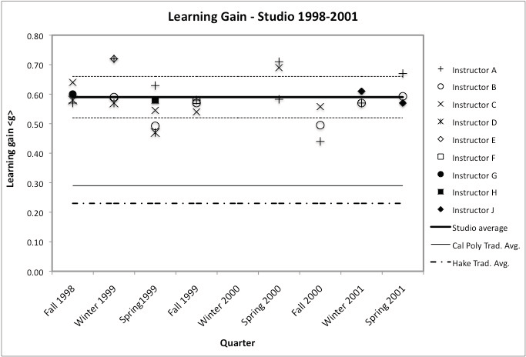
Apply concepts of force & motion like physicist to make predictions in real-world context?
average trad. Cal Poly instruction
1st year mechanics
Cal Poly, Hoellwarth and Moelter,
Am. J. Physics May ‘11
9 instructors, 8 terms, 40 students/section.
Same instructors, better methods = more learning!

Slide 19
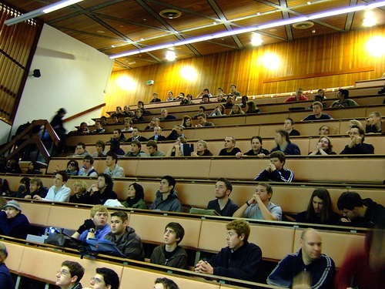
Learning in the in classroom*
Comparing the learning in two ~identical sections
UBC 1st year college physics.
270 students each.
Control--standard lecture class– highly experienced Prof with good student ratings.
Experiment–- new physics Ph. D. trained in principles & methods of research-based teaching.
They agreed on:
Same learning objectives
Same class time (3 hours, 1 week)
Same exam (jointly prepared)- start of next class
mix of conceptual and quantitative problems
*Deslauriers, Schelew, Wieman, Sci. Mag. May 13, ‘11
Notes:
review quickly

Slide 20
Experimental class design
1. Targeted pre-class readings—basic information
2. Questions to solve, respond with clickers or on worksheets, discuss with neighbors.
Instructor circulates, listens.
3. Discussion by instructor follows, not precedes.
Targeted feedback to prepared students.
Answering questions.
(but still talking ~50% of time)

Slide 21
Histogram of test scores
average 41 ± 1 %
74 ± 1 %
guess
Clear improvement for entire student population.
Engagement 85% vs 45%.

Slide 22
U. Cal. San Diego, Computer Science
Failure & drop rates– Beth Simon et al., 2012
same 4 instructors, better methods = 1/3 fail rate
Notes:
Intuition behind CS1.5 is that CS1 is the immediate pre-curser to CS1.5. What likely occurred here was that, with standard instruction, the students who might have failed CS1.5 were already gone having failed CS1 and having not returned. So CS1.5 with standard instruction has a much improved fail rate, but that’s misleading...

Slide 23
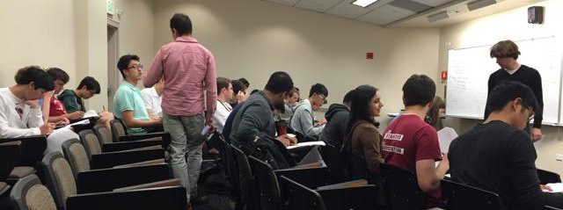
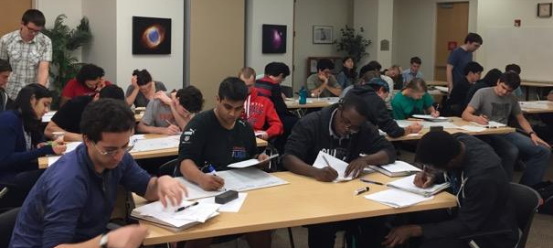
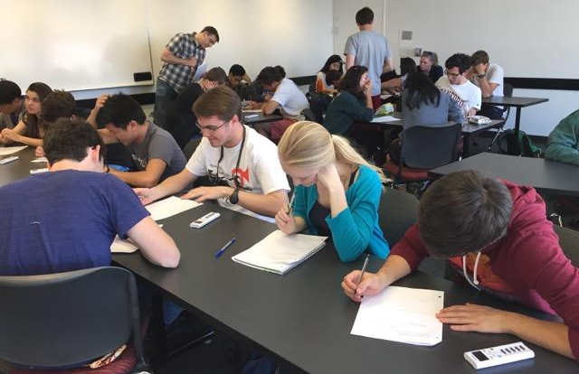
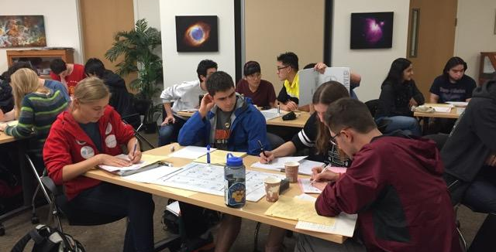
Also works for advanced courses 2nd - 4th yr physics Univ. British Columbia & Stanford
Design and implementation: Jones, Madison, Wieman, Transforming a fourth year modern optics course using a deliberate practice framework, Phys Rev ST – Phys Ed Res, V. 11(2), 020108-1-16 (2015)

Slide 24
Final Exam Scores
nearly identical (“isomorphic”) problems
(highly quantitative and involving transfer)
practice & feedback 2nd instructor
practice & feedback, 1st instructor
1 standard deviation improvement
taught by lecture, 1st instructor, 3rd time teaching course
Yr 1 Yr 2 Yr 3
Jones, Madison, Wieman, Transforming a fourth year modern optics course using a deliberate practice framework, Phys Rev ST – Phys Ed Res, V. 11(2), 020108-1-16 (2015)

Slide 25
Stanford Outcomes
7 physics courses 2nd-4th year, seven faculty, ‘15-’16
Attendance up from 50-60% to ~95% for all.
Covered as much or more content
Student anonymous comments:
90% positive (mostly VERY positive, “All physics courses should be taught this way!”)
only 4% negative
All the faculty greatly preferred to lecturing.
Typical response across ~ 250 faculty at UBC & U. Col. Once learned the necessary expertise of teaching, much more rewarding, would never go back to old methods.

Slide 26
Type of evidence led to a message from the President (2017) Mary Sue Coleman, AAU
https://www.aau.edu/sites/default/files/AAU-Files/STEM-Education-Initiative/STEM-Status-Report.pdf
“… AAU continues its commitment to achieving widespread systemic change in this area and to promoting excellence in undergraduate education at major research universities.
…
We cannot condone poor teaching of introductory STEM courses … simply because a professor, department and/or institution fails to recognize and accept that there are, in fact, more effective ways to teach. Failing to implement evidence-based teaching practices in the classroom must be viewed as irresponsible, an abrogation of fulfilling our collective mission to ensure that all students who are interested in learning and enrolled in a STEM course. ….”

Slide 27
Evidence for class-action suit? ☺
But since better for students, and faculty prefer, may be quicker and easier ways than lawsuit...

Slide 28
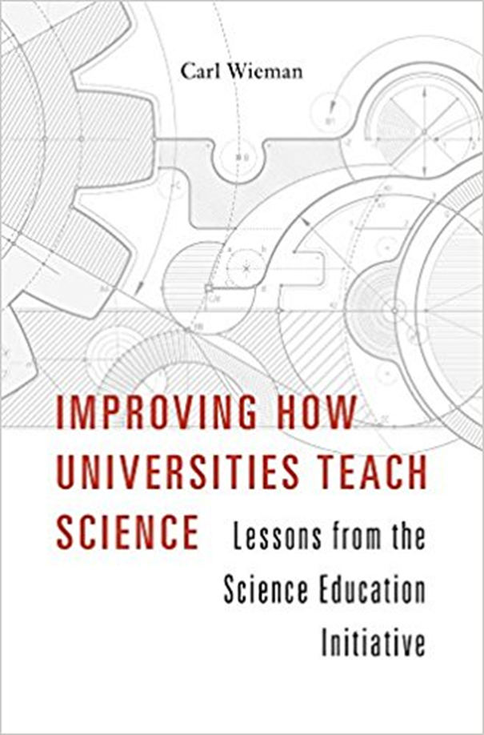
For faculty and administrators,
not students...
What universities and departments can do to make large scale changes in teaching. Expertise.
transformed the teaching of ~ 250 science faculty and
~ 200,000 credit hours/year at UBC & CU.

Slide 29
Conclusion for students:
Expertise in teaching grounded in research on learning expertise in the disciplines.
Recognize that most faculty don’t have this teaching expertise or aware it exists. Universities don’t measure or reward.
Students can make their learning more effective and efficient by taking responsibility for it, and using research on learning.
slides will be available
Good References:
D. Schwartz et. al. “The ABCs of how we learn”
S. Ambrose et. al. “How Learning works”
Ericsson & Pool, “Peak:...”
cwsei.ubc.ca-- resources (implementing best teaching methods, resources for students)

Slide 30
Necessary 1st step-
better evaluation of teaching quality
“A better way to evaluate undergraduate science teaching” Change Magazine, Jan-Feb. 2015, Carl Wieman
Requirements:
measures what leads to most learning
equally valid/fair for use in all courses
actionable-- how to improve, & measures when do
is practical to use routinely
student course evaluations fail on all but #4
Better way–characterize the practices used in teaching a course, extent of use of research-based methods.
“Teaching Practices Inventory” http://www.cwsei.ubc.ca/resources/TeachingPracticesInventory.htm
better proxy for what matters

Slide 31
~ 30 extra slides below

Slide 32
III. How to apply in classroom?
practicing thinking with feedback
Example– large intro physics class
(similar chem, bio, comp sci, ...)
Teaching about electric current & voltage
1. Preclass assignment--Read pages on electric current. Learn basic facts and terminology without wasting class time. Short online quiz to check/reward.
2. Class starts with question:

Slide 33
When switch is closed, bulb 2 will
a. stay same brightness, b. get brighter
c. get dimmer,
d. go out.
1
2
3
answer &
reasoning
3. Individual answer with clicker
(accountability=intense thought, primed for learning)
Jane Smith
chose a.
4. Discuss with “consensus group”, revote.
Instructor listening in! What aspects of student thinking like physicist, what not?

Slide 34
5. Demonstrate/show result
6. Instructor follow up summary– feedback on which models & which reasoning was correct, & which was incorrect and why. Many student questions.
Students practicing thinking like physicists--
(applying, testing conceptual models, critiquing reasoning...)
Feedback that improves thinking—other students, informed instructor, demo

Slide 35
“A time for telling” Schwartz and Bransford,
Cognition and Instruction (1998)
People learn from telling, but only if well-prepared to learn.
Activities that develop knowledge organization structure.
Students analyzed contrasting cases ⇒recognize key features
Predicting results of novel experiment

Slide 36
A better way to evaluate undergraduate science teaching
Change Magazine, Jan-Feb. 2015
Carl Wieman
“The Teaching Practices Inventory: A New Tool for Characterizing College and University Teaching in Mathematics and Science”
Carl Wieman* and Sarah Gilbert
(and now engineering & social sciences)
Try yourself. ~ 10 minutes to complete.
http://www.cwsei.ubc.ca/resources/TeachingPracticesInventory.htm
Provides detailed characterization of how
course is taught

Slide 37
Research on Learning
Components of effective teaching/learning—
expertise required.
Motivation
relevant/useful/interesting to learner
sense that can master subject
Connect with prior thinking
Apply what is known about memory
short term limitations
achieving long term retention
Explicit authentic practice of expert thinking
Timely & specific feedback on thinking
differences
across
learners

Slide 38
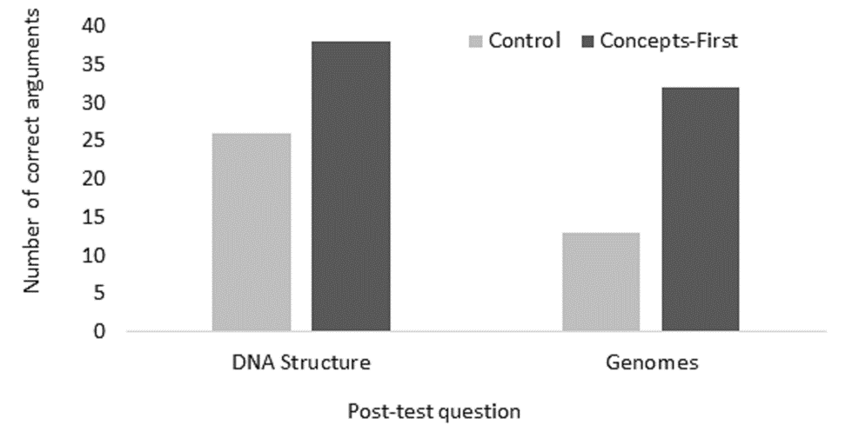
Biology Jargon bogs down working memory, reduces learning?
Control Experiment
preread: textbook jargon-free
active learning class
common post-test
“Concepts first, jargon second improves understanding”
L. Macdonnell, M. Baker, C. Wieman,
Biochemistry and Molecular biology Education
Control jargon-free
Small change, big effect!
# of students
DNA structure Genomes
Post-test results

Slide 39
Emphasis on motivating students
Providing engaging activities and talking in class
Failing half as many
“Student-centered” instruction
Aren’t you just coddling the students?
Like coddling basketball players by having them run up and down court, instead of sitting listening?
Serious learning is inherently hard work
Solving hard problems, justifying answers—much harder, much more effort than just listening.
But also more rewarding (if understand value & what accomplished)--motivation

Slide 40
A few final thoughts—
1. Lots of data for college level,
does it apply to K-12?
There is some data and it matches.
Harder to get good data, but cognitive psych
says principles are the same.
2. Isn’t this just “hands-on”/experiential/inquiry learning?
No. Is practicing thinking like scientist with feedback.
Hands-on may involve those same cognitive processes, but often does not.

Slide 41
Use of Educational Technology
Danger!
Far too often used for its own sake! (electronic lecture)
Evidence shows little value.
Opportunity
Valuable tool if used to supporting principles of effective teaching and learning.
Extend instructor capabilities.
Examples shown.
Assessment (pre-class reading, online HW, clickers)
Feedback (more informed and useful using above, enhanced communication tools)
Novel instructional capabilities (PHET simulations)
Novel student activities (simulation based problems)

Slide 42
2 simple immediately applicable findings from research on learning. Apply in every course.
expertise and homework design
reducing demands on short term memory

Slide 43
Expertise practiced and assessed with typical HW & exam problems.
Provide all information needed, and only that information, to solve the problem
Say what to neglect
Not ask for argument for why answer reasonable
Only call for use of one representation
Possible to solve quickly and easily by plugging into equation/procedure
concepts and mental models + selection criteria
recognizing relevant & irrelevant information
what information is needed to solve
How I know this conclusion correct (or not)
model development, testing, and use
moving between specialized representations
(graphs, equations, physical motions, etc.)

Slide 44
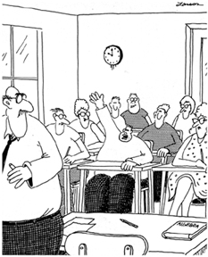
2. Limits on short-term working memory--best established, most ignored result from cog. science
Working memory capacity
VERY LIMITED!
(remember & process
5-7 distinct new items)
MUCH less than in
typical lecture
slides to be
provided
Mr Anderson, May I be excused?
My brain is full.

Slide 45
A scientific approach to teaching
Improve student learning & faculty enjoyment of teaching
My ongoing research:
1. Bringing “invention activities” into courses– students try to solve problem first. Cannot but prepare them to learn.
2. Making intro physics labs more effective.
(our studies show they are not. Holmes & Wieman, Amer. J. Physics)
3. Analyzing and teaching effective problem solving strategies using interactive simulations.

Slide 46
Lesson from these Stanford courses—
Not hard for typical instructor to switch to active learning and get good results
read some references & background material (like research!)
fine to do incrementally, start with pieces

Slide 47
No Prepared Lecture
Actions
Students
Instructors
Preparation
Complete targeted reading
Formulate/review activities
Introduction (2-3 min)
Listen/ask questions on reading
Introduce goals of the day
Circulate in class, answer questions & assess students
Activity (10-15 min)
Group work on activities
Listen/ask questions, provide solutions & reasoning when called on
Facilitate class discussion, provide feedback to class
Feedback
(5-10 min)

Slide 48
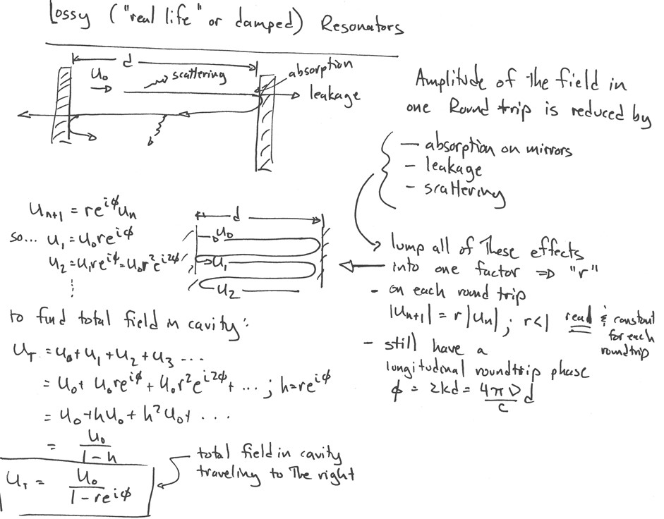
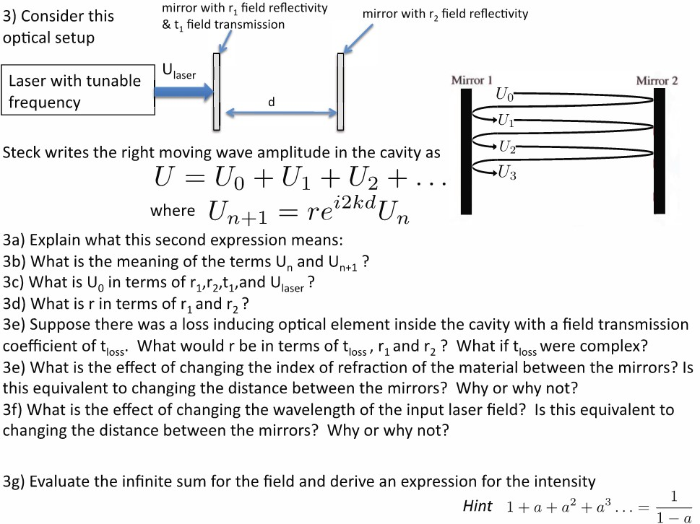
Lecture Notes Converted to Activities
Often added bonus activity to keep advanced students engaged

Slide 49
Pre-class Reading
Purpose: Prepare students for in-class activities; move learning of less complex material out of classroom
Spend class time on more challenging material, with Prof giving guidance & feedback
Can get >80% of students to do pre-reading if:
Online or quick in-class quizzes for marks (tangible reward)
Must be targeted and specific: students have limited time
DO NOT repeat material in class!
Heiner et al, Am. J. Phys. 82, 989 (2014)

Slide 50
Stanford Active Learning Physics courses (all new in 2015-16)
2nd-4th year physics courses, 6 Profs
PHYS 70 | Modern Physics | Wieman | Aut 2015
PHYS 120 | E&M I | Church | Win 2016
PHYS 121 | E&M II | Hogan | Spr 2016
PHYS 130 | Quantum I | Burchat | Win 2016
PHYS 131 | Quantum II | Hartnoll | Spr 2016
PHYS 110 | Adv Mechanics | Hartnoll | Aut 2015
PHYS 170 | Stat Mech | Schleier-Smith | Aut 2015

Slide 51
Math classes– similar design
Other types of questions---
What is next (or missing) step(s) in proof?
What is justification for (or fallacy in) this step?
Which type of proof is likely to be best, and why?
Is there a shorter/simpler/better solution? Criteria?

Slide 52
Reducing demands on working memory in class
Targeted pre-class reading with short online quiz
Eliminate non-essential jargon and information
Explicitly connect
Make lecture organization explicit.

Slide 53
My background in education
Students:17 yrs of success in classes.
Come into my lab clueless about physics?
2-4 years later ⇒ expert physicists!
?????? ~ 25 years ago
Research on how people learn, particularly physics
explained puzzle
different way to think about learning and teaching
got me started doing physics/sci ed research--
controlled experiments & data!

Slide 54
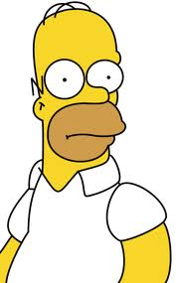

Perceptions about science
Novice
Expert
Content: isolated pieces of information to be memorized.
Handed down by an authority. Unrelated to world.
Problem solving: following memorized recipes.
Content: coherent structure of concepts.
Describes nature, established by experiment.
Prob. Solving: Systematic concept-based strategies.
measure student perceptions, 7 min. survey. Pre-post
best predictor of
physics major
intro physics course ⇒ more novice than before
chem. & bio as bad
*adapted from D. Hammer

Slide 55
Perceptions survey results–
Highly relevant to scientific literacy/liberal ed.
Correlate with everything important
Who will end up physics major 4 years later?
7 minute first day survey better predictor than first year physics course grades
recent research⇒ changes in instruction that achieve positive impacts on perceptions

Slide 56
How to make perceptions significantly more like physicist (very recent)--
process of science much more explicit
(model development, testing, revision)
real world connections up front & explicit

Slide 57
Student Perceptions/Beliefs
Kathy Perkins, M. Gratny
60%
All Students (N=2800)
Percent of Students
50%
Intended Majors (N=180)
Survived (3-4 yrs) as Majors (N=52)
40%
30%
20%
10%
0%
0
10
20
30
40
50
60
70
80
90
100
Novice
Expert
CLASS Overall Score
(measured at start of 1st term of college physics)
60%
Actual Majors who were
B
Percent of Students
originally intended phys majors
50%
Actual Majors who were NOT
40%
originally intended phys majors
30%
20%
10%
0%
0
10
20
30
40
50
60
70
80
90
100
CLASS Overall Score
(measured at start of 1st term of college physics)

Slide 58
Student Beliefs
60%
Actual Majors who were
Percent of Students
originally intended phys majors
50%
Survived as Majors who were NOT
40%
originally intended phys majors
30%
20%
10%
0%
0
10
20
30
40
50
60
70
80
90
100
Novice
Expert
CLASS Overall Score
(measured at start of 1st term of college physics)

Slide 59
Perfection in class is not enough!
Not enough hours
Activities that prepare them to learn from class
(targeted pre-class readings and quizzes)
Activities to learn much more after class
good homework–-
builds on class
explicit practice of all aspects of expertise
requires reasonable time
reasonable feedback

Slide 60
Motivation-- essential
(complex- depends on background)
Enhancing motivation to learn
a. Relevant/useful/interesting to learner
(meaningful context-- connect to what they know and value)
requires expertise in subject
b. Sense that can master subject and how to master,
recognize they are improving/accomplishing
c. Sense of personal control/choice

Slide 61
How it is possible to cover as much material?
(if worrying about covering material not developing students expert thinking skills, focusing on wrong thing, but…)
transfers information gathering outside of class,
avoids wasting time covering material that students already know
Advanced courses-- often cover more
Intro courses, can cover the same amount.
But typically cut back by ~20%, as faculty understand better what is reasonable to learn.

Slide 62
Benefits to interrupting lecture with challenging
conceptual question with student-student discussion
Not that important whether or not they can answer it, just have to engage.
Reduces WM demands– consolidates and organizes.
Simple immediate feedback (“what was mitosis?”)
Practice expert thinking. Primes them to learn.
Instructor listen in on discussion. Can understand and guide much better.

Slide 63
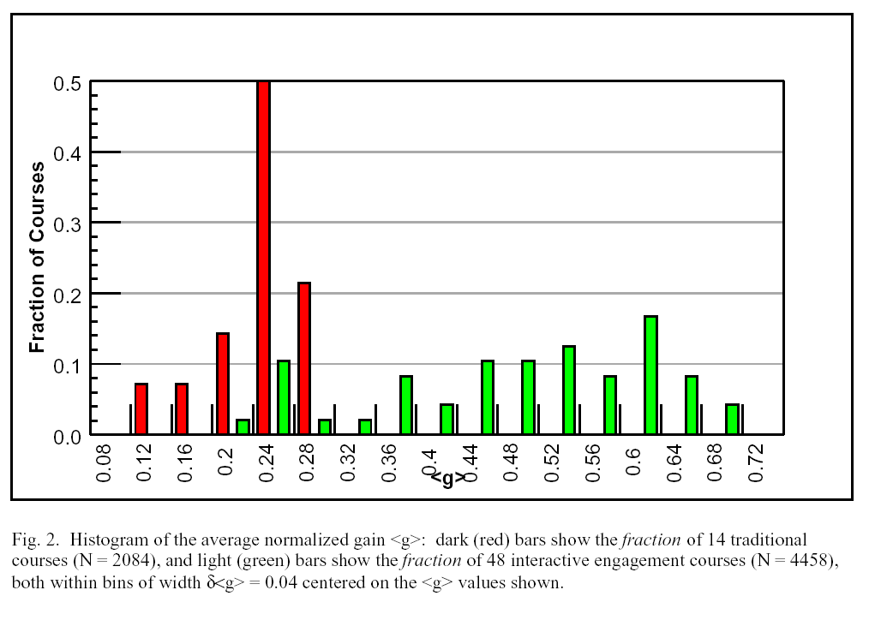
Measuring conceptual mastery
Force Concept Inventory- basic concepts of force and motion Apply like physicist in simple real world applications?
Test at start and end of the semester--
What % learned? (100’s of courses/yr)
Average learned/course
16 traditional Lecture
courses
improved
methods
Fraction of unknown basic concepts learned
On average learn <30% of concepts did not already know.
Lecturer quality, class size, institution,...doesn't matter!
R. Hake, ”…A six-thousand-student survey…” AJP 66, 64-74 (‘98).

Slide 64
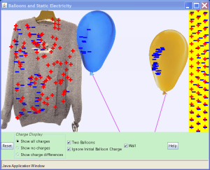
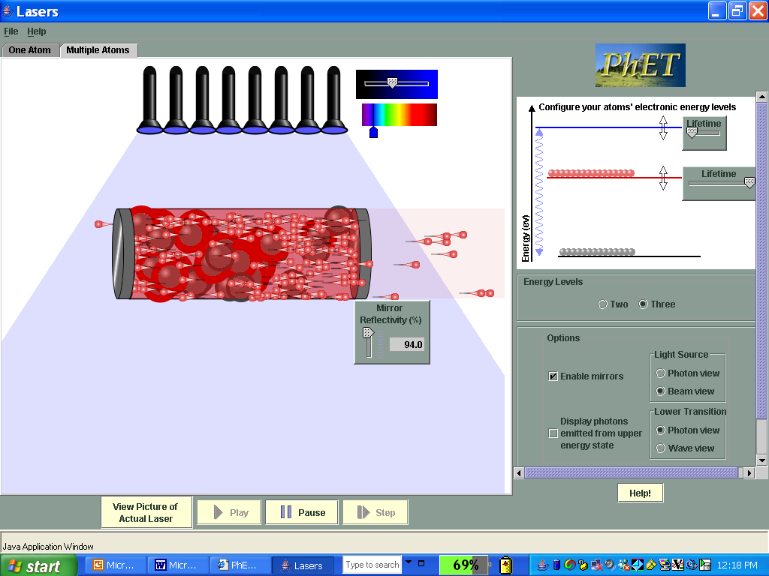
Highly Interactive educational simulations--
phet.colorado.edu >100 simulations
FREE, Run through regular browser. Download
Build-in & test that develop expert-like thinking and
learning (& fun)
balloons and sweater
laser

Slide 65
clickers*--
Not automatically helpful--
give accountability, anonymity, fast response
Used/perceived as expensive attendance and testing device⇒ little benefit, student resentment.
Used/perceived to enhance engagement, communication, and learning ⇒ transformative
challenging questions-- concepts
student-student discussion (“peer instruction”) & responses (learning and feedback)
follow up instructor discussion- timely specific feedback
minimal but nonzero grade impact
*An instructor's guide to the effective use of personal response systems ("clickers") in teaching-- www.cwsei.ubc.ca
Notes:
Putting research into practice in classroom
(and homework, and exams, etc.)
Knowing what students are thinking in classroom and connecting to that.
Enhanced communication and feedback.
Not about more quizes/test… not just because more alert.
Clickers provide powerful psychological combination:
personal accountability/commitment
peer anonymity
1. Feedback to instructor.
2. Feedback to students.
3. Students intellectually active-- a dialogue.
Using clickers for max benefits
communication system
Class built around series of questions to students: challenging concepts or applications, predictions or explanations of demonstration experiments, ...
Small group discussion ("peer instruct."), consensus answers
Explicit focus on novice/expert views, reasoning, problem solving.
Collaborative problem solving/scientific discourse, self-monitoring.

Slide 66
long term retention
Retention curves measured in Bus’s Sch’l course.
UBC physics data on factual material, also rapid drop but pedagogy dependent. (in prog.)
Notes:
cw

Slide 67
Comparison of teaching methods: identical sections (270 each), intro physics. (Deslauriers, Schewlew, submitted for pub)
___I___________
Experienced highly rated instructor-- trad. lecture
_____II_________
Very experienced highly rated instructor--trad. lecture
very well measured--identical
wk 1-11
wk 1-11
Wk 12-- experiment
Notes:
ld

Slide 68
Two sections the same before experiment.
(different personalities, same teaching method)
 | Control Section | Experiment Section
Number of Students enrolled | 267 | 271
Conceptual mastery(wk 10) | 47± 1 % | 47 ± 1%
Mean CLASS (start of term) (Agreement with physicist) | 63±1% | 65±1%
Mean Midterm 1 score | 59± 1 % | 59± 1 %
Mean Midterm 2 score | 51± 1 % | 53± 1 %
Attendance before | 55±3% | 57±2%
Attendance during experiment | 53 ±3% | 75±5%
Engagement before | 45±5 % | 45±5 %
Engagement during | 45 ±5% | 85 ± 5%

Slide 69
Comparison of teaching methods: identical sections (270 each), intro physics. (Deslauriers, Schewlew, submitted for pub)
___I___________
Experienced highly rated instructor-- trad. lecture
_____II_________
Very experienced highly rated instructor--trad. lecture
identical on everything
diagnostics, midterms, attendance, engagement
wk 1-11
wk 1-11
Wk 12-- competition
elect-mag waves
inexperienced instructor
research based teaching
elect-mag waves
regular instructor
intently prepared lecture
wk 13 common exam on EM waves
Notes:
ld

Slide 70
2. Attendance
control experiment
53(3) % 75(5)%
3. Engagement
45(5) % 85(5)%
Notes:
ld

Slide 71
Design principles for classroom instruction
1. Move simple information transfer out of class. Save class time for active thinking and feedback.
2. “Cognitive task analysis”-- how does expert think
about problems?
3. Class time filled with problems and questions that call for explicit expert thinking, address novice difficulties, challenging but doable, and are motivating.
4. Frequent specific feedback to guide thinking.
DP

Slide 72
What about learning to think more innovatively?
Learning to solve challenging novel problems
Jared Taylor and George Spiegelman
“Invention activities”-- practice coming up with
mechanisms to solve a complex novel problem.
Analogous to mechanism in cell.
2008-9-- randomly chosen groups of 30, 8 hours of
invention activities.
This year, run in lecture with 300 students. 8 times per term. (video clip)

Slide 73
Reducing unnecessary demands on working memory improves learning.
jargon, use figures, analogies, pre-class reading

Slide 74
UBC CW Science Education Initiative and U. Col. SEI
Changing educational culture in major research university science departments
necessary first step for science education overall
Departmental level
⇒scientific approach to teaching, all undergrad courses = learning goals, measures, tested best practices
Dissemination and duplication.
All materials, assessment tools, etc to be available on web

Slide 75
Institutionalizing improved research-based
teaching practices. (From bloodletting to antibiotics)
Goal of Univ. of Brit. Col. CW Science Education Initiative (CWSEI.ubc.ca) & Univ. of Col. Sci. Ed. Init.
Departmental level, widespread sustained change
at major research universities
⇒scientific approach to teaching, all undergrad courses
Departments selected competitively
Substantial one-time $$$ and guidance
Extensive development of educational materials, assessment tools, data, etc. Available on web.
Visitors program

Slide 76
Fixing the system
but...need higher content mastery,
new model for science & teaching
Higher ed
K-12 teachers
everyone
STEM teaching &
teacher preparation
STEM higher Ed
Largely ignored, first step
Lose half intended STEM majors
Prof Societies have important role.

Slide 77
Many new efforts to improve undergrad stem education (partial list)
College and Univ association initiatives
(AAU, APLU) + many individual universities
2. Science professional societies
3. Philanthropic Foundations
4. New reports —PCAST, NRC (~april)
5. Industry– WH Jobs Council, Business Higher Ed Forum
6. Government– NSF, Ed $$, and more
7. ...

Slide 78
Motivation
Prior Knowledge and
Experiences
expert-novice differences
difficult ideas
Brain science
Self efficacy
belief can learn subject
know how to learn it
see are learning
Enablers of D. P.
working memory
cognitive load
optimizing use
long term memory
• connecting with
• spaced, interleaved,
repeated practice
interest & value
sense of belonging & supportive ed environ
Time (on task)
connects with
& builds on
guides
design
optimize use
essential &
guides design
Deliberate Practice of desired expert thinking
Metacognition
Learning goals
including metacog
knowledge org
Practice Tasks
expert decision making
prob solving processes
and procedures,
knowledge organization,
planning and checking
Guiding Feedback
Important features: timely, specific, why incorrect wrong, ...
Group work/
collab learning
supports
Formative assessment
provides

