Slide 1

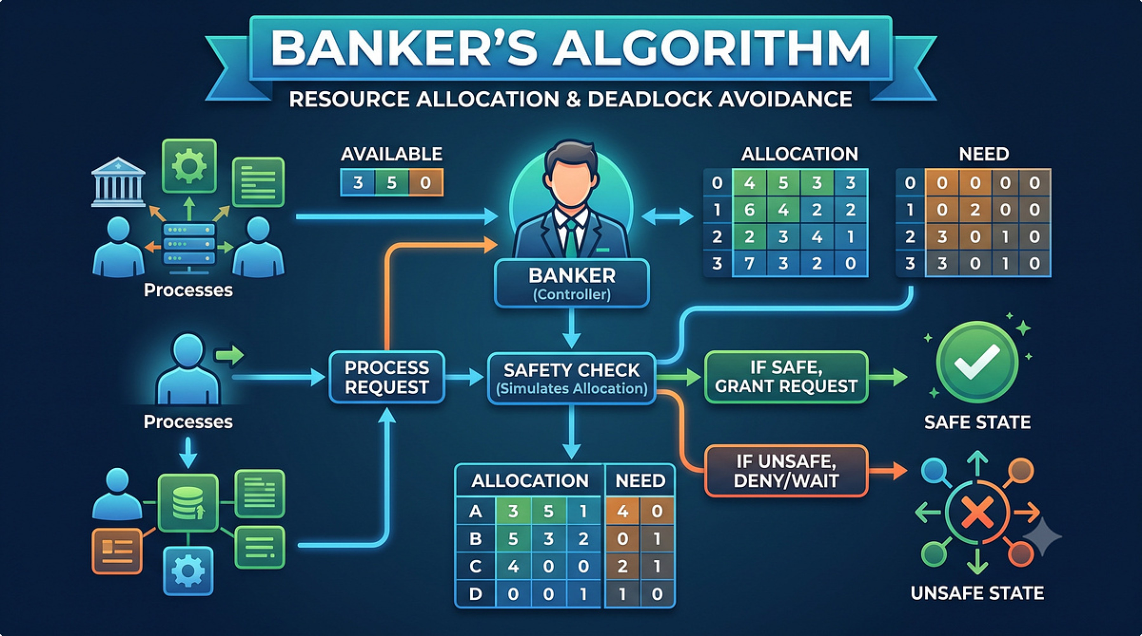
Banker's Algorithm
Deadlock Avoidance & System Safety Tracking
The Banker's Algorithm is a classic resource-allocation and deadlock-avoidance algorithm used by operating systems to ensure the system never allocate resources in a way that leaves some processes unable to finish.
Analogy: the OS acts like a bank — it grants resource requests only when it can still satisfy every customer's maximum need.

Slide 2





The 4 Pillars of System State
Max Matrix
Allocation Matrix
Each process's maximum demand for every resource type (what it may request at peak).
Resources currently assigned to each process (what we have already given).
Available Array
Need Matrix
Unallocated resources in the system — what the "bank" has on hand now.
The remaining resources each process needs to finish (Max − Allocation).
Golden Rule: Need[i][j] = Max[i][j] − Allocation[i][j]. The algorithm compares Need to Available/Work.

Slide 3
Code Walkthrough: Initialization
The program reads n (processes) and m (resource types), then accepts Available, Max, and Allocation. It computes Need dynamically so the safety check uses current values.
Key idea: compute Need once after input, then use Need and a temporary Work array for safety checks.
// Calculate Need = Max - Allocation
for (i = 0; i < n; i++) {
for (j = 0; j < m; j++) {
need[i][j] = max[i][j] - allocation[i][j];
}
}
Focus: the nested loop subtracts Allocation from Max per resource. Highlight this subtraction — it defines each process's remaining requirement.

Slide 4

Code Walkthrough: The Safety Engine
The safety loop repeatedly scans for a process i that is not finished and whose Need ≤ Work (current simulated available resources). When found, the algorithm "executes" that process (conceptually) and reclaims its Allocation into Work.
This simulation avoids real allocation — it only checks whether a safe execution order exists.
// Execute and release resources
if (canExecute) {
for (j = 0; j < m; j++)
work[j] += allocation[i][j]; // Reclaim resources
finish[i] = true;
safeSequence[count++] = i;
found = true;
}
Callout: work[j] += allocation[i][j] reclaims resources after a process finishes — increasing available capacity for others.

Slide 5
Visualizing the State Table (Safe Scenario)
Initial Available: [3, 3, 2] — three processes (P0, P1, P2) and three resource types (A, B, C).
Process | Allocation (A B C) | Maximum (A B C) | Need (A B C)
P0 | 0 1 0 | 7 5 3 | 7 4 3
P1 | 2 0 0 | 3 2 2 | 1 2 2
P2 | 3 0 2 | 9 0 2 | 6 0 0
Note: Need column is highlighted — it's the value compared to Available/Work during the safety check.

Slide 6
Tracing the Safe Sequence
Step 1 — Check P0
Need [7,4,3] vs Available [3,3,2] → 7>3 so P0 cannot run. (Result: ❌)
Step 2 — Check P1
Need [1,2,2] ≤ Available [3,3,2] → P1 runs and releases Allocation [2,0,0]. (Result: ✅)
New Available: [3,3,2] + [2,0,0] = [5,3,2]
Step 3 — Check P2
Need [6,0,0] vs Available [5,3,2] → 6>5 so P2 cannot run yet. (Result: ❌)
Step 4 — Repeat Loop
Algorithm continues scanning; as Work increases by reclaiming allocations from completed processes, previously blocked processes may become runnable until all finish or none can.
Visual cues: successes use green checks and failures use red X's. Show the arithmetic for each Available update clearly.

Slide 7

Visualizing the State Table (Unsafe Scenario)
Tight resources create an unsafe state. Initial Available: [0, 1, 0]
Process | Allocation (A B C) | Maximum (A B C) | Need (A B C)
P0 | 2 0 0 | 7 5 3 | 5 5 3
P1 | 2 0 0 | 3 2 2 | 1 2 2
P2 | 3 0 2 | 9 0 2 | 6 0 2
Available array [0, 1, 0] shown in bold red to highlight scarcity — likely cause of deadlock.

Slide 8

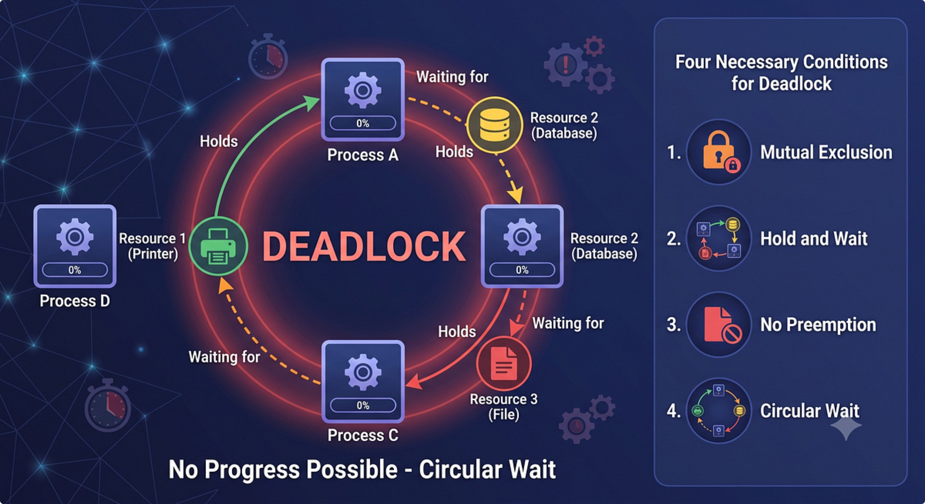
Tracing the Unsafe State — Deadlock
Check P0
Check P1
Check P2
Need [5,5,3] vs Available [0,1,0] → Wait (❌).
Need [1,2,2] vs Available [0,1,0] → Wait (❌).
Need [6,0,2] vs Available [0,1,0] → Wait (❌).
Since no process could be executed during the full scan, the variable found remains false, triggering the break condition: if (!found) break; — the algorithm halts without a safe sequence.
Deadlock Detected — no process can finish with current Available resources.

Slide 9

Code Walkthrough: Final Verdict Logic
After the safety loop ends, the program decides if the system is safe by comparing the count of finished processes to n. If all processes finished, we have a safe sequence; otherwise the system is in an unsafe (potentially deadlocked) state.
if (count == n) {
printf("SYSTEM IS IN A SAFE STATE\n");
printf("Safe Sequence: ");
// Loop to print P0 -> P1 -> P2
} else {
printf("SYSTEM IS IN AN UNSAFE STATE\n");
printf("Deadlock detected.\n");
}
Practical tip: print the safeSequence array to verify the exact order processes can finish — helpful for debugging and grading.

