Slide 1
Enterprise HR Knowledge Assistant
Learned halting for
self-correcting RAG
M.Tech Integrated Software Engineering
Final Review 3 · 14 October 2026
Working implementation • transparent trajectories • controlled evaluation
01 | REVIEW 3 · HR KNOWLEDGE ASSISTANT
Notes:
Opening: This is a working capstone prototype with evidence-bounded research. The independent pilot and live monetary comparison are not complete. Do not introduce the project as production ready.

Slide 2
The problem: relevant evidence can still be incomplete
HR questions combine eligibility, limits and approval conditions.
More retrieval can add work without resolving the missing condition.
The system must show what supports an answer—and when it cannot answer.
02 | REVIEW 3 · HR KNOWLEDGE ASSISTANT
Notes:
Explain the difference between relevant text and complete policy support. A confident classifier can end retrieval while an answer still needs to abstain.

Slide 3
Research questions remain separate
Does learned stopping change local retrieval effort?
Can it preserve independently assessed answer correctness and source support?
Do resolver, context selection and evidence gates help independently?
Does actual external API usage change?
03 | REVIEW 3 · HR KNOWLEDGE ASSISTANT
Notes:
State hypotheses as questions, not conclusions. The cost question is architectural: local loops do not necessarily incur Gemini requests.

Slide 4
Architecture: stopping and authorization are distinct
Stage | Implementation / responsibility
Authenticate | Existing JWT + protected FastAPI /ask
Resolve & retrieve | Verified acronyms; Chroma corpus; local rewrites
Stop / continue | Four-feature Logistic Regression; maximum 3 attempts
Authorize answer | Evidence gate + narrow source-specific validators
Respond | Local verified rule, final Gemini generation or abstention
04 | REVIEW 3 · HR KNOWLEDGE ASSISTANT
Notes:
The diagram is a logical path. Authentication precedes the request. A local source validator can authorize its narrow answer separately from the generic critic. Gemini is final generation, not a critic call every iteration.

Slide 5
Four features; one preserved classifier
Feature | Meaning
Attempt | Current retrieval iteration
Current score | Semantic / keyword critic score
Best score | Highest critic score observed so far
Score delta | Current score − previous best; first attempt = 0
05 | REVIEW 3 · HR KNOWLEDGE ASSISTANT
Notes:
The supplied saved classifier is preserved byte for byte. Delta is current score minus prior best, not always current minus immediately previous score. Threshold 0.75 belongs to the critic, not the Logistic Regression probability.

Slide 6
A STOP prediction never proves an answer
Critic threshold remains 0.75; the trained model is unchanged.
Insufficient evidence remains blocked unless a narrow source rule verifies its exact claim.
Maternity eligibility and CL carry-forward use separate deterministic checks.
P(STOP) is not answer confidence.
06 | REVIEW 3 · HR KNOWLEDGE ASSISTANT
Notes:
Use CL as the example: the model can predict STOP with an insufficient critic. The existing narrow source validator supplies the answer only when exact supporting section evidence is present.

Slide 7
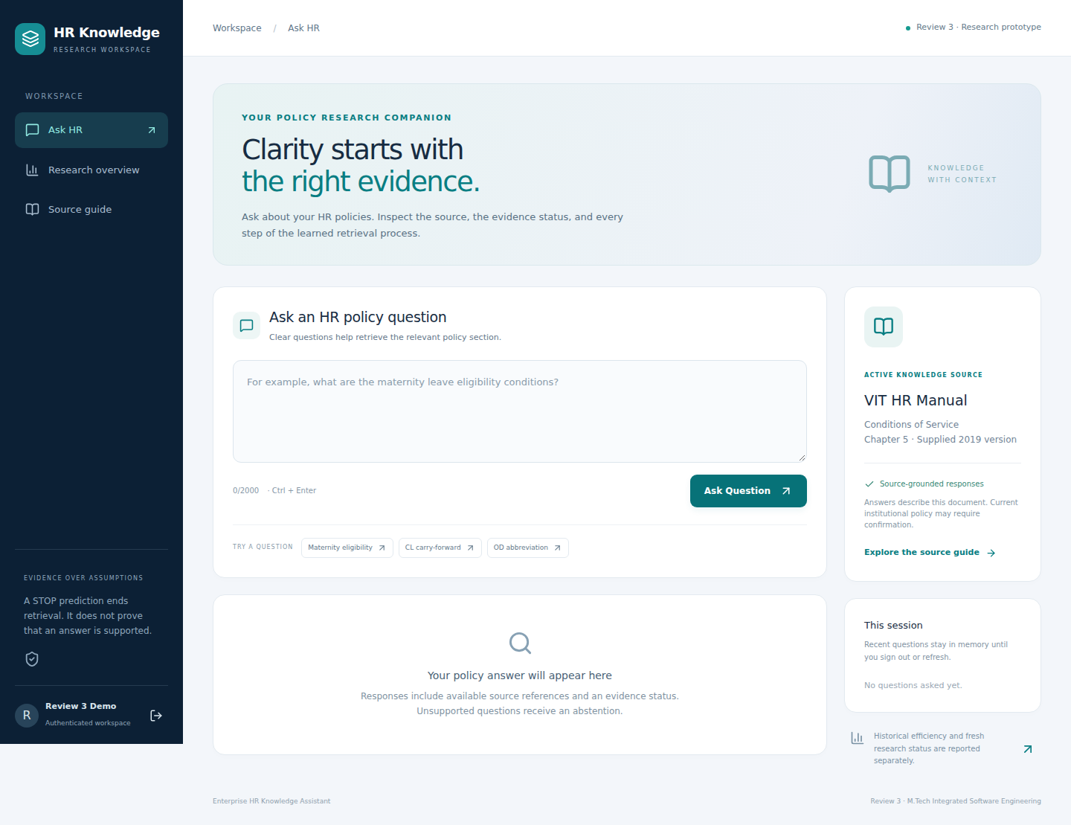
A modern interface over the same API
07 | REVIEW 3 · HR KNOWLEDGE ASSISTANT
Notes:
This is an actual authenticated browser capture, not a generated mockup. Explain source status, source reference and query submission.

Slide 8
The trajectory exposes the actual stopping decision
Attempt | Critic | Policy | P(STOP)
1 | 0.57 | CONTINUE | 0.319
2 | 0.71 | STOP | 0.842
CL answer: section 5.5.1 supports the 31 May lapse rule.
This answer comes from source verification, not critic sufficiency.
08 | REVIEW 3 · HR KNOWLEDGE ASSISTANT
Notes:
Real CL response: first critic .57 CONTINUE, second .71 STOP with P(STOP) .842. Source-specific rule verifies the answer. The classifier is not credited for proving the policy.

Slide 9
Historical results are useful—but not independent
100 questions · 75% critic success each · 89/100 overlap training
09 | REVIEW 3 · HR KNOWLEDGE ASSISTANT
Notes:
Provenance: advanced_question_results_v2.csv and verified_metrics.json. Historical baseline is not the new strict three-call control. The 75% number is critic-defined retrieval success, not human answer accuracy.

Slide 10
Thirty candidates, zero claimed independent approvals
Screening item | Observed status
Candidate questions | 30; five categories × six
Historical reference inventory | 214 unique questions
High similarity / broad-topic overlap | 2 / 23 candidates
Independent approval / final freeze | Pending / not frozen
10 | REVIEW 3 · HR KNOWLEDGE ASSISTANT
Notes:
Questions were authored from source without querying the system. Category quotas are six each. Source excerpts and drafts need review. High-similarity flags and broad family overlaps are distinct and not disjoint counts.

Slide 11
Four policies share the retrieval components
Policy | Stopping rule
Single | One retrieval
Critic-guided | Sufficient critic; otherwise guard or budget
Learned | Saved classifier; otherwise guard or budget
Fixed budget | Exactly three retrieval calls
11 | REVIEW 3 · HR KNOWLEDGE ASSISTANT
Notes:
Critic and learned preserve the no-rewrite guard. Strict budget deliberately repeats unchanged queries to make three actual retrieval calls. This is documented, not silently patched into the application.

Slide 12
Fresh development run: no universal winner
4 known questions × 4 policies × 3 repetitions · retrieval only
12 | REVIEW 3 · HR KNOWLEDGE ASSISTANT
Notes:
Four previously used questions, three repetitions, 48 observations. Repetitions measure timing variation, not independent samples. No candidate was run. Do not use this graph to claim generalization.

Slide 13
Final critic scores can worsen after more retrieval
Policy | Attempts | Critic sufficient | Human correctness
learned | 1.50 | 25% | Not measured
critic | 1.25 | 50% | Not measured
single | 1.00 | 50% | Not measured
budget | 3.00 | 0% | Not measured
Original-question support and human answer quality must be assessed separately.
13 | REVIEW 3 · HR KNOWLEDGE ASSISTANT
Notes:
This is failure evidence worth showing. The critic is computed on each final rewritten query. It does not imply that budget answers are all wrong, because source rules may still support a narrow response.

Slide 14
API cost savings are not established
Critic, rewriter and halting policy run locally.
Gemini is used for final generation; context length can change token cost.
No fresh matched successful API pairs; no monetary reduction claim.
Failures with missing usage remain unknown cost.
14 | REVIEW 3 · HR KNOWLEDGE ASSISTANT
Notes:
The development benchmark makes no API calls by design. Never report that as a measured zero-dollar cost advantage. Existing pilot has zero matched successes. Account tier is unverified. Official pricing record is in the package.

Slide 15
Ablations must isolate each contribution
Change | Hold constant / measure
Acronym resolver | Same questions, policy and source corpus
Context selection | Same index and final model/prompt
Stopping policy | Same critic, retrieval and rewriting
Gate / source rules | Same stored evidence; quality and abstention
15 | REVIEW 3 · HR KNOWLEDGE ASSISTANT
Notes:
Source validators on/off can be assessed on identical stored contexts. No generalized quality benefit is measured. Separate section-aware indexing is pending because the existing database must remain protected.

Slide 16
Verification supports the demo—not production readiness
89 tests pass; React / TypeScript production build passes.
Authenticated policy responses and trajectories pass desktop/mobile checks.
Model, corpus and index hashes remain unchanged.
HTTPS, load, document ACLs and Windows acceptance remain unverified.
16 | REVIEW 3 · HR KNOWLEDGE ASSISTANT
Notes:
89 tests comprise the original 80 Review 3 tests, two roots and seven benchmark tests. Browser tests used real model and copied database with temporary account. Credentials are excluded from package.

Slide 17
The closest prior work limits novelty claims
Self-RAG / CRAG: reflection and corrective retrieval.
Adaptive-RAG: strategy selection by question complexity.
Stop-RAG: learned value-based stopping; TASR: a calibrated stopping rule.
The current contribution is auditable integration; measurable novelty is still unproven.
17 | REVIEW 3 · HR KNOWLEDGE ASSISTANT
Notes:
Primary sources verified 14 October 2026. Self-RAG ICLR 2024, Adaptive-RAG NAACL 2024. CRAG cited as arXiv v3, not an unverified conference acceptance. Stop-RAG v1 and TASR v3 are workshop-related records, not main-conference novelty evidence.

Slide 18
Approval and blind review come before final claims
Review source answers and replace or resolve semantic overlaps.
Record genuine independent approval bound to the candidate hash.
Freeze dataset, code and assets; run the final controlled evaluation.
Collect two blinded reviews, adjudicate and report agreement.
18 | REVIEW 3 · HR KNOWLEDGE ASSISTANT
Notes:
Explain that the freeze guard checks content hashes and recorded named approvals but cannot verify a human identity by itself. Supervisory verification remains necessary. Blank ratings are intentional.

Slide 19
Publication and IP need evidence and coordination
Working software alone does not establish patentable novelty.
Compare specific technical claims against corrective RAG and stopping prior art.
Discuss dated implementation and public disclosures with VIT IPR and qualified counsel.
Align university review, any filing and paper/thesis publication.
19 | REVIEW 3 · HR KNOWLEDGE ASSISTANT
Notes:
Preliminary discussion, not legal advice. Official VIT IPR policy amendment 16 April 2024 describes disclosure and professional review. Existing public repository history must be disclosed to the advisor/counsel; no patentability guarantee.

Slide 20
A working demonstration; an unfinished independent study
Ready: working UI, tests, development evidence, candidate materials and reproducibility workflow.
Pending: independent approval, held-out answer quality, matched API costs and Windows acceptance.
Demonstrate the evidence trail—and explain exactly what each metric means.
20 | REVIEW 3 · HR KNOWLEDGE ASSISTANT
Notes:
Close honestly. Deliverables are in START_HERE. Do not claim the pending independent study is finished. Suggested viva questions and complete bibliography are in documents.

