Slide 1
Atc kot app guide
ver.1.0

Slide 2
Manual
Top
TO
(Top Object)
LO
(Left Object)
Standard
RO
(Reft Object)
Left
Center
Right
BO
(Bottom Object)
Bottom
* 다른 오브젝트를 기준으로 상대적 거리를 표기할 때,
상단 오브젝트와의 거리는 TO
좌측 오브젝트와의 거리는 LO
우측 오브젝트와의 거리는 RO
하단 오브젝트와의 거리는 BO 로 표기하겠습니다.
혹시 명칭에서 혼동이 올 수 있으면 말씀해 주세요.
* 좌표는 위와같은 기준을 토대로 표기하였습니다.

Slide 3
History
NO. | Date | Version | File | List | Writer
1 | 16.03.18 | 1.0 | atc_kot_app_guide_160318 | Guide 제작

Slide 4
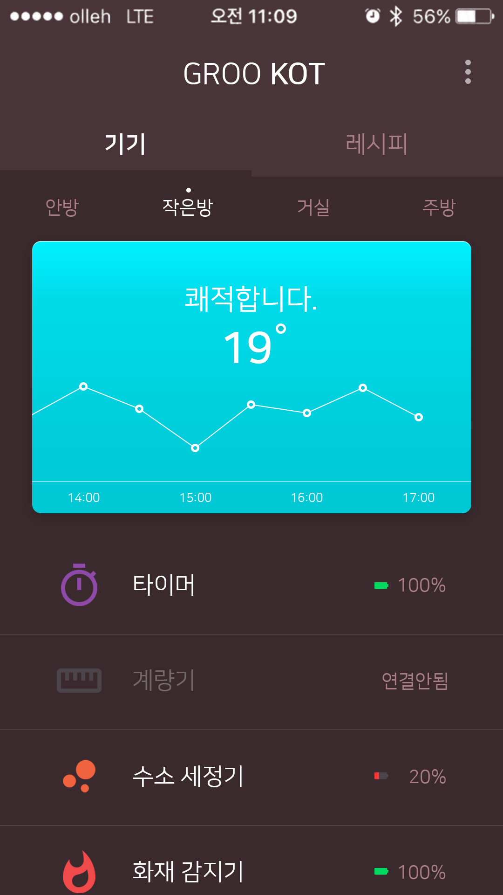
1. Main
1080
기본 가이드는 1080 x 1920 으로 합니다.
720 x 1280은 현재의 가이드를 ½로 적용하면 됩니다
1920

Slide 5
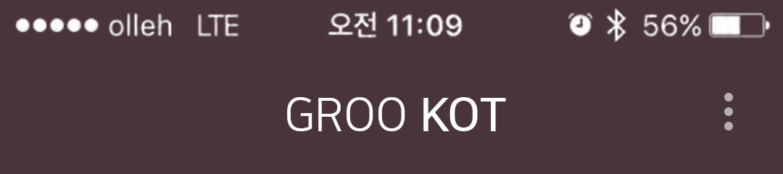


1. Main
1080
199
692
70
88
31
3
127
110
240
68
1
2
88
45
42
1
Position: left 199 top 127
Font: Nanum Square(Regular, Medium)
Font Size: 64px
Area: 692 x 68
Align: Area Center
Color: (255.255.255 / #ffffff)
2
btn_set.png
Position: left 961, top 110
Image Size: 88 x 88
2
actionbar.png
Position: left 0, top 0
Image Size: 1080 x 240

Slide 6

1. Main
1080
540
540
44
4
54
1
2
240
27
14
3
540
1
2
Position: left 0 top 284, left 540 top 284
-normal
Font: Nanum Square(Regular)
Font Size: 50px
Area: 540 x 54
Align: Area Center
Color: (169.126.135 / #a97e87)
-Focus
Font: Nanum Square(Medium)
Font Size: 50px
Area: 540 x 54
Align: Area Center
Color: (255.255.255 / #ffffff)
139
3
tabs_focus.png
Position: left 0 top 365, left 540 top 365
Image Size: 540 x 14
4
tabs.png
Position: left 0 top 240
Image Size: 1080 x 139

Slide 7
1. Main
1080
270
270
270
270
43
1
2
240
1
Position: left 0 top 425, left 270 top 425, left 540 top 425, left 810 top 425,
-normal
Font: Nanum Square(Regular)
Font Size: 40px
Area: 270 x 43
Align: Area Center
Color: (169.126.135 / #a97e87)
-Focus
Font: Nanum Square(Regular)
Font Size: 40px
Area: 270 x 43
Align: Area Center
Color: (255.255.255 / #ffffff)
139
3
tabs_dot.png
Position: left 130 top 403, left 400 top 403, left 670 top 403, left 940 top 403
Image Size: 10 x 10

Slide 8

1. Main
1080
68
404
57
57
33
393
68
240
111
60
1
31
2
2
3
139
94
237
2
4
26
19
56
142
78
161
78
161
78
161
78
143
1
Position: left 68 top 610
Font: Nanum Square(Regular)
Font Size: 60px
Area: 944 x 60
Align: Area Center
Color: (0.0.0 / #ffffff)
2
Position: left 472 top 701, left 529 top 701
Font: Nanum Square(Bold)
Font Size: 94px
Area: 57 x 94
Align: Area Center
Color: (0.0.0 / #ffffff)
3
tem.png
Position: left 586 top 688
Image Size: 33 x 107
3
Card_line.png
Position: left 68 top 1032
Image Size: 944 x 2

Slide 9
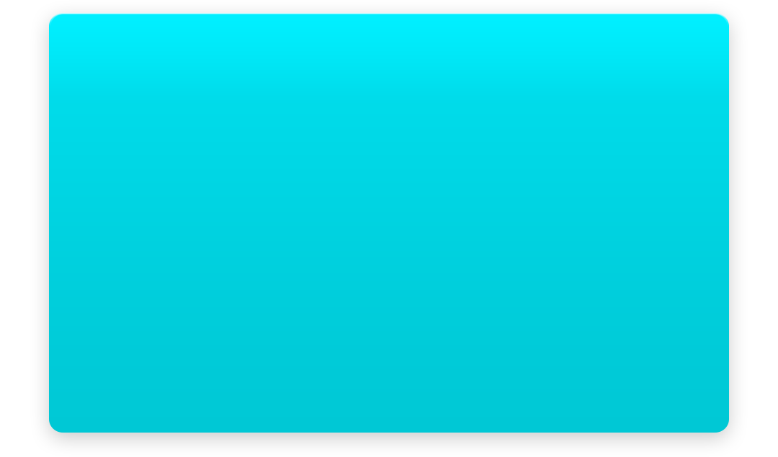
1. Main
1080
68
404
57
57
33
393
68
1
240
111
60
31
139
94
3
237
2
26
19
2
56
142
78
161
78
161
78
161
78
143
1
card.png
Position: left 0 top 499
Image Size: 1080 x 636
2
Position: left 142 top 1053, left 381 top 1053, left 620 top 1053, left 859 top 1053
Font: Nanum Square(Regular)
Font Size: 26px
Area: 78 x 26
Align: Area Center
Color: (0.0.0 / #ffffff)
3
Card_dot.png
Image Size: 18 x 18

Slide 10














1. Main
1080
118
104
61
473
324
104
1
2
50
240
99
139
104
50
99
104
50
99
104
50
1
Icon_01~07.png
Position: left 118 top 1205, 1408, 1613, 1821
Image Size: 104 x 114
Icon_dim_01~07.png
Position: left 118 top 1205, 1408, 1613, 1821
Image Size: 104 x 114
2
Position: left 283 top 1232, 1435, 1640, 1848
Font: Nanum Square(Regular)
Font Size: 50px
Area: 473 x 50
Align: Area Left
Color: (0.0.0 / #ffffff)
(113.105.107 / #71696b)

Slide 11





1. Main
1080
792
52
194
42
1
2
50
240
1
4
139
204
3
50
1
204
1
1
Battery_01~05.png
Position: left 792 top 1237, 1440, 1645, 1853
Image Size: 52 x 40
2
Position: left 792 top 1237, 1440, 1645, 1853
Font: Nanum Square(Regular)
Font Size: 40px
Area: 194 x 40
Align: Area Left
Color: (169.126.135 / #a97e87)
3
Position: left 792 top 1237, 1440, 1645, 1853
Font: Nanum Square(Regular)
Font Size: 40px
Area: 246 x 40
Align: Area Left
Color: (169.126.135 / #a97e87)
1
List_line.png
Position: left 0 top 1360, 1565, 1770
Image Size: 1080 x 1

