Slide 1
Atc kot app guide
ver.1.3

Slide 2
Manual
Top
TO
(Top Object)
LO
(Left Object)
Standard
RO
(Reft Object)
Left
Center
Right
BO
(Bottom Object)
Bottom
* 다른 오브젝트를 기준으로 상대적 거리를 표기할 때,
상단 오브젝트와의 거리는 TO
좌측 오브젝트와의 거리는 LO
우측 오브젝트와의 거리는 RO
하단 오브젝트와의 거리는 BO 로 표기하겠습니다.
혹시 명칭에서 혼동이 올 수 있으면 말씀해 주세요.
* 좌표는 위와같은 기준을 토대로 표기하였습니다.

Slide 3
History
NO
Date
Version
File
List
1
16.03.18
1.0
atc_kot_app_guide_160318
Guide 제작

Slide 4
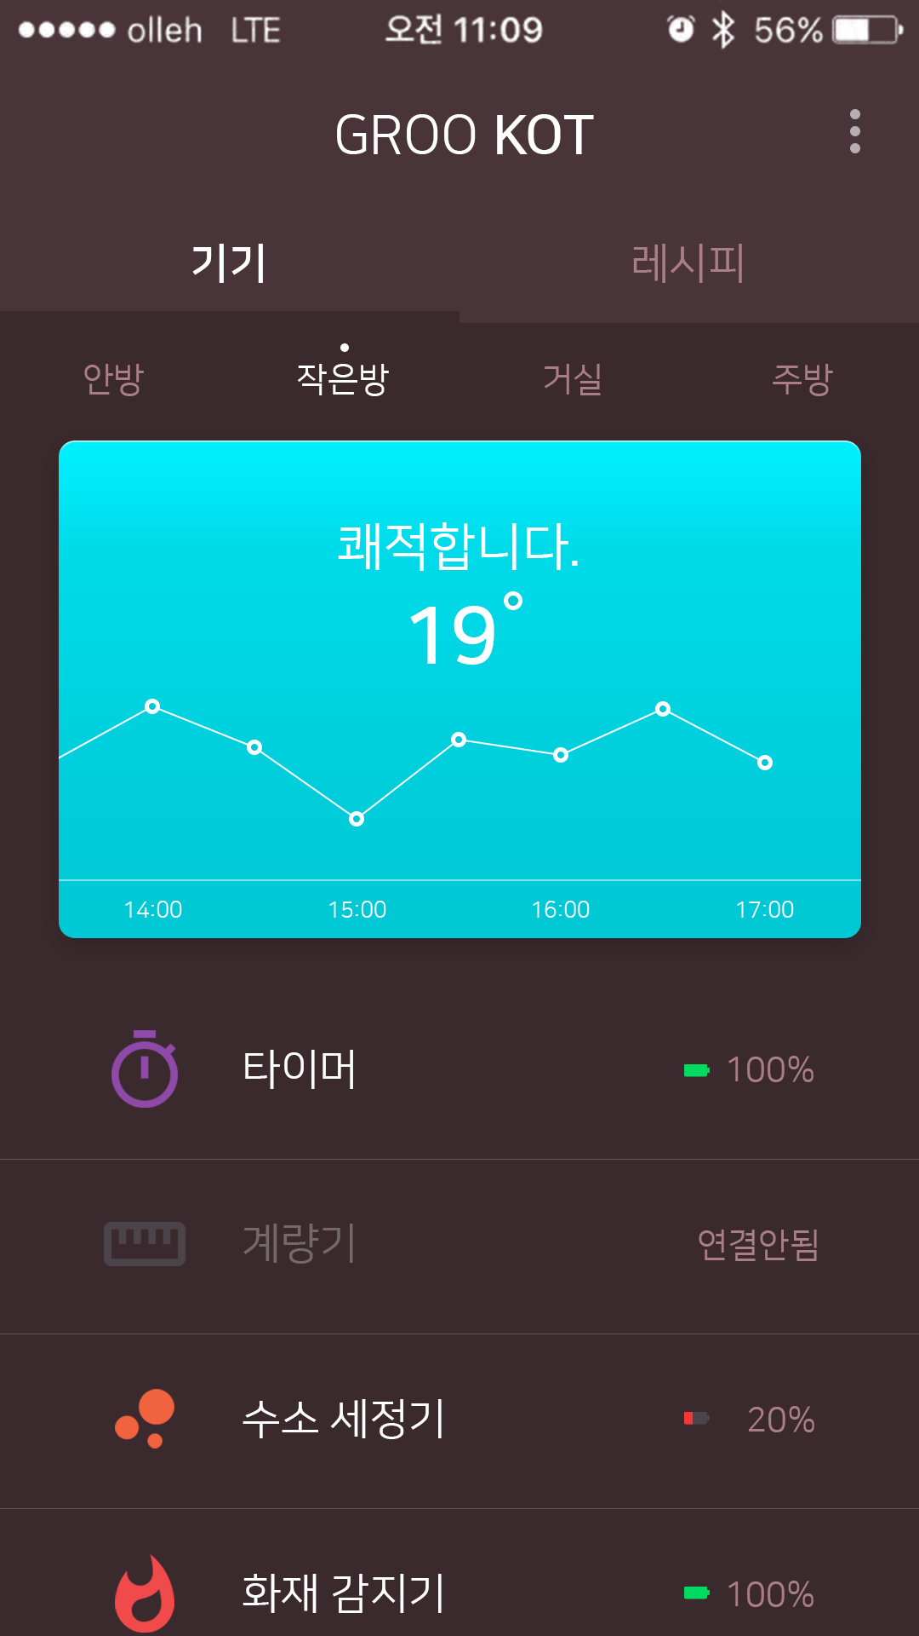
1. Main
1080
기본 가이드는 1080 x 1920 으로 합니다.
720 x 1280은 현재의 가이드를 ½로 적용하면 됩니다
1920

Slide 5
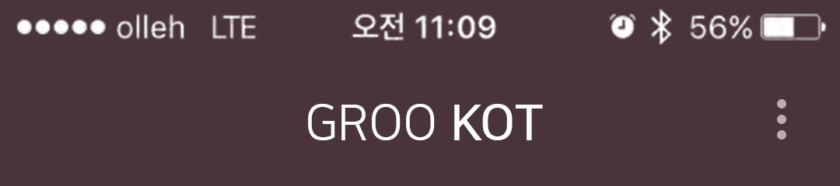


1. Main
1080
199
692
70
88
31
3
127
110
240
68
1
2
88
45
42
1
Position: left 199 top 127
Font: Nanum Square(Regular, Medium)
Font Size: 64px
Area: 692 x 68
Align: Area Center
Color: (255.255.255 / #ffffff)
2
btn_set.png
Position: left 961, top 110
Image Size: 88 x 88
2
actionbar.png
Position: left 0, top 0
Image Size: 1080 x 240

Slide 6

1. Main
1080
540
540
44
4
54
1
2
240
27
14
3
540
1
2
Position: left 0 top 284, left 540 top 284
-normal
Font: Nanum Square(Regular)
Font Size: 50px
Area: 540 x 54
Align: Area Center
Color: (169.126.135 / #a97e87)
-Focus
Font: Nanum Square(Medium)
Font Size: 50px
Area: 540 x 54
Align: Area Center
Color: (255.255.255 / #ffffff)
139
3
tabs_focus.png
Position: left 0 top 365, left 540 top 365
Image Size: 540 x 14
4
tabs.png
Position: left 0 top 240
Image Size: 1080 x 139

Slide 7
1. Main
1080
270
270
270
270
43
1
2
240
1
Position: left 0 top 425, left 270 top 425, left 540 top 425, left 810 top 425,
-normal
Font: Nanum Square(Regular)
Font Size: 40px
Area: 270 x 43
Align: Area Center
Color: (169.126.135 / #a97e87)
-Focus
Font: Nanum Square(Regular)
Font Size: 40px
Area: 270 x 43
Align: Area Center
Color: (255.255.255 / #ffffff)
139
3
tabs_dot.png
Position: left 130 top 403, left 400 top 403, left 670 top 403, left 940 top 403
Image Size: 10 x 10

Slide 8

1. Main
1080
68
404
57
57
33
393
68
240
111
60
1
31
2
2
3
139
94
237
2
4
26
19
56
142
78
161
78
161
78
161
78
143
1
Position: left 68 top 610
Font: Nanum Square(Regular)
Font Size: 60px
Area: 944 x 60
Align: Area Center
Color: (0.0.0 / #ffffff)
2
Position: left 472 top 701, left 529 top 701
Font: Nanum Square(Bold)
Font Size: 94px
Area: 57 x 94
Align: Area Center
Color: (0.0.0 / #ffffff)
3
tem.png
Position: left 586 top 688
Image Size: 33 x 107
3
Card_line.png
Position: left 68 top 1032
Image Size: 944 x 2

Slide 9
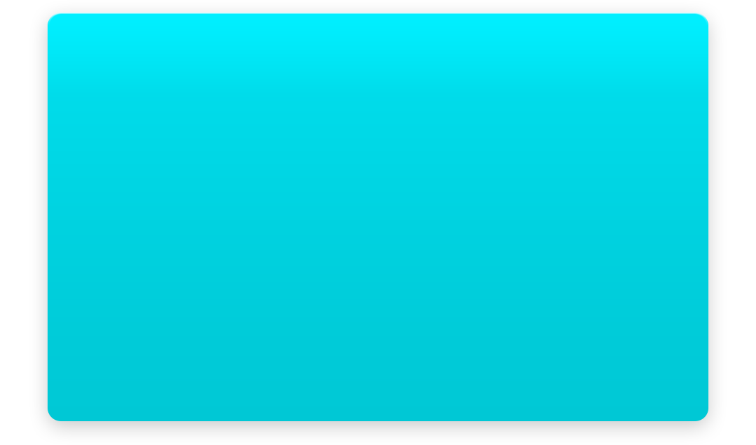
1. Main
1080
68
404
57
57
33
393
68
1
240
111
60
31
139
94
3
237
2
26
19
2
56
142
78
161
78
161
78
161
78
143
1
card.png
Position: left 0 top 499
Image Size: 1080 x 636
2
Position: left 142 top 1053, left 381 top 1053, left 620 top 1053, left 859 top 1053
Font: Nanum Square(Regular)
Font Size: 26px
Area: 78 x 26
Align: Area Center
Color: (0.0.0 / #ffffff)
3
Card_dot.png
Image Size: 18 x 18

Slide 10














1. Main
1080
118
104
61
473
324
104
1
2
50
240
99
139
104
50
99
104
50
99
104
50
1
Icon_01~07.png
Position: left 118 top 1205, 1408, 1613, 1821
Image Size: 104 x 114
Icon_dim_01~07.png
Position: left 118 top 1205, 1408, 1613, 1821
Image Size: 104 x 114
2
Position: left 283 top 1232, 1435, 1640, 1848
Font: Nanum Square(Regular)
Font Size: 50px
Area: 473 x 50
Align: Area Left
Color: (0.0.0 / #ffffff)
(113.105.107 / #71696b)

Slide 11
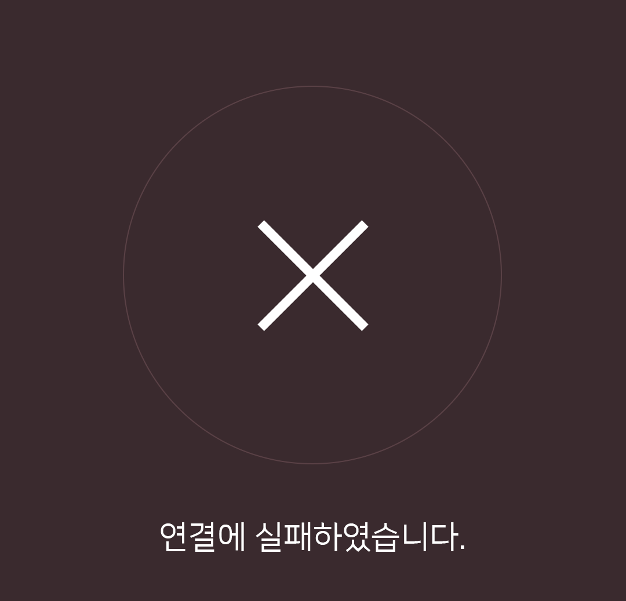





1. Main
1080
792
52
194
42
1
2
50
240
1
4
139
204
3
50
1
204
1
1
Battery_01~05.png
Position: left 792 top 1237, 1440, 1645, 1853
Image Size: 52 x 40
2
Position: left 792 top 1237, 1440, 1645, 1853
Font: Nanum Square(Regular)
Font Size: 40px
Area: 194 x 40
Align: Area Left
Color: (169.126.135 / #a97e87)
3
Position: left 792 top 1237, 1440, 1645, 1853
Font: Nanum Square(Regular)
Font Size: 40px
Area: 246 x 40
Align: Area Left
Color: (169.126.135 / #a97e87)
1
List_line.png
Position: left 0 top 1360, 1565, 1770
Image Size: 1080 x 1

Slide 12
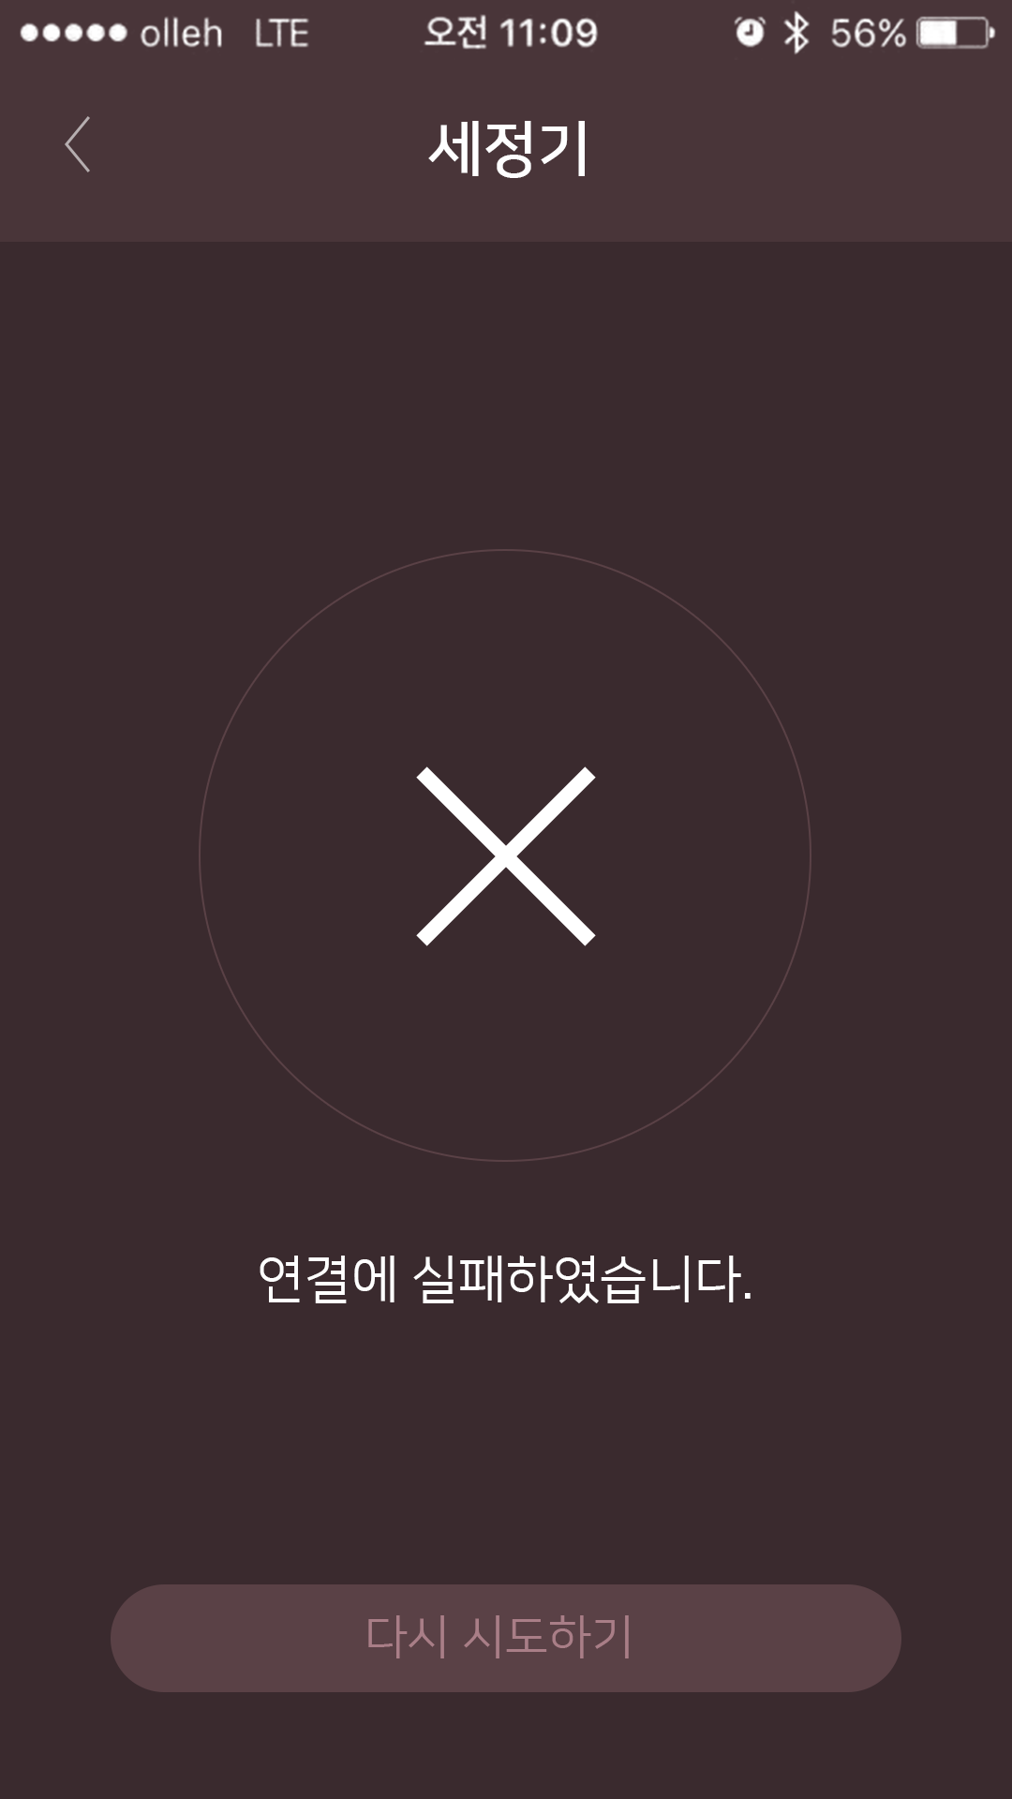
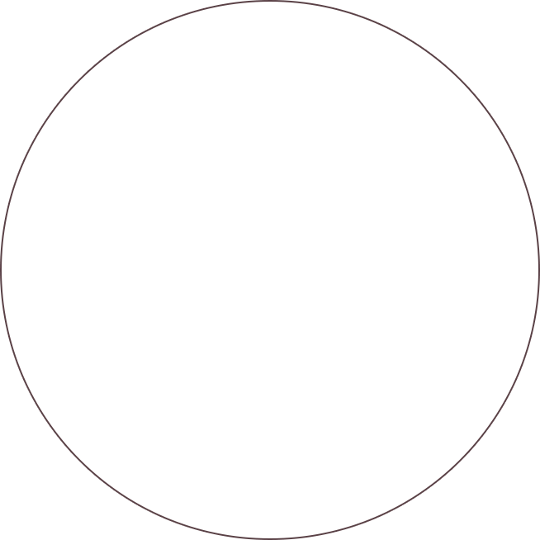
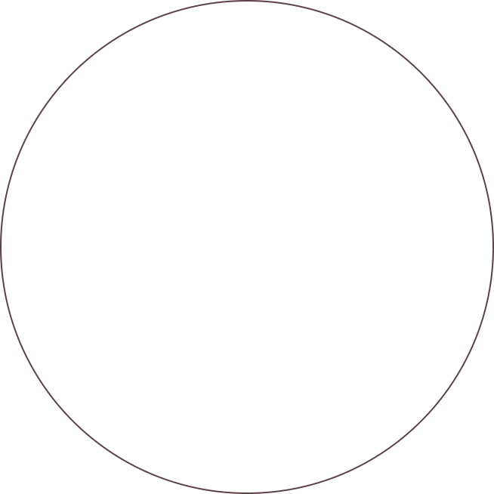
2. 기기추가
1080
213
654
213
240
1
139
654
100
252
2
52
100
1
connect_fail.png
Position: left 213 top 586
Image Size: 654 x 654
2
Position: left 0 top 1340
Font: Nanum Square(Regular)
Font Size: 55px
Area: 194 x 40
Align: Area Center
Color: (0.0.0 / #ffffff)

Slide 13
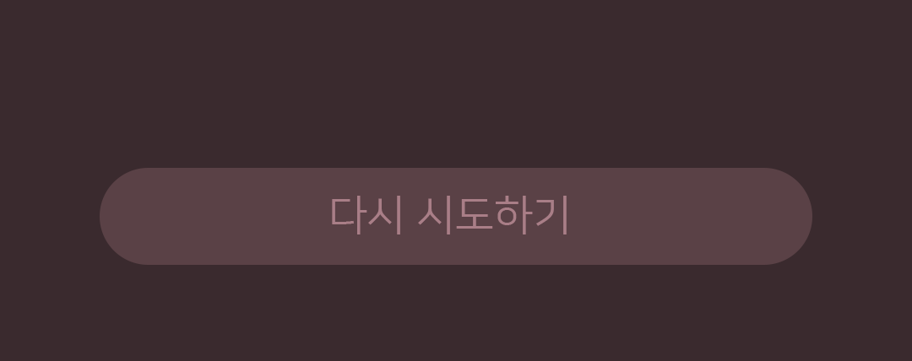

2. 기기추가
1080
213
654
213
240
1
115
2
139
654
844
1
connect_fail_btn.png
Position: left 118 top 1691
Image Size: 844 x 115
2
Position: left 393 top 1724
Font: Nanum Square(Regular)
Font Size: 50px
Area: 844 x 15
Align: Area Center
Color: (169,126,135 / #a97e87)
428

Slide 14
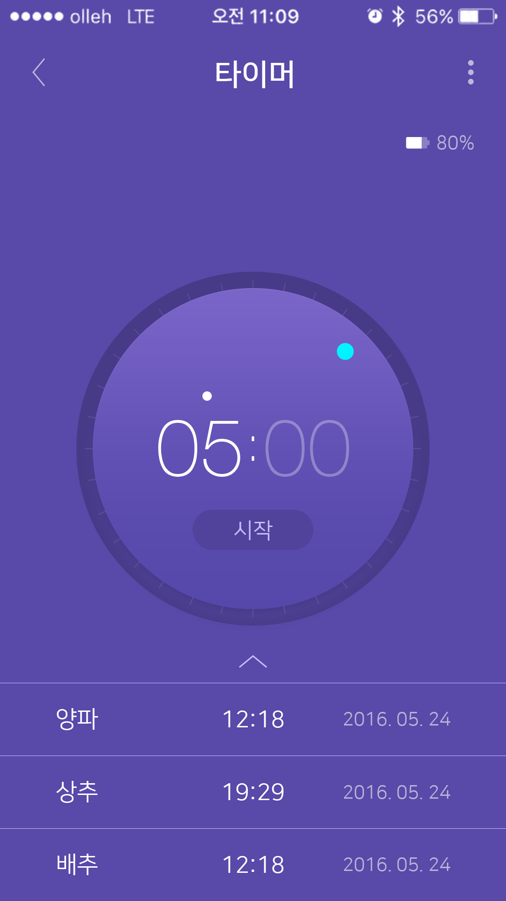
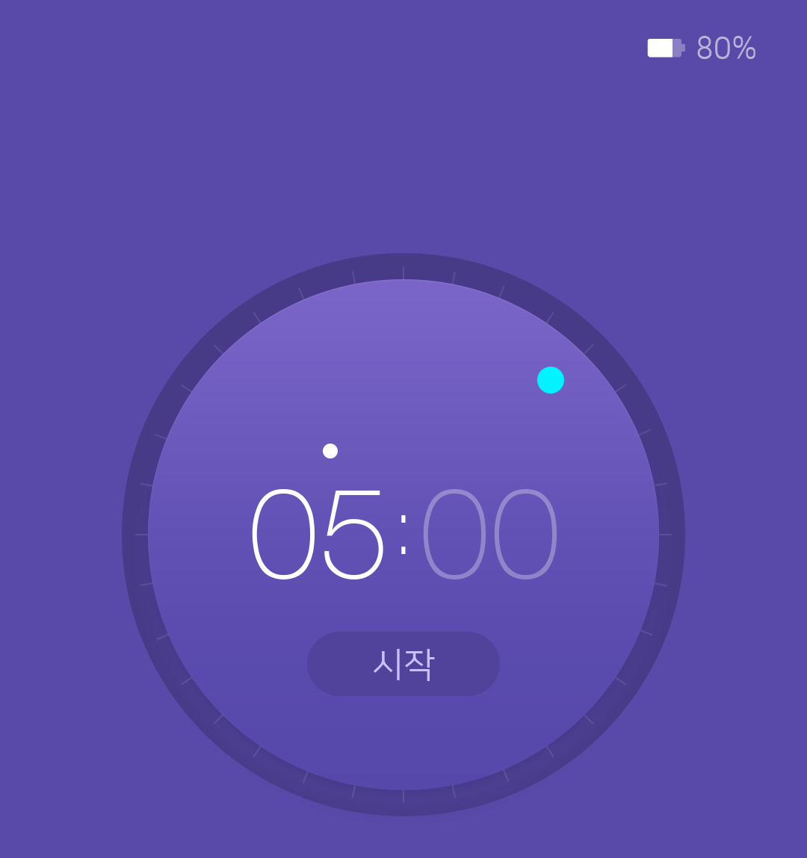
3. 타이머
1080
213
654
280
120
1
2
31
240
1029
1149
1
Battery_B_01~05.png
Position: left 866 top 292
Image Size: 51 x 25
531
2
Position: left 922 top 288
Font: Nanum Square(Regular)
Font Size: 40px
Area: 78 x 31
Align: Area Left
Color: (184,179,215 / #b8b3d7)

Slide 15





3. 타이머
163
754
163
1
controller_gradation_bg.png
X : 163, Y : 579
Width : 754, Height : 754
controller_gradation.png
X : 181, Y : 597
Width : 718, Height : 718
120
219
1
2
3
309
5
2
timer_controller2.png
X : 179, Y : 595
Width : 722, Height : 722
754
6
130
69
4
86
161
57
163
415
163
3
controller_dot.png
X : 719, Y : 731
Width : 36, Height : 36
5
X : 337, Y : 895
Width : 176, Height : 121
Font: HelveticaNeueLT 35Thin
Font Size: 170 PX
Align: Area Center
Color: (0.0.0 / #ffffff), (0.0.0 / #ffffff / alpha 30%)
05
4
X : 411, Y : 1086
Width : 258, Height : 86
Font: Nanum Square(Regular)
Font Size: 46px
Area: 258 x 86
Align: Area Center
Color: (0.0.0 / #ffffff / alpha 70%)
start_btn_bg.png
6
X : 537, Y : 929
Width : 6, Height : 53
Font: HelveticaNeueLT 35 Thin
Align: Area Center
Font Size : 100 PX / Auto
Color: (0.0.0 / #ffffff)
:

Slide 16
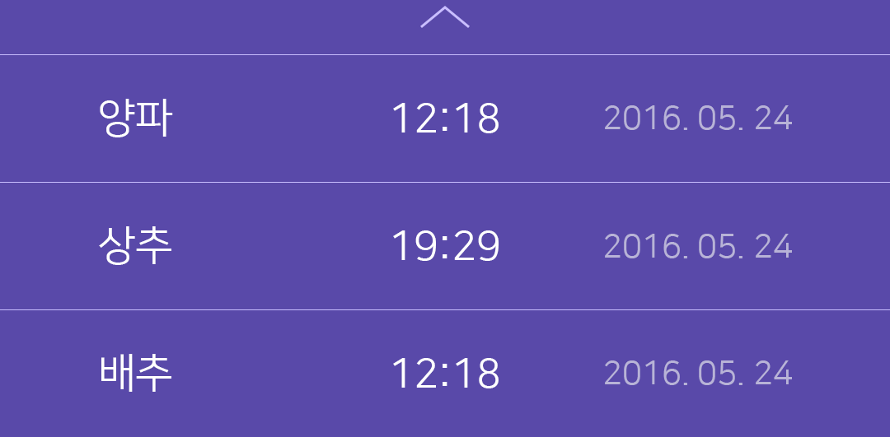
3. 타이머
118
844
118
4
66
4
up_arr.png
X : 510, Y : 1396
Width : 60, Height : 27
down_arr.png
X : 510, Y : 1396
Width : 60, Height : 27
5
1
2
3
154
1
531
154
1
155
5
device_list_line.png
X : 0, Y : 1354
Width : 1080, Height : 1
1
X : 121, Y : 1511
Width : 89, Height : 47
NanumSquareR / Regular
Align: Area Left
Area: 280 x 47
Align: Area Left
Font Size : 50 PX
Color: (0.0.0 / #ffffff)
2
X : 442, Y : 1511
Width : 224, Height : 47
NanumSquareR / Regular
Align: Area Center
Area: 206 x 47
Font Size : 50P
Color: (0.0.0 / #ffffff)
3
X : 714, Y : 1511
Width : 248, Height : 47
NanumSquareR / Regular
Align: Area Right
Area: 248 x 47
Font Size : 40PX
Color: (0.0.0 / #ffffff / alpha 50%)

Slide 17
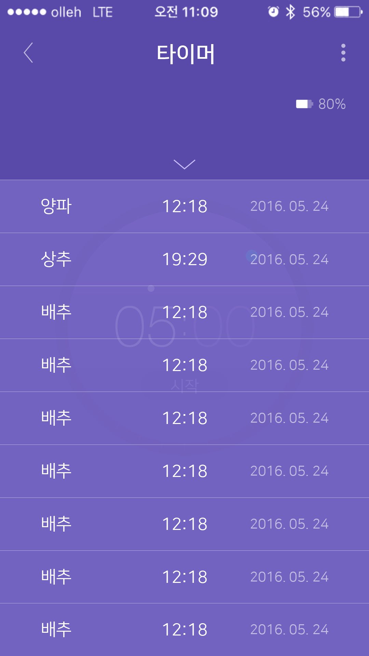
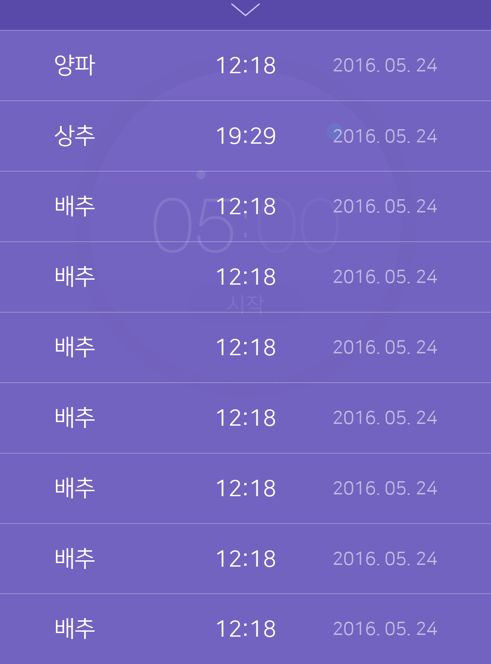
3. 타이머 리스트 업
1080
213
654
280
1
66
1
240
2
154
154
1460
1460
1
up_arr.png
X : 510, Y : 1396
Width : 60, Height : 27
down_arr.png
X : 510, Y : 1396
Width : 60, Height : 27
2

Slide 18

3. 타이머 리스트 업
118
844
118
66
1
X : 121, Y : 1511
Width : 89, Height : 47
NanumSquareR / Regular
Font Size : 50 PX
Align: Area Left
Area: 280 x 47
Align: Area Left
Color: (0.0.0 / #ffffff)
1
1
2
3
154
1
154
2
X : 442, Y : 1511
Width : 224, Height : 47
NanumSquareR / Regular
Align: Area Center
Area: 206 x 47
Font Size : 50PX / Auto
Color: (0.0.0 / #ffffff)
4
1460
3
X : 714, Y : 1511
Width : 248, Height : 47
NanumSquareR / Regular
Align: Area Right
Area: 248 x 47
Font Size : 40PX / Auto
Color: (0.0.0 / #ffffff / alpha 50%)
4
timer_list_bg.png
X : 0, Y : 526
Width : 1080, Height : 1394

Slide 19
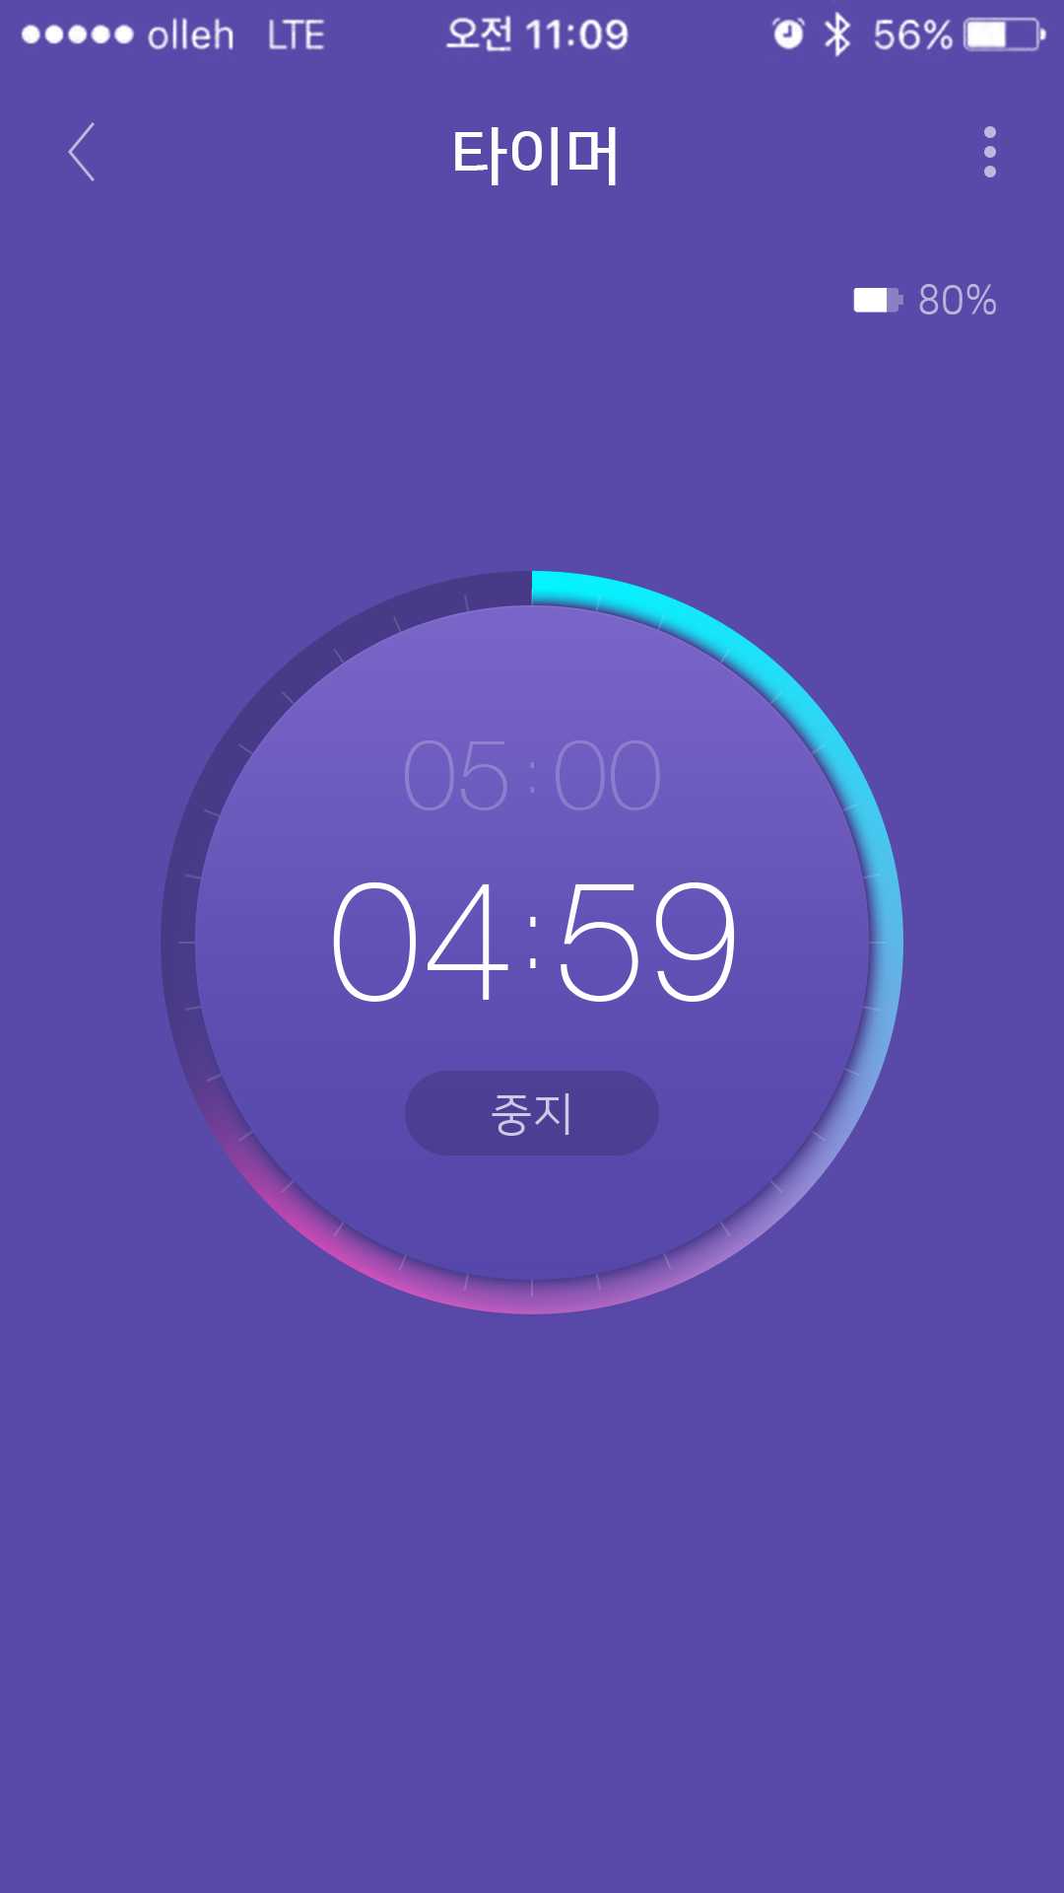
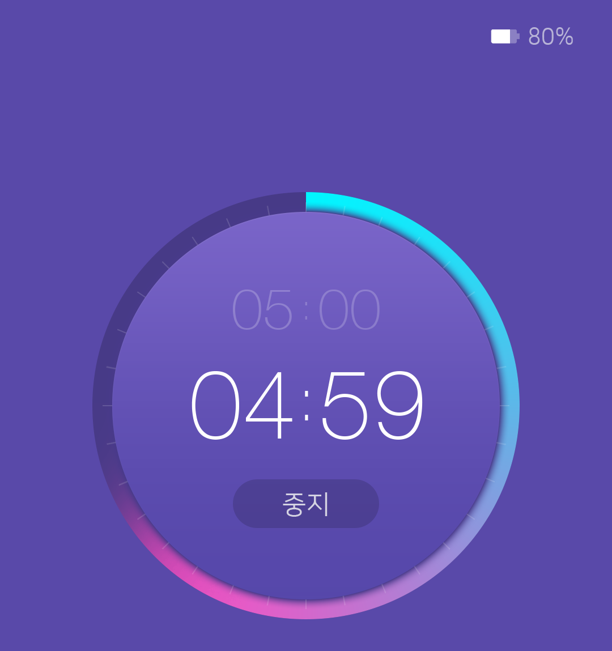
3. 타이머 카운트중
1080
280
120
240
172
1
2
72
1029
64
130
1149
69
86
161
1
X : 400, Y : 751
Width : 266, Height : 72
Font: HelveticaNeueLT 35 Thin
Align: Area Center
Font Size : 100 PX / Auto
Color: (0.0.0 / #ffffff / alpha 25%)
05
00
2
Font: HelveticaNeueLT 35 Thin
Align: Area Center
Font Size : 60 PX / Auto
Color: (0.0.0 / #ffffff / alpha 25%)
531
:

Slide 20
3. 타이머 카운트중
1080
213
654
280
120
240
172
72
1029
64
1
130
1149
69
2
86
161
1
X : 337, Y : 895
Width : 176, Height : 121
Font: HelveticaNeueLT 35Thin
Font Size: 170 PX
Align: Area Center
Color: (0.0.0 / #ffffff),
04
59
531
2
X : 411, Y : 1086
Width : 258, Height : 86
Font: Nanum Square(Regular)
Font Size: 46px
Area: 258 x 86
Align: Area Center
Color: #ffffff / alpha 70%
start_btn_bg.png

Slide 21

3. 타이머 카운트중
1080
213
654
280
120
240
1
172
72
1029
64
130
1149
69
86
161
1
rolling2.png
X : 163, Y : 579
Width : 754, Height : 754
531

Slide 22
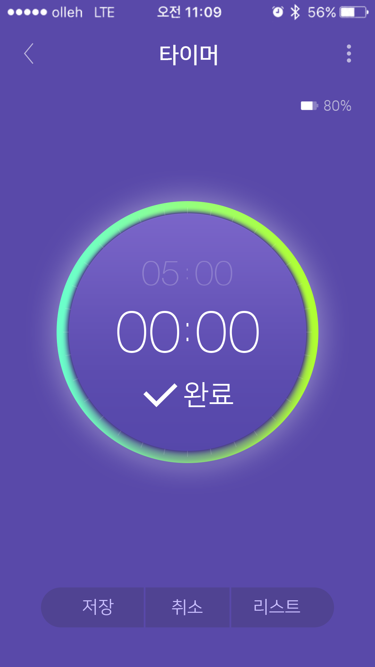
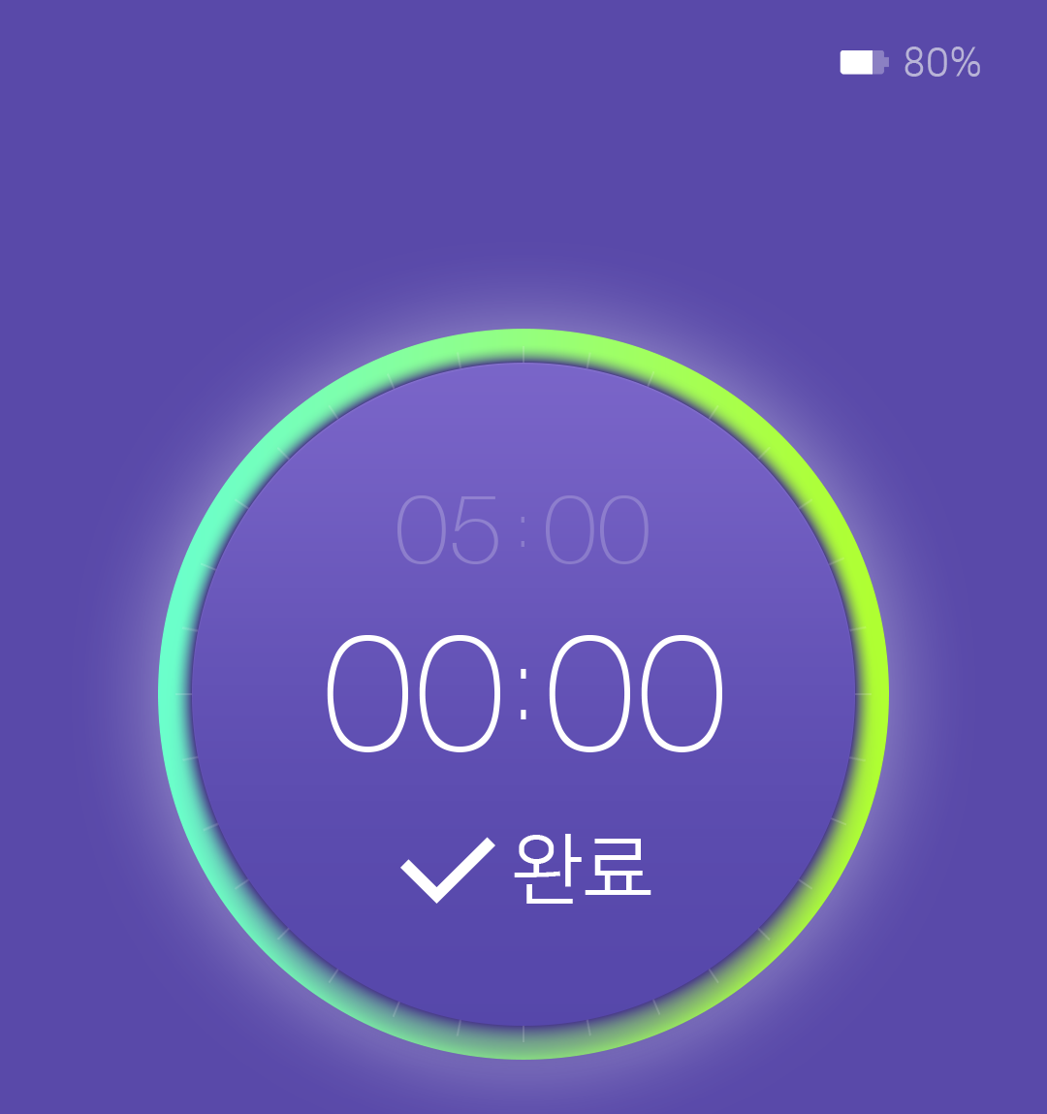

3. 타이머 완료
1080
213
654
280
120
240
172
72
1029
64
130
1149
69
1
2
86
161
1
2
complete_circ.png
X : 411, Y : 1103
Width : 98, Height : 69
X : 528, Y : 1100
Width : 142, Height : 72
Font: Nanum Square(Regular)
80 PX / Auto
Area: 258 x 86
Align: Left
Color: (0.0.0 / #ffffff)
531

Slide 23

3. 타이머 완료
1080
213
654
280
120
240
1
172
72
1029
64
130
1149
69
86
161
1
complete_circ.png
X : 74, Y : 490
Width : 932, Height : 932
531

Slide 24




3. 타이머 완료
1080
118
844
118
240
302
531
1
2
3
115
114
296
5
242
5
296
1149
1
timer_save.png
X : 118, Y : 1691
Width : 296, Height : 115
NanumSquareR / Regular
Align: Area Center
Font Size : 50 PX
Color: #000000 / alpha 70%
2
timer_cancel.png
X : 419, Y : 1691
Width : 242, Height : 115
NanumSquareR / Regular
Align: Area Center
Font Size : 50 PX
Color: #000000 / alpha 70%
302
3
timer_list_view.png
X : 666, Y : 1691
Width : 296, Height : 115
NanumSquareR / Regular
Align: Area Center
Font Size : 50 PX
Color: #000000 / alpha 70%
531
115
114

Slide 25
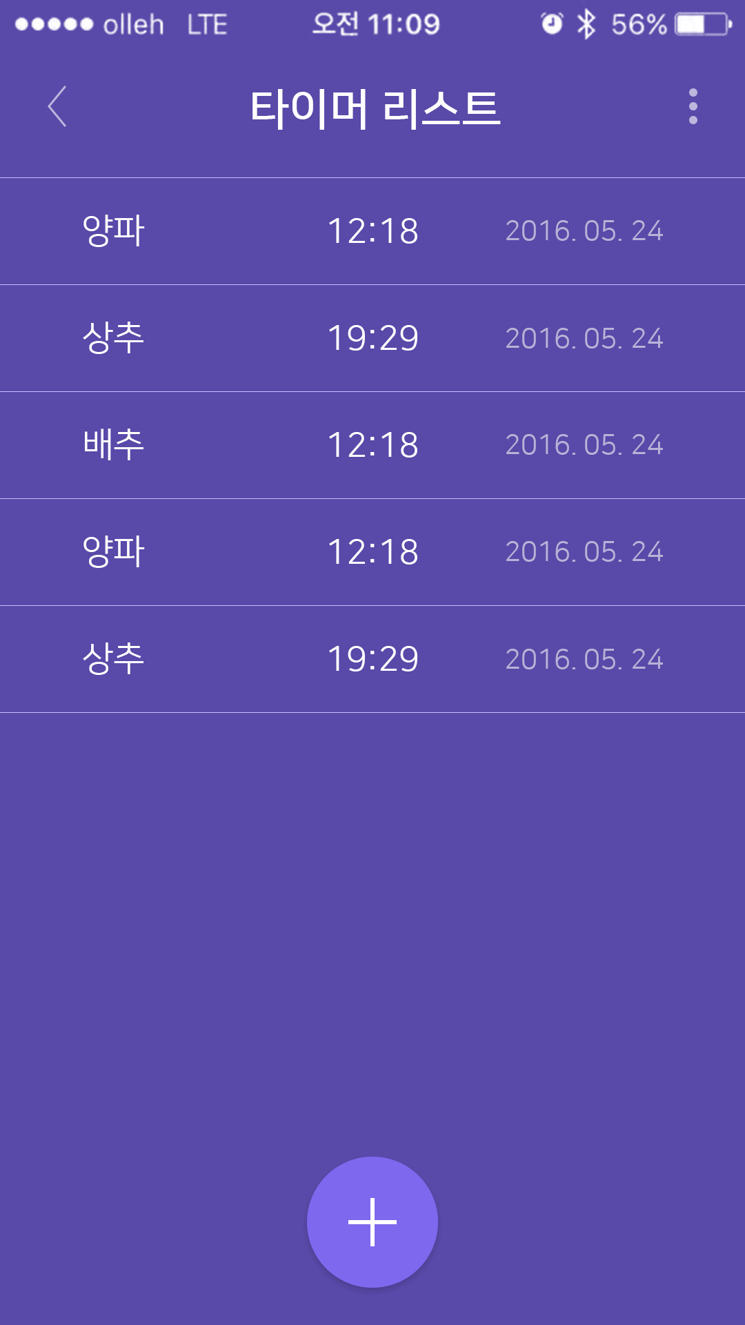

3. 타이머 리스트
1080
1
device_list_line.png
X : 0, Y : 1354
Width : 1080, Height : 1
240
1
17
2
X : 121, Y : 311
Width : 89, Height : 47
NanumSquareR / Regular
Area: 280 x 47
Align: Area Left
Font Size : 50 PX
Color: (0.0.0 / #ffffff)
2
3
4
154
1
154
3
X : 442, Y : 311
Width : 224, Height : 47
NanumSquareR / Regular
Area: 206 x 47
Align: Area Center
Font Size : 50PX / Auto
Color: (0.0.0 / #ffffff)
1433
4
X : 714, Y : 311
Width : 248, Height : 47
NanumSquareR / Regular
Area: 248 x 47
Align: Area Right
Font Size : 40PX / Auto
Color: (0.0.0 / #ffffff / alpha 50%)
5
timer_plus.png
X : 437, Y : 1673
Width : 206, Height : 206
2
206
437
206
437
41

Slide 26
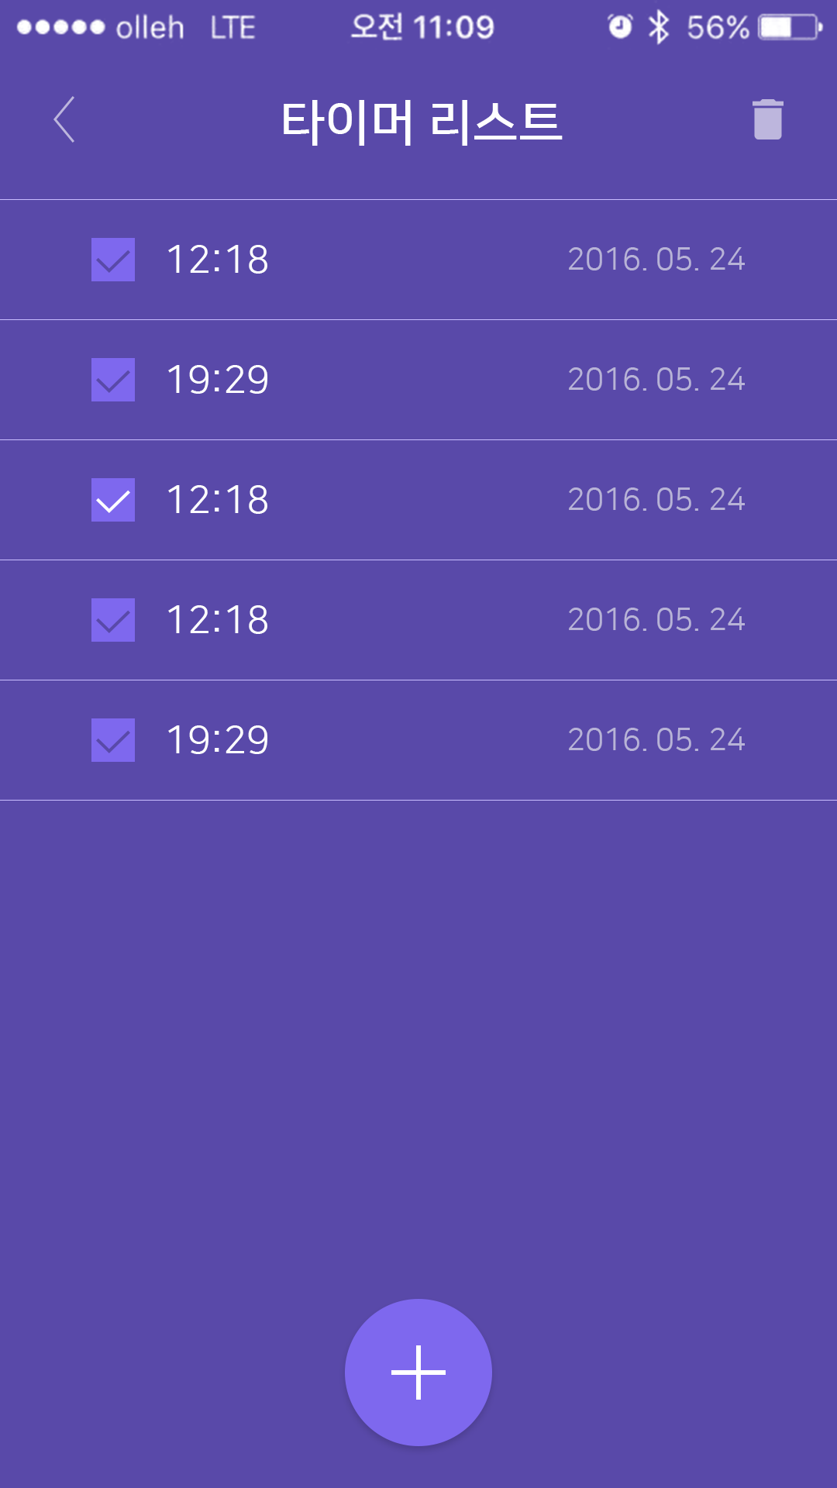



3. 타이머 리스트 편집
1080
40
69
129
1
checkbox1.png
X : 118, Y : 307
Width : 56, Height : 56
240
3
52
59
49
1
56
2
checkbox2.png
X : 118, Y : 462
Width : 56, Height : 56
49
1
2
3
recycle.png
X : 971, Y : 129
Width : 40, Height : 52
1433
206
56
45
206
437
41
118

Slide 27
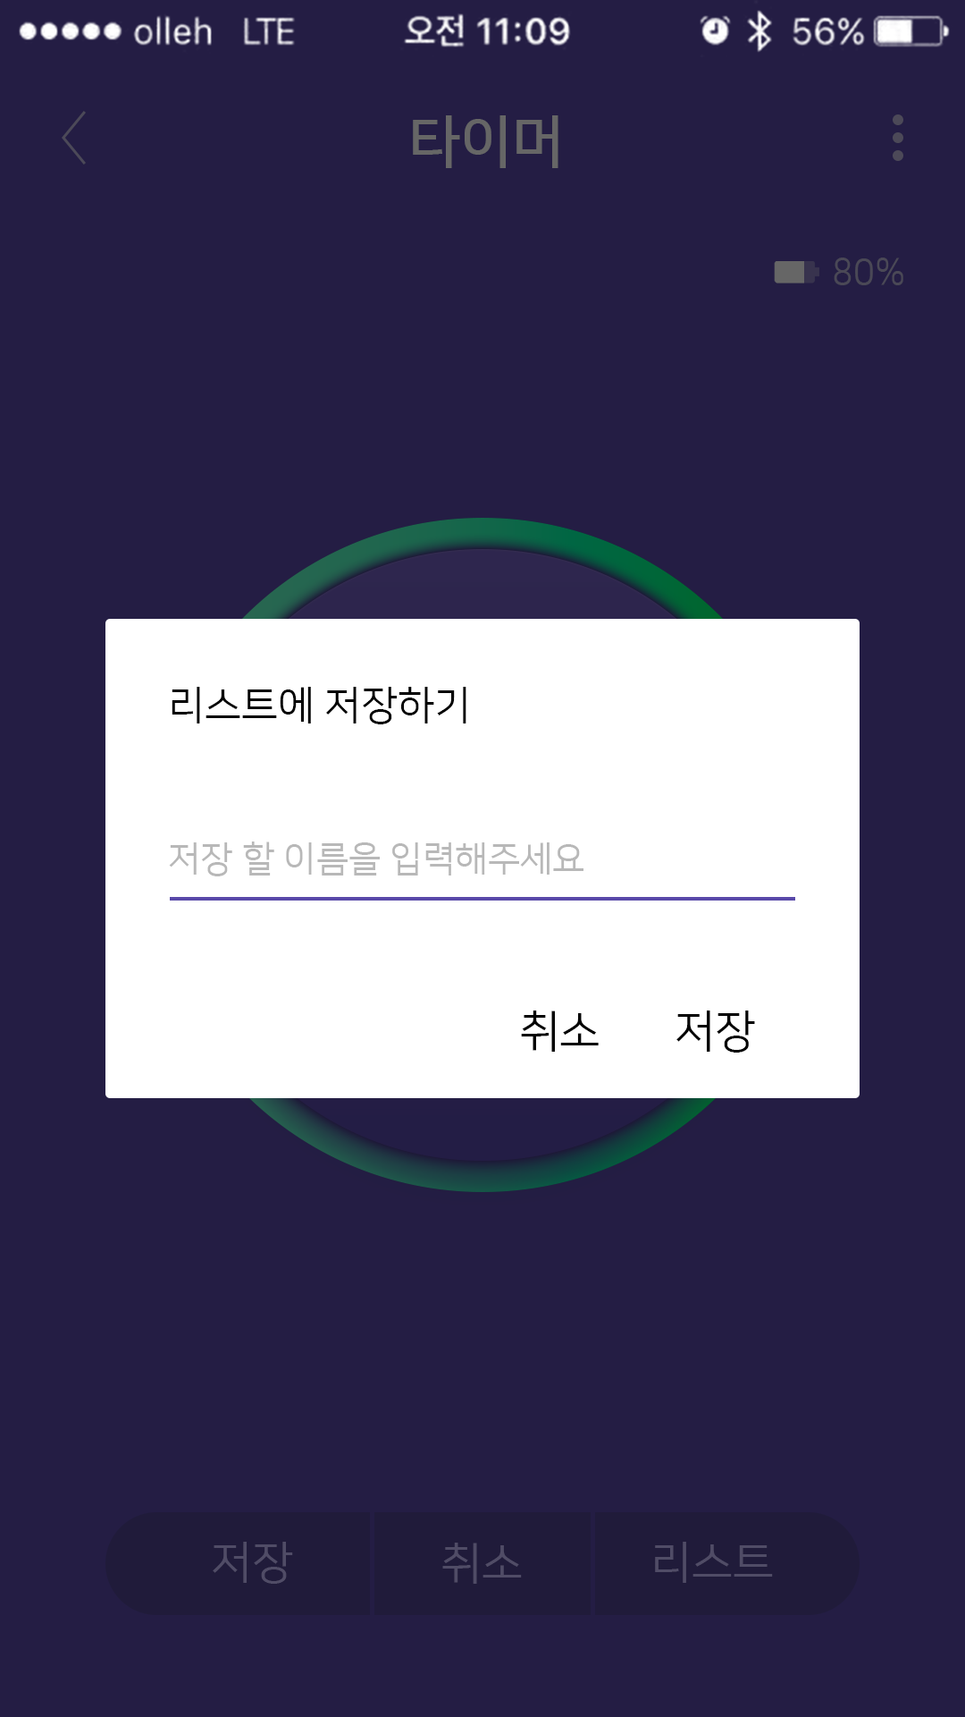

3. 타이머 리스트 편집
118
844
118
1
popup_bg1.png
X : 118, Y : 692
Width : 844, Height : 536
240
1
76
2
42
131
2
X : 193, Y : 768
Width : 345, Height : 42
NanumSquareR / Regular
Area: 470 x 47
Align: Area Left
Font Size : 45 PX
Color: (0.0.0 / #000000)
X : 193, Y : 941
Width : 464, Height : 39
NanumSquareR / Regular
Area: 694 x 39
Align: Area Left
Font Size : 40 PX
Color: (0.0.0 / #000000/ alpha 40%)
1433
39
3
3
23
4
123
5
6
47
51
4
popup_line.png
X : 193, Y : 1003
Width : 694, Height : 4
5
X : 538, Y : 1130
Width : 173, Height : 47
NanumSquareR / Regular
Area: 173 x 47
Align: Area Center
Font Size : 50 PX
Color: (0.0.0 / #000000)
X : 714, Y : 1130
Width : 173, Height : 47
NanumSquareR / Regular
Area: 173 x 47
Align: Area Center
Font Size : 50 PX
Color: (0.0.0 / #000000)
6
118
75
75
118

