Slide 1



Model Transformations Require Formal Semantics
Yu Sun¹, Zekai Demirezen¹, Tomaz Lukman², Marjan Mernik³,
Jeff Gray¹
¹ Department of Computer and Information Sciences, University of Alabama at Birmingham
{yusun, zekzek, gray}@cis.uab.edu
²Jožef Stefan Institute
Dept. of Systems and Control
tomaz.lukman@ijs.si
³ University of Maribor, Slovenia
marjan.mernik@uni-mb.si
This work funded in part by NSF
CAREER award CCF-0643725.

Slide 2
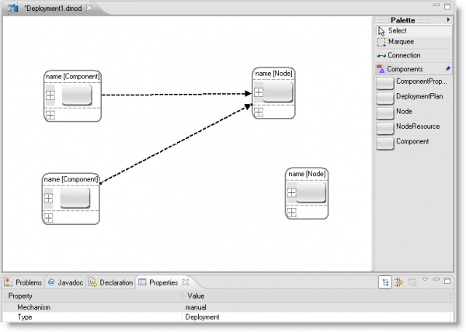
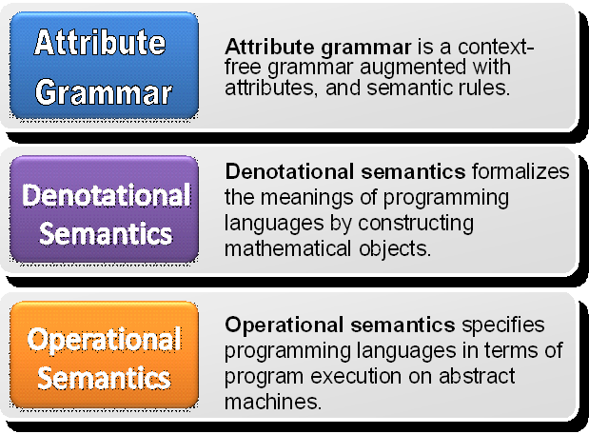

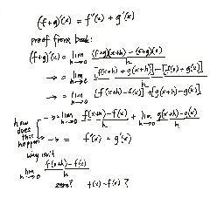
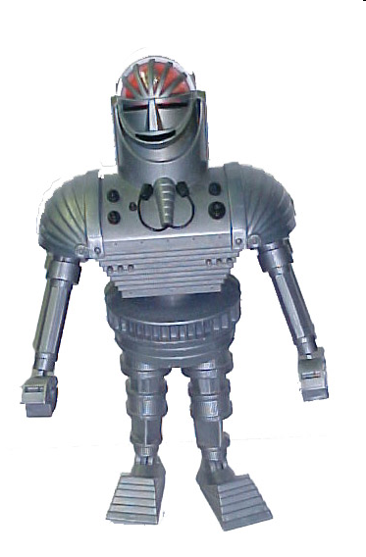
Overview
Lack of Semantics
Metamodeling Environments
Model Transformation has to preserve behavior
Motivation
Define Optimization for
the DSML
Methods for Representing Semantics in Grammarware
Background
C [[ left ]] (x,y) = (x+Δx,y+Δy) where Δx=-1 and Δy=0
C [[ right ]] (x,y) = (x+Δx,y+Δy) where Δx=+1 and Δy=0
C [[ down ]] (x,y) = (x+Δx,y+Δy) where Δx=0 and Δy=-1
C [[ up ]] (x,y) = (x+Δx,y+Δy) where Δx=0 and Δy=+1
C [[ C1 C2 ]] (x,y) = let (x+Δx1, y+Δy1) = C [[ C1]] (x,y) in
let (x+Δx1+Δx2, y+Δy1+Δy2) = C [[ C2]] (x+Δx1, y+Δy1) in
(x+Δx1+Δx2, y+Δy1+Δy2)
Goals
Prove the
Optimization Correctness
Define a Semantics for the DSML
Case Study
Robot DSL/DSML

Slide 3
Motivation
A primary shortcoming that can be found in many model transformation approaches and tools is the lack of formal semantics to define the meaning of a modeling abstraction
An example of transformation is the modification of a particular source code (or model) to support some desired optimization
One essential requirement of optimization is to ensure that the semantics of the program (or model) is preserved in the whole process of optimization
The more mature foundation of programming language theory could be used to define the semantics of a DSL such that a formal optimization proof is realizable

Slide 4





Approaches to Define
Language Semantics
Attribute
Grammar
Attribute grammar is a context-free grammar augmented with attributes and semantic rules.
Denotational semantics formalizes the meanings of a programming language by constructing mathematical objects.
Operational semantics specifies a programming language in terms of program execution on abstract machines.

Slide 5
Robot DSL
GRAMMAR
P ∈ Program
C ∈ Command
P ::= begin C end
C ::= left | right | up | down | C1C2
PROGRAM
begin
left
up
down
up
end
DENOTATIONAL SEMANTICS
P : Program → Int*Int
P [[ begin C end ]] = C [[ C ]] (0,0)
C :: Command → Int*Int → Int*Int
C [[ left ]] (x,y) = (x+Δx,y+Δy) where Δx=-1 and Δy=0
C [[ right ]] (x,y) = (x+Δx,y+Δy) where Δx=+1 and Δy=0
C [[ down ]] (x,y) = (x+Δx,y+Δy) where Δx=0 and Δy=-1
C [[ up ]] (x,y) = (x+Δx,y+Δy) where Δx=0 and Δy=+1
C [[ C1 C2 ]] (x,y) = let (x+Δx1, y+Δy1) = C [[ C1]] (x,y) in
let (x+Δx1+Δx2, y+Δy1+Δy2) = C [[ C2]] (x+Δx1, y+Δy1) in (x+Δx1+Δx2, y+Δy1+Δy2)

Slide 6
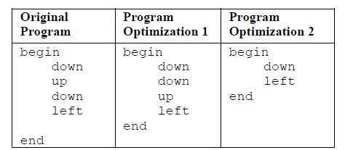
Program Optimization in DSL
In Optimization 1, the sequence of moves can be rearranged so that the same type of moves are adjacent
The rationale behind Optimization 1 is that the robot can move faster if there is no need to change the direction
In Optimization 2, some combinations of moves have no effect and can be eliminated

Slide 7
Optimization Correctness in DSL
To prove "begin C1 C2 end" = "begin C2 C1 end"
We have to show that:
P [[ begin C1 C2 end ]] = P [[ begin C2 C1 end ]]
In other words, we have to prove:
C [[ C1 C2 ]] (0,0) = C [[ C2 C1 ]] (0,0)
Since:
C [[ C1 C2 ]] (0,0) = let (Δx1, Δy1) = C [[ C1]] (0,0) in
let (Δx1+Δx2, Δy1+Δy2) = C [[ C2]] (Δx1, Δy1) in (Δx1+Δx2, Δy1+Δy2)
C [[ C2 C1 ]] (0,0) = let (Δx2, Δy2) = C [[ C2]] (0,0) in
let (Δx2+Δx1, Δy2+Δy1) = C [[ C1]] (Δx2, Δy2) in (Δx2+Δx1, Δy2+Δy1)
Also: (Δx1+Δx2, Δy1+Δy2) = (Δx2+Δx1, Δy2+Δy1) (due to associativity of +)
We can get: C [[ C1 C2 ]] (0,0) = C [[ C2 C1 ]] (0,0)
Therefore: P [[ begin C1 C2 end ]] = P [[ begin C2 C1 end ]]

Slide 8
DSML Semantics
Can we utilize a DSL semantics formalism to define optimizations in DSML?
Current state of the art tools
  GME
  Atom³
  GEMS
  Kermeta

Slide 9
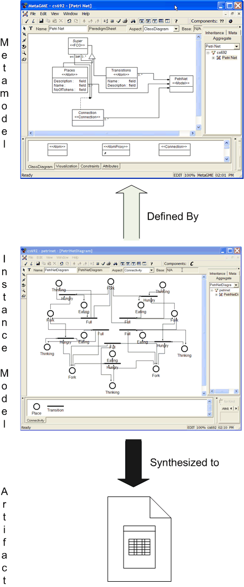
DSML Platforms and Semantics GME
M
e
t
a
m
o
d
e
l
Metamodeling
Interface
Application
Domain
Environment Evolution
Application Evolution
Metamodel Definition
App
1
App
2
App
3
DEFINE
The semantics of the a DSML is hard-coded into the model interpreter
Modeling Environment
M
o
d
e
l
Model Builder
Meta-Level
Translation
Model
Interpretation
INTERPRET
Models
I
n
t
e
r
p
r
e
t
e
r
void CComponent::InvokeEx(CBuilder &buil
der,CBuilderObject *focus, CBui
lderObjectList &selected, long param)
{
CString DMSRoot = "";
DMSRoot = SelectFolder("Please Select DMS
Root Folder:");
if (DMSRoot != "") {
DMSRulePath =
DMSRoot + RULESPATH + "Rules\\";
MSRuleApplierPath
= DMSRoot + RULESPATH + "RuleApplier\\";
AfxMessageBox("DMSRulePath =
" + DMSRulePath , MB_OK);
CString OEPRoot = "";
OEPRoot = SelectFolder("Please Selec
Model Interpreters

Slide 10
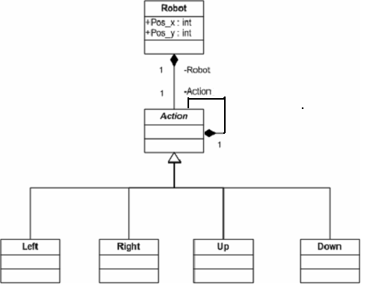
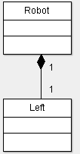

DSML Platforms and Semantics Atom³ Graph Rewriting
Robot Metamodel
Left Action Semantics
LHS
RHS
=
Pos_x
Pos_y
Pos_x--
Pos_y

Slide 11
DSML Platforms and Semantics
GEMS Interpreter
Robot Metamodel
Robot Semantics
int temp_x=Integer.parseInt((String)(tovisit.
getParent().getAttribute("Pos_x")));
int temp_y=Integer.parseInt((String)(tovisit.
getParent().getAttribute("Pos_y")));
MakeAction((Robot)(tovisit.getParent()),
tovisit, temp_x,temp_y);
displayRobotPosition(tovisit);
visitContainer(tovisit);
public class RobotInterpreter extends AbstractInterpreter{
public void visitLeft(Left tovisit) {
}
public void visitRight(Right tovisit) {
…
}
public void visitUp(Up tovisit) {
…
}
public void visitDown(Down tovisit) {
…
}
int temp_x = Integer.parseInt((String)(tovisit.
getParent().getAttribute("Pos_x")));
int temp_y = Integer.parseInt((String)(tovisit.
getParent().getAttribute("Pos_y")));
MakeAction((Robot)(tovisit.getParent()),
tovisit, temp_x, temp_y);
displayRobotPosition(tovisit);
visitContainer(tovisit);

Slide 12
DSML Platforms and Semantics
Kermeta
Robot Metamodel
Robot Semantics
class Robot {
attribute pos_x:int;
attribute pos_y:int;
reference actionList:Action[0..1];
operation run():int is do
actionList.move(this);
end
}
class Action{
operation move(r:Robot ):int is do
end
}
class Left{
operation move(r:Robot):int{
r.pos_x:=r.pos_x-1;
}
}
Run()
Move(Robot r)

Slide 13
Problems Related with
DSML Semantics
Lack of semantic reasoning, which is needed for proofs
Lack of formal proof of the optimization
Hard to comprehend semantics
Hard to generate model interpreters automatically
Difficulties in compiler verification
Limitations in proving properties of domain concepts
Lack of connection between Transformation and Semantic Layers

Slide 14

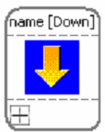

Defining DSML Optimization
Model Transformation by Example
Optimization #1
Optimization #2

Slide 15
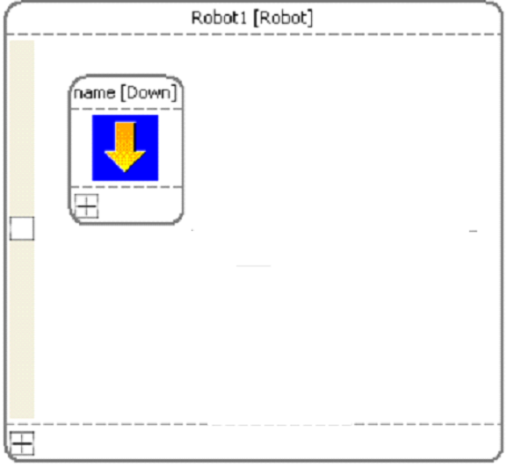

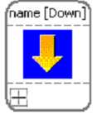
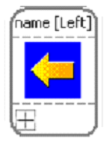
Model Optimization in DSML
Optimization#1
Optimization#2

Slide 16
Conclusion
Due to the lack of formal semantics for DSMLs, the real meaning of a modeling language is available only in associated model interpreters
As a consequence, model transformations cannot be verified for preserving the semantics
Traditional programming language theory could be used to define the semantics of a DSML such that a formal optimization proof is realizable
Future Work: Proof for DSML optimization

Slide 17
Question?
Comments?
zekzek@uab.edu
www.cis.uab.edu/zekzek
This work funded in part by NSF
CAREER award CCF-0643725.

Slide 18
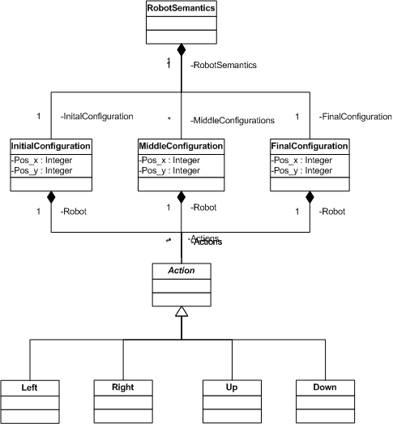
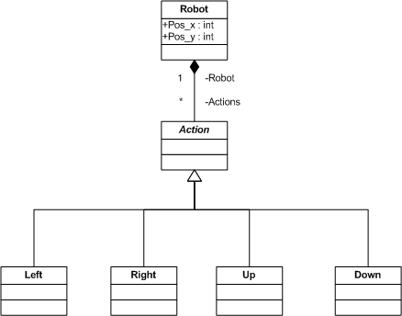
Robot DSML
Syntax Metamodel
Semantics Metamodel

