Slide 1




End-User Support for Debugging Demonstration-based Model Transformation Execution
Yu Sun University of Alabama at Birmingham
PAR Works
Jeff Gray University of Alabama
ECMFA @ Montpellier, France
July 3rd, 2013
University of Alabama at Birmingham
University of Alabama
This research is supported by
NSF CAREER award CCF-1052616

Slide 2
Outline
Model Transformation by Demonstration (MTBD)
MTBD Debugger

Slide 3





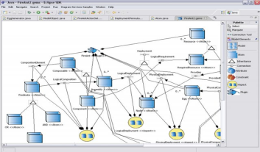
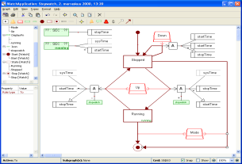
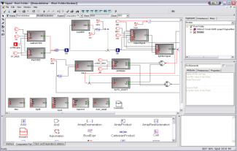




Domain-Specific Modeling (DSM)
DSM specifies a system using domain concept models, and enables code generation from models
Problem Domains
Represent the System
Domain- Specific Modeling Languages
Generate the Code
Low-Level Software Artifacts
…

Slide 4












DSM Helps End-User Programming
DSM enables end-users to participate in software development
End-Users
End-User Developers
Upgrade
Using DSM

Slide 5
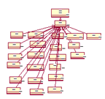

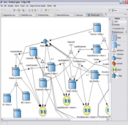
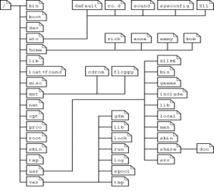

Typical Model Evolution Activities
Model Evolution
Model Scalability
Aspect-Oriented Modeling
Model Management
Model Refactoring
Model Layout
A
B
F
c
d
e
B
B
c
d
e
c
d
e

Slide 6
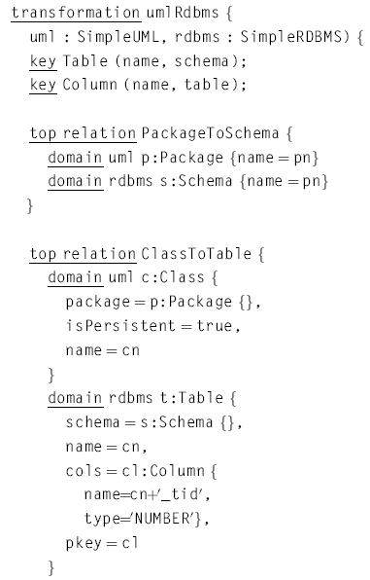
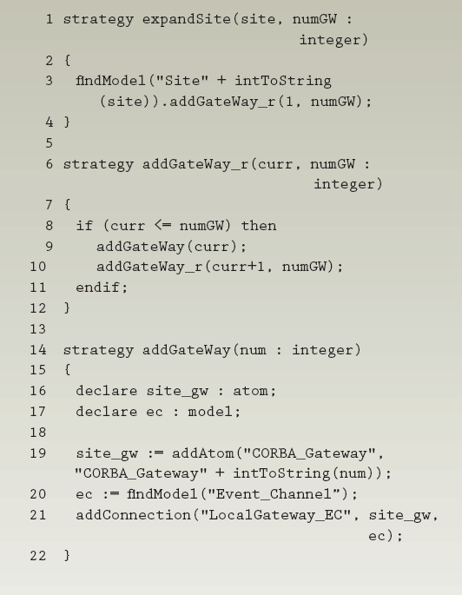
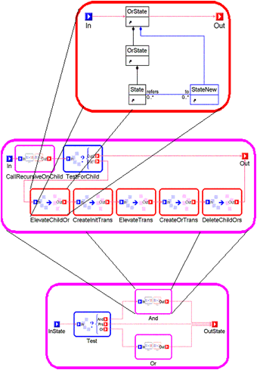
Using Model Transformation Languages
MTLs are specialized languages to implement model transformation tasks
Automate model transformations by programming
Popular Model Transformation Languages
QVT
Query/View/Transformation
GReAT
Graph Rewriting and Transformation
ECL
Embedded Constraint Language

Slide 7
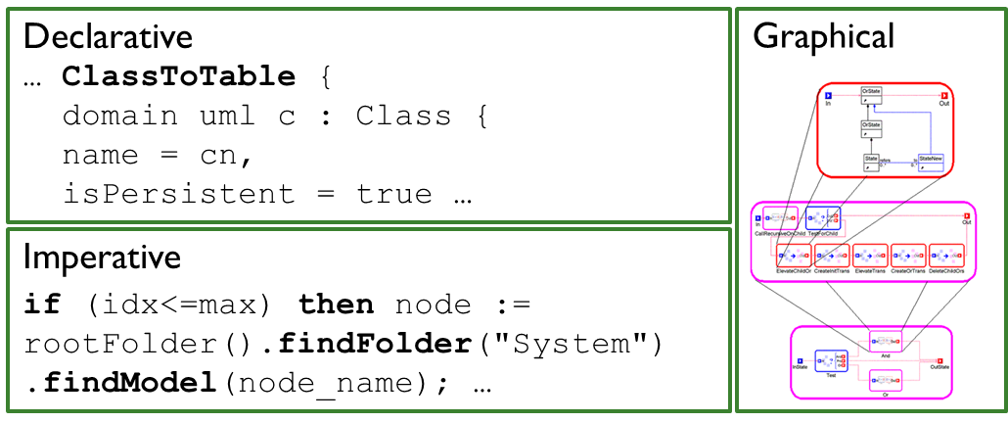
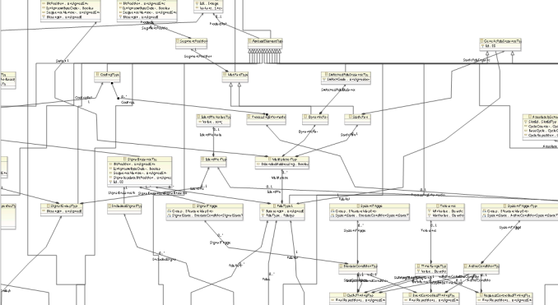
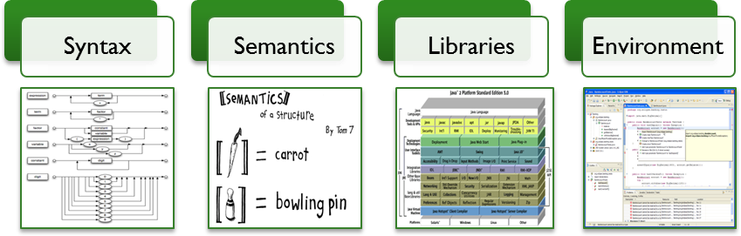

Difficult to Learn and Use MTLs
Diversity of MTLs
Metamodel
Programming Concepts
End-Users

Slide 8
The Challenges Lead to an Irony
A technology meant to enable end-users to participate in software development, does not enable end-users to change and evolve the software
End-Users
End-User Developers
End-Users
Upgrade
Degrade
Using DSM
Using MTL
Modeling System
Model Evolution

Slide 9
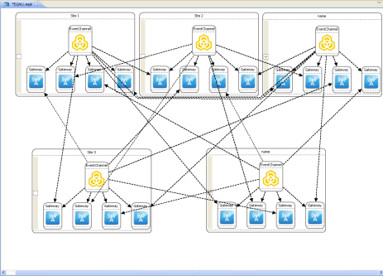
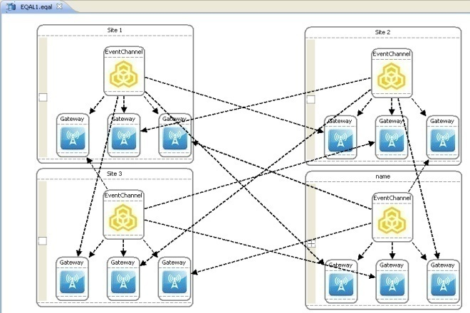



Model Transformation By Demonstration (MTBD)
A complete model transformation framework
Specify and execute model transformations
Users are fully isolated from MTLs and metamodel definitions
Infer and generate model transformation patterns by demonstrating model transformations on concrete examples
Add, Remove, Update

Slide 10









Overview of MTBD
MT Specification
User
Demonstration
Operation
Recording
Operation
Optimization
Pattern
Inference
User
Refinement
MT Execution
Pattern Execution
Pattern
Repository
Correctness Checking
Execution Control

Slide 11
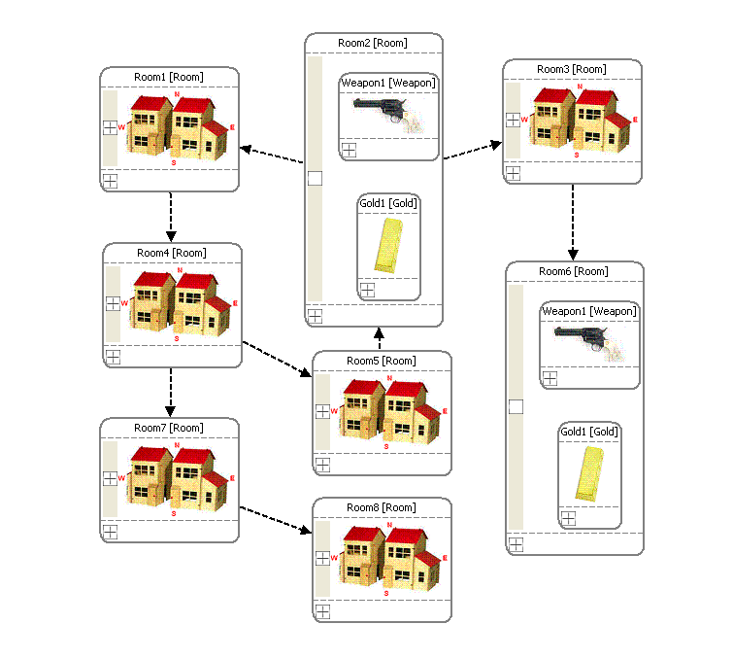
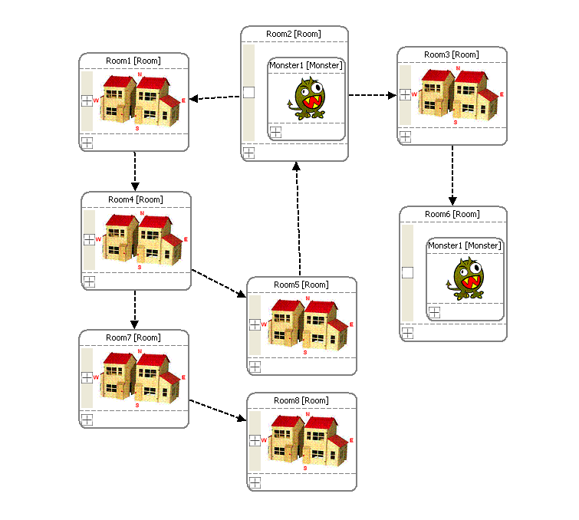
A Model Transformation Example
If a room contains both a weapon (>100) and gold, replace them with a monster having half the power of the weapon
110
55
120
60
Source model with the weapon and gold
Target model with the monster

Slide 12
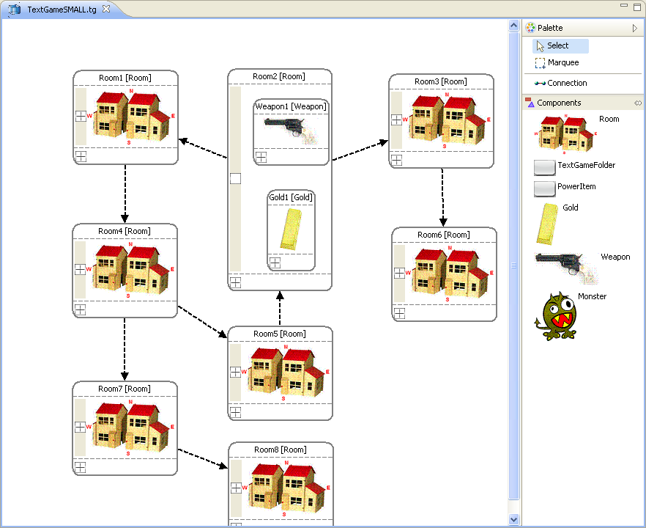
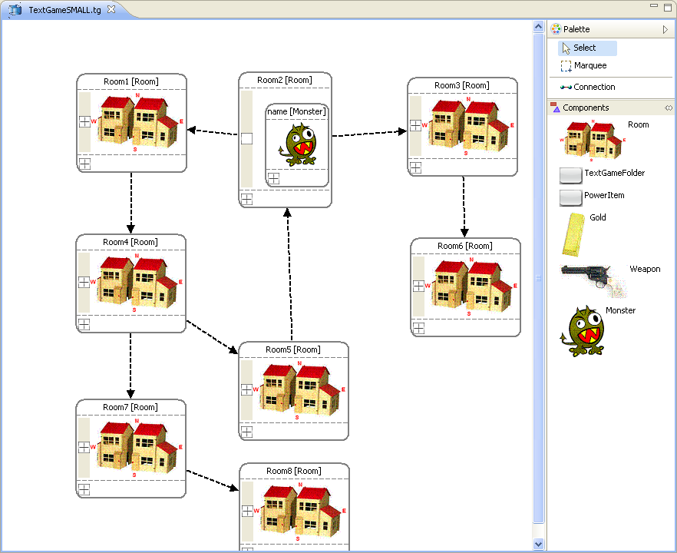
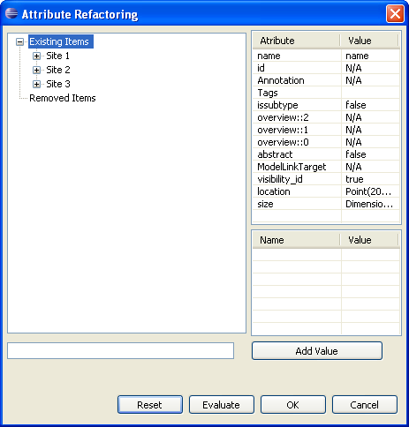
User Demonstration
User
Demonstration
Edit a sample source model to change it into the desired target model, reflecting the purpose of the transformation
Operation
Recording
Operation
Optimization
Pattern
Inference
User
Refinement
Before Demonstration
After Demonstration
Pattern Execution
Pattern
Repository
Attribute refactoring to demonstrate attribute transformation on a concrete model
100 / 2
Correctness Checking
Execution Control
Notes:
Recapture attribute refactor figure!
Insert attribute figures.

Slide 13
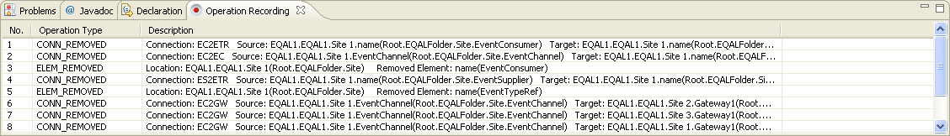
Operation Recording
User
Demonstration
All the user operations performed during the demonstration will be recorded, as well as the related context information
Operation
Recording
Operation
Optimization
Pattern
Inference
User
Refinement
Step | Operation Type | Detail
1 | Delete Element | Root.MazeFolder.Room2.Weapon1
2 | Delete Element | Root.MazeFolder.Room2.Gold1
3 | Add Element | Root.MazeFolder.Room2 (Monster1)
4 | Update Element | Root.MazeFolder.Room2.Monster1.power (Root.MazeFolder.Room2.Weapon1.power / 2)
Pattern Execution
Pattern
Repository
Correctness Checking
Execution Control

Slide 14
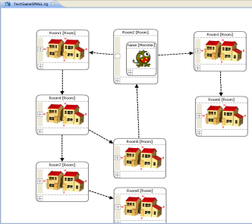
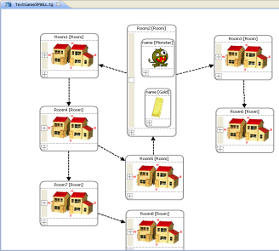
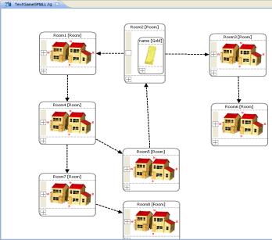
Operation Optimization
Users may perform meaningless operations that need to be optimized
User
Demonstration
…
…
Step | Operation
1 | Add a Monster1 in Room2
2 | Add the Gold1 in Room2
… | …
… | Delete Monster1 in Room2
Operation
Recording
Operation
Optimization
Pattern
Inference
User
Refinement
for each op in the input operation list
switch (op.type)
case ADD_ELEM:
for each op_temp after the current op in the list
if op_temp.type == REMOVE_ELEM and op_temp removes what op added
and the element was not referred in between
then remove both op and op_temp from the list
case MODIFY_ELEM:
traverse the final model instance and search the element being modified
if not found then remove op from the list
… …
Pattern Execution
Pattern
Repository
Correctness Checking
Execution Control
Notes:
Other opts

Slide 15
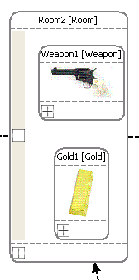
Pattern Inference
User
Demonstration
A transformation pattern consists of:
Transformation precondition (When and Where)
Transformation actions (How)
Operation
Recording
Operation
Optimization
Pattern
Inference
User
Refinement
Precondition (Elements needed)
elem1.elem2.elem3.elem4
elem1.elem2.elem3.elem6
elem1.elem2.elem3 (elem5)
elem1.elem2.elem3.elem5
Precondition (Elements Type)
elem1 – Root
elem2 – MazeFolder
elem3 – Room
elem4 – Monster
elem5 – Weapon
elem6 – Gold
Pattern Execution
Pattern
Repository
No. | Transformation Actions
1 | Remove elem4
2 | Remove elem6
2 | Add elem5 in elem3
3 | Set elem5.power = elem4.power / 2
Correctness Checking
Execution Control

Slide 16
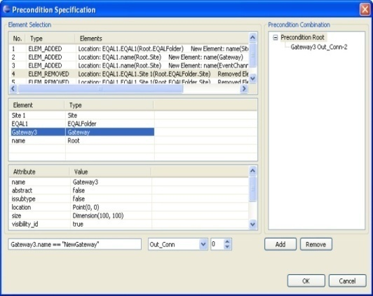
User Refinement
The initially inferred pattern is usually not accurate:
Preconditions are not specific enough
Transformation actions are not generic enough
User
Demonstration
Precondition (Elements needed)
elem1.elem2.elem3.elem4 (elem4 > 100)
elem1.elem2.elem3.elem6
elem1.elem2.elem3 (elem5)
elem1.elem2.elem3.elem5
Precondition (Elements Type)
elem1 – Root
elem2 – MazeFolder
elem3 – Room
elem4 – Monster
elem5 – Weapon
elem6 – Gold
Operation
Recording
Operation
Optimization
Pattern
Inference
User
Refinement
> 100
Pattern Execution
Pattern
Repository
Weapon1.strength > 100
User-centric interfaces are provided to enable user refinement:
Users continue to work at the model instance level
Isolate users from knowing MTLs and metamodels
Correctness Checking
Execution Control
Notes:
Recapture the figure.

Slide 17
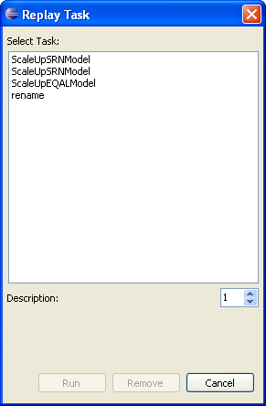
Pattern Repository
All the finalized patterns are stored in the repository for future reuse
User
Demonstration
Operation
Recording
Operation
Optimization
Pattern
Inference
User
Refinement
Pattern Execution
Pattern
Repository
Correctness Checking
Execution Control
Notes:
Recapture the figure.

Slide 18
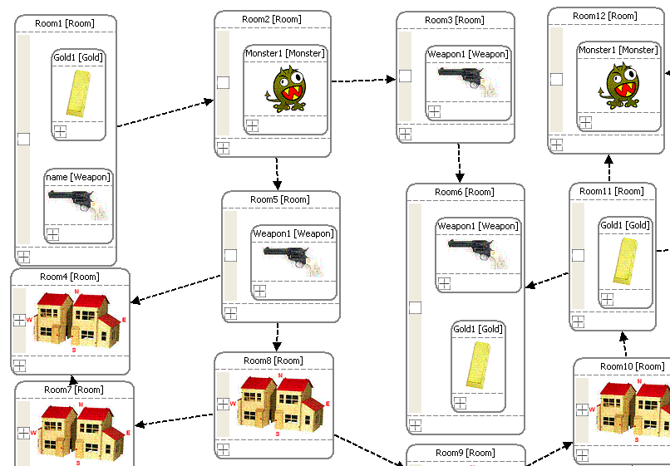
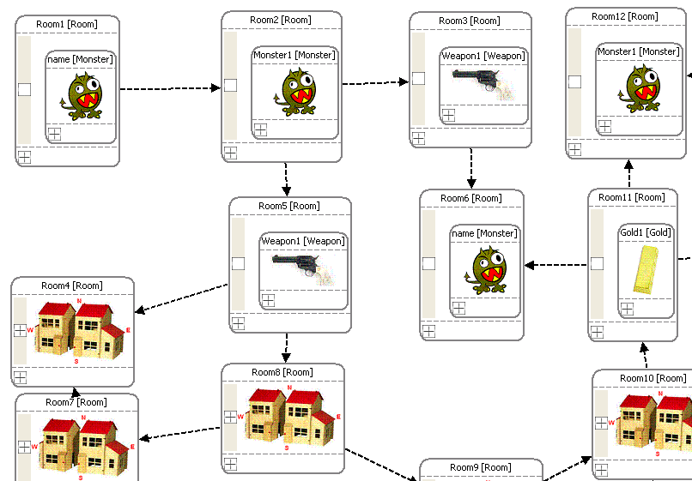
Pattern Execution
The execution engine is responsible for:
Precondition matching
Execution of transformation actions
User
Demonstration
No. | Transformation Actions
1 | Remove elem4
2 | Remove elem6
2 | Add elem5 in elem3
3 | Set elem5.power = elem4.power / 2
Operation
Recording
Operation
Optimization
Pattern
Inference
User
Refinement
>100
Pattern Execution
Pattern
Repository
Traverse the whole model instance and list all elements
Start to match the elements in the precondition one-by-one
Backtracking algorithm is used
Correctness Checking
Execution Control
Notes:
alg

Slide 19
Correctness Checking
User
Demonstration
To prevent the execution from violating the metamodel definitions:
Each execution is logged
Correctness checking is performed after each execution
After a violation occurs, all the executed operations will be undone
Operation
Recording
Operation
Optimization
Pattern
Inference
User
Refinement
Pattern Execution
Pattern
Repository
Correctness Checking
Execution Control

Slide 20
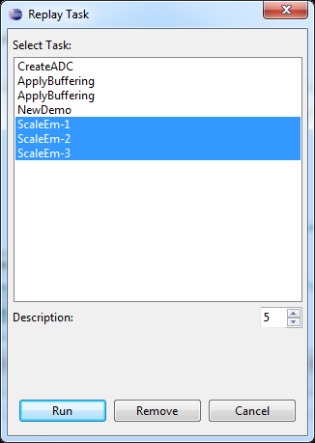
Execution Control
An execution controller is built to enable:
Execute multiple transformation patterns
Control the execution sequence of multiple transformation patterns
Control the number of execution times
User
Demonstration
Operation
Recording
Operation
Optimization
Pattern
Inference
User
Refinement
Pattern Execution
Pattern
Repository
Correctness Checking
Execution Control

Slide 21









Practical and Incremental Development of MTBD
Model Evolution
Model Scalability
Aspect-Oriented Modeling
Model Management
Model Refactoring
Model Layout
For each type of model evolution:
Identify the critical requirements
Update MTBD to make it work
User
Demonstration
Operation
Recording
Operation
Optimization
Pattern
Inference
User
Refinement
Pattern Execution
Pattern
Repository
Correctness Checking
Execution Control

Slide 22


The Need for a MTBD Debugger
MT Specification
User
Demonstration
Users can make mistakes, and bugs can happen.
Users can make mistakes, and bugs can emerge
Operation
Recording
Operation
Optimization
Pattern
Inference
User
Refinement
Reusing existing patterns may cause unknown errors
MT Execution
Pattern Execution
Pattern
Repository
Correctness Checking
Execution Control
Transformation Pattern
Models
Models’

Slide 23


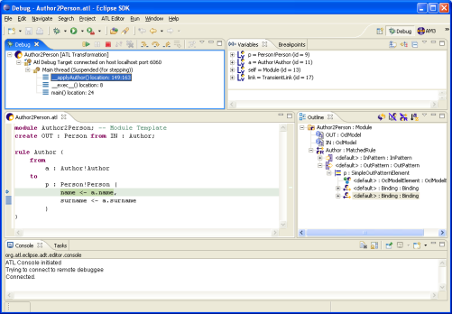
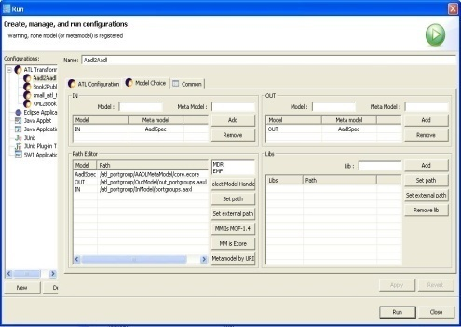
Lack of an End-User MTL Debugger
Bugs can occur in MTL rules
Most MTLs do not have an associated debugger
Some existing debuggers are at the same level as MTLs, so not appropriate for end-users
Models
Models’
MTL Rules
End-Users

Slide 24
MTBD Debugger: Being User-Centric
The debugger should be at the same level of abstraction as MTBD, and be domain-focused
End-Users
End-User Developers
End-User Developers
End-Users
Using MTBD
Upgrade
Debugging
Using DSM
Modeling System
Model Evolution
Debugging Model Evolution

Slide 25
MTBD Debugger: Being User-Centric
The debugger should be at the same level of abstraction as MTBD, and be domain-focused
End-Users
End-User Developers
End-User Developers
End-User Developers
Using MTBD Debugger
Using MTBD
Upgrade
Using DSM
Modeling System
Model Evolution
Debugging Model Evolution

Slide 26
Overview of MTBD Debugger
MT Specification
User
Demonstration
Transformation Pattern
Models
Models’
User
Refinement
Operation
Recording
Operation
Optimization
Pattern
Inference
Pattern Matching View
Precondition
Pattern Execution View
Transformation Actions
MT Execution
Pattern Execution
Pattern
Repository
MTBD Debugger
Correctness Checking
Execution Control

Slide 27
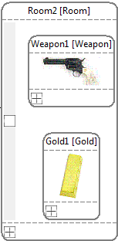
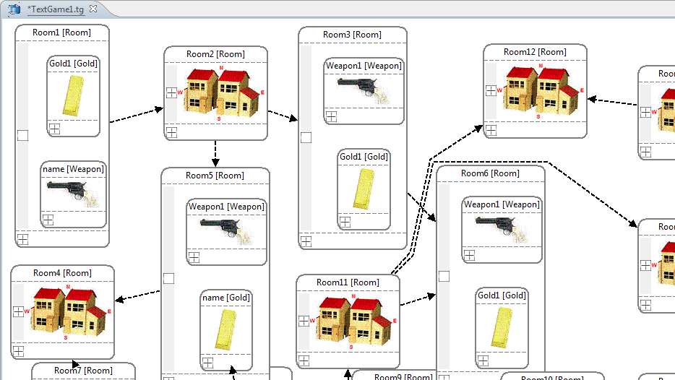
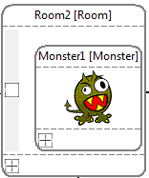
MTBD Debugger Case Study
Replace Monster with Weapon + Gold
(Monster.Strength > 100)
120
120
Sequence | Operation Performed
1 | Remove Monster1 in Root.TextGameFolder.Room2
2 | Add a Weapon in Root.TextGameFolder.Room2
3 | Add a Gold in Root.TextGameFolder.Room2
4 | Set Root.TextGameFolder.Room2.Weapon.strength = Monster1.strength = 120
5 | Set precondition on Monster1: Monster1.strength > 10
This error may cause the generated pattern to be over-matched in the model

Slide 28
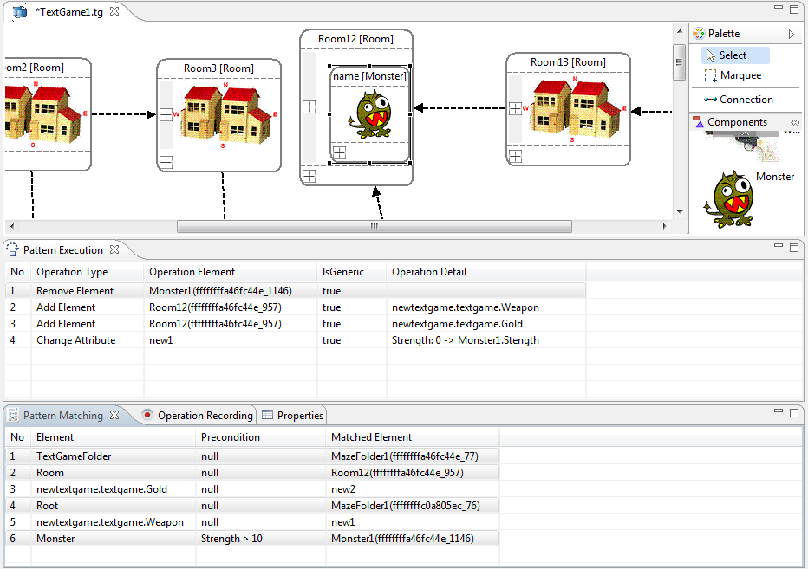

MTBD Debugger In Action
Pattern Execution View
Step-through each transformation action
Display relative information
Track the currently matched elements
25
Pattern Matching View
Display the information about the matched elements
Display the precondition

Slide 29
MTBD Debugger In Action
Common Bugs
Over-Matched Precondition
Under-Matched Precondition
Incorrect Generic Operation
Choosing Wrong Element
Incorrect Attribute Expression
25

Slide 30
MTBD Debugger In Action
Common Bugs
Over-Matched Precondition
Under-Matched Precondition
Incorrect Generic Operation
Choosing Wrong Element
Incorrect Attribute Expression
25

Slide 31
MTBD Debugger In Action
Common Bugs
Over-Matched Precondition
Under-Matched Precondition
Incorrect Generic Operation
Choosing Wrong Element
Incorrect Attribute Expression
25

Slide 32
MTBD Debugger In Action
Common Bugs
Over-Matched Precondition
Under-Matched Precondition
Incorrect Generic Operation
Choosing Wrong Element
Incorrect Attribute Expression
25

Slide 33
MTBD Debugger Summary
MTBD Debugger assists in debugging MTBD transformation patterns
Pattern Matching View checks the matching elements
Pattern Execution View traces the transformation actions
MTBD Debugger is at the same level of abstraction as MTBD
Users do not need to know MTLs
Users are isolated from metamodels

Slide 34
Conclusion & Future Work
Enable end-users to participate in changing and evolving software models with reusable transformations and debugging support
Model Transformation By Demonstration (MTBD)
An end-user centric model transformation approach to support model evolution activities
MTBD Debugger
An end-user centric debugging facility for MTBD
Next version
Improve user experience by adding graphical representations
Breakpoint support
Use MTBD debugger to support MTL debugging

Slide 35

Thank you
Personal:
http://students.cis.uab.edu/yusun
Model Transformation By Demonstration:
http://www.cis.uab.edu/softcom/mtbd
Model Transformation By Demonstration

Slide 36
Related Work
MTL Debugger (ATL, Fujaba)
Allilaire ‘06, Königs ’05, Wagner ’06
Transformation Nets (TNs) Supported Debugging
Schoenboeck ’10
Forensic MT Debugging
Hillberd ‘07
M2T (Model-to-Text) Debugging
Dhoolia‘10

